Slide 1

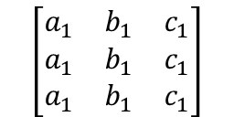
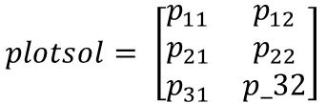
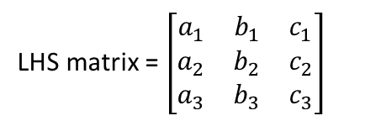

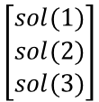
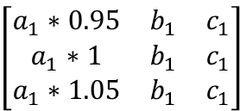
Model_LHS
Generate LHS matrix
Parambarplot(wave, timepoint)
Read LHS matrix
For j = rows of LHS
Duplicate row j
LHS matrix = $\left[\begin{matrix}a_{1} & b_{1} & c_{1} \\ a_{2} & b_{2} & c_{2} \\ a_{3} & b_{3} & c_{3}\end{matrix}\right]$
$$\left[\begin{matrix}a_{1} & b_{1} & c_{1} \\ a_{1} & b_{1} & c_{1} \\ a_{1} & b_{1} & c_{1}\end{matrix}\right]$$
For i = columns
(parameter)
Odesolve
T1D_ode
For each parameter i, down 5%
$$\left[\begin{matrix}a_{1}∗0.95 & b_{1} & c_{1} \\ a_{1}∗1 & b_{1} & c_{1} \\ a_{1}∗1.05 & b_{1} & c_{1}\end{matrix}\right]$$
$$\left[\begin{matrix}sol(1) \\ sol(2) \\ sol(3)\end{matrix}\right]$$
$$plotsol(i,:)= \left[\begin{matrix}\left(\frac{sol\left(1\right)}{sol\left(2\right)}−1\right)∗100\% & \left(\frac{sol\left(3\right)}{sol\left(2\right)}−1\right)∗100\%\end{matrix}\right]$$
For each parameter i, up 5%
Absolute value
Maximize plotsol by row
$$plotsol= \left[\begin{matrix}p_{11} & p_{12} \\ p_{21} & p_{22} \\ p_{31} & p_32\end{matrix}\right]$$
$$\left|plotsol\right|$$

