Slide 1
Housekeeping Vendor Best Practice Program

Slide 2
Training Participants
Housekeeping Vendors
AIC
All Jersey
Tactical
First Choice
KBS
Housekeeping Vendor Management Team
Cathy Prenosil – Group Manager
Jenny Reyes – R100 Specialist
Jill Stacy – R200 Specialist
Krista Aldrich – R300 Specialist
Angela Amazi – R400 Specialist
Brad Buysse – Coordinator
Sara Haggard – Coordinator

Slide 3
Objective
Today’s training will introduce you to the Housekeeping Best Practice program. We have developed these best practices based on feedback we have received from Housekeeping Vendors and Building Services partners.
The Housekeeping Best Practice Program consists of new and enhanced processes that have been developed to achieve brand results, maximize relationships, and drive accountability.

Slide 4
Attention Vendors – Great News!
Based on Vendor feedback the SBS will officially be the main point of contact for Vendors at the store. This will allow STL’s and ETL’s the ability to focus on store operations.
The monthly Brand Scorecard will be replaced with an enhanced survey program.

Slide 5
Program Rollout Date
September 17th, 2007

Slide 6
Overview
SBS Brand Maintenance Daily Walk Program
Escalation Program
Non-Performance Penalties Process
Great Looking Store (GLS) Partner Visit Program
Vendor Partnership Survey

Slide 7
SBS Daily Brand Maintenance Walk Program

Slide 8
SBS Brand Maintenance Walk Program
Current Process:
The SBS completes the SBS Brand Maintenance Checklist every morning to rate the brand of the store in both interior and exterior areas.
New Process:
The Vendors and the SBS will walk the housekeeping portion of the SBS Brand Maintenance Checklist together. This process will help to build partnerships on the housekeeping brand of the store.

Slide 9
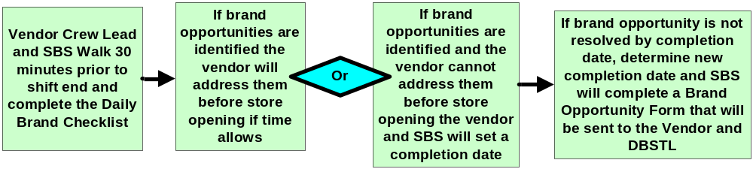
SBS Brand Maintenance Walk Program
Vendor and SBS Brand Maintenance Walk Flow

Slide 10
SBS Brand Maintenance Walk Program
A Housekeeping Vendor Communication Guide has been created to provide helpful guidelines for effective communication between Vendors, Building Services, and Store Teams.
  The communication guide includes an English/Spanish Translation Guide for key housekeeping terms.

Slide 11

SBS Brand Maintenance Walk Program

Slide 12
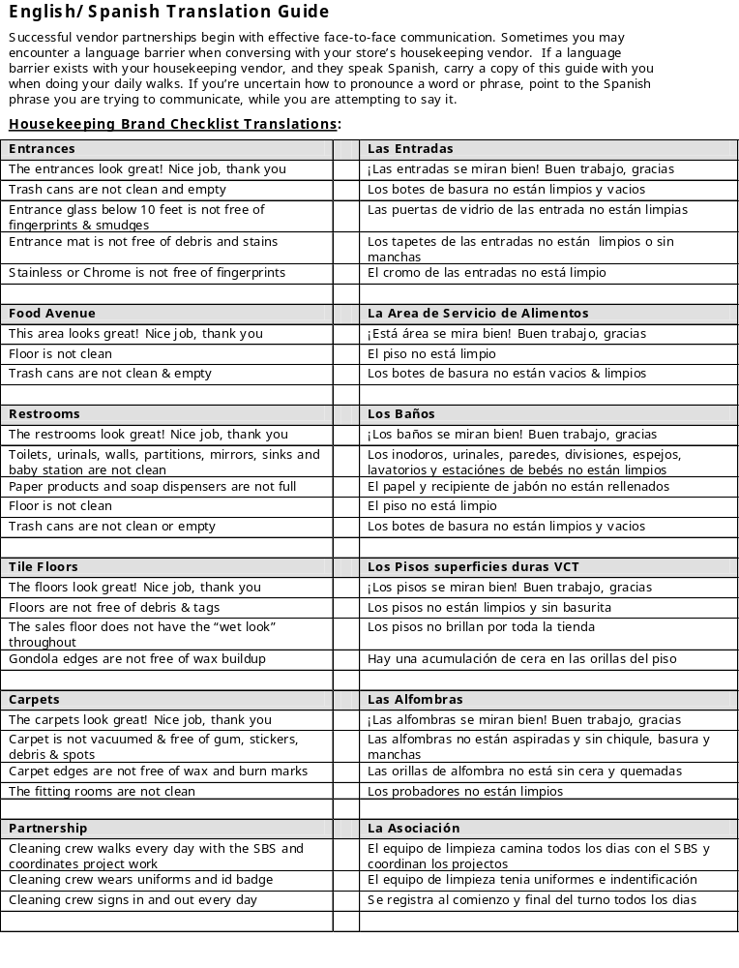
SBS Brand Maintenance Walk Program

Slide 13
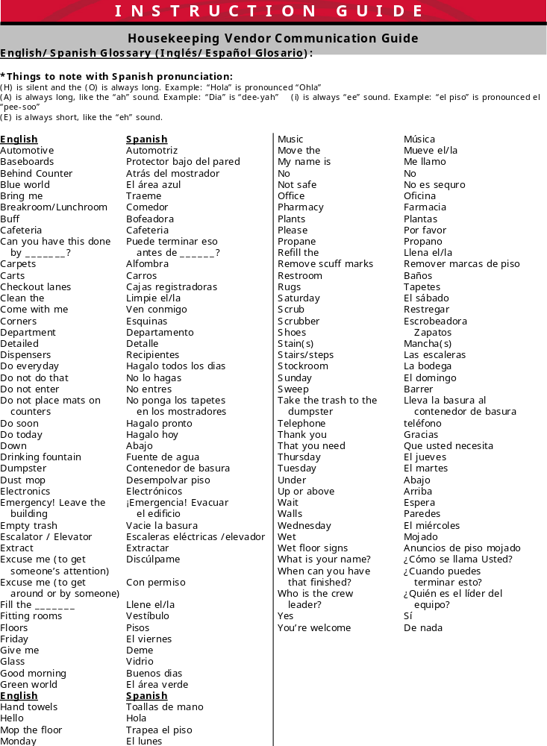
SBS Brand Maintenance Walk Program

Slide 14
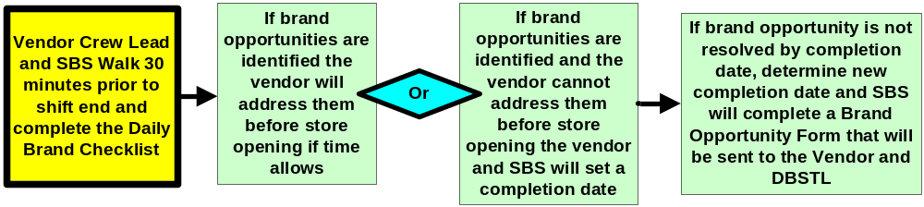
SBS Brand Maintenance Walk Program
Vendor and SBS will walk the SBS Brand Maintenance Checklist 30 minutes prior to the end of shift to identify any brand opportunities or wins.
The Vendor and SBS will focus on the following areas:
Front Entrance | Restrooms | Carpet
Food Ave | Tile | Partnership

Slide 15
SBS Brand Maintenance Walk Program
The Vendor and SBS walk the housekeeping portion of the checklist and determine if each area is B (Brand), or N (Not Brand).
Definitions of Brand and Not Brand:
  Brand - Acceptable
    Both results and how they are achieved often meet and sometimes exceed brand. Acceptable guest impressions.
  Not Brand - Unacceptable
    Both results and how they are achieved do not meet or inconsistently meet brand. Strong probability of guest disappointment.

Slide 16
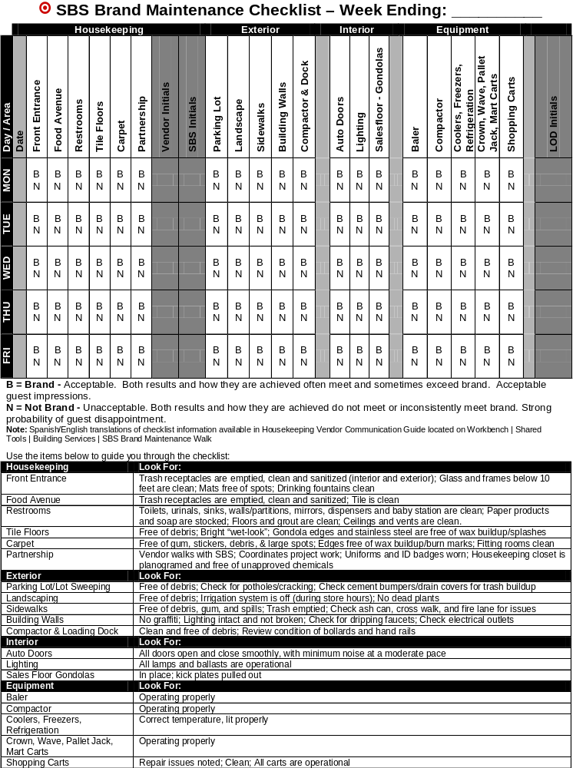
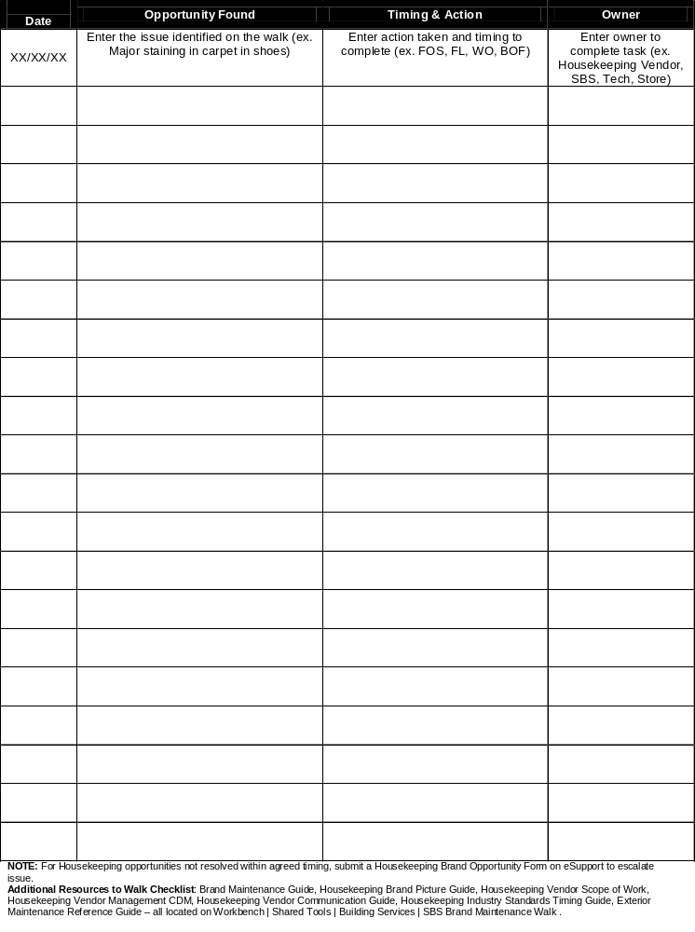
SBS Brand Maintenance Walk Program

Slide 17
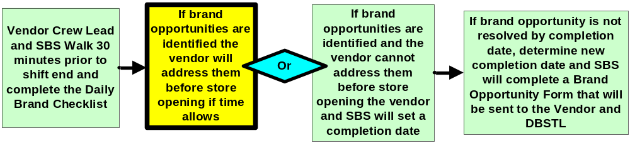
SBS Brand Maintenance Walk Program
If brand opportunities are identified during the walk the Vendor will fix them on the spot if the opportunity can be resolved before store opening without creating a safety concern.
  Fixed on Spot (FOS) Examples:
  Emptying trash; cleaning glass below 10’; refilling paper products/soap; cleaning toilets, sinks, and mirrors; removing loose debris and scuff marks from flooring.

Slide 18
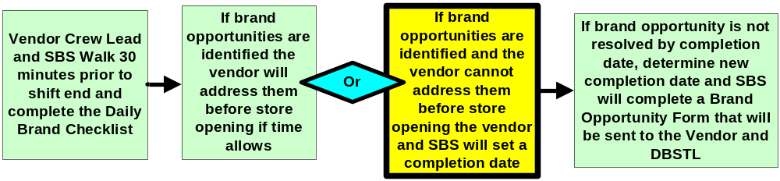
SBS Brand Maintenance Walk Program
If brand opportunities are identified during the walk that cannot be resolved before store opening due to time limitations and safety concerns, the Vendor and SBS will establish a completion date for the opportunity.
  Fix Later (FL) Examples:
  Extracting carpet; auto scrubbing floors; grout cleaning; detailing of corners and edges; escalator rails/treads.

Slide 19
SBS Brand Maintenance Walk Program
We have provided Building Services with Target Suggested Cleaning Times and Housekeeping Industry Standard Cleaning Times to be used as a guide when establishing completion dates.
Target Suggested Cleaning Times:
  Restroom sinks, toilets, urinals, walls, partitions, mirrors, baby changing station, vents: 1 day
  Restroom grout: 2 days
  Entrances (excluding carpet extraction): 1 day
  Entrance carpet extraction (may require multiple extractions): 7 days
  Food Avenue trash: 1 day
  Food Avenue grout: 2 days
  Tile dust mop: 1 day
  Tile scrub & recoat: 7-10 days (depending on store flow process)
  Carpet vacuum: 1 day
  Carpet extraction (may require multiple extractions): 7-10 days
  Offstage: 7 days
  Backroom main aisles: 1x per week only

Slide 20
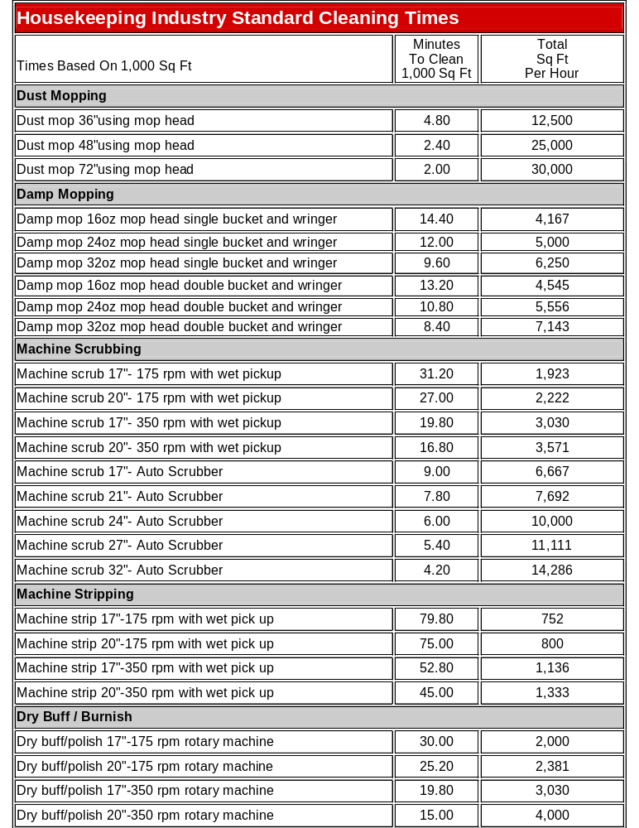
SBS Brand Maintenance Walk Program

Slide 21
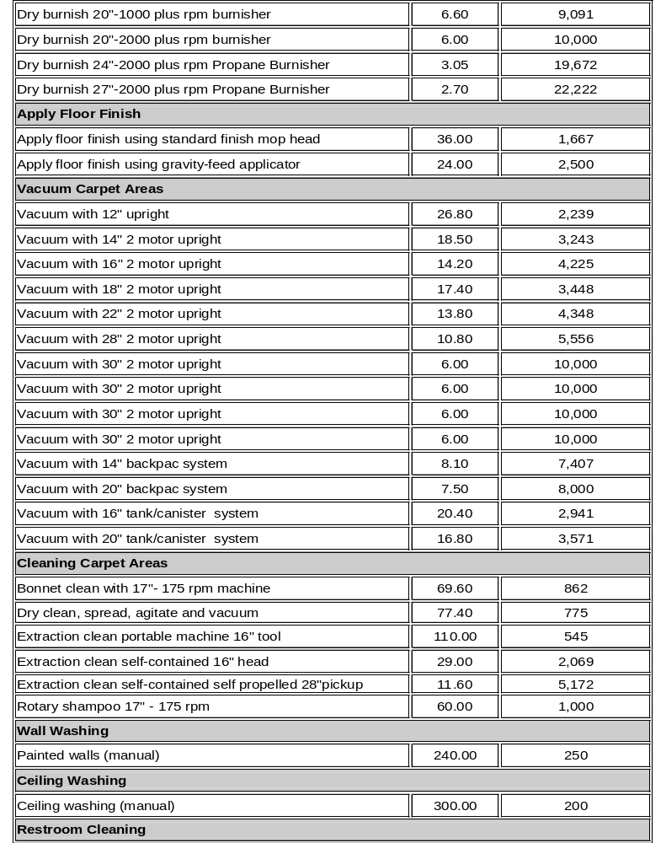
SBS Brand Maintenance Walk Program

Slide 22
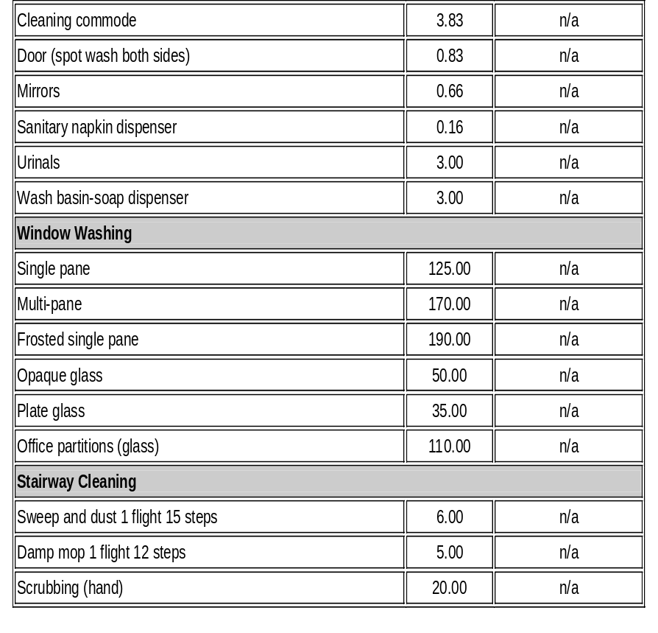
SBS Brand Maintenance Walk Program

Slide 23
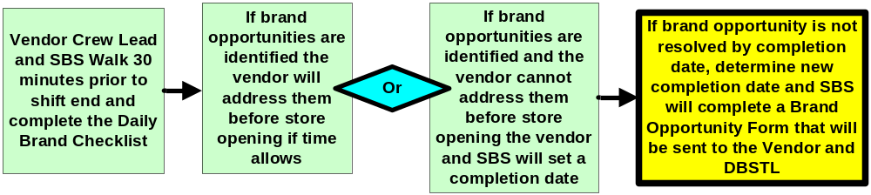
SBS Brand Maintenance Walk Program
If the brand opportunity has not been resolved by the completion date established during the walk, the SBS will complete a Brand Opportunity Form (BOF) which will be sent to the Vendor and DBSTL outlining the opportunity details and completion date.

Slide 24
SBS Brand Maintenance Walk Program
The Brand Opportunity Form (BOF) is a new communication tool that will be replacing the current work order process for all escalated housekeeping brand opportunities.
Brand Opportunity Forms will only be created by the SBS.
Vendors will receive the Brand Opportunity notice via email within 24 hours.
The Brand Opportunity notice will provide a case number and detailed information to the Vendor by specifying the exact location of the brand opportunity in the store.
The Vendor will respond to the SBS and DBSTL within 24 hours to acknowledge opportunity.
Brand opportunity case numbers will not need to be completed via the IVR line.
Reporting on the Brand Opportunity Forms will be sent to the Vendors once a month and will point out any global trends.

Slide 25
SBS Brand Maintenance Walk Program
Import example of BOF email the vendor will receive…. Called Chad 7-23-07 @ 12:30

Slide 26
SBS Brand Maintenance Walk Program
There are seven main categories the SBS will choose from and a variety of sub-categories to help the Vendor locate the opportunity easily within the store.
Seven Main Categories:
  Front Entrance
  Food Ave
  Restrooms
  VCT Tile
  Carpet
  Partnership
  Housekeeping Supply Closet

Slide 27
SBS Brand Maintenance Walk Program
Sub-Categories for Opportunity Areas:
Front Entrance
Debris on Front Entrance mat
Spots on Front Entrance mat
Spots on Glass under 10 feet
Trash (interior and exterior) is not emptied
Text Box to write additional comments
Food Ave
Food tile is Ave not clean
Trash Receptacles not emptied, clean and sanitized
Text box to write additional comments

Slide 28
SBS Brand Maintenance Walk Program
Restrooms
Select Restroom:
Men’s
Women’s
Family
Pharmacy
Team Member
Restroom Opportunity Areas:
Baby changing table is not clean
Walls are not clean
Partitions are not clean
Doors are not clean
Floor tile is not clean
Floor grout is not clean
Supplies are not filled
Sinks are not cleaned
Toilets are not clean
Urinals are not clean
Vents
Text box to fill in any additional comments

Slide 29
SBS Brand Maintenance Walk Program
Tile
Select Tile Area:
Bakery
Breakroom
Consumables
HBA
Electronics
MMB/Entertainment
Housewares
Deli
Domestics
Chemicals
Home Improvement
Meat
Produce
Sporting Goods
Toys
TMSC
Seasonal
Checklanes
Home Storage
Tile Opportunity Areas:
Tile is dull
Tile is not clean
Tile is yellow
Wax build up along edges
Wax build up on stainless
Text box to write additional comments

Slide 30
SBS Brand Maintenance Walk Program
Carpet
Select Carpet Area
Boys
Fitting Room
Girls
Infants/Toddlers
Intimate
Jewelry/Accessories
Men’s
Offices
Shoes
Women’s
Carpet Opportunity Areas:
Carpet has debris
Carpet has spots
Wax build up on carpet edges
Fitting room mirrors
Fitting room walls/partitions are not clean
Fitting room benches
Text box to write additional comments

Slide 31
SBS Brand Maintenance Walk Program
Partnership Opportunity Areas:
Uniforms not worn by crew members
ID’s not worn by crew members
Crew lead is not partnering with housekeeping vendor
Text box to write additional comments
Housekeeping Supply Closet Opportunity Areas:
Equipment not working/safety concerns
Chemical supply closet is not organized to planogram
Unapproved chemicals in the supply closet
Text box to write additional comments

Slide 32
Questions
What is the Brand Opportunity Form replacing?
The work order number has now been replaced by a ____ number?
Who submits Brand Opportunity Form for brand opportunities?
When does the Vendor need to respond to the SBS after receiving the Brand Opportunity Form ?
Does the Vendor need to “Complete” the case number via IVR?
The Vendor will walk with the ____ 30 minutes prior to shift end.
The scoring system on the Daily Checklist has changed from R,Y,G to what?
When brand opportunities are identified the Vendor must always address the opportunity on the spot before store opening. (T/F)
If brand opportunities are found and cannot be address on the spot, the Vendor and SBS should what?

Slide 33
Questions about SBS Brand Maintenance Walk Program?

Slide 34
Housekeeping Vendor Escalation Process

Slide 35
Housekeeping Vendor Escalation Process
The escalation process has been defined to provide a uniform and global direction for Vendors and Building Services Field teams to resolve Housekeeping brand opportunities

Slide 36
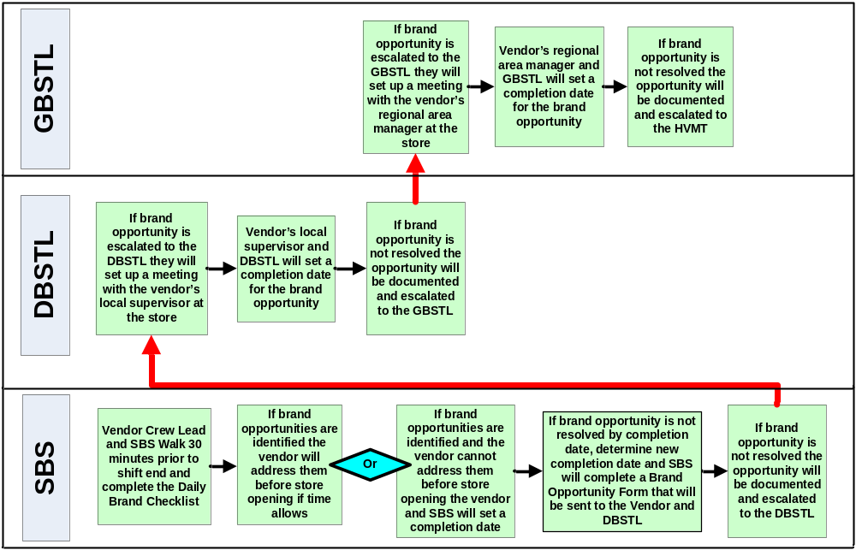
Housekeeping Vendor Escalation Process
Escalation Process Flow

Slide 37
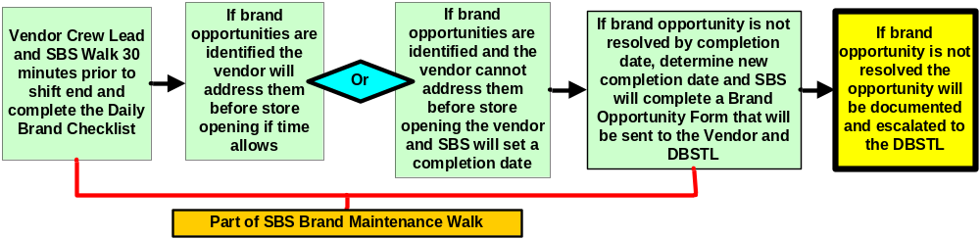
Housekeeping Vendor Escalation Process
Vendor and SBS Escalation:
The SBS will follow up on the Brand Opportunity Form completion date that was agreed upon to verify that the opportunity has been resolved.
If the brand opportunity is not resolved by agreed upon completion date the SBS will complete a Housekeeping Vendor Escalation Worksheet and escalate the opportunity to the DBSTL.
  On the Escalation Worksheet the SBS will document what has been done to resolve the brand opportunity and the case number from the brand opportunity form.

Slide 38
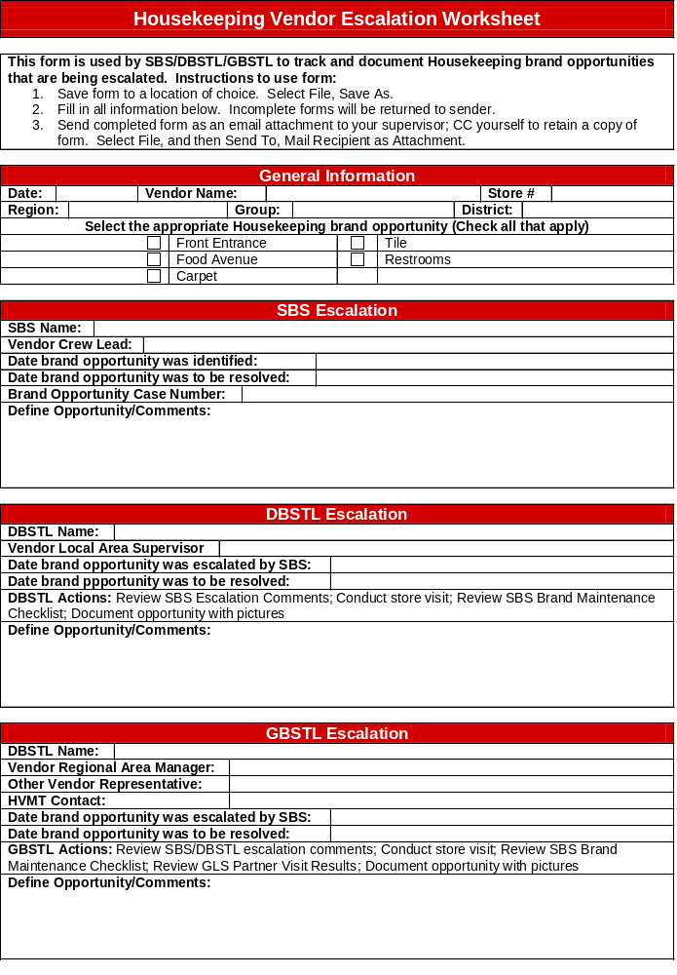
Housekeeping Vendor Escalation Process

Slide 39
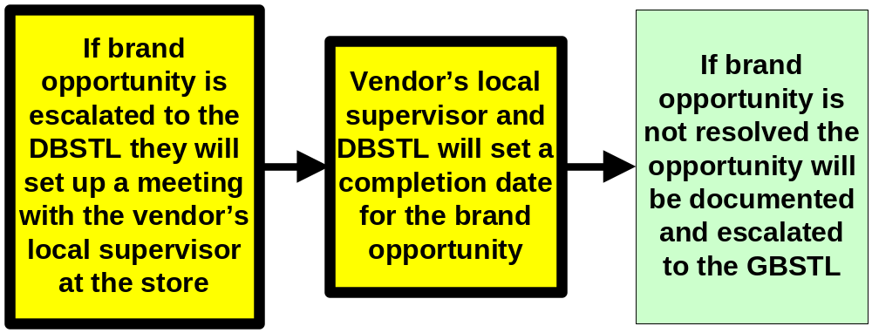
Housekeeping Vendor Escalation Process
Vendor and DBSTL Escalation:
Once a brand opportunity is escalated to the DBSTL they will set up a meeting at the store with the Vendors Local Supervisor to discuss the opportunity details.
  The DBSTL will review the information provided in the Housekeeping Vendor Escalation Worksheet in addition to the SBS Brand Maintenance Checklists.
  The DBSTL will also take pictures of the brand opportunity.
The vendor and DBSTL will establish a new completion date

Slide 40
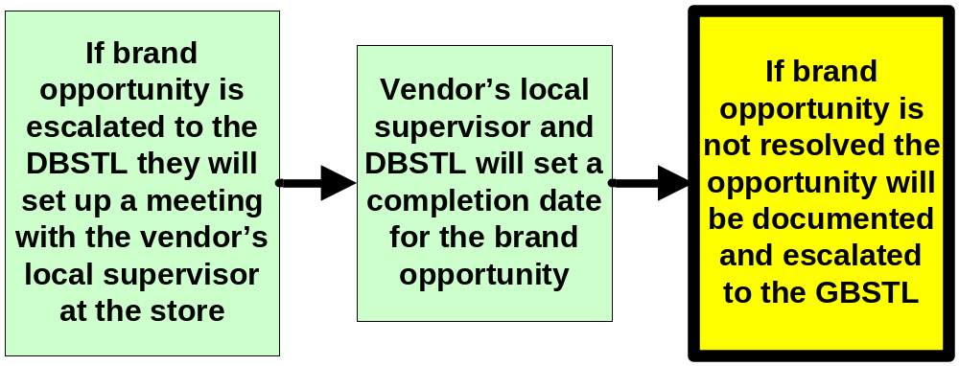
Housekeeping Vendor Escalation Process
Vendor and DBSTL Escalation:
If the brand opportunity is not resolved the DBSTL will update the Housekeeping Vendor Escalation Worksheet and escalate the opportunity to the GBSTL.

Slide 41
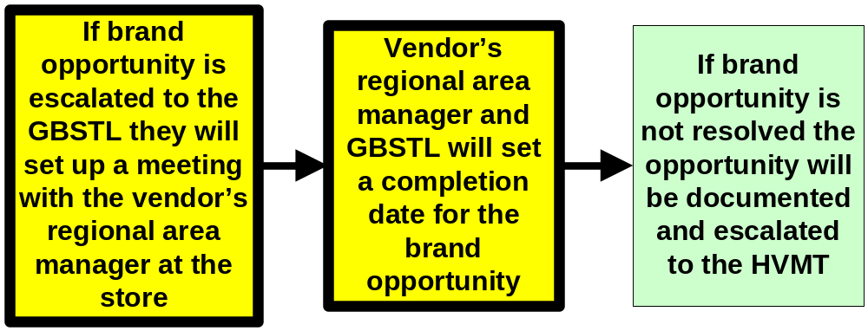
Housekeeping Vendor Escalation Process
Vendor and GBSTL Escalation:
Once a brand opportunity is escalated to the GBSTL they will set up a meeting at the store with the Vendors Regional Area Manager to discuss the opportunity details.
  The GBSTL will review the information provided in the Housekeeping Vendor Escalation Worksheet, the SBS Brand Maintenance Checklists, photos of brand opportunity, and the monthly Great Looking Store Partner Visit Survey results.
  The Vendor and GBSTL will establish a new completion date.

Slide 42
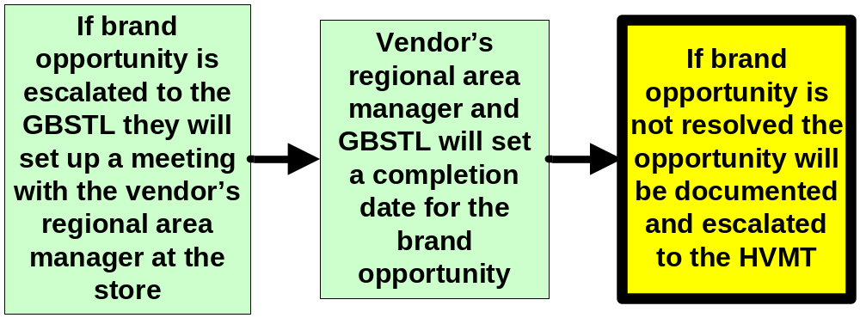
Housekeeping Vendor Escalation Process
Vendor and GBSTL Escalation:
If the brand opportunity is not resolved GBSTL will update the Housekeeping Vendor Escalation Worksheet and escalate the opportunity to the Housekeeping Vendor Management Team (HVMT).

Slide 43
Questions
Who does the SBS work with to resolve brand opportunities?
When does the SBS create a Brand Opportunity Form?
Who does the SBS escalate opportunities to if they are not resolved?
The DBSTL will reach out to the Vendor’s _________ to attempt to resolve the opportunity?
Who will take pictures of the brand opportunity?

Slide 44
Questions about Housekeeping Vendor Escalation Process?

Slide 45
Housekeeping Vendor Non- Performance Penalty Program

Slide 46
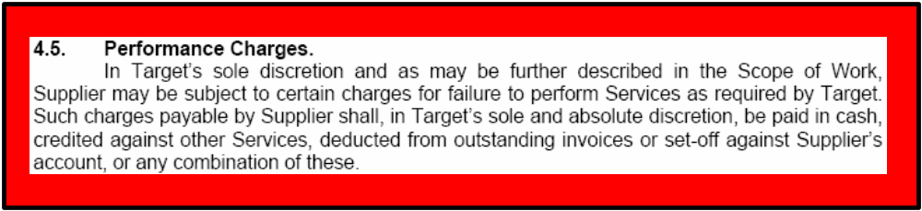
Vendor Non-Performance Penalty Process
In accordance with Target’s Housekeeping contract, Vendors will be held accountable for failure to perform services as required by Target.
Target will hold Vendors accountable for:
Brand Opportunities
No Shows

Slide 47
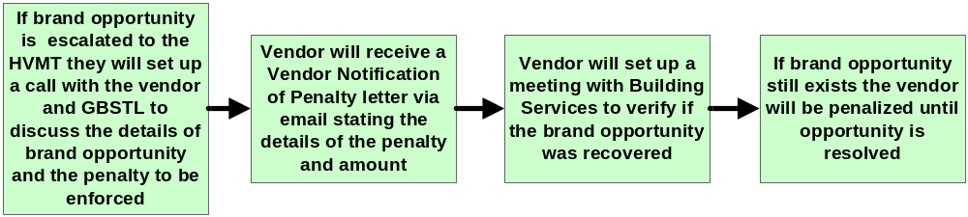
Vendor Non-Performance Penalty Process
Brand Opportunity Penalty Flow

Slide 48
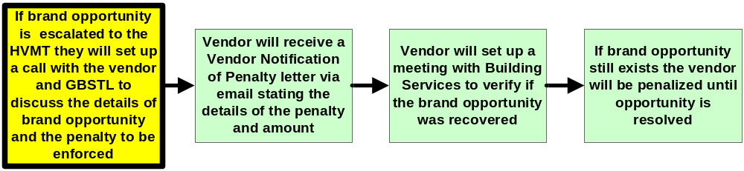
Vendor Non-Performance Penalty Process
Brand Opportunity Penalty
If the brand opportunity is escalated to the HVMT we will set up a call with the Vendor and GBSTL
The call will consist of the following items:
    Review the escalation documentation and any photos
    SBS Brand Maintenance Checklists
    GLS Partner Visit Survey results
    Identify the penalty start date
    Set up a “sign off” meeting between the Vendor and GBSTL to walk the store when the brand opportunity will be resolved.

Slide 49
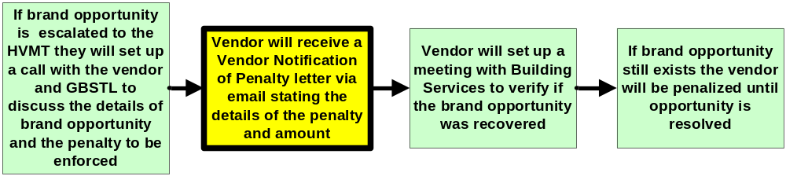
Vendor Non-Performance Penalty Process
Brand Opportunity Penalty
Vendor will receive a Vendor Notification of Penalty letter via email from the GBSTL within 24 hours of the call.
This letter will state the details that were discussed during the call including the start date that the penalty will be enforced until the brand opportunity is resolved.

Slide 50
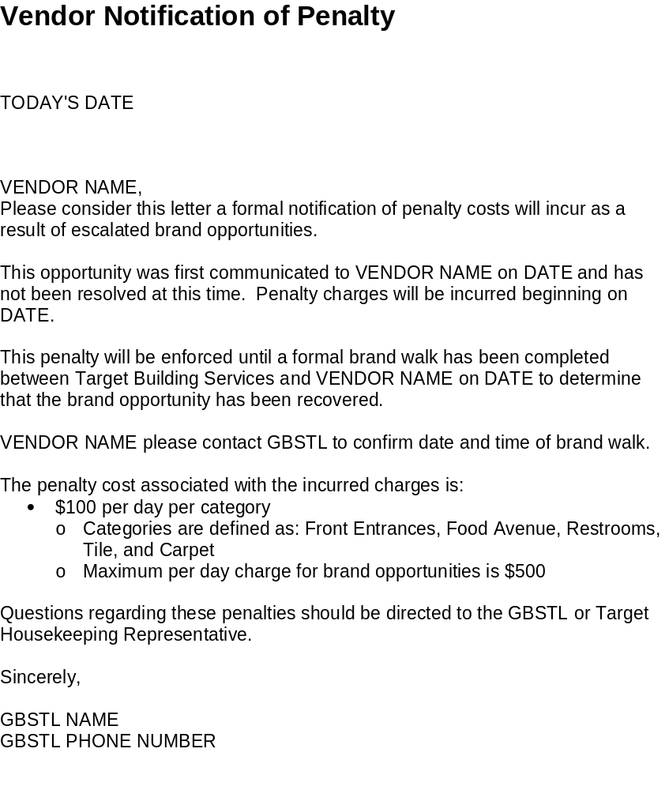
Vendor Non-Performance Penalty Process

Slide 51

Vendor Non-Performance Penalty Process
Brand Opportunity Penalty Flow
Vendor will walk with Building Services at the store to verify the brand opportunity has been resolved.
  If the brand opportunity has been resolved the penalty charges will stop and the GBSTL will inform the Housekeeping Vendor Management Team.
  If the brand opportunity has NOT been resolved the penalty charges will continue until resolved. The GBSTL will inform the Housekeeping Vendor Management Team.
    Housekeeping Vendor Management Team will schedule a second call between the Vendor and GBSTL to discuss the brand opportunity.

Slide 52
Vendor Non-Performance Penalty Process
Brand Opportunities:
Vendors may be penalized $100 for each of the following brand opportunities:
  Front Entrance
  Food Ave
  Restrooms
  Tile
  Carpet
A maximum of $500 may be withheld per day for brand opportunities.

Slide 53
Vendor Non-Performance Penalty Process
No Shows:
Vendors will be penalized $300 for each No Show occurrence.
Per the Target Housekeeping contract, No Shows are defined as one or zero crew members showing up for the entire shift.
No Show penalties may be assessed in addition to any brand opportunity penalties.
Vendors will receive a “Housekeeping Vendor No Show Penalty Form” via email from the DBSTL or GBSTL to notify them of the No Show and penalty charge within 24 hours of occurrence.
If the Vendor would like to dispute the penalty charge for a “No Show” they will need to contact the DBSTL.

Slide 54
Vendor Non-Performance Penalty Process

Slide 55
Vendor Non-Performance Penalty Process
Timing of Penalties
All penalties will be tracked by Housekeeping Vendor Management Team and penalty charges will be withheld from monthly contract payment.
Housekeeping Vendor Management Team will provide the Vendors with monthly penalty reporting.

Slide 56
Questions
Vendors will be penalized for not performing to Target Standards? (Y/N)
There are two categories for penalties, Brand Opportunities and ___________?
Once opportunities are escalated to the HVMT a conference call will be set up with HVMT, Vendor and ________?
What amount will a Vendor be withheld for each category?
What will be withheld from the Vendor for No Shows?
A No Show is when zero or ____ crew members show up for the entire shift.
How often will penalties be withheld each month?

Slide 57
Questions about Vendor Non-Performance Penalty Process?

Slide 58
Great Looking Store Partner Visit Survey

Slide 59
Great Looking Store Partner Visit Survey
The Great Looking Store Partner Visit Survey is a tool for the DBSTL and STL to partner together to evaluate the brand in all stores.
  The new Partner Visit Survey will be replacing the Brand Scorecard and DBSTL Visit Guide.
  After reviewing the SBS Brand Maintenance Checklist the DBSTL and the STL will complete the Partner Visit Survey.
    Partner Visit Survey can be completed anytime throughout the fiscal month.
  The first Partner Visit Survey will be completed in September and results will be available in October.
  Housekeeping Vendor Management Team will provide monthly reporting to the Vendors

Slide 60
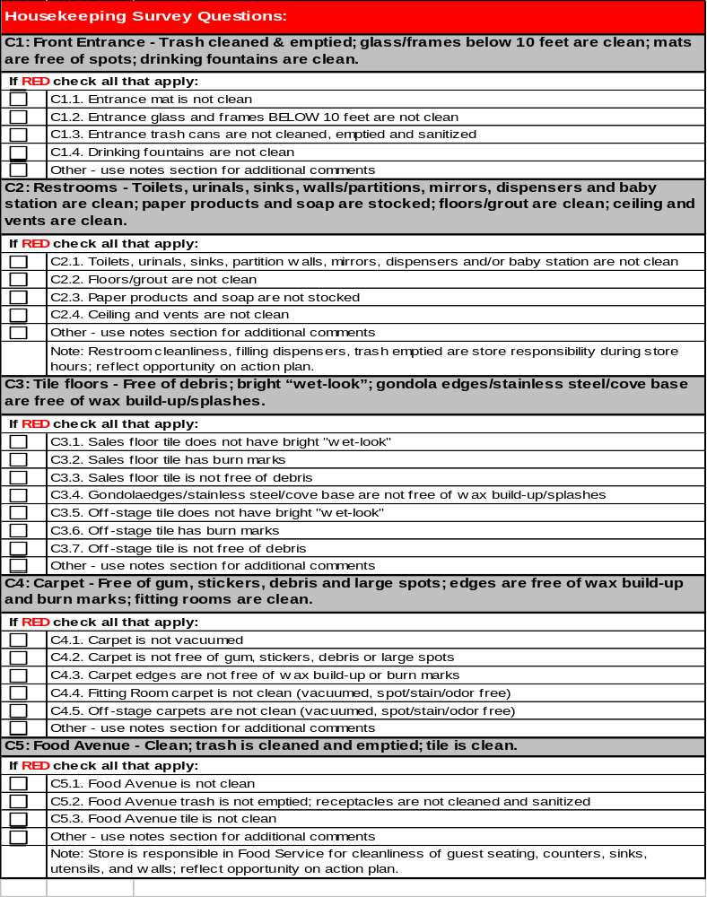
Great Looking Store Partner Visit Survey

Slide 61
Great Looking Store Partner Visit Survey
Great Looking Store (GLS) – Partner Visit Survey Rating
(This rating system has not changed from the Brand Scorecard rating system)
Green - Target Brand: (100-85)
Both results and how they are achieved consistently meet and often exceed brand
Exceptional guest impressions
Yellow - Acceptable: (84-61)
Both results and how they are achieved often meet and sometimes exceed brand
Some opportunities for improvement, however, overall Acceptable guest impressions
Red - Unacceptable: (60 & Below)
Both results and how they are achieved does not meet or inconsistently meets brand
Strong probability of guest disappointment

Slide 62
Questions
What is the GLS-Partner Visit Survey replacing?
Who will be filling out the Partner Visit Survey?
When will the Partner Visit Survey be completed each month?
Has the scoring method changed from the Brand Scorecard? (Y/N)
What question has been removed on the Partner Visit Survey that was part of the Housekeeping section on the Brand Scorecard?

Slide 63
Questions about Great Looking Store Partner Visit Survey?

Slide 64
Vendor Partnership
Survey

Slide 65
Vendor Partnership Survey
The Vendor Partnership Survey has been created to provide the Vendor an opportunity to give Housekeeping Vendor Management Team feedback on overnight operations and overall communication.
  This optional survey is an additional outlet to share feedback, which may be taken at any time.
  The Vendor Partnership Survey can be completed by any Vendor employee.
  The Vendor will call BSOC at 888-888-0304
      Select option (#)
      Answer 3 (Y/N) questions
  Housekeeping Vendor Management Team will review survey results monthly.

Slide 66
Vendor Partnership Survey
Vendor Partnership Survey Questions:
Overnight Flow Team meets and effectively coordinates nightly processes and project work with Housekeeping crew? (Y/N)
Flow/Wave process is being executed by the overnight flow team to allow the Housekeeping crew floor space? (Y/N)
The SBS walks with the Housekeeping crew 30 minutes prior to shift end to identify brand opportunities? (Y/N)
Other Comments?

Slide 67
Questions
The Vendor Partnership Survey can be completed by anyone that works for the Vendor? (Y/N)
How is the survey completed?
How many questions will be asked when the vendor calls into BSOC?

Slide 68
Questions about Vendor Partner Survey?

Slide 69
Vendor Next Steps:
Training of all crew and management on the new Housekeeping Best Practice Program needs to be completed by September 10th.
  This training will be recorded and sent to you for your reference so you can use it as a resource or training tool.
A questionnaire will be sent to you regarding this program. to identify any questions/concerns you may have about the programs.
Attend follow up meeting for FAQ’s August 14th.
Contact List for Vendor Field Teams is needed by August 14th.

Slide 70
Forms /Resources
General Resources
Industry Standard Cleaning Times
Housekeeping Scope of Work
Housekeeping/Flow Routines
Housekeeping Profile Worksheet
Housekeeping Vendor Communication Guide
Housekeeping Vendor Core Roles
Forms
Housekeeping Brand Opportunity (example)
Housekeeping Vendor Escalation Worksheet
Housekeeping Vendor Notification of Penalty Letter
Housekeeping Vendor No Show Penalty Form

Slide 71
Program Rollout Date
September 17th, 2007

Slide 72
Questions?

