Slide 1
Presentation for
Bachelor of Art Degree
Regional Food's Featured Ingredient Extraction Algorithm and Its Application
Environment and Information Studies
Nguyen Trung Duc

Slide 2
Introduction
Some introduction about the multimedia for cooking and about this thesis.

Slide 3
WHEN IS THE ALGORITHM USEFUL?
When we want to transform recipes of a region to have the taste of another region.
  For example: Kanto taste to Kinki taste.
Why we need that?
  You may want to eat another region’s foods but there are some taste that you dislike.
  You are getting bored of your daily menu and want to add new tastes.

Slide 4
Contributions
Regional Food's Featured Ingredient Extraction Algorithm
Application System Design & Implementation
Fast meta data recalculation algorithm for the system.

Slide 5
Regional Food's Featured Ingredient Extraction Algorithm
Approach: From Ingredients.
Proposed Featured Index (FI) to for comparing the relative importance of ingredients between regions.
Formula:
  i: ingredient.
  R:set of recipe in a Region.
  A: set of recipe in All the country.
Example:

Slide 6
Ingredient Frequency (IF)
This formula calculates the popularity of an ingredient with respect to a region’s recipes.
Formula:
  i: (i)ngredient.
  R: set of all recipe in the (R)egion.
  r: one (r)ecipe in the region.
Example:
  Region's recipes: R = a set of 50 recipes.
  Number of recipes in which miso appears: 45 recipes.

Slide 7
Ingredient Amount (IA)
The taste of a food not only depends on the ingredients, but also how much of an ingredient is added. Even when an ingredient has a high value of IF , it might not be the region’s featured ingredient, due to only a small amount being added.
  For example: miso has IF of 0.9 in Kanto, but it might have only a little amount in each recipe.
Formula:
  i: (i)ngredient.
  R: set of all recipe in the (R)egion.
  AR: set of recipe in (A)ll (R)egion.

Slide 8
Ingredient Amount (IA)
Formula:
  i: (i)ngredient.
  r : a (r)ecipe in one region.
  S: set of recipes in Region.
Meaning: Normalize the results to get a per-recipe average so that recipe-number variance doesn’t skew the results.

Slide 9
Ingredient Uniqueness (IU)
To be a featured ingredient of a region, the ingredient must satisfy the condition that it appears exclusively in one region.
Formula:
  i: (i)ngredient.
  A: set of (A)ll (R)egion in the country.
  R: one (R)egion in the country.
Example:
  Pepper appears in Kanto and Kinki over 7 regions of Japan.

Slide 10
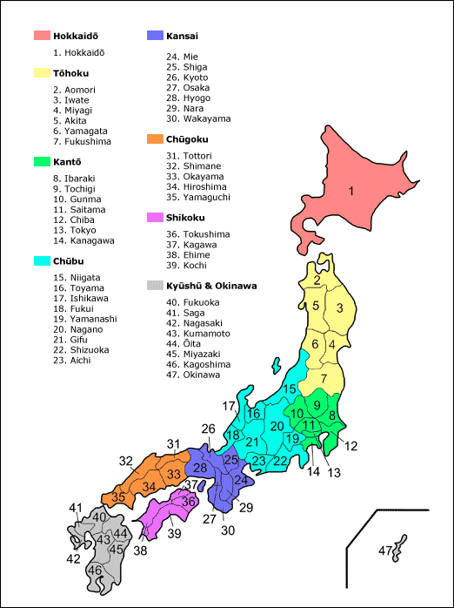
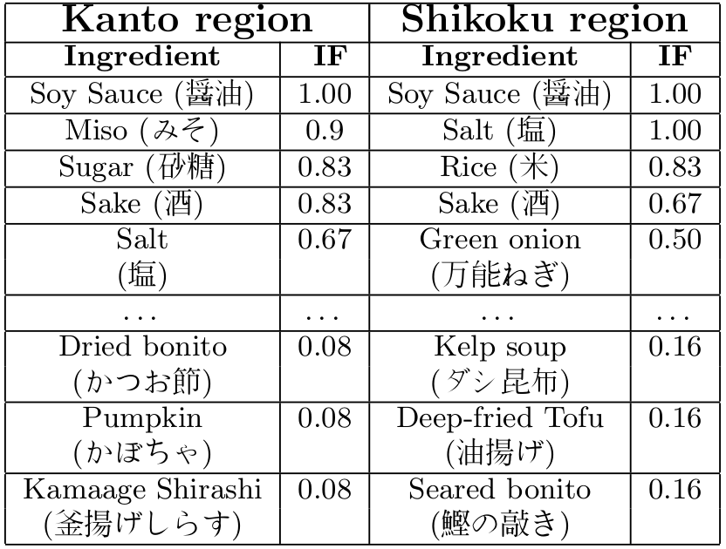
Experimental Ingredient Frequency (IF)

Slide 11
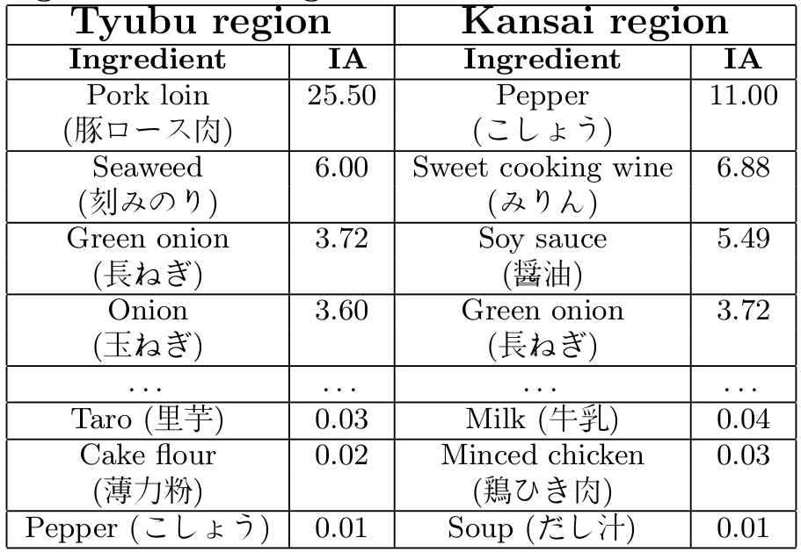
Experimental Ingredient Amount (IA)

Slide 12
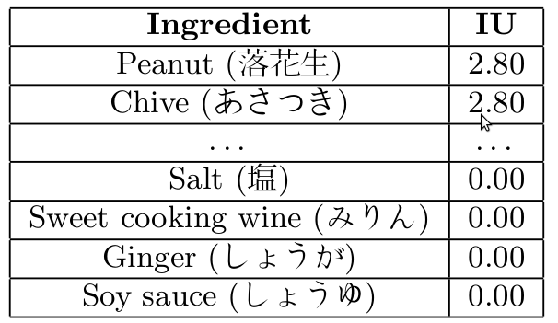
Experimental Ingredient Uniqueness(IU)

Slide 13
System's Functions
Major function: Transform a recipe from original regional taste to a specified regional taste.
Minor function: Accept as input ingredients available in a user’s home, and suggest possible recipes.
  For example: If we have in our home
    Onion 2
    Sugar 1kg
    Soy Sauce 500 ml
    Ginger 300g
    Vegetable Oil 200ml
    Eggs 5
  Caramelized Onion, Onion Skin Easter Eggs,…

Slide 14
Application System Architecture

Slide 15
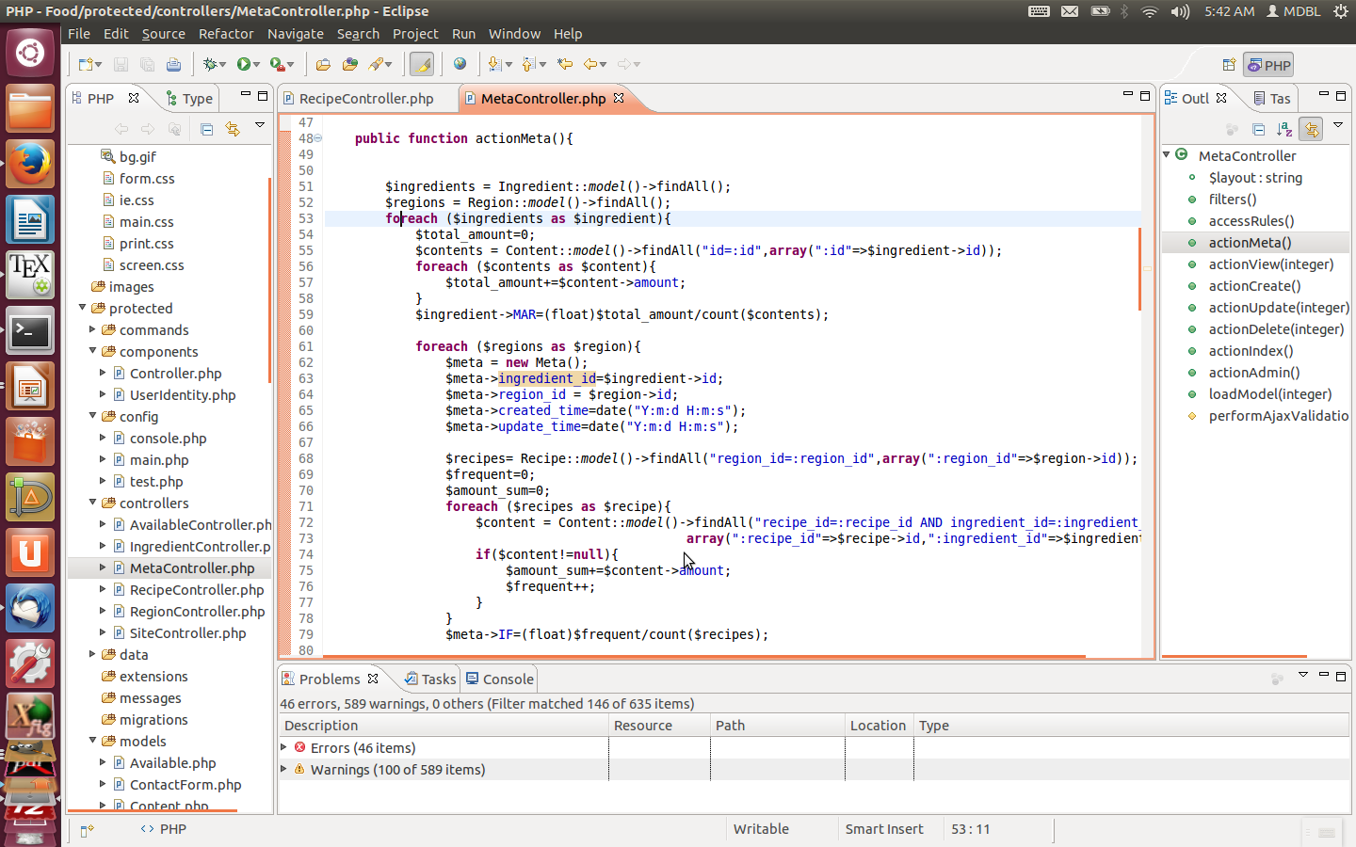
Problem on Database's update

Slide 16
Meta data Recalculation

Slide 17
6.Database design
Entity Relation Diagram
Making Scheme

Slide 18
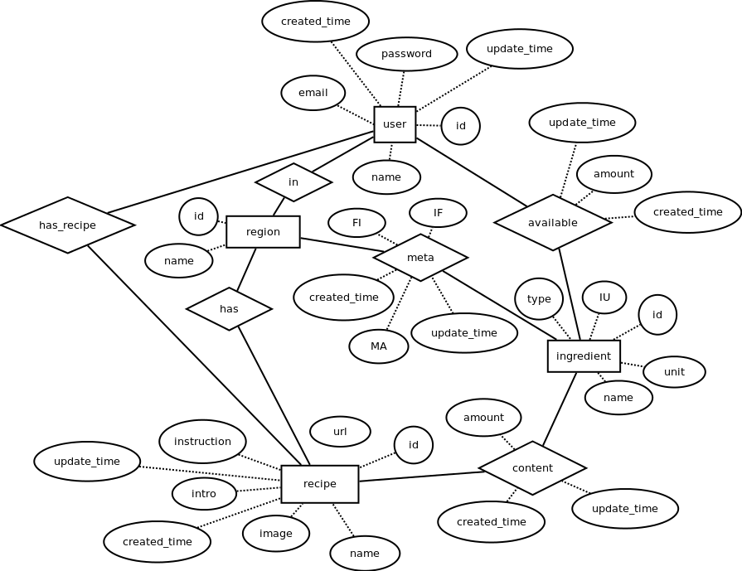
Entity Relation Diagram

Slide 19
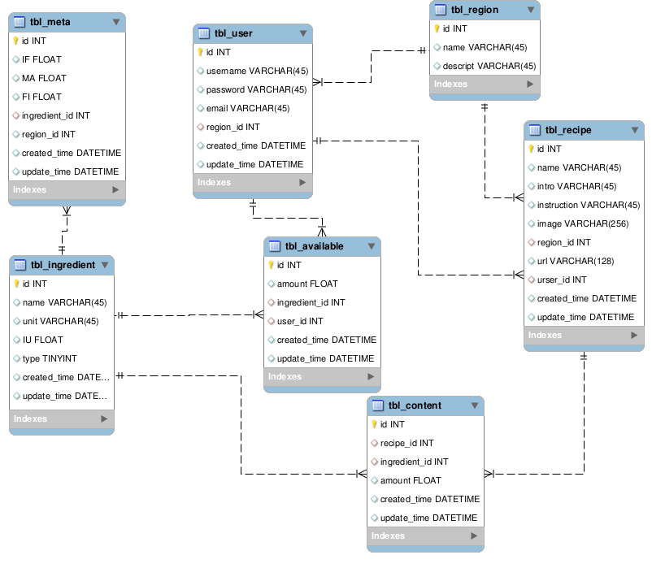
Database Scheme

Slide 20
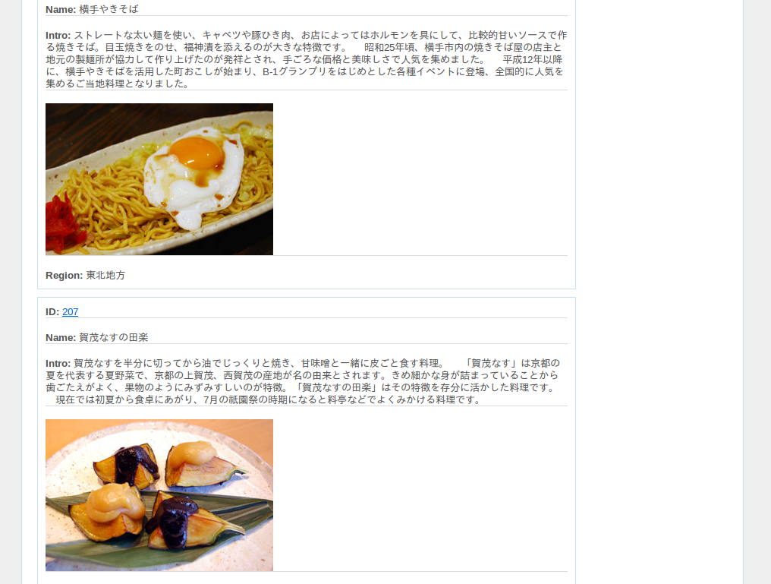
Web's Interfaces

Slide 21
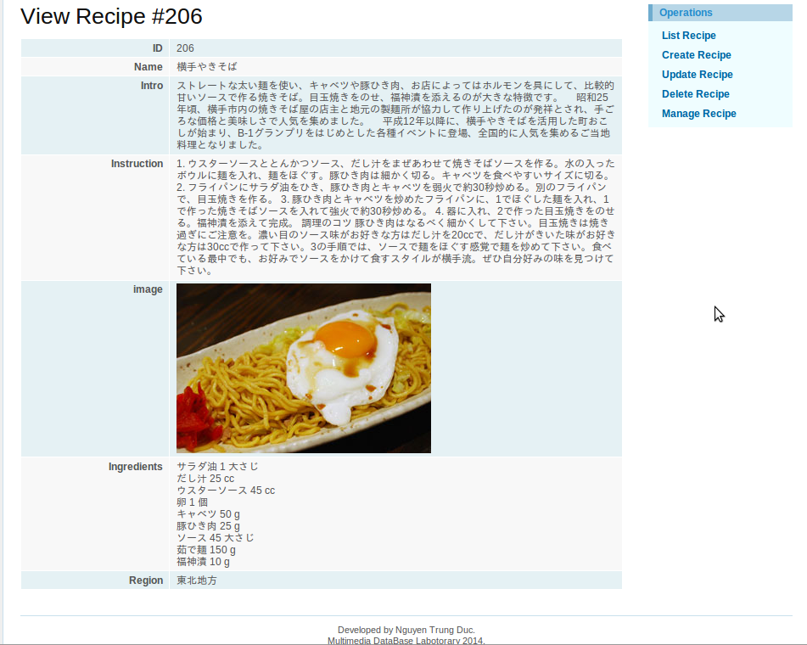
Web's Interfaces

Slide 22
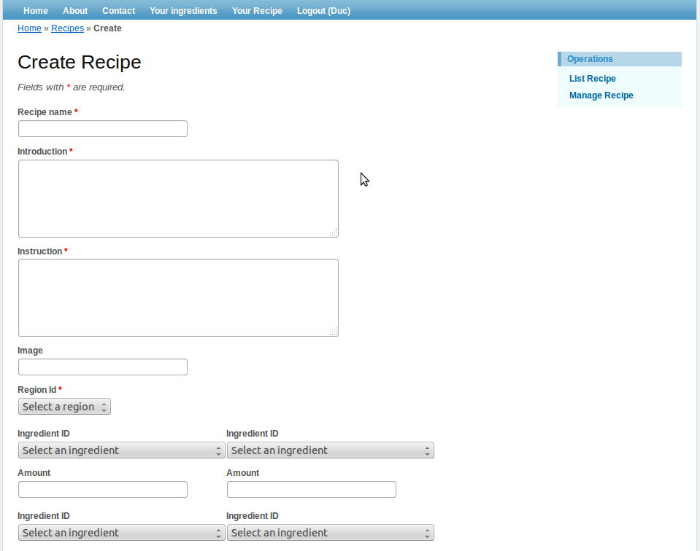
Web's Interfaces

Slide 23
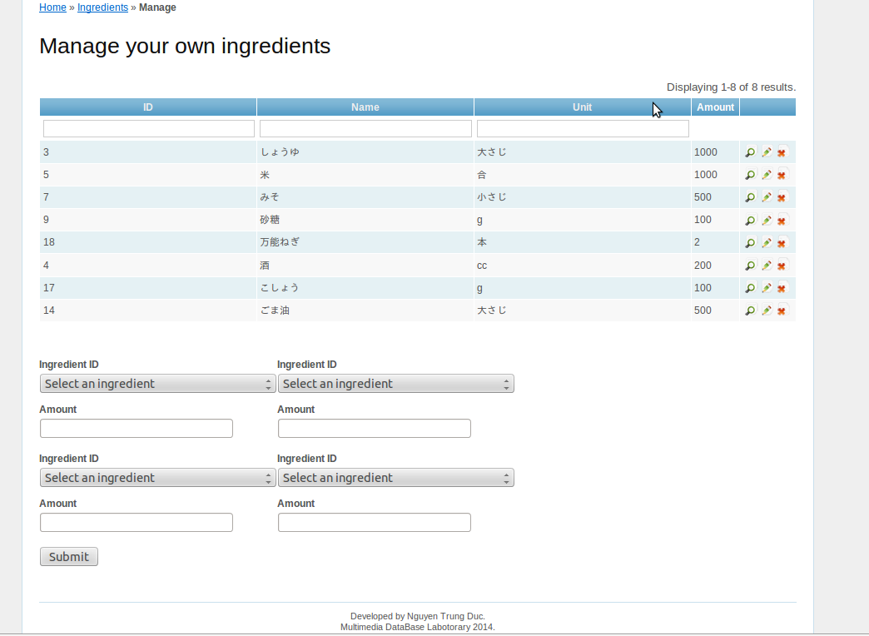
Web's Interfaces

Slide 24
Future Works
Analyze food’s features by applying different methods for seasoning ingredients and non-seasoning ingredients.
Making a matrix for conversion between different quantities.
Standardize the database.

Slide 25
Conclusion
Regional Food's Featured Ingredient Extraction Algorithm
Application System Design & Implementation
Fast meta data recalculation algorithm for the system.

Slide 26
Thanks for your attention!

