Slide 1
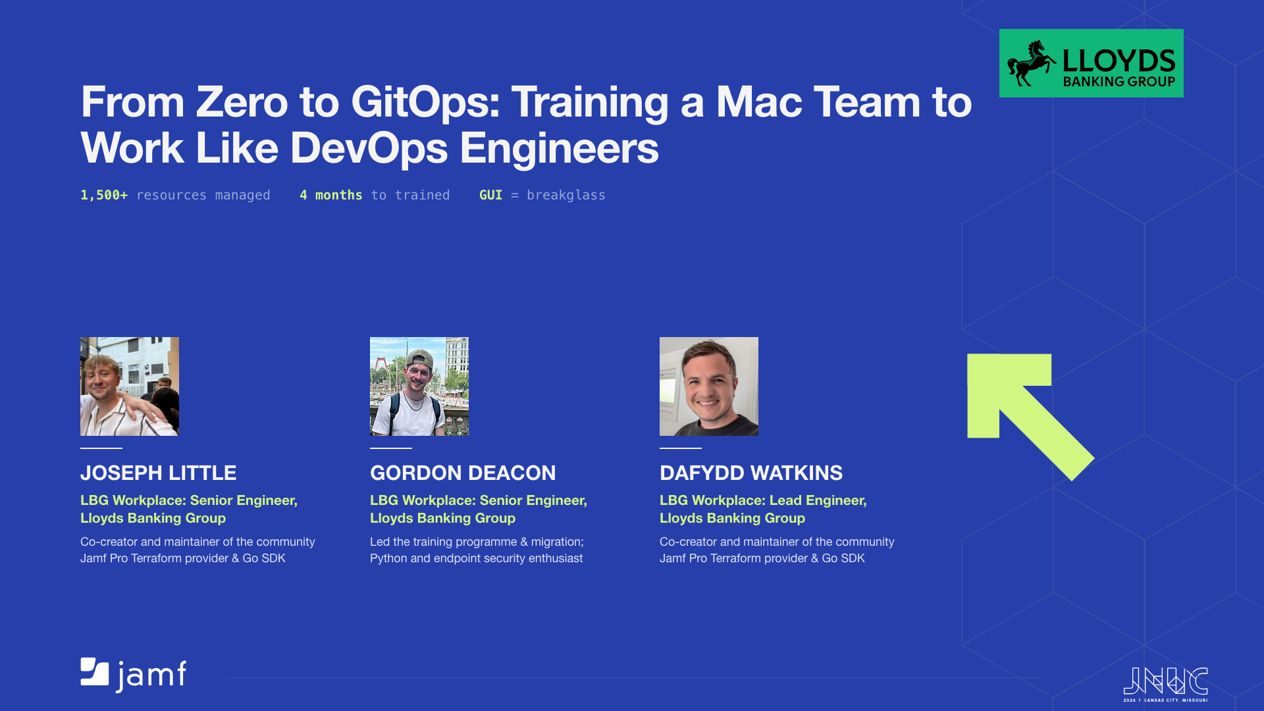
Notes:
Welcome. This is the story of how a ClickOps Mac team became a GitOps team at enterprise scale - over 1,500 resources under management, full team trained in four months, GUI access now breakglass only. Three of us led this: Dafydd and Joseph, co-creators of the community Jamf Pro Terraform provider and Go SDK, and Gordon, who ran the training programme and migration once knowledge transfer was complete.

Slide 2
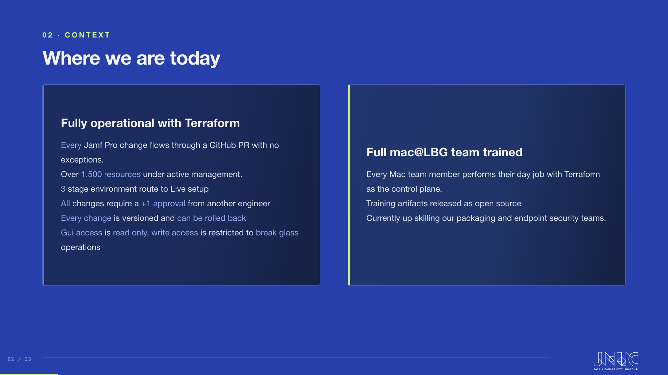
Notes:
Where the team is today, before the story starts. Fully operational: every change through a PR, 1,500+ resources, GUI is breakglass only. And the whole Mac team trained, with the packaging and endpoint security teams now following. The speakers were introduced on the title slide.

Slide 3
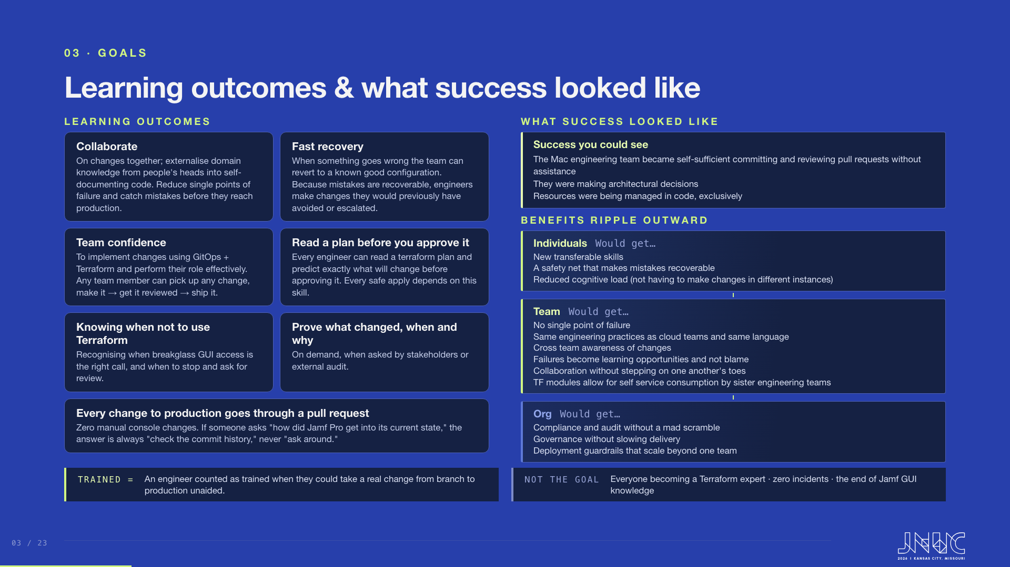
Notes:
Two halves: what engineers can do once trained, and what success looked like when it arrived. The learning outcomes are capabilities, not policies: collaborating through self-documenting code, the confidence to take any change end to end, recovery to a known good configuration, reading a plan well enough to predict its effect before approving, and the judgement to know when breakglass GUI access or a second opinion is the right call. Fast recovery has a second-order effect worth calling out: once mistakes were recoverable, engineers took on changes they would previously have avoided or escalated. Success was observable, not abstract: the Mac engineering team became self-sufficient committing and reviewing pull requests without assistance, they were making architectural decisions, and resources were being managed in code exclusively. Be honest about non-goals too: not everyone becomes a Terraform expert, incidents still happen, and Jamf GUI knowledge still matters for breakglass. And name the finish line: an engineer counted as trained when they could take a real change from branch to production unaided.

Slide 4
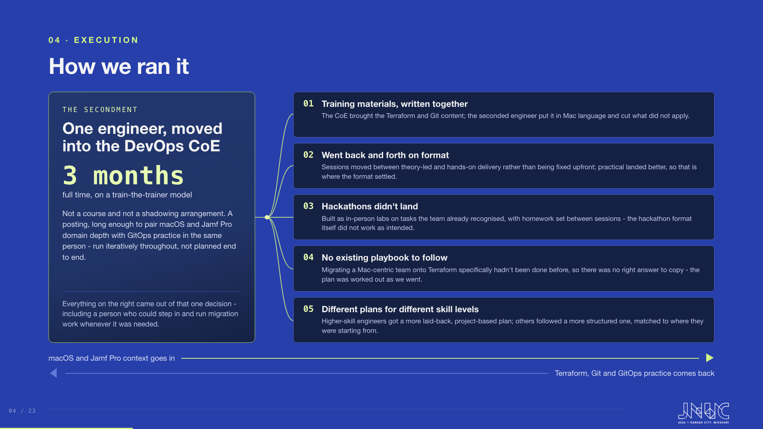
Notes:
Everything here came out of one decision. We seconded a Mac engineer into the DevOps Centre of Excellence full time for three months on a train-the-trainer model. That is the whole slide: a posting, not a course, and it was run iteratively throughout rather than planned end to end. Five things came out of it. We wrote the training materials together, so the CoE brought the Terraform and Git content and the seconded engineer put it in Mac language and cut what did not apply. We went back and forth on delivery format: sessions started theory-led, we tried hands-on instead, and practical won out, so that is where we settled. The hackathons did not land - built as in-person labs on tasks the team already recognised, with homework set between sessions, but the format itself did not work as intended. None of this followed an existing playbook: migrating a Mac-centric team specifically onto Terraform had not been done before, so there was no right answer to copy, and the plan was worked out as we went. And we settled on different delivery plans by skill level - higher-skill engineers got something more laid-back and project-based, others followed a more structured plan matched to where they were starting from. The arrows at the bottom are the point: this was a two-way trade. Mac domain context went into the CoE, and Terraform, Git and GitOps practice came back - and it is also why the same engineer could step in and run migration work whenever it was needed.

Slide 5
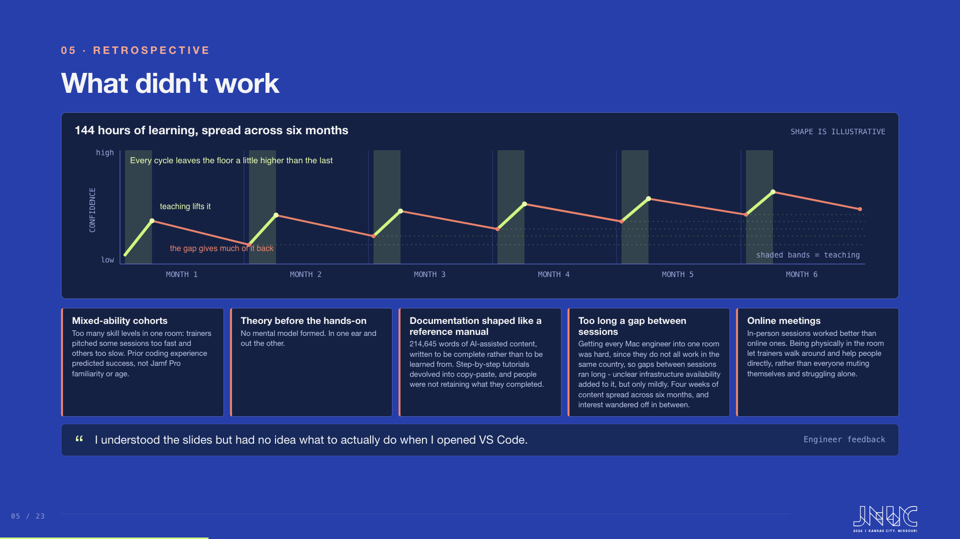
Notes:
This is the most useful slide in the deck for anyone planning their own programme, so do not rush it. Walk the chart first. Six months, six teaching sessions. Every session lifts confidence, and every gap that follows gives some of it back, but not all of it - people did genuinely build confidence over the six months, so the whole thing trends gently upwards overall even though there is a real dip after every gap. Be clear that the shape is illustrative rather than measured; the six months and the 144 hours are real. The important thing is the total: 144 hours is roughly four weeks of learning, which for this many topics is about right. It was not the volume that hurt us, it was the calendar. Spread four weeks of content across six months and people learn a bit, stop, let it settle, come back, and somewhere in there interest wanders off - and whatever was gained since the last session leaks away in the gap that follows, which is the dip you see after every session. Then take the chips underneath. Mixed-ability cohorts: everyone in the room together, so trainers were pitching some sessions too fast and others too slow for parts of the room. What actually predicted who would do well was prior coding experience, not Jamf Pro familiarity and not age, which surprised us. Theory before the hands-on: no mental model formed and the words went in one ear and out the other. Documentation shaped like a reference manual: 214,645 words of AI-assisted content, written to be complete rather than to be learned from, so large that people did not take it in - step-by-step tutorials inside it devolved into copy-paste, completed but not retained. Too long a gap between sessions: getting every Mac engineer into one room was genuinely hard, since they do not all work in the same country, and that is what stretched the gaps out. Unclear infrastructure availability made it a little worse in a few cases, but it was a minor factor, not the main one. And in-person mattered more than online: being physically in the room let trainers walk around and help someone the moment they got stuck, rather than everyone muting themselves and struggling alone on a call. What replaced all of this now lives on the next slide - 3,778 words, 57 times smaller, and we wrote it after direct feedback that the first was too heavy going and too theoretical.

Slide 6
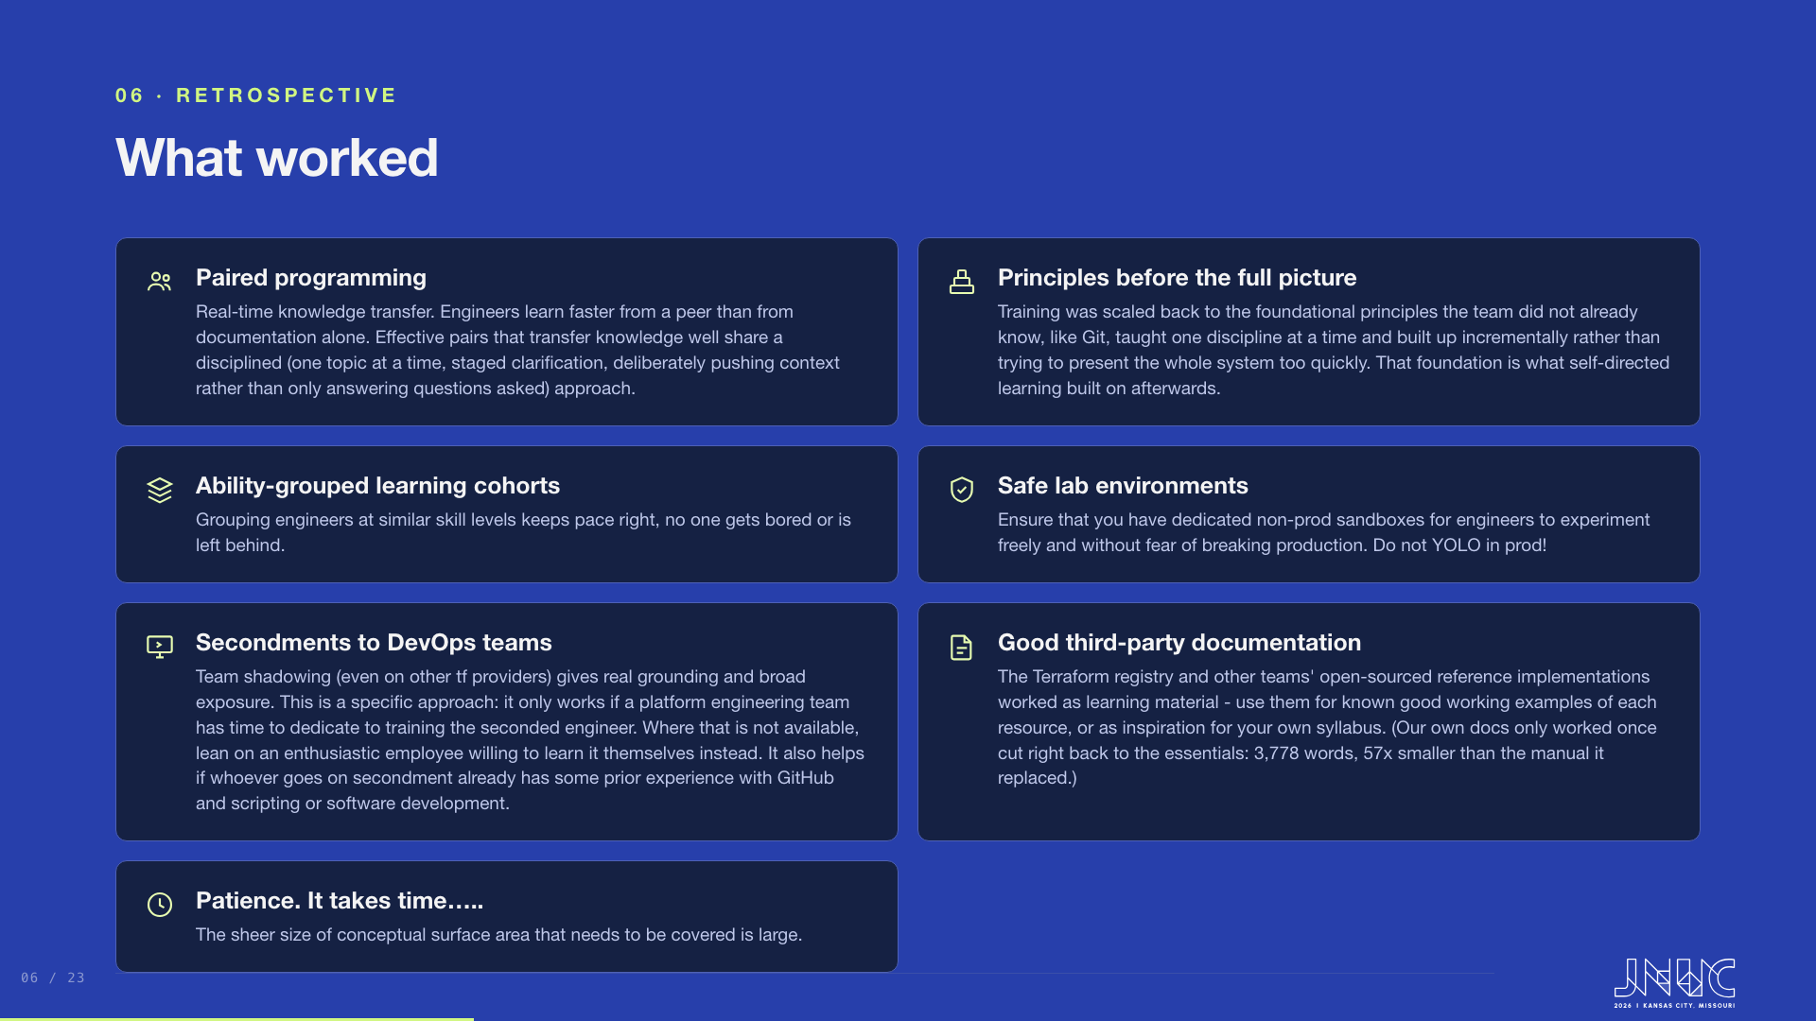
Notes:
Principles first: teach each discipline individually before building up to the full picture, starting with what the team didn't already know, like Git. On third-party documentation, point to our own replacement curriculum as the example: 3,778 words across two modules and four labs, one of them deliberately broken, 57 times smaller than the 214,645-word manual it replaced, and both public in the training repo for people to compare.

Slide 7
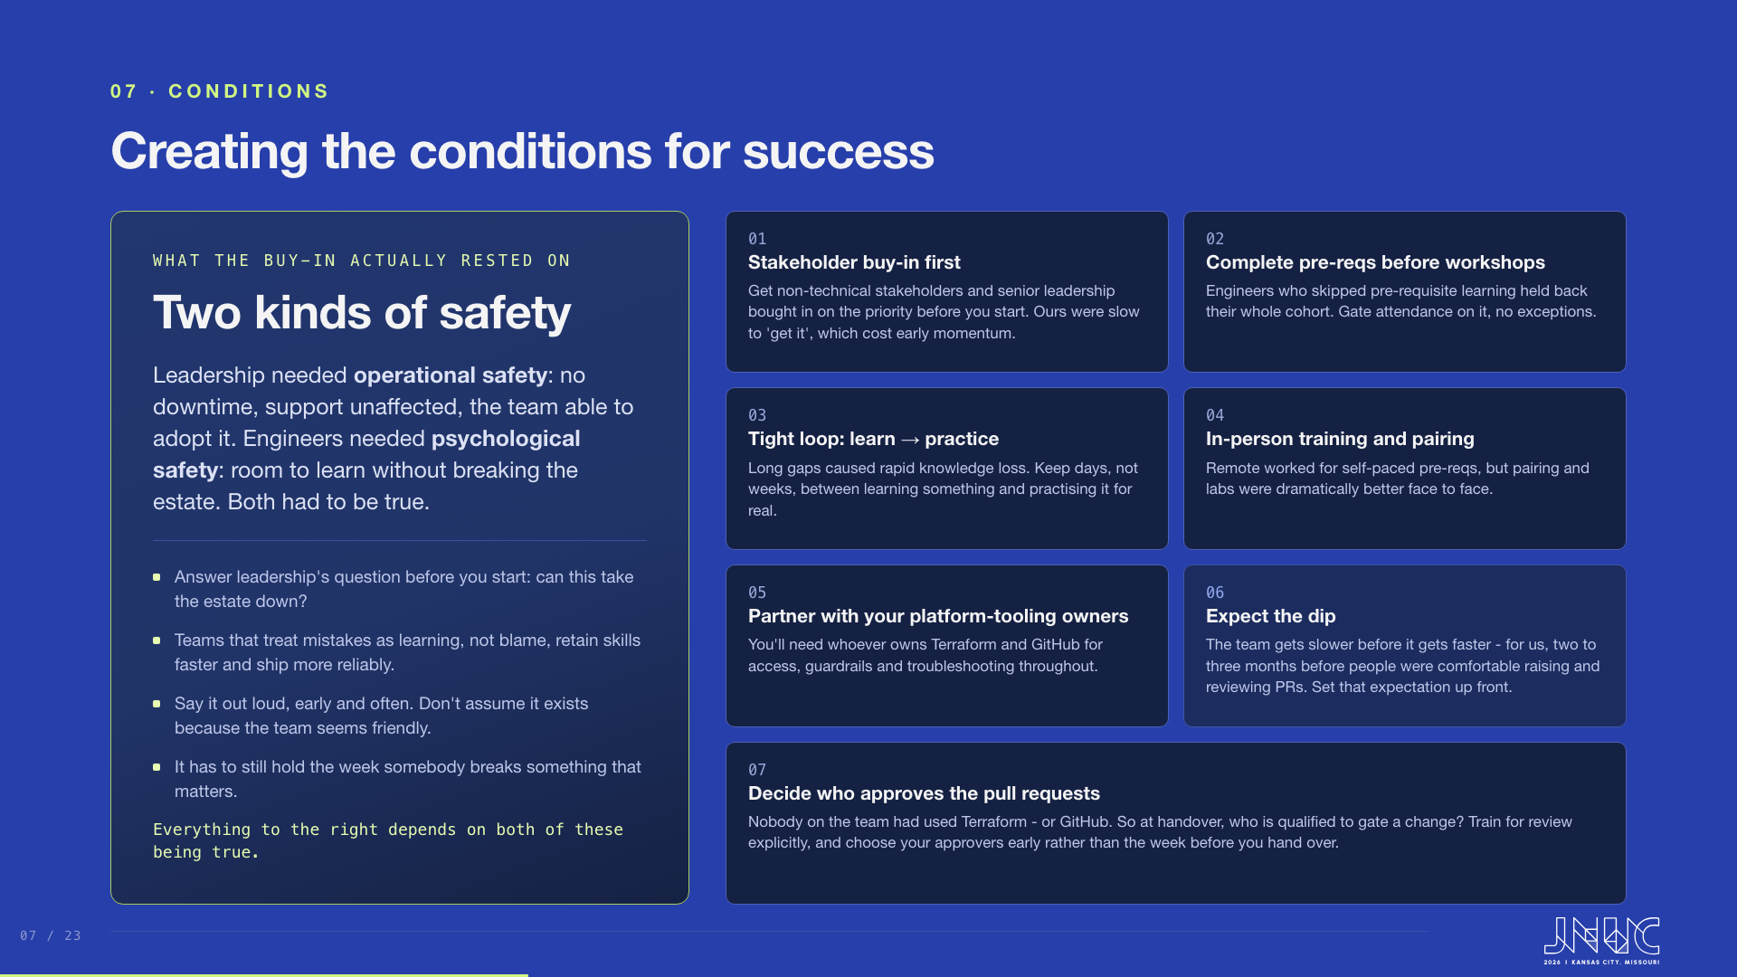
Notes:
Lead with the panel on the left, and give it time. Of everything on this slide, psychological safety is the one that carries the rest, and it is the most evidenced: teams that treat mistakes as learning rather than blame retain skills faster and ship more reliably. Three practical things follow from that. Make it explicit, out loud and more than once, because assuming it is understood is not the same as saying it. Do not assume it already exists just because the team seems friendly to each other. And it has to still hold the week somebody breaks something that matters, which is the only real test of it. Then take the six on the right briskly, because they are all conditions we have already touched elsewhere in the talk. Get stakeholder buy-in before you start; ours were slow to get it and that cost us early momentum. Gate workshop attendance on completed pre-requisites, with no exceptions, because the engineers who skipped the pre-work held back their whole cohort. Keep days rather than weeks between learning something and practising it. Do the pairing and labs in person. Build the relationship with whoever owns Terraform and GitHub early, because you will need them for access, guardrails and troubleshooting throughout. And expect the dip: the team gets slower before it gets faster, so set that expectation up front and early friction reads as part of the plan rather than as failure.

Slide 8
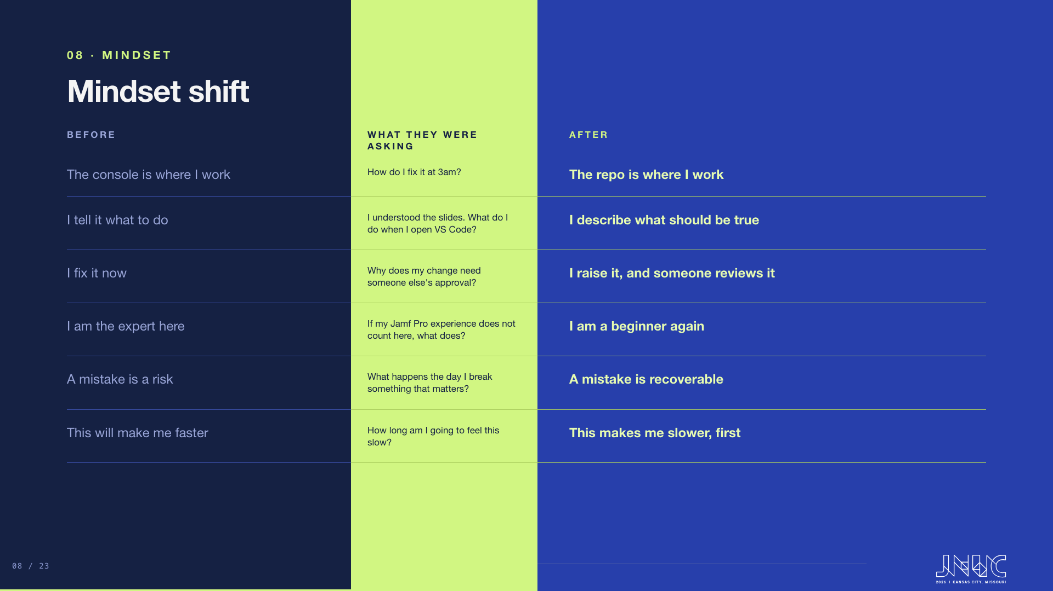
Notes:
The most important slide in the deck, and the shape of it is the argument: nobody moved from the left column to the right without asking these first. Take a row at a time and answer the question as you go - they all have answers, and the answers are the right-hand column. The console one is the rule people break first, and the honest answer to the 3am question is that breakglass stays, as a decision rather than a habit. The VS Code question is one of the engineers' own words turned round, and it is the best evidence we have that front-loading theory does not work. The beginner-again row is the one that stings: prior coding experience predicted who found this easy, and years of Jamf Pro did not. The recoverable row is the unlock. And say the last one out loud - the team gets slower before it gets faster, two to three months for us, and if you do not name that up front people conclude they are failing. Louise five slides on is one person living this.

Slide 9
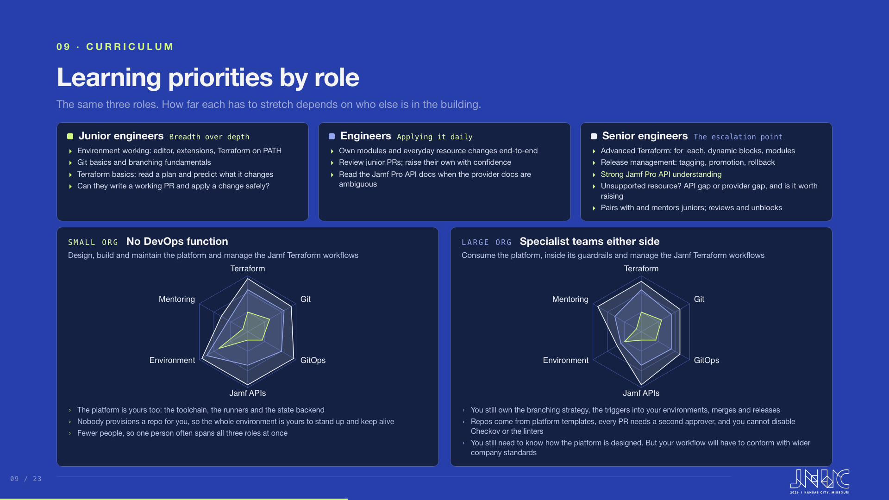
Notes:
Teach to the role, but the real point of this slide is the pair of charts underneath. The three roles are the same in both, and the coloured chip on each card is the key to the shapes. Juniors need breadth over depth: a working environment, Git basics, branching fundamentals, and enough Terraform to read a plan and predict what it will change. The test is simple - can they write a working PR and apply a change safely. Engineers own modules and everyday resource changes, review each other's work, and go to the Jamf Pro API docs directly when the provider documentation is ambiguous. Seniors are the escalation point rather than a separate species: advanced Terraform, release management, and a strong understanding of the Jamf Pro API, including working out whether an unsupported resource is an API gap or a provider gap and whether it is worth raising upstream. Note what is deliberately absent: provider architecture and SDK design. Building the provider is a different job from using it, and no Mac team needs a Go developer in order to adopt any of this. Now the two charts, and there are two things to draw out. First, look at Jamf APIs. That score is identical in both, deliberately. No external team is ever going to know your own service's APIs better than the team that owns the service, so org size makes no difference to it whatsoever. Second, and this is the real distinction, look at Environment. In a small organisation you design it, build it and maintain it: the toolchain, the runners, the state backend, all of it, because nobody provisions a repo for you. In a large organisation that arrives from the internal developer platform as a template, so the burden lifts. But be careful how you say the rest, because Git and GitOps barely move between the two. In a large organisation you still own your branching strategy, you still wire the event triggers into your own environments, and you still handle merges to main and releases. What you lose is not the knowledge, it is the authority: every PR needs a second approver, your GitHub access stops at the edges of what you own, and you cannot turn off Checkov or the linters even if you want to. That is the sentence worth landing. You still need to know how the platform is designed, but your workflow will have to conform with wider company standards, and how much of it you can change is entirely dependent on your own organisation. Note the wording on both panels: in either case you are managing the Jamf Terraform workflows. What differs is whether you also design, build and maintain the platform underneath them, or consume it inside somebody else's guardrails.

Slide 10
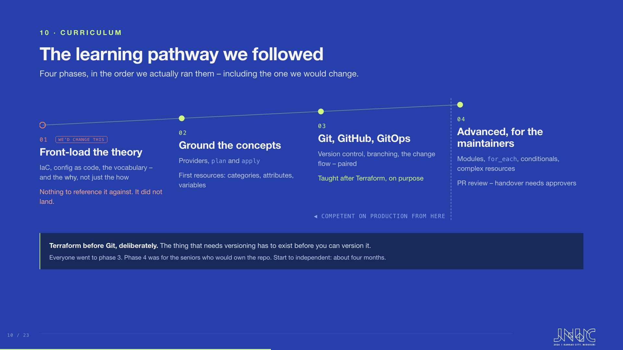
Notes:
Four phases, in the order they were actually run. Follow the track with your hand as you speak - it climbs, because each phase stands on the one before. Phase one is the hollow amber stop, and it is the one to do differently: the whole team had no DevOps, GitOps or IaC background, so the theory was front-loaded to explain not just the how but the why. Nobody had anything to reference it against - they were reading information that meant nothing against their day job. Say that plainly rather than defending it. Phase two grounds the concepts: what a provider is, how to plan and apply a change, first resources. Phase three is the one that sounds backwards, and it is the most useful thing on the slide. We stepped back and taught Git, GitHub and GitOps only after people were writing Terraform. Nobody in the team had really used Git, and it is genuinely complex. Teaching a version control system is fine, but what do you put in it? Engineers told us directly that they needed context in order to learn, so we adapted: make the context exist first, then teach the thing that manages it. Phase four was aimed mainly at the senior engineers who would own the repo after handover - modules, for_each, conditionals, complex resources, and pull request review, because handover needs people who can approve a change. That is condition 07 from the conditions slide arriving again. Point at the dashed gate before you get there: an engineer was competent to make changes on a live production instance from the end of phase three, once Git and the GitOps flow were in. Everything to the left of that line is the whole team; phase four is the maintainers only. That is the answer to

Slide 11
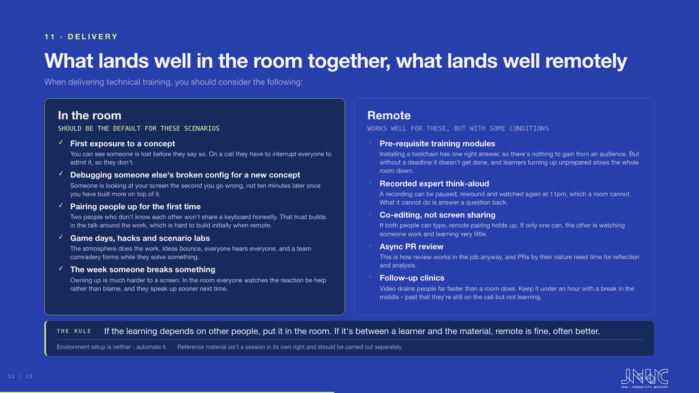
Notes:
The point of this slide is the small print, not the headings. Anyone can tell you to do training in person. What people actually need is the reason, because the reason is what they can apply to their own material. Left column, and every one of these comes down to the same thing: what you can see, and how cheap it is to ask. First exposure - in a room you can see somebody is lost from across the table, before they have said a word. On a call, asking for help means unmuting and stopping everyone else, so people sit there quietly instead, and you find out three weeks later. Debugging a broken config - somebody is looking at your screen the second you go wrong, not ten minutes later after you have piled three more mistakes on top of the first one. That is why the replacement curriculum hands people a config with faults planted in it. Pairing - and be precise here, because the research does not say what people assume. Distributed pairing, including a 2023 systematic review, performs about as well as sitting together, provided both people can actually type. What the same review found really matters is whether the pair get on. Two people who do not know each other will not share a keyboard honestly, and that trust gets built in the chat around the work, which a scheduled call has none of. So form the pair in the room; after that it can go remote quite happily. Game days and hacks - here it is simply the atmosphere. Ideas bounce, people overhear each other, and a team forms while they are solving something. Nobody has ever built that on a call. And the week someone breaks something - owning up to a screen is much harder than owning up to a room, and in a room everyone else watches the reaction be help rather than blame, which is what makes them speak up sooner the next time. That is the whole mechanism behind psychological safety, and it is why remote can maintain it but rarely creates it. Right column, and the heading matters: with conditions. Pre-requisites - nobody needs to watch you install a toolchain, so do not waste a room on it. But ungated, it does not get finished: median completion for self-paced online content sits around 12.6%, against 60 to 90% for a cohort with a date on it. That is the evidence behind condition 02 earlier. Recorded walkthroughs - a recording can be paused, rewound and watched again at 11pm, which a room genuinely cannot do. What it cannot do is answer a question back, so it is for the parts with a fixed answer. Co-editing - if both people can type it holds up; if only one can, the other is watching somebody work, which is not learning. Pull request review is the easy one to justify, because it is how review works in the job anyway - doing it remotely is not a compromise, it is the real thing. And pull requests by their nature need time for reflection and analysis, which is exactly what a room does not give you. And keep clinics short, because video genuinely drains people faster than a room does - videoconference fatigue shows up on EEG and ECG within about fifteen minutes and is significant by fifty. So under an hour, with a break in the middle. Past that they are still on the call but they have stopped learning, and a full day of remote workshop is a wasted day. Then the rule at the bottom, which is the sentence to leave them with, and it is just the two columns said once. Everything on the left is there because the learning depends on other people - being seen when you are lost, being caught at the moment you go wrong, being reassured when you break something. Everything on the right is between a learner and the material, where there is one right answer, or where they need to pause, re-read and think. So: if the learning depends on other people, put it in the room; if it is between a learner and the material, remote is fine and often better. And the two asides on the right matter more than they look. Environment setup belongs in neither column - automate it, which is exactly what our platform arriving late cost us. And reference material is not a session in its own right - it should be carried out separately, which is the 214,645-word manual said as a delivery rule.

Slide 12
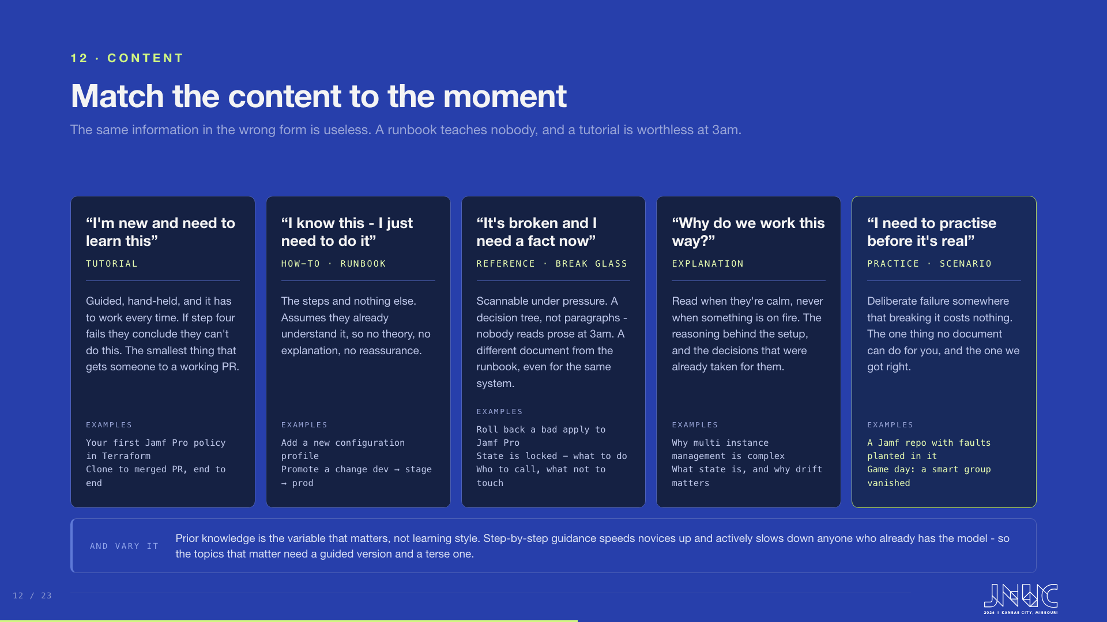
Notes:
The headings on this slide are deliberately the moment the person is in, not the type of document, because the moment is what tells you which document to write. Five moments, five different pieces of material, and the same facts in the wrong one of them are useless. Somebody learning this for the first time needs a tutorial - guided, hand-held, and it has to work every time, because if step four fails they conclude they cannot do this. Somebody who already understands it and is just doing the job needs a runbook: the steps, no theory. Somebody in the middle of an incident needs reference material they can scan under pressure - a decision tree, not paragraphs, because nobody reads prose at three in the morning, and that is a genuinely different document from the runbook even when it covers the same system. Somebody asking why we work this way needs explanation, read when they are calm rather than when something is on fire. And the fifth one is the one documentation cannot do at all: practice, somewhere that breaking it costs nothing. This split is not something we invented - it is close to the Diataxis framework used for technical documentation, which separates tutorials, how-to guides, reference and explanation by the need they serve. The reason to care is our own mistake, and it is worth saying out loud here: the 214,645-word curriculum was not bad writing. It was reference material, written to be complete and correct, handed to people who needed a tutorial. Same facts, wrong form, and it did not land. Then the blue strip at the bottom, and be careful with this one. The instinct to vary the material is right, but the usual reason given for it - matching people's learning styles - does not hold up. The meshing hypothesis has been tested repeatedly; Pashler and colleagues reviewed more than seventy studies and found essentially no support, and it is now generally classed as a neuromyth. The variable that does hold up is prior knowledge. The expertise reversal effect, which has been meta-analysed and generalises well, shows that step-by-step guidance helps novices and actively slows down people who already have the mental model, because they have to keep cross-referencing the help against what they already know. That matches what we found ourselves: prior coding experience predicted who did well, not Jamf Pro familiarity and not age. So for the topics that matter, write two versions - a guided one and a terse one - and let people pick. Note also what is deliberately not on this slide: new-starter onboarding, which gets its own slide shortly with the artifacts pack, the skills check and the buddy.

Slide 13
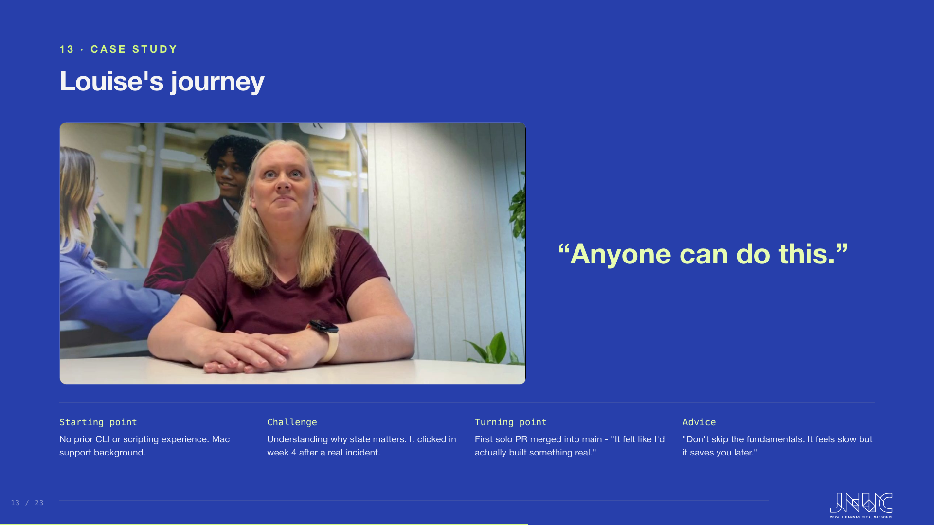
Notes:
Louise's story shows this is achievable from any starting point. No prior CLI, Mac support background. State clicked in week four after a real incident. Her turning point was the first solo PR merged to main. Her advice: don't skip the fundamentals. The interview is on the slide - press play, it runs 2 minutes 52 seconds. The space bar plays and pauses it while it has focus; the arrow keys still move the deck, so you do not have to click away to advance.

Slide 14
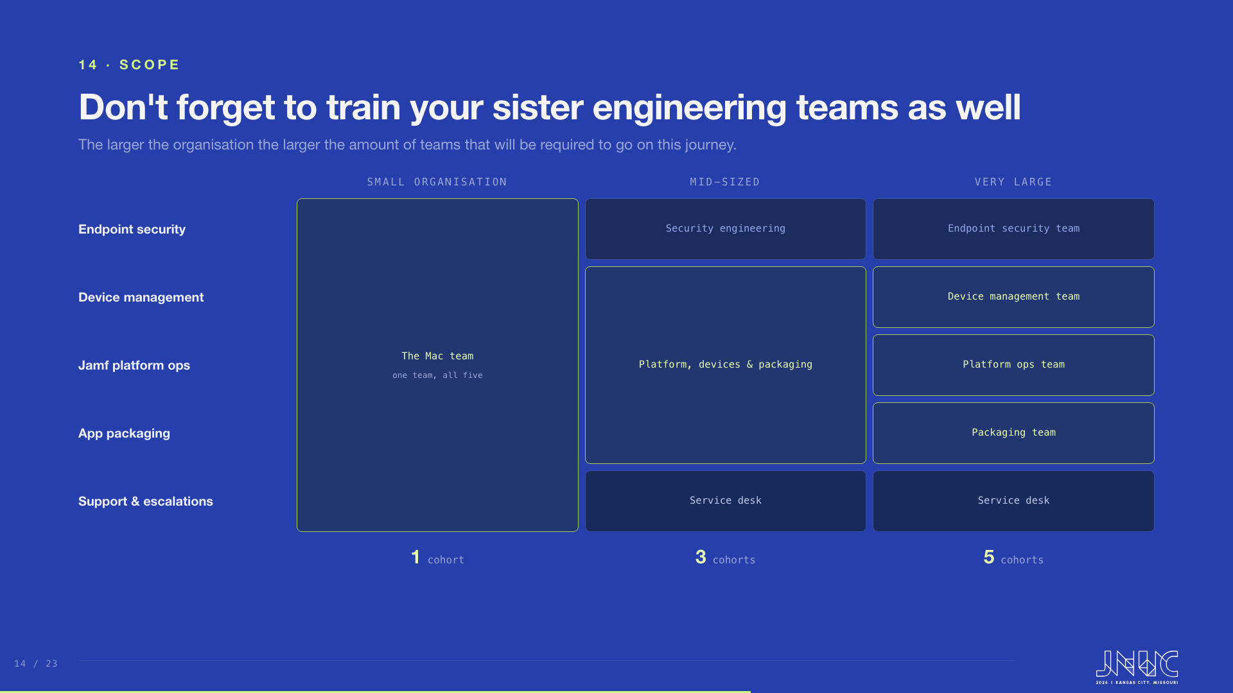
Notes:
The transition does not stop at the core Mac team, and this slide is how you work out how far it does go. Five responsibilities sit behind Jamf Pro: endpoint security, device management, Jamf platform ops, support and escalations, and application packaging. Every organisation has all five. What differs is how many teams they are spread across. Ask people to find their own organisation in one of the three columns. On the left, a small organisation, where one team owns all five - that is the single tall box, and it is one cohort to train. In the middle, a mid-sized organisation, and this is the most common shape by a distance: device management, Jamf platform ops and application packaging stay together as one engineering team, security engineering has broken out on its own, and the service desk takes support and escalations. Three boxes, three cohorts. On the right, a very large organisation, where each responsibility is somebody's whole job and you have five separate teams to teach. The instruction is simple: count the boxes in your column, and that is the number of cohorts you have to run. Worth saying explicitly that the curriculum barely changes between those three columns - what changes is how many times you deliver it, how much coordination it takes, and how many different managers you need bought in before you start, which is condition 01 from earlier. The grouping in the middle column is the common one rather than the only one; if security has not broken out in their organisation yet, the middle column is a two-box column for them. And a rule worth keeping from the way we scoped this: a team that only triggers actions does not need to author Terraform, but a team that manages resources does. That is what decides whether a cohort gets the full authoring curriculum or a shorter read-and-triage one.

Slide 15
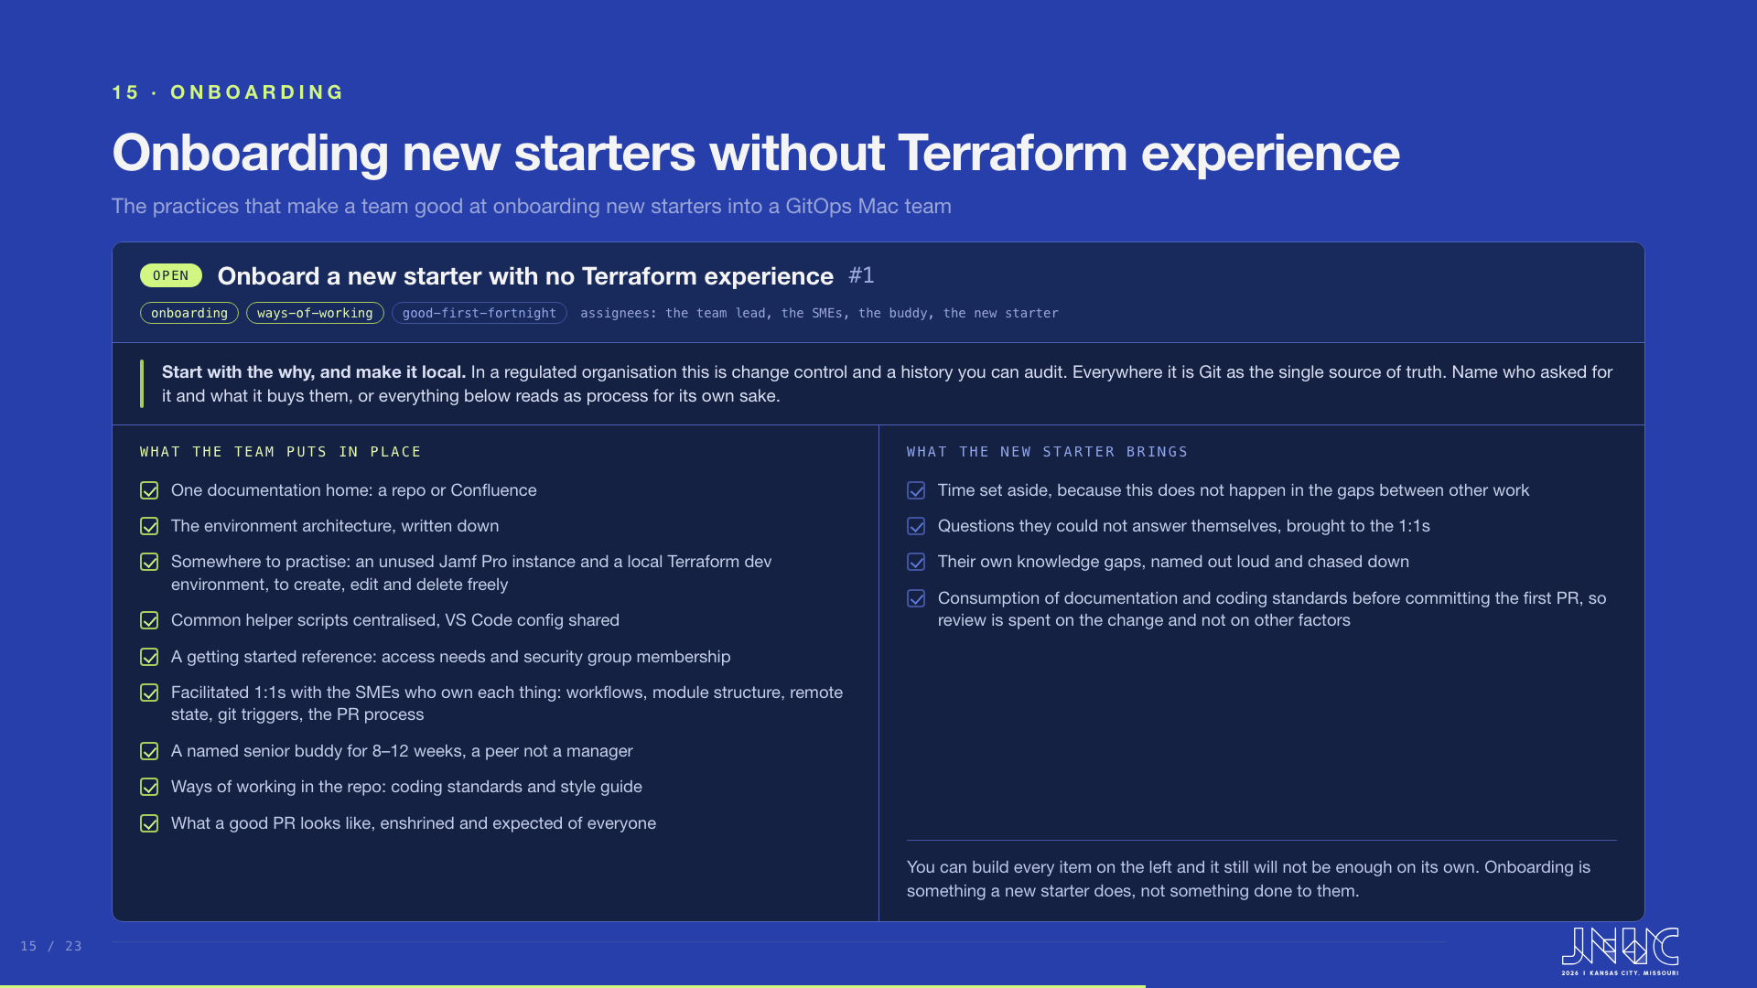
Notes:
Gordon presents this. The market and skills-shortage framing belongs to the hiring slide that follows - do not open on it. This one is practical advice, so pitch it at the room: these are the practices that made us good at taking someone on, and most of them are cheap. Start with the description at the top, because the why is contextual and nobody can write it for you. In a regulated organisation it is change control and a history you can audit; everywhere it is Git as the single source of truth. Name who asked for it and what it buys them, or everything underneath reads as process for its own sake. Then the left column, which is the work the team does once and then benefits from for every person who follows. One documentation home, a repo or Confluence, rather than five bookmarks and a folder somebody left on a share. The environment architecture written down. The common helper scripts centralised so nobody writes the same one twice, and the VS Code guidance and config shared. A getting started reference covering the dull blockers that actually stop somebody in week one: access requests and security group membership. Then the people, and these are the two that get skipped when everyone is busy. Facilitated 1:1s between the new starter and whoever owns each thing, booked in rather than hoped for, covering workflows, the structure of the modules, the remote state backend, the git triggers and the pull request process. And a named senior buddy for 8 to 12 weeks, a peer rather than a manager, who pairs, reviews and takes the first questions. Then the standard. A ways of working document in the repo carrying the coding standards and the style guide, and a written definition of what a good pull request looks like on this team, expected of everyone and not just of new starters. Dwell on that one, because it is the payoff for the whole slide: write it down once and review stops being about naming and indentation, so CODEOWNERS spend their attention on the change itself. Then the right column, and be straight about it without being po-faced. You can put every item on the left in place and it will still not carry somebody on its own. The new starter has to set the time aside, because this does not happen in the gaps between other work. They have to bring the questions they could not answer themselves. They have to name their own gaps rather than hope nobody notices, and actually read the documentation and the coding standards before committing their first pull request, so that review is spent on the change and not on everything around it. Worth saying plainly that this is the half you cannot do for them, and that it is the reason aptitude and attitude matter more in hiring than a Terraform CV. Somewhere to practise is the item people miss and the one worth dwelling on: an unused Jamf Pro instance plus a local Terraform dev environment where a new starter can create, edit and delete freely. If the only place they can practise is a place that matters, they will not practise.

Slide 16
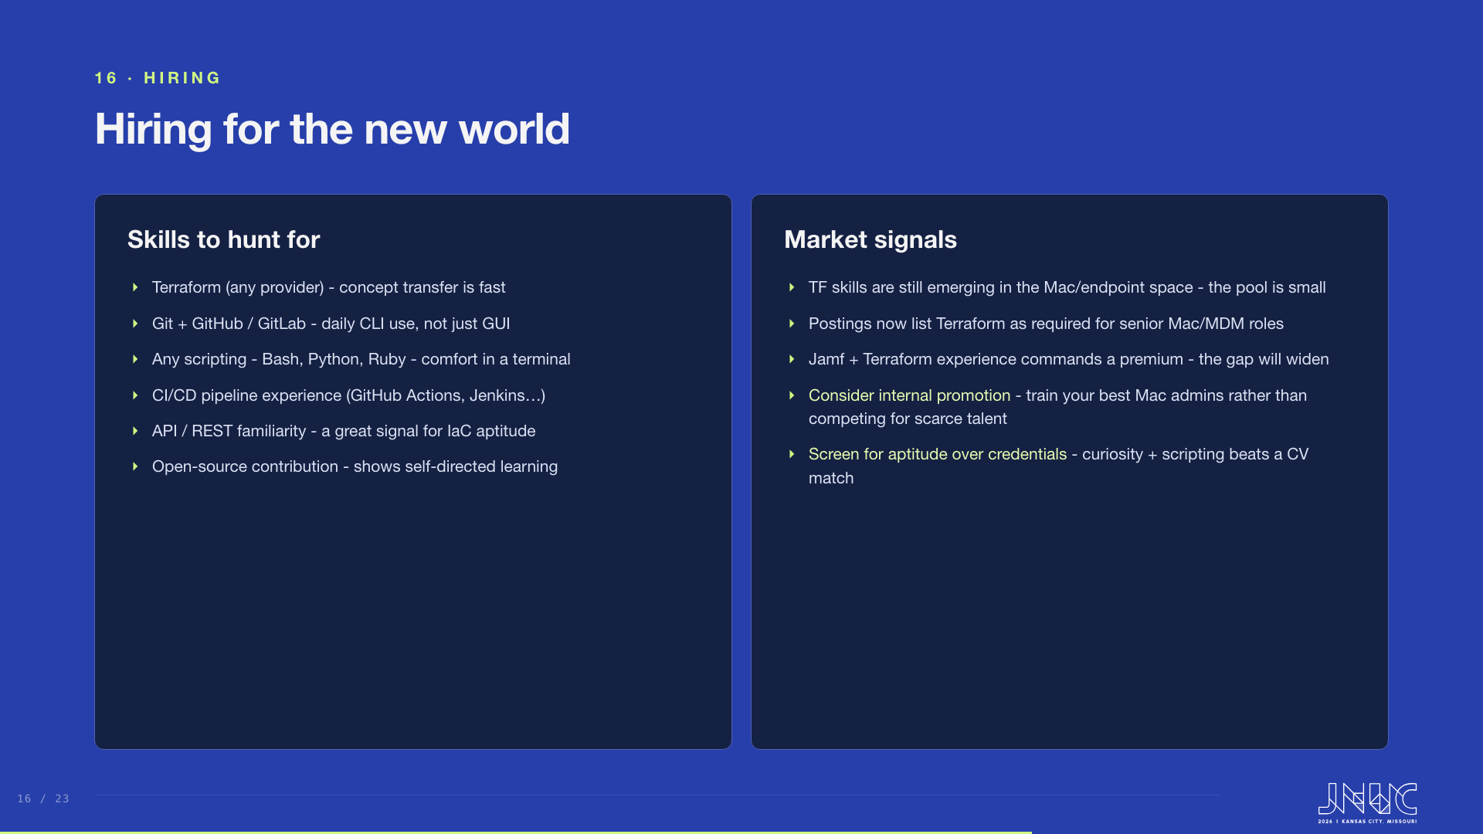
Notes:
Hire for aptitude. Hunt for Terraform on any provider, daily Git CLI use, any scripting, CI/CD, API familiarity, and open-source contribution. The market: TF skills are still emerging in the Mac space, the pool is small, and Jamf-plus-Terraform commands a premium. Often the best move is to train your strongest Mac admins.

Slide 17
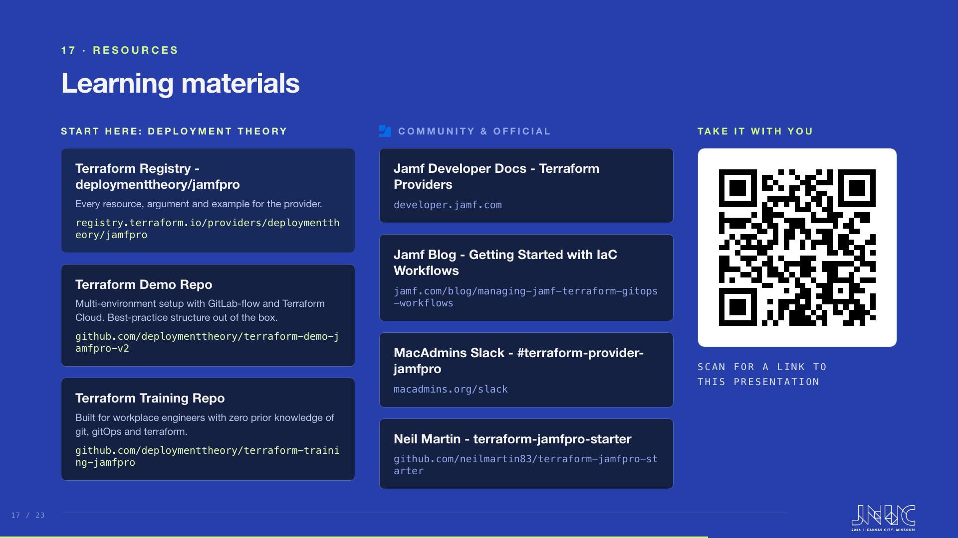
Notes:
Where to send people. Start with the Deployment Theory Terraform registry and demo repo, and the training repo built for workplace engineers. Then the community and official set: Jamf developer docs, the Jamf blog IaC walkthrough, the MacAdmins Slack channel, and Neil Martin's starter repo. Point at the QR code on the right and leave this slide up while you take questions - it opens a link to this presentation, so nobody needs to photograph the URLs.

Slide 18
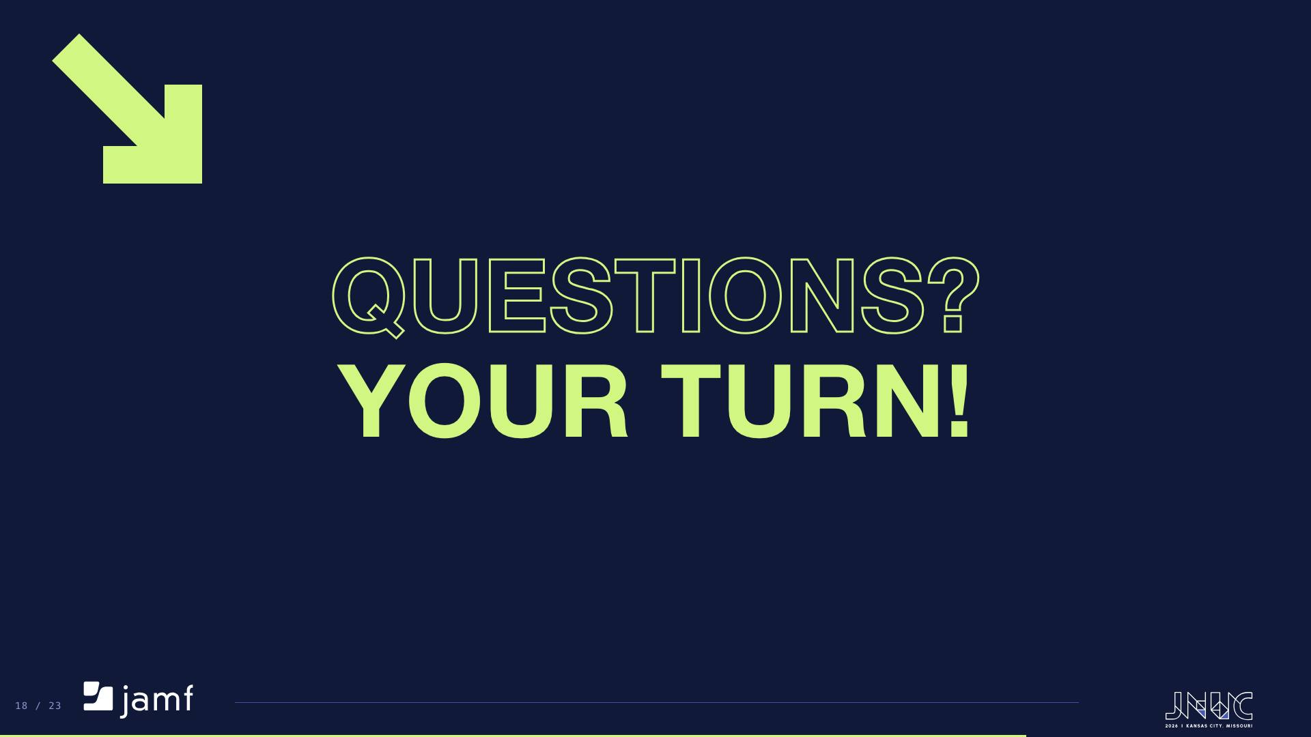
Notes:
Open the floor. Point people at the resources slide for links, and at the appendix for the colour system behind the original deck design.

Slide 19
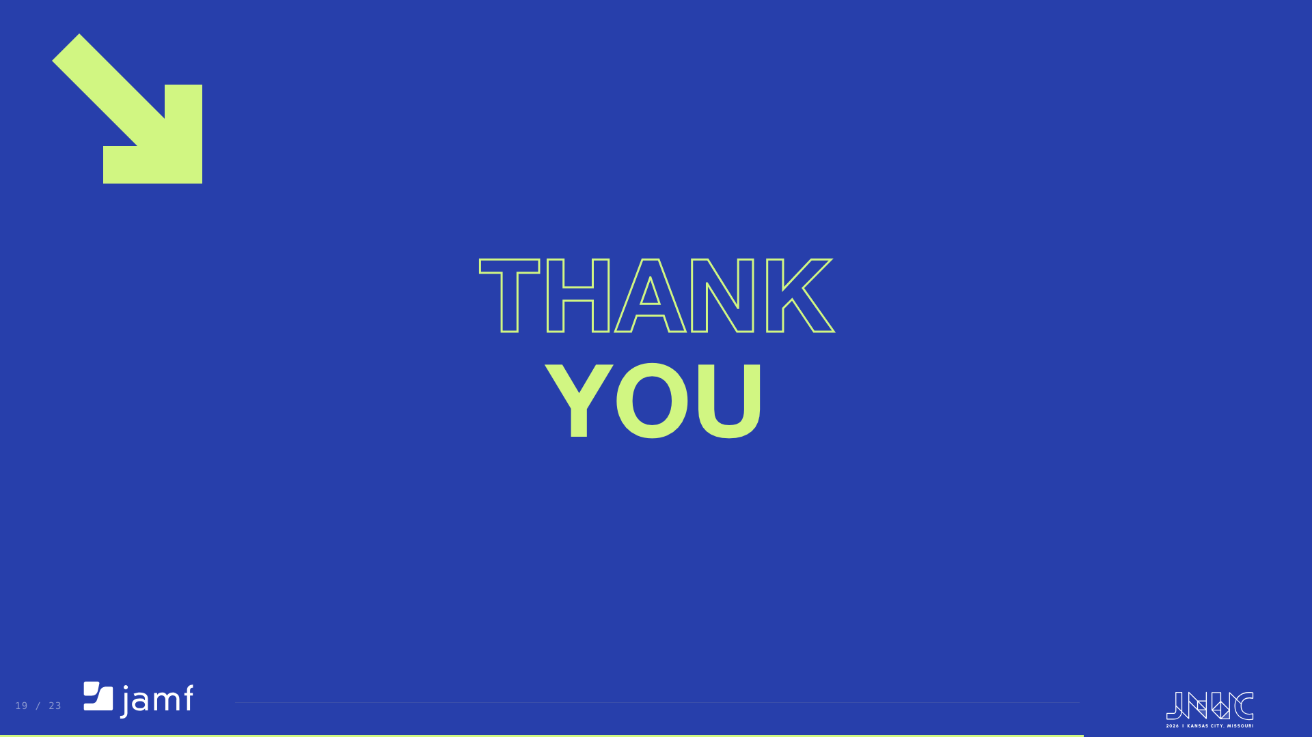
Notes:
Thank the audience and close. The appendix slide after this one is reference material for readers of the published deck, not part of the talk.

Slide 20
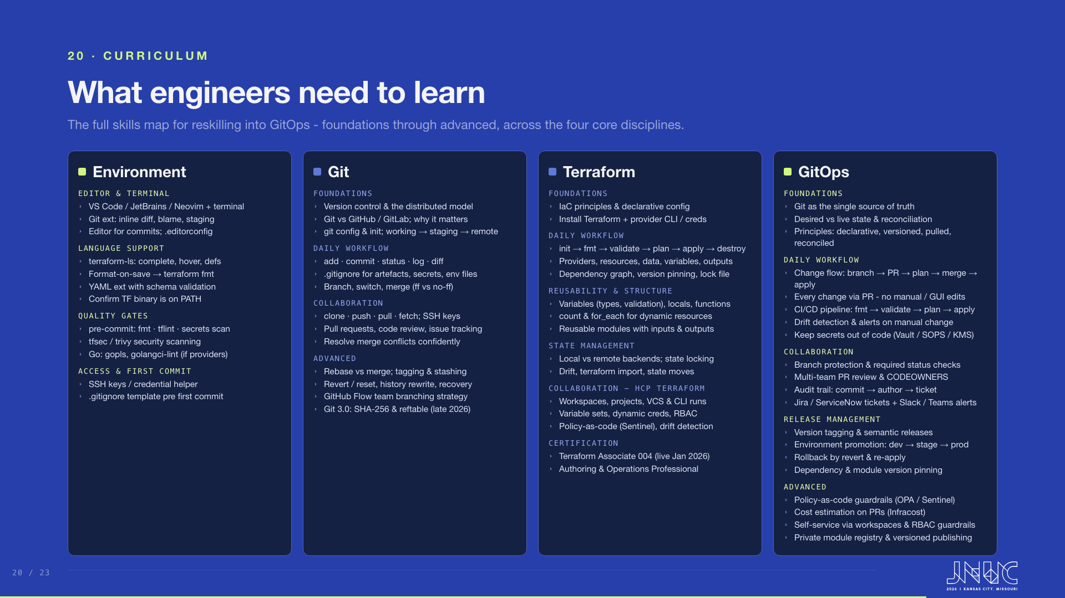
Notes:
The full skills map. Environment covers editor, terminal, language support and quality gates. Git runs from foundations through daily workflow, collaboration and advanced history work. Terraform goes foundations through state, HCP Terraform collaboration and certification. GitOps covers the change flow, collaboration, release management and policy-as-code guardrails.

Slide 21
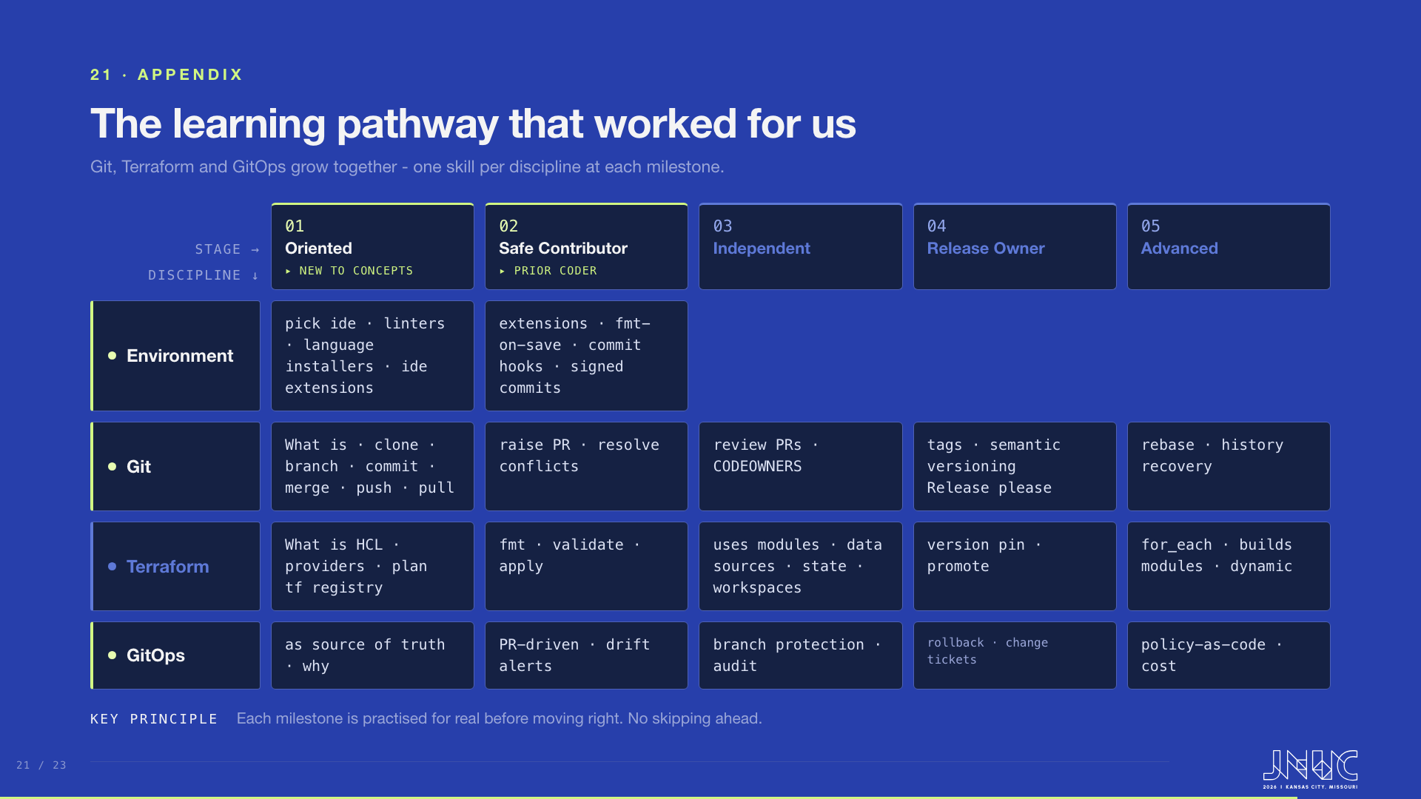
Notes:
APPENDIX - not presented. Kept as reference after slide 9 was rebuilt as the four-phase route; this is the discipline-by-stage matrix behind it. A discipline-by-stage matrix: Git, Terraform and GitOps advancing in parallel, one skill per discipline at each milestone.

Slide 22
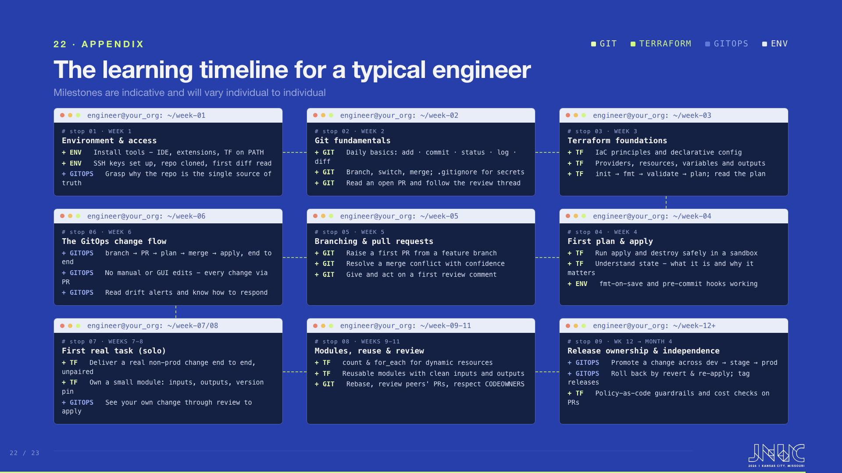
Notes:
APPENDIX - not presented. Kept as reference after slide 9 was rebuilt as the four-phase route; this is the same pathway projected onto a calendar. A week-by-week view of the same pathway for a typical engineer. Weeks 1 to 3 are environment, Git fundamentals and Terraform foundations. Weeks 4 to 6 are first plan and apply, branching and pull requests, and the full GitOps change flow. From week 7 they take a real task solo, then modules and review, then release ownership by month four.

Slide 23
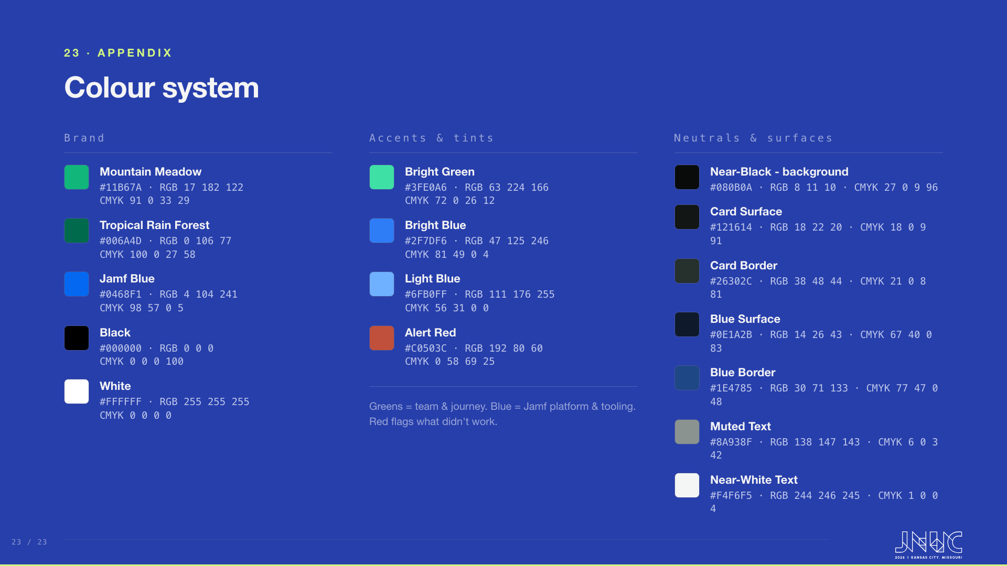
Notes:
Appendix: the full colour system. Lloyds Mountain Meadow and Tropical Rain Forest greens carry the team and journey; Jamf blue carries the platform and tooling. Black and white are the brand base; the tints and surfaces are derived for on-screen dark UI.

