Slide 1
MCP+2-opt
Monte-Carlo “Popularity” with 2-opt

Slide 2
Overview
Popularity Algorithm
Monte Carlo Popularity mod
2-opt
Results
Summary

Slide 3
Popularity Algorithm
Inspired by Nearest Neighbor
Factor edge length and average length of “short” edges outbound from the destination city into edge’s “popularity”
Average outbound edge length = 11.2
Take average of edges shorter than the average:
(7+8) / 2 = 7.5
Edge Popularity Score = 9 + (7.5 / factor)
7
8
9
15
12
14

Slide 4
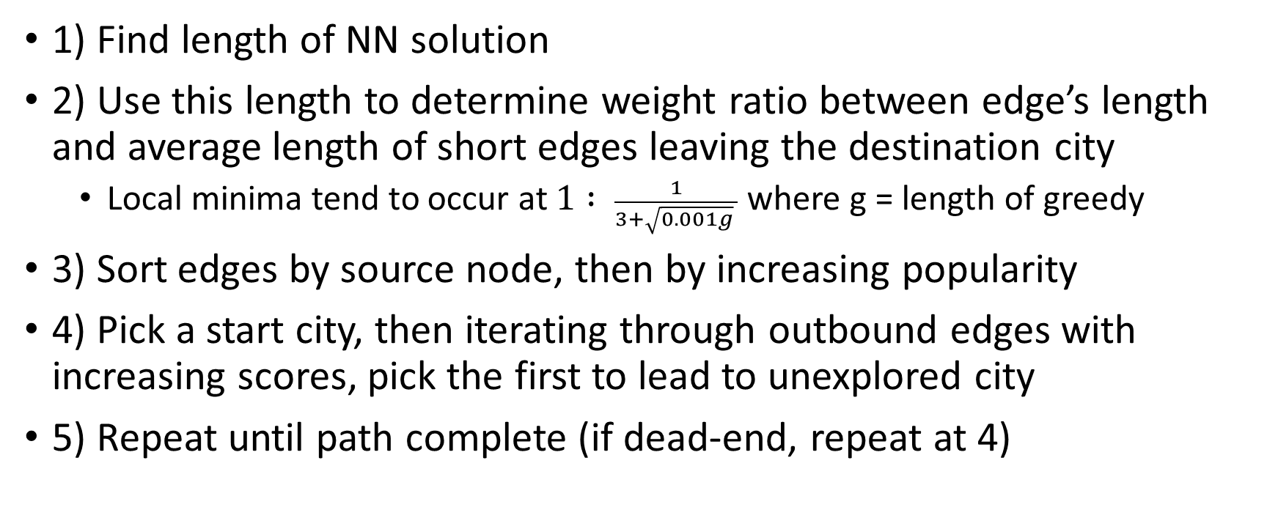
Popularity Algorithm
1) Find length of NN solution
2) Use this length to determine weight ratio between edge’s length and average length of short edges leaving the destination city
Local minima tend to occur at $1 : \frac{1}{3+\sqrt{0.001g} }$ where g = length of greedy
3) Sort edges by source node, then by increasing popularity
4) Pick a start city, then iterating through outbound edges with increasing scores, pick the first to lead to unexplored city
5) Repeat until path complete (if dead-end, repeat at 4)

Slide 5
Monte Carlo Popularity mod
On scale of the ratios between two factors of Popularity, local minimas exist at (mostly) unpredictable locations
Adjust ratio based on last Popularity result to find other minimas

Slide 6
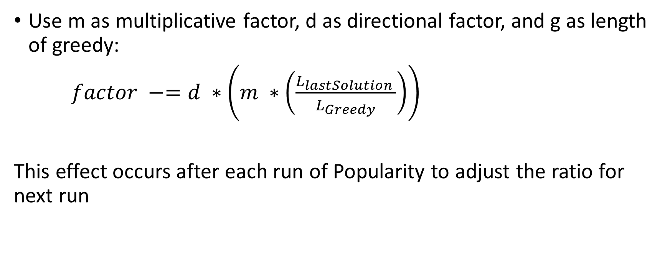
Monte Carlo Popularity mod
Use m as multiplicative factor, d as directional factor, and g as length of greedy:
$factor −=d ∗\left(m ∗\left(\frac{L_{lastSolution }}{L_{Greedy}}\right)\right)$
This effect occurs after each run of Popularity to adjust the ratio for next run

Slide 7
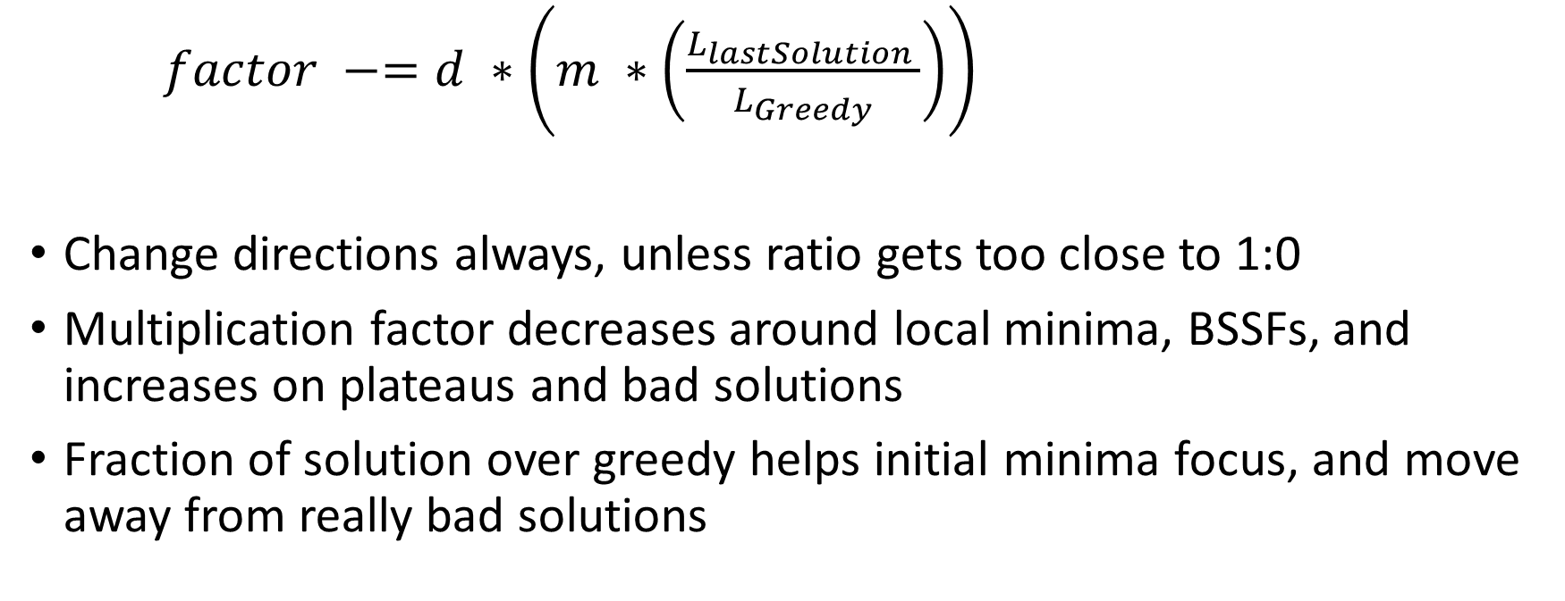
Monte Carlo Popularity mod
$factor −=d ∗\left(m ∗\left(\frac{L_{lastSolution }}{L_{Greedy}}\right)\right)$
Change directions always, unless ratio gets too close to 1:0
Multiplication factor decreases around local minima, BSSFs, and increases on plateaus and bad solutions
Fraction of solution over greedy helps initial minima focus, and move away from really bad solutions

Slide 8
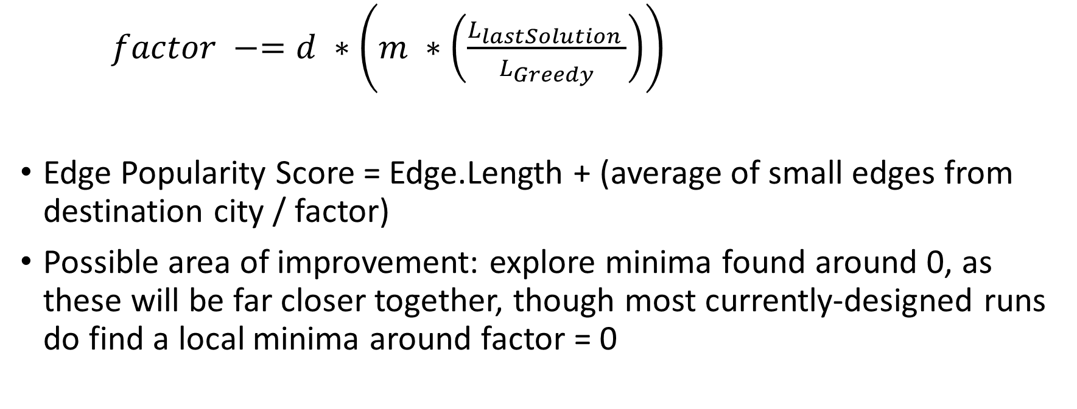
Monte Carlo Popularity mod
$factor −=d ∗\left(m ∗\left(\frac{L_{lastSolution }}{L_{Greedy}}\right)\right)$
Edge Popularity Score = Edge.Length + (average of small edges from destination city / factor)
Possible area of improvement: explore minima found around 0, as these will be far closer together, though most currently-designed runs do find a local minima around factor = 0

Slide 9
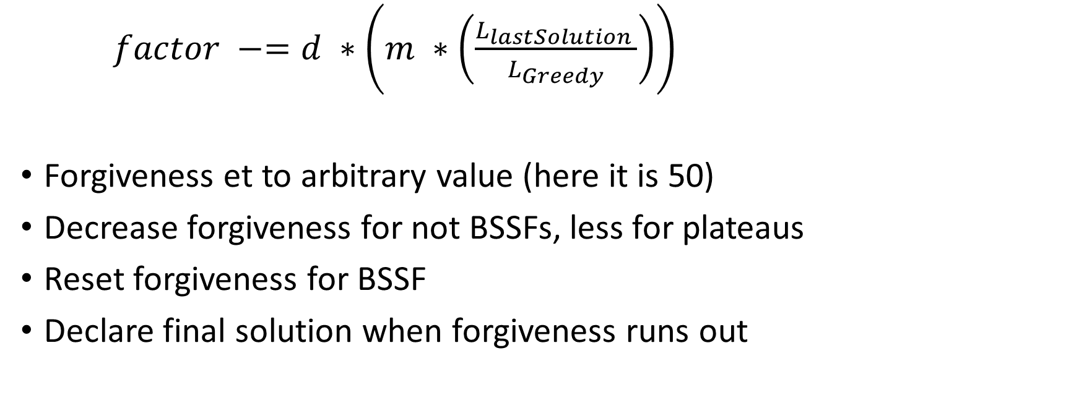
Monte Carlo Popularity mod
$factor −=d ∗\left(m ∗\left(\frac{L_{lastSolution }}{L_{Greedy}}\right)\right)$
Forgiveness et to arbitrary value (here it is 50)
Decrease forgiveness for not BSSFs, less for plateaus
Reset forgiveness for BSSF
Declare final solution when forgiveness runs out

Slide 10
2-Opt
Local search algo by G.A. Croes in 1958
“Can it be shorter by reversing subsequences of path?”
In symmetrical graphs, this will shorten any path that crosses over itself by “undoing” the cross

Slide 11
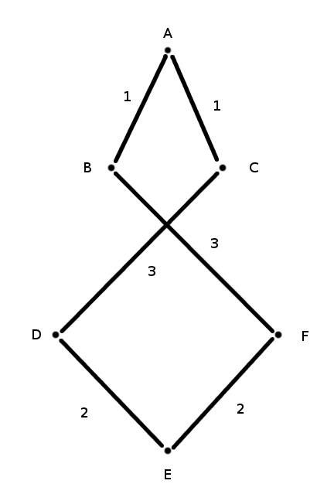
A C D E F B
12

Slide 12
A C D E F B
12

Slide 13
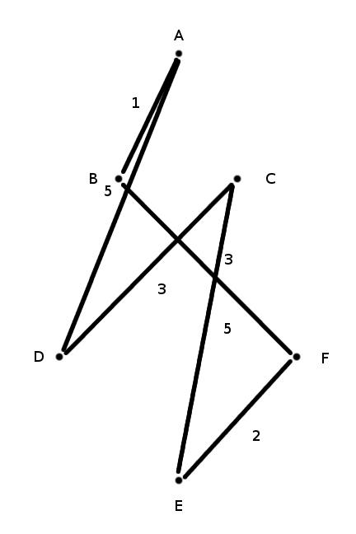
A D C E F B
19

Slide 14
A C D E F B
12

Slide 15
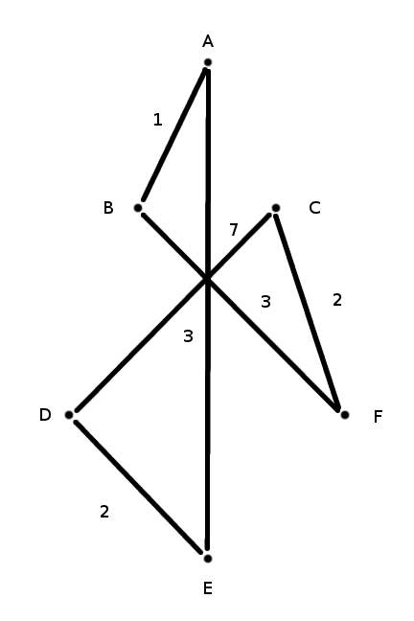
A E D C F B
18

Slide 16
A C D E F B
12

Slide 17
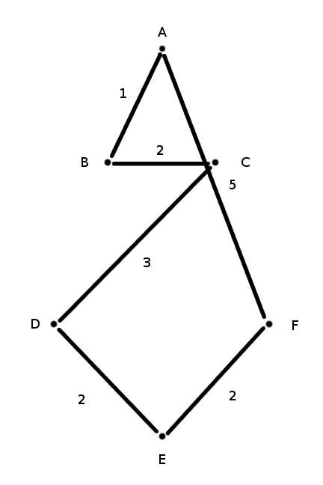
A F E D C B
15

Slide 18
A C D E F B
12

Slide 19
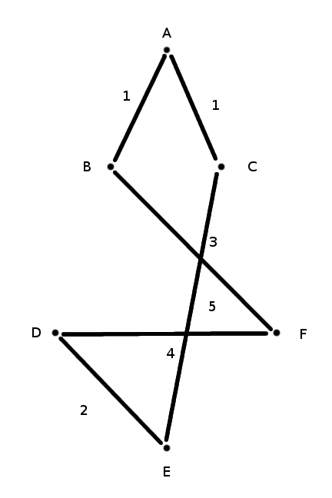
A C E D F B
16

Slide 20
A C D E F B
12

Slide 21
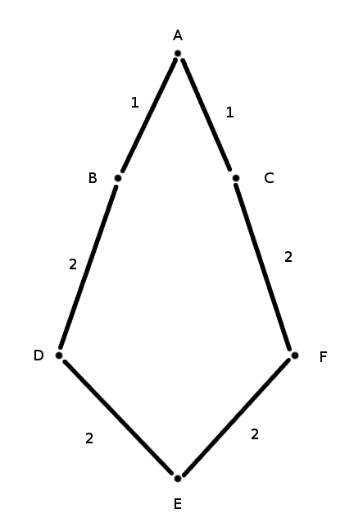
A C F E D B
10

Slide 22
2-Opt
We optimized by caching edge sums for subsequences to be reversed
2-opt’s worst case: final iteration finding no improvements, does O(n^3) additions
Caching requires only O(n^2) additions

Slide 23
Results (small sets)
Random
Greedy (NN)
Branch & Bound
MCP+2Opt
# Cities | Length | Time | Length | Improv | Time | Length | Improv | Time | Length | Improv
15 | 7843 | 0.00015 | 3404 | 56.60% | 0.27 | 3288 | 3.41% | 0.04 | 3375 | 0.85%
20 | 10118 | 0.00014 | 4428 | 56.24% | TB | TB | TB | 0.27 | 4111 | 7.15%
25 | 13062 | 0.00021 | 5062 | 61.25% | TB | TB | TB | 0.10 | 4440 | 12.29%
30 | 15742 | 0.00037 | 5750 | 63.47% | TB | TB | TB | 0.16 | 4782 | 16.84%
40 | 20123 | 0.00051 | 6526 | 67.57% | TB | TB | TB | 0.26 | 5513 | 15.53%
50 | 26190 | 0.00078 | 7298 | 72.13% | TB | TB | TB | 0.04 | 5965 | 18.27%
60 | 30247 | 0.00114 | 8386 | 72.28% | TB | TB | TB | 0.66 | 6555 | 21.83%
70 | 36480 | 0.00152 | 8746 | 76.02% | TB | TB | TB | 0.69 | 7051 | 19.38%
80 | 42413 | 0.00195 | 9516 | 77.56% | TB | TB | TB | 0.87 | 7645 | 19.66%
90 | 46888 | 0.00247 | 10454 | 77.70% | TB | TB | TB | 1.14 | 8043 | 23.07%
100 | 52162 | 0.00303 | 10716 | 79.46% | TB | TB | TB | 1.55 | 8656 | 19.22%

Slide 24
Results (medium sets)
Random
Greedy (NN)
Branch & Bound
MCP+2Opt
# Cities | Length | Time | Length | Improv | Time | Length | Improv | Time | Length | Improv
150 | 79680 | 0.00681 | 13898 | 82.56% | TB | TB | TB | 2.69 | 11047 | 20.51%
200 | 102825 | 0.01 | 16092 | 84.35% | TB | TB | TB | 6.43 | 12916 | 19.73%
250 | 128531 | 0.02 | 18209 | 85.83% | TB | TB | TB | 9.29 | 14672 | 19.42%
300 | 155044 | 0.03 | 20406 | 86.84% | TB | TB | TB | 12.19 | 16727 | 18.03%
350 | 184518 | 0.04 | 22030 | 88.06% | TB | TB | TB | 18.22 | 18016 | 18.22%
400 | 208270 | 0.05 | 23496 | 88.72% | TB | TB | TB | 25.53 | 20022 | 14.78%
450 | 235491 | 0.06 | 25820 | 89.04% | TB | TB | TB | 29.35 | 21602 | 16.33%
500 | 259818 | 0.07 | 26783 | 89.69% | TB | TB | TB | 34.32 | 22744 | 15.08%
550 | 283214 | 0.09 | 29052 | 89.74% | TB | TB | TB | 48.18 | 23988 | 17.43%
600 | 311388 | 0.1 | 29940 | 90.39% | TB | TB | TB | 48.92 | 25770 | 13.93%
650 | 338311 | 0.12 | 31571 | 90.67% | TB | TB | TB | 68.14 | 26068 | 17.43%

Slide 25
Results (large sets)
Random
Greedy (NN)
Branch & Bound
MCP+2Opt
# Cities | Length | Time | Length | Improv | Time | Length | Improv | Time | Length | Improv
700 | 362926 | 0.14 | 32858 | 90.95% | TB | TB | TB | 77.33 | 27662 | 15.81%
750 | 389826 | 0.16 | 34849 | 91.06% | TB | TB | TB | 90.80 | 29185 | 16.25%
800 | 415808 | 0.19 | 35931 | 91.36% | TB | TB | TB | 93.17 | 30632 | 14.75%
850 | 439890 | 0.20 | 37208 | 91.54% | TB | TB | TB | 129.20 | 30952 | 16.81%
900 | 468965 | 0.24 | 38559 | 91.78% | TB | TB | TB | 143.40 | 32014 | 16.97%
950 | 494474 | 0.26 | 39713 | 91.97% | TB | TB | TB | 150.76 | 32866 | 17.24%
1000 | 523200 | 0.28 | 41493 | 92.07% | TB | TB | TB | 155.77 | 34495 | 16.87%
1200 | 631316 | 0.42 | 45964 | 92.72% | TB | TB | TB | 217.05 | 38368 | 16.53%
1400
1600 | 838218 | 0.73 | 55192 | 93.42% | TB | TB | TB | 254.98 | 46488 | 15.77%
1800

