Slide 1
MCP+2-opt
Monte-Carlo “Popularity” with 2-opt

Slide 3
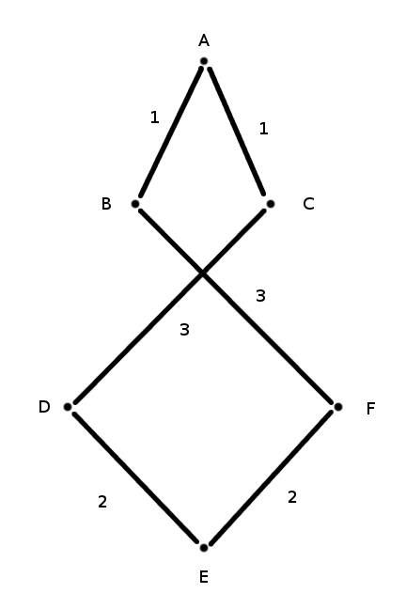
A C D E F B
12

Slide 4
A C D E F B
12

Slide 5
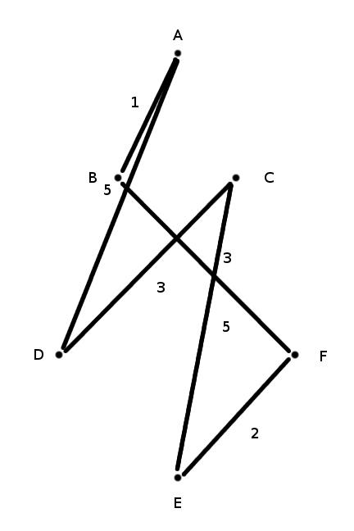
A D C E F B
19

Slide 6
A C D E F B
12

Slide 7
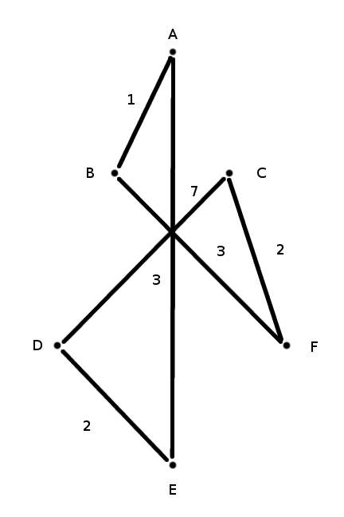
A E D C F B
18

Slide 8
A C D E F B
12

Slide 9
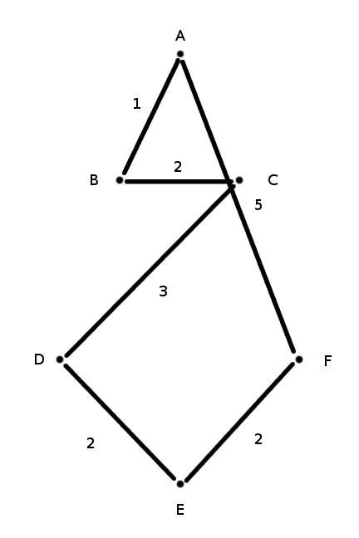
A F E D C B
15

Slide 10
A C D E F B
12

Slide 11
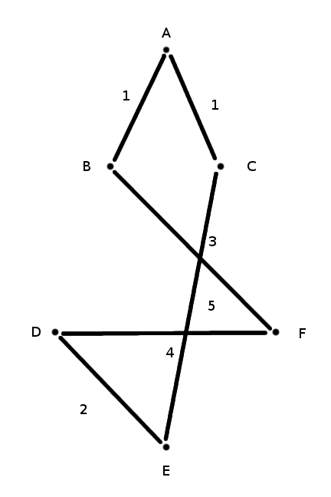
A C E D F B
16

Slide 12
A C D E F B
12

Slide 13
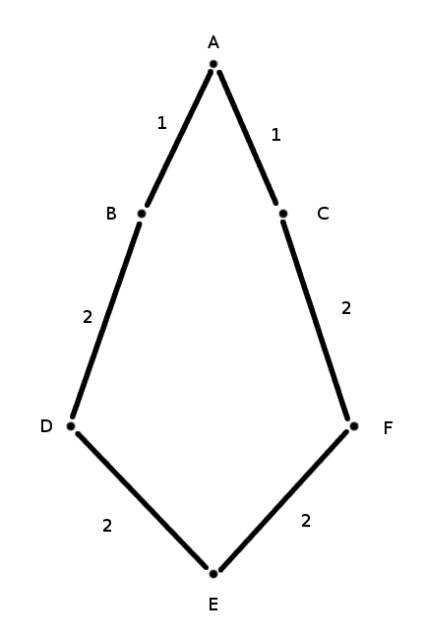
A C F E D B
10

