Slide 1

Nom Noms
The Tinder for Food

Slide 2
Question of Life:
What to Eat??

Slide 3

Let Nom Nom solve it for You!!!

Slide 4
Key Functionality: Swiping
Randomly generates types of food for swiping
Once a user swiped a type of food, generates nearby restaurants of the type

Slide 5
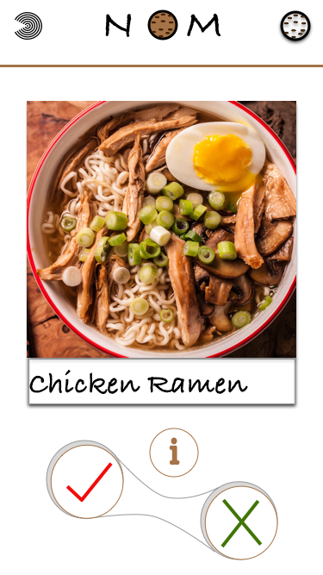
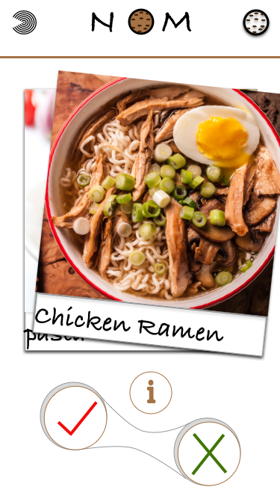
Swipe Right for Yes!
Swipe Right

Slide 6
Key Functionality: Store Preferences and Filtering
Stores “Yes” swipes for future reference for each session
“Save” and “Never show up” make sure the preferences are stored for an authenticated user
Filter location and price

Slide 7
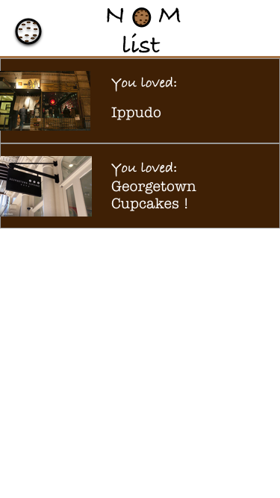
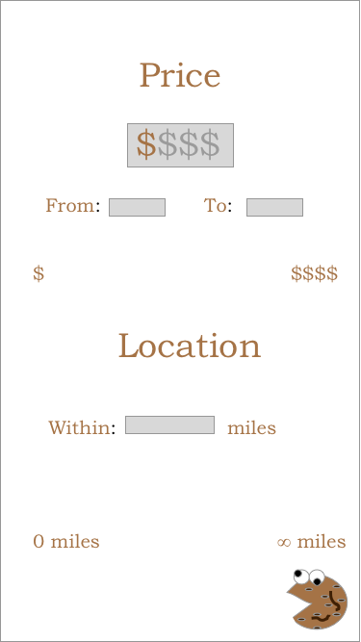

Slide 8
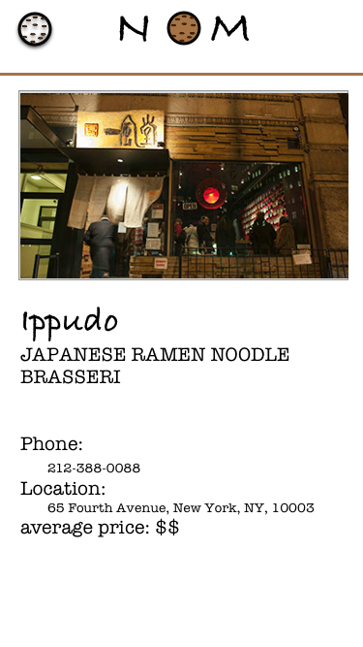
Key Functionality: Restaurant
Information
Show information for each saved restaurant
Links users to Yelp reviews and delivery options

Slide 9
Intended Audience
A cure for the indecisive, a resource for the homebodies, and a tool for the hungry.
So… basically whoever that uses Yelp and Seamless
Why using Nom Nom rather than Yelp or Seamless?
More integrated
More customized and user-focused
More fun!!

Slide 10
Challenges and Resources
Challenges
Geolocation base search
Mass data storage
Dynamic outside links
Match suggestions
Matching algorithms
Resources
Google Map API
Firebase
Clarifai
Yelp API
Tinder API (private but some people sniffed parts of it)

Slide 11
Logic Flow
Decide What to Eat
Decide Where
Links to delivery options and reviews
Yelp, Seamless, UberEats
Restaurant information
Number, menu, operation hours
Second Swipe and store Liked food types
save for session
Liked restaurants list
save for session
Check liked food types
save for user
save for user
Check liked restaurants list
Check a liked restaurant
First Swipe
Linking to delivery options and reviews
Check liked food types
Back to swipe 2
Back to swipe 1
Back to swipe 1
Back to restaurants list

