Slide 1
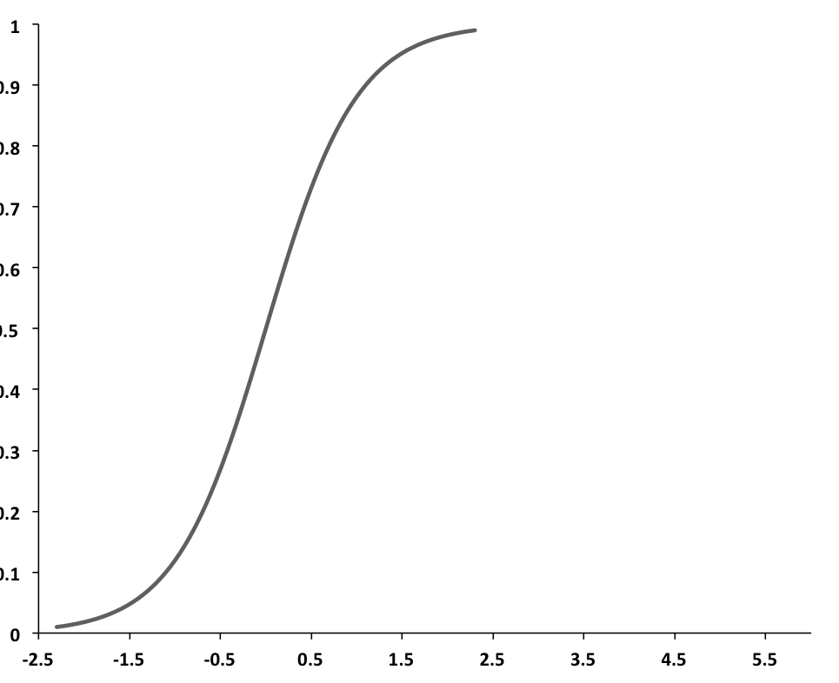
X (depth)
I - Front
Sonic Point
f(x) = (tanh (x) + 1.0)/2
H neutral
H partially ionized
H fully ionized
Δ
ΔS
depth
r₀ - dr
r₀
r
1.0 - dR
1.0
R = r / r₀
0
x₀ = 2.3
x = x₀ (R + dR -1.0) / dR

