Slide 1
Lok Sabha Elections 2024
By: Anshul Sharma

Slide 2
Index
About the dataset
Combining tables
Visualizations and Analysis
Insights

Slide 3
Data Overview
This dataset contains 2 tables:
First table consists of 543 rows and 10 columns
It consists of columns named:
Id: it’s a serial number for the rows
State: Name of the state of India
Constituency_num: Contains constituency number of related constituency
Constituency: Comprises of names of constituencies.
Leading_candidate: Standing candidate with highest amounts of votes
Leading_Party: Party which currently has a lead in votes in a constituency
Trailing_candidate: Standing candidate which doesn’t have highest amounts of votes
Trailing_Party: Party which is currently trailing in votes in a constituency
Margin: Amount of votes by which a candidate is leading
Result: shows whether results are released or in counting process, etc
Second table consists of 2 columns and 63 rows
It consists of columns named:
Party_name: It shows names of parties participating in election
Alliance: Shows alliance of which the party is part of or independent of alliances.

Slide 4
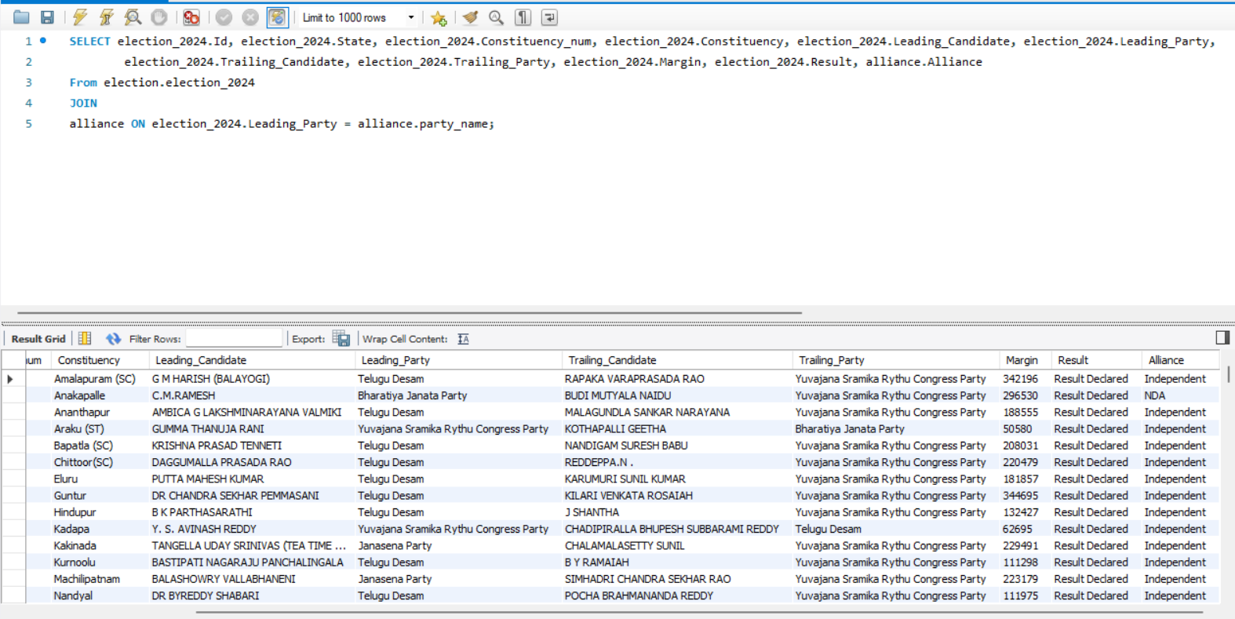
Joining both tables for easy analysis

Slide 5


Microsoft Power BI

Slide 7
Party status by constituency

Slide 10
Insights
Gumma Thanuja Rani (YSRCP) in Araku (ST): The YSRCP candidate won against the BJP candidate Kothapalli Geetha by a margin of only 50,580 votes, which is notably close given the expected dominance of BJP in many regions.
Independent Candidates: In Andhra Pradesh, several independent candidates performed surprisingly well, with significant margins that indicate a shift in voter sentiment. For instance, T. Uday Srinivas from the Janasena Party won in Kakinada with a margin of 229,491 votes, suggesting strong local support that diverges from party lines.
Dhubri (Assam): The Indian National Congress candidate Rakibul Hussain defeated his opponent from the All India United Democratic Front by a staggering 1,012,476 votes, showcasing a significant swing in voter preference that was unexpected in a region often competitive between these parties.
Bihar's RJD Performance: The Rashtriya Janata Dal managed to secure unexpected wins in constituencies like Aurangabad, where Abhay Kumar Sinha defeated BJP's Sushil Kumar Singh by 79,111 votes. This result suggests a potential resurgence of RJD in areas where BJP previously held sway.
Telugu Desam Party (TDP): The TDP's strong performance in Andhra Pradesh, particularly in constituencies like Amalapuram where G M Harish won by 342,196 votes, indicates a robust comeback against the YSRCP, which was not anticipated given the latter's previous dominance in the state.

Slide 11
Urban V/S Rural Performance
Telugu Desam Party (TDP)
Urban Areas: TDP showed strong performance in urban constituencies, particularly in cities like Visakhapatnam and Vijayawada, where candidates won by significant margins. For example, in Visakhapatnam, TDP's Sribharat Mathukumili won by 504,247 votes.
Rural Areas: TDP also maintained a solid presence in rural constituencies, winning several seats with large margins, such as in Amalapuram (SC) where G M Harish won by 342,196 votes.
Bharatiya Janata Party (BJP)
Urban Areas: The BJP exhibited strength in urban constituencies in Assam, such as Guwahati, where Bijuli Kalita Medhi won by 251,090 votes. This trend suggests a preference for BJP in urban settings, likely due to its development agenda and urban-centric policies.
Rural Areas: In rural constituencies, the BJP also secured wins, but the margins were often narrower compared to urban victories. For instance, in Karimganj, the margin was only 18,360 votes, indicating a more competitive landscape in rural regions.
General Observations
Urban Preference for BJP: The BJP's consistent performance in urban areas across states like Assam suggests a trend where urban voters favor the party's development narrative.
Rural Support for Regional Parties: Regional parties like TDP and YSRCP performed better in rural constituencies, reflecting their focus on local issues and grassroots engagement.
Mixed Results in Transition Zones: In constituencies that are transitioning from rural to urban, such as those near major cities, the results were mixed, with parties like TDP and BJP competing closely.
These patterns indicate that while BJP tends to perform better in urban areas, regional parties like TDP and YSRCP maintain significant support in rural regions.

