Slide 1

Case 2
Tanjit , Thanh, Syed, Divya, Priya, Ralf

Slide 2

Overview
Find stocks currently below 200 day moving average
Finding stocks currently above 200 day moving average
Calculate 50 day moving average
Analyze correlation between 200d and 50d moving average, direction stock moves
Our stocks pick

Slide 3
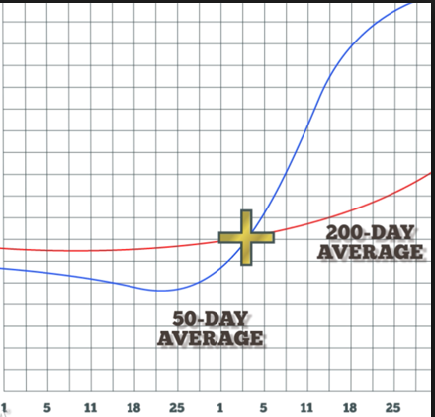
What is the Golden Cross?
The golden cross is a technical chart pattern indicating the potential for a major rally
The golden cross appears on a chart when a stock's short-term moving average crosses above its long-term moving average
In our case, the short-term window is the 50-day moving average, and the long-term window is the 200-day moving average

Slide 4

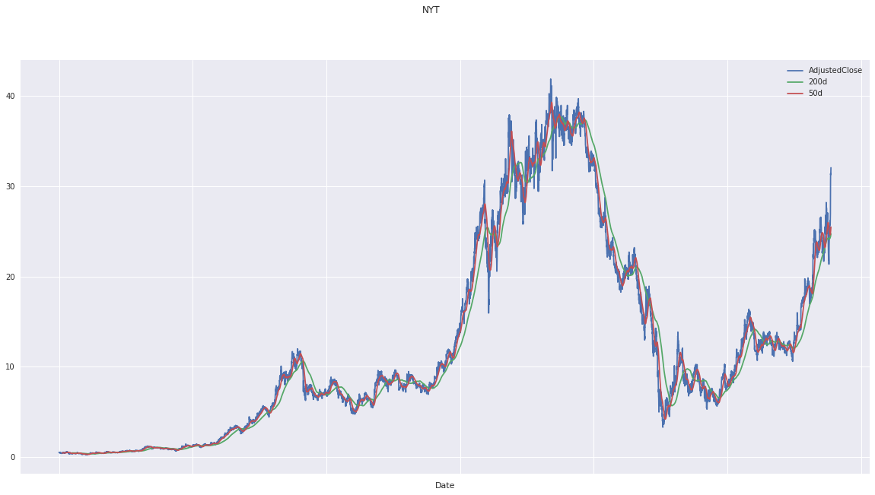
The New York Times (NYT)
Business Model: Ads and Subscriptions
Golden Cross Date: 10-25-2018
Current Stock Price $33.62
Price 50 DMA X 200 DMA: $26.83
A Staple in the News Industry
2018 (Q4): 5.99% Return on Assets
Profit Margin: 7.29%
Safe Stock with Low Volatility -
& Moderate Returns

Slide 5
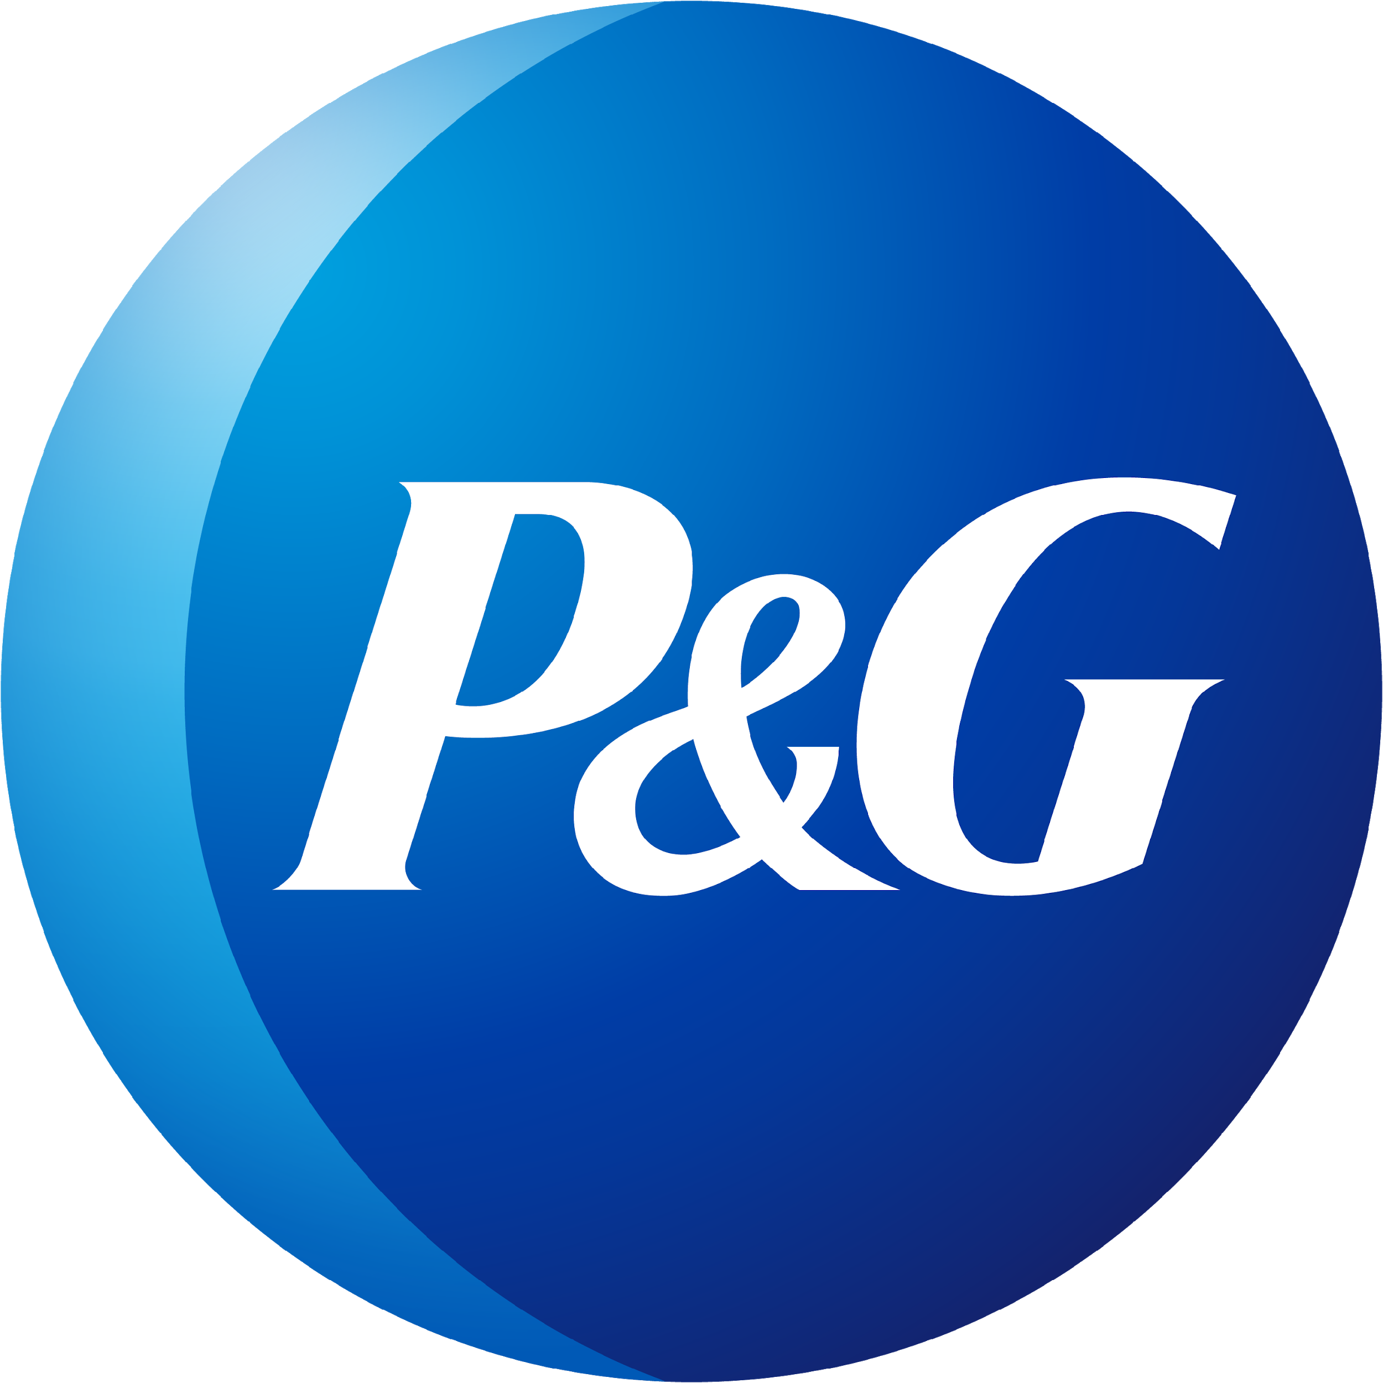
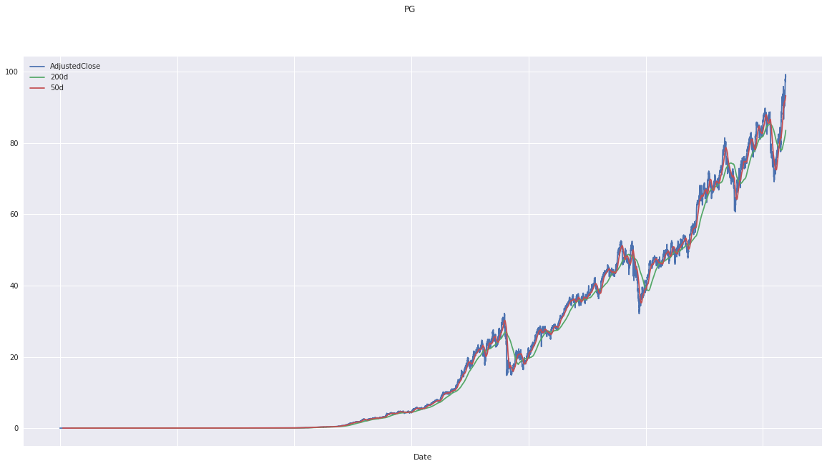


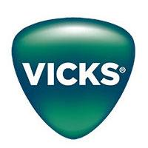

Procter & Gamble (PG)
Current Stock Price $99.30
Golden Cross Date 09/17/2018
Price 50 DMA X 200 DMA: $85.82
FY19 Q2: EPS of $1.25 beat by $0.04
Revenue of $17.44B beat by $280.00M
Safe Stock with Low Volatility

Slide 6
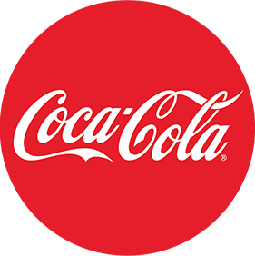
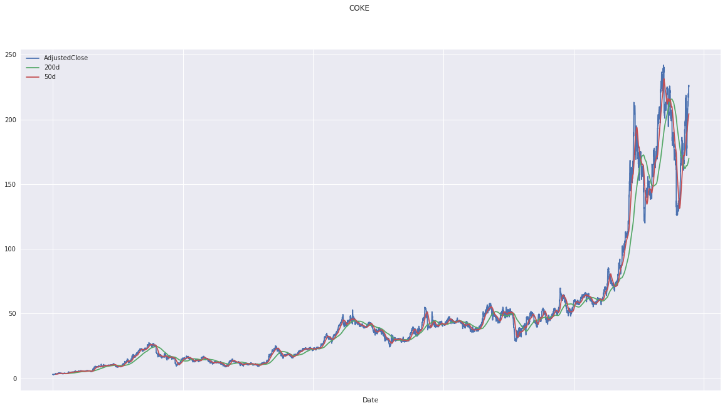
The Coca-Cola Company (KO)
Golden Cross Date: 08-21-2018
Price 50 DMA X 200 DMA: $49.79
Current Stock Price:$45.60
Considered a bullish stock by experts
High Market Share
Safe Investment

Slide 7

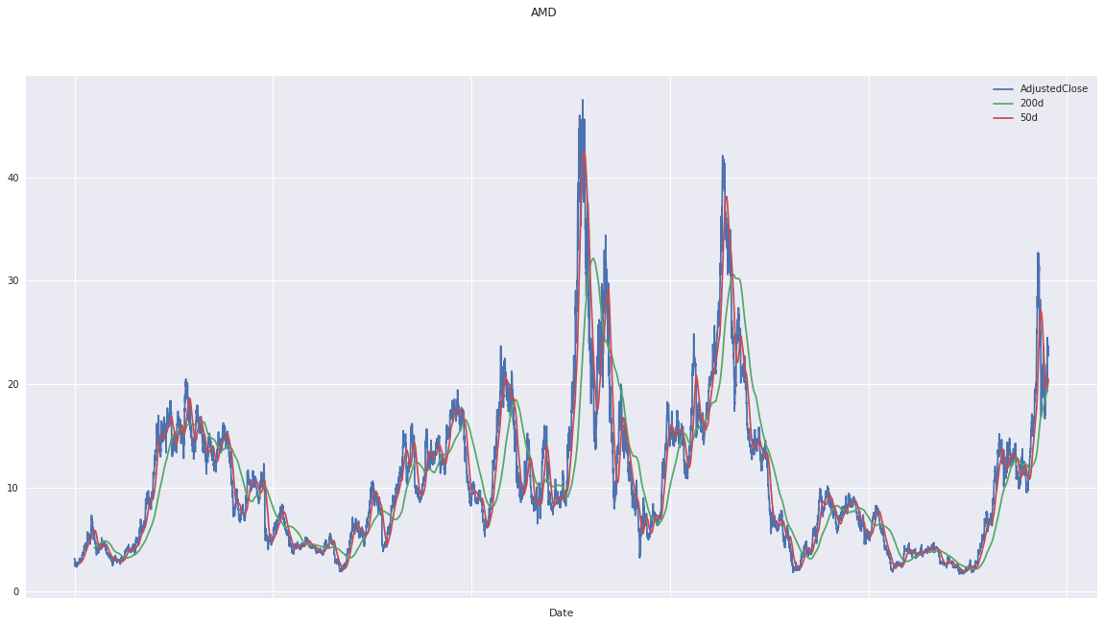
Advanced Micro Devices (AMD)
Current Stock Price $23.52
Golden Cross Date: 06/12/2018
Price 50 DMA X 200 DMA: $15.73
Q2: EPS of $0.14 beat by $0.01
Growing in the CPU and GPU market
Blockchain involvement

Slide 8

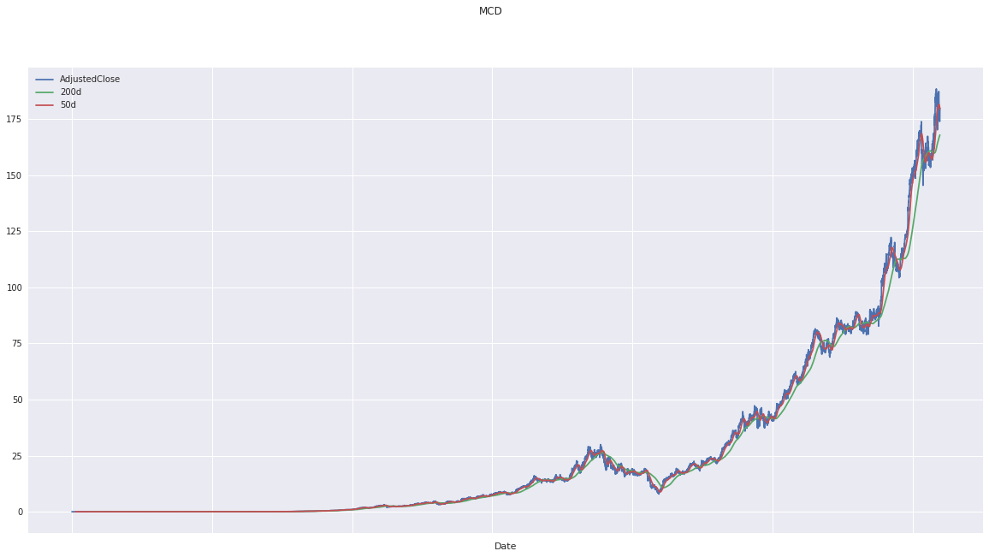
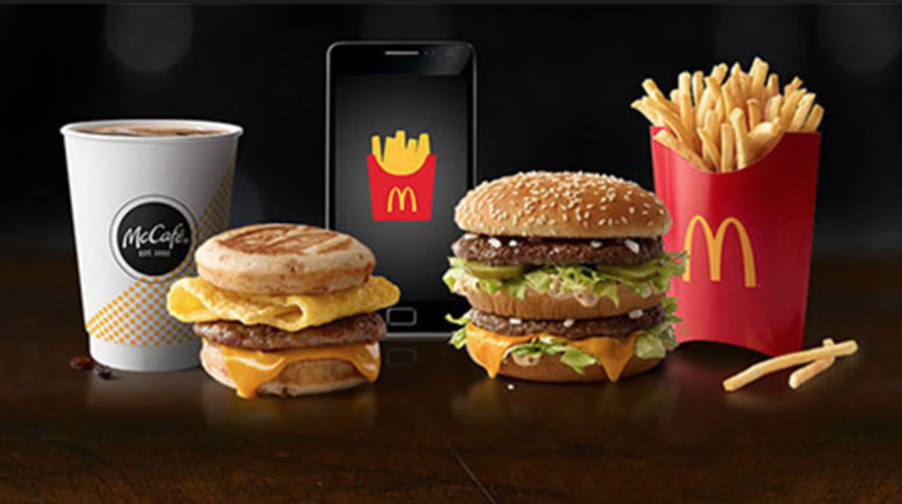
McDonald’s Corporation (MCD)
Current Stock Price: $181.35
Golden Cross Date: 10/25/2018
Price 50 DMA X 200 DMA: $165.50
Q4: EPS of 1.97 beat by $0.08
Dividend Yield: 2.57%
Q4-Global comparable sales increase by 4.5%
A sturdy business and a great dividend

Slide 9

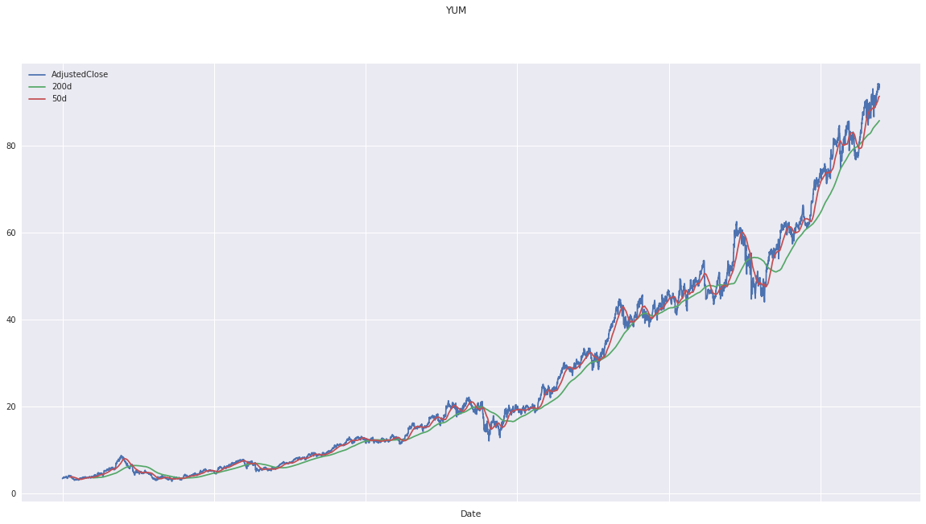
YUM! Brands, Inc. (YUM)
Formerly Tricon Global Restaurants, Inc., is an American fast food company.
A Fortune 500 corporation, Yum! operates the brands Taco Bell, Kfc, Pizza Hut etc.
Yum’s business model.
Yum China
Golden cross: 9-21-2018
Golden cross price: 89.00
Current Stock Price: 95.93
Notes:
September 21 , 50d moving average crossed 200d now moved up

Slide 10

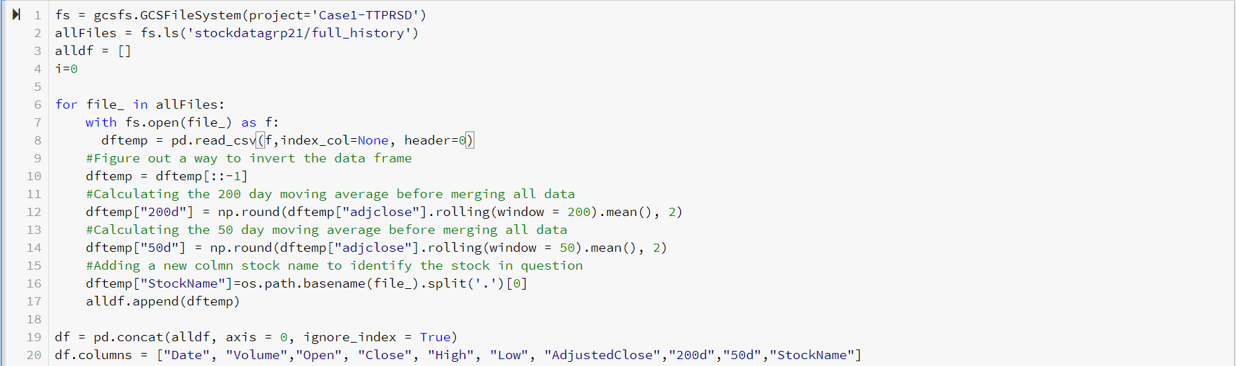
Python Code

Slide 11
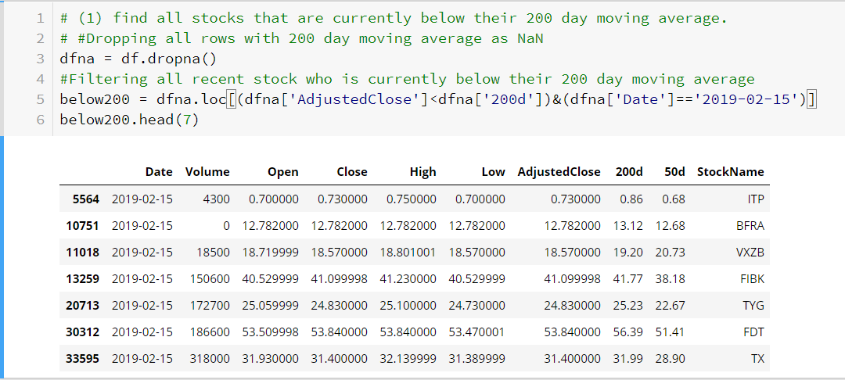
Find all stocks that are currently below their 200 day moving average
Notes:
This is the code used to

Slide 12
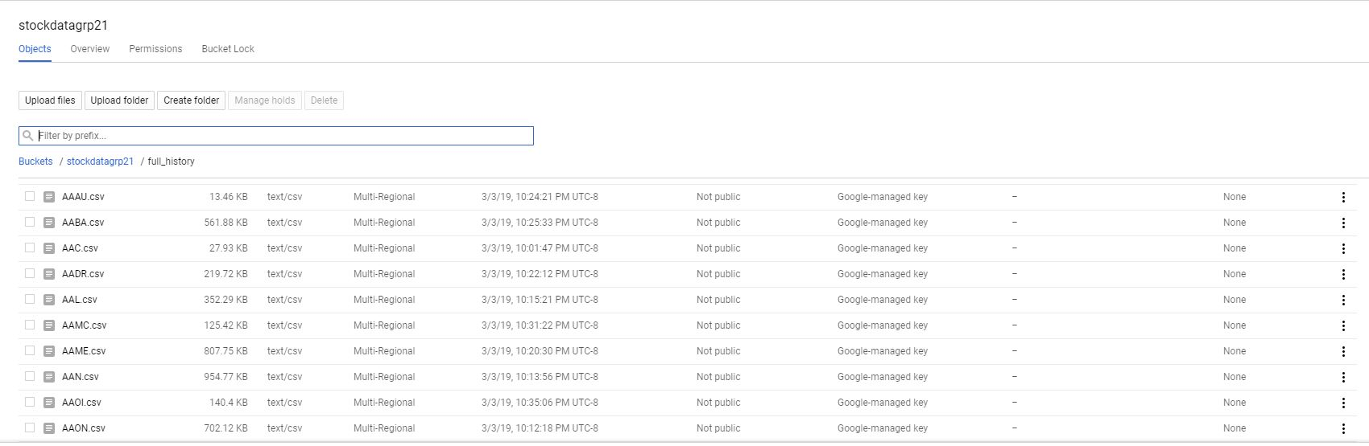
Data Storage Bucket

Slide 13
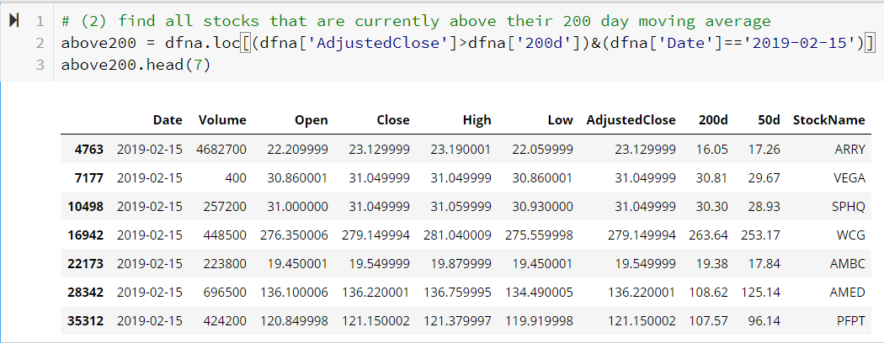
Find All Stocks that are Currently above their 200 day moving average using Datalab

Slide 14
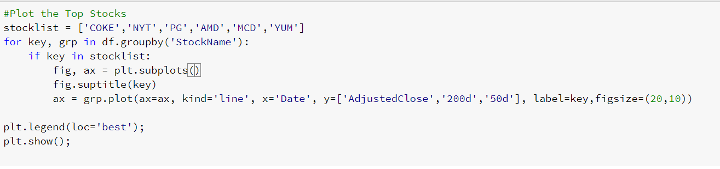
Top Stocks Golden Cross

Slide 15
Findings and Recommendations
According to our findings, reflected in stocks we picked, there is a correlation between the movement of the 50d and 200d moving averages
When a stock’s 50 DMA exceeds the 200 DMA (The Golden Cross), it typically resulted in a spike in stock price, at least in the short-term
We suggest that when determining the entry point for purchasing a stock, the days immediately following the Golden Cross would be ideal, and likely to result in short-term gains

Slide 16
Questions or Comments

