Slide 1

Blockchain based FRAUD DETECTION OF CROSS BORDER PAYMENTS
University of New Haven – Tagliatela College of Engineering
DSCI 6007-03
Distributed & Scalable Data Engineering

Slide 2



MEET Our team
Vittu Ramadasu Darshan
Sirisha Gajula
Kishan Sai Saguturu

Slide 3
PROJECT CHALLENGE
Cross-border blockchain transactions are vulnerable to fraud due to:
Anonymity - Hard to trace bad actors
Speed of Transactions - Hard to detect fraud in real time
Lack of Central Authority – No oversight over transactions
Traditional fraud detection methods are outdated

Slide 4

OUR SOLUTION
We are building a real-time fraud detection system that:
Monitors live blockchain transactions (Ethereum, Bitcoin)
Detects fraudulent activities using Machine Learning
Triggers fraud alerts when high-risk transactions are identified
Provides real-time fraud analytics via AWS Quicksight
Data Required:
Real-time blockchain transactions
Historical fraud data

Slide 5
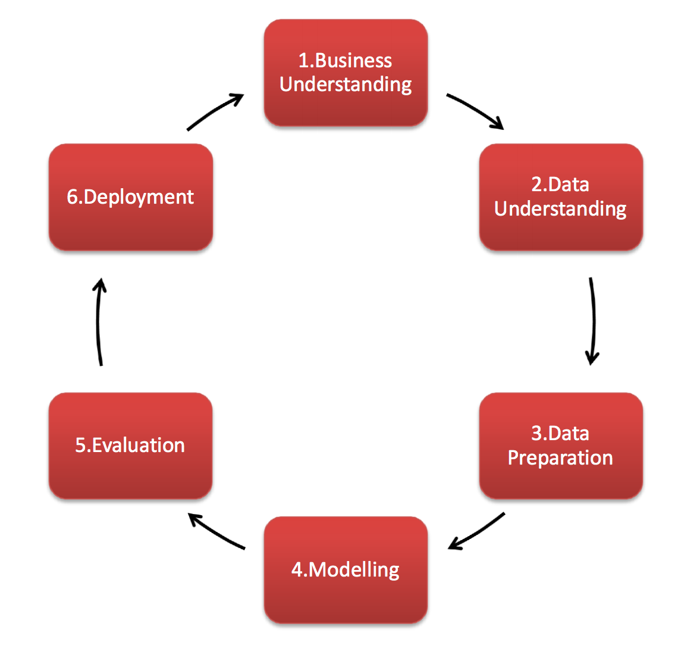
CRISP-DM DIAGRAM

Slide 6
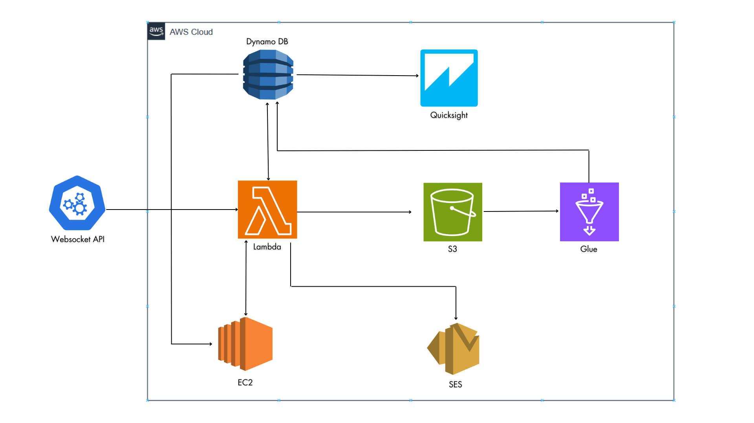
PLANNED PROJECT ROADMAP

Slide 7








TOOLS & TECHNOLOGIES

Slide 8
Business impact
Real time Fraud Prevention
Regulatory Compliance (AML & KYC)
Reduced Financial Losses
Enhanced Fraud Analytics & Monitoring
Scalability & Cost Savings

Slide 9
CONCLUSION
To build a real time blockchain fraud detection system
To integrate AI to detect and prevent fraudulent transactions.
To develop a scalable and efficient AWS-based solution.
Our solution improves security in blockchain payments, ensuring safer, more reliable transactions for businesses and financial institutions.

Slide 10


