Slide 1
1
DEPTCOFFER
SUPERVISOR
Presented by
Dr. N.SARAVANAN, Ph.D., MISTE.,
Associate Professor,
Department of Computer Science and Engineering
ADITYA R
ARUN AP
GOKULRAJA LP
Notes:
1

Slide 2

ABSTRACT
MODULES
INPUT & OUTPUT DESCRIPTION
MODULE INTERFACE DIAGRAM
TECHNOLOGIES USED
CONCLUSION
2
SYNOPS
I
S
Notes:
1

Slide 3
ABSTRACT
3
This project is an open source software which can be used by any college.
Here the user(student) can request anything related their needs in the department in our web application.
Needs like leave requisition, on-duty form, bonafide certificate, etc.
After the approval of supervisor, the admin will give the final call.
All details are maintained in the database for future reference.
Notes:
1

Slide 4
MODULES
4
Login Module
User Module
Supervisor Module
Admin Module
Notes:
1

Slide 5
LOGIN MODULE
4
This is the general login page for all the end-user :
Admin
Supervisor
User
Based on the username and password, the according page will be displayed.
Notes:
1

Slide 6
USER MODULE
5
After validating the correct credentials for the user, the user page will be displayed.
Here the user requests to the supervisor.
After the approval from both supervisor and the admin, the user will get the certificate.
Certificate contains the unique id which can be validated anytime.
If required, user must submit the details with the proof which will be stored in database.
Notes:
1

Slide 7
SUPERVISOR MODULE
6
After validating the correct credentials for the supervisor, the supervisor dashboard will be displayed.
Here all the requests from the user will be displayed for the approval.
After the approval, the further request is sent to the admin.
Notes:
1

Slide 8
ADMIN MODULE
7
After validating the correct credentials for the admin, the admin dashboard will be displayed.
Here all the request which is approved by the supervisor will be displayed for the admin approval.
If the admin approves the request then the certificate will be generated with the unique id.
Admin can cancel the request at any time and the notification will be sent to the user.
Everything is stored in database which will be retrieved and displayed on admin dashboard.
Notes:
1

Slide 9
INPUT DESCRIPTION
8
LOGIN :
User Name
Password
USER :
Request to the supervisor
SUPERVISOR :
Accept the request
ADMIN :
Accept the request which is approved by Supervisor
Notes:
1

Slide 10
OUTPUT DESCRIPTION
9
LOGIN :
Redirected to respected dashboard
USER :
Approved status with certificate
SUPERVISOR :
Approved status
ADMIN :
Acceptance status with certificate
Notes:
1

Slide 11

MODULE INTERFACE DIAGRAM
10
LOGIN &
SIGN-IN
SENT
REQUEST
ACCEPT
REQUEST
SUPERVISOR
REQUEST
STATUS
CANCEL
REQUEST
VALIDATION
USER
RETRIEVE ALL
INFORMATION
LOG-OUT
ADMIN
Notes:
1

Slide 12
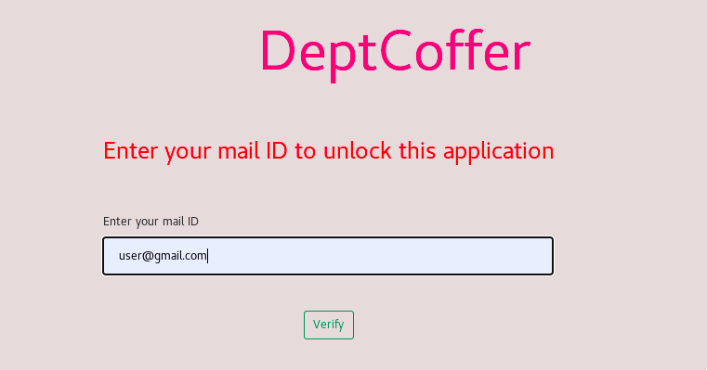
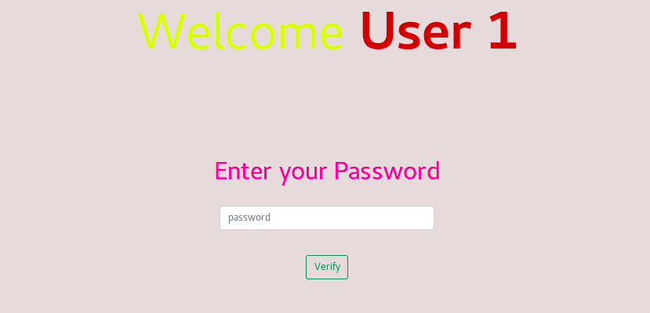
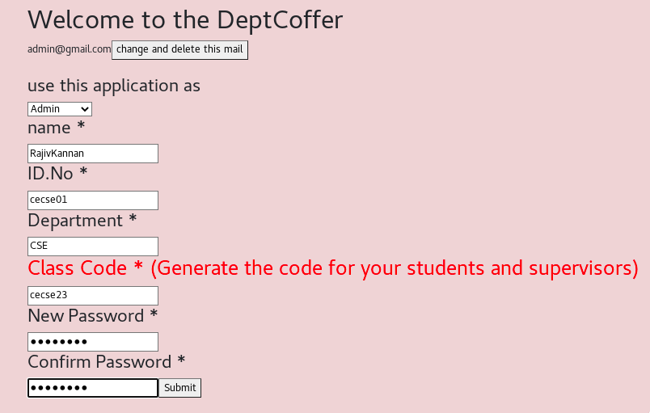
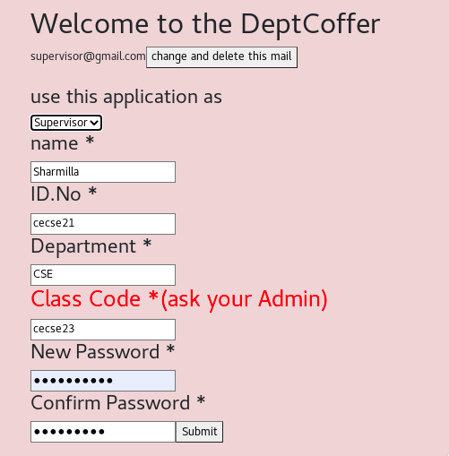
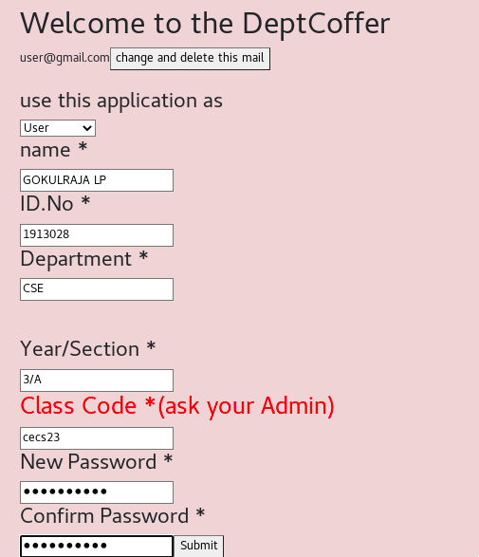
SCREEN SHOTS
12
Notes:
1

Slide 13
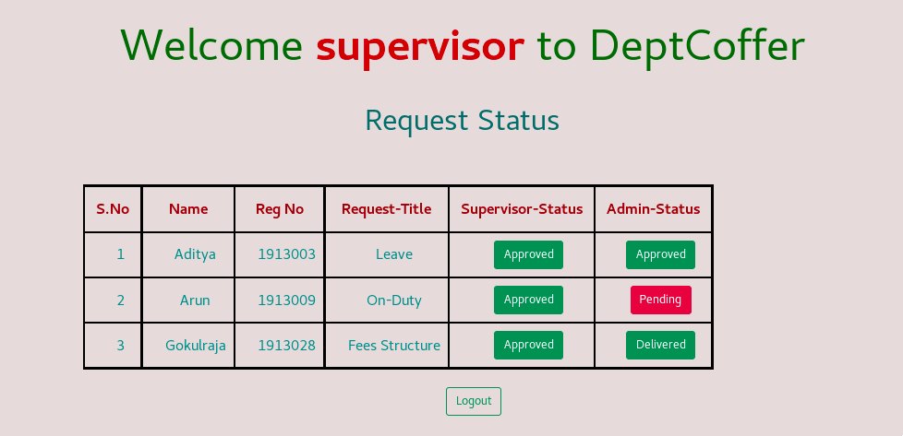
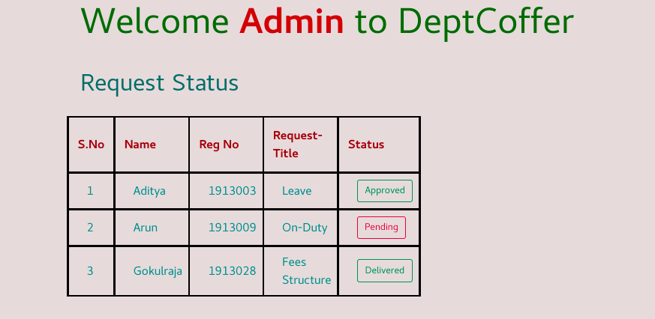
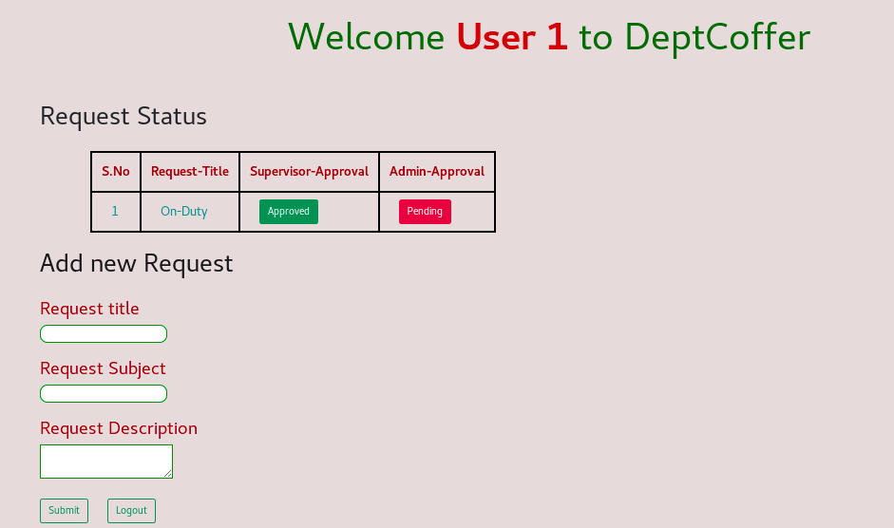
SCREEN SHOTS
13
Notes:
1

Slide 14
TECHNOLOGIES USED
14
FRONT-END :
React JS
BACK-END :
Firebase
Notes:
1

Slide 15
CONCLUSION
15
DeptCoffer is a useful tool for Request management to the organization.
It reduces the paperwork and manual validation.
It can apply to any institution or organization. E.g.: Schools, Colleges, Government and Private sectors. The
user requests to the supervisor, if the supervisor accepts the request then the request is sent to the admin, if both are accepting the request, the user is approved
Notes:
1

Slide 16
REFERENCES
16
[1] https://reactjs.org/docs/getting-started.html
[2] https://firebase.google.com/docs
[3] https://docs.github.com/en
[4] https://getbootstrap.com/docs/5.0/getting-started/introduction/
Notes:
1

Slide 17
PUBLICATION
17
[1] Dr. N. Saravanan, Ph.D., MISTE., R. Aditya, AP. Arun and L.P. Gokulraja, “Deptcoffer (Request Management System)”, in Artificial Intelligence, Cyber Security, Data Science and Machine Learning Conference, Malla Reddy Institute of Technology and Science, Hyderabad.
Notes:
1

Slide 18
THANK YOU
Any queries ?
FOR HEAR ABOUT DEPTCOFFER
Notes:
1

Slide 19
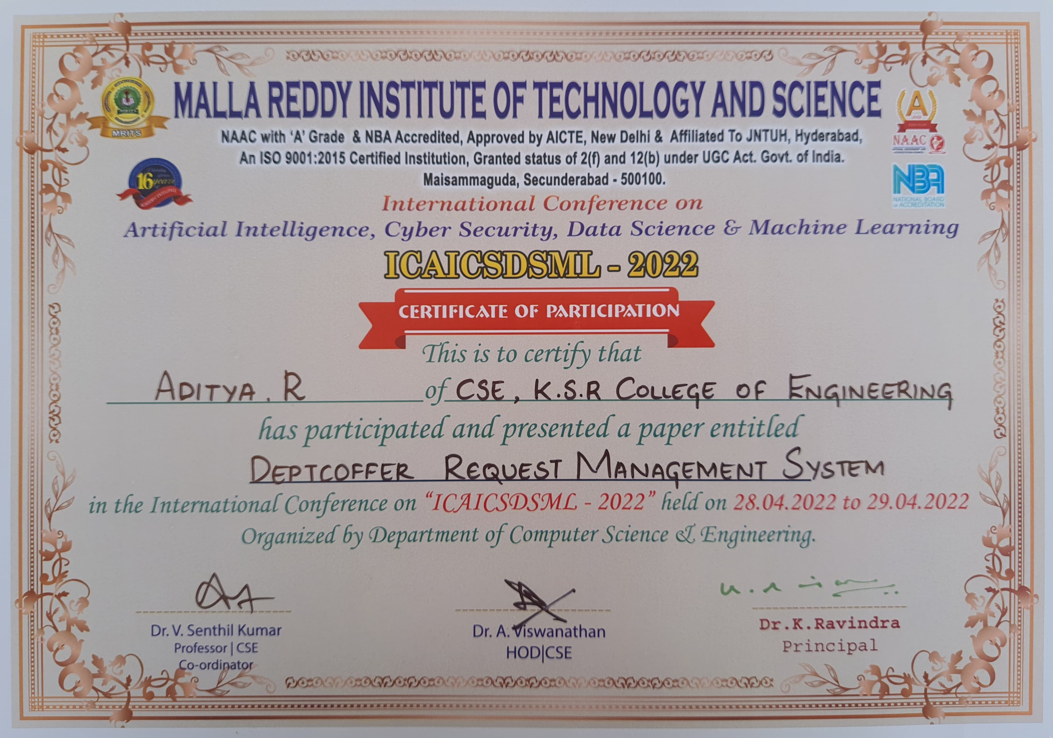

Slide 20
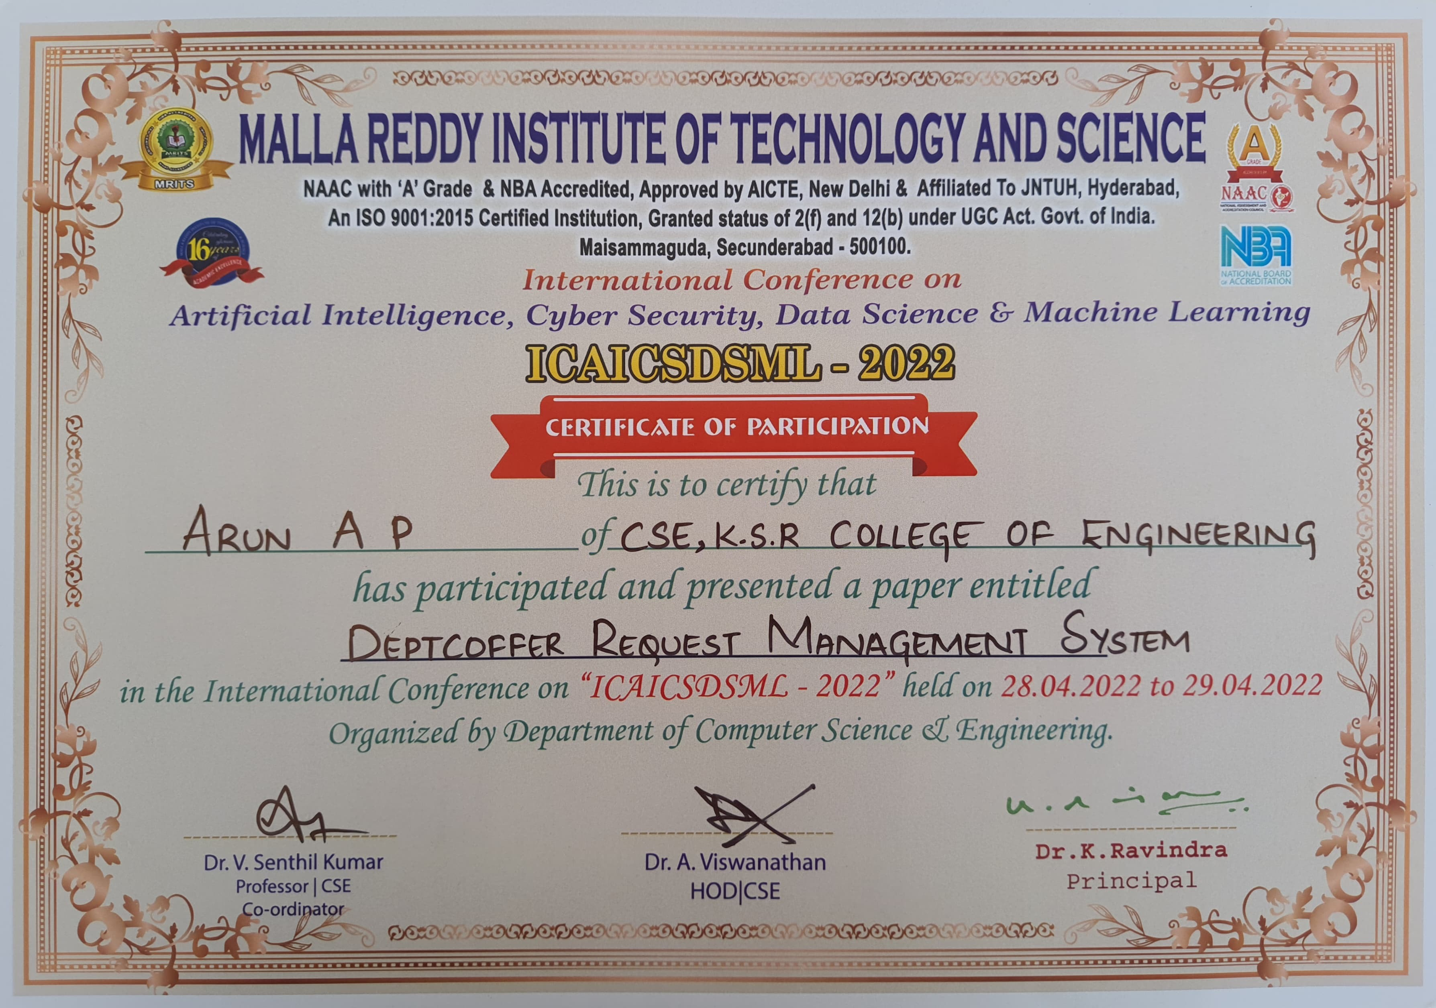

Slide 21
