Slide 1
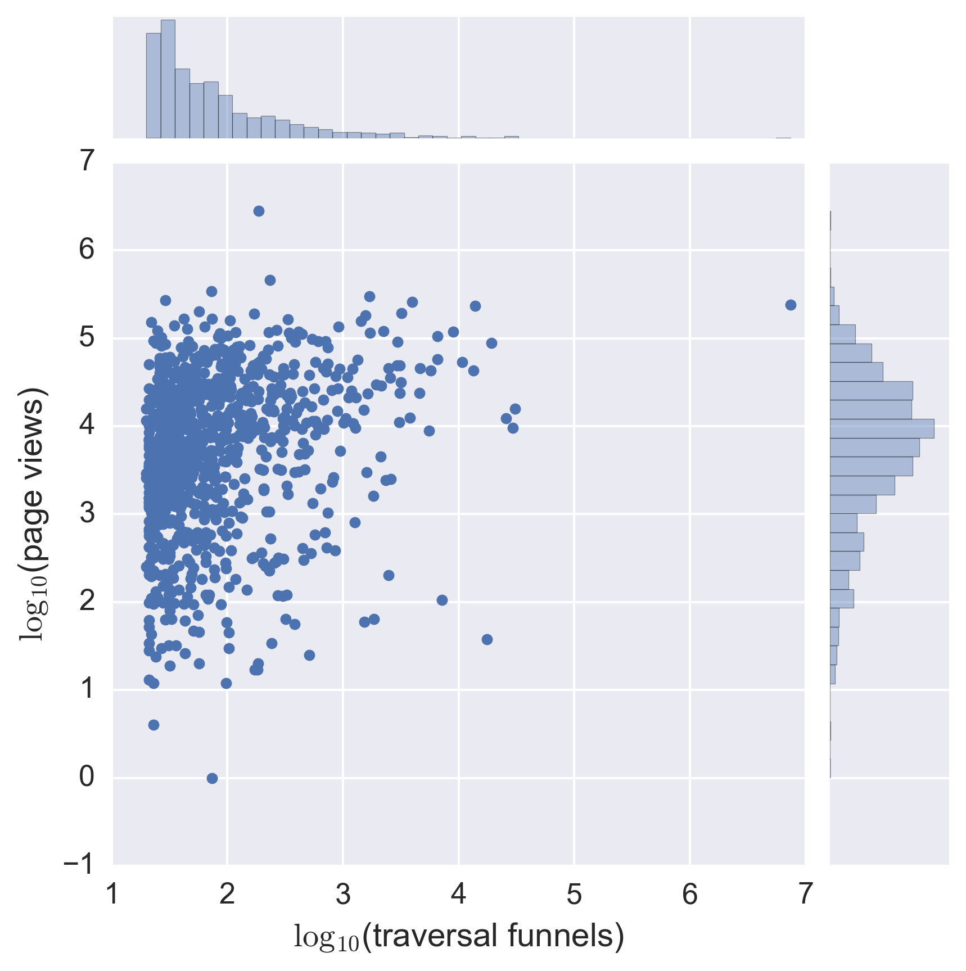
Halloween
Scientology
Philosophy
Presentation
Tree of life
Southeast Europe
Census-Designated Place
List of minor planets/25001–25100

