Slide 1
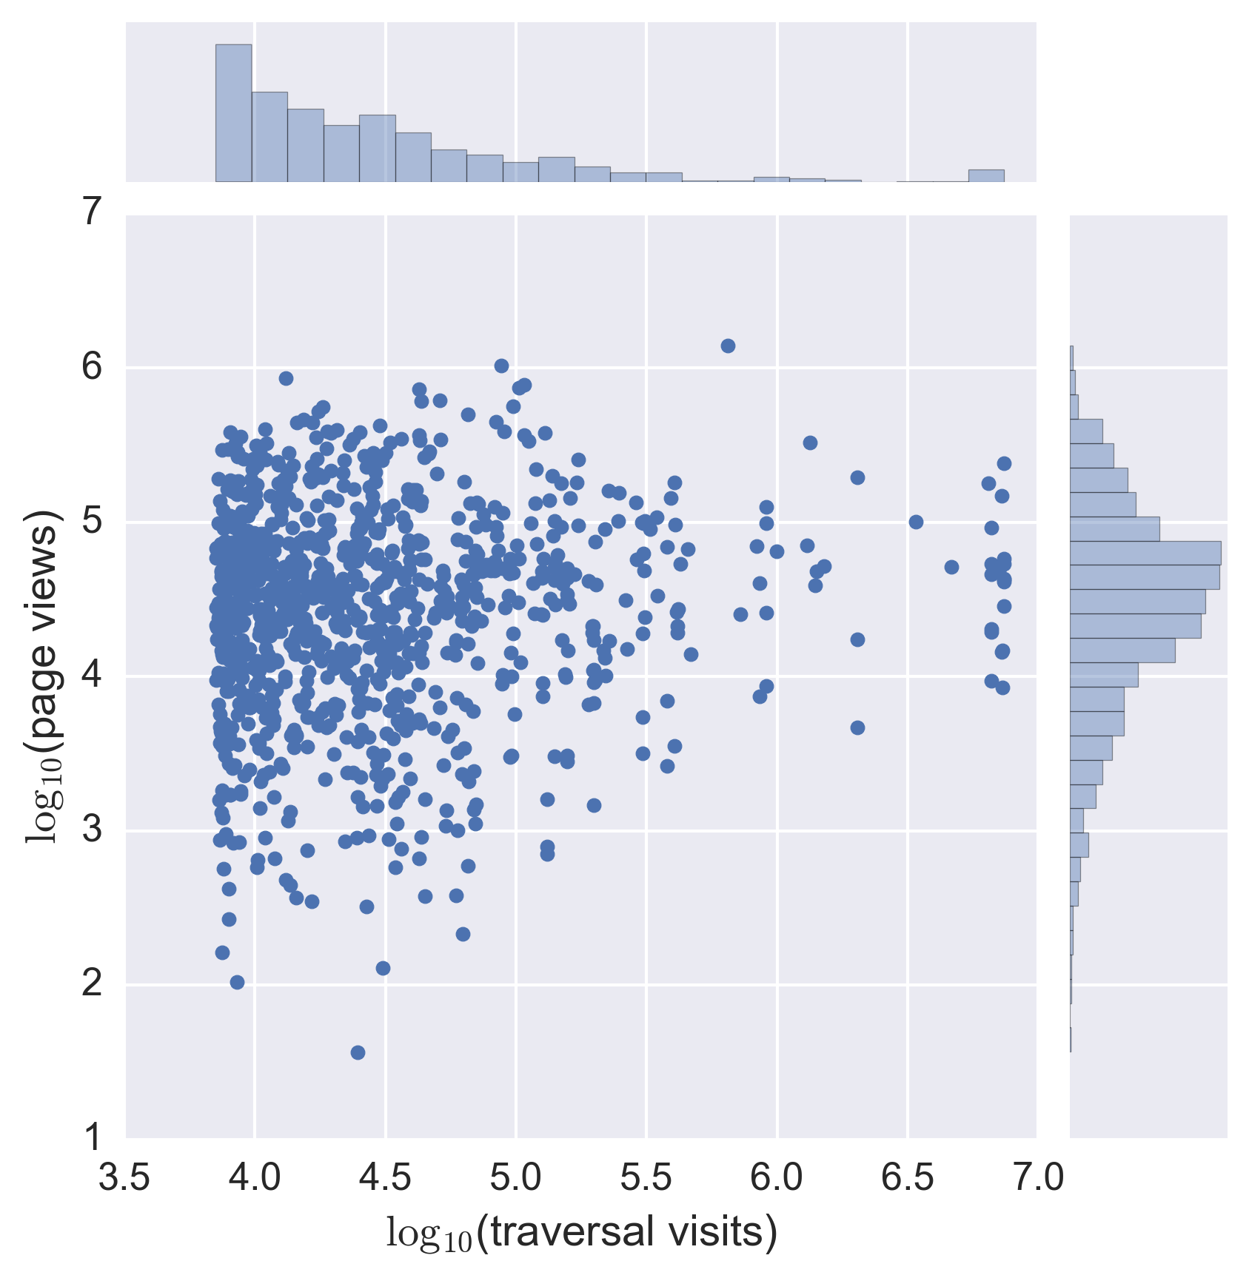
World War II
India
United States
Census-Designated Place

