Slide 1
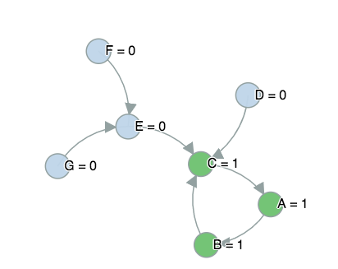
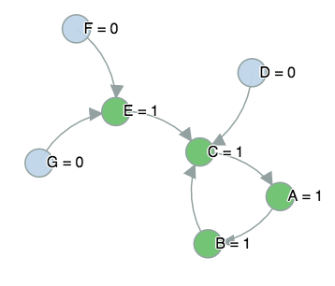
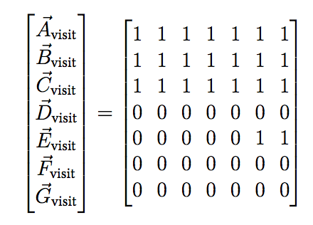
Traversal Algorithm
article | first link
A | → | B
B | → | C
C | → | A
D | → | C
E | → | C
F | → | E
G | → | E
Visits Path starting at article A
Visits Path starting at article G
Traversal Visits Matrix

