Slide 1

Wikiland

Slide 2
extinct
useless
pointless
irrelevant
95%
Wikiland
Notes:
Show example for “Train”—explain game

Slide 3
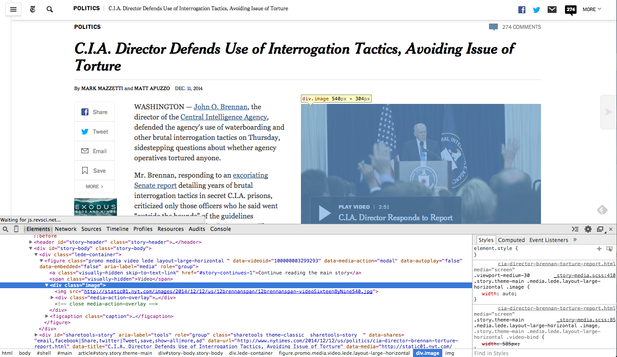

Slide 4
Wikiland
4.7 million articles
112GB xml dump
Media-Wiki Markup
templates: {{template: page name}}
links: [[link | display name]]

Slide 5
Alice, don’t reinvent the wheel
import
xml.etree, ✓
mediamarkup parser, ✓
regex, ✓
beautiful soup✓
Is Banana not a fruit?
Notes:
mediamarkup parser
Python! 7 releases github
regex to eliminate parentheses
What can go wrong? Banana is not a fruit?
Wikpedia: show banana and United States

Slide 6
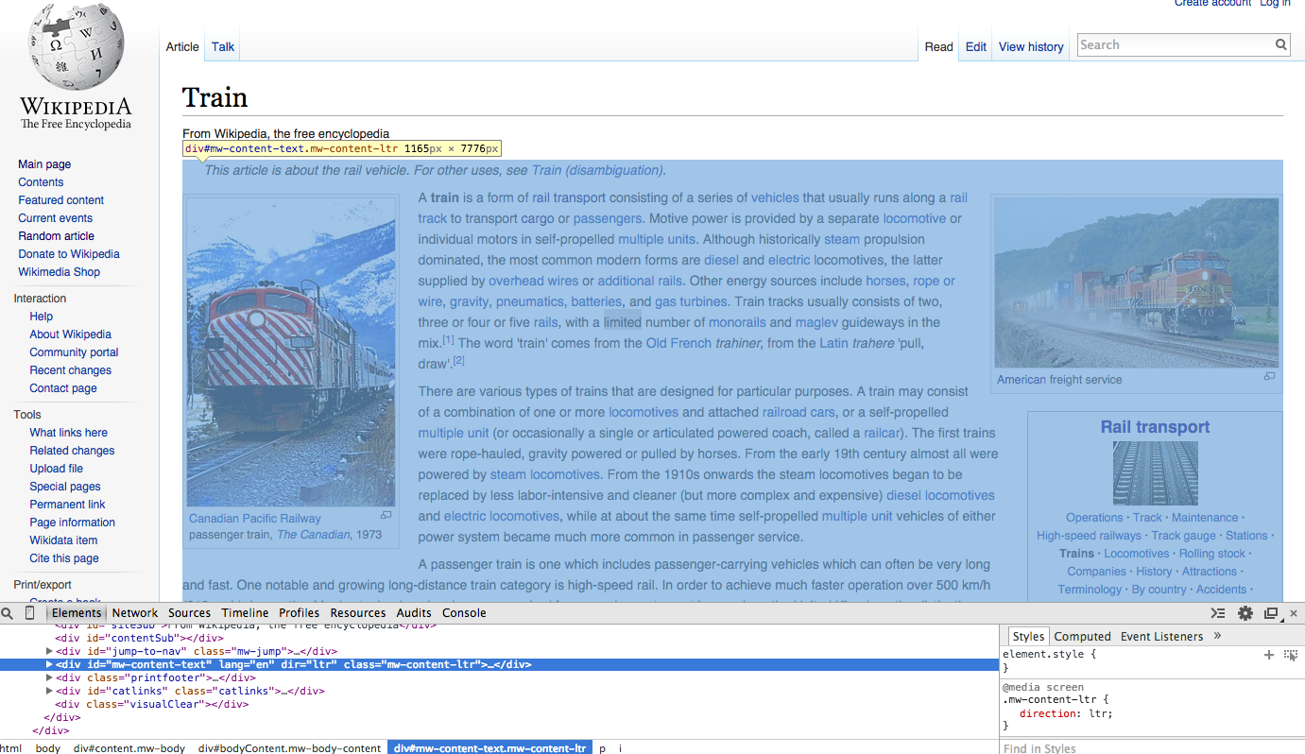

Slide 7
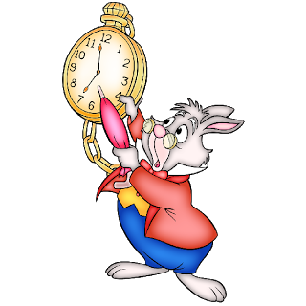
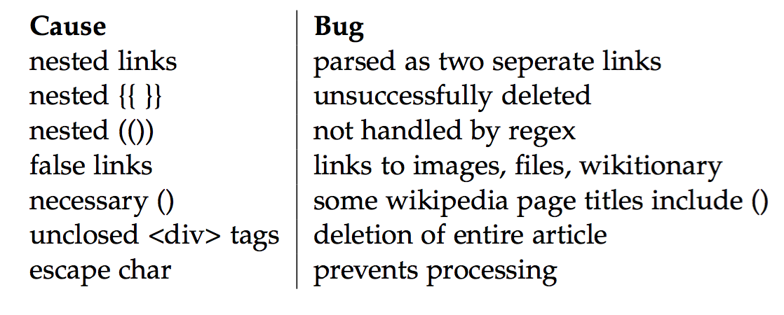
{I’m{nested}}
I link to a file
I’m an \n escape character, destroyer of all
I’m beautifulsoup in a fight with mediawiki parser
I’m a good ()
I’m an unclosed <div>, article bye bye
Slow

Slide 8

Alice restarts
Key: loop through article text once
{{ }}
<ref>, <div>
()
Only if all are a green, get link.
false link? X
Notes:
show code

Slide 9

United States
Notes:
Page traversing, “ending up” at :
Philosophy center or something else?
Eliminate duplicates to account for loops

Slide 10
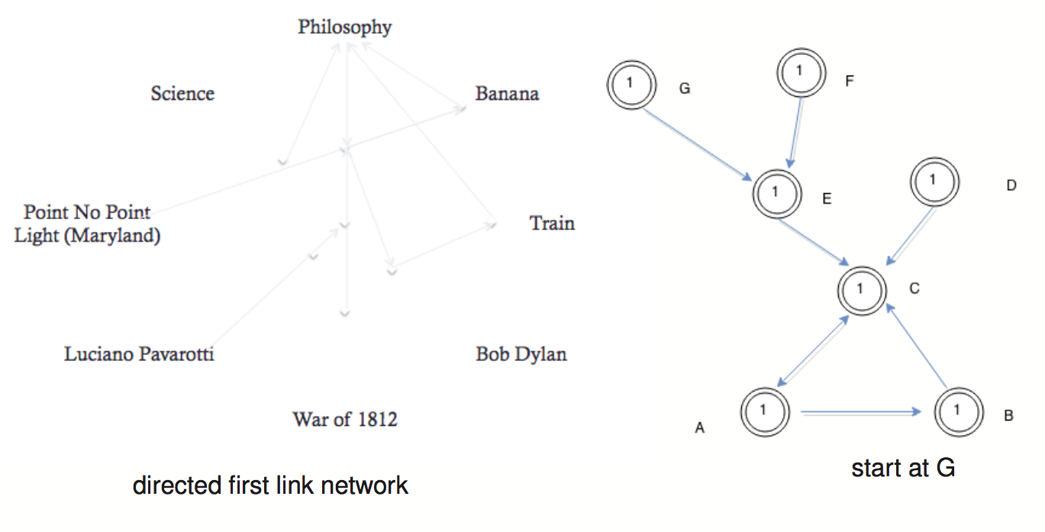
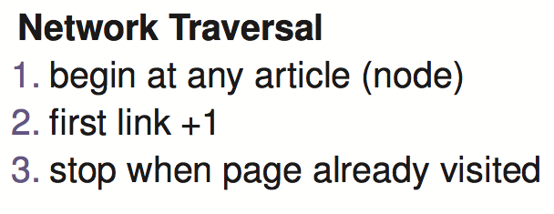
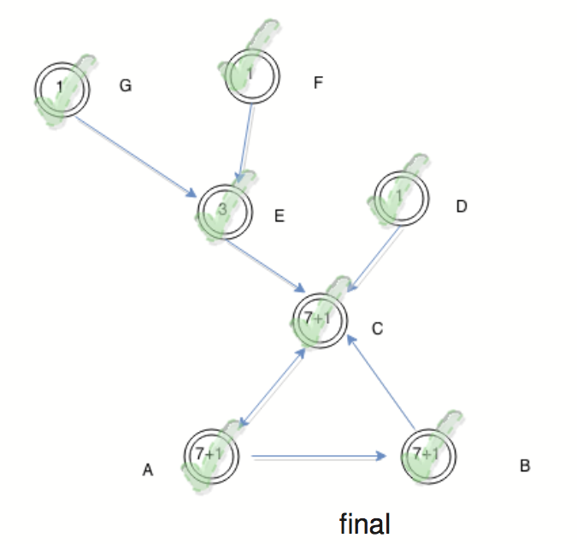
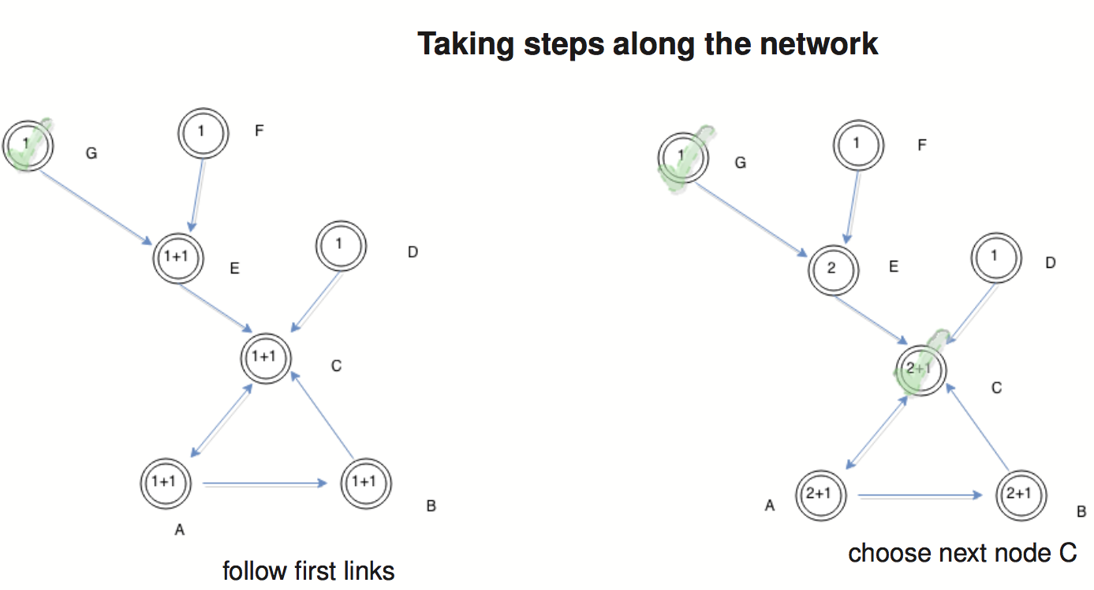
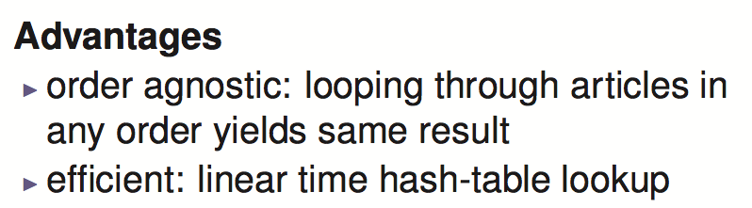
Notes:
Mention sample

Slide 11

What can Alice measure?
path length
visits
loops
loop feeds
Notes:
Mention sample

Slide 12
Alice’s Discoveries
To ipython land →
What are you wondering about?

Slide 13
Wikipedia

Slide 14

Caught in a loop

Slide 15
