Slide 1
Model Evaluation Techniques in Unsupervised Learning
Detailed Presentation with Graphical Understanding

Slide 2
Introduction to Unsupervised Learning
No labeled target variable
Finds hidden patterns or structure in data
Common tasks: Clustering & Dimensionality Reduction
Evaluation is challenging due to absence of ground truth

Slide 3
Why Model Evaluation is Important?
Determines quality of clusters or embeddings
Helps compare multiple models
Assists in selecting optimal parameters (like K)
Ensures meaningful pattern extraction

Slide 4
Types of Evaluation Techniques
1. Internal Evaluation Metrics
2. External Evaluation Metrics
3. Relative Evaluation
4. Stability-Based Evaluation

Slide 5
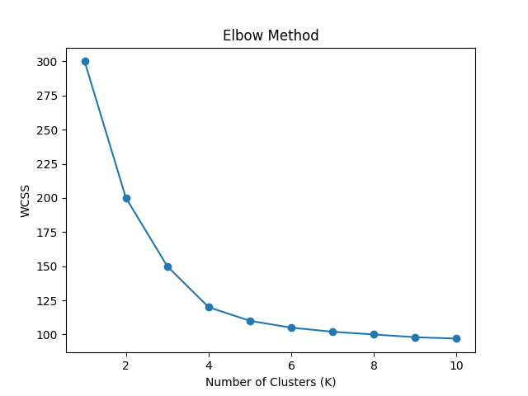
Elbow Method (Internal Evaluation)

Slide 6
Silhouette Score
Measures how similar an object is to its own cluster
Range: -1 to +1
Higher value indicates better clustering
Formula considers intra-cluster and inter-cluster distance

Slide 7
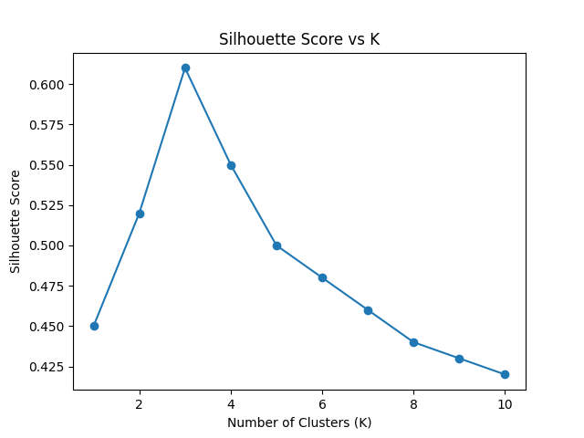
Silhouette Score Graph

Slide 8
Davies-Bouldin Index
Measures average similarity between clusters
Lower value indicates better clustering
Based on ratio of within-cluster scatter to between-cluster separation

Slide 9
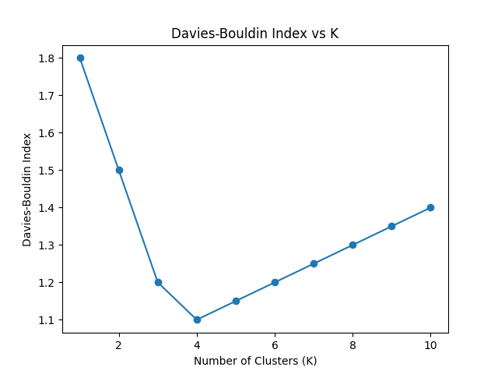
Davies-Bouldin Index Graph

Slide 10
External Evaluation Metrics
Used when ground truth labels are available
Adjusted Rand Index (ARI)
Normalized Mutual Information (NMI)
Homogeneity & Completeness Score

Slide 11
Evaluation in Dimensionality Reduction
Reconstruction Error (PCA)
Explained Variance Ratio
Trustworthiness & Continuity (t-SNE, UMAP)
Visual inspection of embeddings

Slide 12
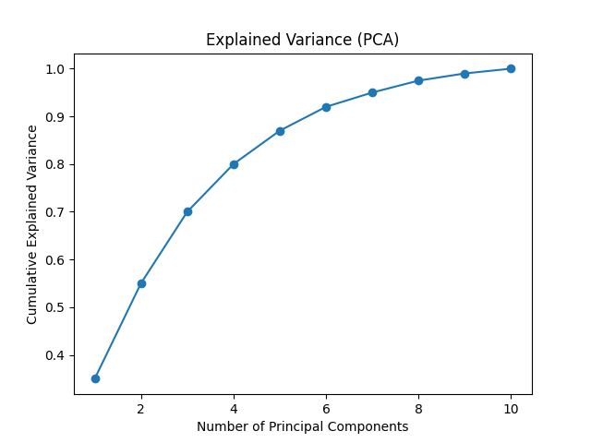
PCA Explained Variance Graph

Slide 13
Conclusion
Internal metrics evaluate structure without labels
External metrics compare with true labels
Relative metrics help choose best model
Visualization plays key role in evaluation

