Slide 1













CERVICAL CANCER PREDICTION MAMA AI: Healthcare system

Slide 2
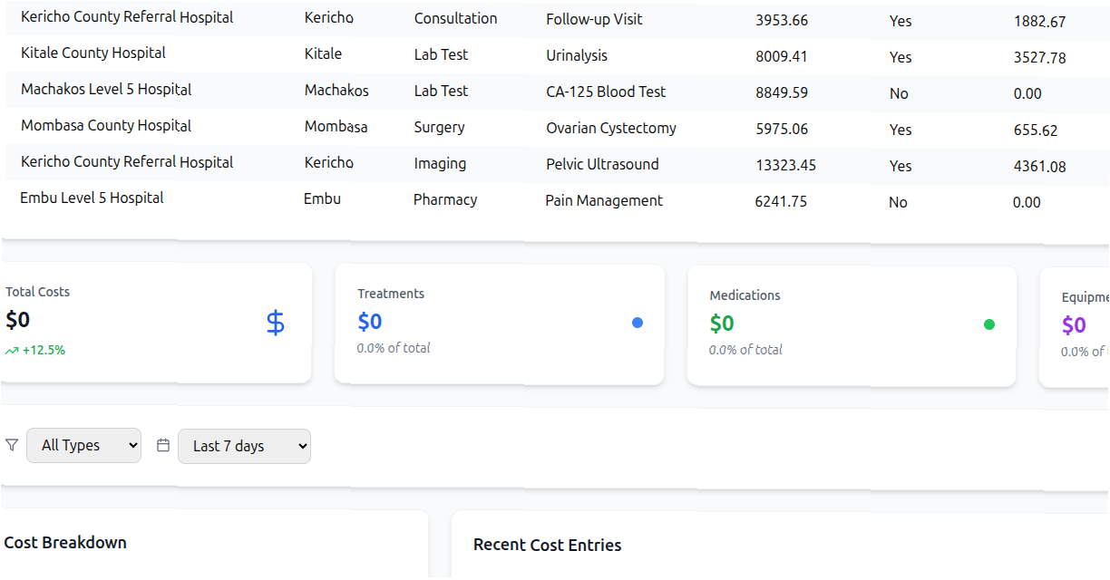
BRIDGING HEALTHCARE WITH AI
Welcome to a new era of healthcare management.
Our system provides intelligent tools for both patients and medical professionals, optimizing care and improving outcomes.
We used data provided for
Data exploratory Analysis
Feature Engineering
Model Training and Evaluation where Random Forest achieved the highest accuracy 95 percent .

Slide 3


Addressing Real-World Challenges in Kenyan Healthcare
Our solution directly tackles critical issues faced by clinicians and patients in Kenya, focusing on improving access, efficiency, and the quality of care.
Clinical Impact
Patient Relevance
Enhancing diagnostic accuracy and streamlining patient pathways for better health outcomes.
Empowering patients with personalized health data and accessible support features.

Slide 4
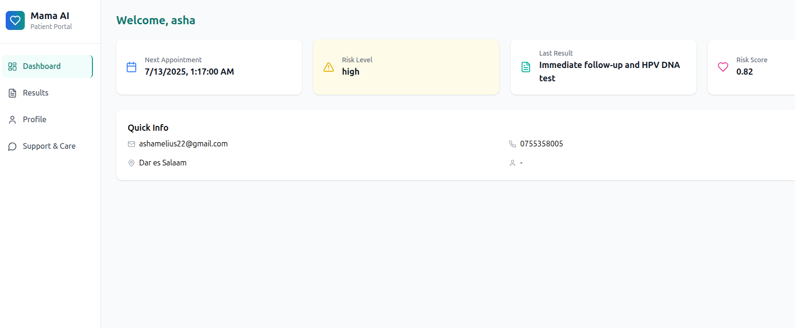
Patient Dashboard: Empowering Individuals
The Patient Dashboard is designed to put health information directly into the hands of individuals, fostering proactive health management and engagement.
Clinical Impact
Personal Health Metrics: Comprehensive view of vital signs, activity levels, and risk scores.
Test Results Access: Secure and timely access to all laboratory and diagnostic results.
Support Features: Consultation groups and a nearby hospital locator for immediate assistance.
Profile & History: Easy management of personal profiles and access to historical health data for continuity of care.

Slide 5
Doctor/Clinician Dashboard: Streamlining Operations
The Doctor/Clinician Dashboard provides a centralized, intuitive interface for healthcare professionals to manage patients, resources, and critical data efficiently.
High-Risk Cases
Total Patients
Overview of active patient count.
Identify patients requiring immediate attention.
Upcoming Appointments
Resource Efficiency
Daily and weekly schedule at a glance.
Key metrics on facility and staff utilization.

Slide 6


Advanced Predictive Analytics: Technical Innovation
Our system incorporates cutting-edge machine learning for enhanced diagnostic accuracy and
operational foresight.
^{Risk Assessment Engine}
Demand Forecasting
Utilizing a Random Forest model for early cervical cancer prediction, improving early detection rates and patient outcomes.
Leveraging XGBoost to accurately predict demand for medical resources, reducing waste and ensuring availability.

Slide 7
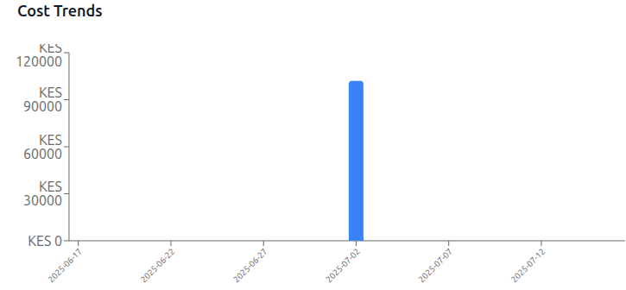
Cost Analysis& Optimization
Our system provides robust tools for tracking and optimizing treatment costs, enhancing financial sustainability for healthcare providers.
Track 2: Ovarian Cyst Growth & Treatment Prediction
PULP Optimization
We use the PuLP library to implement linear programming models, which systematically identify the most cost-effective resource allocation.
Treatment Cost Tracking: Detailed breakdown of expenses associated with various medical procedures and patient care.
Optimization Algorithms: Identifying opportunities to reduce operational costs without compromising quality of care.

Slide 8
Inventory Management: Ensuring Supply & Efficiency
Efficient inventory management is critical for operational excellence and patient safety, ensuring that essential medical items are always available.
Medical Item Tracking
Real-time monitoring of all medical supplies, from consumables to specialized equipment, preventing shortages.
Demand Forecasting
Predictive analytics to anticipate future needs for medical supplies based on patient trends and seasonal demands.
Cost Optimization Tools
Strategies and algorithms to minimize inventory holding costs and procurement expenses while maintaining optimal stock levels.
Track 2: Ovarian Cyst Growth & Treatment Prediction
System Activity Logs
Comprehensive logs of all user actions, system changes, and data access, ensuring accountability and security.

Slide 9







MEET OUR TEAM
ASHA MELIUS KISONGA
MLOps ENGINEER
PROJECT MANAGER
ALFREDA UHEGA
DATA SCIENTIST
PRODUCT MANAGER

