Slide 1
myService Module
Verion 1.0
myService an extend mode of Get-Service cmdlet
Author:
Badrane Derbazi
DocuWare ²⁰²²

Slide 2
01
02
Table of contents
03
04
00
myService
Whoa!
Why creating a new Cmdlets?
List of Functions
Overview of the function
The Module
How to use
What Next?
Idea for the next version

Slide 3

01
myService
Why creating a new Cmdlets?
Notes:
A Script module is a text file
PSM1 extension
Saved in a sub-Folder below the normal module folders
PSM1 file and the module folder names must be the same
The file contains function definitions and export directives

Slide 4
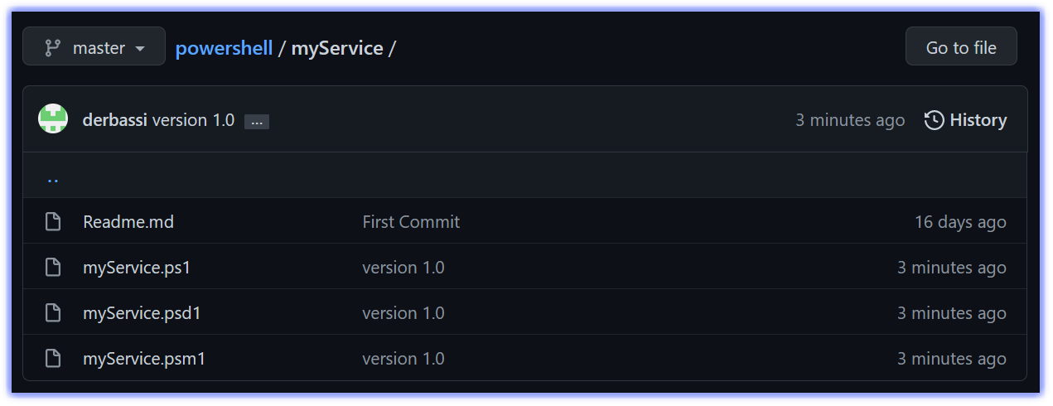
myService
myService will helps you to get not only the state of the service but also the Process ID, the Start Mode and Required / dependencies services.
The module contains Eleven (11) Cmdlets.
https://github.com/derbassi/powershell/tree/master/myService

Slide 5
Verb naming recommendation ?
Get, Start, Stop
Specifies an action that retrieves a resource
Initiates an operation
Discontinues an activity
Update
Modify the actual state
Verbs
Nouns
Export
Encapsulates the primary input into a persistent data store, such as a file, or into an interchange format.
Notes:
According to Microsoft verb naming recommendation https://docs.microsoft.com/en-us/powershell/scripting/developer/cmdlet/approved-verbs-for-windows-powershell-commands?view=powershell-7.2
I used the following verbs:
Get
Start
Stop
Change
Export

Slide 6
02
List of Functions
Overview of the functions
Notes:
Searching service(s) with a partial name and list Process ID, State, Start Mode
List of Services according to their mode of start-up
Changing StartMode from one state to another state
Get-MyService results exported to HTML Format
List all the running services with Process ID and State
Display the list of started services
Display the list of started services
Stop/Check a service
Start/Check a service
List of the service or services in which a particular service is required to it/them to run
Get the Service or Services in which a particular service depends to it/them to run

Slide 7
Get, Change, Export, Stop & Start
Get-MyService
Get-StartModeMyService
Get-AllMyRunningService
Get-AllMyStoppedService
Get-MyServiceProcessID
Get-MyRequiredService
Get-myDependentService
Update-MyServiceStartMode
Export-StartModeToHTML
Stop-MyService
Start-MyService
Notes:
Searching service(s) with a partial name and list Process ID, State, Start Mode
List of Services according to their mode of start-up
Changing StartMode from one state to another state
Get-MyService results exported to HTML Format
List all the running services with Process ID and State
Display the list of started services
Display the list of started services
Stop/Check a service
Start/Check a service
List of the service or services in which a particular service is required to it/them to run
Get the Service or Services in which a particular service depends to it/them to run

Slide 8

A picture is worth a thousand words

Slide 9
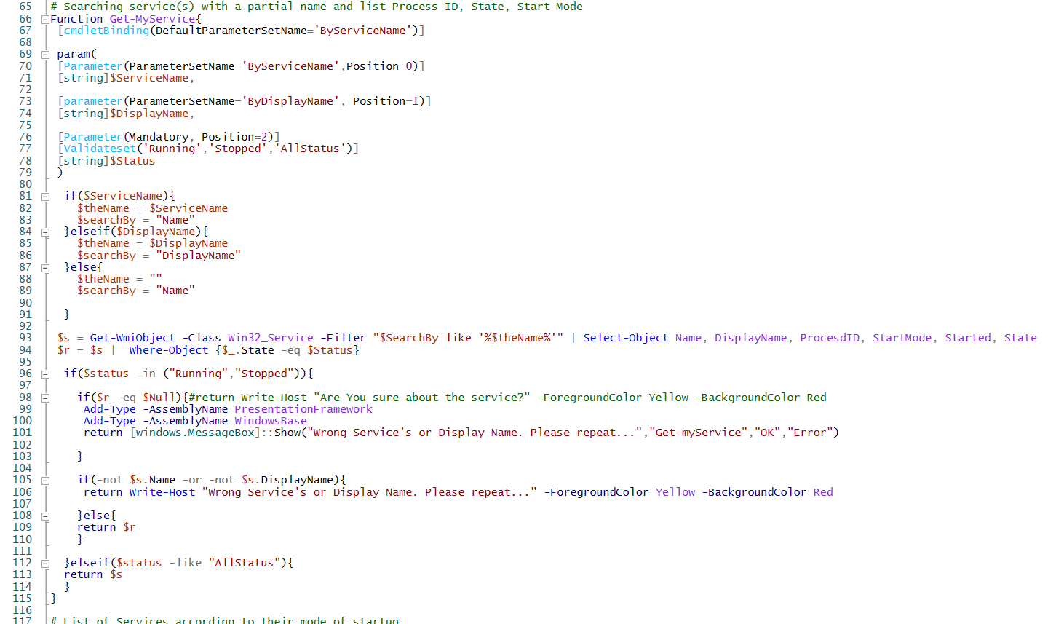
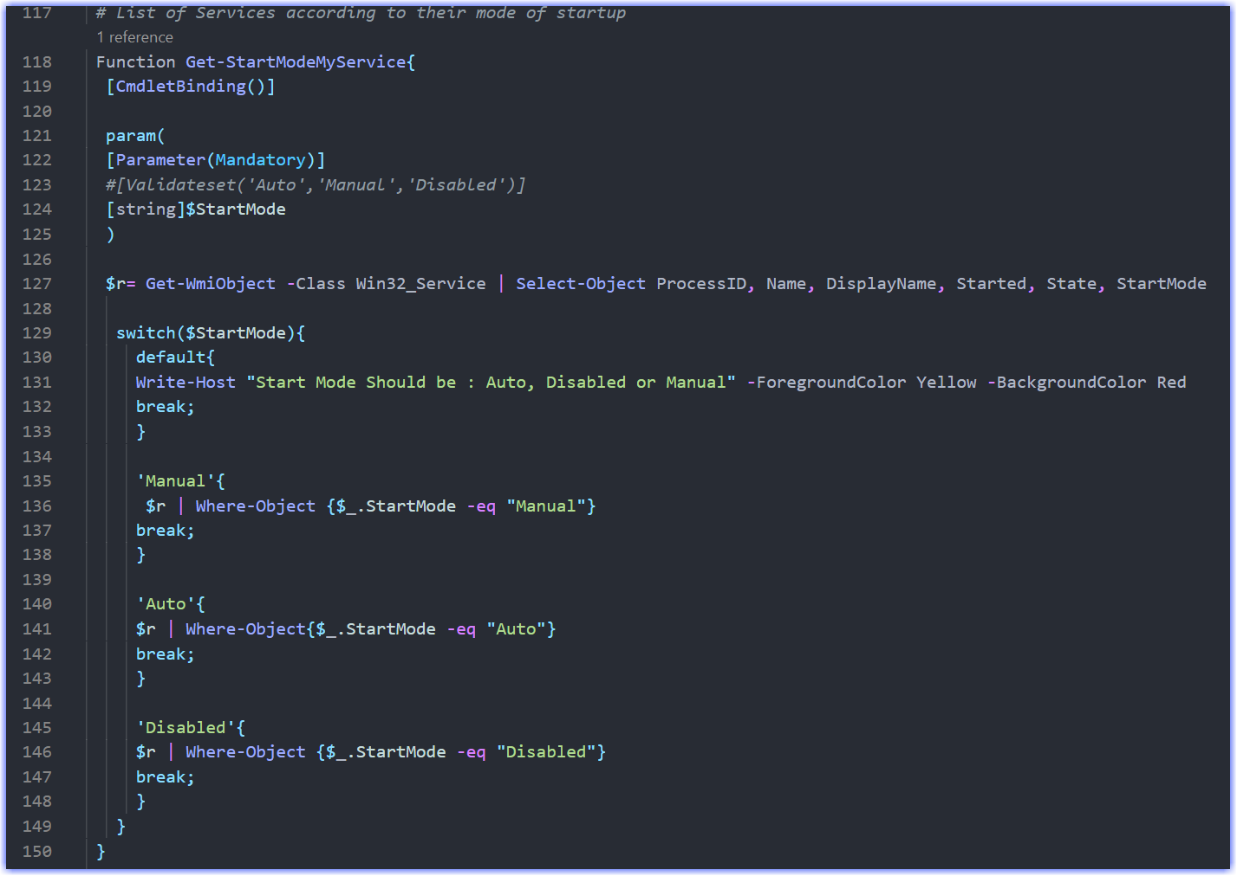
Get-MyService function
Get-StartModeMyService function

Slide 10
03
The Module
03
How to use
Notes:
Searching service(s) with a partial name and list Process ID, State, Start Mode
List of Services according to their mode of start-up
Changing StartMode from one state to another state
Get-MyService results exported to HTML Format
List all the running services with Process ID and State
Display the list of started services
Display the list of started services
Stop/Check a service
Start/Check a service
List of the service or services in which a particular service is required to it/them to run
Get the Service or Services in which a particular service depends to it/them to run

Slide 11

01
02
Move your folder under the PowerShell Home Folder
Import-Module Cmdlet
To import the new module
$env:PSModulePath
Notes:
Generate the manifest
New-ModuleManifest -path C:\Users\Administrator\OneDrive\Documents\WindowsPowerShell\Modules\myService.psd1 -Author 'Badrane DERBAZI' -CompanyName 'DocuWare' -RootModule 'myService.psm1' -FunctionsToExport @('Get-RegistryKey','Set-RegistryKey') -Description 'MyService Module'

Slide 12

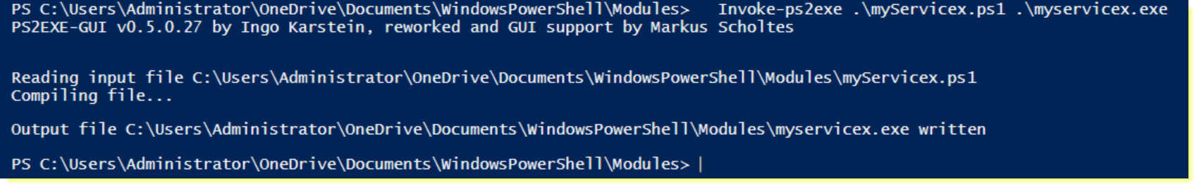
What Next?
Idea for the next version
04
GUI
.Net
XAML
Executable
ps2exe
Notes:
.Net form Example (source → https://bit.ly/3bSW282)
[void] [System.Reflection.Assembly]::LoadWithPartialName("System.Drawing")
[void] [System.Reflection.Assembly]::LoadWithPartialName("System.Windows.Forms")
$Form = New-Object system.Windows.Forms.Form
$Form.Text = "My Outlook Mailbox v1.3"
$Form.width = 330
$Form.height = 300
$Icon = New-Object system.drawing.icon("$FolderPath\outlook.ico")
$Form.Icon = $Icon
$form.StartPosition = "CenterScreen"
# CheckBox Sender
$cbx1 = New-Object System.Windows.Forms.CheckBox
$cbx1.Text = "Sender"
$cbx1.AutoSize = $True
$cbx1.Location = New-Object Drawing.Point 10,10
$Form.Controls.Add($cbx1)
$textfield1 = New-Object System.Windows.Forms.TextBox
$textfield1.Location = New-Object Drawing.Point 80,10
$textfield1.Size = New-Object Drawing.Point 180,30
$Form.Controls.Add($textfield1)
# CheckBox Replied
# This check Box can be combined with the others
$cbxRe = New-Object System.Windows.Forms.CheckBox
$cbxRe.Text = "Re"
$cbxRe.AutoSize = $True
$cbxRe.Location = New-Object Drawing.Point 270,12
$Form.Controls.Add($cbxRe)
# CheckBox Received Time
$cbx2 = New-Object System.Windows.Forms.CheckBox
$cbx2.Text = "Received Time"
$cbx2.AutoSize = $True
$cbx2.Location = New-Object Drawing.Point 10,40
$Form.Controls.Add($cbx2)
# Function Pick a Date 1
function pickDate1{
$form = New-Object Windows.Forms.Form
$form.Text = "Select a Date"
$form.Size = New-Object Drawing.Size @(243,230)
$form.StartPosition = "CenterScreen"
$Icon = New-Object system.drawing.icon("$FolderPath\outlook.ico")
$Form.Icon = $Icon
$calendar = New-Object System.Windows.Forms.MonthCalendar
$calendar.ShowTodayCircle = $False
$calendar.MaxSelectionCount = 1
$form.Controls.Add($calendar)
$OKButton = New-Object System.Windows.Forms.Button
$OKButton.Location = New-Object System.Drawing.Point(38,165)
$OKButton.Size = New-Object System.Drawing.Size(75,23)
$OKButton.Text = "OK"
$OKButton.DialogResult = [System.Windows.Forms.DialogResult]::OK
$form.AcceptButton = $OKButton
$form.Controls.Add($OKButton)
$CancelButton = New-Object System.Windows.Forms.Button
$CancelButton.Location = New-Object System.Drawing.Point(113,165)
$CancelButton.Size = New-Object System.Drawing.Size(75,23)
$CancelButton.Text = "Cancel"
$CancelButton.DialogResult = [System.Windows.Forms.DialogResult]::Cancel
$form.CancelButton = $CancelButton
$form.Controls.Add($CancelButton)
$form.Topmost = $True
$result = $form.ShowDialog()
if ($result -eq [System.Windows.Forms.DialogResult]::OK)
{
$date = $calendar.SelectionStart
$textfield2.Text = $date
}
}
# Function Pick a Date 2
function pickDate2{
$form = New-Object Windows.Forms.Form
$form.Text = "Select a Date"
$form.Size = New-Object Drawing.Size @(243,230)
$form.StartPosition = "CenterScreen"
$Icon = New-Object system.drawing.icon("$FolderPath\outlook.ico")
$Form.Icon = $Icon
$calendar = New-Object System.Windows.Forms.MonthCalendar
$calendar.ShowTodayCircle = $False
$calendar.MaxSelectionCount = 1
$form.Controls.Add($calendar)
$OKButton = New-Object System.Windows.Forms.Button
$OKButton.Location = New-Object System.Drawing.Point(38,165)
$OKButton.Size = New-Object System.Drawing.Size(75,23)
$OKButton.Text = "OK"
$OKButton.DialogResult = [System.Windows.Forms.DialogResult]::OK
$form.AcceptButton = $OKButton
$form.Controls.Add($OKButton)
$CancelButton = New-Object System.Windows.Forms.Button
$CancelButton.Location = New-Object System.Drawing.Point(113,165)
$CancelButton.Size = New-Object System.Drawing.Size(75,23)
$CancelButton.Text = "Cancel"
$CancelButton.DialogResult = [System.Windows.Forms.DialogResult]::Cancel
$form.CancelButton = $CancelButton
$form.Controls.Add($CancelButton)
$form.Topmost = $True
$result = $form.ShowDialog()
if ($result -eq [System.Windows.Forms.DialogResult]::OK)
{
$date = $calendar.SelectionStart
$textfield4.Text = $date
}
}
# Date 1
$button1 = New-Object Windows.Forms.Button
$button1.ForeColor = "Blue"
$button1.text = "Date 1"
$button1.Location = New-Object Drawing.Point 125, 35
$button1.Size = New-Object Drawing.Point 45,25
$button1.add_click({pickDate1})
$form.controls.add($button1)
$textfield2 = New-Object System.Windows.Forms.TextBox
$textfield2.Location = New-Object Drawing.Point 175,40
$textfield2.Size = New-Object Drawing.Point 113,40
$Form.Controls.Add($textfield2)
# Date 2
$button4 = New-Object Windows.Forms.Button
$button4.ForeColor = "Blue"
$button4.text = "Date 2"
$button4.Location = New-Object Drawing.Point 125, 65
$button4.Size = New-Object Drawing.Point 45,25
$button4.add_click({pickDate2})
$form.controls.add($button4)
$textfield4 = New-Object System.Windows.Forms.TextBox
$textfield4.Location = New-Object Drawing.Point 175,65
$textfield4.Size = New-Object Drawing.Point 113,40
$Form.Controls.Add($textfield4)
# CheckBox Importance
$cbx3 = New-Object System.Windows.Forms.CheckBox
$cbx3.Text = "Importance"
$cbx3.AutoSize = $True
$cbx3.Location = New-Object Drawing.Point 10,70
$Form.Controls.Add($cbx3)
# List of Importance Type 1, 2 or 3
$comboBox = New-Object System.Windows.Forms.ComboBox
$comboBox.Location = New-Object System.Drawing.Size(90,70)
$comboBox.Size = New-Object System.Drawing.Size(30,20)
$comboBox.Height = 29
[void] $comboBox.Items.Add("1")
[void] $comboBox.Items.Add("2")
[void] $comboBox.Items.Add("3")
$Form.Controls.Add($comboBox)
# CheckBox Subject
$cbx4 = New-Object System.Windows.Forms.CheckBox
$cbx4.Text = "Subject"
$cbx4.AutoSize = $True
$cbx4.Location = New-Object Drawing.Point 10,100
$Form.Controls.Add($cbx4)
$textfield3 = New-Object System.Windows.Forms.TextBox
$textfield3.Location = New-Object Drawing.Point 80,100
$textfield3.Size = New-Object Drawing.Point 180,30
$Form.Controls.Add($textfield3)
# CheckBox Everything
$cbx5 = New-Object System.Windows.Forms.CheckBox
$cbx5.Text = "Everything"
$cbx5.AutoSize = $True
$cbx5.Location = New-Object Drawing.Point 10,130
$Form.Controls.Add($cbx5)
# Unread Emails
$cbx6 = New-Object System.Windows.Forms.CheckBox
$Font = New-Object System.Drawing.Font("Arial",8,[System.Drawing.FontStyle]::Bold)
$cbx6.Font = $Font
$cbx6.Text = "Unread"
$cbx6.ForeColor = "Blue"
$cbx6.AutoSize = $True
$cbx6.Location = New-Object Drawing.Point 250,130
$Form.Controls.Add($cbx6)
### Function Get Outlook Messages
Function GetMyeMails{
$olFolders = “Microsoft.Office.Interop.Outlook.olDefaultFolders” -as [type]
$outlook = new-object -comobject outlook.application
$namespace = $outlook.GetNameSpace(“MAPI”)
$folder = $namespace.getDefaultFolder($olFolders::olFolderInBox)
$folder.items |
Select-Object -Property Subject, Importance, ReceivedTime, SenderName, UnRead, Body
# Show the Close Button
$form.controls.add($button3)
}
# Export Button
$button2 = New-Object Windows.Forms.Button
$button2.text = "Export"
$button2.Location = New-Object Drawing.Point 10,160
$button2.add_click({GetMyeMails})
$form.controls.add($button2)
# Label 1
$lbl1 = New-Object System.Windows.Forms.Label
$Font = New-Object System.Drawing.Font("Arial",8,[System.Drawing.FontStyle]::Bold)
$lbl1.Font = $Font
$lbl1.Text = "Combination:"
$lbl1.AutoSize = $True
$lbl1.ForeColor = "Blue"
$lbl1.Location = New-Object Drawing.Point 10,208
$Form.Controls.Add($lbl1)
# Label2
$lbl2 = New-Object System.Windows.Forms.Label
$Font = New-Object System.Drawing.Font("Arial",8,[System.Drawing.FontStyle]::Italic)
$lbl2.Font = $Font
$lbl2.Text = "* Sender && Received Time or Sender && Subject"
$lbl2.AutoSize = $True
$lbl2.Location = New-Object Drawing.Point 10,225
$Form.Controls.Add($lbl2)
# Label3
$lbl3 = New-Object System.Windows.Forms.Label
$Fon3 = New-Object System.Drawing.Font("Arial",8,[System.Drawing.FontStyle]::Italic)
$lbl3.Font = $Font
$lbl3.Text = "* Unread && Received Time or Unread Only"
$lbl3.AutoSize = $True
$lbl3.Location = New-Object Drawing.Point 10,240
$Form.Controls.Add($lbl3)
# Close Button
$button3 = New-Object Windows.Forms.Button
$button3.text = "Close"
$button3.ForeColor= "Red"
$button3.Location = New-Object Drawing.Point 230,160
$button3.add_click({$form.Close()})
# Show The Form
#$Form.Add_Shown({$Form.Activate()})
$Form.ShowDialog()

Slide 13
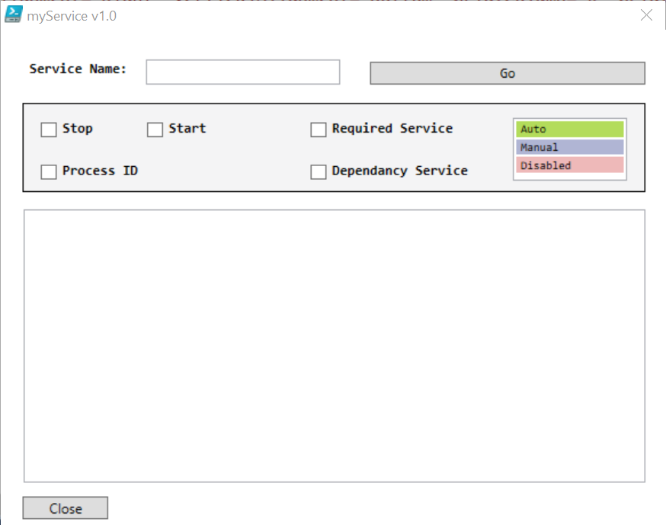
GUI
XAML
Export-StartModeToExcel
Delete-myService
GUI xaml or .Net
Notes:
myServicex.ps1
Add-Type -AssemblyName presentationframework
[xml]$xaml=@'
<?xml version="1.0" encoding ="utf-16"?>
<Window
xmlns="http://schemas.microsoft.com/winfx/2006/xaml/presentation"
Name="myService" Width="500" MinHeight="462" MinWidth="588" ResizeMode="NoResize" SizeToContent="Height" Title="myService v1.0" WindowStartupLocation="CenterScreen" Height="460.667">
<Grid Margin="0,0,4.667,21">
<Rectangle Fill="#FFF4F4F5" HorizontalAlignment="Left" Height="78" Margin="19,64,0,0" Stroke="Black" VerticalAlignment="Top" Width="545"/>
<Label Content="Service Name:" Width="107" Height="26" Margin="20,22,0,0" HorizontalAlignment="Left" VerticalAlignment="Top" Grid.Column="0" Grid.Row= "0" FontFamily="Consolas" FontWeight="Bold" />
<TextBox Width="170" Height="22" Margin="127,26,0,0" HorizontalAlignment="Left" VerticalAlignment="Top" Grid.Column="0" Grid.Row="0" />
<TextBox Width="544" Height="239" Margin="20,157,0,0" HorizontalAlignment="Left" VerticalAlignment="Top" HorizontalContentAlignment="Left" HorizontalScrollBarVisibility="Auto" IsReadOnly="True" Text="" VerticalScrollBarVisibility="Auto" Grid.Column="0" Grid.Row="0" FontFamily="Consolas" FontSize="10" />
<Button Name="Go" Content="Go" Width="241" Height="20" Margin="0,0,13.333,364" HorizontalAlignment="Right" VerticalAlignment="Bottom" Grid.Column="0" Grid.Row="0" RenderTransformOrigin="-0.796,0.283" FontFamily="Consolas" />
<CheckBox Content="Stop" HorizontalAlignment="Left" Margin="34,80,0,0" VerticalAlignment="Top" FontFamily="Consolas" FontWeight="Bold"/>
<CheckBox Content="Start" HorizontalAlignment="Left" Margin="127,80,0,0" VerticalAlignment="Top" FontFamily="Consolas" FontWeight="Bold"/>
<ListBox HorizontalAlignment="Left" Height="55" Margin="448,77,0,0" VerticalAlignment="Top" Width="100" FontFamily="Consolas" FontSize="10">
<ListBoxItem Content="Auto" Background="#FFB3DC5B"/>
<ListBoxItem Content="Manual" Background="#FFB0B5D4"/>
<ListBoxItem Content="Disabled" Background="#FFEEB9B9"/>
</ListBox>
<CheckBox Content="Process ID" HorizontalAlignment="Left" Margin="34,117,0,0" VerticalAlignment="Top" FontFamily="Consolas" FontWeight="Bold"/>
<CheckBox Content="Required Service" HorizontalAlignment="Left" Margin="270,80,0,0" VerticalAlignment="Top" FontFamily="Consolas" FontWeight="Bold" RenderTransformOrigin="0.472,0.267"/>
<CheckBox Content="Dependancy Service" HorizontalAlignment="Left" Margin="270,117,0,0" VerticalAlignment="Top" FontFamily="Consolas" FontWeight="Bold" RenderTransformOrigin="0.472,0.267"/>
<Button Name="Close" Content="Close" Width="75" Height="20" Margin="0,0,483,-16" HorizontalAlignment="Right" VerticalAlignment="Bottom" Grid.Column="0" Grid.Row="0" />
</Grid>
</Window>
'@
$myReader = (New-Object System.Xml.XmlNodeReader $xaml)
$myForm = [Windows.Markup.XamlReader]::Load($myReader)
$myForm.FindName("Close").add_click({
$myForm.Close()
})
$myForm.ShowDialog()

Slide 14
Tools
1- PowerShell ISE
2- Microsoft Visual Code
3- Microsoft Visual Studio 2019
4- ps2exe
5- SnagIt 2021
6- Git Bash
Notes:
https://github.com/MScholtes/PS2EXE
https://code.visualstudio.com/
https://visualstudio.microsoft.com/downloads/
https://www.techsmith.com/screen-capture.html
My Public PowerShell Repository
https://github.com/derbassi/powershell

Slide 15
Thank you!
Do you have any Questions?
badrane@derbazi.net

