Slide 1


Develop Game Project

Slide 2


“Tangkap Aku Pak”
Team List
YOPI RAGIL PERMANA PUTRA
DERBY PRAYOGO

Slide 3


Team List
Introduction
Concept
Extra Preparation
Tantangan Mengerjakan Project
Cerita Sukses
Dan lain-lain
Github Workflow
Demo
OUTLINE

Slide 4
INTRODUCTION

Slide 5
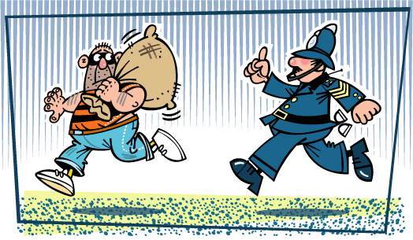
INTRODUCTION

Slide 6
CONCEPT

Slide 7
Concept
1. Generate Board
2. Character
3. Sound Effect

Slide 8
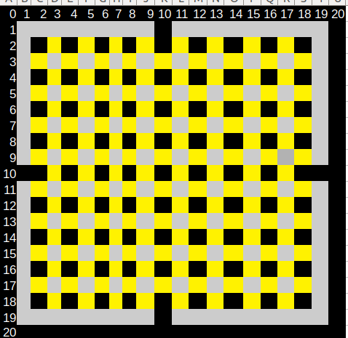
Generate Board
Random
Wall
Street

Slide 9


Character
Polisi
Maling

Slide 10
Code Concept
Audio
Character
Play
Generate Board
Button
Timer
Random board

Slide 11
EXTRA PREPARATION

Slide 12
Tantangan
Mengerjakan
Project
Ide game
styling
Coding

Slide 13
Cerita
Sukses
Game selesai

Slide 14
GIT WORKFLOW

Slide 15
Git Workflow
https://github.com/derbyps/gameDev/network
https://github.com/derbyps/gameDev/network

Slide 16
DEMO APLIKASI

