Slide 1
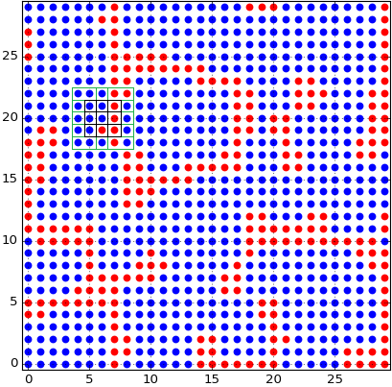
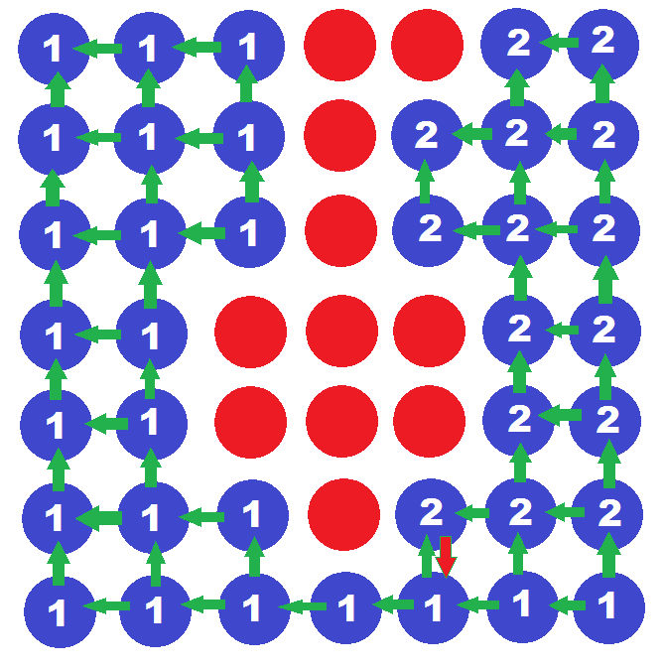
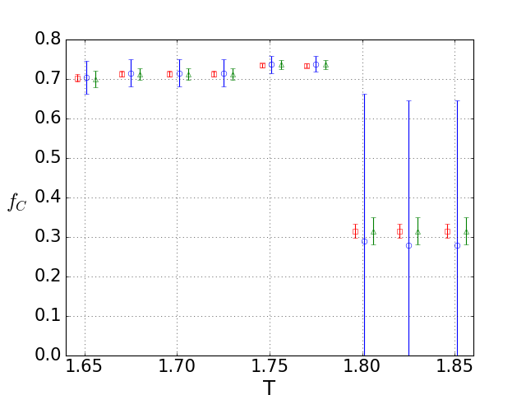
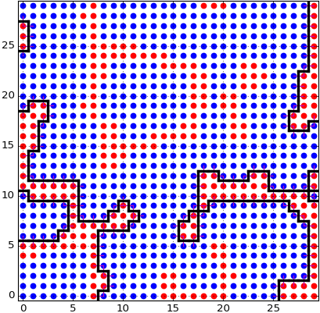

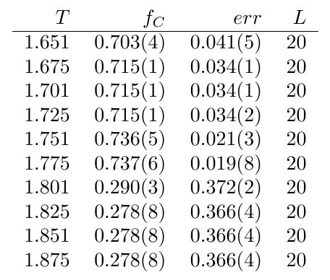
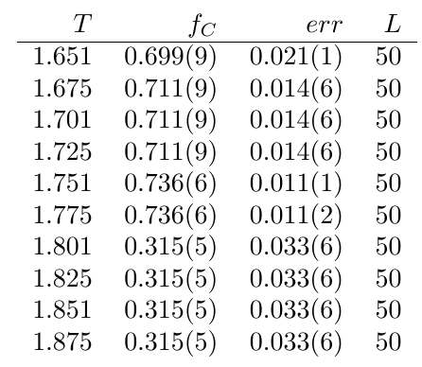
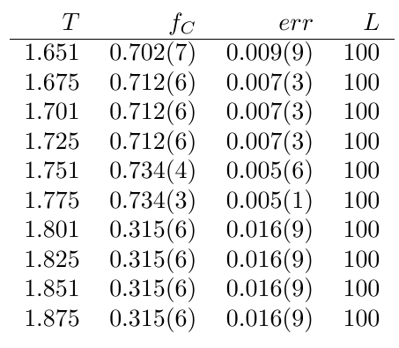
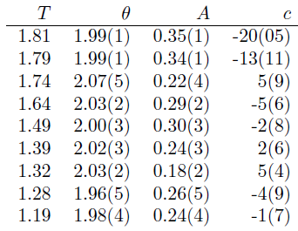
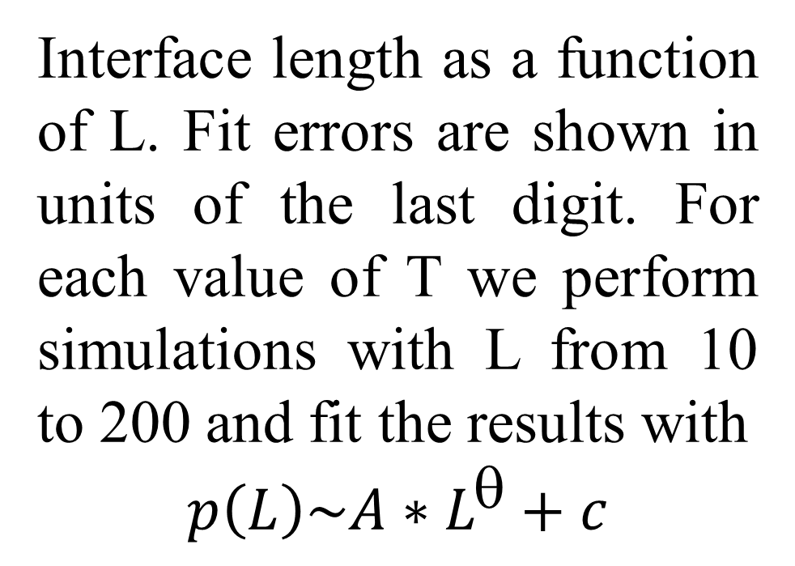
Algorithms for research critical parameters of Prisoner's Dilemma.
S.Kolotev, L.Shchur, E.Burovsky
This work is supported by the Russian Science Foundation (Project no.14-21-00158).
In this work we describe algorithms for investigating critical properties of
Prisoner's Dilemma model. They include consistent algorithm of the model, how it was parallelized,
Hoshen-Kopelman algorithm, boundary calculation algorithm and computation of statistics
Hoshen-Kopelman algorithm (HK76)
Standard PD model with two players.
T is parameter and maximum payoff from game
 | Сooperator | Defector
Cooperator | (1, 1) | (0, T)
Defector | (T, 0) | (0, 0)
…
Parallel version with OpenMP – each row
of the lattice processed by a thread.
Thread4
L[i] – numeric array of clusters, where i – cluster label
(number on a picture), and element of the array, number
of players = cluster size. Each check 2 neighbor player
and compare its label. If only one label – new player gets
this label, else cluster with larger label becomes a part of
less one and its size add to less label cluster. And size of
Large label is replaced by negative less label(it means
that one cluster merge into another – red arrow on picture).
Thread3
Thread2
Thread1
PD model with on square lattice with periodic boundary conditions.
Blue player– cooperator, Red player– defector. Strategy of the player in the center of black square in the next round will be the strategy of a player in the black square with maximum payoff from games with their neighbors.
Density of cooperators , as function of the payoff the lattice sizes 20x20 (blue circles), 50x50 (green triangles), and 100x100 (red squares). For clarity, triangles are shifted horizontally slightly to the left and squares are shifted to the right.
Interface length as a function of L. Fit errors are shown in units of the last digit. For each value of T we perform simulations with L from 10 to 200 and fit the results with
$$p\left(L\right)\sim {A∗L}^{θ}+c$$
Algorithms described in this work let us calculate valuable characteristics of PD model.
Using them we revealed curios results for example interface length as function of L.
These results will be useful for further research of PD model.
References:
1. R. Axelrod, W.D. Hamilton, The Evolution of Cooperation, Science, 211(4489), 1390 (1981).
2. see, e.g., R. Axelrod, The Evolution of Cooperation, Basic Books, 2006, and references therein.
3. M.A. Nowak and R.M. May, Evolutionary games and spatial chaos, Nature 359, 826 (1992).
4. M.A. Nowak and R.M. May, The spatial dilemmas of evolution, Int. J. Birurcation and Chaos 3(1), 35-78 (1993).

