Slide 1

SE 2226 Software Quality Assurance and Testing Project
1
Department: Software Engineering
Lecturer: Doç.Dr. Korhan Karabulut
Prepared By:
Arda Gürkan- 23070006096
Emir Ersan- 23070006057
Can Gere- 23070006047
Tibet Derebağ- 23070006024
23070006047@stu.yasar.edu.tr

Slide 2

OVERVIEW
2
1.Project Purpose & Tested Features
2. Black Box Techniques
https://tr.wikipedia.org/wiki/Dosya:Trendyol_online.png
23070006047@stu.yasar.edu.tr

Slide 3
Problem Purpose & Tested Features
3
Tested key user actions on Trendyol. (search, login, filter, placing an order)
Focused on verifying correct system behavior.
Black-box testing techniques were applied.
Test scenarios were based on user interaction flow.
23070006047@stu.yasar.edu.tr

Slide 4
BLACK BOX TECHNIQUES
4
23070006047@stu.yasar.edu.tr

Slide 5
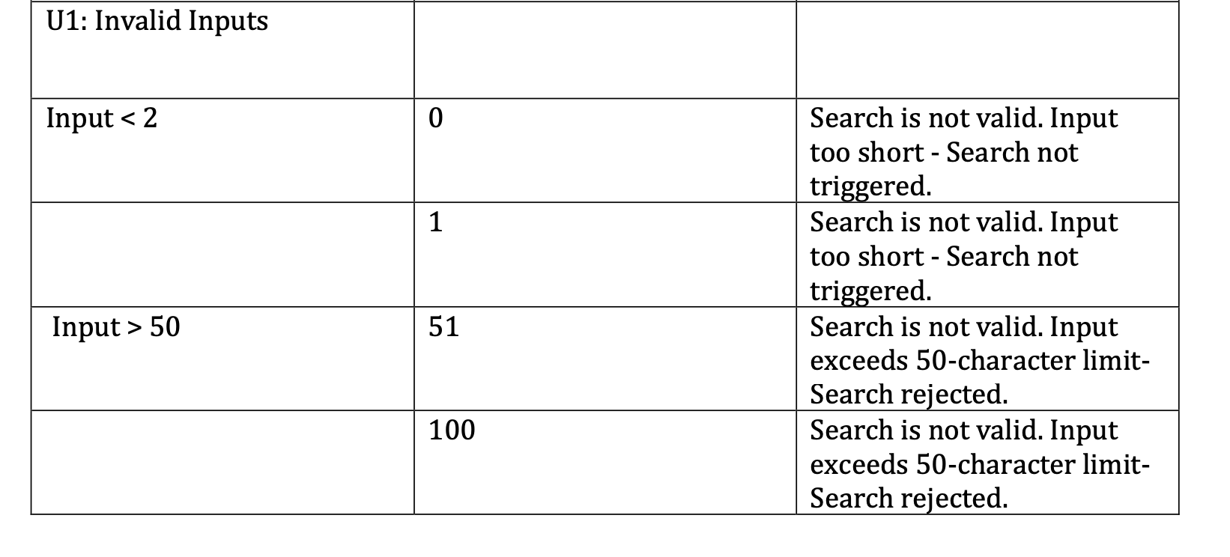
Boundary Value Analysis:
5
This test was conducted to verify the system's handling of minimum and maximum character limits.
23070006047@stu.yasar.edu.tr

Slide 6
Boundary Values Based On Character Count
6
2-4: Battery
5-10: Oil Mix
11-14: Lip oil–Tire Pressure Sensor
15-19: Mug
30-40: Car Gear Knob
41-50: “No products found”
23070006047@stu.yasar.edu.tr

Slide 7
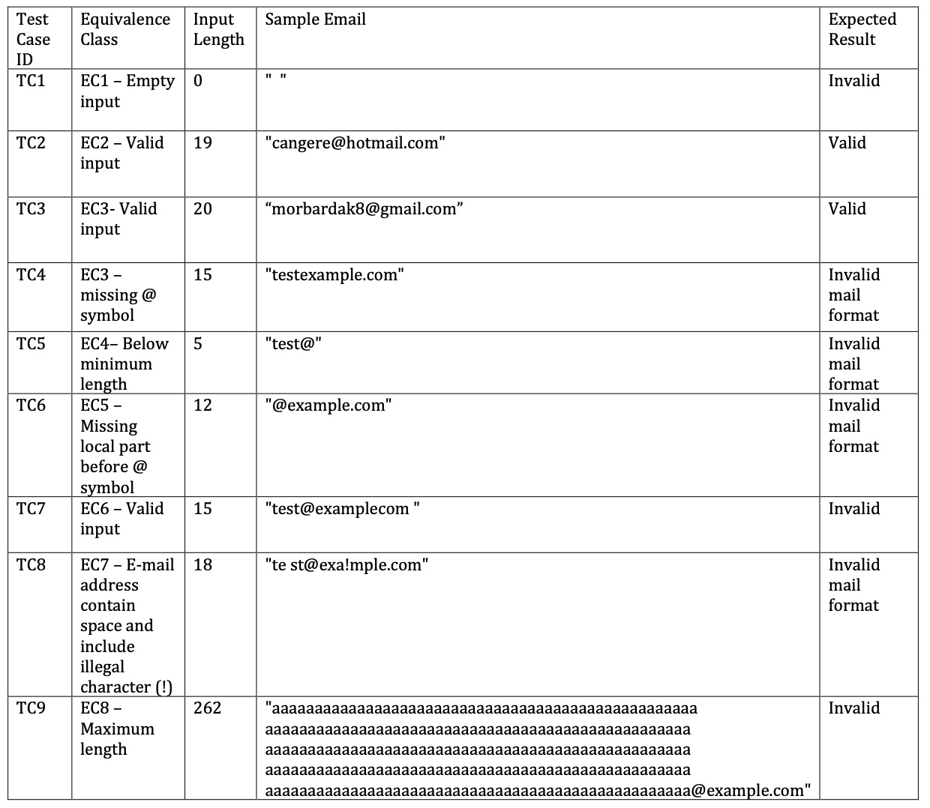
Equivalance Class Partitioning
7
This table represents Equivalance Class Partitioning for the email input field on Trendyol’s login page.It is based on character length constraints only.
23070006047@stu.yasar.edu.tr

Slide 8
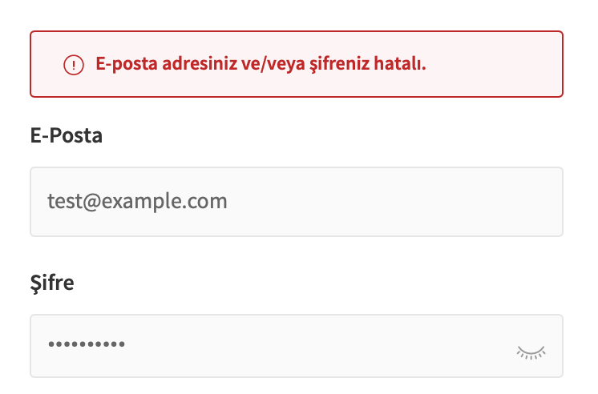
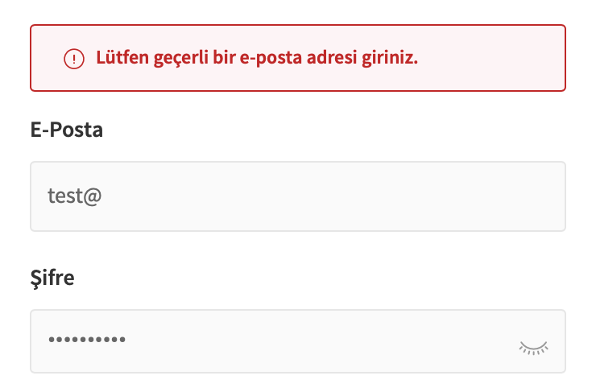
ERROR TYPES
8
VALID EMAIL FORMAT
1-In the first image, the email is in valid format which is why the system checks the credentials and shows a login error because the account doesn’t exists.
2-In the second the email is incorrect so the system immediately shows an error message about the invalid email.
https://www.trendyol.com/giris?cb=%2F
INVALID EMAIL FORMAT
23070006047@stu.yasar.edu.tr
https://www.trendyol.com/giris?cb=%2F

Slide 9
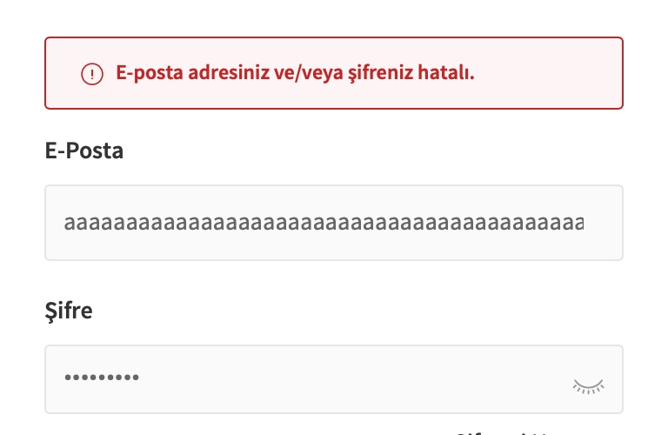
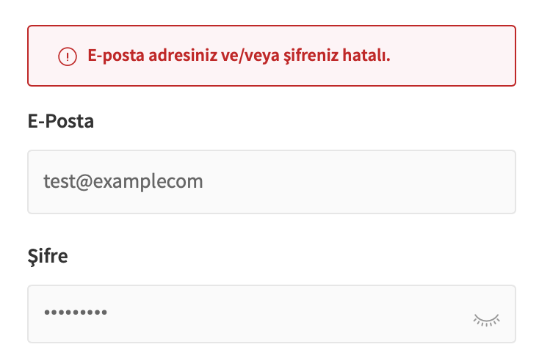
FAILED CASES
9
OVERLY LONG EMAIL
Invalid email formats were not correctly identified. System treated them as valid and showed a login error instead.
https://www.trendyol.com/giris?cb=%2F
EMAIL WITH NO DOT IN DOMAIN
23070006047@stu.yasar.edu.tr
https://www.trendyol.com/giris?cb=%2F

Slide 10
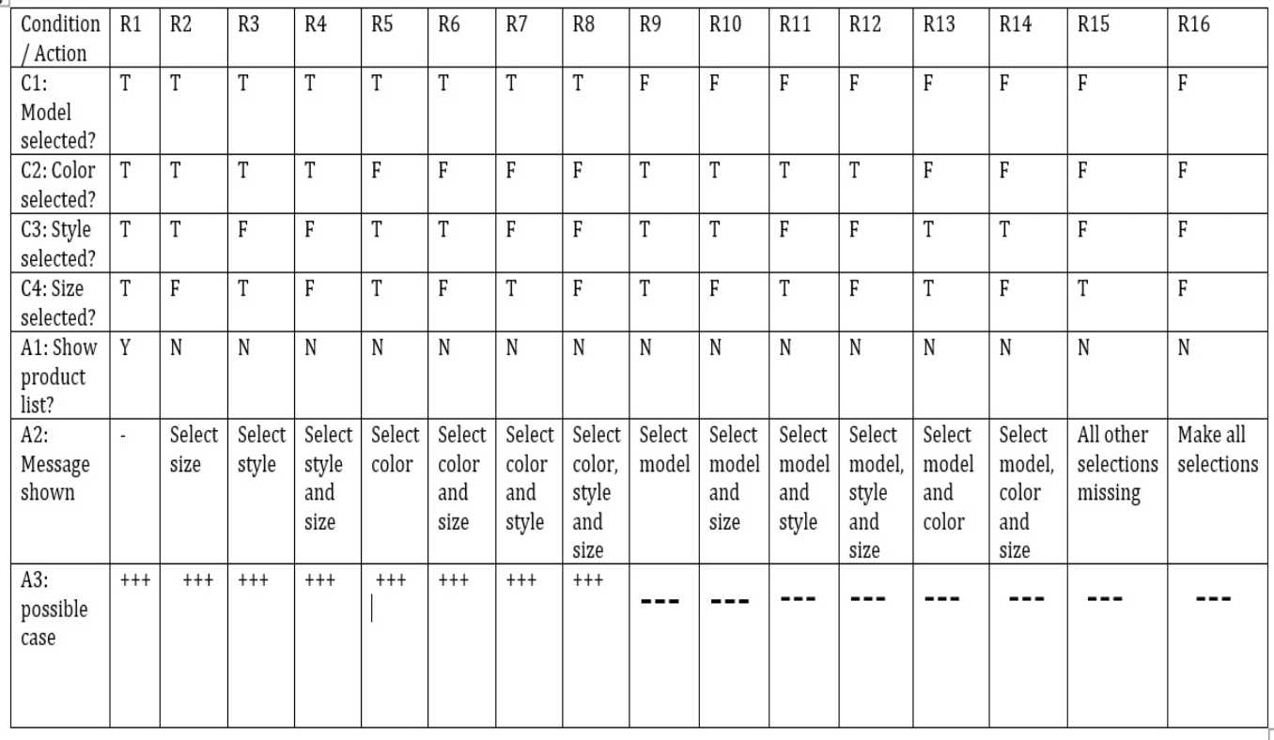
10
This decision table determines whether products will be listed based on user selections during the shoe filtering process on Trendyol.Conditions are listed in rows (short side),and rules (R1-R16) are listed in columns (long side) 2^4 =16 rules cover all combination
23070006047@stu.yasar.edu.tr

Slide 11
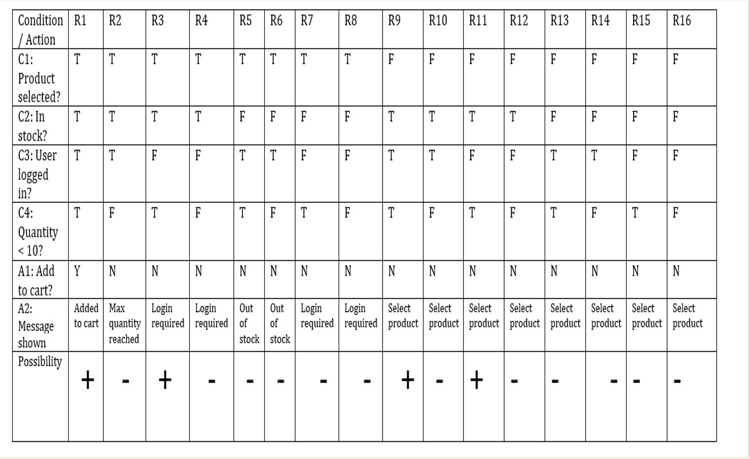
11
Unique combination of these conditions. Based on the inputs, the system provides appropriate actions such as adding the item to the cart, showing a message, or preventing the action. This helps systematically cover all possible cases and ensures correct system behavior under different scenarios.
23070006047@stu.yasar.edu.tr

Slide 12
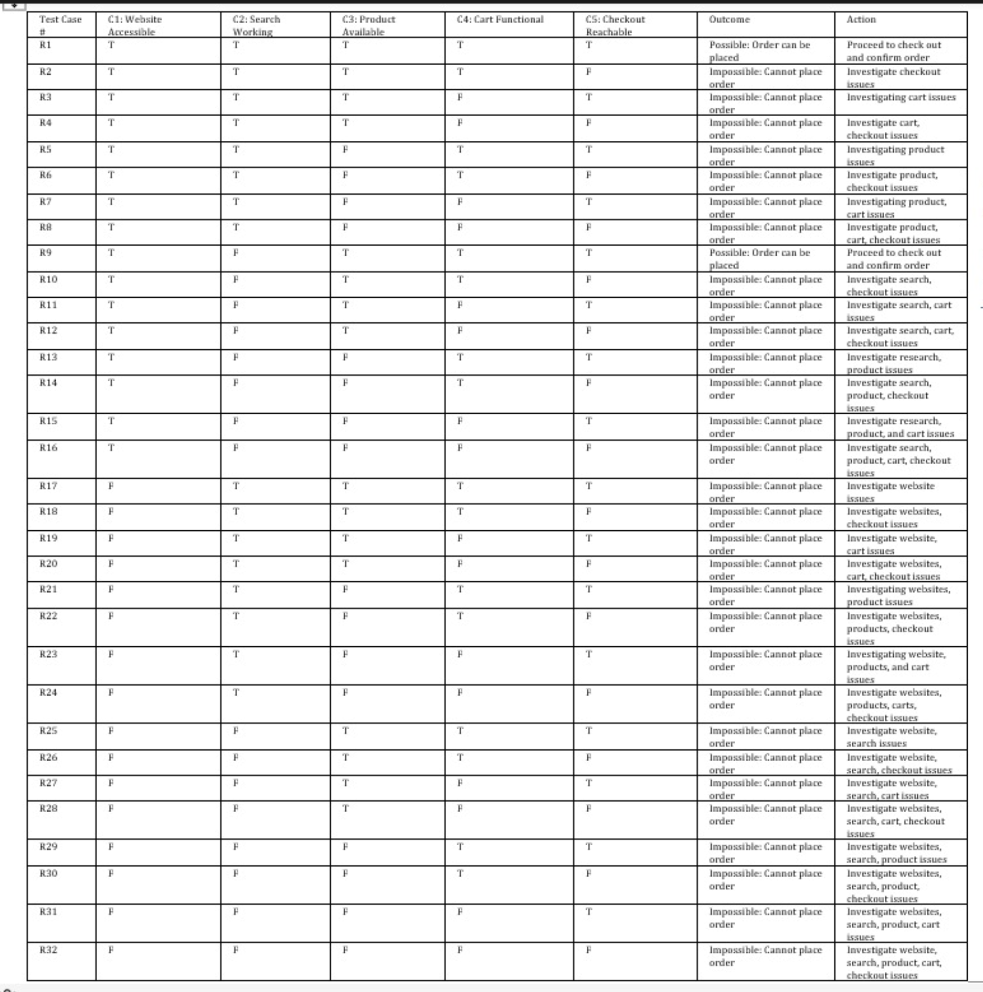
13
12
23070006047@stu.yasar.edu.tr

Slide 13
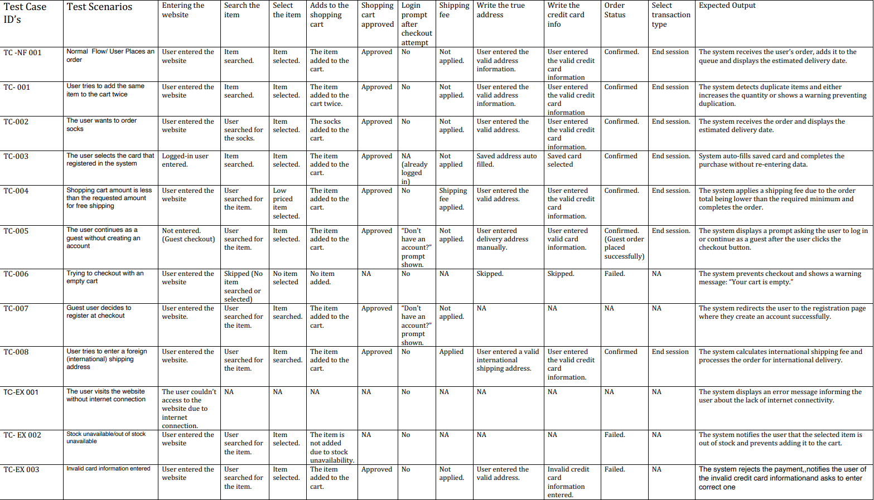
Use Case Test
13
23070006047@stu.yasar.edu.tr

Slide 14
THANK YOU FOR LISTENING ☺

Slide 15
ADDITIONAL VIDEOS

