Slide 1

PDE3413 Coursework 2
Presented by: Dereck Lam Hon Wah
(Call Centre Helper, n.d.)

Slide 2
PROBLEm to be solved ?
Numbers of burglaries and housebreaking are increasing, and rising more frequent these days.
Less than 30% of buildings have a reliable surveillance system and are 300% more likely to be robbed. (Homan, n.d.).
Unaffordable for low income owners and small businesses.

Slide 3
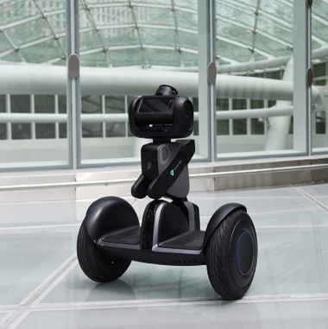
EXISTING SOLUTION
Nimbo, a new intelligent security robot that is both smart and economical .
Monitor, interact with, capture, and even chase burglars, they make use of a variety of technology.
LIDAR, videography, photography, artificial intelligence, machine learning, simultaneous location and mapping (SLAM), sensors, the Internet of Things, GPS, and other technologies are all included in these digital guardians (in.micron.com, n.d.).
Nimbo (hellonimbo.com, n.d.)

Slide 4
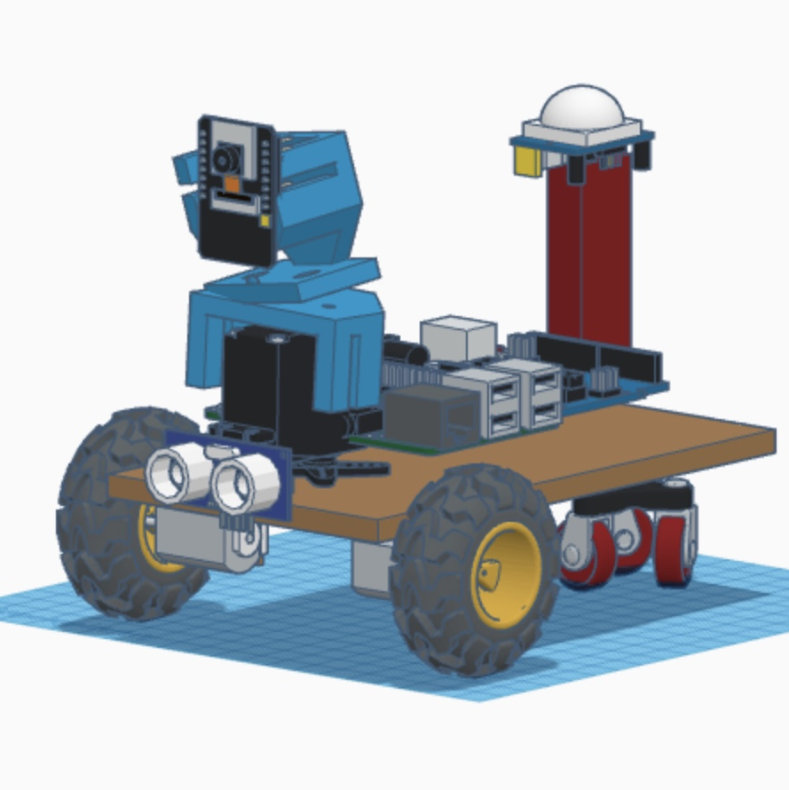
IMPLEMENTATION
AlarmBuzz, a low budget autonomous burglar detection robot.
Offers a way to combat the rising number of burglaries and housebreaking.
Designed with a vision sensor, uses a model of the environment, and detects intruders by employing its mobility and real-time monitoring capabilities.

Slide 5
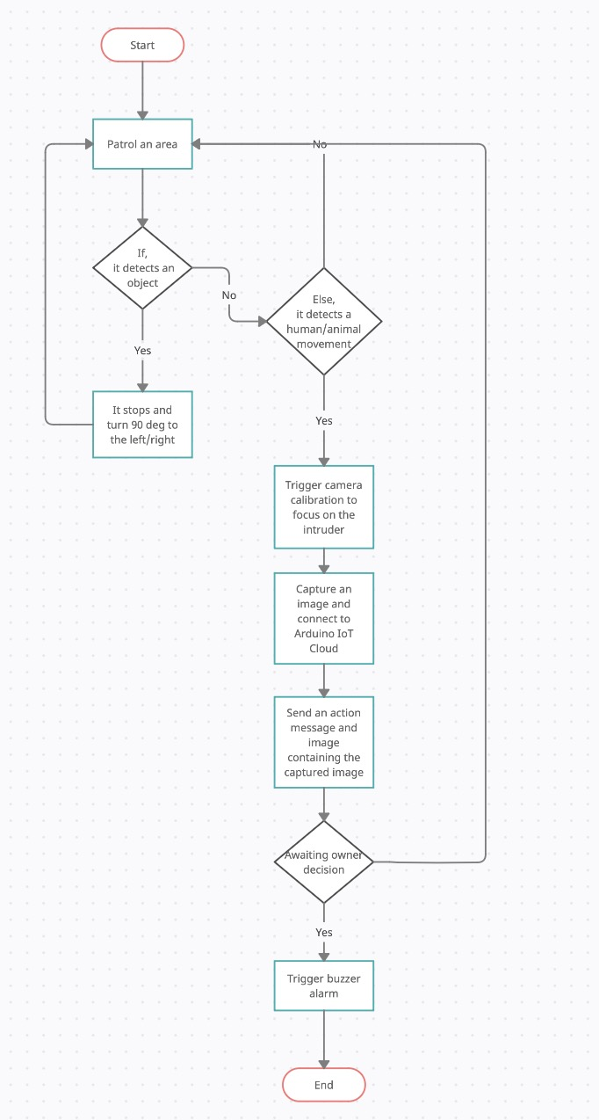
CONCEPTUAL BEHAVIOUR

Slide 6
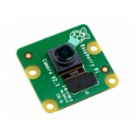
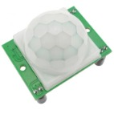
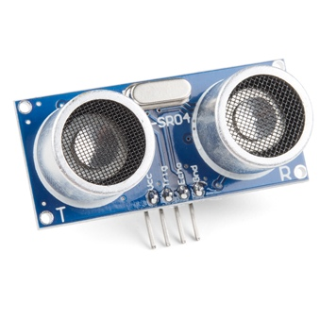
Sensors
ElectroPeak
HC-SR501
PIR Sensor
Ultrasonic
Distance
Sensor
HC-SR04
Raspberry pi
Camera v2
(grobotronics.com, n.d.)
(grobotronics.com, n.d.)
(Sparkfun.com, 2017)

Slide 7
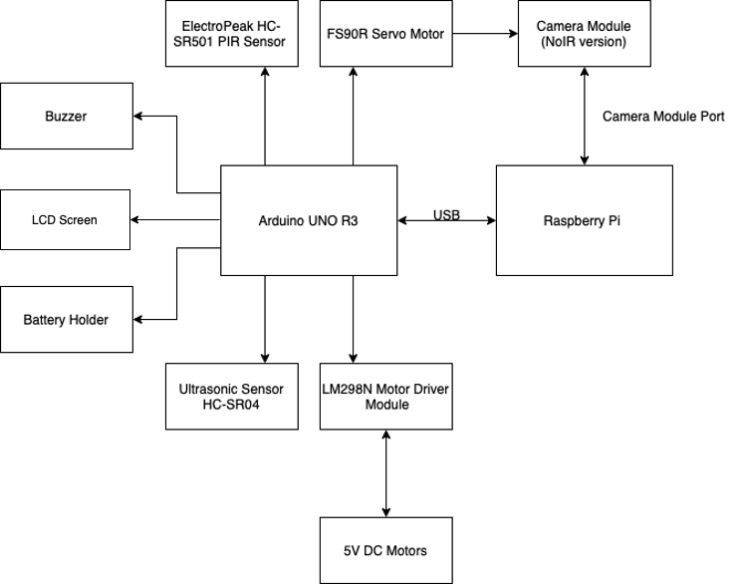
PHYSICAL ARCHITECTURE

Slide 8
Question ???

Slide 9
REFERENCE LIST
Call Centre Helper. (n.d.). What Is Robotic Process Automation? [online] Available at: https://www.callcentrehelper.com/robotic-process-automation-2-153272.htm [Accessed 8 Nov. 2022].
grobotronics.com. (n.d.). PIR Sensor Module - HC-SR501. [online] Available at: https://grobotronics.com/pir-sensor-module.html [Accessed: 17 Oct. 2022].
grobotronics.com. (n.d.). Raspberry Pi Camera Module V2 (8MP,1080p). [online] Available at: https://grobotronics.com/raspberry-pi-camera-module-v2-8mp-1080p.html [Accessed: 17 Oct. 2022].
Homan, R. (n.d.). Burglary Statistics 2022. [online] Bankrate. Available at: https://www.bankrate.com/insurance/homeowners-insurance/house-burglary-statistics/#stats. [Accessed: 15 Oct. 2022]
‌NBC News. (n.d.). Security robots expand across U.S., with few tangible results. [online] Available at: https://www.nbcnews.com/business/business-news/security-robots-expand-across-u-s-few-tangible-results-n1272421. [Accessed: 1 Nov. 2022]
Sparkfun.com. (2017). Ultrasonic Distance Sensor - HC-SR04 - SEN-15569 - SparkFun Electronics. [online] Available at: https://www.sparkfun.com/products/15569. [Accessed: 17 Oct. 2022]

