Slide 1

BAHIR DAR UNIVERSITY
BAHIR DAR INSTITUTE OF TECHNOLOGY
SCHOOL OF RESEARCH AND GRADUATE STUDIES
FACULTY OF COMPUTING
Automatic Amharic Word Sense Disambiguation at Sentence Level by Deep Learning Approach
MSc Thesis Presentation
By
Dereje Senay
Advisor : Tesfa Tegegne (PhD)
Bahir Dar, Ethiopia
June 2021

Slide 2
Outlines
Introduction
Statement of the Problem
Related Work
Design of the System
Experiment, Result and Discussion
Conclusion and Future Work

Slide 3
Introduction
__________________________________________________________________________
NLP is the essential part of computer science in which computational linguistics and machine learning are broadly used.
The Machine learns the syntax and semantics of human language; process and it gives the output to the user.
The task of identifying which sense of a word’s meaning is used in a sentence when the word has multiple meanings known as WSD.
WSD is the task of identifying the right sense or meaning of the word or phrase with respect to its context.

Slide 4
Amharic is a member of the Semitic language in the part of Afro-Asiatic family like that of Arabic and Hebrew its script inherited from Geez, its word size increase day to day.
Amharic has 34 base characters, resulting in a total of 238 = (7*33) Amharic characters.
It has complex morphological structure with SV/OV/SOV/OSV grammatical structure.
Example ልጁ ወደቀ/ lij u wedek’e the boy fell
Cont.
ኣዳኙ አንበሳውን ገደለው adany u ānibesa wini gedele wi
Sub suffix VERB
Sub suffix Object Suffix Verb suffix
አንበሳውን አዳኙ ገደለው/ ānibesa wini adany u gedele wi
root verb f-r-d+ ee + CVCVC leads to the stem ferede (‘judgment’)
O S V

Slide 5
Amharic Ambiguity
____________________________________________________________________
Ambiguity is a quality of any thought, idea, statement, or claim whose meaning, intention, or interpretation cannot be determined decisively by a set of rules or processes
Based on Amare(2000) there were six types of ambiguity.
Phonological ambiguity- interpretation of speech sounds within and across words. Example ስራ ስሩ ጥሩ ነው/various root are good or it is good to work
Lexical semantic ambiguity- Words that have several meanings might lead to various interpretations by various people. Categorical, homonymy, and homophone affixes
አክርማ ሰጠችኝ/ she gave me a type of color grass or she gave me for after a time delay

Slide 6
… Amharic Ambiguity
Structural ambiguity - structure has more than one possible place, structural ambiguity can occur
የጎጃም ገብስ ጠላ ሰጠችኝ/Beer made of barley from Gojjam
/Beer of barley from Gojjam/የገብስ ቢራ ከጎጃም
Referential ambiguity - Pronouns and antecedents are the same numbers, gender, and person/ካሳ ስለተመረቀ ተደሰተ
Semantic ambiguity - This type of ambiguity is caused by polysemic, idiomatic, and metaphorical constituents. Ex.መብራቱ ጠፋ
Orthographic ambiguity - The context can be used to deduce a word's intended meaning
Ex. መኪናው ይሰራል

Slide 7
Cont.
The task of WSD consists of selecting the intended meaning or sense from a pre-defined set of senses for that word in a given context.
We can take an example word ሀረግ/Phrase/ has three synsets, three glosses, and 8 relations of the word.
ሀረግ1: ከአጠገቡ በሚገኙ ዛፎችና ቋሚ ነገሮች ላይ እየተጠመጠመ እና እየተሳበ የሚያድግ እንደ ሃረግ ሬሳ፣ ጥሮ አይነት እጽዋት።/It grows like a corpse, like a corpse, twisting and pulling on nearby trees and shrubs./
ሀረግ2: ለጌጥ ሲባል በጥርብ እንጨት፣ በመጽሃፍትና ሐልውቶች ላይ እንደ ሃረግ እየተለጣጠፈ የሚሰራ ንድፍ።/Design for decorative wood carvings, books and statues./

Slide 8
Cont.
_____________________________________________________________________________
ሀረግ3: ሁለትና ከሁለት በላይ ቃላቶቸን የያዘ ማሰሪያ አንቀጽ የሌለዉ የአረፍተ ነገር ከፋይ።/A sentence without a binding paragraph containing two or more words./
Its relation used as a dataset for this research was
Hypernyms: እጽዋት በዛፎች ላይ የሚጠመጠሙ ሃረጎችንም ይይዛል።/It also contains phrases that are wrapped around trees./
Hyponymy: ሃረግ በዛፎች ላይ የሚጠመጠም የእጽዋት አይነት ነው።/Phrase is a type of plant that grows on trees./
As shown above example hypernymy “እጽዋት”/plant/ hyponymy “ሃረግ”/phrase/the family of phrase is plant.

Slide 9
Cont.
__________________________________________________________________________________________
WSD identified one of the three methods
Knowledge-based approaches use dictionaries while the supervised approaches are based on hand labeled data that are typically lexical samples.
unsupervised approaches use the information found in un-annotated corpora to distinguish the word meaning.
WordNet developed one of the three methods:
Semi-automatic approaches of WordNet development extend manually created training sets by large corpora of unlabeled data to improve WSD performance.
This research WordNet prepared by manual since, there were a lack of annotated Amharic corpora that contains ambiguous words

Slide 10
Related Work
No | Authors | Title | Year | Method | Gap
3 | Bekeli | A Generic Approach towards All Words Amharic Word Sense Disambiguation | 2017 | Generic approach/Lesk algorithm | algorithm includes multiple words having multiple senses are considered at once problem.
5 | Du, et al. | Using BERT for Word Sense Disambiguation | 2019 | ELMo, GPT,BERT | Need pre-trained data and SemCor
6 | Mulugeta | Word Sense Disambiguation for Amharic Sentences using WordNet Hierarchy | 2019 | Context-to-gloss overlap and Augmented semantic space | Augmented semantic space is highly dependent on the number of words that exist in the WordNet. The wordnet didn’t consider antonyms, homonymy, troponymy, and holonomy relation of the words
4 | Getaneh | Amharic WordNet construction Using Word Embedding | 2020 | word embedding (CBOW and skip-gram) | Didn’t include the meronym, holonomy, and troponymy relation of the word.

Slide 11
Statement of the Problem
______________________________________________
Due to lack of resources like WordNet and SemCor and morphological complexity disambiguation is very difficult task in Amharic.
Recent work (Mieraf, 2019) done on WSD at sentence level by context to gloss overlap method.
augmented semantic space is highly dependent on the number of words that exist in the WordNet.
Context-to gloss overlap is only effective for short sentences due to short sentences have a smaller number of context words which makes the frequency count smaller.

Slide 12
Cont.
_______________________________________________________
Semantic similarity method had a problem of two concepts that have the same path length have similar distances; even though those have different meanings.
semantic similarity would be impracticable to implement because it consumes much more memory and is unable to update the model with the additional text corpus without re-training from the beginning.
Didn’t take into account antonym, homonymy, troponymy, and holonomy lexical relations of the ambiguous words.

Slide 13
Research Questions
___________________________________________
This study attempts to answer the following research questions.
RQ1: Can we use a Bidirectional LSTM network for Amharic word sense ambiguity
problem?
RQ2: Which hyperparameter/s more influence automatic Amharic word sense
disambiguation model during training?
RQ3: Which deep learning approach is effective for Amharic word sense Ambiguity
problem?
RQ4: To what extent Bi-LSTM network disambiguates Amharic ambiguous words?

Slide 14
Objectives of the Research
______________________________________________
The general objective of this research is to design Automatic Amharic word sense disambiguation system by using deep learning.
To achieve the general objective, we designed the following specific objectives.
To prepare a dataset with its relation in Amharic ambiguous words.
To review related works on word sense disambiguation and literature reviews.
To design Amharic WordNet.
To design an automatic word sense disambiguation model.
To test and evaluate Bi-LSTM model using a prepared dataset

Slide 15
Scope and limitation of the study
_______________________________________________________________
The study limited on synonym, hyponymy, hypernymy, meronomy, antonym, holonomy, troponomy, and homonymy of given word lexical relations occurred Lexical, semantic and orthographic ambiguity.
However, two types of meronymy relations of a single word the substance and entailment, and
Structural, phonological and referential ambiguity
would not the part of this research because of Amharic WordNet resources and pre-trained data constraint (limitation).

Slide 16
Significance of the study
_________________________________________________________________________________
The result produces experimental evidence demonstrated on bidirectional long short-term memory (BI-LSTM) for the development of an automatic Amharic WSD model.
The study useful for future researchers and the dev.'s of different NLP application
Information Extraction
Machine Translation
Information Retrieval
Event Extraction
Speech processing

Slide 17
Methodology
_______________________________________________________
In this study, we will follow design science six steps to achieve the desired objective.
Problem, objective, design and dev.t, Demonstration, evaluation and communication
Dataset preparation: The dataset preparation for this research started by finding 159 ambiguous words within 460 glosses prepared in the WordNet.
2164 sentences prepared for training, 0.1 validation and 0.1 sentences for testing.
Those sentence reviewed by the acknowledge experts which is taken both were agree.
Source:- Amharic news, magazines, Amharic dictionaries, online Amharic sketch engines.
Preprocessing – Tokenization, stop-word removal, normalization, stemming

Slide 18
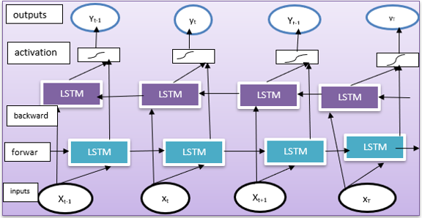
…Algorithm: Bi-LSTM
Figure 1: Bi-LSTM internal structure

Slide 19
Lexical Relations
Synonymy refers to the existence of terms with closely related meanings
Ex: Ambiguous word ሸቀሸቀ/Merchandise/ with its synonym meaning within the context ነዘነዘ፣ አመመ/It hurts, it hurts/
Hypernym-Hyponym: a semantic relationship between a generic and unique word is represented by hyponymy. Class and sub-class are defined by hypernym and hyponym, respectively
Example: የተሾመው ጠጅ በቤት ውስጥ ከሚዘጋጁ መጠጦች አንዱ ነው/Wine is one of the most popular home-made drinks/- Hyponym from the ambiguous word ሾመ(hyponym) is a kind of Hypernym since it’s the largest class and member relationship. Hyponym of መጠጥ is ጠጅ(member)
Meronym-Holonomy-part of a whole is called a meronymy and the whole of a part is called a
holonomy

Slide 20
…Lexical Relations
Meronomy 1 - ጠላ የተሾመበት እንስራ ጆሮ ተበጠሰ/the jar of the appointed jar is
broken/Meronomy of ጆሮ(part) is እንስራ(whole).
Antonymy is a lexical relationship between word forms, not a semantic relationship. Different types of opposites; Gradation, Markedness, Converses
Antonym 2 - ቀለመ ለሚለው ቃል ተቃራኒው ለቀቀ ነው/the opposite is true of the word color
Homonym Relations- Homonym is a relationship that exists between lexemes that have the same word form but are not semantically related.
Toponym Relations- Troponym is a particular kind of entailment that involves temporal co-extensiveness for the two verbs
Troponym 1- የተገፋው ሳንቃ በር ተቀረቀረ።/The pushed wooden door is locked

Slide 21
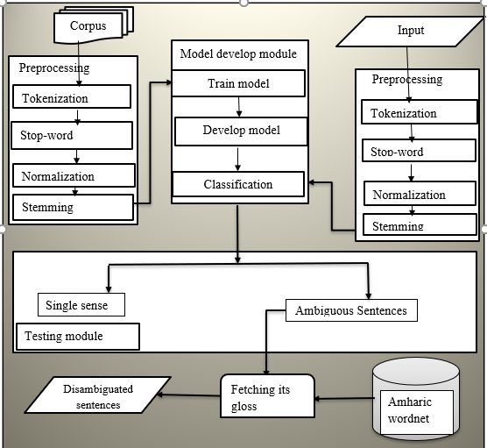
Model Building
Figure 2: The general outflow Proposed Automatic WSD System Architecture

Slide 22
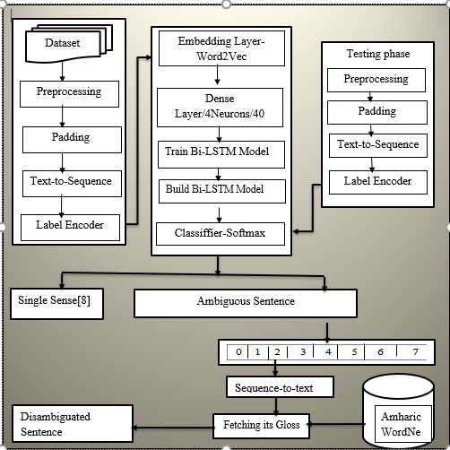
Bi-LSTM Model for WSD
Figure 3: The proposed WSD system Architecture

Slide 23
Hyperparameter Selection
__________________________________________________________________________
The goal of Hyperparameter Optimization (HPO) is to automate the hyperparameter tuning process and enable users to apply machine learning models to real-world issues.
To find ideal hyper-parameters, it's critical to use the right optimization methodology.
There were a number of hyperparameter selection algorithms from thus we used random search algorithm.
It works on finding the best fit hyperparameter by a number of trial based on the given dataset.

Slide 24
Hyperparameters of the experiment
Hyperparameters | Experiment 1 | Experiment 2 | Experiment 3
Random state | 0 | 10 | 42
Optimizer | SGD | Nadam | Adam
Activation | tanh | ReLU | GELU
Regularize |  |  | L2(0.001)
Batch size | 32 | 16 | 8
Dropout | 0.1 | 0.2 | 0.39
Number of Neurons | 100 | 60 | 40
Dense layer | 7 | 5 | 4
Constant Hyperparameters | Emb =Word2vec Split ratio = 0.1 Epochs = 10 | Emb = Word2vec Split ratio = 0.1 Epochs = 10 | Emb = Word2vec Split ratio = 0.1 Epochs = 10
LSTM | 88% | 82% | 94%
CNN | 88% | 88% | 91%
Bi-LSTM | 94% | 89% | 96%

Slide 25
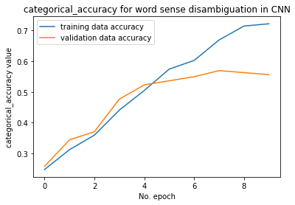
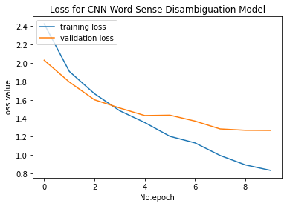
Experimental Result of CNN model
Figure 4 shows the training accuracy and validation accuracy of CNN model on automatic Amharic word sense disambiguation problems. This result was better than the remaining experiments of CNN, its validation accuracy and training accuracy gone in the same way without much difference.
Figure 4: Training Accuracy with Loss of CNN Model

Slide 26
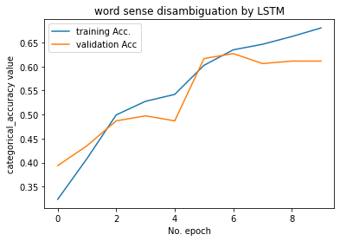
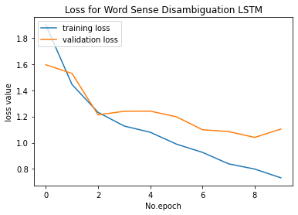
Experimental Result of LSTM model
Training and validation accuracy of LSTM model has good performance as the result presented. The model validation and training accuracy gone on parallelly.
Figure 5: Training Accuracy with Loss of LSTM Model

Slide 27
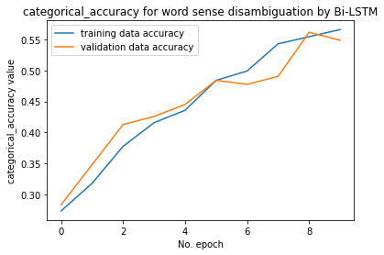
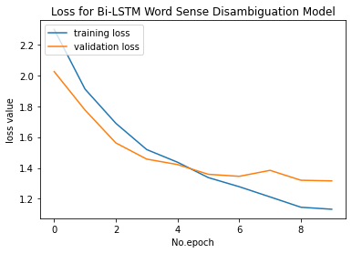
Experimental Result of Bi-LSTM model
During this experiment, the training accuracy, and validation accuracy distribution in solving Amharic word sense disambiguation problems which one outperforms from the three experiments displayed by the curve.
Figure 6: Training and validation Accuracy and loss of Bi-LSTM Model

Slide 28
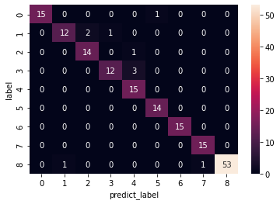
Confusion matrix of Bi-LSTM Model and Error Analysis
Figure 7: Confusion Matrix of Bi-LSTM Model

Slide 29
… Error Analysis
The error analysis of this model by MSE, MAE, and RMSE calculated and interpreted in the following way,
MSE = ((15-15)2+(12-13)2+(14-16)2+(12-13)2+(15-19)2+(14-15)2+(15-15)2+(15-16) 2+(53-53)2)/9
= (0+1+4+1+16+1+0+1+0)/9
= 24/9
= 2.6 RMSE=√MSE
RMSE= √2.6
= 1.6
Mean square error gives a positive value for every error since the error is an error and given attention or more weight for larger differences. Since the smaller the mean squared error, the closer fit is to the data point.
MAE = 1/9(|15-15|+|12-13|+|14-16|+|12-13|+|15-19|+|14-15|+|15-15|+|15-16|+|53-53|)
= 1/9(0+1+2+1+4+1+0+1+0)
= 1/9(10)
= 1.11, this result implies an average of 1.11 rate miss classified from every 9 classes.

Slide 30
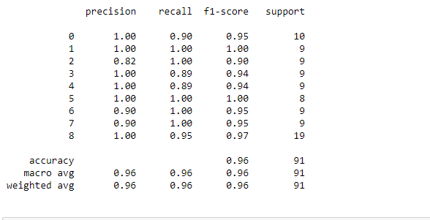
Cont.
_______________________________________________________
Since, our model performance measured on performance metrics (precision, recall and f1-score). The following table shows an average performance of Bi-LSTM model on three experiments.
Figure 8 : performance of Bi-LSTM model on Amharic WSD

Slide 31
The overall performance of the three models
Figure 9: Three Deep Learning Algorithms Performance on Amharic WSD

Slide 32
The Comparison Results in the Previous Amharic WSD Model and our Model
Authors | Approach | Size of dataset | Accuracy
Mulugeta et al. 2019 | Knowledge base (context overlap and augmented semantic space) | 17 words and 350 sentences for testing only | 80% accurate
Our Experiment | Deep learning (Bi-LSTM) | 159 words, 460 synsets, and 2164 sentences for testing and training | 96% accurate
The research comparison has been done due to problem similarity but the model and dataset strictly differ.

Slide 33
Conclusion
_______________________________________________________________
According to the results, LSTM, CNN, and Bi-LSTM obtained 88 percent, 89 percent, and 93 percent average accuracy during the three experiments, respectively.
Bi- LSTM, rather than the other models, obtained the state-of-the-art outcome by obtaining 96 percent accuracy, according to the experimental results. Besides, we used a Bi-LSTM model for solving Amharic ambiguity problems.
The preparation of sentence datasets and language resource constraints, such as SemCor of Amharic, were also obstacles in this study.
Even though the dataset and models were different, the research outperformed earlier studies by 16 percent.

Slide 34
Future work
_____________________________________________________________
The substance of and entailment members of meronomy were not handled in this study. So, we recommended the following points in the study:
Designing automatic Amharic word sense disambiguation model which includes the two meronomy relations the substance of and entailment.
Designing Amharic word sense disambiguation model that considers structural ambiguity, phonological ambiguity, and referential ambiguity.
Designing Automatic word sense disambiguation model by using contextual embedding by using BERT without WordNet by applying transfer learning.

Slide 35
Contribution of this Research
_____________________________________________________________________
The designed LSTM, CNN, and Bi-LSTM; those are useful for the classification of Amharic word sense ambiguity problems.
The study designed the first model an automatic Amharic word sense disambiguation model by deep learning approach by using WordNet.
We could take into account antonymy, toponymy, holonomy, and homonymy relations or senses of ambiguous words not covered by the other researchers.

Slide 36
... Contribution of this Research
_______________________________________________________________
Dataset was 2164 Amharic sentences and Amharic WordNet which has 460 glosses in 159 ambiguous words by itself because of containing 8-word relations that were useful for disambiguating ambiguous words for different NLP applications.
We developed word2vec word embedding models that handle the vocabulary and context by CBOW within a size of 29.8 MB 310,138 sentences within 378,797 vocabulary size as embedding layers.

Slide 37
Thank you!!!

