Slide 1
Untitled
Derek Corcoran

Slide 2
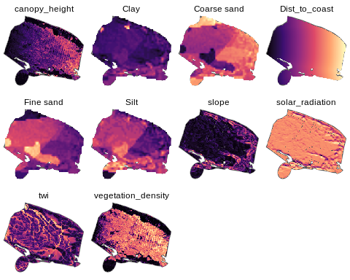
Variables Husby

Slide 3
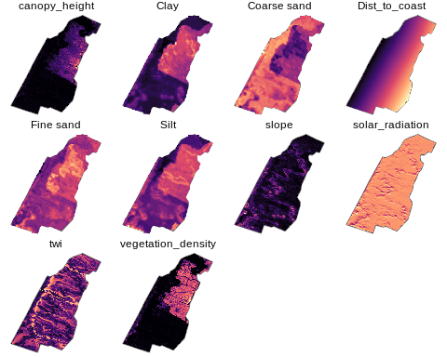
Variables Trojborg

Slide 4
Optimal strata
Used Simple Structure Index to determine optimal Strata
Between 2 and 10 groups, 100 iterations
9 groups Husby, 5 groups Trojborg

Slide 5
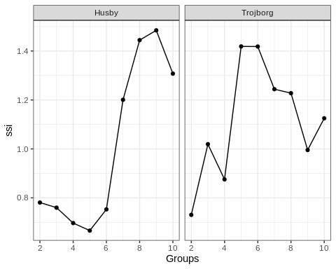

Slide 6
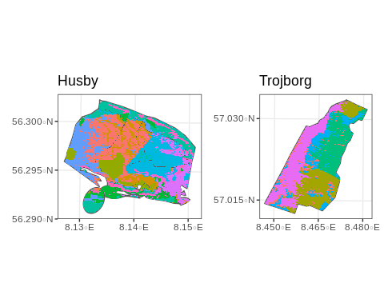
Groups

