Slide 1
Railway Ticking System

Slide 2
Outline
General Illustration
Database Design
Back-End
Front-end
Demo
Summary

Slide 3
General Illustration
RTS(Railway Ticking System) is to simulate a real-time system to help user book railway tickets online
Actors:
USER: Login/out, search, buy, refund and check history
ADMIN: Login/out, add/change tickets

Slide 4
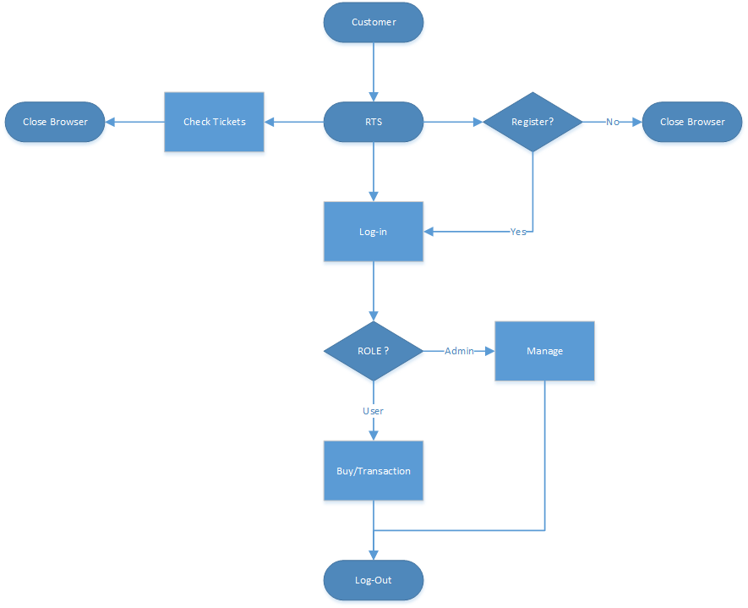

Slide 5
Outline
General Illustration
Database Design
Back-End
Front-end
Demo
Summary

Slide 6
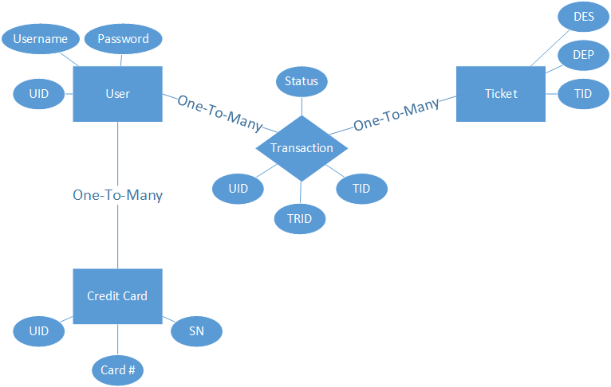
Database Design

Slide 7
Database Design
Connect to Oracle
JNDI
SessionFactory Bean
Annotation
Pure annotation mapping
Hibernate Dao
Generic Methods

Slide 8
Outline
General Illustration
Database Design
Back-End
Front-end
Demo
Summary

Slide 9
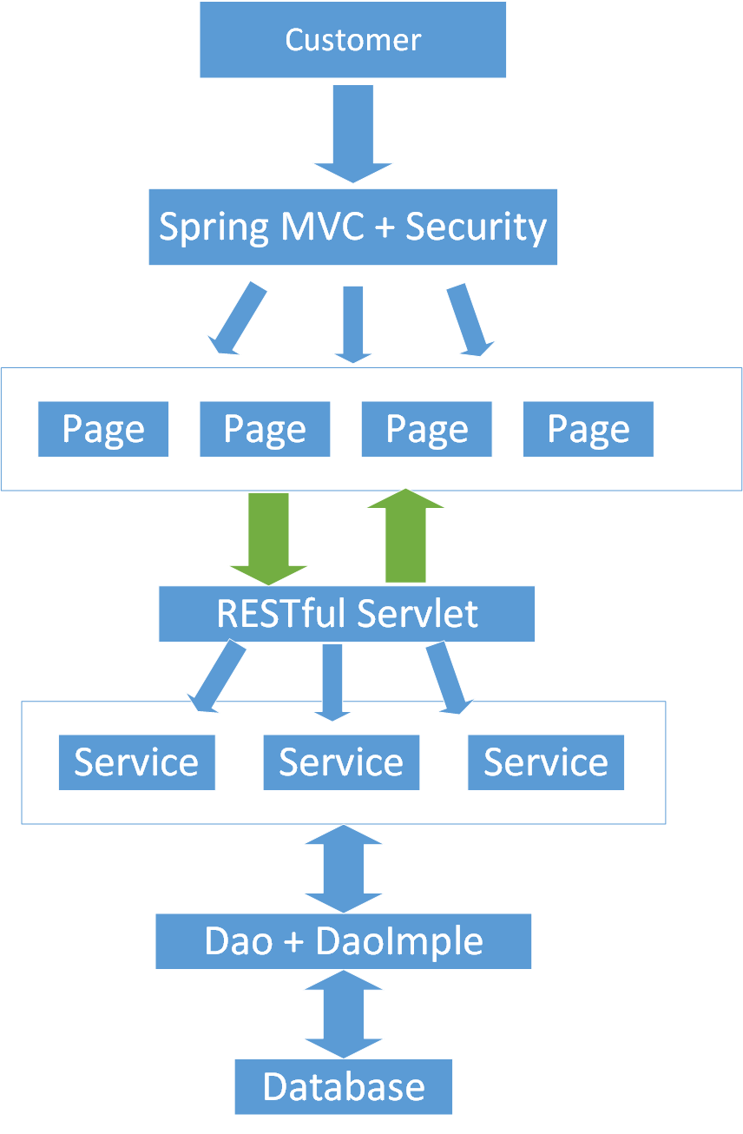

Slide 10
Back-End
Spring
Spring MVC
Spring Security
RESTful
Core Services
Multi-Threading

Slide 11

Multi-Threading
Traditional System:
Serves large amount of users
SIMULTANEOUSLY
What’s happened?
Negative transaction history
Long waiting time
Can’t get in website

Slide 12
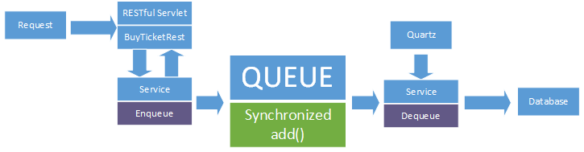

Multi-Threading
How to solve it?

Slide 13
Outline
General Illustration
Database Design
Back-End
Front-end
Demo
Summary

Slide 14

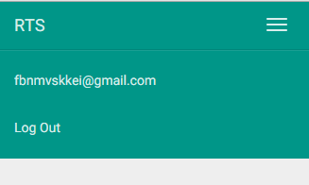
Front-End
User Information Security
Remember Me
Responsive design

Slide 15
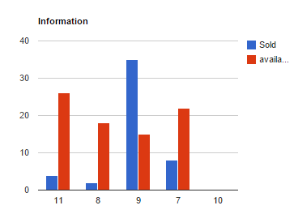
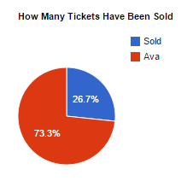
Front-End
Google Chart
Magnificent, splendid, elegant web page
Side bar
Flat Design
Awesome

Slide 16

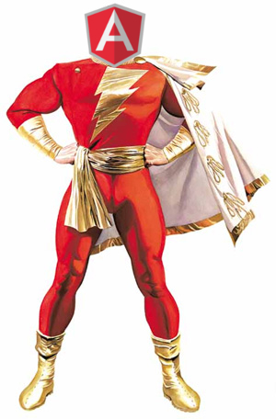




Technology list

Slide 17

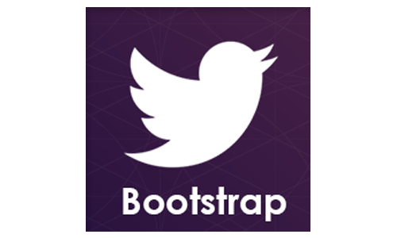

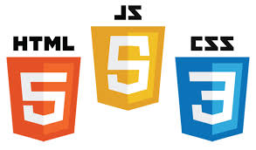


Technology list

Slide 18
Demo

Slide 19

Thank You

