Slide 1




Slide 2

Derek Gathright (@derek)
Kevin Williams
Steven Chau (@whereisciao)
William Clausen (@willstryker08)
And thanks to everyone else who pitched in!

Slide 3








Slide 4

InstallFest
  9-11
  Cover WebOS, SDK, Mojo, Eclipse basics
HackFest
  11-4
  Impromptu / BarCamp format of sessions and app building
DemoFest
  4-5
  Demo any applications that have been built
  Giveaway prizes

Slide 5

  SDK Installation & Eclipse Overview: William Clausen
  jQuery overview: Derek Gathright
  Sprint Developer Sandbox: Koya Ramprasad
  Mojo storage: Kevin Williams
  Community resources: Rick Boatright
  Porting JavaScript Applications to WebOS: Rick Boatright
  Overview of Git / Version control software: Mike Gaffney
  Making your app sticky: Barbara Ballard
  Using Fireworks to Design a Pre UI: Buck Sommerkamp

Slide 6


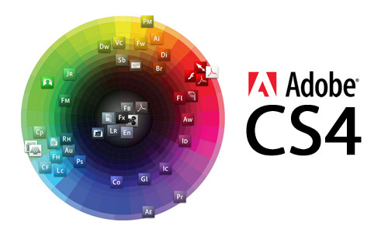
Palm - WebOS books
Adobe - CS4 "Web Premium" License
Sprint - Open Developers Conference pass

Slide 7

  PreCentral.net sponsored
  Applications submitted to PreCentral for judges selection into final round
  Apps with the highest rating wins $200 gift card towards a Pre
  Categories
    Media: Creating or managing music, photos, or videos
    Communication: Making it easier to get a message from point A to point B
    Games: Tapping, wiping, and shaking just for fun.
    Productivity and Reference: tools to help you manage tasks and GTD
    System utilities: Things that make the Pre more hackable or configurable

Slide 8

Twitter Hashtag - #pdckc
IRC - #pdckc on freenode
Bar - Opens at 11am downstairs!
PreCentral.net - Use "predevcamp09" get 10% off
Cleanup - HAVE TO LEAVE THIS PLACE SPOTLESS!!!

Slide 9


Slide 10


