Slide 2
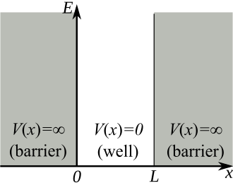


$$x$$

Slide 3
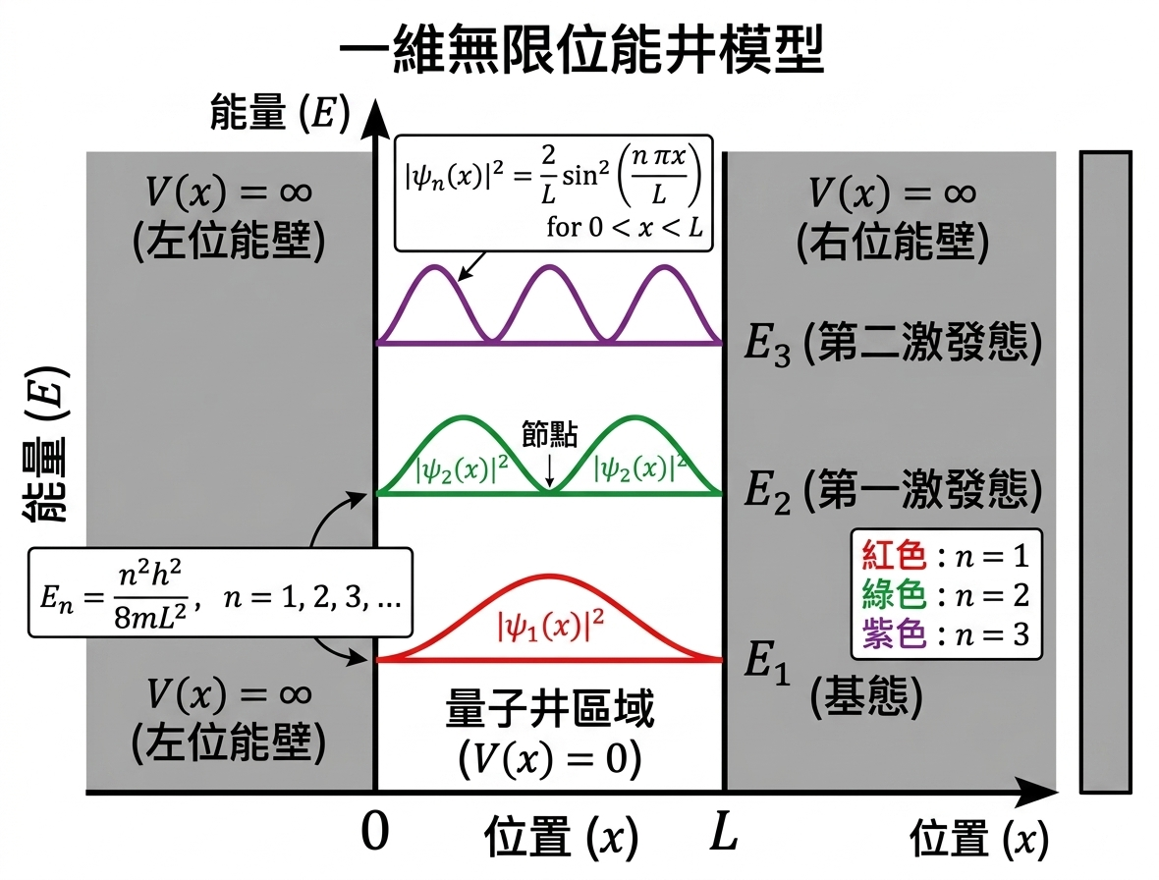

Slide 4


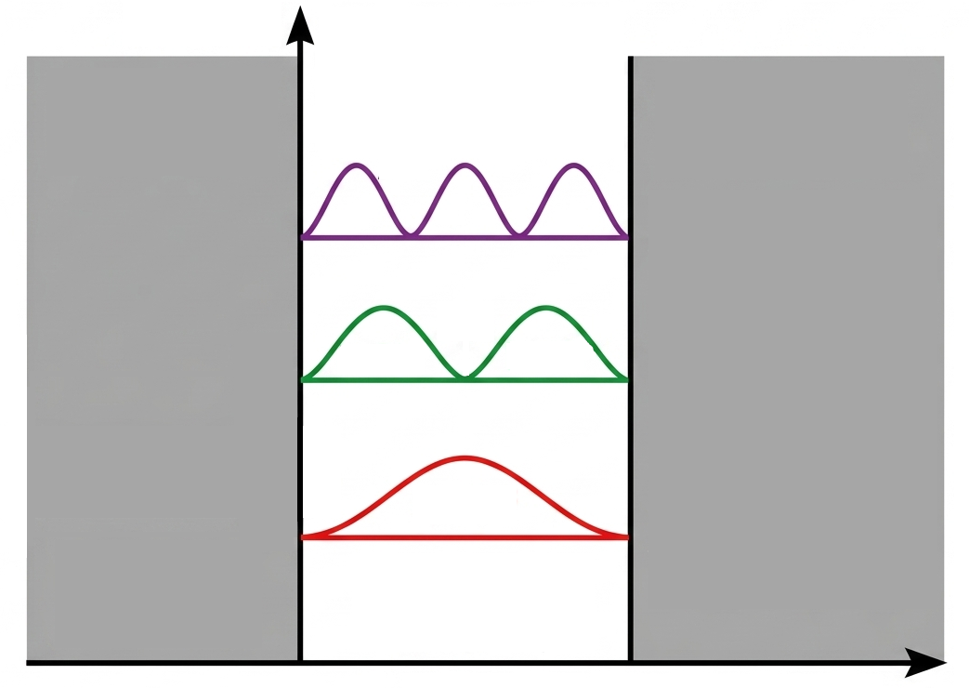






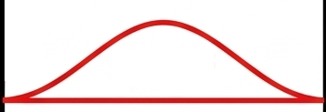




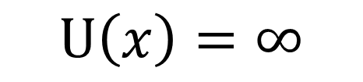
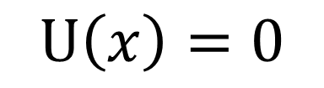


$$U\left(x\right)=∞$$
$${|ψ}_{3}\left(x\right)| {_}^{2}$$
$$U\left(x\right)=0$$
$$U\left(x\right)=∞$$

