Slide 2
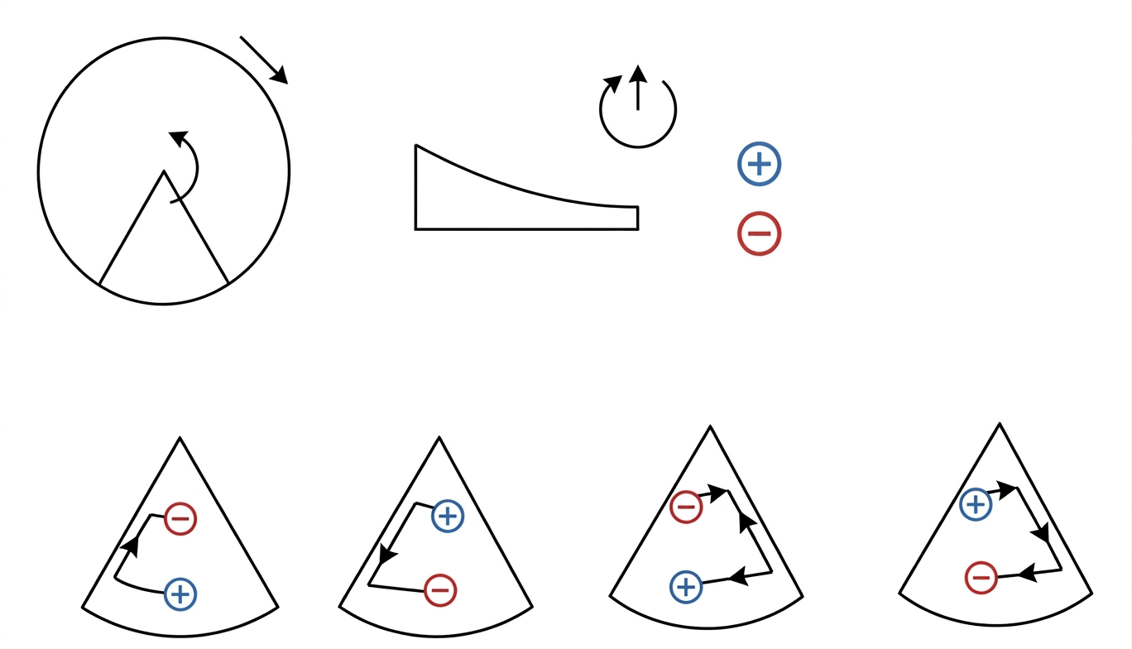

Slide 3
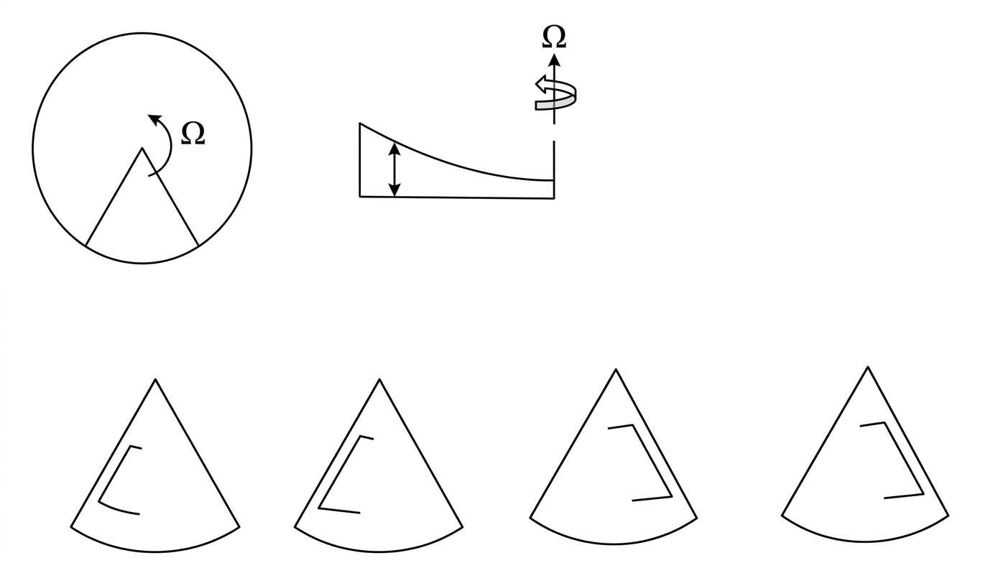

Slide 4
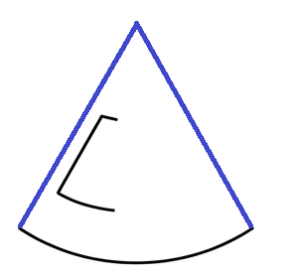


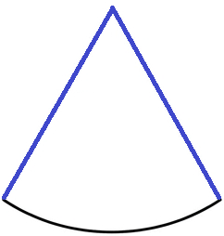




















$$(1)$$
$$A$$
$$(2)$$
$$A$$
$$(3)$$
$$A$$
$$(4)$$
$$A$$
$$(5)$$
$$A$$
$$(6)$$
$$A$$
$$(7)$$
$$A$$
$$(8)$$
$$A$$
$$(9)$$
$$A$$
$$(10)$$
$$A$$
$$(11)$$
$$A$$
$$(12)$$
$$A$$
：Intermediate Water Mass source
：Intermediate Water Mass sink
：Time-averaged Surface Currents

Slide 5
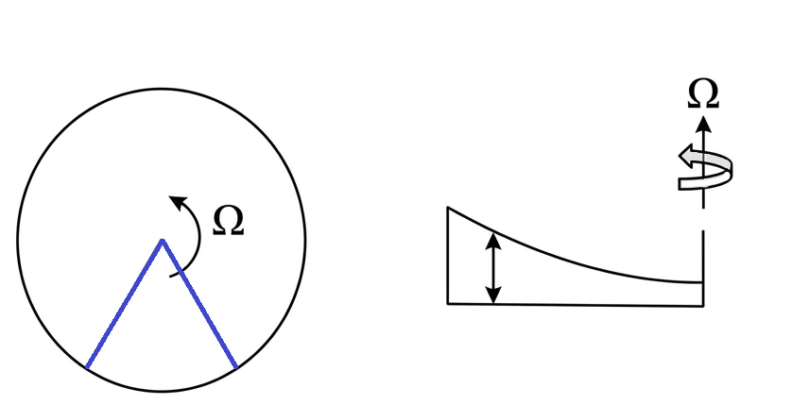
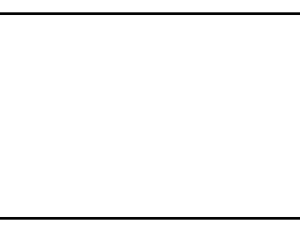


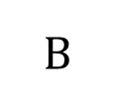
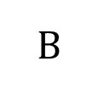

$$A$$
Rotating Sector Model
North Polar View
Cross section
$$h$$
lateral friction
$$B$$
$$A$$
$$B$$
表層海流
mass sink

