Slide 2
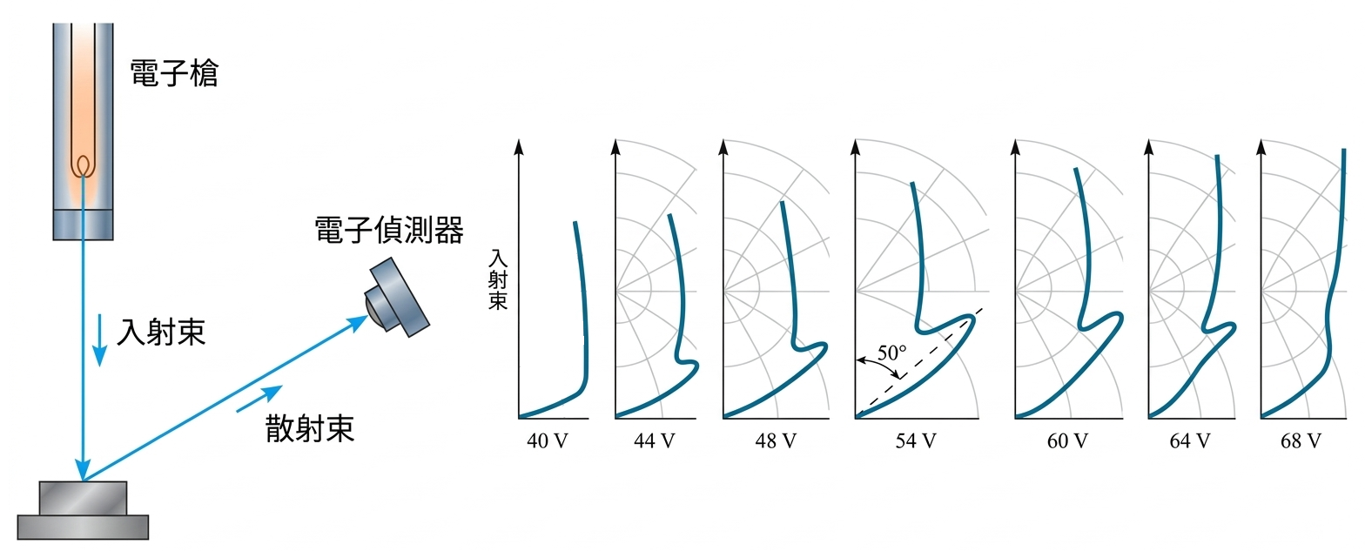
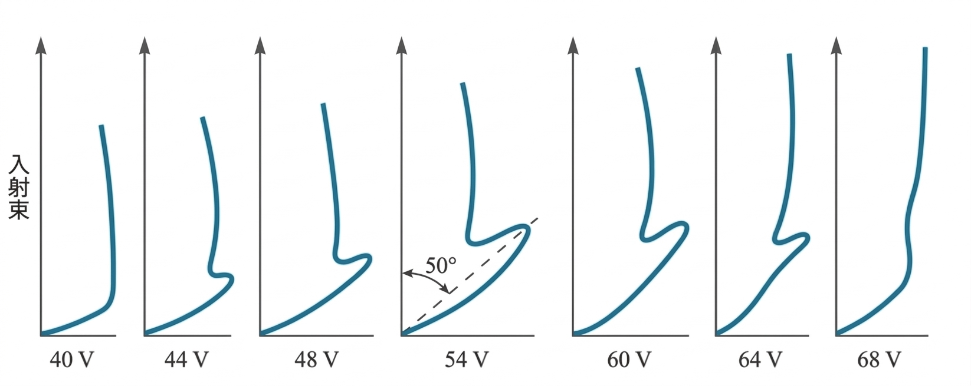
Davisson-Germer Experiment Schematic & Data Plots
靶材(鎳單晶體)

