Slide 1


Django night – 21 ottobre 2011
Writing Views
Valeria Leonardi
@vleonardi

Slide 2

The (Python) Web framework for perfectionists with deadlines
Notes:
Cos’è Django, o, meglio Jang-oh?
E’ un web-framework scritto interamente in Python, che nasce da un’esigenza pratica: un team di sviluppatori americani creavano e manutenevano numerosi siti di news locali. Si dovettero imbattere in deadline «ostiche» in quanto sia i giornalisti che il «management» dietro questi siti richiedevano di continuo l’aggiunta di features (spesso comuni tra loro), con pochissimo preavviso (qualche giorno o addirittura qualche ora). Per riuscire a «stare dietro» a queste deadlines così «incalzanti» crearono un Web-Framework «salva tempo» per creare e manutenere questi siti in modo veloce ma preciso, che svilupparono per due anni, prima di renderlo pubblico e rilasciarlo nel 2005 come software open-source. Attualmente Django è un progetto maturo, con migliaia di utenti che contribuiscono alla crescita di tale progetto e numerosi utilizzi di tale framework per siti di produzione.

Slide 3

Web-Poll Application
Notes:
Per capire le principali funzionalità di Django e la metodologia per la creazione di un’applicazione, vediamo in concreto una semplicissima applicazione reale e i passi fondamentali da affrontare per il suo sviluppo.
L’applicazione in questione permetterà di eseguire sondaggi; per ognuno, avremo una domanda e una serie di risposte, tra cui gli utenti dovranno scegliere. Visualizzeremo poi quante volte ciascuna risposta è stata scelta.

Slide 4
App Polls
Edit The file polls/views.py to look like this:
def detail(request, question_id):
response = "You're looking at question %s." % question_id
return HttpResponse(response)
def results(request, question_id):
response = "You're looking at the results of question %s."% question_id
return HttpResponse(response )
def vote(request, question_id):
response = "You're voting on question %s." % question_id
return HttpResponse(response)
Edit The file polls/urls.py to look like this:
urlpatterns = [
url(r'^$', views.index, name='index'),
url(r'^(?P<question_id>[0-9]+)/$', views.detail, name='detail'), # ex: /polls/5/
url(r'^(?P<question_id>[0-9]+)/results/$', views.results, name='results'), # ex: /polls/5/results/
url(r'^(?P<question_id>[0-9]+)/vote/$', views.vote, name='vote'), # ex: /polls/5/vote/
]
Notes:
Setup views

Slide 5
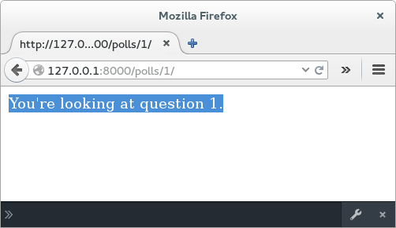
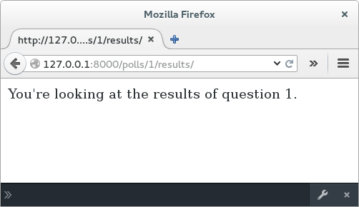
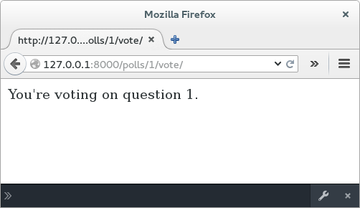
App Polls
View the new pages
Notes:
Test views in browser with:
http://localhost:8000/polls/1/ --get first question
http://localhost:8000/polls/1/results -- get first question results
http://localhost:8000/polls/1/vote --vote on questions

Slide 6
App Polls
Run the commands to see the new Python functionality:
  python manage.py shell
Test the newly created functionality in a file shellTestViewFunctions.py
from polls.views import *
from django.http import HttpRequest
request = HttpRequest() ##initialize a http request
question_id = 1 ##set the test question id
indexResp = index(request) ##return the index page as a response
print indexResp ##print the html string returned
Content-Type: text/html; charset=utf-8
Hello, admin. You're at the polls index.
print indexResp.content ##just view the content of the response
Hello, admin. You're at the polls index.
detailResp = detail(request, question_id) ##return a detail repsone
resultsResp = results(request, question_id) ##return results response
voteResp = vote(request, question_id) ##return a vote response
Notes:
Test the views in Python shell. Users will need to import the view files directly. This will become increasingly import for class based views.

Slide 7
App Polls
Run the commands to see the new Python functionality (continued):
from django.test import Client
c = Client(HTTP_HOST= 'localhost') ##run a client as though accessing the url
response = c.get('/polls/',request.GET) ##get the html response
print response ##
X-Frame-Options: SAMEORIGIN
Content-Type: text/html; charset=utf-8
Hello, admin. You're at the polls index.
response = c.get('/polls/1/',request.GET) ##get the html response
print response ##
X-Frame-Options: SAMEORIGIN
Content-Type: text/html; charset=utf-8
You're looking at question 1.
Notes:
Test the views in Python shell. Users will need to import the view files directly. This will become increasingly import for class based views.

Slide 8
App Polls
Run the commands to see the new Python functionality (continued):
Make sure the server is up and running at
http://localhost:8000
from django.core.urlresolvers import reverse
import requests
indexURL = reverse(index) ##negotiate the url pointing to the index function
url = "http://127.0.0.1:8000" + indexURL ##set the full url
resp = requests.get(url) #request the index page
resp.text ##html output from the page
u"Hello, admin. You're at the polls index."
resp.status_code ##status code = 200 is normal
200
Notes:
Test the views in Python shell. Users will need to import the view files directly. This will become increasingly import for class based views.

