Slide 1


Writing Views with content and templates
Derek Wilson

Slide 2

The (Python) Web framework for perfectionists with deadlines
Notes:
Cos’è Django, o, meglio Jang-oh?
E’ un web-framework scritto interamente in Python, che nasce da un’esigenza pratica: un team di sviluppatori americani creavano e manutenevano numerosi siti di news locali. Si dovettero imbattere in deadline «ostiche» in quanto sia i giornalisti che il «management» dietro questi siti richiedevano di continuo l’aggiunta di features (spesso comuni tra loro), con pochissimo preavviso (qualche giorno o addirittura qualche ora). Per riuscire a «stare dietro» a queste deadlines così «incalzanti» crearono un Web-Framework «salva tempo» per creare e manutenere questi siti in modo veloce ma preciso, che svilupparono per due anni, prima di renderlo pubblico e rilasciarlo nel 2005 come software open-source. Attualmente Django è un progetto maturo, con migliaia di utenti che contribuiscono alla crescita di tale progetto e numerosi utilizzi di tale framework per siti di produzione.

Slide 3

Web-Poll Application
Notes:
Per capire le principali funzionalità di Django e la metodologia per la creazione di un’applicazione, vediamo in concreto una semplicissima applicazione reale e i passi fondamentali da affrontare per il suo sviluppo.
L’applicazione in questione permetterà di eseguire sondaggi; per ognuno, avremo una domanda e una serie di risposte, tra cui gli utenti dovranno scegliere. Visualizzeremo poi quante volte ciascuna risposta è stata scelta.

Slide 4
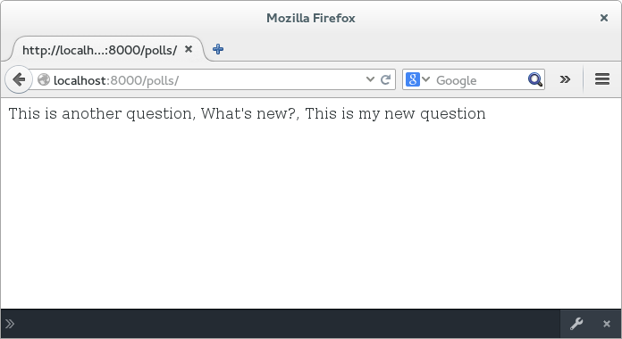
App Polls (View Content)
Edit The file polls/views.py to look like this:
def index(request):
latest_question_list = Question.objects.order_by('-pub_date')[:5]
output = ', '.join([q.question_text for q in latest_question_list])
resp = HttpResponse( output )
return resp
View the new page
Notes:
Setup views

Slide 5
App Polls (Templates)
Edit The file polls/views.py to look like this:
from django.http import HttpResponse
from django.template import loader
from .models import Question
def index(request):
latest_question_list = Question.objects.order_by('-pub_date')[:5]
output = ', '.join([q.question_text for q in latest_question_list])
template = loader.get_template('index.html') ##will look for the file in the template directory
context = {
'latest_question_list': latest_question_list,
}
resp = HttpResponse(template.render(context, request))
return resp
Notes:
Setup views

Slide 6
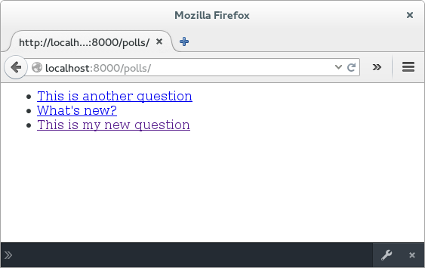
App Polls (Templates)
Edit the “template” file polls/templates/index.html to look like this
{% if latest_question_list %}<!-- test if list exists -->
<ul>
{% for question in latest_question_list %} <!-- Iterate through list -->
<li>
<a href="/polls/{{ question.id }}/">{{ question.question_text }}</a> <!--call each entry as a database object -->
</li>
{% endfor %}
</ul>
{% else %}
<p>No polls are available.</p>
{% endif %}
Notes:
Setup views

Slide 7
App Polls (Templates)
Edit The file polls/views.py to look like this:
This will automatically render the content to the template
from django.shortcuts import render
def index(request):
latest_question_list = Question.objects.order_by('-pub_date')[:5]
context = {'latest_question_list': latest_question_list}
resp= render(request, 'index.html', context) ## will look for the file in the template directory
return resp
Notes:
Setup views

Slide 8
App Polls (Templates)
Run the commands to see the Python functionality:
  python manage.py shell
Test the newly created functionality in the file shellTestViewFunctions.py
from polls.views import *
from django.http import HttpRequest
request = HttpRequest() ##initialize a http request
indexResp = index(request) ##return the index page as a response
print indexResp ##print the html string returned
Content-Type: text/html; charset=utf-8
<!-- test if list exists -->
<ul>
<!-- Iterate through list -->
<li>
<a href="/polls/2/">This is another question</a> <!--call each entry as a database object -->
</li>
<!-- Iterate through list -->
<li>
Notes:
Test the views in Python shell. Users will need to import the view files directly. This will become increasingly import for class based views.

Slide 9
App Polls (Templates)
Run the commands to see the Python functionality as executed by the webserver:
  python manage.py shell
Test the newly created functionality in the file shellTestViewFunctions.py
from django.test import Client
c = Client(HTTP_HOST= 'localhost') ##run a client as though accessing the url
esponse = c.get('/polls/',request.GET) ##get the html response
print response ##print the server response
X-Frame-Options: SAMEORIGIN
Content-Type: text/html; charset=utf-8
<!-- test if list exists -->
<ul>
<!-- Iterate through list -->
<li>
<a href="/polls/2/">This is another question</a> <!--call each entry as a database object -->
</li>
.......more
Notes:
Test the views in Python shell. Users will need to import the view files directly. This will become increasingly import for class based views.

Slide 10
App Polls (Templates)
Run the commands to see the Python functionality:
  http http://localhost:8000/polls/
HTTP/1.0 200 OK
Content-Type: text/html; charset=utf-8
Date: Thu, 22 Jun 2017 15:27:08 GMT
Server: WSGIServer/0.1 Python/2.7.7
X-Frame-Options: SAMEORIGIN
<ul>
<li>
<a href="/polls/2/">This is another question</a> <!--call each entry as a database object -->
</li>
  http http://localhost:8000/polls/1/
HTTP/1.0 200 OK
Content-Type: text/html; charset=utf-8
Date: Thu, 22 Jun 2017 15:36:49 GMT
Server: WSGIServer/0.1 Python/2.7.7
X-Frame-Options: SAMEORIGIN
You're looking at question 1.
Notes:
Test the views in Python shell. Users will need to import the view files directly. This will become increasingly import for class based views.

Slide 11
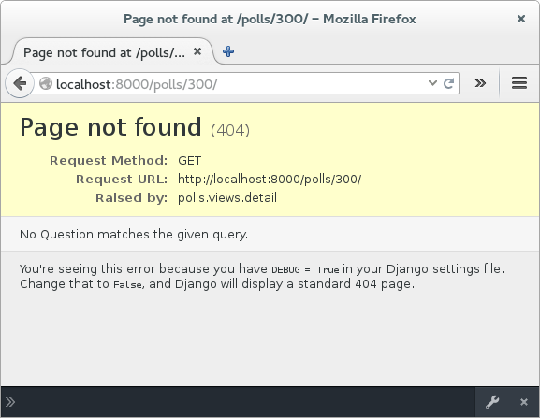
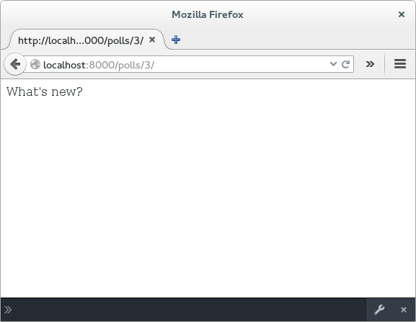
App Polls (Templates)
Edit The file polls/views.py to look like this:
from django.shortcuts import get_object_or_404, render
##the get_object_or_404 will return “page not found” if there is no database entry with this id
def detail(request, question_id):
question = get_object_or_404(Question, pk=question_id)
resp = HttpResponse(question)
return resp
Invalid Request at:
/polls/2600/
Valid Request at:
/polls/1/
Notes:
Setup views

Slide 12
App Polls (Templates)
Run the commands to see the Python functionality:
  python manage.py shell
Test the newly created functionality in the file shellTestUrlsFunctions.py
from django.core.urlresolvers import resolve, reverse
from polls.views import index, detail, results, vote
import re
##Test the url functionality with both regex patterns, url reverse and the url resolver
##The regex will test a pattern to a string to help setup url definitions
match=re.match(r'^(?P<question_id>[0-9]+)/vote/$','111/vote/')
match.group()#'111/vote/
match.groupdict()#{'question_id': '111'} This is the argument extracted from the pattern
##url reverse will determine the url needed from the urls.py
reverse(detail,kwargs={'question_id': u'1'}) #u'/polls/1/'
reverse(vote,kwargs={'question_id': u'1'}) #u'/polls/1/vote/'
rm=resolve('/polls/1/') #ResolverMatch(func=polls.views.detail, args=(), kwargs={'question_id': u'1'}, url_name=detail, app_names=[], namespaces=[])
rm=resolve('/polls/1/vote/') ##will test the vote url to return the function parameters
#ResolverMatch(func=polls.views.vote, args=(), kwargs={'question_id': u'1'}, url_name=vote1, app_names=[], namespaces=[])z
Notes:
Test the views in Python shell. Users will need to import the view files directly. This will become increasingly import for class based views.

Slide 13
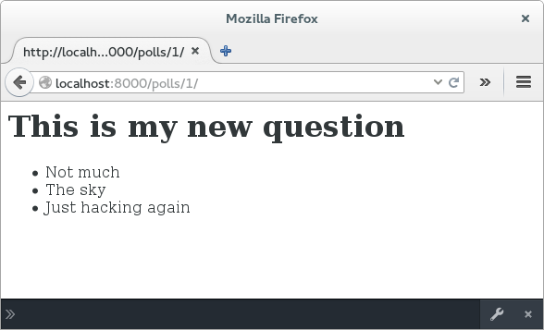
App Polls (Templates)
Edit The file polls/views.py to look like this:
def detail(request, question_id):
question = get_object_or_404(Question, pk=question_id)
return render(request, 'detail.html', {'question': question})
Edit The file polls/templates/details.html to look like this:
<h1>{{ question.question_text }}</h1>
<ul>
{% for choice in question.choice_set.all %}
<li>{{ choice.choice_text }}</li>
{% endfor %}
</ul>
View the page
Notes:
Setup views

