Slide 1


Writing Forms
Derek Wilson

Slide 2

The (Python) Web framework for perfectionists with deadlines
Notes:
Cos’è Django, o, meglio Jang-oh?
E’ un web-framework scritto interamente in Python, che nasce da un’esigenza pratica: un team di sviluppatori americani creavano e manutenevano numerosi siti di news locali. Si dovettero imbattere in deadline «ostiche» in quanto sia i giornalisti che il «management» dietro questi siti richiedevano di continuo l’aggiunta di features (spesso comuni tra loro), con pochissimo preavviso (qualche giorno o addirittura qualche ora). Per riuscire a «stare dietro» a queste deadlines così «incalzanti» crearono un Web-Framework «salva tempo» per creare e manutenere questi siti in modo veloce ma preciso, che svilupparono per due anni, prima di renderlo pubblico e rilasciarlo nel 2005 come software open-source. Attualmente Django è un progetto maturo, con migliaia di utenti che contribuiscono alla crescita di tale progetto e numerosi utilizzi di tale framework per siti di produzione.

Slide 3

Web-Poll Application
Notes:
Per capire le principali funzionalità di Django e la metodologia per la creazione di un’applicazione, vediamo in concreto una semplicissima applicazione reale e i passi fondamentali da affrontare per il suo sviluppo.
L’applicazione in questione permetterà di eseguire sondaggi; per ognuno, avremo una domanda e una serie di risposte, tra cui gli utenti dovranno scegliere. Visualizzeremo poi quante volte ciascuna risposta è stata scelta.

Slide 4
App Polls (Vote on Content)
Edit The file polls/views.py to look like this:
This introduces the post request where the server will process the posted data.
from django.urls import reverse
def vote(request, question_id):
question =get_object_or_404(Question, pk=question_id)
try:
selected_choice = question.choice_set.get(pk=request.POST['choice'])
except (KeyError, Choice.DoesNotExist):
# Redisplay the question voting form.
return render(request, 'detail.html', {
'question': question,
'error_message': "You didn't select a choice.",
#error message present will show up in html page
})
else:
selected_choice.votes += 1
selected_choice.save()
# Always return an HttpResponseRedirect after successfully dealing
# with POST data. This prevents data from being posted twice if a
# user hits the Back button.
return HttpResponseRedirect(reverse('detail', args=(question.id,)))
Notes:
Setup views

Slide 5
App Polls (Templates)
Run the commands to see the Python functionality:
  python manage.py shell
Test the newly created functionality in the file shellTestViewFunctions.py
from polls.views import *
from django.http import HttpRequest
from polls.models import Question, Choice
request = HttpRequest() ##initialize a http request
question_id = 1 ##set the test question id
question = get_object_or_404(Question, pk=question_id)
request.POST['choice'] = 2 ##set the post data to the question number
##request the choice corresponding to this choice ID
selected_choice = question.choice_set.get(pk=request.POST['choice'])
selected_choice.votes += 1 ##increment the vote count
selected_choice.save() ## save to the database
#Test the whole function
resp=vote(request, question_id)
print resp
Content-Type: text/html; charset=utf-8
Location: /polls/1/
Not much=35
Notes:
Test the views in Python shell. Users will need to import the view files directly. This will become increasingly import for class based views.

Slide 6
App Polls (Templates)
Run the commands to see the Python functionality as executed by the webserver:
  python manage.py shell
Test the newly created functionality in the file shellTestViewFunctions.py
from django.test import Client
request = HttpRequest()
request.POST['choice'] = 2 ##set the post data to the question number
c = Client(HTTP_HOST= 'localhost') ##run a client as though accessing the url
response = c.post('/polls/1/vote/',request.POST) ##get the html response
print response ##print the server response
X-Frame-Options: SAMEORIGIN
Content-Type: text/html; charset=utf-8
Location: /polls/1/
Not much=43
Notes:
Test the views in Python shell. Users will need to import the view files directly. This will become increasingly import for class based views.

Slide 7
App Polls (Templates)
Test the POST request from the command line as follows:
  http --form POST http://localhost:8000/polls/1/vote/ choice=4
HTTP/1.0 302 Found
Content-Type: text/html; charset=utf-8
Date: Thu, 06 Jul 2017 18:34:17 GMT
Location: /polls/1/
Server: WSGIServer/0.1 Python/2.7.7
X-Frame-Options: SAMEORIGIN
Just hacking again=17
Notes:
Test the views in Python shell. Users will need to import the view files directly. This will become increasingly import for class based views.

Slide 8
App Polls (Vote on Content)
Edit The file polls/templates/detail.html to look like this:
<h1>{{ question.question_text }}</h1> <!--braces contain tags of context data -->
<p><strong>-{% if error_message %}{{ error_message }}{% endif %}</strong></p>
<form action="{% url 'vote' question.id %}" method="post">
{% csrf_token %}
<table >
{% for choice in question.choice_set.all %}
<tr>
<td>
<input type="radio" name="choice" id="choice{{ forloop.counter }}" value="{{ choice.id }}" />
<label for="choice{{ forloop.counter }}">{{ choice.choice_text }}</label><br />
</td>
<td>
{{ choice.votes }}
</td>
</tr>
{% endfor %}
</table>
<input type="submit" value="Vote" />
</form>
Notes:
Setup views

Slide 9
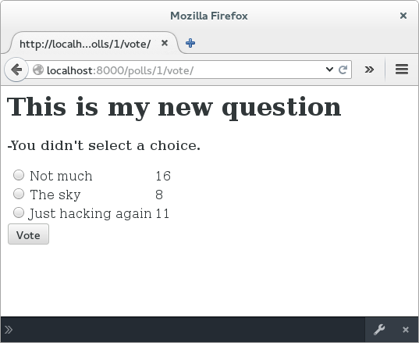
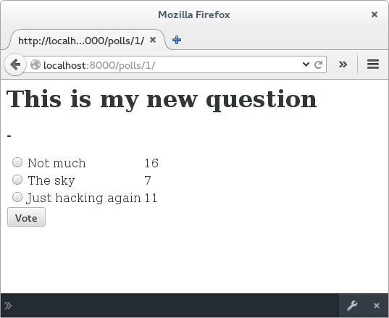
App Polls (Vote on Content)
View the page after making a valid selection
And invalid selection
Notes:
Setup views

