Slide 1

Python Web Framework
Balakumar Parameshwaran
24-10-2013
http://www.balakumarp.com
Notes:
<number>

Slide 2
Agenda
Introduction
Features
Installation
Django Architecture
Project structure
Settings
Project / Site creation
URL Dispatcher
Who uses it?
Questions
<number>
Notes:
<number>

Slide 3
Introduction
Django is a free and open source web application framework, written in Python, which follows the Model–View–Controller architectural pattern.
It is maintained by the Django Software Foundation (DSF), an independent organization.
Encourages rapid development and clean, pragmatic design.
Named after famous Guitarist Django Reinhardt
Developed by Adrian Holovaty & Jacob Kaplan-moss
Created in 2003, open sourced in 2005
1.0 Version released in Sep 3 2008, now 1.5.4
<number>
Notes:
<number>

Slide 4
Features
Object Relational Mapper - ORM
MVC (MVT) Architecture
Focuses on automating as much as possible and adhering to the DRY principle
Template System
Out of the box customizable Admin Interface, makes CRUD easy
Built-in light weight Web Server
Elegant URL design
Custom Middleware
Authentication / Authorization
Internationalization support
Cache framework, with multiple cache mechanisms
Fast Development
Free, and Great Documentation
<number>
Notes:
<number>

Slide 5
Installation
Prerequisites
Python
PIP for installing Python packages ()
pip install Django==1.5.4
OR - python setup.py install
pip install mysql-python
MySQL on windows
Add Python and Django to env path
PYTHONPATH D:\Python27
Path D:\Python27; D:\Python27\Lib\site-packages; D:\Python27\Lib\site-packages\django\bin;
Testing installation
shell> import django; django.VERSION;
<number>
Notes:
<number>

Slide 6
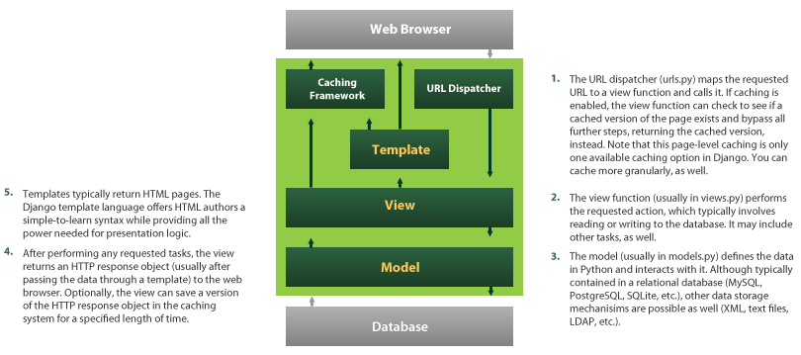
Django Architecture
Models Describes your data
Views Controls what users sees
Templates How user sees it
Controller URL dispatcher
<number>
Notes:
<number>

Slide 7
Project Directory Structure
demosite/ ---------------------------------- Just a container for your project. Its name doesn’t matter to Django; you can rename
it to anything you like.
manage.py ------------------------- A command-line utility that lets you interact with this Django project in various ways.
Type python manage.py help. You should never have to edit this file.
demosite/ ------------------------- Actual Python package for your project. Use this name to import anything inside it
(e.g. import demosite.settings)
__init__.py ----------------- A file required for Python to treat the demosite directory as a package.
settings.py ----------------- Settings/configuration for this Django project
urls.py ---------------------- Root URL config, the URLs for this Django project, provides mapping to views
wsgi.py ---------------------- An entry-point for WSGI-compatible webservers to serve your project
templates/ ----------------- HTML files , renders based on views. You can change to any dir, configurable in settings.py
static/ ----------------------- CSS, JS, images.. etc, configurable in settings.py
demoapp/ -----------------
__init__.py --------
urls.py ------------
views.py ---------- Responsible for processing a user’s request and for returning the response
models.py --------- A model is the single, definitive source of information about your data.
Generally, each model maps to a single database table.
admin.py ---------- It reads metadata in your model to provide a powerful and production-ready interface
forms.py ----------- To create and manipulate form data
<number>
Notes:
<number>

Slide 8
Settings
Project settings.py overrides from <python>/Lib/site-packgaes/django/conf/global_settings.py
Set DJANGO_SETTINGS_MODULE for your Project, tells django which settings to be used. (demoproject.settings)
export/set DJANGO_SETTINGS_MODULE=demoproject.settings
For server mod_wsgi: os.environ['DJANGO_SETTINGS_MODULE'] = 'demoproject.settings'
DEBUG True or False
DATABASES ENGINE postgresql_psycopg2', 'mysql', 'sqlite3' or 'oracle'.. etc
ROOT_URLCONF
MEDIA_ROOT directory that will hold user-uploaded files
MEDIA_URL To serve media files
STATIC_ROOT To any server static files css, js.. and admin UI files (can add more dirs to STATICFILES_DIRS)
STATIC_URL To serve static files
TEMPLATE_DIRS Template directories
Using settings in Python code
from django.conf import settings
if settings.DEBUG:
# Do something
<number>
Notes:
<number>

Slide 9
Project / Site Creation
Creating new Project
django-admin.py startproject demoproject
A project is a collection of applications
Creating new Application
python manage.py startapp demosite
An application tries to provide a single, relatively self-contained set of related functions
Using the built-in web server
python manage.py runserver
python manage.py runserver 80
Runs by default at port 8000
It checks for any error and validate the models. Throws errors/warnings for any misconfigurations and invalid entries.
<number>
Notes:
<number>

Slide 10
URL Dispatcher / Patterns
Root URL should be configured in settings.py
ROOT_URLCONF = 'app.urls'
Syntax
patterns(prefix,
(regular expression, Python callback function [, optional dictionary [, optional name]])
)
Example:
urlpatterns = patterns(' ',
(r'^articles-year/$', 'mysite.news.views.articles_year'),
)
Note:
No need to add a leading slash (/articles-year)
The 'r' in front of each regular expression string is optional but recommended. It tells Python that a string is "raw" -- that nothing in the string should be escaped.
In python, the ‘\’ backslash character in control chars must be escaped for regular expression use. Basically we have to add one more slash i.e , . To work around backslash plague, you can raw string, by prefixing the string with the letter r.
<number>
Notes:
<number>

Slide 11
Can include other URLconf modules
urlpatterns = patterns(' ',
url(r'^support/', include('demoproject.support.urls')),
)
Using Prefix
urlpatterns = patterns(' ',
(r'^articles/(\d{4})/$', 'mysite.news.views.articles_year'),
(r'^articles/(\d{4})/(\d{2})/$', 'mysite.news.views.articles_month'),
)
Here mysite.news.views is common, so can be rewritten as follows
urlpatterns = patterns('mysite.news.views',
(r'^articles/(\d{4})/$', 'articles_year'),
(r'^articles/(\d{4})/(\d{2})/$', 'articles_month'),
)
Passing extra arguments and Dictionary mapping
patterns(' ',
(r'^articles/(?P<year>\d{4})/$', 'articles_year'), {'foo': 'bar'}),
)
We can get the values in views.py as year='2005', foo='bar'
<number>
Notes:
<number>

Slide 12
Who uses Django?
BitBucket
DISQUS (serving 400 million people)
Pinterest
Instagram
dPaste
Mozilla (support.mozill, addons.mozilla)
NASA
PBS (Public Broadcasting Service)
The Washington Post, NY Times, LA Times, The Guardian
National Geographic, Discovery Channel
<number>
Notes:
<number>

