Slide 1

Introduction to

Slide 2
What is Django?
Django is a high-level Python Web framework that encourages rapid development and clean, pragmatic design.
Django makes it easier to build better Web apps more quickly and with less code.
The Web framework with perfectionists with deadlines.

Slide 3
Django Components
Think MTV instead of MVC
Models - Django ORM
Templates - Django Template Engine
Views - Python function, Request in Response out.
URL Patterns - Regular expression based

Slide 4
Lets Build a Project
./django-admin.py startproject spamstr
spamstr/
  __init__.py
  manage.py
  settings.py
  urls.py

Slide 5
Lets Add an App
./manage.py startapp person
spamstr/
  person/
    __init__.py
    models.py
    views.py

Slide 6
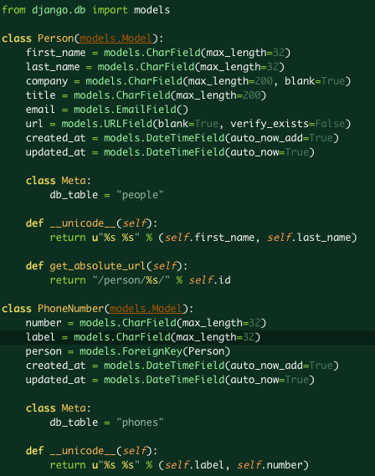
models.py

Slide 7
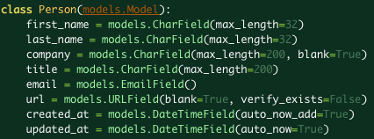
models.py

Slide 8
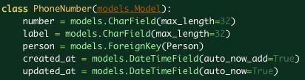
models.py

Slide 9
Create Your Database
./manage.py syncdb
    ...
    Creating table peopleCreating table phones
    ...

Slide 10
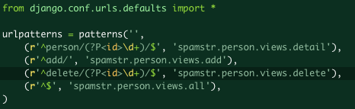
urls.py

Slide 11
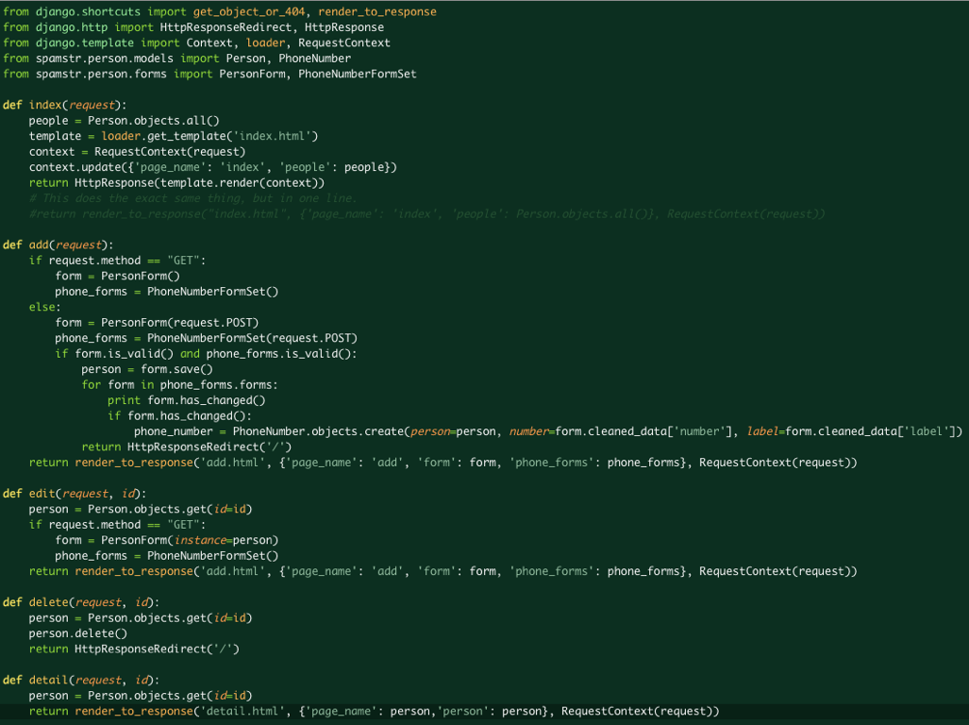
views.py
Notes:
This is a test

Slide 12
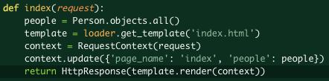
views.py

Slide 13
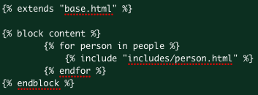
index.html

Slide 14
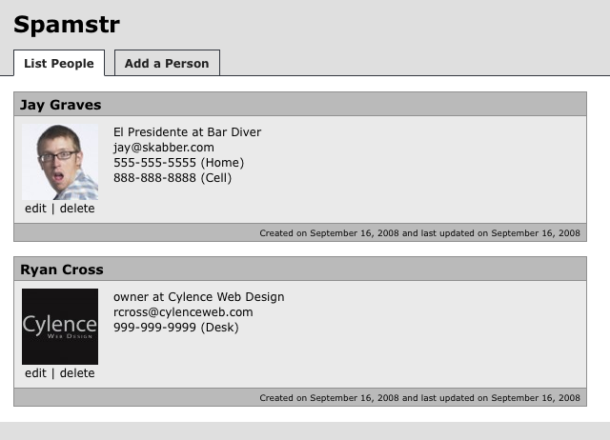
./manage.py runserver

Slide 15
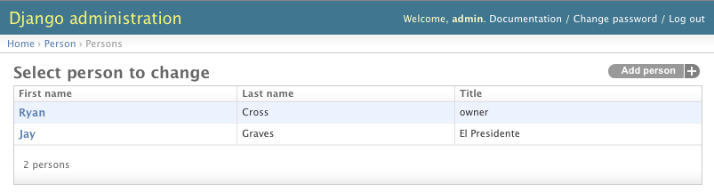
Admin

Slide 16
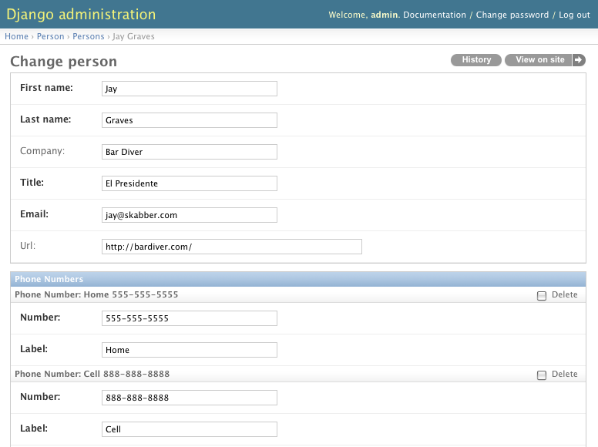
Admin

Slide 17
Thank You
Django - http://www.djangoproject.com/
spamstr-django
http://github.com/skabber/spamstr-django/

