Slide 1
Predicting Personal Medical Cost
Team: Niraja Bohidar, Derek Banks, Jay Hombal, Ronak Rijhwani
08/03/2020

Slide 2

The Context
Today in the United States -
High healthcare/medical cost is a concern for everyone.
Increasing Healthcare costs stop people from getting the needed care or fill prescriptions.
Many families report difficulty in affording healthcare costs.
Difficulty in paying bills has significant consequences for US families.
It is an interesting problem to explore and learn more, so we choose the Medical Cost Personal Dataset from Kaggle.

Slide 3
The Project Goal
Explore
1
Explore to gain insights and make observations of the response variable and the qualitative and quantitative predictors in the dataset.
Analyze
2
Analyze the correlation and directionality of the dataset
Predict
3
Create a model a best fit linear or logistic model to estimate the medical charges based on the demographic predictor variables and evaluate the validity and usefulness of this model.

Slide 4
The Executive Summary
Goal : To build a model that can predict an American’s expected medical costs based on demographic information.
Results : We can predict whether an individual’s medical costs are above or below $20,000.
Data :The data set gives the age, sex, bmi, number of children, smoker status, region of residence, and medical charges for 1338 individuals.
Key finding : The odds of one's charges being over $20,000 is multiplied by a factor of 116 for a smoker compared to a non-smoker, while age and BMI are held constant.

Slide 5
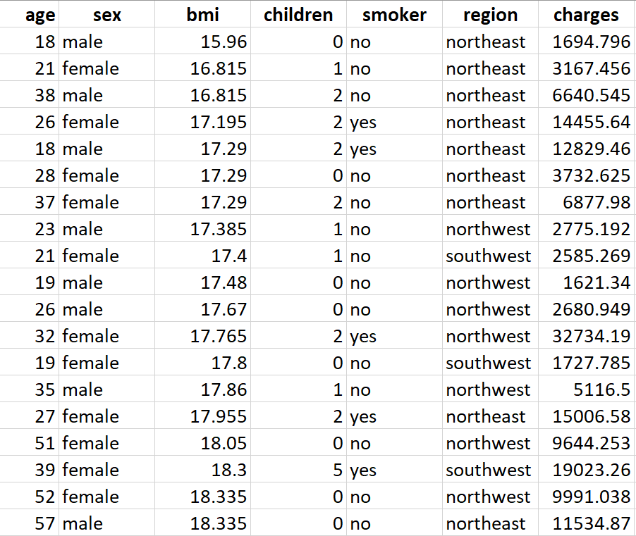
The Nature of the Personal Medical Cost Dataset
The features are :
age: This is an integer indicating the age of the primary beneficiary
sex: This is the policy holder's gender, either male or female
bmi: This is the body mass index (BMI), which provides a sense of how over or under-weight a person is relative to their height. BMI is equal to weight (in kilograms) divided by height (in meters) squared. An ideal BMI is within the range of 18.5 to 24.9
children: This is an integer indicating the number of children/dependents covered by the insurance plan.
smoker: This is yes or no, depending on whether the insured regularly smokes tobacco.
region: This is the beneficiary's place of residence in the U.S., divided into four geographic regions: northeast, southeast, southwest, or northwest
Hypothesis: Medical Expenses challenging to estimate accurately is difficult because high-cost conditions are random and rare. However, we expect that older people & smokers & obese (bmi>30) people are at a higher risk and may have significant medical expenses.

Slide 6
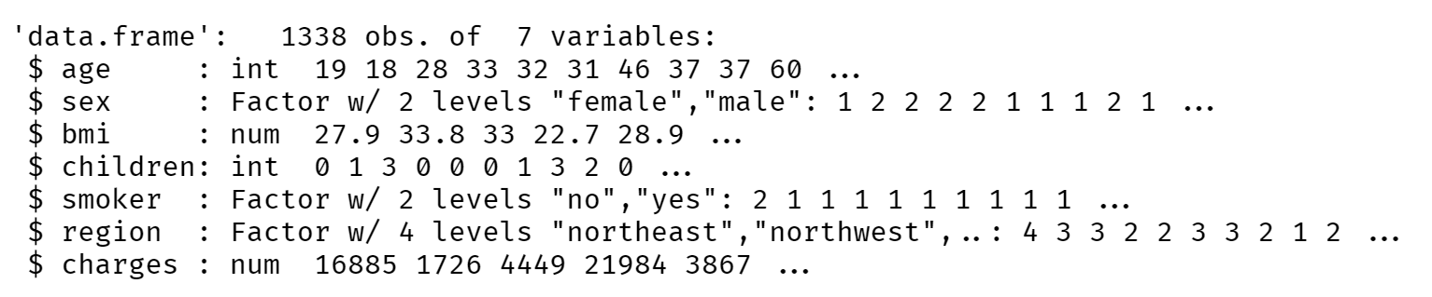
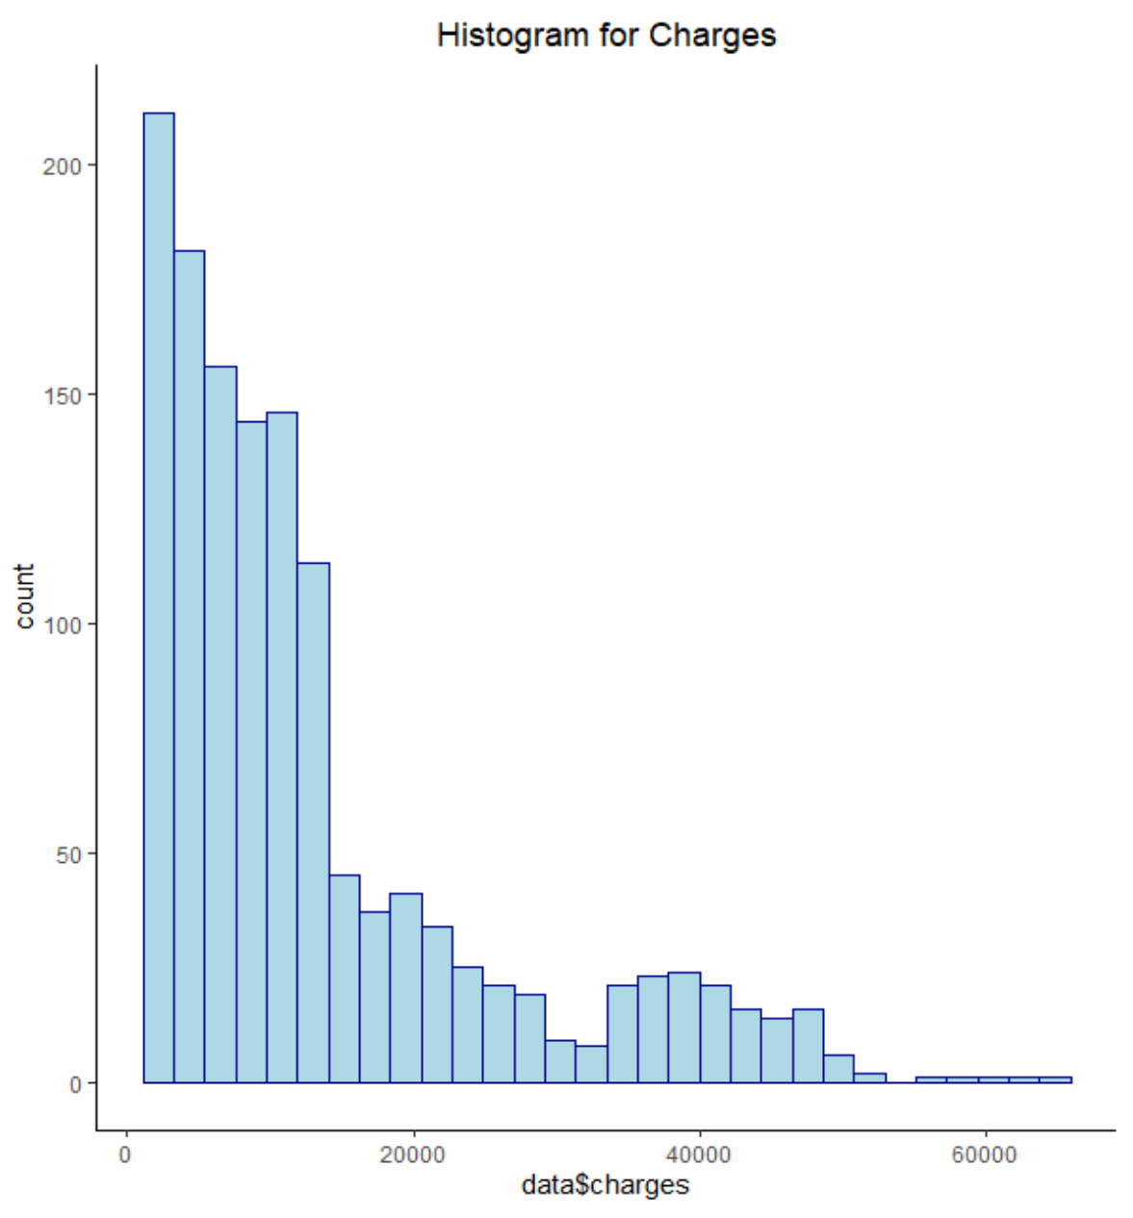

Exploring and Preparing the data
Sample Size: n = 1338
Response variable: charges
Predictor variables:
Categorical: sex, smoker, and region
Quantitative: age, bmi, and children
The response variable mean is higher than the median, because data is right-skewed. The evidence can be observed in the histogram.
Transformation for a more normal distribution

Slide 7
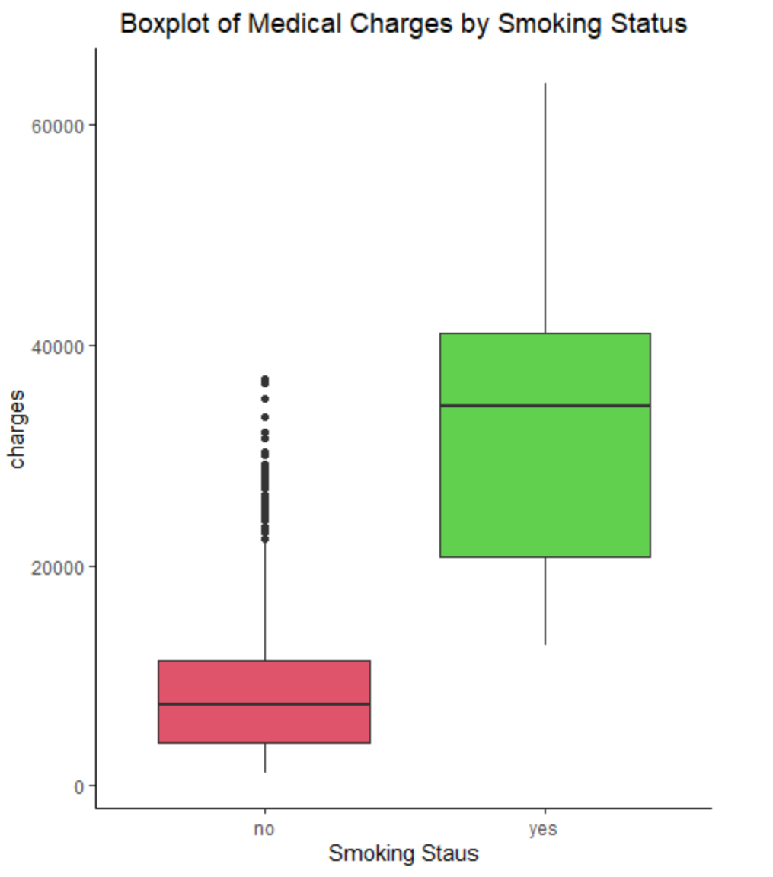
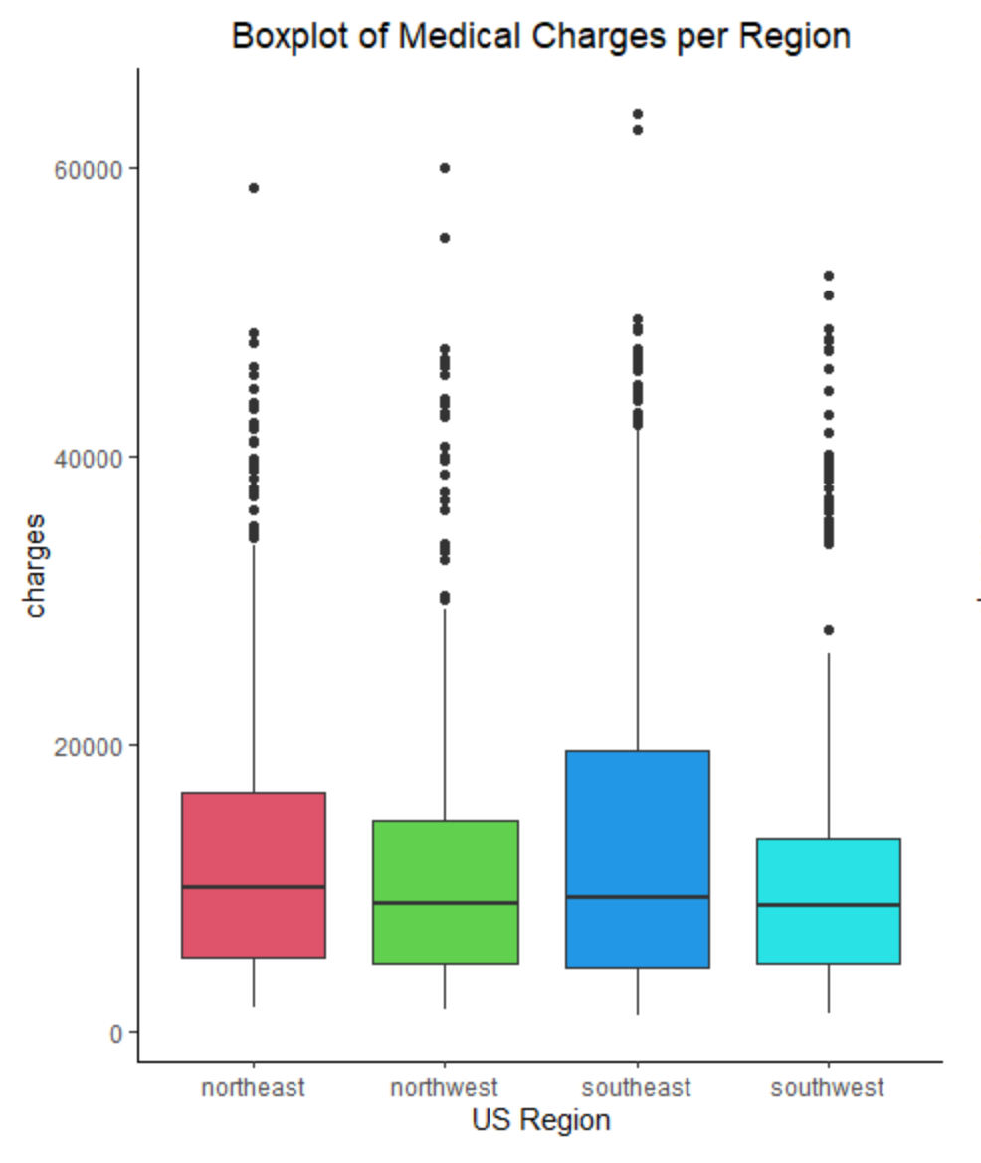
People who smoke & living in the southeast region are at risk for higher medical charges
The people in the southeast region have higher medical charges than the people living in other regions.
The medical charges for smokers is higher than non-smokers

Slide 8
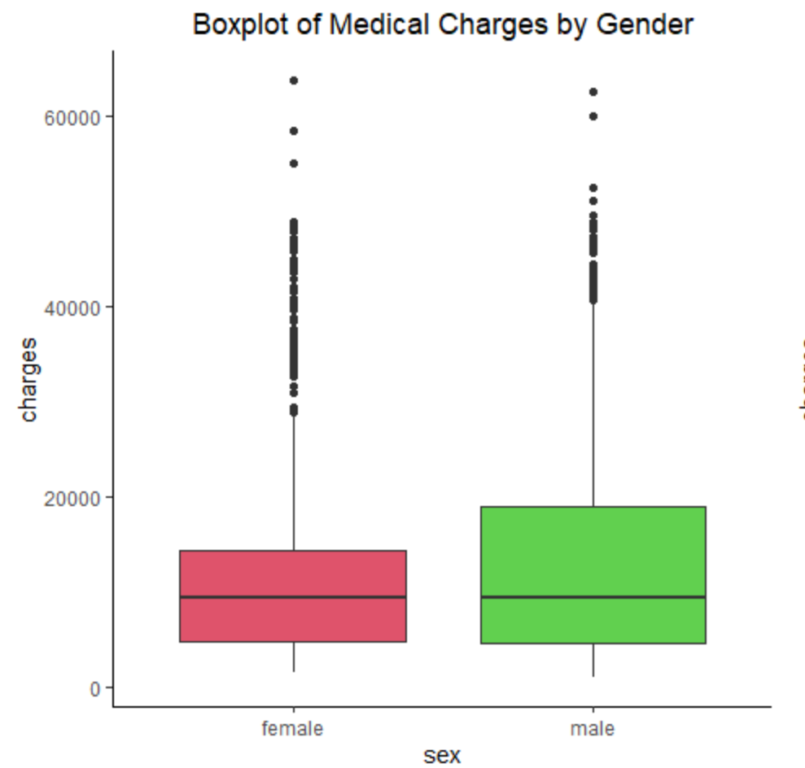
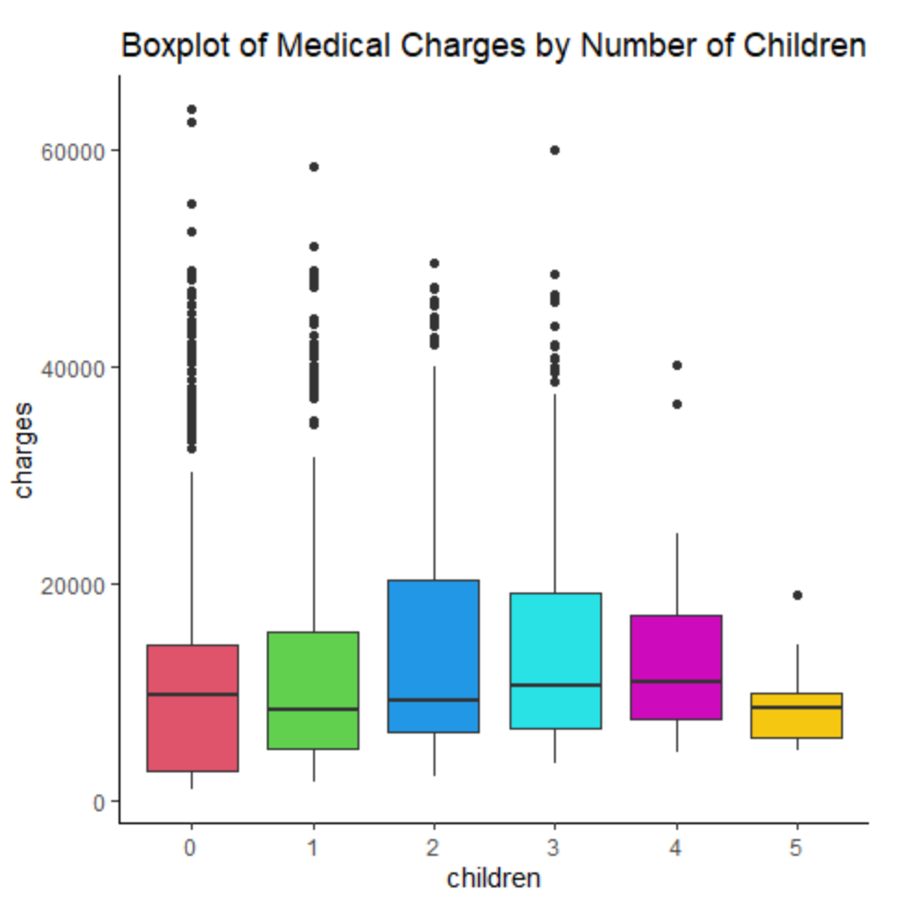
People with five children have the lowest median value for charges & men seem to have higher expenses
An interesting observation is that the medical charges for people with 5 children is lower than people with people with four or less children
The median value of the medical charges for both male and female sex is almost equal. the third quartile for male seems to greater than female, so the data may be skewed towards the men.

Slide 9
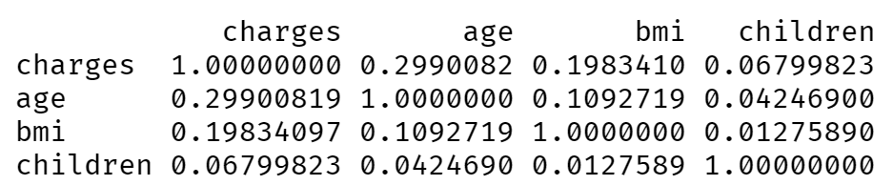
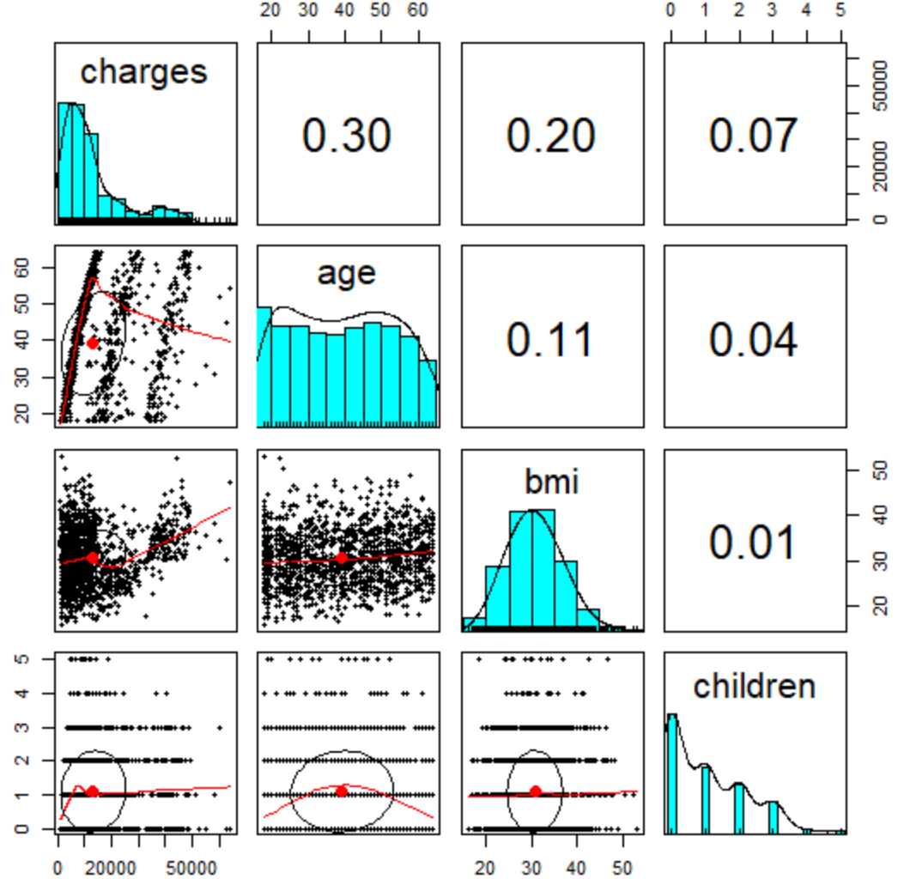
Explore the relationship between the response variable and the qualitative and quantitative predictors in the dataset
A quick review of the correlation matrix shows
There is no strong correlation between the predictors and the response variable.
The Age and charges, bmi and charges variables appear to have moderate correlation
The children and charges appear to have weak correlation
The eclipse shape shown in correlation matrix scatter plots indicates the correlation between the two variables; the more it is stretched, the stronger the correlation

Slide 10
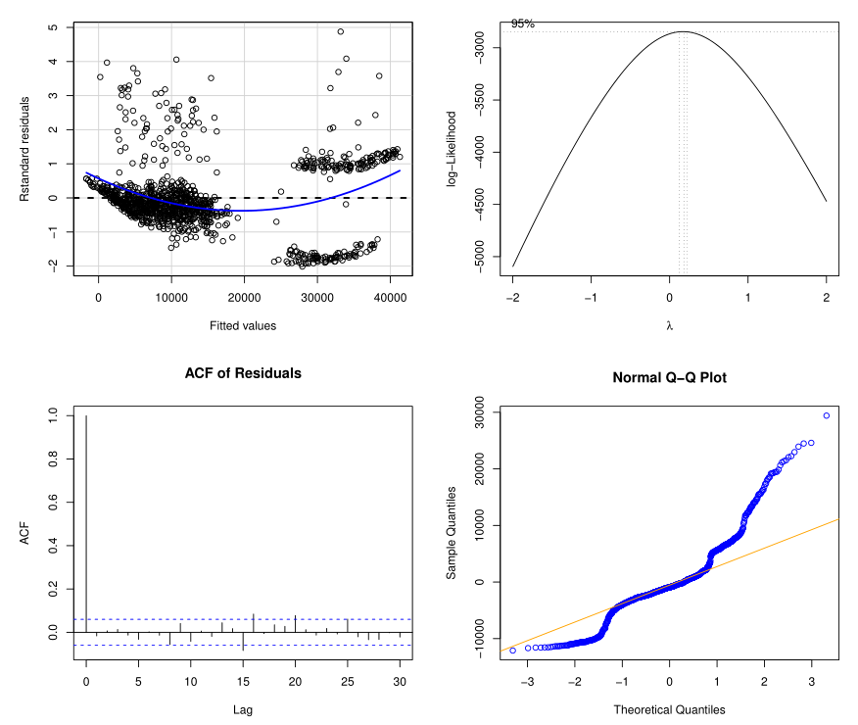
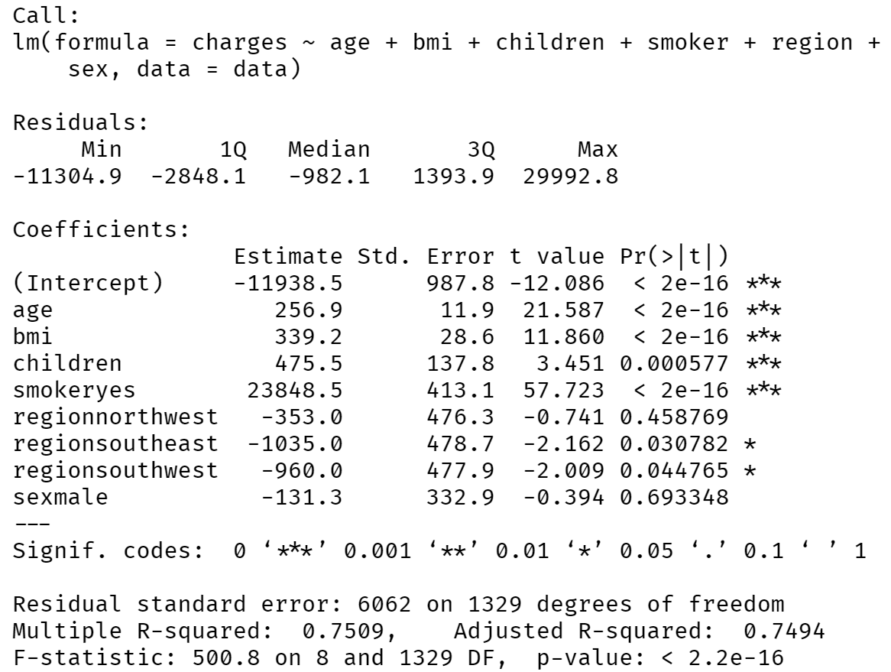
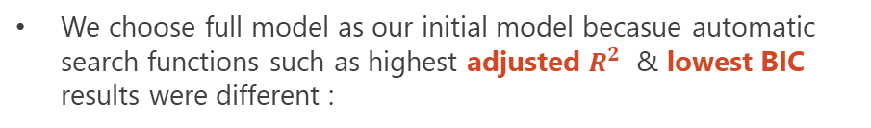
Initial MLR Model failed to satisfy regression assumptions
We choose full model as our initial model becasue automatic search functions such as highest adjusted $R^{2}$ & lowest BIC results were different :
From the plots, we can infer that our transformed model
We can see Non-constant variance as seen in the box-cox plot.
And Non-linear relationship between y & Xs is seen in the residual plot.
Heavy tails in normal Q-Q plot indicate the data is skewed.
We need to transform y to address Non-constant variance then test assumptions again, transform x to address Non-linearity if it is still an issue

Slide 11
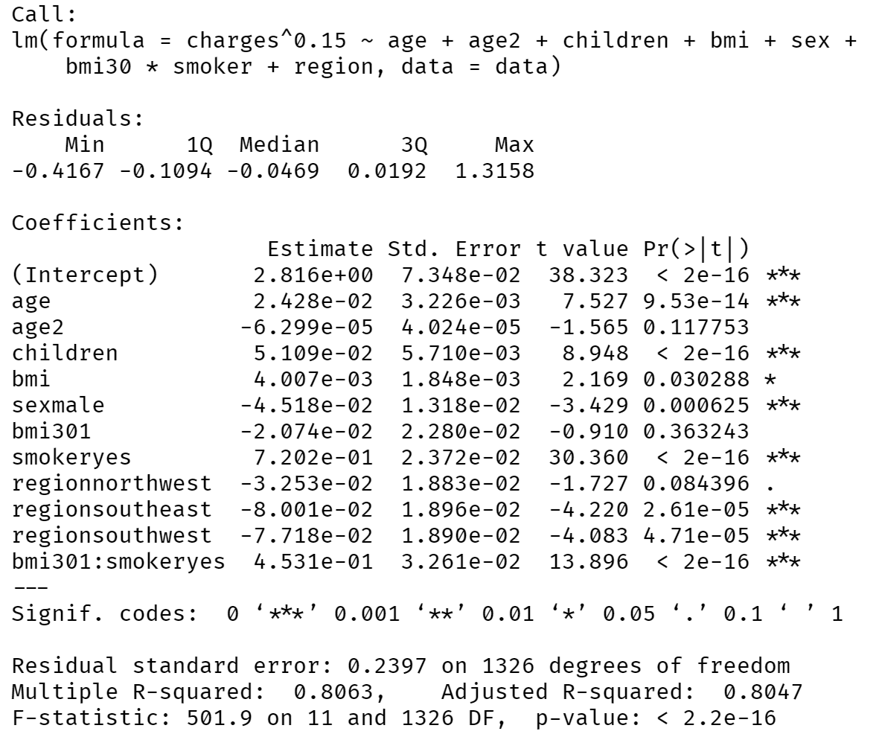
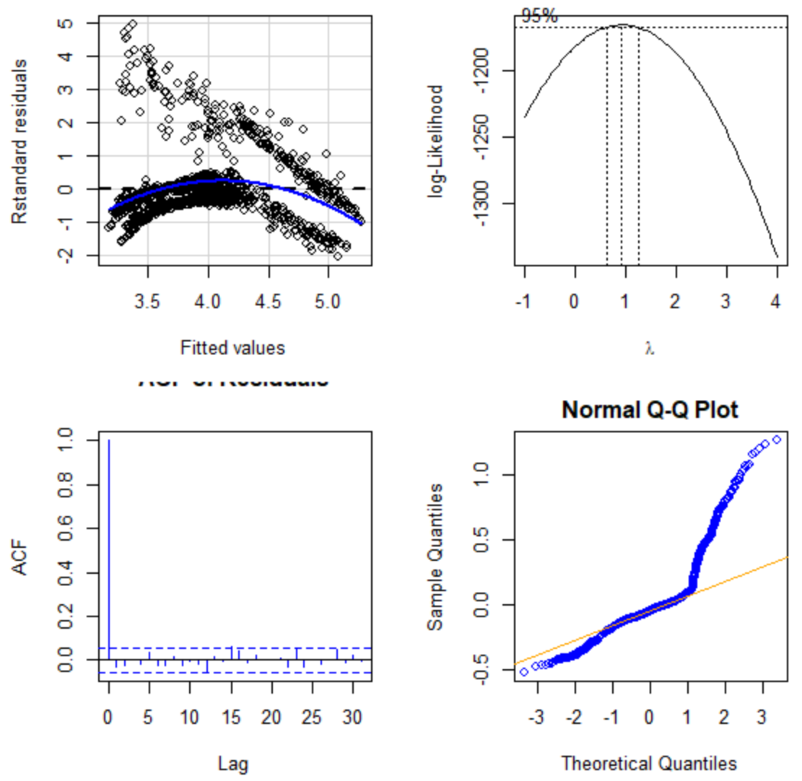
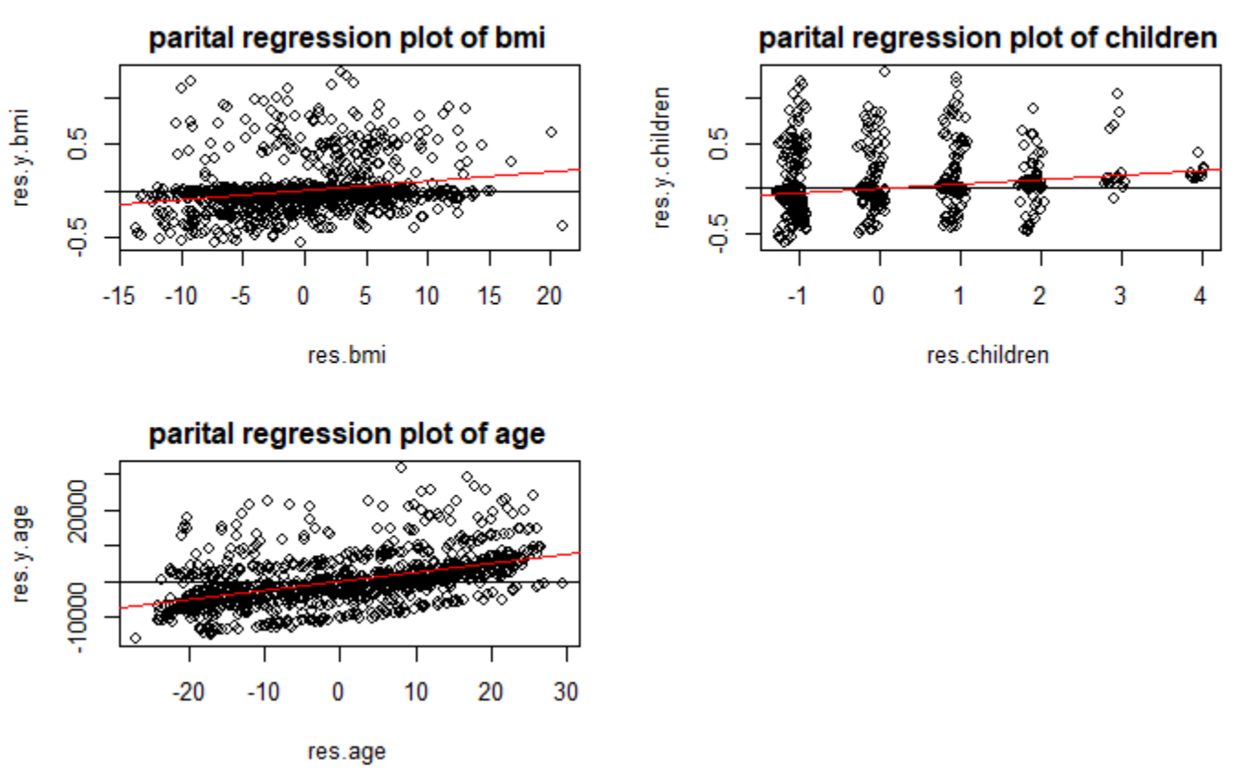
The transformed model still shows the presence of non-linearity because of skewed data or outliers
First, we choose to transform the response variable to attempt address the non-constant variance.
From our hypothesis, we think non-linearity in the dataset can be addressed by transforming the predictors’ age, old people & people with high bmi likely to have high medical expenses, bmi>30 is considered high risk
We introduced a second-order variable for age2 = age^2 and introduced a categorical variable bmi30 ( is 1 if bmi >30 else 0)
We also noted that people who smoke are likely to have low bmi, so introduced interaction between bmi30 and smoker
From the plots, we can infer that our initial model
Variance is still not constant
But we still see Non-linear relationship between y & Xs in the residual plot
Heavy tails can in normal Q-Q plot indicating the data is skewed
partial regression plot, confirm that the predictors bmi, age and children is appropriate

Slide 12
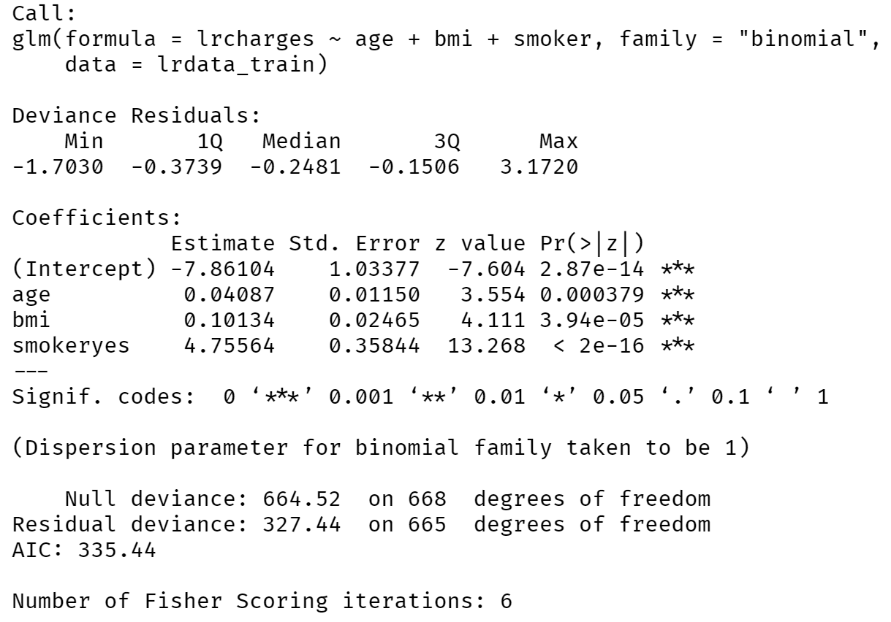
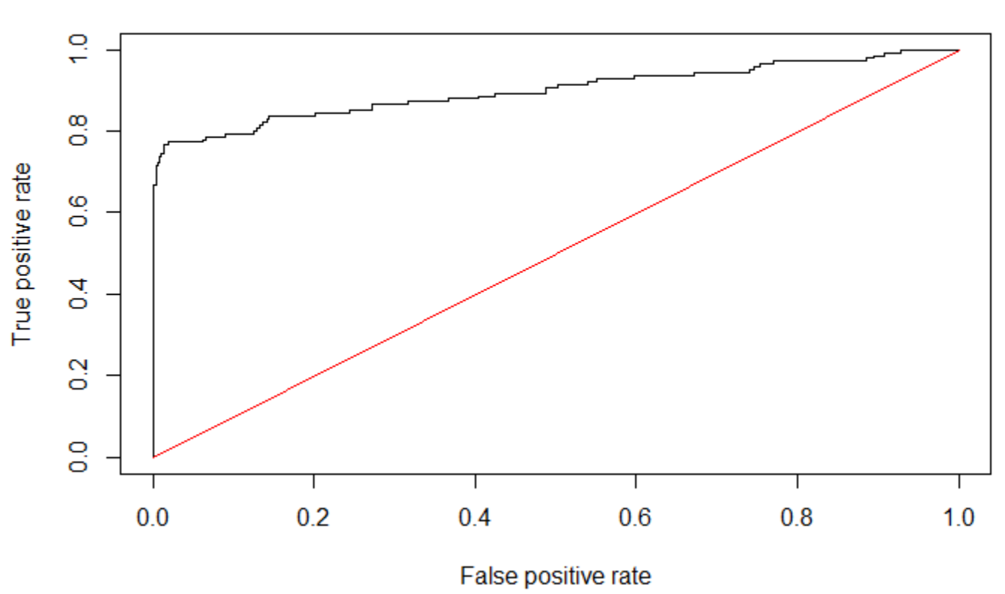
Alternate model : Our final logistic regression model after validating assumptions and testing for significant predictors
We were able to remove sex, region, and children as predictors based on the results from hypothesis testing, Wald test ad delta G^2 test.
Large difference between null and residual deviations confirms that the model has better predictability.
The AUC value for our model is 0.8999704. The AUC value is higher than 0.5, which means the model does better than random guessing the classifying observations.
Our goal was to minimize the false positive rate so we can reduce the error in the prediction that medical charges can be greater than $20000 when it is less than $20000
The false positive rate for our logistic regression model was 0.0625, it is a small number, and we are satisfied with it.
ROC
AUC : 0.8999704

Slide 13
Initial MLR model did not satisfy linear regression assumptions even after transforming Y and X, but the alternate Logistic Regression model has better predictability
Even after applying transformations, the model fit is still not satisfying linear regression assumptions.
We still see non-linearity, and non-constant variance issues are still not addressed in the model.
It could be due to skewed data or outliers in the dataset.
So we conclude that our initial transformed model is useful for exploring the relationship between predictor and response variables. However, the predicted values will be unreliable.
The alternate logistic regression model has the better predictability
Our team recommendation:
The logistic regression model has better predictability.

Slide 14

Project Conclusion
We prefer the logistic regression model as it has better predictability
Observation:
Our data is skewed when it comes to age & smokers, producing more balanced dataset may improve the predictability of our initial MLR model

