Slide 1


Survey of Data Methods Useful in the ONDRI Environment: Part III
Kelly Sunderland, Malcolm Binns, Derek Beaton, Pradeep Raamana
2019-Sep-10

Slide 2
Ordination
Dimensionality reduction/projection
Subspace/manifold method (learning)
Orthogonal transformation
Diagonalization or matrix factorization
Matrix approximations
Matrix decomposition
Linear autoencoder (single layer a.k.a. stupid neural network)
Sometimes correctly, sometimes incorrectly: factor analyses
Spectral decomposition
(Specific types of) “MVPA” and “RSA” in neuroimaging
Multivariate statistics
SURPRISE: It’s all just sort of Principal Components Analysis (PCA)

Slide 3
Generalization of
GENERALIZATION
METHOD
Basis of
Some sort of relationship

Slide 4
Chaos!
STATIS
MCA
PLS
CA
PCA
MMDS
MFA
PLS-R
PC-R
CCA
DA
PLSCAN
PLSPM
MBPLS
RRR
PLSC
FA
gCCA
Rotations
CFA & SEM
EFA
ICA

Slide 5
Overview
PCA
Something like
a PCA but with multiple tables, or structure for the columns?
a correlation or regression between tables?
a PCA but for all those weird types of data?

Slide 6
A component (sometimes a.k.a. factor)
A new variable
Bits & pieces (weights, “loadings”) of all original variables
Each explains a proportion of total variance
All observations exist along them
Is orthogonal subsequent to the previous components

Slide 7
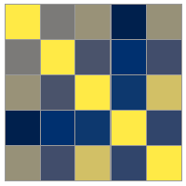

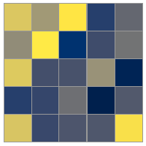
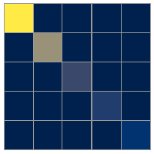
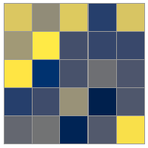
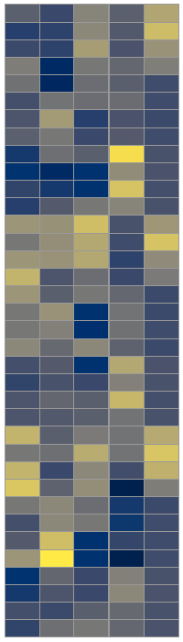
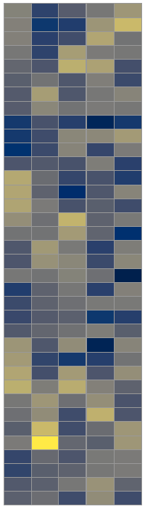
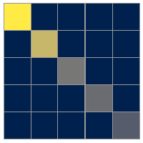
Eigenvalue Decomposition (EVD)
Singular value decomposition (SVD)
cor
Magic EVD box
DATA
(SCALED)
Magic SVD box

Slide 8
Eigenvalue Decomposition (EVD)
Singular value decomposition (SVD)
X^{T}X = VLV^{T} = V^{T}D²V^{T}
X^{T}X
Magic EVD box
X = UDV^{T}
X
Magic SVD box

Slide 9
Eigenvalue Decomposition (EVD)
Singular value decomposition (SVD)
cor
Magic EVD box
DATA
(SCALED)
Magic SVD box

Slide 10
Eigenvalue Decomposition (EVD)
Singular value decomposition (SVD)
Component (factor) scores
Loadings
DATA
(SCALED)
Magic SVD box
Singular values = square root of the variance
Squared singular values = Eigenvalues = variance

Slide 11
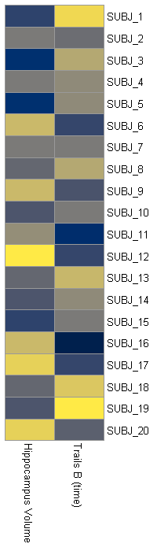
Tiny example
Magic SVD box

Slide 12
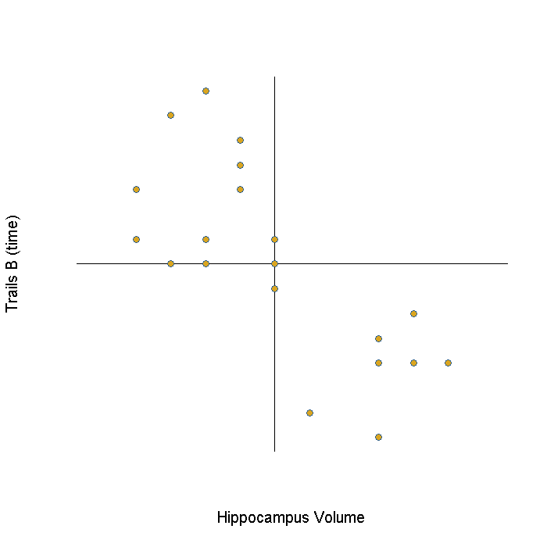

Slide 13
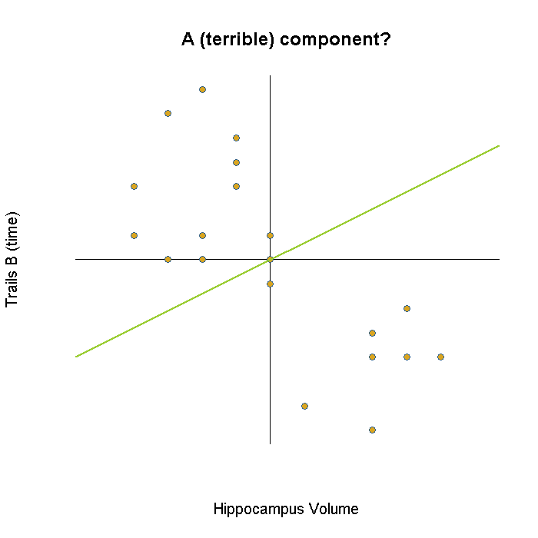

Slide 14
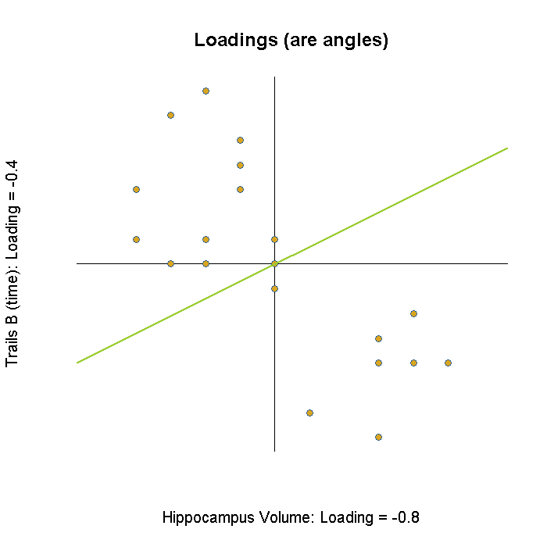

Slide 15
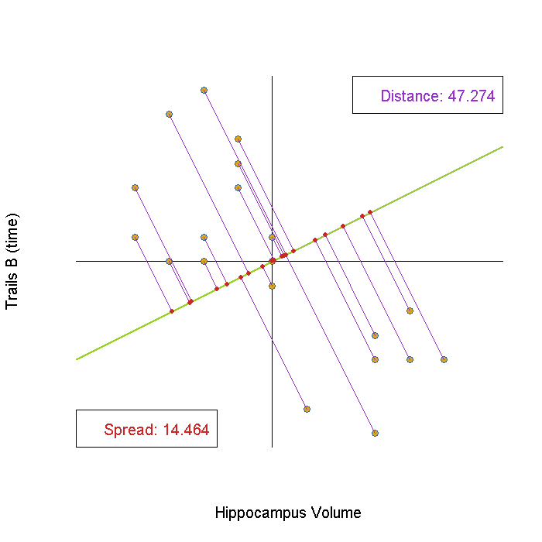

Slide 17
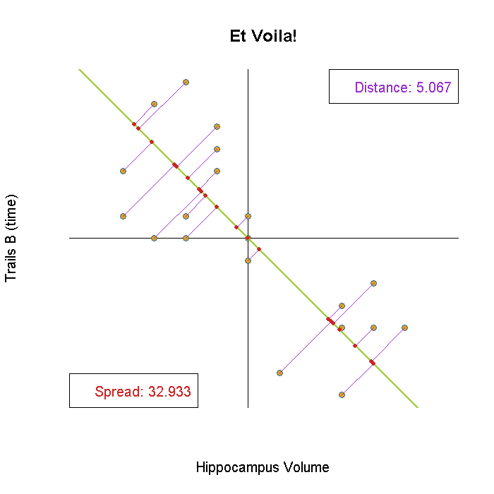

Slide 18
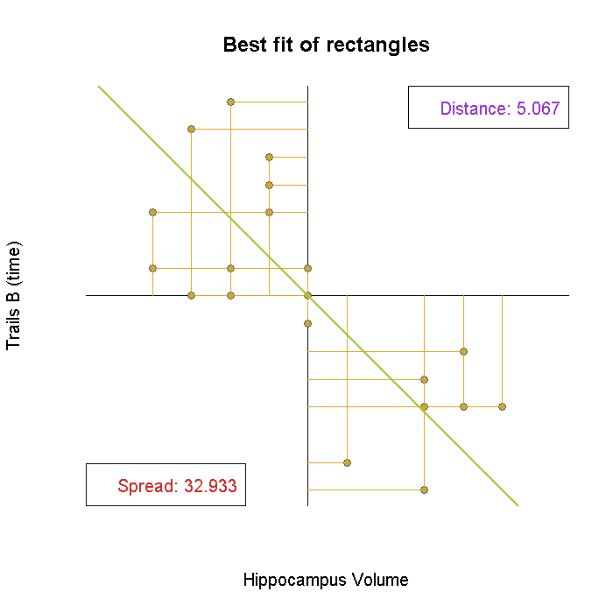

Slide 19
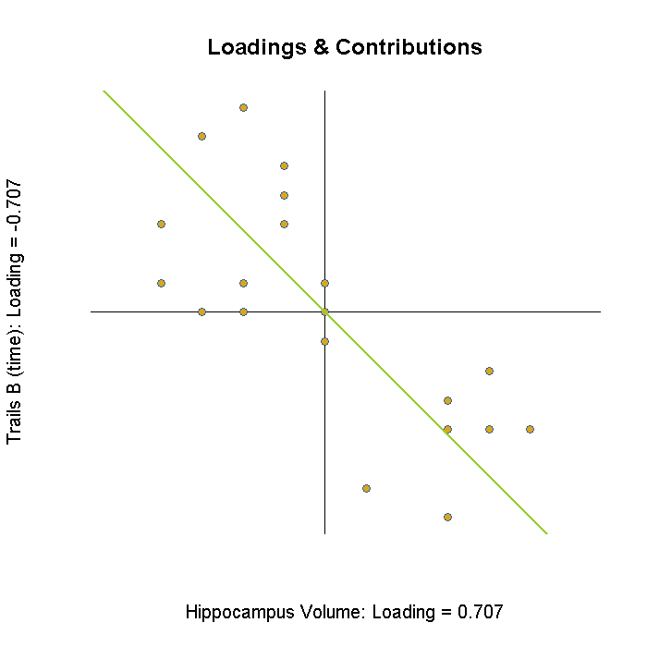

Slide 20
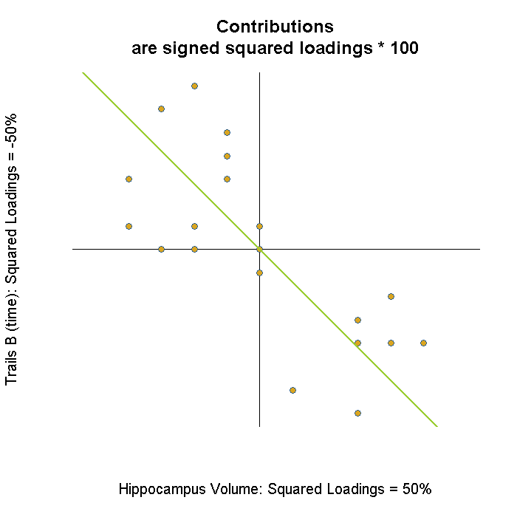

Slide 21
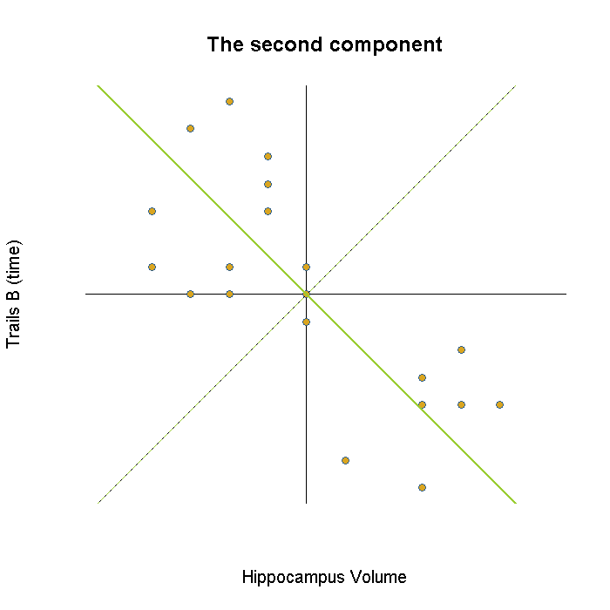

Slide 22
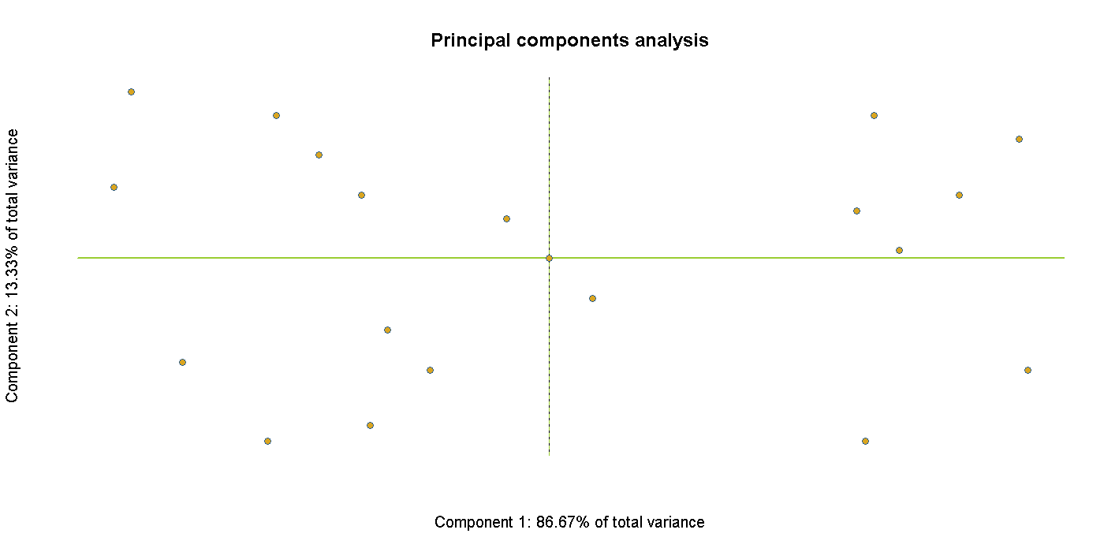

Slide 23
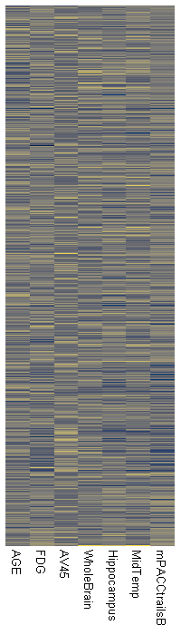
Scaling up
Magic SVD box

Slide 24
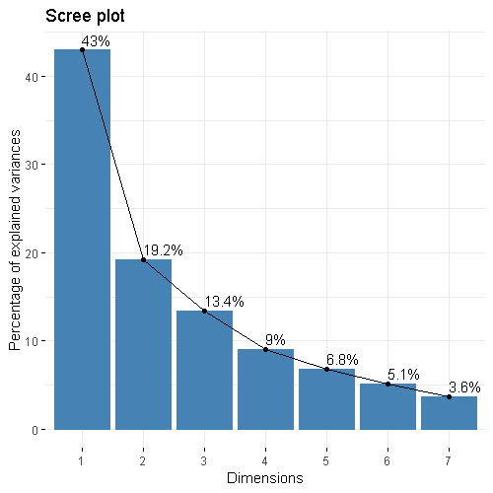
Scaling up

Slide 25
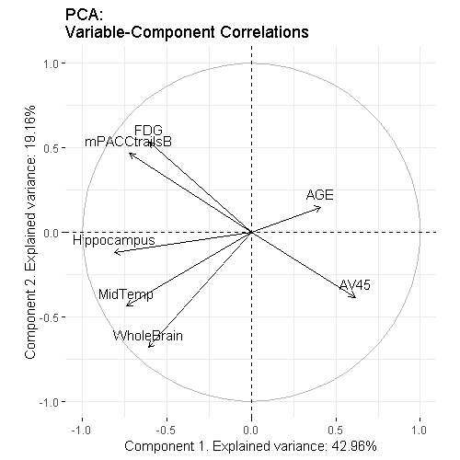
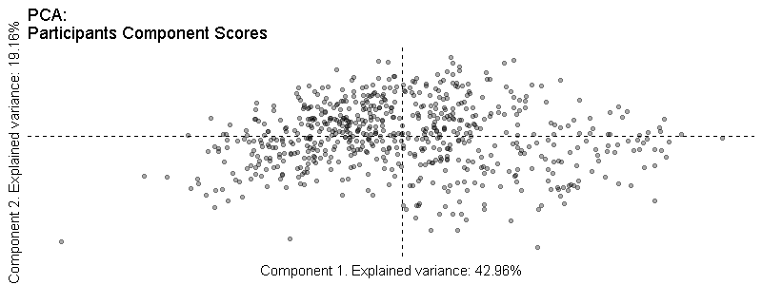
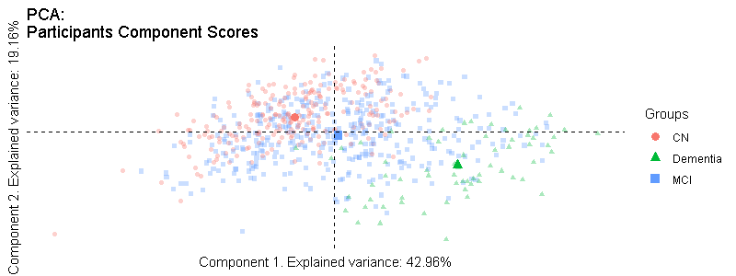
Scaling up

Slide 26
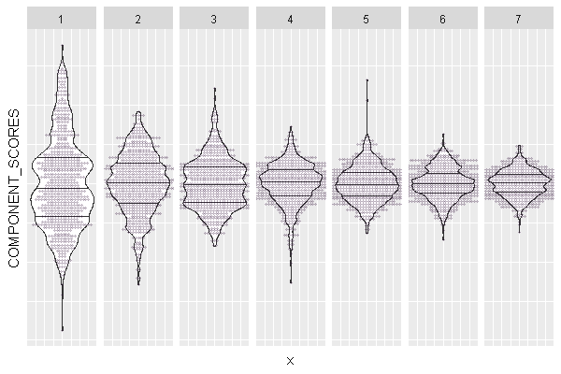
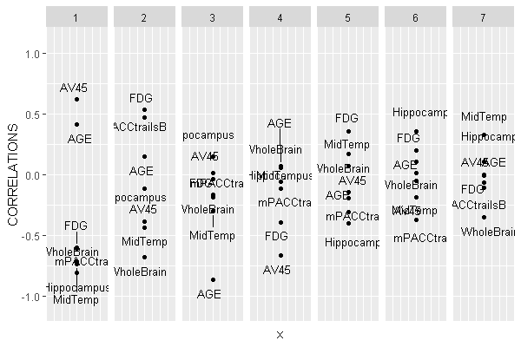
Scaling up

Slide 27
What if things are more complex?
PCA
Something like
a PCA but with multiple tables, or structure for the columns?
a correlation or regression between tables?
a PCA but for all those weird types of data?

Slide 28
What if things are more complex?
PCA
Something like
a PCA but with multiple tables, or structure for the columns?
a correlation or regression between tables?
a PCA but for all those weird types of data?

Slide 29
Chaos!
STATIS
MCA
PLS
CA
PCA
MMDS
MFA
PLS-R
PC-R
CCA
DA
PLSCAN
PLSPM
MBPLS
RRR
PLSC
FA
gCCA
Rotations
CFA & SEM
EFA
ICA

Slide 30
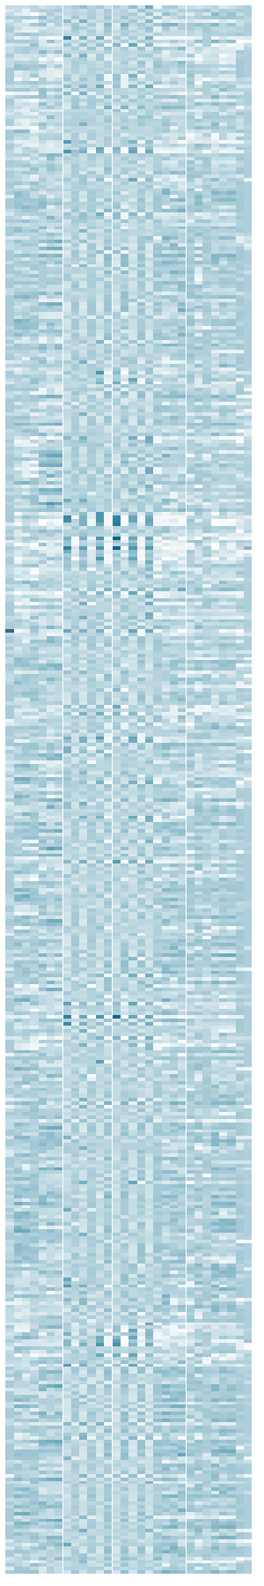
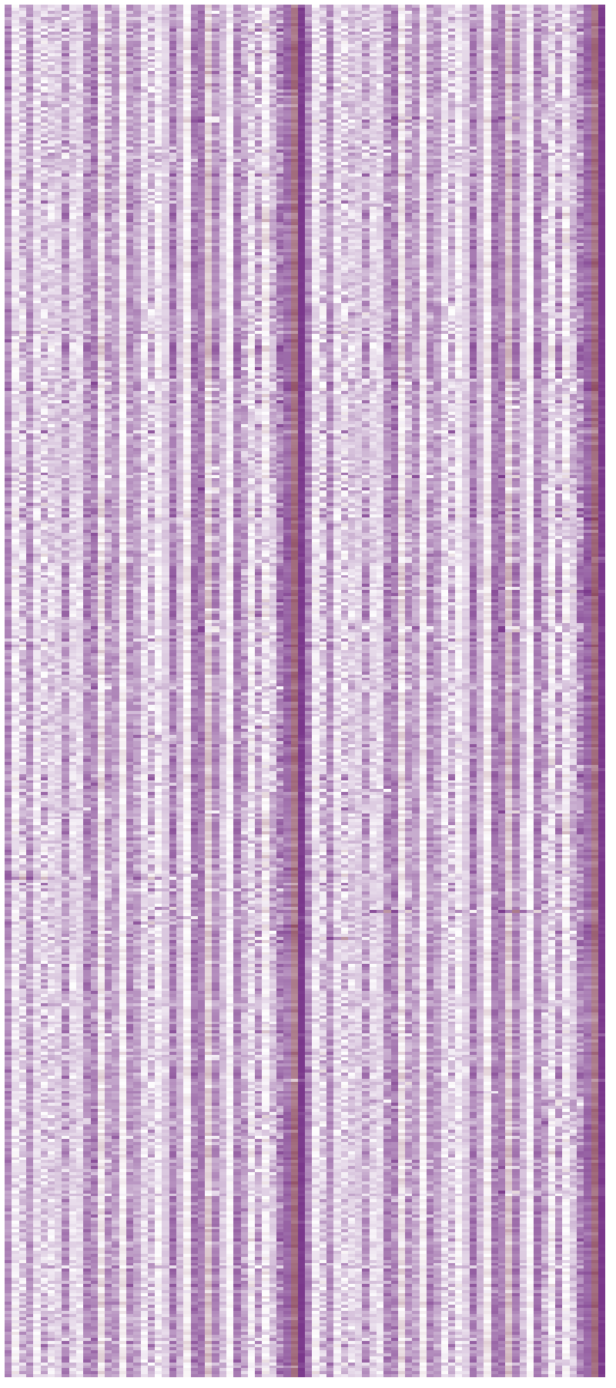
Multiple Factor Analysis
NPSY
GNMC
NIMG

Slide 31
Multiple Factor Analysis
BAD IDEA
Magic SVD box
123 total variables
Each variable is normed

Slide 32
Multiple Factor Analysis
30 / 123 = ~24 %
9 / 123 ~7%
84 / 123 = ~68%

Slide 33
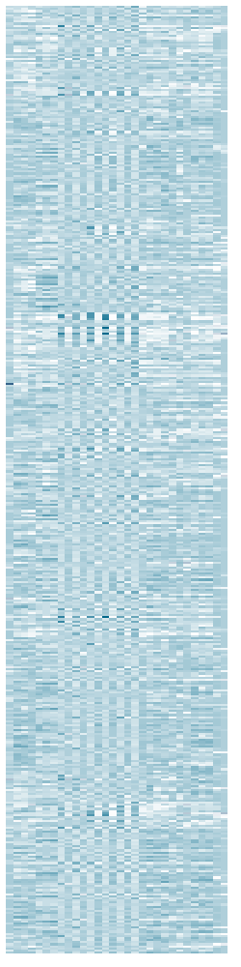
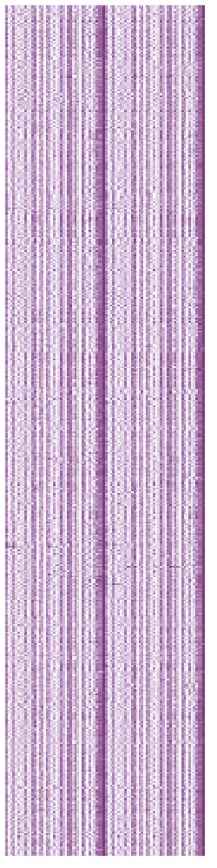
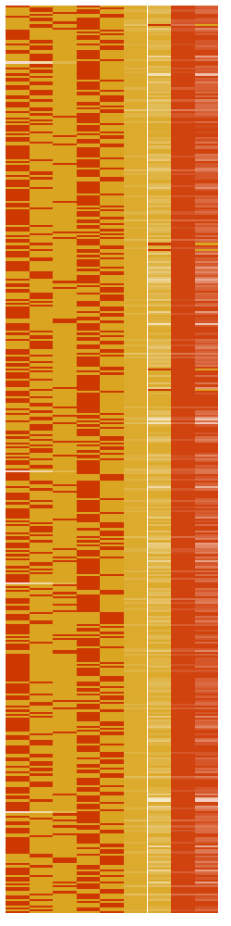
Multiple Factor Analysis
30 variables 1 / 3 = ~33 %
9 variables 1 / 3 = ~33%
84 variables 1 / 3 = ~33%

Slide 34
Making it Fair Analysis
Magic SVD box
123 total variables
Each variable and table is normed

Slide 35
What if things are more complex?
PCA
Something like
a PCA but with multiple tables, or structure for the columns?
a correlation or regression between tables?
a PCA but for all those weird types of data?

Slide 36
Chaos!
STATIS
MCA
PLS
CA
PCA
MMDS
MFA
PLS-R
PC-R
CCA
DA
PLSCAN
PLSPM
MBPLS
RRR
PLSC
FA
gCCA
Rotations
CFA & SEM
EFA
ICA

Slide 37
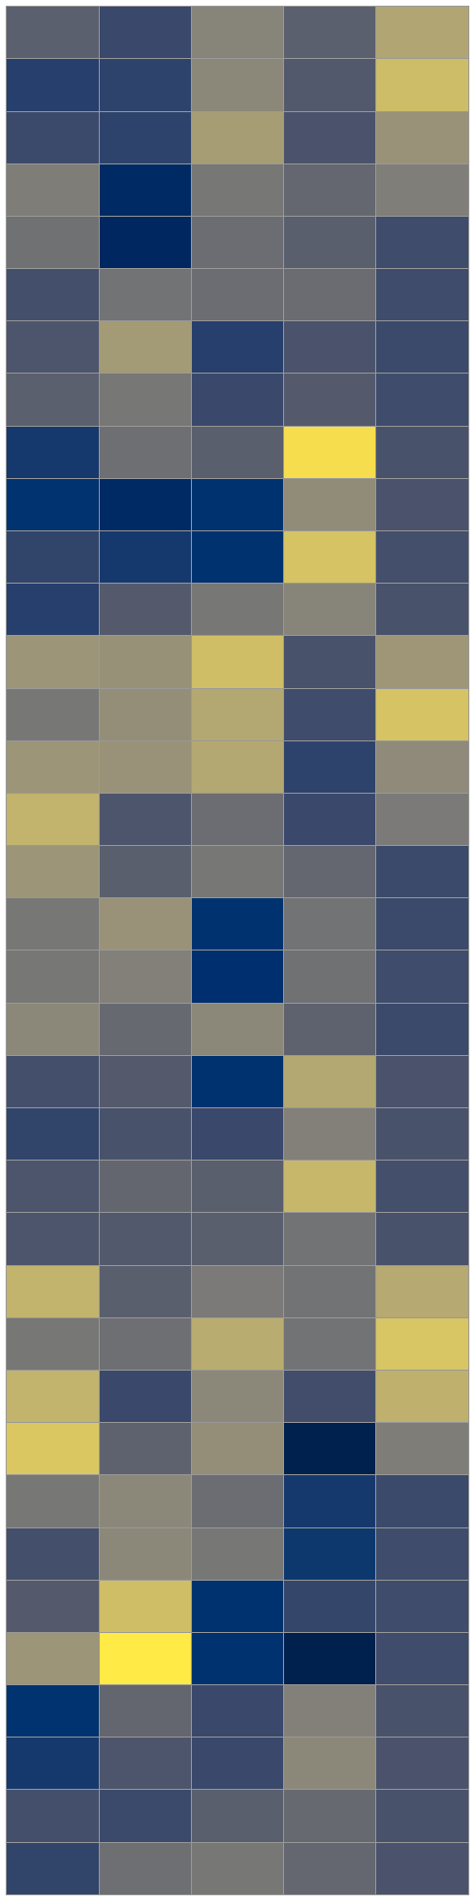
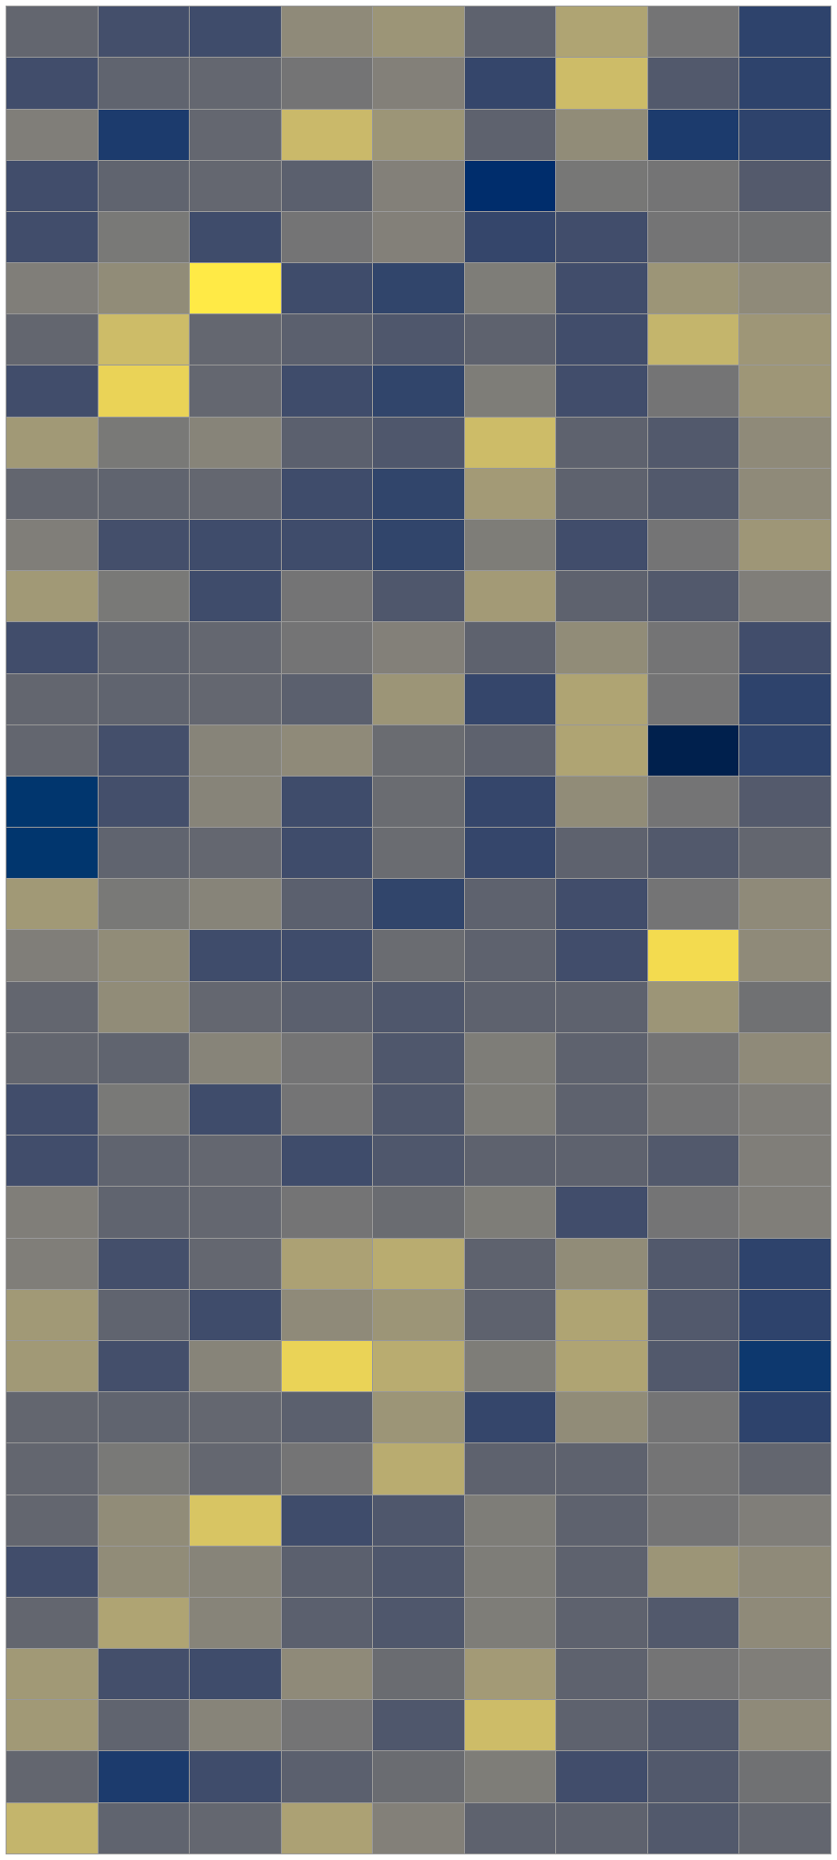
Between Two Tables
X
Y

Slide 38
Between Two Tables
X
Y

Slide 39
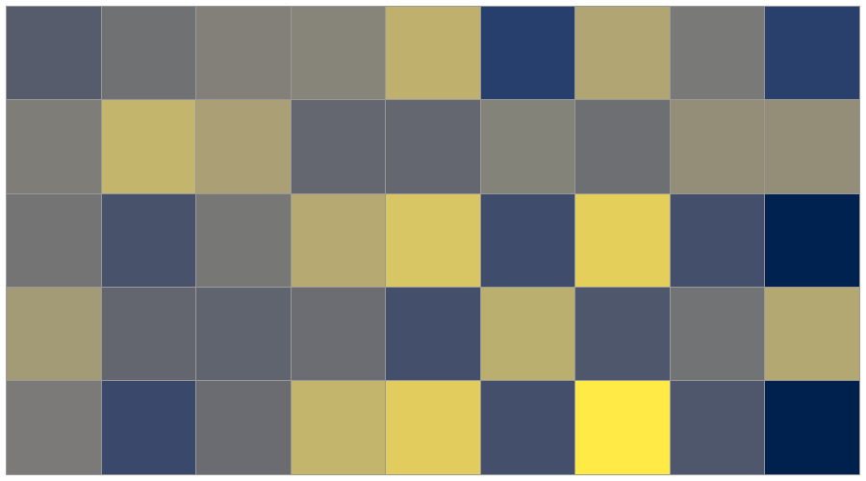
Between Two Tables
✖️
〓
X
Y
R

Slide 40
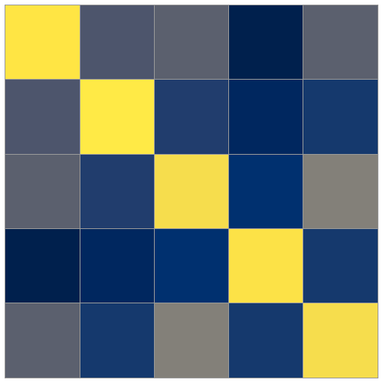
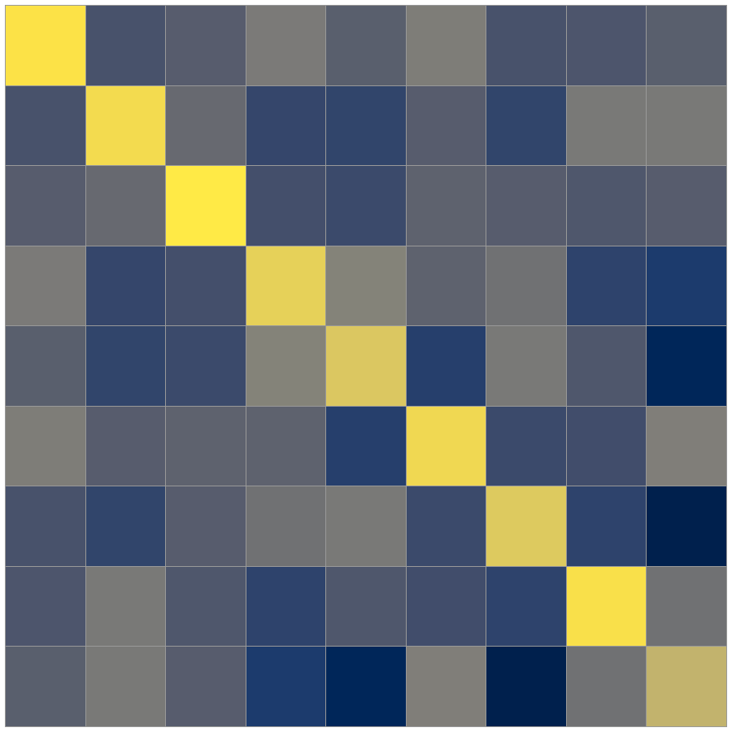
Between Two Tables
Partial least squares (“correlation”)
Reduced rank regression
Canonical correlation analysis
X^{T}Y
X^{T}Y
X^{T}Y
X^{T}X
(X^{T}X)(Y^{T}Y)

Slide 41
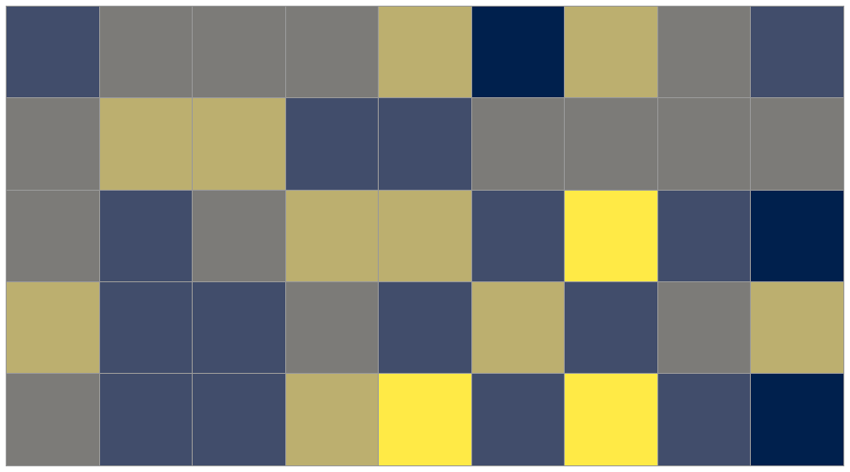
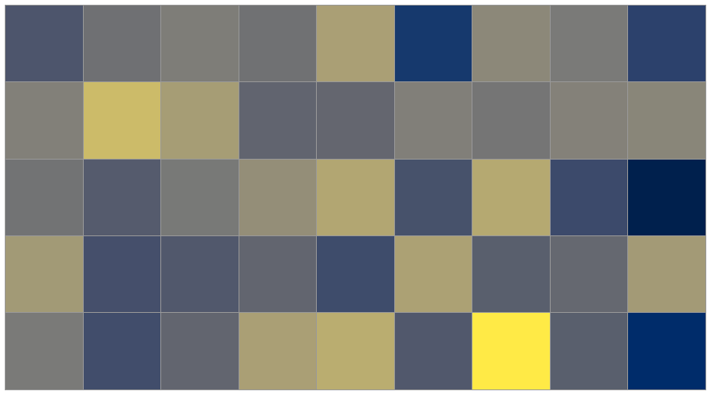
Between Two Tables
Partial least squares (“correlation”)
Reduced rank regression
Canonical correlation analysis
Magic SVD box
Magic SVD box
Magic SVD box

Slide 42
What if things are more complex?
PCA
Something like
a PCA but with multiple tables, or structure for the columns?
a correlation or regression between tables?
a PCA but for all those weird types of data?

Slide 43
Everything up until now
Generally normal(-ish) variables
Assumed strictly continuous
What about
Non-normal?
Counts?
Ordinal or Likert?
Lots of zeros?
Categorical?
That you can compute a meaningful correlation matrix

Slide 44
Chaos!
STATIS
MCA
PLS
CA
PCA
MMDS
MFA
PLS-R
PC-R
CCA
DA
PLSCAN
PLSPM
MBPLS
RRR
PLSC
FA
gCCA
Rotations
CFA & SEM
EFA
ICA

Slide 45
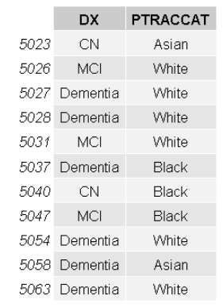
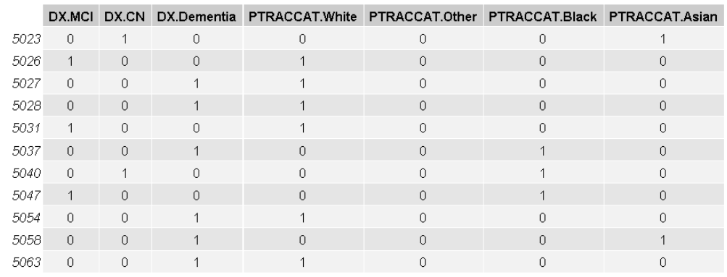
Correspondence Analysis

Slide 46
Correspondence Analysis
"coding categorical variables with the indicator matrix of dummy variables and considering them as Gaussian, for instance, is almost a crime."
"Jan de Leeuw and the French School of Data Analysis" (Husson, Josse, Saporta)
Notes:
“An exotic technique only used by the French” - Reviewer 2
In response to a French person (seriously)

Slide 47
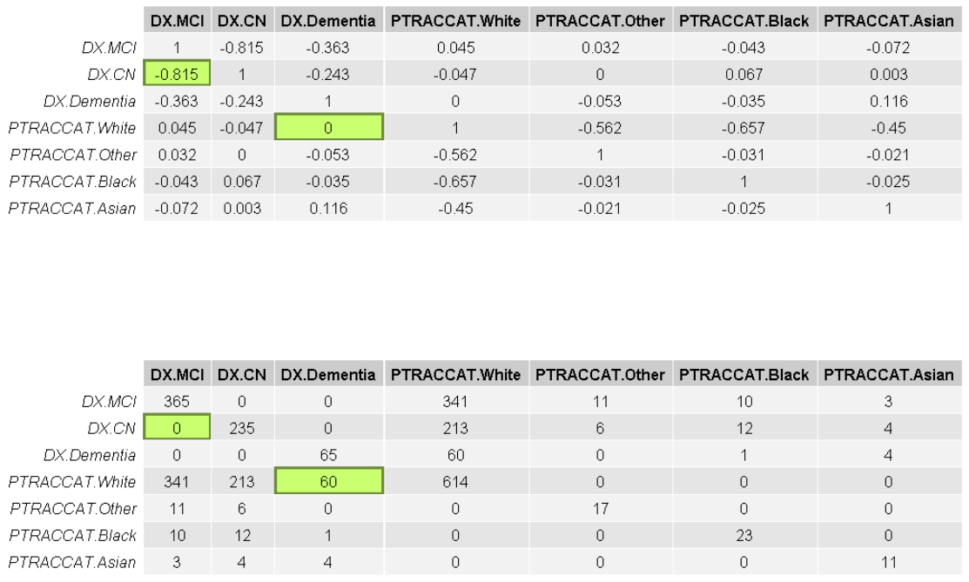

Slide 48
Correspondence Analysis
Just like PCA but designed for
Non-normal
Counts
Ordinal & Likert
Lots of zeros
Categorical
Generalizes PCA
Through the magic of Chi-squared preprocessing
It’s all you’ll ever need if you know
But you need to know that it exists

Slide 49
What about everything else?
Maybe another time?
100s, if not 1000s, of PCA-based or PCA-like methods
Did not cover
{Distances & MDS & Clustering} and Networks
Discriminant/groups
t-SNE/UMA, some types of neural networks & some other types of other neural networks
Anything regarding all of the particulars of how/what to interpret
Significance, stability, selection, and inference

Slide 50
Questions and Comments

