Slide 1
An Introduction to ANOVA in R.
Daniel Faso Derek Beaton
Noah Sasson Hervé Abdi

Slide 2
An Introduction to ANOVA in R.
Daniel Faso Derek Beaton
Noah Sasson Hervé Abdi

Slide 3
An Introduction to ANOVA in R.
Daniel Faso Derek Beaton
Noah Sasson Hervé Abdi

Slide 4
An Introduction to ANOVA in R.
Daniel Faso Derek Beaton
Noah Sasson Hervé Abdi

Slide 5
An Introduction to ANOVA in R.
Daniel Faso Derek Beaton
Noah Sasson Hervé Abdi
Joseph Dunlop

Slide 6
Outline
We have a lot to talk about!
What is, and why use R?
All sorts of ANOVAs
And (most) everything to go with them!

Slide 7
Outline
We have a lot to talk about!
What is, and why use R?
All sorts of ANOVAs
And (most) everything to go with them!

Slide 8
R
Stats or Programming?
Gratis vs. Libre?

Slide 9
R
Stats or Programming?
Gratis vs. Libre?

Slide 10
R
Stats and Programming
Gratis and Libre

Slide 11
R
Stats and Programming
R is a language
R is an environment
Gratis and Libre

Slide 12
R
Stats and Programming
Gratis and Libre
Free (as in beer)
Free (as in speech)
No cost, no restrictions

Slide 13
R Communities
Several major ones:
CRAN
BioConductor
R-Forge

Slide 14
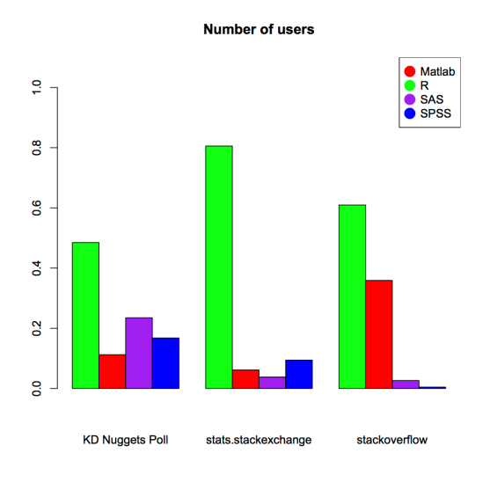
We promise!

Slide 15
R Communities
Community provides add-ons
Called packages
March, 2013: 4380 packages (CRAN)
February, 2014: 5206 packages (CRAN)

Slide 16
R is a language
What if something doesn’t exist?
Make it yourself!
R is Turing Complete

Slide 17
R as a language
Syntax comes from S
R syntax is a bit similar to Matlab
But with some special features specifically for “speaking stats”

Slide 18
All sorts of interfaces
R is ugly.
And sometimes slow.
But people are changing that!
Remember: beer and speech!

Slide 19
Yuck!

Slide 20
Less yuck

Slide 21
SPSS like

Slide 22
SPSS like

Slide 23
Matlab like

Slide 24
And many more
RED
TinnR
RevoR
A commercial version with free academic license
Which means it’s faster and comes with support!

Slide 25
Moving on
For today, we’ll stick with regular ugly R.

Slide 26
Outline
We have a lot to talk about!
What is, and why use R?
All sorts of ANOVAs
And (most) everything to go with them!

Slide 27
All sorts of ANOVAs
S = Subjects
A = independent variable A
a = level of A
S(A) = one factor between
S x A = one factor within (repeated)
y = Dependent Variables

Slide 28
All sorts of ANOVAs
S = Subjects
A = independent variable A
a = level of A
S(A) = one factor between
S x A = one factor within (repeated)
y = Dependent Variables

Slide 29
All sorts of ANOVAs
S = Subjects
A = independent variable A
a = level of A
S(A) = one factor between
S x A = one factor within (repeated)
y = Dependent Variables

Slide 30
All sorts of ANOVAs
S = Subjects
A = independent variable A
a = level of A
S(A) = one factor between
S x A = one factor within (repeated)
y = Dependent Variables

Slide 31
All sorts of ANOVAs
S = Subjects
A = independent variable A
a = level of A
S(A) = one factor between
S x A = one factor within (repeated)
y = Dependent Variables

Slide 32
All sorts of ANOVAs
S = Subjects
A = independent variable A
a = level of A
S(A) = one factor between
S x A = one factor within (repeated)
y = Dependent Variables

Slide 33
All sorts of ANOVAs
S = Subjects
A = independent variable A
a = level of A
S(A) = one factor between
S x A = one factor within (repeated)
y = Dependent Variables

Slide 34
All sorts of ANOVAs
S(A)
S(A x B) – balanced and unbalanced
S(A) x B – balanced and unbalanced
S(A x B) x C

Slide 35
All sorts of ANOVAs
S(A)
S(A x B) – balanced and unbalanced
S(A) x B – balanced and unbalanced
S(A x B) x C

Slide 36
All sorts of ANOVAs
S(A)
S(A x B) – balanced and unbalanced
S(A) x B – balanced and unbalanced
S(A x B) x C

Slide 37
All sorts of ANOVAs
S(A)
S(A x B) – balanced and unbalanced
S(A) x B – balanced and unbalanced
S(A x B) x C

Slide 38
All sorts of ANOVAs
S(A)
S(A x B) – balanced and unbalanced
S(A) x B – balanced and unbalanced
S(A x B) x C

Slide 39
Outline
We have a lot to talk about!
What is, and why use R?
All sorts of ANOVAs
And (most) everything to go with them!

Slide 40
(Most) Everything
Transforming data
Plotting results
Saving results
Post hoc tests
And (maybe) many more!

Slide 41
(Most) Everything
Transforming data
Plotting results
Saving results
Post hoc tests
And (maybe) many more!

Slide 42
(Most) Everything
Transforming data
Plotting results
Saving results
Post hoc tests
And (maybe) many more!

Slide 43
(Most) Everything
Transforming data
Plotting results
Saving results
Post hoc tests
And (maybe) many more!

Slide 44
(Most) Everything
Transforming data
Plotting results
Saving results
Post hoc tests
And (maybe) many more!

Slide 45
Quick background
Two important concepts:
Variables
Functions
These are how R works

Slide 46
Quick background
Two important concepts:
Variables
Functions
These are how R works

Slide 47
Variables
Called so because they can change
But they only change when you make them change

Slide 48
Variables
Look like this:
> save.this <- from.that

Slide 49
Variables
Look like this:
> save.this <- from.that

Slide 50
Variables
Look like this:
> save.this <- from.that

Slide 51
Variables
Look like this:
> save.this <- from.that

Slide 52
Variables
Look like this:
> save.this = from.that

Slide 53
Variables
Look like this:
> save.this <- from.that

Slide 54
Quick background
Two important concepts:
Variables
Functions
These are how R works

Slide 55
Quick background
Two important concepts:
Variables
Functions
These are how R works

Slide 56
Functions
y = f(x)
Ew, math.

Slide 57
Functions
Same idea

Slide 58
Functions
y = f(x)

Slide 59
Functions
y = f(x)

Slide 60
Stuff goes in
y = f(x)

Slide 61
Magic
y = f(x)

Slide 62
Save that magic!
y = f(x)

Slide 63
R does the same thing
Say f(x) is √x

Slide 64
f(x)
If x is 4
f(x) is 2

Slide 65
In R?
>sqrt

Slide 66
In R?
>sqrt
But we require ()

Slide 67
In R?
>sqrt()

Slide 68
But really…
>sqrt(4)

Slide 69
But really…
>sqrt(4)
[1] 2

Slide 70
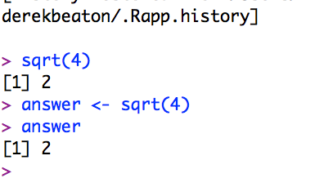
Or…

Slide 71
Or…

Slide 72
Or…

Slide 73
Phew.

Slide 74
Oh…
We still have to talk about ANOVAs!

Slide 75
The real presentation!
Some back and forth

Slide 76
Some back and forth
We need slides & R to show everything today
Follow along as best you can.
If you get lost, we’ll try to help
Notes:
The transition from Derek to Daniel

Slide 77
Basics of R
How can I transition to R?
Notes:
I’m a naïve user, but, I’m here to tell you how to feel comfortable with getting into R

Slide 78
See: very ugly.
Notes:
Yuck, but, a yuck we must deal with if we want to use R!

Slide 79
How to use R
Notes:
Some help resources

Slide 80
Some basics
“Working directory”
What it means
Notes:
Directories are also called folders.

Slide 81
getwd()
get working directory – the folder you’re currently in

Slide 82
setwd()
set working directory – the folder you want to change to

Slide 83
Let’s get & set!
Notes:
Switch over to R to actually change our directory. Open the S(A) first file.

Slide 84
ls()
Lists variables in R’s workspace

Slide 85

ls()
Lists variables in R’s workspace

Slide 86

ls()
Lists variables in R’s workspace

Slide 87
Storing variables
my.var <- 10 + 12

Slide 88
R is a fancy calculator

Slide 89
(Not) Storing variables

Slide 90

(Not Yet) Storing variables

Slide 91
ls()
Lists variables in R’s workspace

Slide 92
ls()
Lists variables in R’s workspace

Slide 93
(Now) Storing variables
my.var <- 10 + 12

Slide 94

Storing variables
my.var <- 10 + 12

Slide 95

Storing variables
my.var <- 10 + 12

Slide 96
ls()
Lists variables in R’s workspace

Slide 97

ls()
Lists variables in R’s workspace

Slide 98
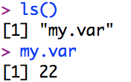
ls()
Lists variables in R’s workspace

Slide 99
Storing variables
my.var <- 10 + 12
We’ll be doing this a lot

Slide 100
rm()
What about getting rid of everything?
rm(list=ls())
BE CAREFUL USING THIS!

Slide 101
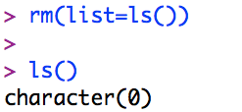
rm()
What about getting rid of everything?
rm(list=ls())
BE CAREFUL USING THIS!

Slide 102
Help!
?
??
Notes:
There are two ways to get help

Slide 103
Help!
? – a.k.a Help
??
Notes:
One question mark means you need the Help files

Slide 104
Help!
? – a.k.a Help
?? – a.k.a Helpless
Notes:
A second question mark means you’re helpless!

Slide 105
Kidding!
? – if you know the name
?? – if you don’t!
Notes:
No, no, not really. But, it’s not a bad mnemonic!

Slide 106
Quick example
?getwd

Slide 108
Quick example
??anova

Slide 110
Really stuck?

Slide 111
Some basic reminders
ANOVA aims to detect differences between means
Null hypothesis is when there is no difference between means

Slide 112
Dan’s turn!
With code walk throughs

Slide 113
Let’s begin!
?aov
Notes:
And now for some ANOVA!

Slide 114
See code for S(A)
Return here for plotting and post-hoc with S(AxB)

Slide 115
We’re back up here!

Slide 116
We’re back up here!
?interaction.plot
Notes:
Let’s take a closer look at interaction plot

Slide 117
?interaction.plot
What does it all mean?

Slide 118
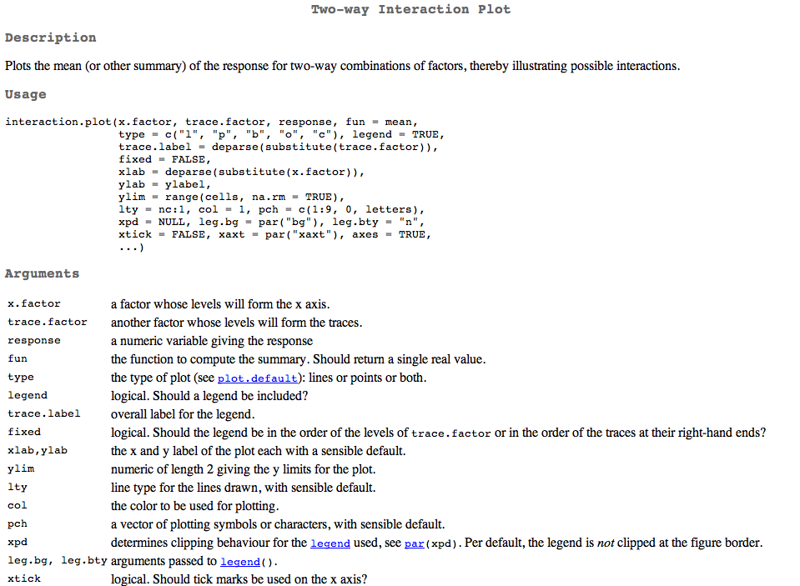
?interaction.plot
Notes:
Yuck, but, quite verbosely yuck!

Slide 119
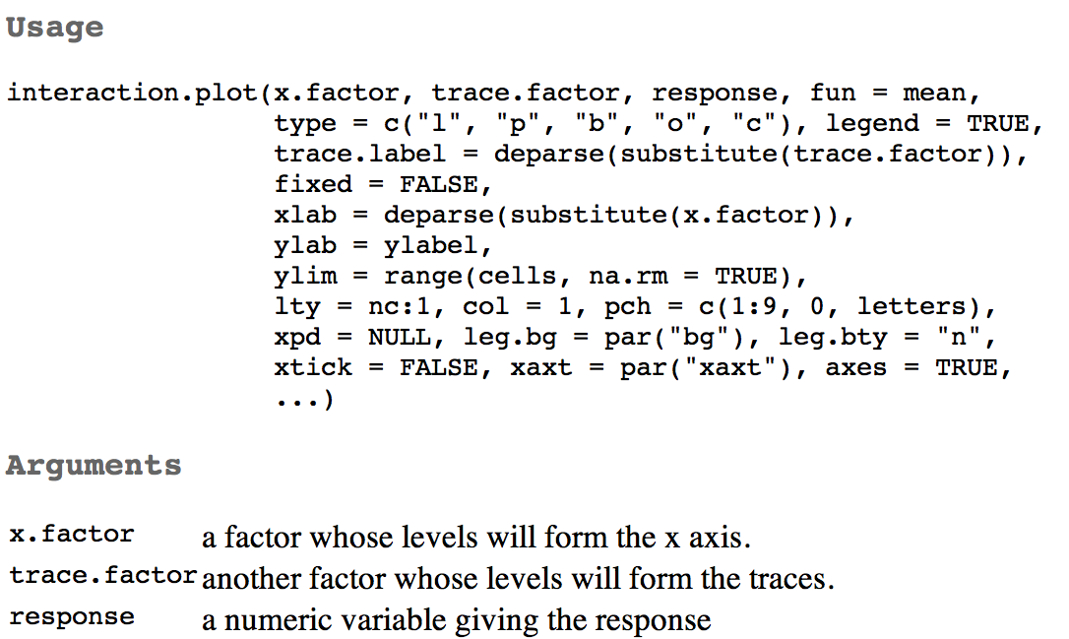

Slide 123
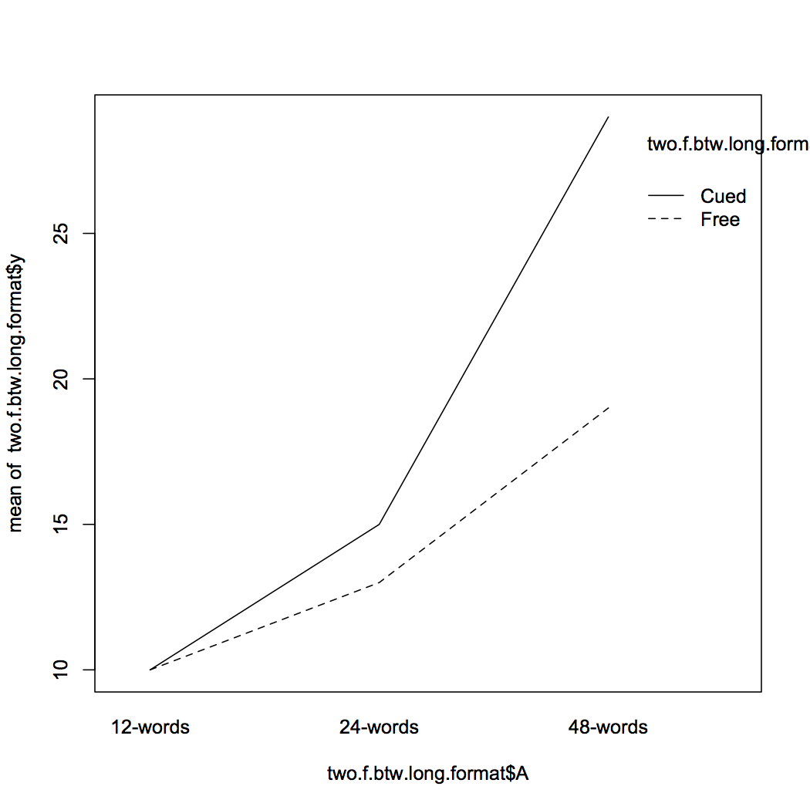
Notes:
It’s OK… but I think we can do better!

Slide 124
But what about the rest?

Slide 125
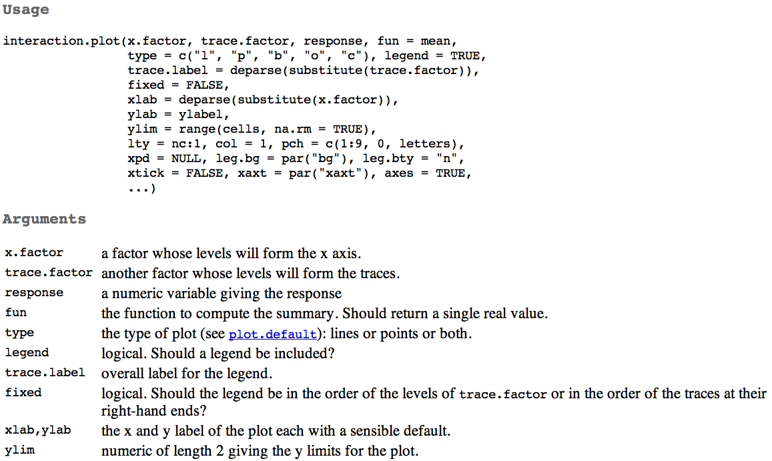

Slide 128
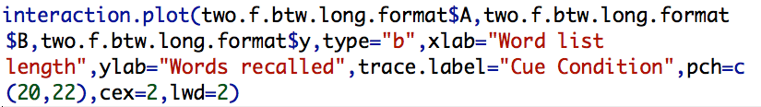
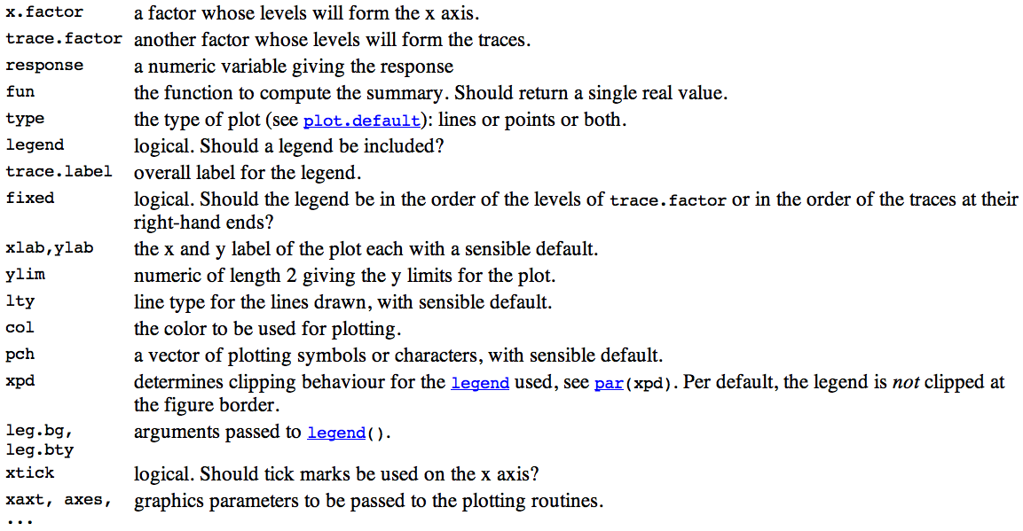

Slide 133
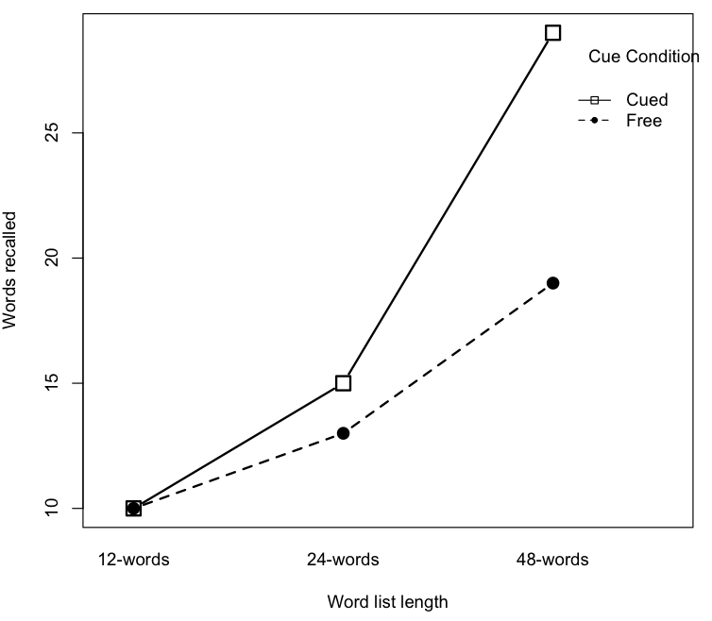

Slide 134
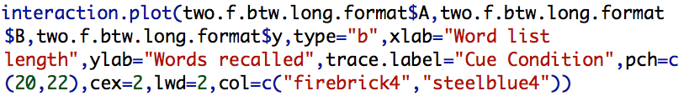

Slide 135
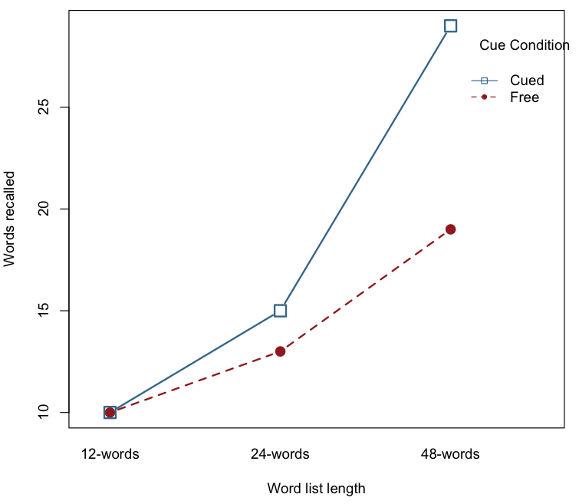

Slide 136
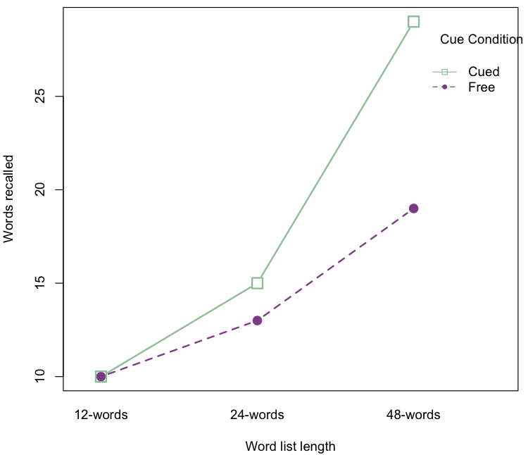

Slide 137
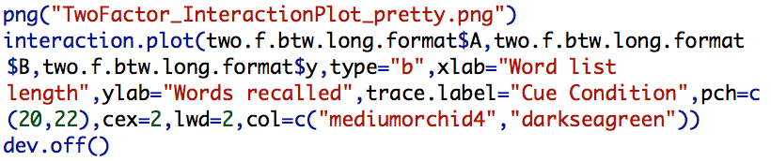

Slide 139
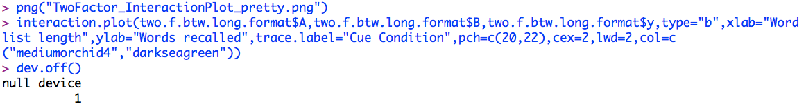
Notes:
Saves the picture for you to your working directory (or other folder if you specify it).

Slide 140
R vs. SPSS
Notes:
So, let’s take a look at that picture I output with a PNG file.

Slide 141
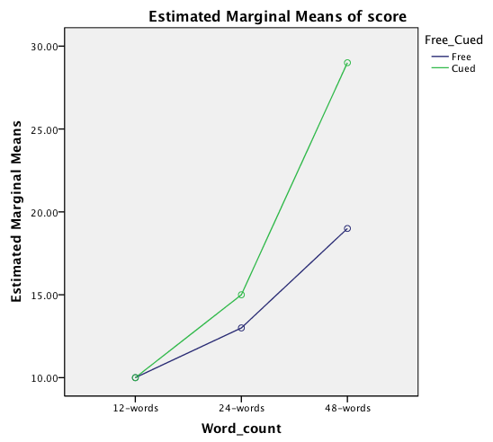
R vs. SPSS
Notes:
And SPSS’s version. Yeah… they’re similar. But all things being the same one costs you thousands per year and the other is free.

Slide 142
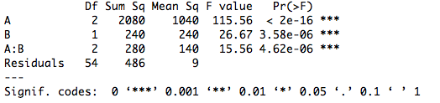
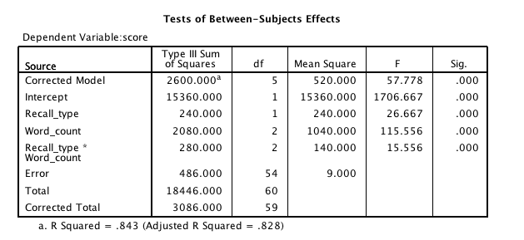
R vs. SPSS
Notes:
And the free one gives you the output in a format that’s quite friendly for APA-style presentation.

Slide 143
R vs. SPSS
Notes:
DEREK YELLS FROM THE CROWD!

Slide 144

Notes:
Like before, we can use the aov() output for post hoc tests.

Slide 145
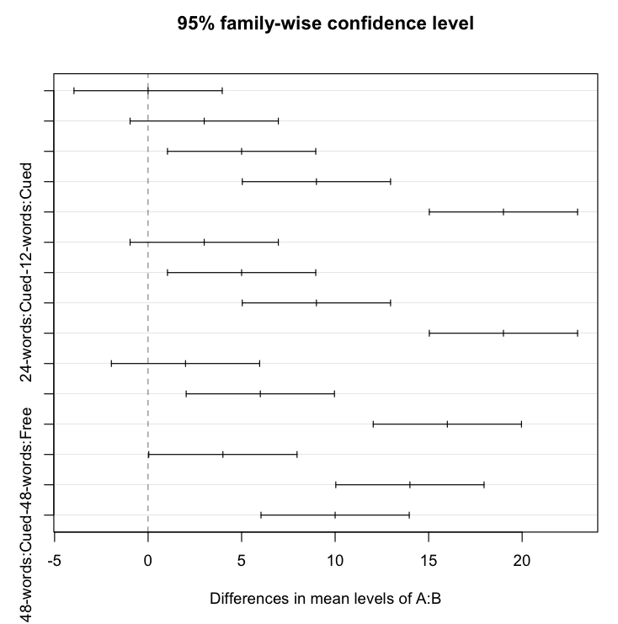
Notes:
But… sometimes the Tukey visualization can be difficult to itnerpret.

Slide 146

Notes:
So we’ll do pairwise comparisons, again!

Slide 147
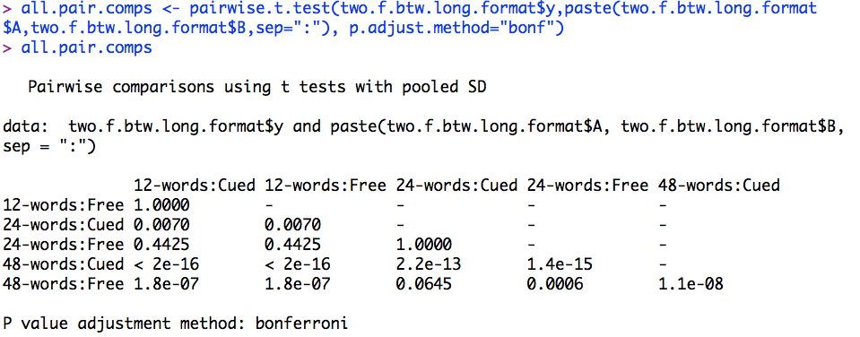
Notes:
Not so bad! The pairwise.t.test function offers many types of p-value corrections.

Slide 150
Derek’s turn!

Slide 151
S(A)xB
Partially repeated

Slide 152
S(A)xB
Partially repeated
A is between
B is within/repeated

Slide 157
reshape()

Slide 158
The data

Slide 159
IDs

Slide 160
Repeated Factor

Slide 161
New DV name

Slide 162
New Repeated IV level names

Slide 163
New Repeated Factor Name

Slide 164
Data shape

Slide 165
Phew
Again.

Slide 166
We know this

Slide 167
But not that!

Slide 168
Together

Slide 169
Output

Slide 170
Output

Slide 171
Output

Slide 172
Output

Slide 173
Output

Slide 174
Output

Slide 175
Output

Slide 176
Same ol’ same ol’

Slide 177
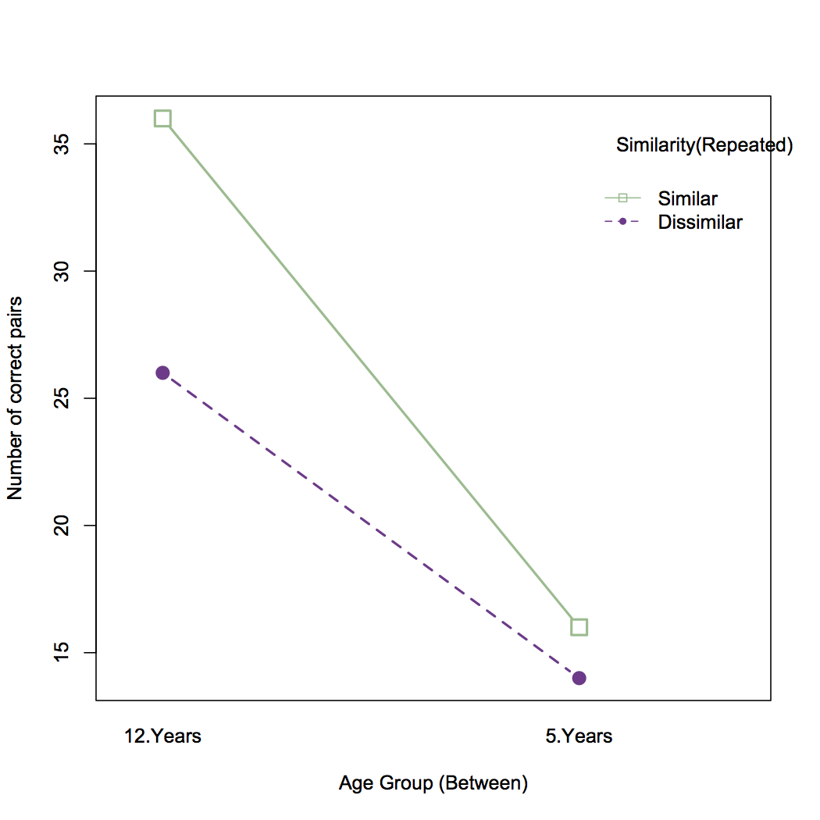

Slide 178
Difficult ANOVAs
What about when things get weird?

Slide 179
So many options
car
lme
ez
lm + aov + drop1

Slide 180
So many options
car
lme
ez
lm + aov + drop1

Slide 181
Easier than
The “easy” pipeline!

Slide 182
Code!
See the Complex_Pipeline

Slide 183
What didn’t we cover?
Really complex ANOVAs
Had between and within, but what about…

Slide 184
Fixed and random?
lm can help.
lme (lme4) is better
You’ll need a book or two!
And something scary…

Slide 185
The Score Model.
Dun dun dun
Y_{abs} = u… + α_{a} + β_{b} + s_{s(a)} + αβ_{ab} + βs_{bs(a)} + e_{bs(a)}

Slide 186
Sums of Squares?
We talked about 1 and 3
There are others!
Some packages allow this
ez, car

Slide 187
Contrasts!
They’re easy
But not really in R…

Slide 188
Packages
car
ez
multcomp
contrasts
So many…

Slide 189
Chicken!
Just do a regression with lm:
res <- lm(y ~ my.contrast)
You’ll have to do your own corrections, though…

Slide 190
Fancy testing methods?
What if my data are weird?
Non normal?
Small sample size?
HUGE sample size?

Slide 191
Resampling
If we’re ready…
we can transition directly
Else,
The answer: bootstrap and permutation

Slide 192
Before we do
Thanks!
Questions?
For now
Comments, complaints, and suggestions
But not until after the next workshop!
Or around at the conference!

