Slide 1
An ExPosition of Bootstrap and Permutation tests for Principal Components Analyses
Derek Beaton
Joseph Dunlop
Hervé Abdi

Slide 2
An ExPosition of Bootstrap and Permutation tests for Principal Components Analyses
Derek Beaton
Joseph Dunlop
Hervé Abdi

Slide 3
Kinds of Data
9 | 6 | 7 | 4 | 5 | 5 | 2 | 2 | 7 | 5 | 1 | 9 | 3 | 3 | 1 | 2 | 2
8 | 5 | 8 | 1 | 1 | 5 | 4 | 2 | 3 | 8 | 2 | 9 | 1 | 5 | 1 | 2 | 2
… | … | … | … | … | … | … | … | … | … | … | … | … | … | … | … | …
2 | 1 | 2 | 2 | 0 | 0 | 2 | 7 | 2 | 6 | 8 | 3 | 6 | 6 | 2 | 6 | 4
2 | 3 | 1 | 4 | 5 | 1 | 3 | 1 | 5 | 6 | 7 | 1 | 3 | 4 | 5 | 7 | 8

Slide 4
An ExPosition of Bootstrap and Permutation tests for Principal Components Analyses
Derek Beaton
Joseph Dunlop
Hervé Abdi

Slide 5
An ExPosition of Bootstrap and Permutation tests for Principal Components Analyses
Derek Beaton
Joseph Dunlop
Hervé Abdi

Slide 6
An ExPosition of Bootstrap and Permutation tests for Principal Components Analyses
Derek Beaton
Joseph Dunlop
Hervé Abdi

Slide 7
An ExPosition of Bootstrap and Permutation tests for Principal Components Analyses
Derek Beaton
Joseph Dunlop
Hervé Abdi
Daniel Faso

Slide 8
Outline
We have a lot to talk about!
Principal Components Analysis (PCA)
Multiple Correspondence Analysis (MCA)
Bootstrap
Permutation

Slide 9
The SVD
We have a lot to talk about!
Principal Components Analysis (PCA)
Multiple Correspondence Analysis (MCA)
Bootstrap
Permutation

Slide 10
Resampling
We have a lot to talk about!
Principal Components Analysis (PCA)
Multiple Correspondence Analysis (MCA)
Bootstrap
Permutation

Slide 11
An ExPosition of
The SVD
Resampling

Slide 12
An ExPosition of
The SVD
Resampling
Notes:
Joseph takes over.

Slide 13
The SVD
Root of all evil most multivariate techniques
Is just an eigendecomposition*
Analyses or pre-analyses
Notes:
What is the SVD?
It is at the core of most multivariate techniques or most multivariate techniques converge to the same solutions.
It’s an eigen for rectangular tables
It’s often used in an analysis, i.e., PCA, or sometimes as a preprocessing step.

Slide 14
Orthogonawesome
The SVD is for rectangular tables
Does two things
Finds the major source of variance
Finds orthogonal slices of your data
Notes:
The SVD has two very important properties:
It finds the major source of variance
2) And then all orthogonal (i.e., uncorrelated) slices of the variance after that.

Slide 15
PCA = SVD
Center & Scale your data
Then SVD
= PCA!
Quick illustration
Notes:
Finally, what we’re here to talk about!
PCA is just the SVD, but with some centering and scaling.
Centering means to subtrac the mean of your measures.
Scaling is to transform them to say z-scores.

Slide 16
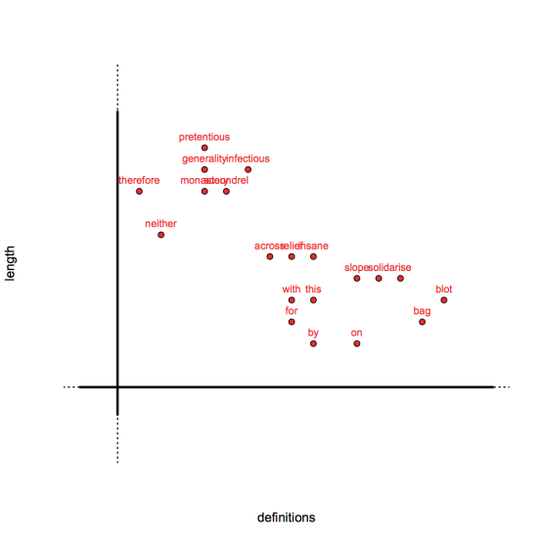
Data
Notes:
20 words with 2 variables: # of definitions and word length

Slide 17
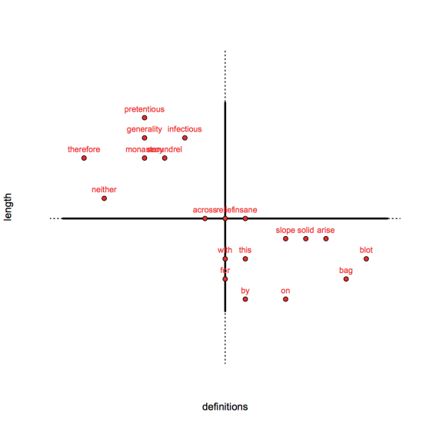
Centered & Normed
Notes:
If we center and scale the data, this is what it looks like. Note the origin in the middle – that’s 0.

Slide 18

Find variance
Notes:
PCA will find the major source of variance. This green line represents that major source of variance. So, how is it defined?

Slide 19
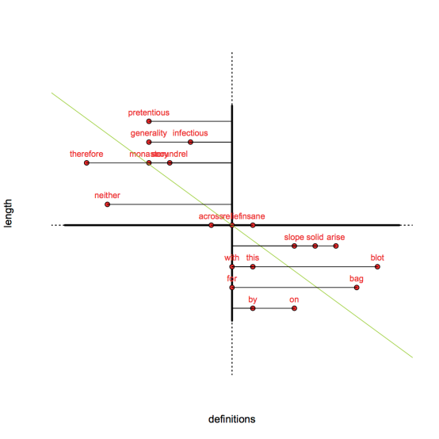
How?
Notes:
First, the distance from one axis

Slide 20
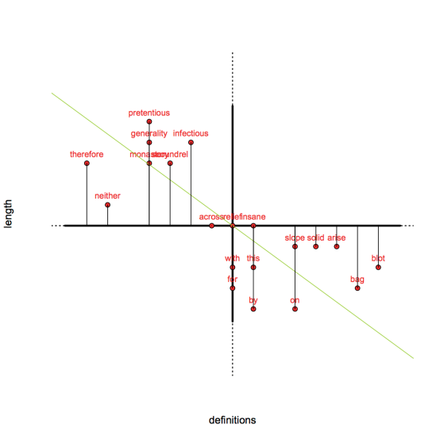
How?
Notes:
And the distance from the other axis

Slide 21
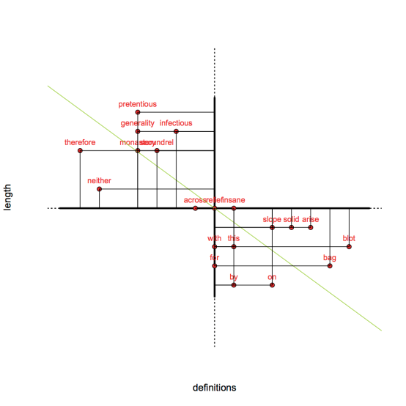
How?
Notes:
Gives you a whole bunch of rectangles. Note how the major source of variance cuts right through all those rectangles.
Well, guess what. That green line is…

Slide 22
That’s a component!
Notes:
A COMPONENT!!!! Our first, or principal, component.

Slide 23
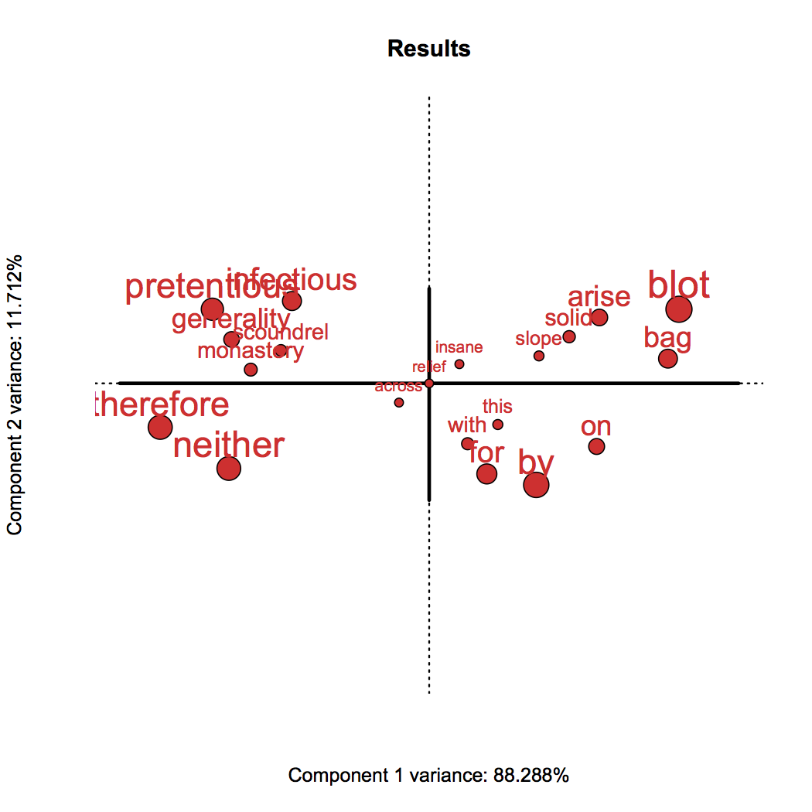
PCA!
Notes:
This is a PCA of that data set. Our first component, or all those rectangles, explains 88% of the total variance.
The second is at a 90 degree angle – or orthogonal – or uncorrelated with the first component. It’s an orthogonal slice _after_ the first component.
This picture shows us something called the factor scores (for the individuals).
But these are the observations. Most want to know how the variables are involved.

Slide 24
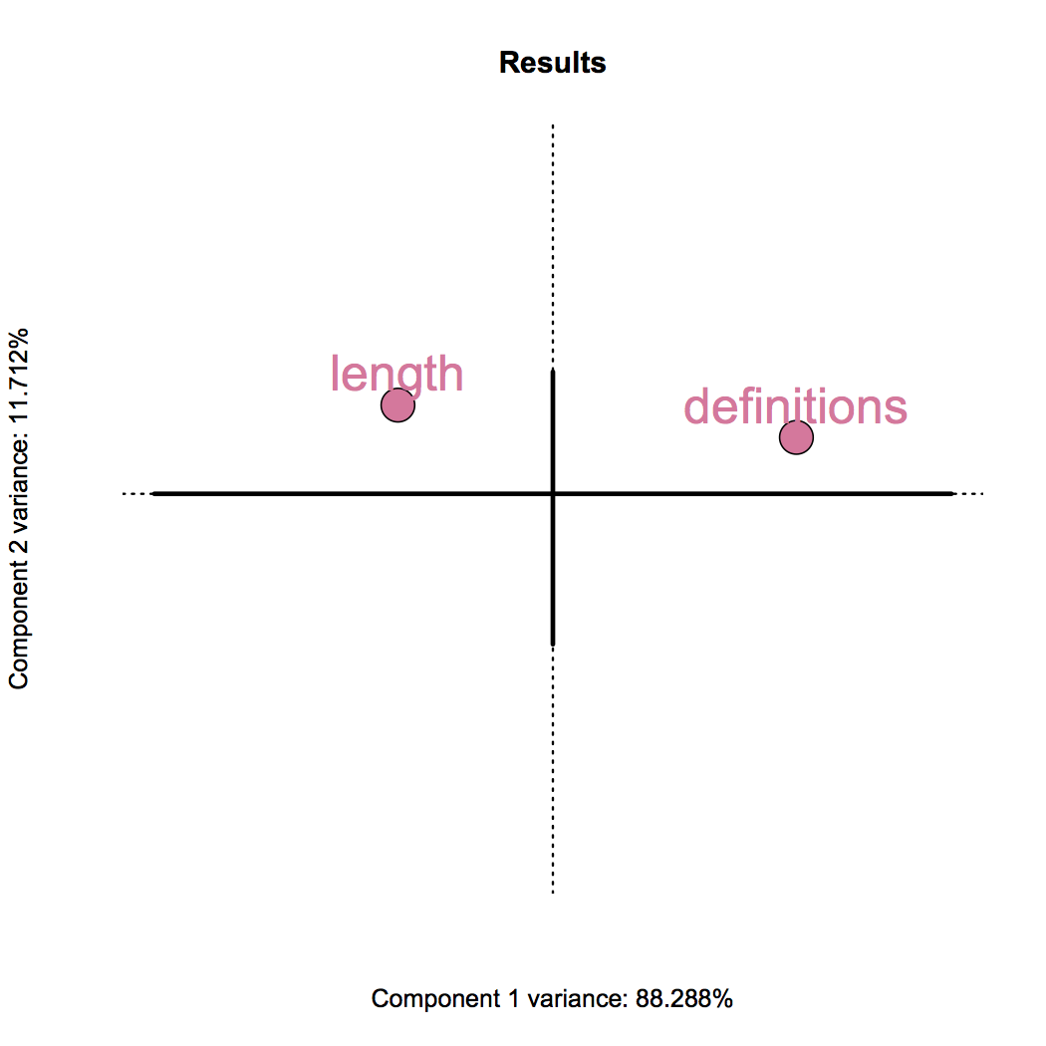
And variables
Notes:
This is a more standard view of PCA. It tells us how the variables are related to the components.
This shows us the factor scores (which are loadings normalized by eigenvalues) of the variables.

Slide 25
PCA!
Notes:
These are positively correlated with definitions --, so, we know that these have more definitions.

Slide 26
And variables
Notes:
This is a more standard view of PCA. It tells us how the variables are related to the components.

Slide 27
PCA!
Notes:
These with length, so, we know they are longer.

Slide 28
PCA!
Notes:
But that first component, the horizontal line, appears to tell us a story. We need to know what these components mean.
First component appears to show a separation of utility (short, many meanings) words versus very specifically defined words.

Slide 29
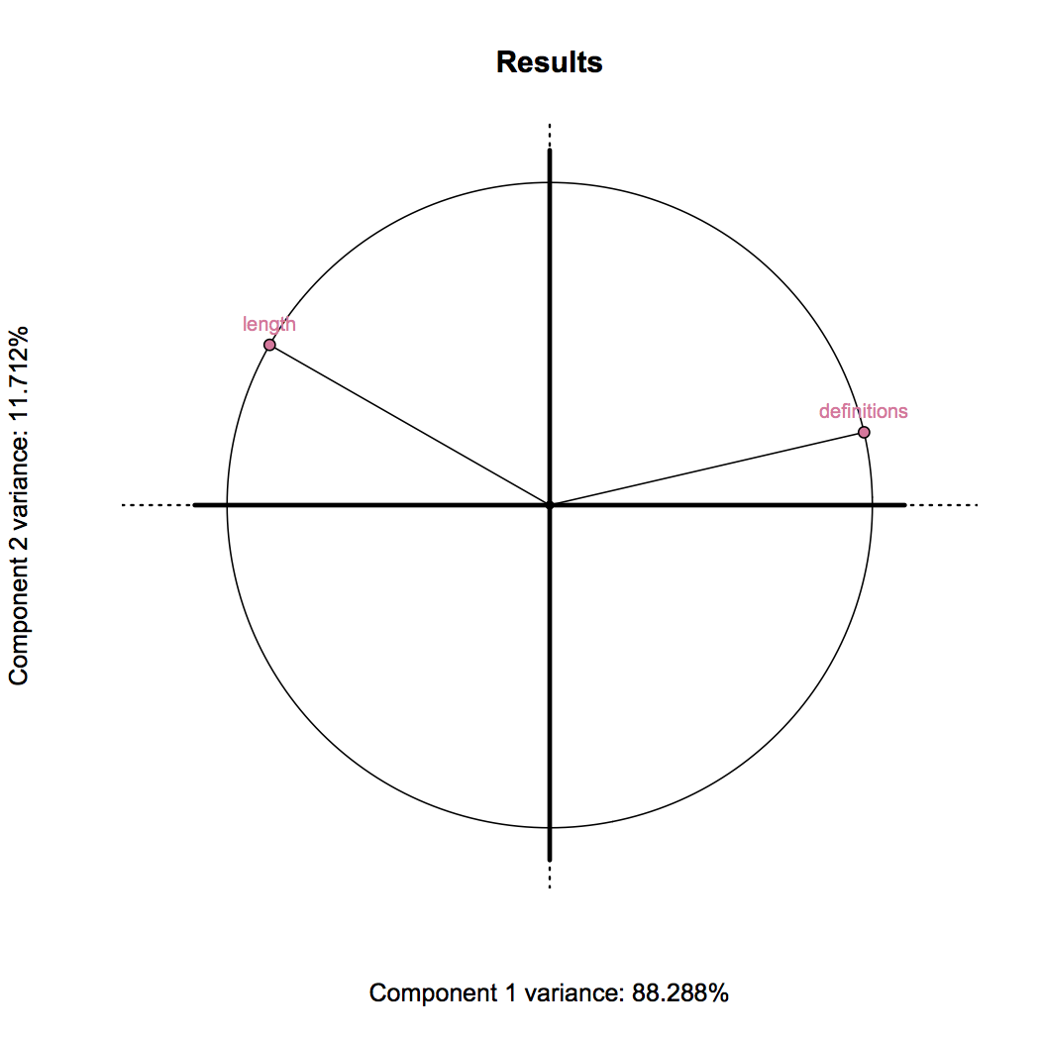
Usual visual
Notes:
Sometimes, we also want to know how correlated variables are with components. This is called the Correlation Circle.

Slide 30
An ExPosition of
The SVD
Resampling
Notes:
Derek takes over.

Slide 31
Resampling
Why?

Slide 32
Resampling
Why?
Provides a null
Provides a distribution
Provides intervals

Slide 33
First: Folklore
Require > 200 (Guilford, 1954) or > 250 (Cattell, 1978) observations
Require 5:1 observations:measures ratio (Gorsuch, 1983)

Slide 34
More Folklore
Keep components with eigen values > 1
Scree/elbow “tests”

Slide 35
Fixing Folklore
High dimensional low sample size can be OK (Jung & Marron, 2009; Chi 2012)
Power derived like MANOVA (in some cases; D’Amico et al., 2001)

Slide 36
Fixing Folklore
Sometimes all eigens < 1

Slide 37
We need a null
Resampling can do that!
Bootstrap (Efron & Tibshirani, 1983, Hesterberg 2011, Chernick 2008)
Permutation (Berry et al., 2011)
But really, Fisher & Student did this first.

Slide 38
Permutation
Scrambles data
An exact test of the H₀
Tests an omnibus effect
Tests each component

Slide 39
Permutation
Obs. | W | Y
1 | 1 | 16
2 | 3 | 10
3 | 4 | 12
4 | 4 | 4
5 | 5 | 8
6 | 7 | 10
r = -0.5

Slide 40
Permutation
Obs. | W | Obs. | Y
1 | 1 | 1 | 16
2 | 3 | 2 | 10
3 | 4 | 3 | 12
4 | 4 | 4 | 4
5 | 5 | 5 | 8
6 | 7 | 6 | 10

Slide 41
Permutation
Obs. | W
1 | 1
2 | 3
3 | 4
4 | 4
5 | 5
6 | 7
Obs. | Y
1 | 16
2 | 10
3 | 12
4 | 4
5 | 8
6 | 10

Slide 42
Permutation
Obs. | W
1 | 1
2 | 3
3 | 4
4 | 4
5 | 5
6 | 7
Obs. | Y
6 | 10
5 | 8
3 | 12
4 | 4
1 | 16
2 | 10

Slide 43
Permutation
Obs. | W
1 | 1
2 | 3
3 | 4
4 | 4
5 | 5
6 | 7
Obs. | Y
6 | 10
5 | 8
3 | 12
4 | 4
1 | 16
2 | 10

Slide 44
Permutation
“Obs.” | W | Y_{perm}
1 | 1 | 10
2 | 3 | 8
3 | 4 | 12
4 | 4 | 4
5 | 5 | 16
6 | 7 | 10

Slide 45
Permutation
“Obs.” | W | Y_{perm}
1 | 1 | 10
2 | 3 | 8
3 | 4 | 12
4 | 4 | 4
5 | 5 | 16
6 | 7 | 10
r = 0.2

Slide 46
Permutation in R
R> sample(1:4,4,FALSE)
2 3 1 4
R> sample(1:4,4,FALSE)
3 2 1 4
R> sample(1:4,4,FALSE)
4 3 2 1
R> sample(1:4,4,FALSE)
3 4 1 2

Slide 47
Bootstrap
Confidence intervals
Which measures are different from each other
t-like tests
Which measures are important to components?

Slide 48
Bootstrap
Obs. | W | Y
1 | 1 | 16
2 | 3 | 10
3 | 4 | 12
4 | 4 | 4
5 | 5 | 8
6 | 7 | 10
r = -0.5

Slide 49
Bootstrap
Obs. | W | Obs. | Y
1 | 1 | 1 | 16
2 | 3 | 2 | 10
3 | 4 | 3 | 12
4 | 4 | 4 | 4
5 | 5 | 5 | 8
6 | 7 | 6 | 10

Slide 50
Bootstrap
Obs. | W
1 | 1
2 | 3
3 | 4
4 | 4
5 | 5
6 | 7
Obs. | Y
1 | 16
2 | 10
3 | 12
4 | 4
5 | 8
6 | 10

Slide 51
Bootstrap
Obs. | W
1 | 1
2 | 3
3 | 4
4 | 4
5 | 5
6 | 7
Obs. | Y
1 | 16
2 | 10
3 | 12
4 | 4
5 | 8
6 | 10

Slide 52
Bootstrap
Obs. | W
1 | 1
5 | 5
5 | 5
6 | 7
5 | 5
3 | 4
Obs. | Y
1 | 16
5 | 8
5 | 8
6 | 10
5 | 8
3 | 12

Slide 53
Bootstrap
Obs. | W
1 | 1
5 | 5
5 | 5
6 | 7
5 | 5
3 | 4
Obs. | Y
1 | 16
5 | 8
5 | 8
6 | 10
5 | 8
3 | 12

Slide 54
Bootstrap
Obs. | W_{boot} | Y_{boot}
1 | 1 | 16
5 | 5 | 8
5 | 5 | 8
6 | 7 | 10
5 | 5 | 8
3 | 4 | 12
r = -0.79

Slide 55
Bootstrap in R
R> sample(1:4,4,TRUE)
1 2 4 4
R> sample(1:4,4,TRUE)
4 4 1 4
R> sample(1:4,4,TRUE)
4 1 2 1
R> sample(1:4,4,TRUE)
4 3 2 1

Slide 56
Simple Resampling Examples
We have permutation and bootstrap tests of just a correlation

Slide 57
Today’s data
Simulated Paranoia Scale data
Some of us have seen it!
Control group, Social Anxiety, Psychosis
20 questions on sub-clinical paranoia
5 responses – none to a lot.

Slide 58
Time for PCA!
Go to code for most of PCA. Return here before the “inference battery”
Notes:
Back to Joseph for code run throughs.

Slide 59
Boot & Perm in PCA
Permutation of components
Notes:
Toss back to Derek; right after 1d_PCA_MoreDetails.R

Slide 60
Permute for Components
Scramble up the data

Slide 61
Permute for Components
Scramble up the data

Slide 62
Permutation
Obs. | W
1 | 1
2 | 3
3 | 4
4 | 4
5 | 5
6 | 7
Obs. | Y
1 | 16
2 | 10
3 | 12
4 | 4
5 | 8
6 | 10

Slide 63
Permutation
Obs. | W
1 | 1
2 | 3
3 | 4
4 | 4
5 | 5
6 | 7
Obs. | Y
6 | 10
5 | 8
3 | 12
4 | 4
1 | 16
2 | 10

Slide 64
Permute for Components
Perform the analysis again
Keep track of singular or eigen values (variance)
Keep only the ones that explain more than chance.

Slide 65
Boot & Perm in PCA
Bootstrap ratios
Notes:
Derek hands off to Joseph, Joseph explains how to interpret the permutation and bootstrap version of PCA.
Pick up at 1e_PCA_Inference.R

Slide 66
Bootstrap for Variables
Find which are significant

Slide 67
Bootstrap
Obs. | W
1 | 1
2 | 3
3 | 4
4 | 4
5 | 5
6 | 7
Obs. | Y
1 | 16
2 | 10
3 | 12
4 | 4
5 | 8
6 | 10

Slide 68
Bootstrap
Obs. | W
1 | 1
2 | 3
3 | 4
4 | 4
5 | 5
6 | 7
Obs. | Y
1 | 16
2 | 10
3 | 12
4 | 4
5 | 8
6 | 10

Slide 69
Bootstrap
Obs. | W
1 | 1
5 | 5
5 | 5
6 | 7
5 | 5
3 | 4
Obs. | Y
1 | 16
5 | 8
5 | 8
6 | 10
5 | 8
3 | 12

Slide 70
Bootstrap for Variables
Perform analysis again
Keep track of how much variables change their position
Compute a t-value
Keep those above a threshold (e.g., 1.96).

Slide 71
And back to PCA!
See the inference results from the code.
Return to the slides after PCA and before MCA
Notes:
Back to J-dawg.

Slide 72
But, Derek Disagrees
Like always

Slide 73
Are the data categorical?
If so, how do we “PCA” with categories?

Slide 74
Today’s data
Simulated Paranoia Scale data
Some of us have seen it!
Control group, Social Anxiety, Psychosis
20 questions on sub-clinical paranoia
5 responses – none to a lot.

Slide 75
Today’s data
Simulated Paranoia Scale data
Some of us have seen it!
Control group, Social Anxiety, Psychosis
20 questions on sub-clinical paranoia
5 responses – none to a lot.

Slide 76
Multiple Correspondence Analysis
What is it?
Why haven’t I heard of it before?

Slide 77
MCA
What is it?

Slide 78
MCA
Q1 | Q2
1 | 1
3 | 2
… | …
… | …
… | …
4 | 2

Slide 79
MCA
Q1 | Q2
1 | 1
3 | 2
… | …
… | …
… | …
4 | 2
1 | 2 | 3 | 4
1 | 0 | 0 | 0
0 | 0 | 1 | 0
… | … | … | …
… | … | … | …
… | … | … | …
0 | 0 | 0 | 1

Slide 80
MCA
Q1 | Q2
1 | 1
3 | 2
… | …
… | …
… | …
4 | 2
1 | 2 | 3 | 4
1 | 0 | 0 | 0
0 | 1 | 0 | 0
… | … | … | …
… | … | … | …
… | … | … | …
0 | 1 | 0 | 0

Slide 81
MCA
Q1 | Q2
1 | 1
3 | 2
… | …
… | …
… | …
4 | 2
1 | 2 | 3 | 4
1 | 0 | 0 | 0
0 | 1 | 0 | 0
… | … | … | …
… | … | … | …
… | … | … | …
0 | 1 | 0 | 0
1 | 2 | 3 | 4
1 | 0 | 0 | 0
0 | 0 | 1 | 0
… | … | … | …
… | … | … | …
… | … | … | …
0 | 0 | 0 | 1
Notes:
Make sure to point out that we get much more detail.
May trick them.

Slide 82
MCA
Many perspectives
PCA, CA, etc…

Slide 83
MCA
Short version:
Compute the marginal probabilities
Compute an observed and expected matrix
Subtract
Multiply by the marginal probabilities.
Notes:
Joseph or Daniel – yell from the crowd at the end of this slide.

Slide 84
That’s familiar!
χ² so far!

Slide 85
MCA
χ² preprocessed disjunctive table
Put through SVD

Slide 86
Back to code!

Slide 87
Conclusions
How many people are “enough”?
How many variables are “too many”?
How many iterations are “enough”?

Slide 88
Enough is enough!
It’s hard to tell, but here are some suggestions

Slide 89
Conclusions
When to use PCA

Slide 90
PCA is for quantitative
Reaction Times
Hits & False alarms
Eye tracking
fMRI
Surveys

Slide 91
Conclusions
When to use MCA

Slide 92
MCA
Demographics data
Genetics
Preference
Surveys

Slide 93
Conclusions
Why resampling?

Slide 94
We need tests
Not folklore!
Some of it’s not bad though
We need to know what is reliable

Slide 95
Big data can be tough
Permutation
Focus on only significant components
Bootstrap
Focus on only significant contributors

Slide 96
What about those groups?
There are between-group (a la, ANOVA) approaches for PCA & MCA

Slide 97
Barycentric (Discriminant)
Barycentric Discriminant Analysis (BADA)
PCA for between groups
Discriminant Correspondence Analysis
MCA for between groups

Slide 98
Fin
Questions, comments, complaints?
If we don’t have time up here, we’ll be around
Please feel free!

Slide 99
General wrap up
We covered a lot in 2.5 hours
We hope it was worth it!

Slide 100
Fin fin
Thanks for sticking around
If you have any questions about either workshop – please find us
Or email us!

