Slide 1
CubeSat Dual Axis Solar Articulation Sunflowers in Space - G22
Elle Barker, Derek Chibuzor,
Yahir Garcia, Didi Abdel Rhim
Notes:
Elle

Slide 2
Overview
Context
What are CubeSats?
Solar Articulation
Design Objective
Development
Assembly
Design Choices
Solar Tracking Algorithm
Testing and Issues
Position & Voltage
Camera Output
Future Application
Questions
OVERVIEW | 1
Notes:
Elle

Slide 3
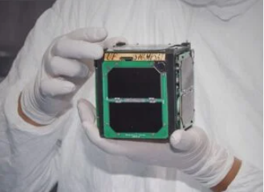
Historical Context
CubeSats were created in 1999 by Professors Bob Twiggs at Stanford and Jordi Puig-Suari at CalPoly [1]
Simple, affordable, and easily produced
Designed and launched by students
Made space more accessible to academic institutions
10 cm x 10 cm x 10 cm (1U) cube, weight limit of 1.33 kg
First CubeSats were launched in 2003 [2]
Demonstrated viability
Standardized launch vehicle (P-Pod) was
a significant asset for broader use
Figure 1: First CubeSat design [1]
CONTEXT | 2
Notes:
Elle

Slide 4
Modern Context
CubeSat use is expanding beyond academic research [3]
Market projected to grow significantly in the coming decade
Improved miniaturization of components
Scalability and rapid deployment via satellite constellations
Broad commercial and government use
Research and exploration for NASA, ESA, & JAXA
Satellite constellations providing global coverage [4]
Starlink constellations from SpaceX
Swarm constellation from Swarm Technologies
CONTEXT | 3
Notes:
Didi
1. Origins of CubeSats
Developed in 1999 by Professors Bob Twiggs (Stanford University) and Jordi Puig-Suari (California Polytechnic State University) with the goal of providing a standard, cost-effective platform for space exploration and research.
The original intent was to create a simple and affordable satellite that university students could design, build, and launch within a short timeframe, making space more accessible to academic institutions.
The first CubeSats were designed to fit in a 10 cm x 10 cm x 10 cm (1U) cube with a weight limit of 1.33 kg, setting the standard for CubeSat design that continues today.
2. Growth and Popularity of CubeSats
CubeSats quickly gained popularity due to their low cost, short development cycles, and versatility. They can be developed in a fraction of the time and cost compared to traditional satellites.
First CubeSat Launch (2003): A group of CubeSats was launched on a Russian rocket. This marked the beginning of CubeSats being used for real-world applications beyond academic projects.
As of 2024, over 2,000 CubeSats have been launched, with applications ranging from Earth observation to communications, technology demonstrations, and scientific research.
3. Technological Advancements and Expanding Capabilities
Initially, CubeSats were limited to low Earth orbit (LEO) missions with short lifespans, primarily used for educational purposes or technology demonstrations.
However, advancements in miniaturization of electronics, sensors, and power systems have enabled CubeSats to take on more complex missions, including:
Interplanetary missions (e.g., NASA’s MarCO CubeSats that accompanied the InSight lander to Mars).
Earth imaging and monitoring (e.g., Planet Labs' constellation of CubeSats for daily Earth observation).
Communications networks (e.g., Swarm Technologies' CubeSat-based IoT networks).
4. The Rise of Commercial and Government Use
CubeSats are no longer just academic tools. They have become essential for both commercial companies and government agencies like NASA, ESA, and JAXA, who use them for research, exploration, and data collection.
The NewSpace industry has driven demand for CubeSats due to their scalability and rapid deployment, especially for satellite constellations that provide services like global internet coverage (e.g., Swarm, Starlink).
CubeSats are seen as a cost-effective way to test new technologies before committing them to larger, more expensive satellite platforms.
5. Challenges and Innovations
Despite their success, CubeSats face limitations in power, communication, and payload capacity due to their small size.
One major challenge is power generation since CubeSats often have fixed solar panels with limited surface area.
Innovations like your dual-axis solar array articulation system are addressing these challenges by optimizing power collection, enabling CubeSats to support more demanding missions.
6. Future Trends and Opportunities
The CubeSat market is projected to grow significantly in the coming decade, driven by miniaturization of components, increasing launch opportunities, and new mission types (e.g., deep space exploration, disaster monitoring).
Your project aligns with the trend of enhancing CubeSat capabilities, allowing them to undertake longer and more complex missions while remaining cost-effective.

Slide 5
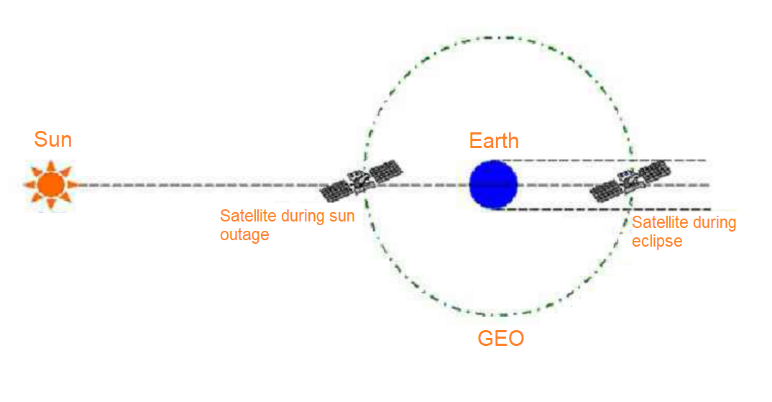
Space Environment Constraints
Limited Power Budget
Variable Sunlight Conditions
Orientation Constraints
Power Demand Peaks
Battery Capacity Limitations
CONTEXT | 4
Notes:
Didi
Battery Capacity Limitations
Constraint: CubeSats are limited in size (e.g., 3U) and cannot accommodate large batteries. This means they have a very restricted energy storage capacity, which impacts the power available for articulation, communication, and payload operations.
Solution: By optimizing solar panel orientation with minimal power consumption, your articulation system ensures that more energy is stored in the batteries, reducing the risk of power shortages during critical operations or extended eclipse periods.
Power Demand Peaks
Constraint: CubeSats often experience sudden peaks in power demand, such as during data transmission or when operating high-power sensors. If the solar panels are not optimally positioned, they may not generate enough power to support these surges, forcing the system to draw heavily from limited battery reserves.
Solution: The dual-axis articulation system helps maximize power input during high-demand periods, ensuring that CubeSats can sustain critical operations without depleting their batteries.
Eclipse and Shadow Periods
Constraint: CubeSats in Low Earth Orbit frequently pass through Earth’s shadow, causing temporary power loss. Fixed panels are less efficient in capturing sunlight immediately after exiting shadow, delaying battery recharge.
Solution: Your system allows panels to quickly reorient toward the sun as soon as the CubeSat exits an eclipse, optimizing the recharge rate and minimizing downtime.
Orientation Constraints Due to Mission Requirements
Constraint: Many CubeSat missions require precise orientation for imaging or communication, limiting their ability to adjust the entire spacecraft to optimize solar panel exposure.
Solution: By enabling independent panel articulation, your system allows CubeSats to maximize power generation without compromising their primary mission orientation.
Limited Power Budget:
Challenge: CubeSats have a very limited surface area for solar panels, which means they can only generate a small amount of power. Articulating mechanisms that optimize sunlight exposure consume extra power, reducing the energy available for the primary mission.
Solution: Our system is designed to be highly efficient, using low-power motors and control algorithms that only adjust the panels when necessary. This ensures that we maximize solar energy capture without significantly increasing power consumption.

Slide 6
Current Articulation Solutions
Body-Fixed
Baseline power to meet minimal demand
Suited for low-cost, short-duration missions
Static Deployed
Slight improvement in power generation
Fixed once deployed, suitable for missions with consistent sun angles on orbit
Single-Axis Articulation
Strikes a balance between increased efficiency and system complexity
Ideal for CubeSats in predictable LEO environments.
Dual-Axis Articulation
Highest complexity and highest power generation
Best for high-demand CubeSat missions
CONTEXT | 5
Notes:
Didi
Explanation:
Baseline Assumptions:
The power efficiency values are estimated by comparing the relative performance of each configuration type. The percentages represent how efficiently each system can capture solar energy under varying mission demands.
For example, a body-fixed system is used as a baseline with an assumed efficiency of 60% in optimal conditions (i.e., always facing the sun). Other configurations are compared to this baseline.
Factors Considered:
Body-Fixed: Limited by its inability to adjust to the sun's position, which reduces its efficiency as the satellite’s orientation changes throughout its orbit.
Static Deployed: Gains some efficiency by increasing surface area, but since it's fixed once deployed, it cannot adapt to changes in sun angles.
Single-Axis Articulation: Can track the sun along one axis (e.g., pitch), which improves efficiency, especially in low Earth orbit (LEO) where the sun angle is more predictable.
Dual-Axis Articulation: Can adjust along two axes (e.g., pitch and yaw), allowing optimal sun tracking regardless of orbit or orientation, making it ideal for deep-space missions or varying orbital conditions.
Relative Power Efficiency Scaling:
The numbers were scaled based on known performance advantages of articulating solar arrays. For instance, dual-axis articulation can theoretically increase solar capture by up to 30-40% over body-fixed systems in environments with varying solar angles, such as deep space.
The efficiency drop-offs for the body-fixed and static-deployed systems under higher demand missions reflect their limitations in power optimization.
these estimates are based on general industry knowledge and theoretical scaling rather than specific test data or direct measurements.

Slide 7
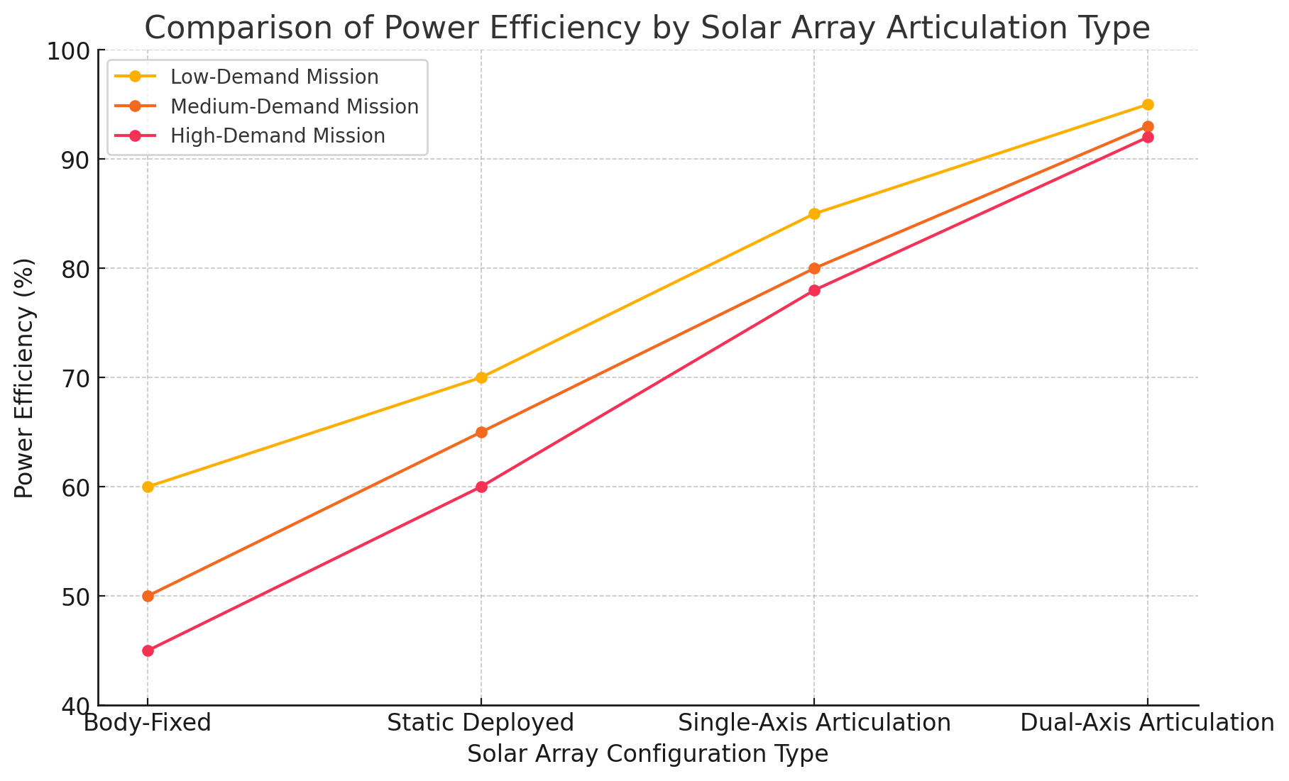
Current Articulation Solutions
Figure 2: Power Efficiency vs. Solar Array Configuration Plot
CONTEXT | 6
Notes:
Didi
Explanation:
Baseline Assumptions:
The power efficiency values are estimated by comparing the relative performance of each configuration type. The percentages represent how efficiently each system can capture solar energy under varying mission demands.
For example, a body-fixed system is used as a baseline with an assumed efficiency of 60% in optimal conditions (i.e., always facing the sun). Other configurations are compared to this baseline.
Factors Considered:
Body-Fixed: Limited by its inability to adjust to the sun's position, which reduces its efficiency as the satellite’s orientation changes throughout its orbit.
Static Deployed: Gains some efficiency by increasing surface area, but since it's fixed once deployed, it cannot adapt to changes in sun angles.
Single-Axis Articulation: Can track the sun along one axis (e.g., pitch), which improves efficiency, especially in low Earth orbit (LEO) where the sun angle is more predictable.
Dual-Axis Articulation: Can adjust along two axes (e.g., pitch and yaw), allowing optimal sun tracking regardless of orbit or orientation, making it ideal for deep-space missions or varying orbital conditions.
Relative Power Efficiency Scaling:
The numbers were scaled based on known performance advantages of articulating solar arrays. For instance, dual-axis articulation can theoretically increase solar capture by up to 30-40% over body-fixed systems in environments with varying solar angles, such as deep space.
The efficiency drop-offs for the body-fixed and static-deployed systems under higher demand missions reflect their limitations in power optimization.
these estimates are based on general industry knowledge and theoretical scaling rather than specific test data or direct measurements.

Slide 8

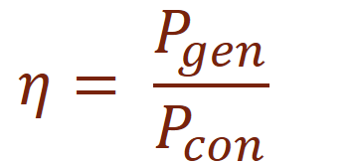
Relevant Equations
Photovoltaic Conversion
Variable Definitions
P_{R} [W] | Radiant Power
A [m²] | Panel Surface Area
Theta [°] | Incident Angle
Ee [W/m²] | Radiant Flux Density
η_{PV} [-] | Panel Efficiency
η [-] | System Efficiency
P_{gen} [W] | Power Generated
P_{con} [W] | Power Consumed
Power Ratio
CONTEXT | 7
Notes:
Elle

Slide 9
Does a dual axis articulated solar array provide power generation benefits that justify the increased complexity, weight, and power consumption compared to simpler solar
arrays at the CubeSat scale?
DESIGN OBJECTIVE | 8
Notes:
Elle

Slide 10
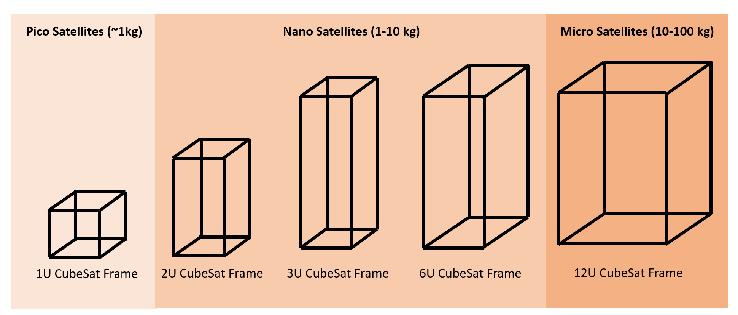
Development
Chose to target a 3U CubeSat configuration
Allows for scalability up or down (1U vs 6U, etc.)
Moderate constraints on expense and size
Selected an infrared camera for sun-sensing
All electronic and structural components are incompatible with space environment since prototyping is done with cheaper materials
Figure 3: CubeSat scaling
DEVELOPMENT | 9
Notes:
Elle

Slide 11
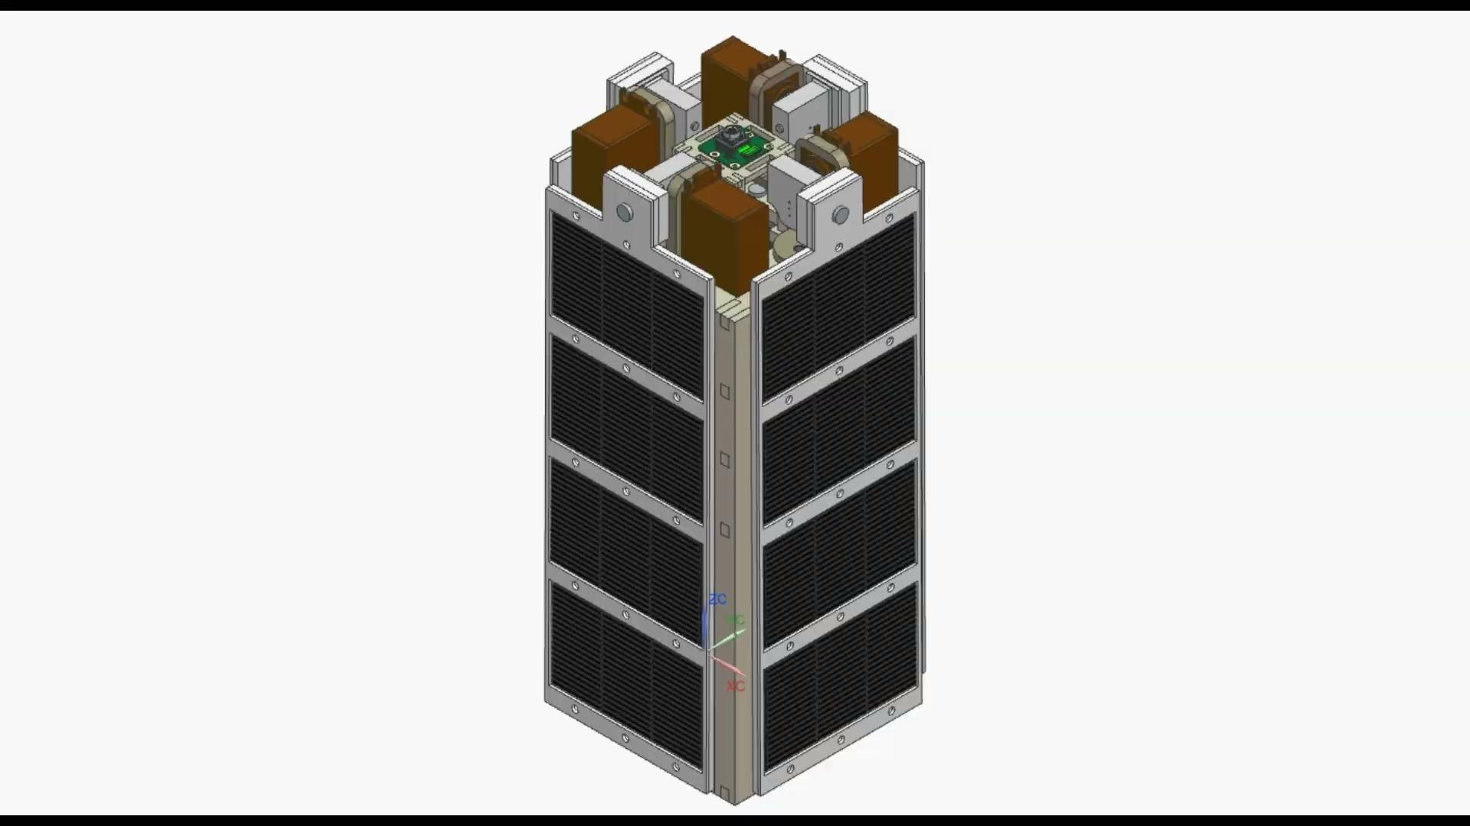
CubeSat Assembly
Figure 4: CAD assembly of designed CubeSat
DEVELOPMENT | 10
Notes:
Yahir

Slide 12
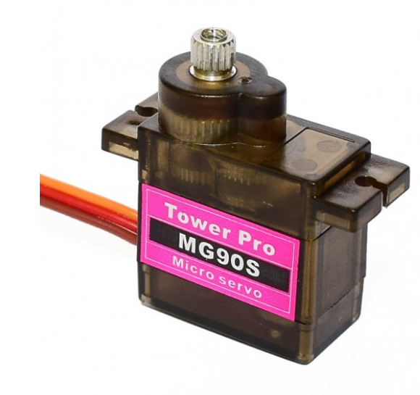
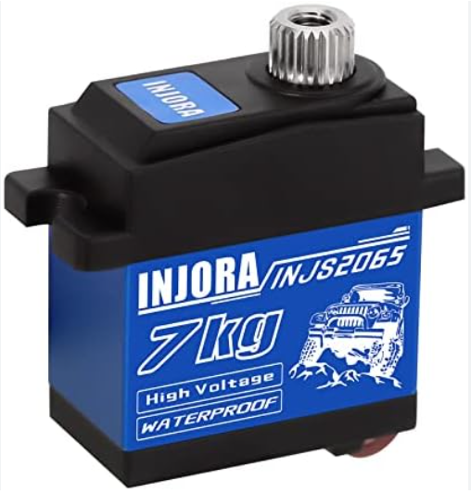
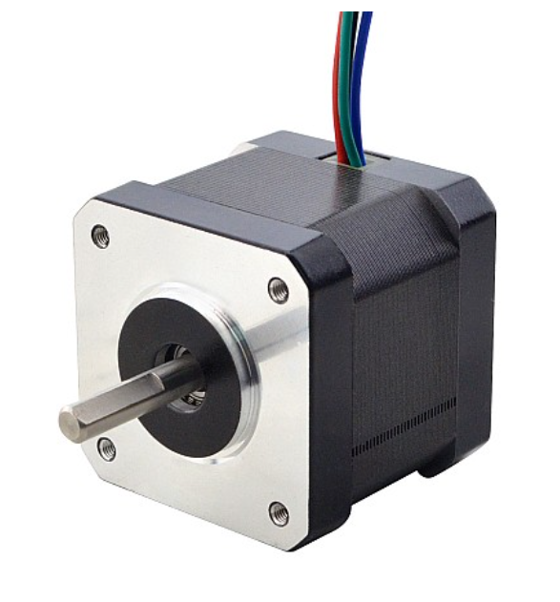
Stepper & Servo Motor
Stepper moves the system on the yaw axis
Servo moves the system on the pitch axis
Necessary for deployment stage
Originally chose the MG90S micro servo motor and NEMA 17-39 stepper motor
Recalculated static torque requirements with initial manufactured components, chose the INJORA 2065 servo
Figure 5a: MG90S micro servo motor
Figure 5b: INJORA 2065 servo motor
Figure 6: NEMA 17-39 stepper motor
DEVELOPMENT | 11
Notes:
Didi

Slide 13
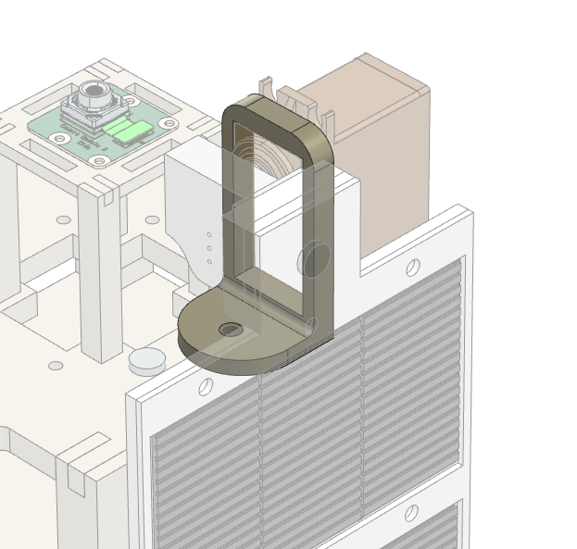
“Tiltaxis”
Connects the rotation of the stepper and servo motors at one point
Houses the servo motor in the upper frame
Stepper motor shaft inserts into the base of the tilt axis
Figure 7: Tilt Axis on CubeSat
DEVELOPMENT | 12
Notes:
Yahir

Slide 14
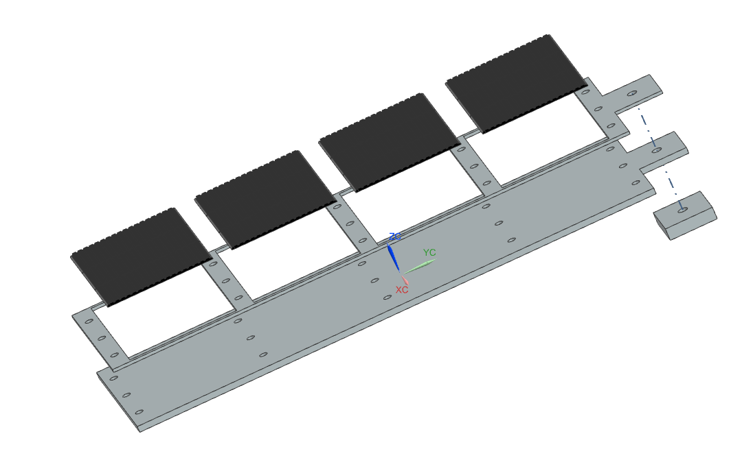
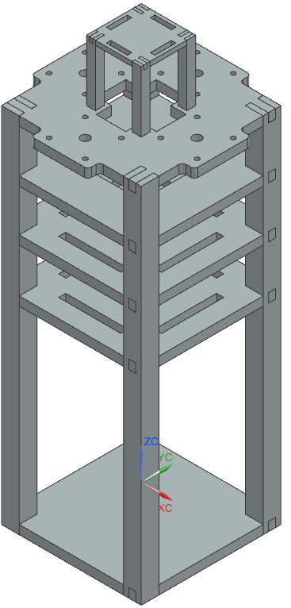
Satellite Frame and Solar Arrays
Mimics the dimensions of a 3U (10x10x30 cm) CubeSat
Laser cut acrylic with finger joints
Epoxy to adhere individual components
Designed for 4 articulated panels, demonstrating concept with one
Purchased AOSHIKE Mini Solar Panels from Amazon
Low quality design
Inexpensive but lacking resilience
Figure 8: Panel Assembly
Figure 9: Satellite Frame Assembly
DEVELOPMENT | 13
Notes:
Yahir

Slide 15
Design Challenges and Solutions
Sizing the servo motor for smooth movement and consistent holding of position
Changed servos 3 times
Predicted torque requirements underestimated actual system
Flawed initial design for frame
Didn’t integrate electronic components well
Inexpensive components were prone to failure
Solar cell wiring broke easily and required repair
Jumper cables displaced easily
Redesigned tiltaxis to accommodate new servo
Fully redesigned frame
Improved spacing for electronic components
Platform for IR camera
Assembly fits 3U constraints
Soldered broken connections in panel system
Modified tracking algorithm
Slowed motor articulation
Improved overall stability
DEVELOPMENT | 14
Notes:
Yahir

Slide 16
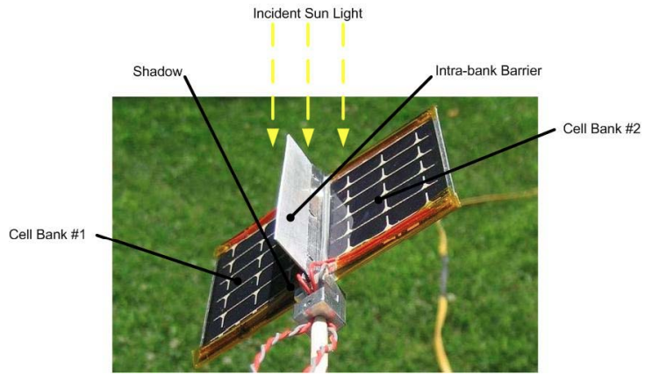
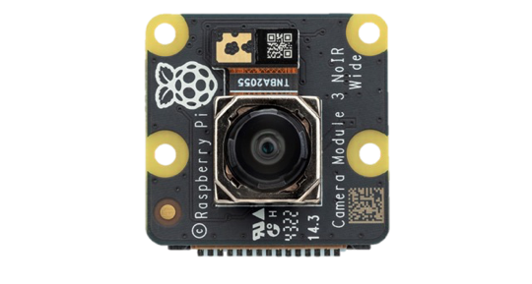
Sun-Sensing Methods
Indirect systems
Photoresistors
Intra-Bank Barrier
Direct systems
Infrared Camera
Figure 10b: Raspberry Pi Camera Module 3 NoIR Wide
FIgure 10a: Intra-Bank Barrier [1]
DEVELOPMENT | 15
Notes:
Derek

Slide 17
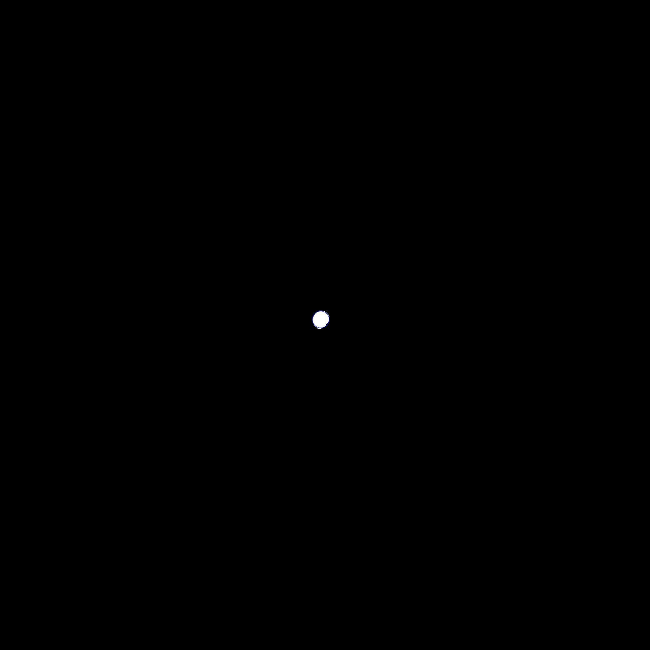
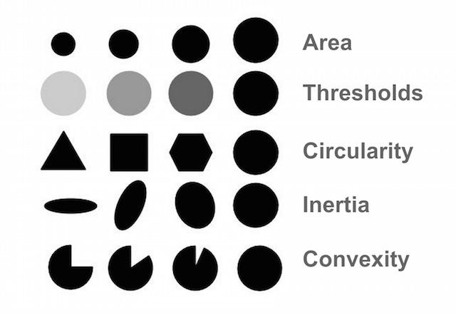
SimpleBlobDetector Parameters
Figure 11: Screen capture of detected light source
Figure 12: SimpleBlobDetector Parameters
DEVELOPMENT | 16
Notes:
Derek

Slide 18
Tracking Algorithm
Initialize Servo, Stepper, Camera, Detector
Main Loop
Capture, Process Frame
(Gaussian Blur, Threshold)
Exception
Exception
Sun Detected?
No
Yes
Calculate Angle, Update Motors
Keyboard Interrupt
End Script, Cleanup Hardware
Figure 13: Solar articulation algorithm diagram
DEVELOPMENT | 17
Notes:
Derek

Slide 19
Multithreading and Concurrency for Real-Time Control
from concurrent.futures import ThreadPoolExecutor
def record_motor_data(t1, t2, m1, m2, start_time):
if not (t1 or t2):
return
while (t1 and not t1.done()) or (t2 and not t2.done()):
t = time.time() - start_time
m1.write_data(t)
m2.write_data(t)
time.sleep(0.02)
with ThreadPoolExecutor(max_workers=2) as executor:
t1 = executor.submit(servo1.move_slow, pitch_angle_setpoint)
t2 = executor.submit(stepper1.move, yaw_angle_setpoint)
record_motor_data(t1=t1, t2=t2, m1=servo1, m2=stepper1, start_time=start_time)
Import multithreading library
Force blocking and record positional data while at least one thread is active
Submit two threads for concurrent execution
DEVELOPMENT | 18
Notes:
Derek

Slide 20
PID Control vs. Dead Reckoning
PID Control
Governing equation derivation
System Identification
Problem: Unknown motor position
Dead reckoning
Problem: Errors accumulate
Solution: Limit switch
DEVELOPMENT | 19
Notes:
Derek

Slide 21
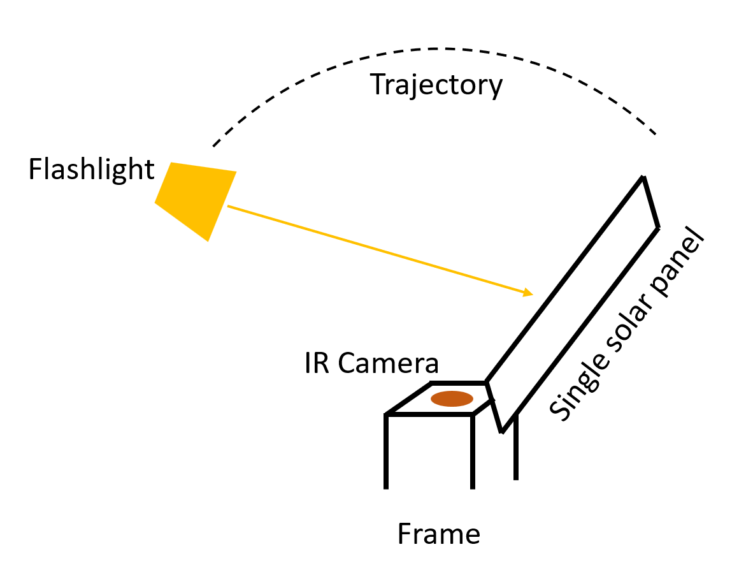
Testing
Original Plan
Verify stable deployment from launch position
Static test of tracking algorithm integration
Long exposure with rooftop test and natural light source
Short, repeated trials with overhead, arcing, artificial light source
Difficult to replicate artificial light source motion with precision
Proper monitoring of rooftop performance wasn’t feasible
Figure 16: Original testing setup
TESTING | 20
Notes:
Elle

Slide 22
Testing
Modified Plan
Allows for use of precise artificial light positioning with traverse
Rotate camera positioning to induce pitching and yaw motion
Highly controlled and replicable
Avoids changing assembly orientation relative to gravity
Doesn’t incorporate panel voltage output since light is oriented to camera
Considering methods to re-incorporate panel output
Voltage output does improve but is not maximized
TESTING | 21
Notes:
Elle

Slide 23
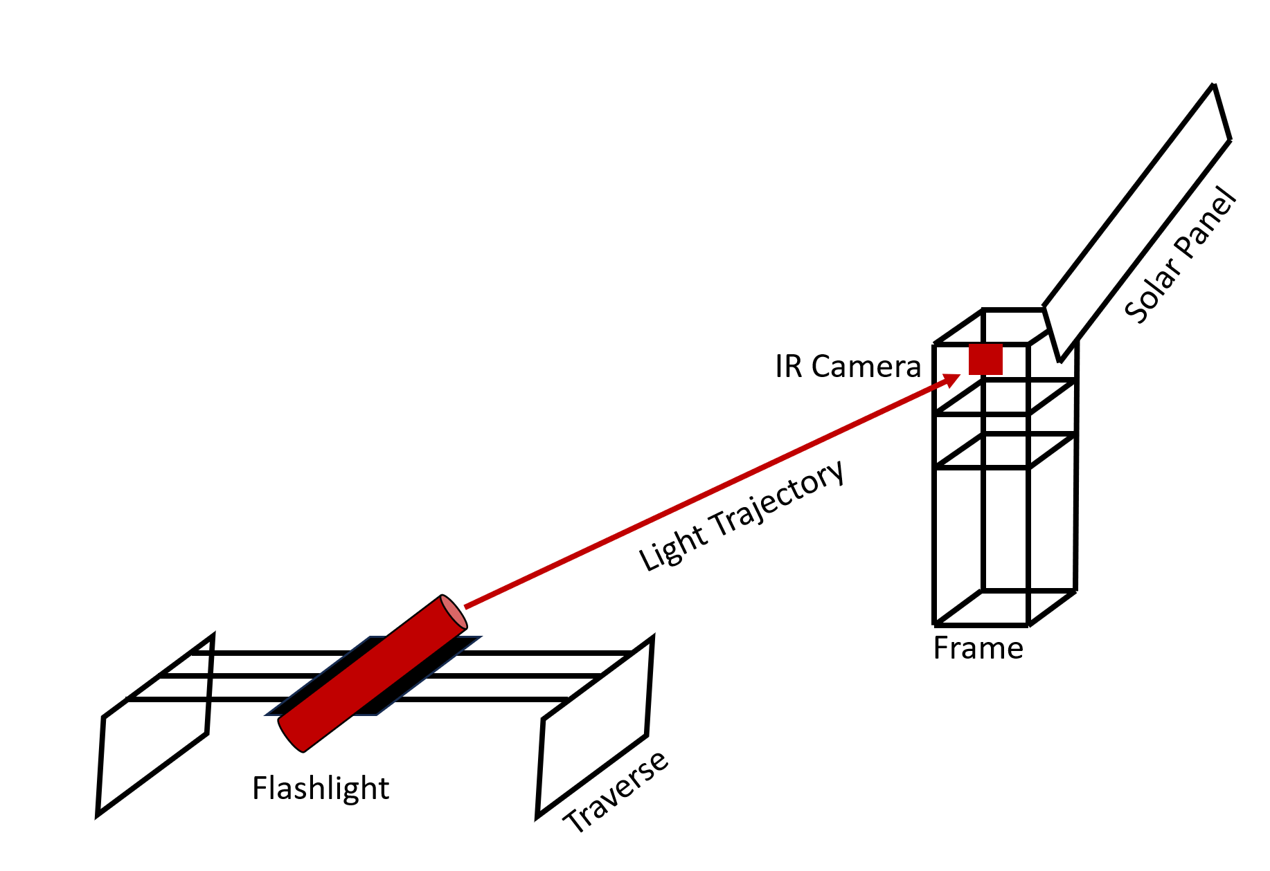
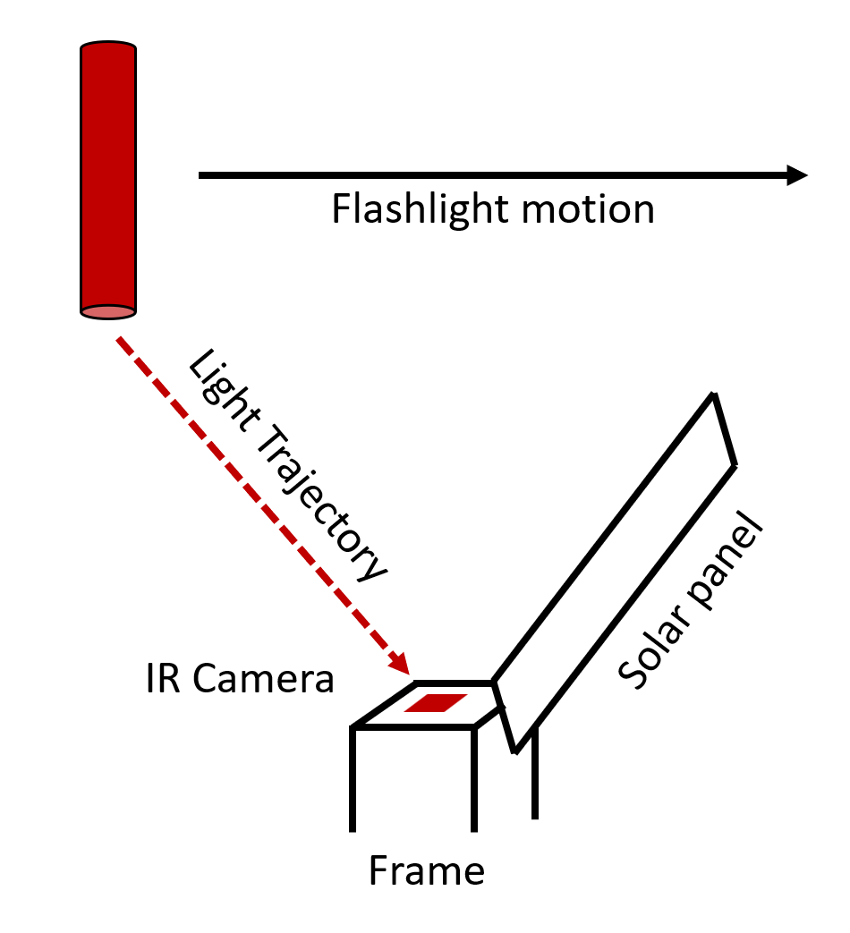
Testing
Figure 17: Representation of system response during modified testing
FIgure 18: Actual setup during modified testing
TESTING | 22
Notes:
Elle

Slide 24
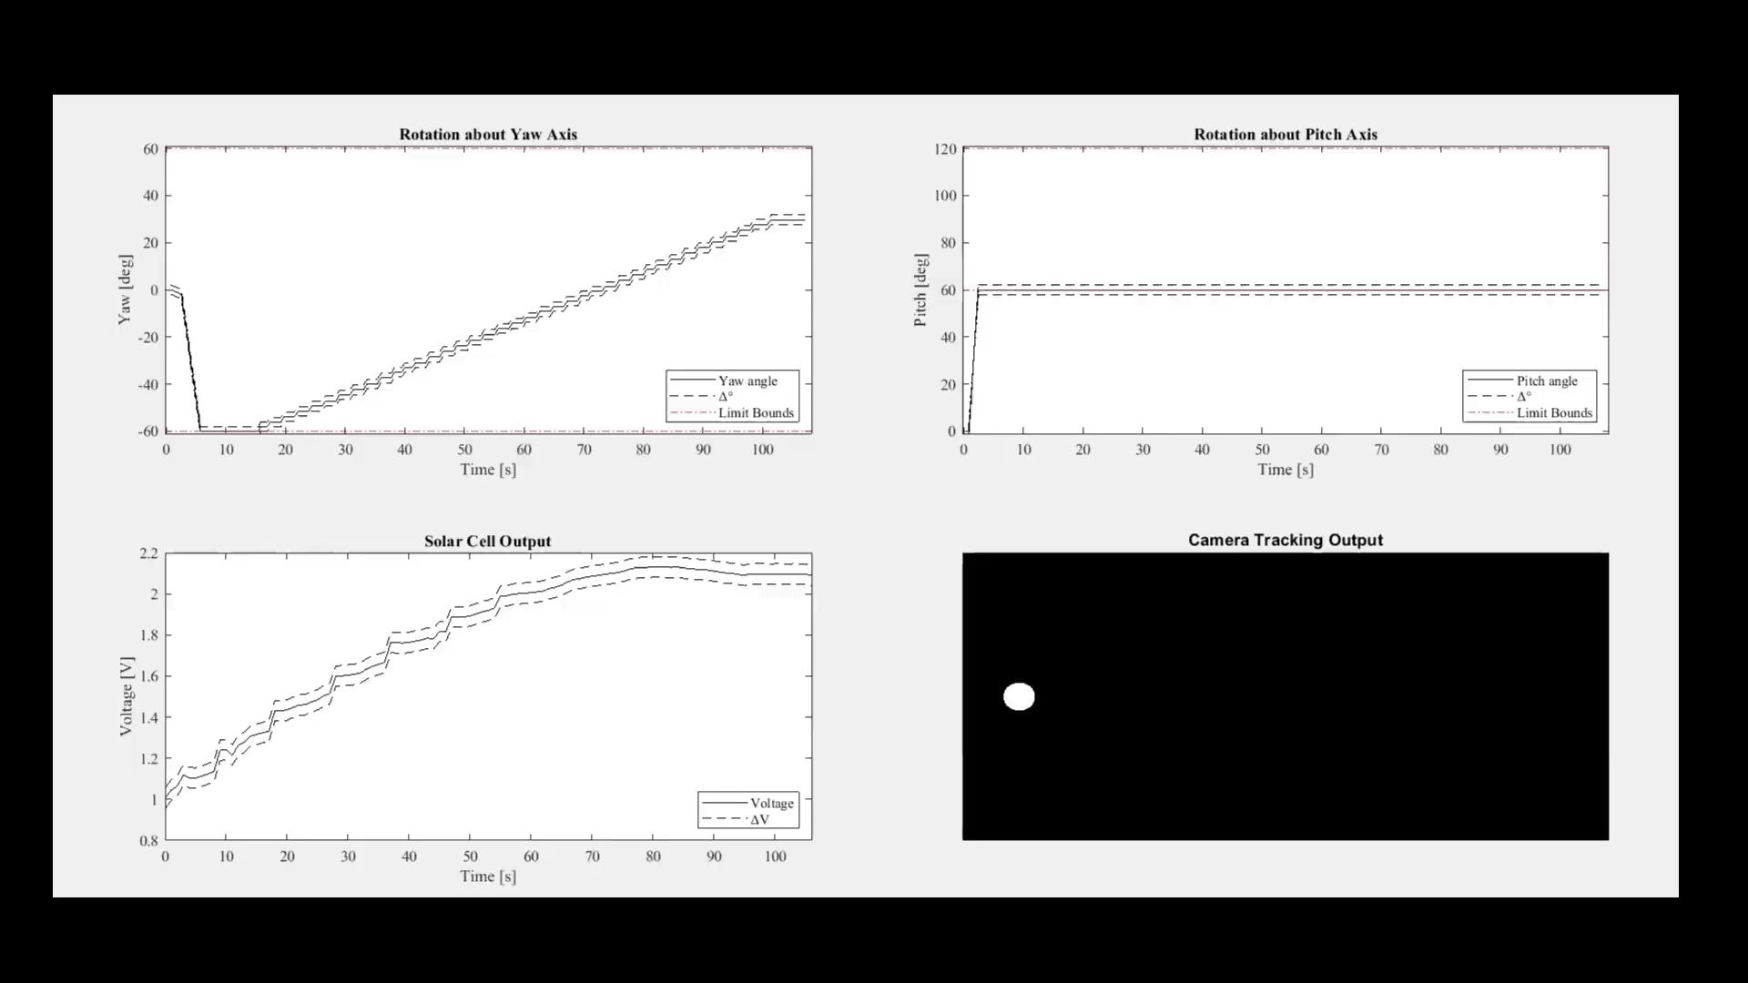
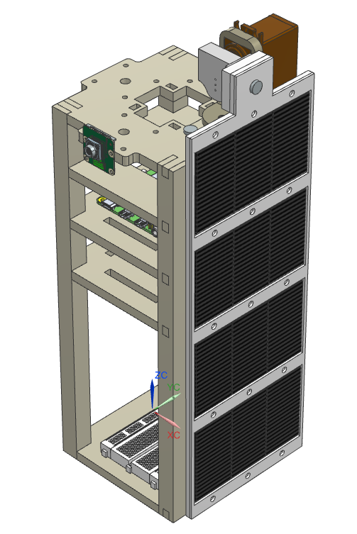
Experimental Data
Figure 19: Panel 90° from camera
CubeSat Placement: 90°; Panel Location: 90° CCW from camera
Δt = 2 ms (Raspberry Pi delay); Light Source: Moving flashlight across x-direction
TESTING | 23
Notes:
Yahir

Slide 25
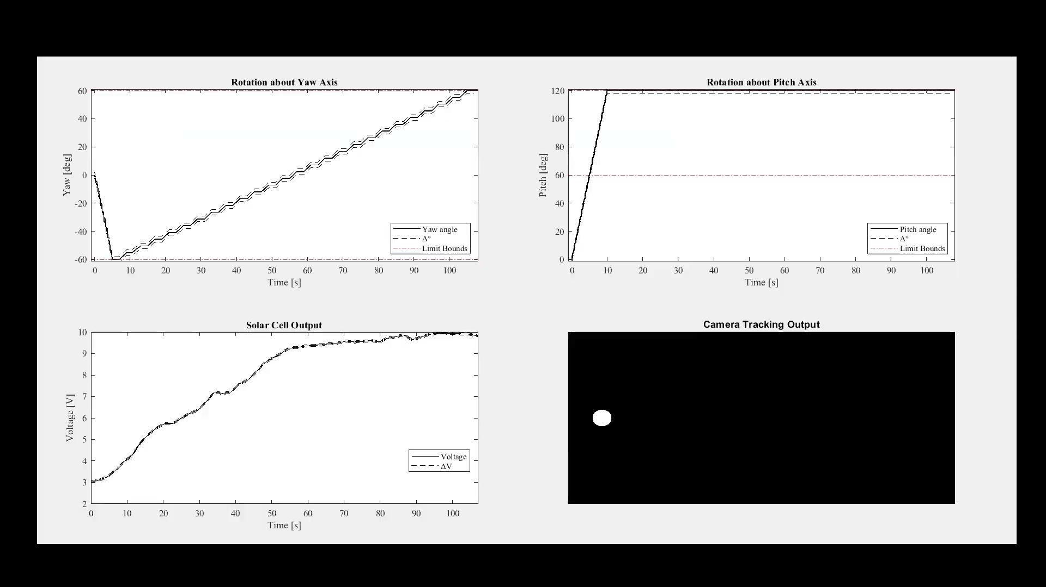
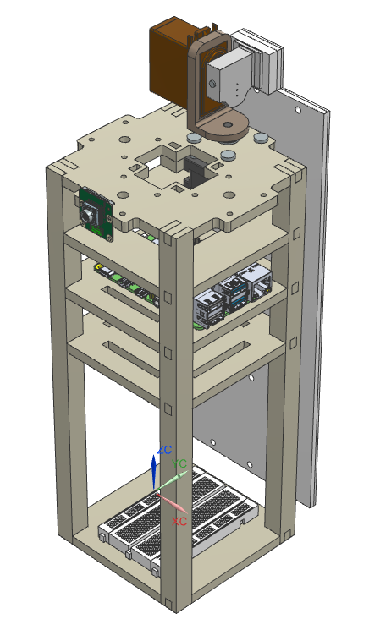
Experimental Data
Figure 20: Panel 180° from camera
CubeSat Placement: 90°; Panel Location: 180° CCW from camera
Δt = 2 ms (Raspberry Pi delay); Light Source: Moving flashlight across x-direction
TESTING | 24
Notes:
Yahir

Slide 26
Future Testing
Less precise, arcing trials to demonstrate improved voltage output
Incorporate voltage output readings into tracking algorithm
Repeating dual axis trials from all three viable camera positions
Comparative trials for performance comparison
Single axis, isolating stepper motor motion about yaw axis
Fixed deployable, pitching 90° and deactivating both motors
TESTING | 25
Notes:
Didi
1. Less precise, arcing trials to demonstrate improved voltage output
Objective: These trials aim to observe how the solar array's voltage output improves when using a less precise but smoother arcing motion.
Details: The idea here is that instead of making precise, stepwise movements, the system will perform broader, smoother arcs to track the sun. This can be beneficial because smoother tracking might reduce power consumption in the motors while still maintaining efficient solar panel orientation. The focus will be on measuring whether this approach yields an increase in average voltage output compared to more precise adjustments.
Implementation: You could implement this by adjusting the tracking algorithm to allow for smoother transitions rather than discrete steps. This can be achieved by reducing the frequency of corrective movements, letting the panels move in a continuous arc instead.
2. Incorporate voltage output readings into tracking algorithm
Objective: This aims to enhance the solar tracking algorithm by directly integrating real-time voltage output data from the solar panels.
Details: By feeding voltage readings into the algorithm, the system can dynamically adjust its orientation to maximize the power output. This real-time feedback loop allows the system to adapt to changes in lighting conditions, optimizing the panel orientation without relying solely on sun-tracking sensors.
Implementation: This would require integrating a voltage sensor with your microcontroller (likely the Raspberry Pi), reading data in real time, and using this information to adjust the motors' movements. The algorithm would prioritize maximizing voltage output rather than solely following a sun-tracking signal.
3. Repeating dual axis trials from all three viable camera positions
Objective: To evaluate the effectiveness of using different camera positions for sun-tracking.
Details: In your current setup, the IR camera is used to detect the sun's position. By testing with the camera mounted in three different positions, you can identify which placement provides the most accurate and efficient tracking. This will help determine the optimal configuration for the CubeSat in orbit.
Implementation: Conduct the same set of tracking trials with the camera mounted in three distinct locations on the CubeSat, comparing the resulting voltage outputs and tracking accuracy. You would analyze data to determine which camera position results in the best power generation.
4. Comparative trials for performance comparison
This involves running experiments to compare the effectiveness of your current dual-axis system against simpler configurations to better understand the benefits of dual-axis articulation.
a. Single axis, isolating stepper motor motion about yaw axis
Objective: To determine the benefits of dual-axis articulation by isolating the stepper motor to only control the yaw axis (horizontal rotation).
Details: Here, you would deactivate the tilt (pitch) control and only allow the panel to rotate horizontally. This will help you assess how much additional power the pitch axis contributes when included.
Implementation: Modify the control system to limit the movement to the yaw axis only. Run trials to measure voltage outputs compared to the dual-axis configuration.
b. Fixed deployable, pitching 90° and deactivating both motors
Objective: To evaluate the performance of the system when set to a fixed 90° pitch angle without active tracking.
Details: This simulates a scenario where the solar array is deployed at a fixed angle without dynamic articulation. By comparing the power output in this fixed configuration to the fully articulated system, you can quantify the benefits of having active tracking.
Implementation: Set the array to a 90° pitch and lock both motors. Record the voltage output over time under varying lighting conditions and compare it with the data from the dual-axis and single-axis configurations.

Slide 27
Future Application
The dual axis design prototype could be applied to the following missions
Interplanetary CubeSats
Polar and High-Inclination Orbits
Prolonged Eclipse Operation
Beyond the 3U configuration, scaling to accommodate the smaller 1U satellite or larger 6U satellite would be fairly straightforward
Autonomous constellations could benefit from the increased power
Reduced down time on orbit
Increased reliability for users
FUTURE APPLICATION | 26
Notes:
Didi
Interplanetary CubeSats: For CubeSats exploring deep space, such as lunar or Mars missions, the ability to adjust solar panels along two axes ensures optimal sunlight capture despite varying angles due to different orbital dynamics. Dual-axis systems provide a critical advantage in environments with unpredictable or low solar incidence angles, maximizing power availability.
Polar and High-Inclination Orbits: CubeSats in polar orbits, especially those conducting Earth observation or climate monitoring, experience constantly changing sun angles. Dual-axis articulation allows these CubeSats to continuously align their solar panels to the sun, ensuring consistent power generation regardless of orbit orientation.
CubeSats for Prolonged Eclipse Operations: In missions where CubeSats experience prolonged eclipses or are in orbits with significant shading (e.g., near asteroids or other celestial bodies), dual-axis articulation allows for rapid realignment to capture sunlight as soon as it becomes available, optimizing charging efficiency during limited exposure windows.

Slide 28
Budget
Table 1: Items purchased
Purchased Items
Solar Cells | AOSHIKE 10 pc 5V 30 mA Mini Solar Panels | 2 | $15.99 | $31.98
Servo Motor | INJORA 7kg 2065 digital servo | 1 | $17.98 | $17.98
Stepper Motor | Nema 17-39 | 1 | $78.64 | $78.64
Infrared Camera | Raspberry Pi Camera Module 3 NoIR | 1 | $35.00 | $35.00
Raspberry Pi 4 | Raspberry Pi 4 Model B - 8 GB RAM | 1 | $75.00 | $75.00
Control Power Supply | Raspberry Pi Power Supply 5.1V 3A with USB C | 1 | $7.95 | $7.95
Standoffs | 320 Piece M2 Male Female Hex Brass Standoffs | 1 | $12.99 | $12.99
Micro HDMI-HDMI Cable | Raspberry Pi Official Micro HDMI to HDMI cable | 1 | $5.95 | $5.95
64 GB Memory Card | SanDisk Pre-Installed NOOBS MicroSD Cards | 1 | $19.95 | $19.95
Thrust Ball Bearings | 6655K72 | 1 | $5.10 | $5.10
DC-DC Buck Converter | LM2596S DC-DC Buck Converter | 1 | $12.99 | $12.99
Plastic Servo Arms | Plastic Servo Arms 23T Blue, 3mm Hole Single/Double Arm for JR 1 Set | 1 | $9.99 | $9.99
Subtotal: $313.22
QUESTIONS | 27
Notes:
Elle

Slide 29
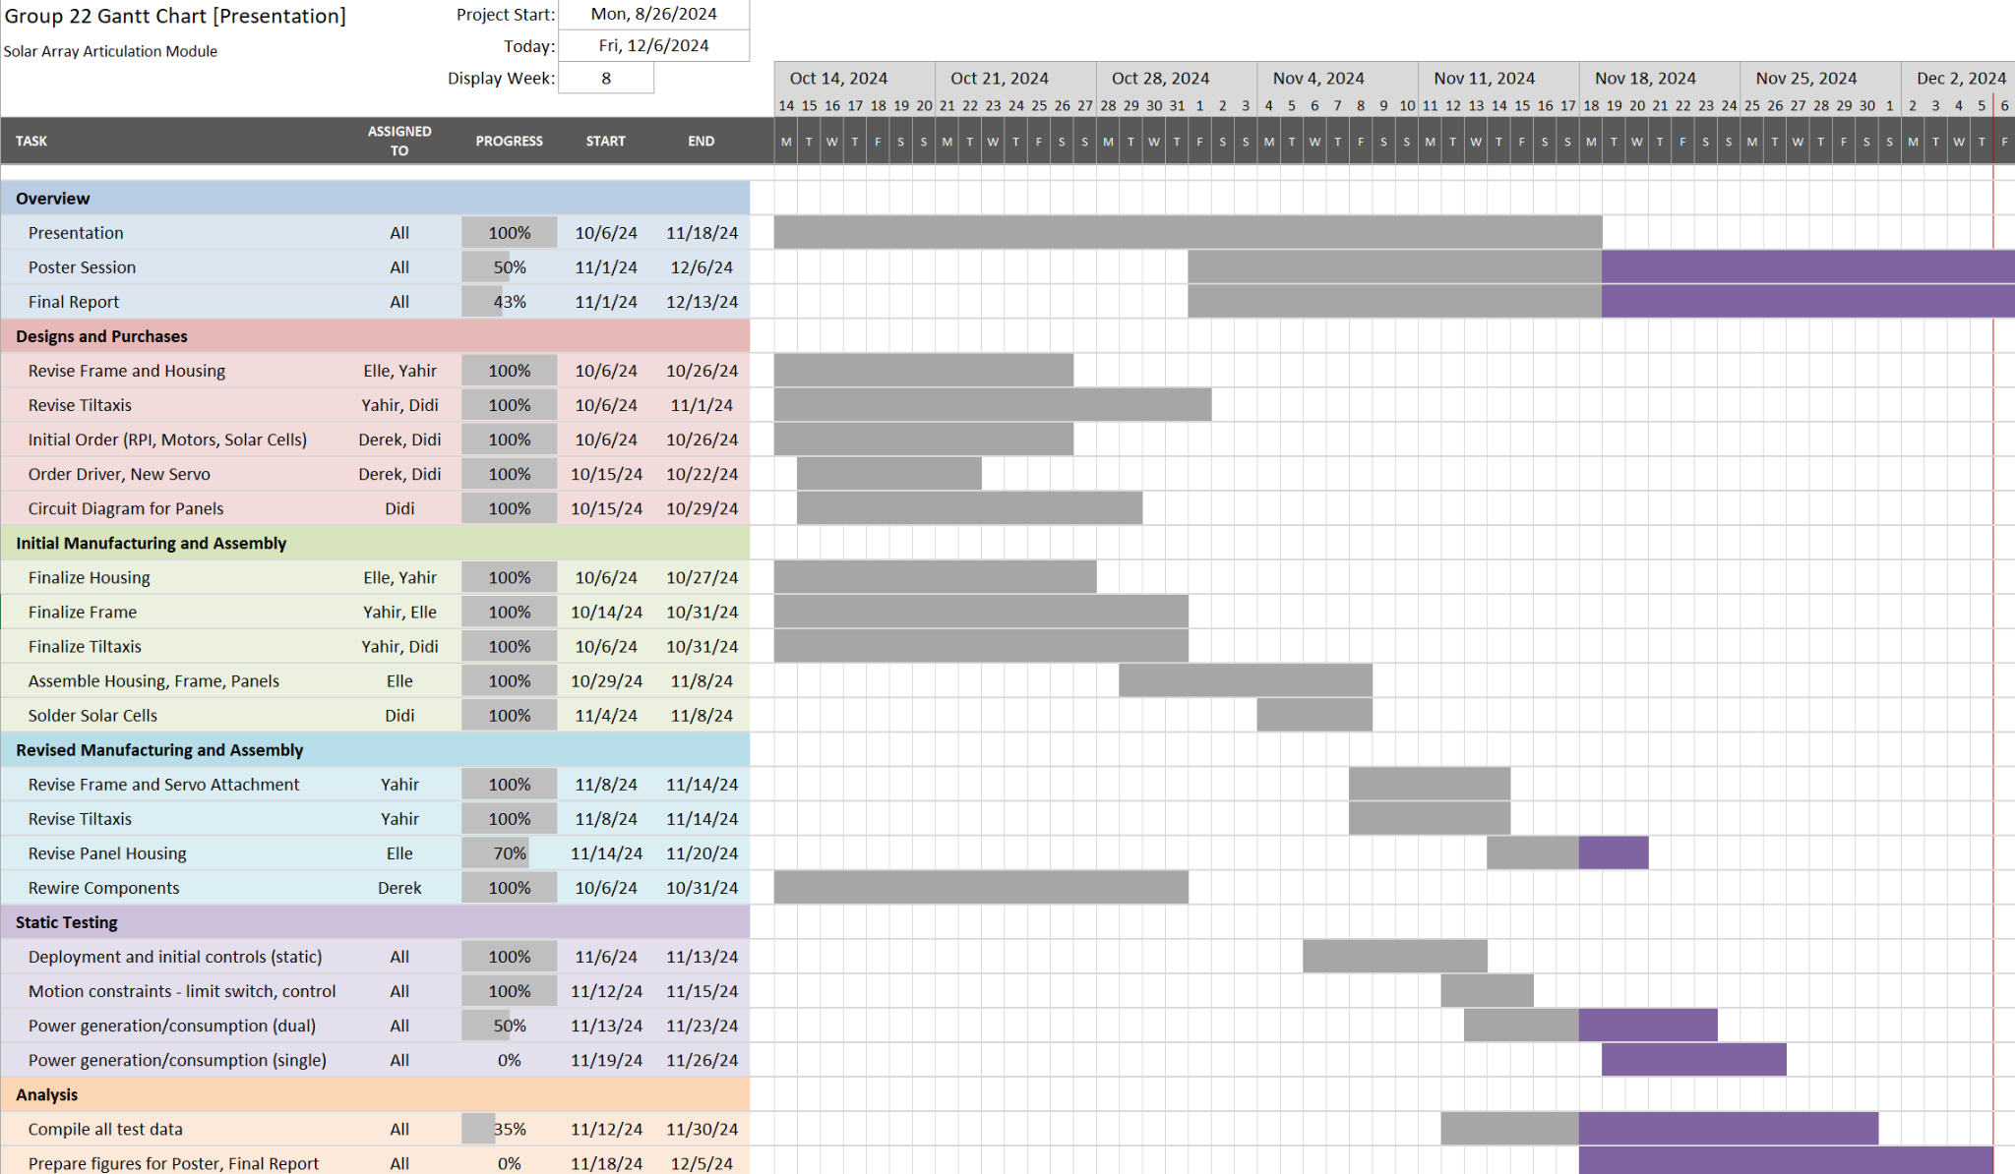
Gantt Chart
SUMMARY | 28
Notes:
Elle

Slide 30
Citations
Normandy, E. “CubeSats”, Space Foundations Technology Hall, Space Foundations, August 2022
https://www.spacefoundation.org/space_technology_hal/cubesats/
Jramer, H “CubeSat - Launch 1” Satellite Missions Catalogue, eoPortal, updated May 2012
https://www.eoportal.org/satellite-missions/cubesat-launch-1#quakesat
Capaletti, C. and Robson, D. “CubeSat Missions and Applications”, CubeSat Handbook, Mission to Design to Operations, 2021, pp. 53-65
https://doi.org/10.1016/B978-0-12-817884-3.00002-3
Jewett, R. “Swarm Founder Suggests Future Starlink, Swarm Products”, ViaSatellite, August 2022
https://www.satellitetoday.com/connectivity/2022/08/09/swarm-founder-suggests-future-starlink-swarm-products-could-highlight-synergies-between-the-services/
Pasaretti, M. and Hayes, R., “Development of a Solar Array Drive Assembly for CubeSat,” Proceedings of the 40th Aerospace Mechanisms Symposium, NASA Kennedy Space Center, May 2010, pp. 445-453
https://esmats.eu/amspapers/pastpapers/pdfs/2010/passaretti.pdf
QUESTIONS | 29
Notes:
Elle

Slide 31

Questions
QUESTIONS | 30

Slide 32
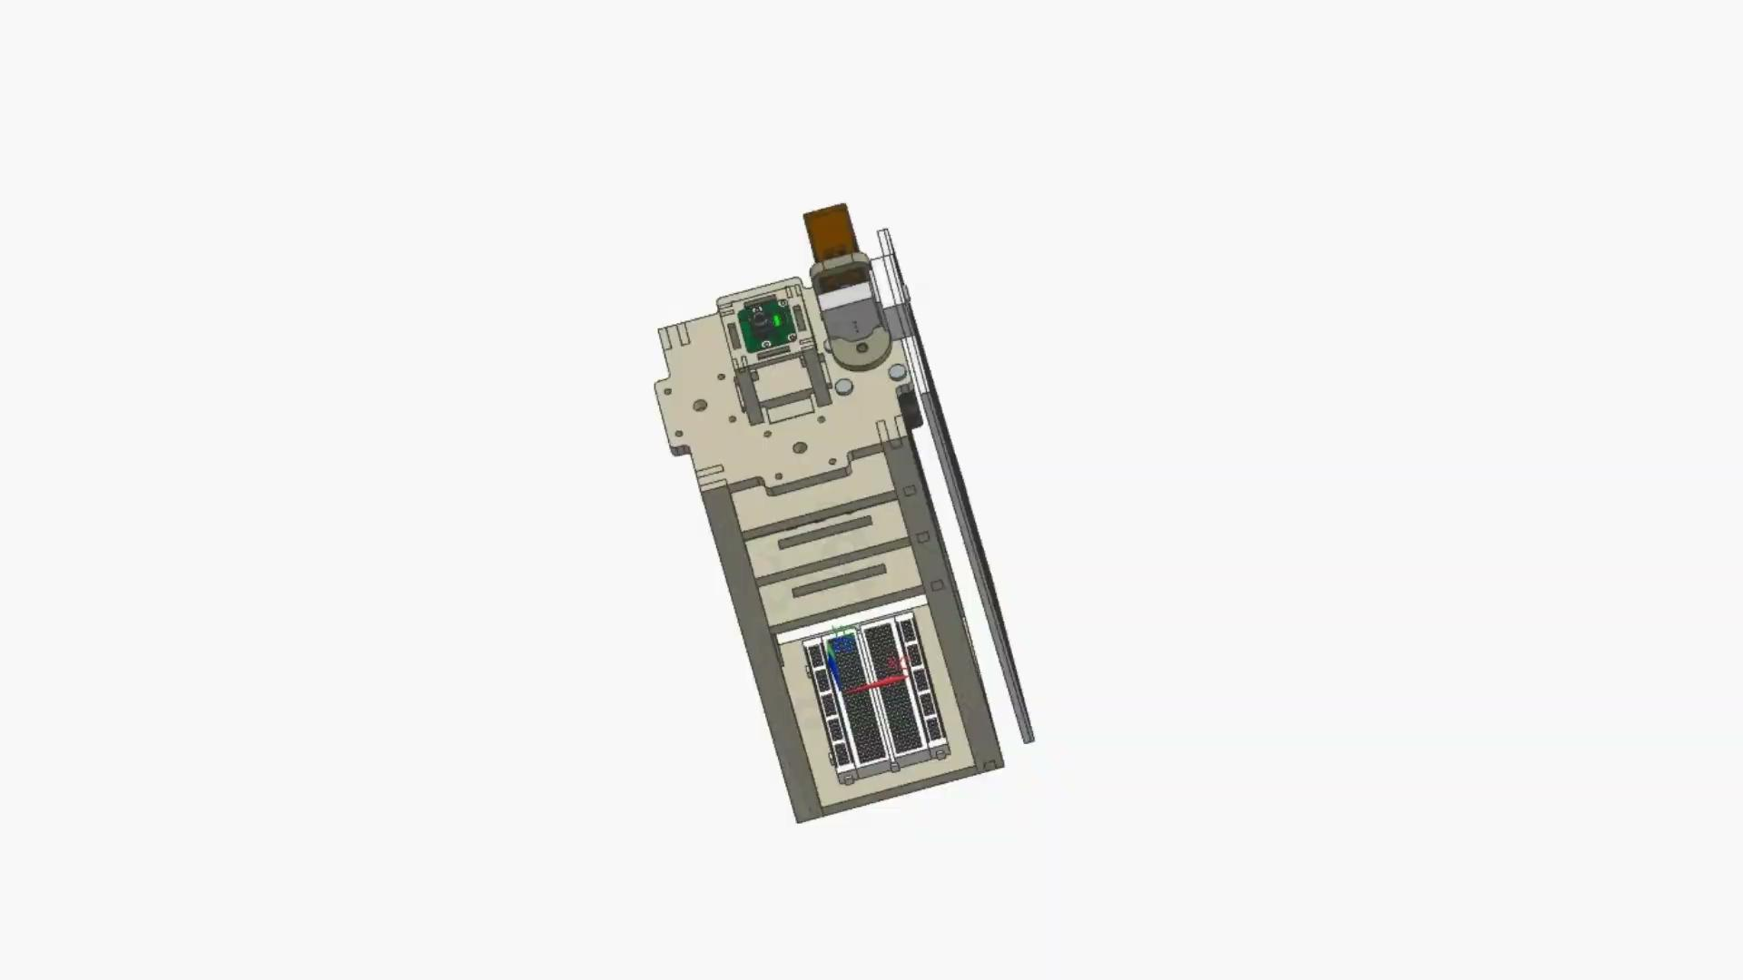

Slide 33
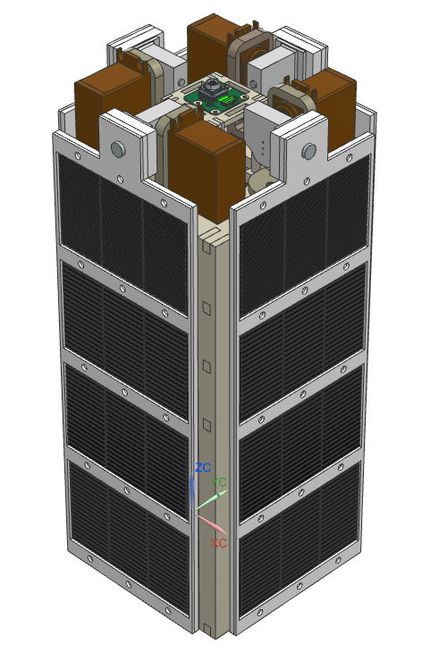
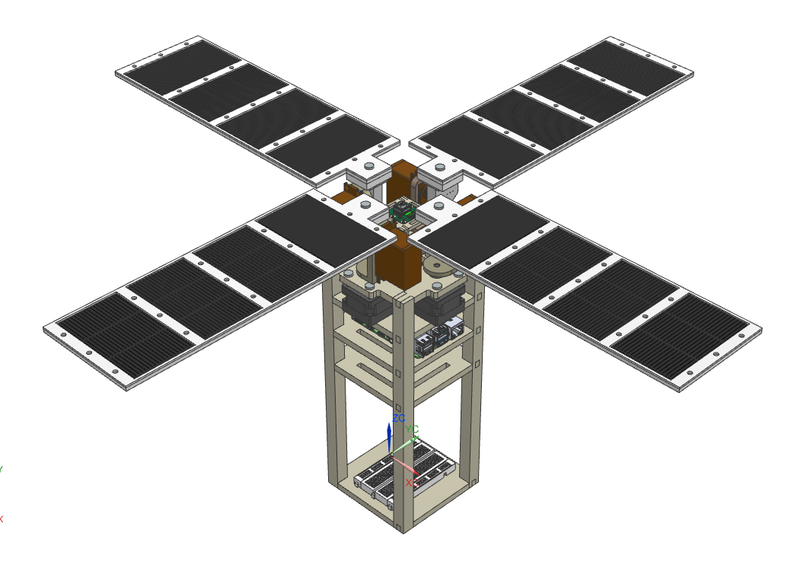
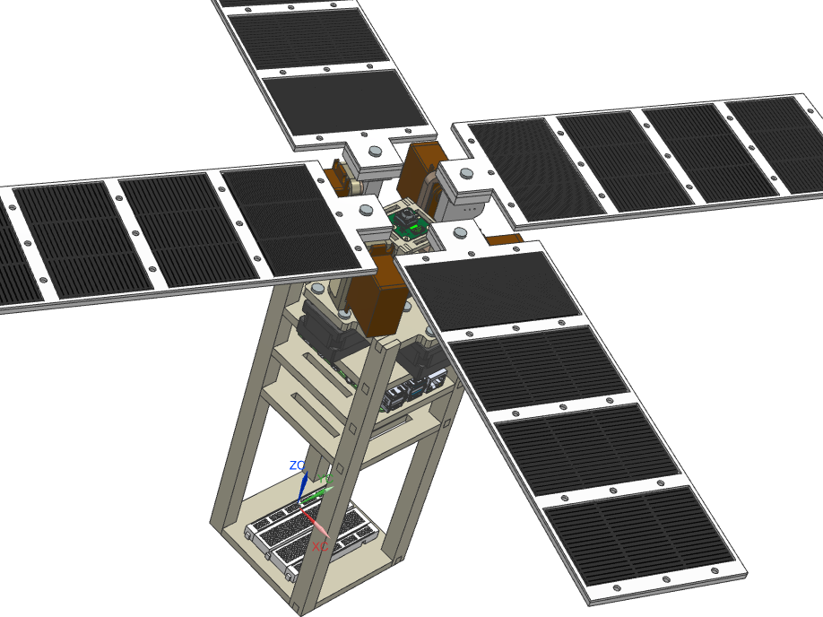
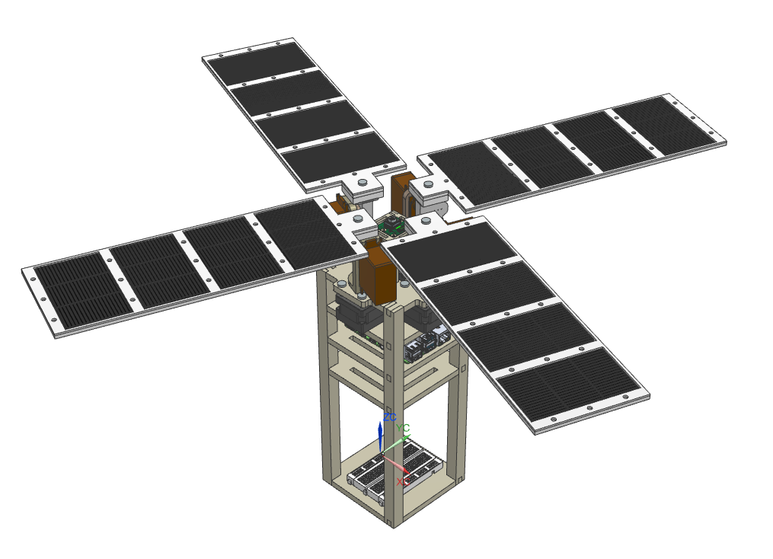
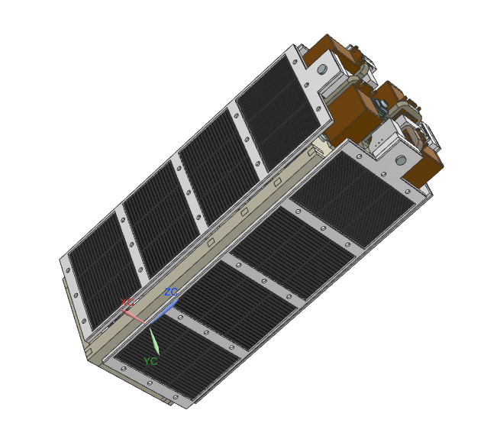
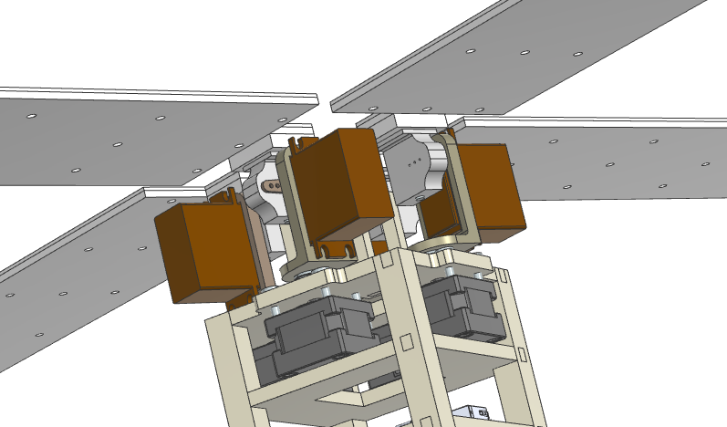

Slide 34


