Slide 1
Tracking People’s Minds during the Spread of 2019-nCoV
~Search Trends and Social Media Data Analysis~
by Team DSI Furniture
Yuki Nishimura, Amaury Sudrie, Derek Chen, Wangzhi Li
Febuary 8, 2020

Slide 2
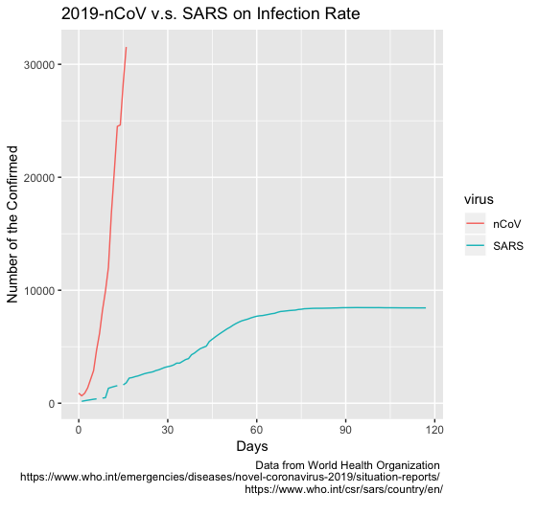
2019-nCoV has been spreading at an incredibly fast pace

Slide 3
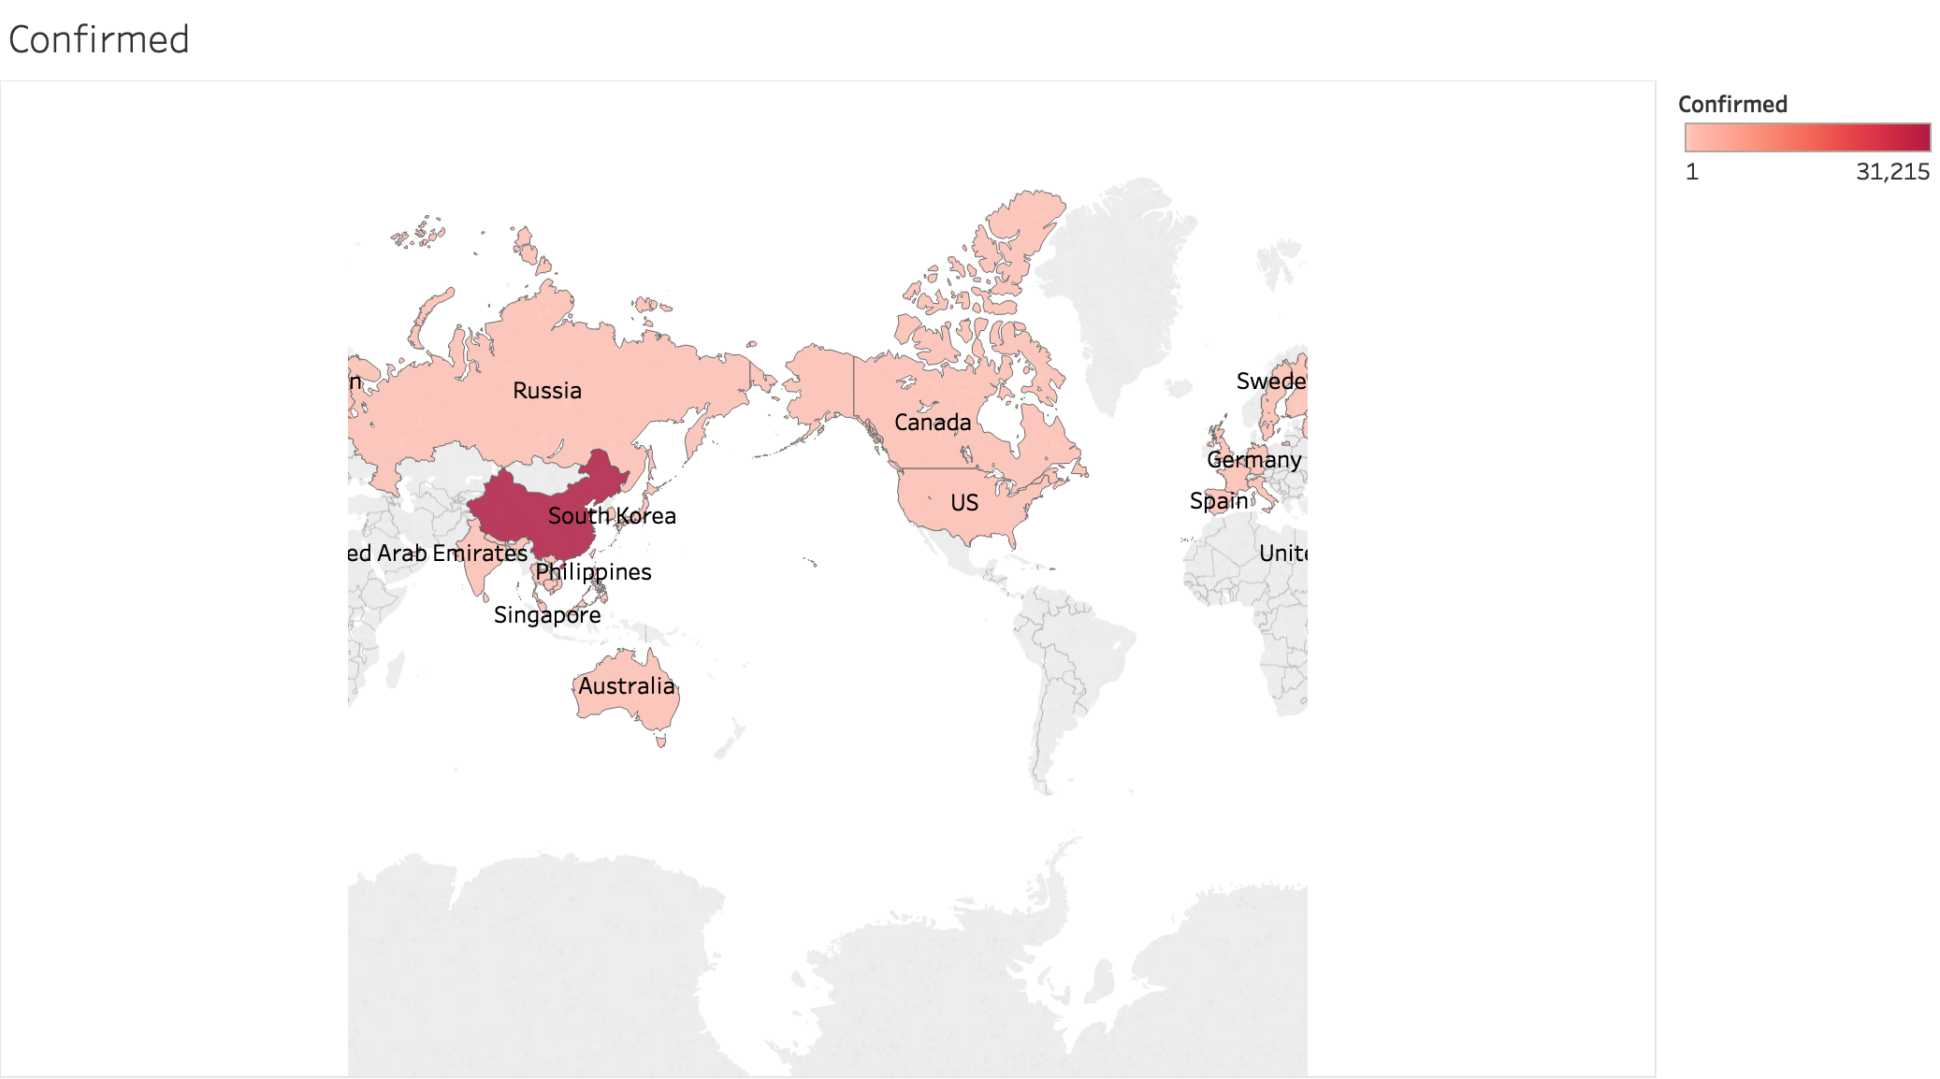
2019-nCoV has been spreading globally

Slide 4
Motivation
2019-nCoV has been spreading at an incredibly fast pace
Were people mentally prepared to prevent infections and spreads?
Track people’s minds during the spread

Slide 5
Content
Tracking Minds
Search Trends (Baidu and Google)
Tweet Sentiment (Weibo and Twitter)
References

Slide 6
Tracking Minds: Search Trends (Baidu and Google)
From the Search Trends of the keyword “coronavirus”, we may see when people are getting serious about the virus
We collected data of the search trend in China from Baidu, and the search trend around the world from Google
2019-nCoV data was collected from Kaggle

Slide 7
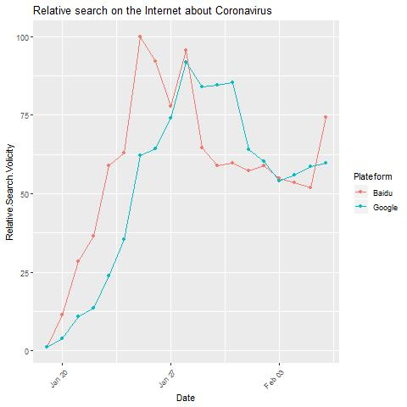
Tracking Minds: Search Trends (Baidu and Google)
There is a time lag between Baidu and Google, which seems to represent the lag between the spread of the virus.
This means that people start to get serious after the virus arrives to their country, which is not a good thing.

Slide 8
Tracking Minds: Tweet Sentiment (Weibo and Twitter)
From the Tweet Sentiment of tweets that include the keyword “coronavirus”, we may see how people’s feelings toward the virus are changing over time
We collected tweet data (100 per day) in China from Weibo, and the tweet data (200 per day) in English-Speaking countries from Google
Same 2019-nCoV data was used

Slide 9
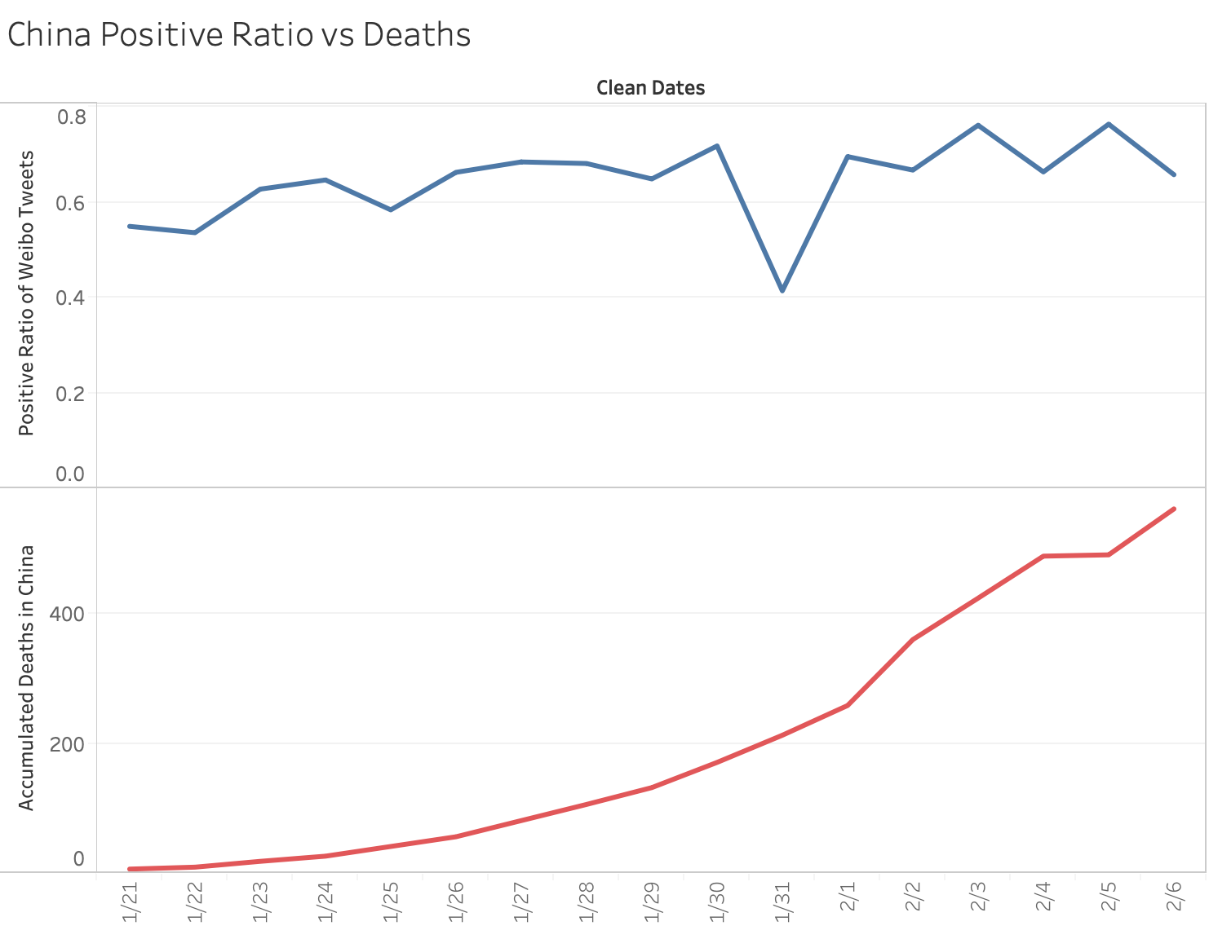
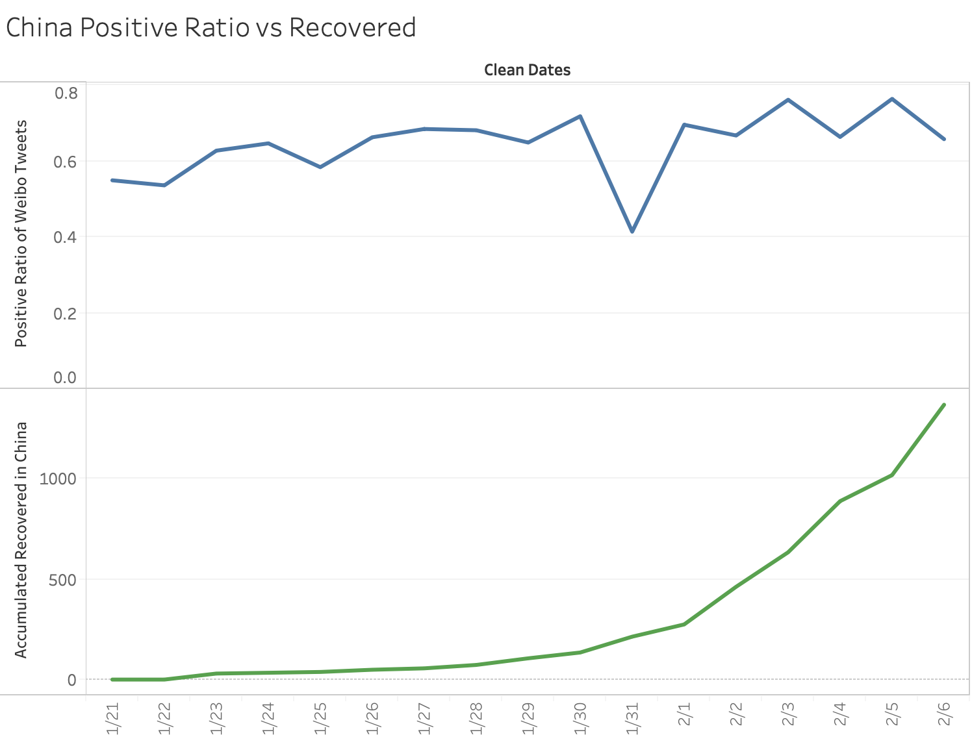
Tracking Minds: Tweet Sentiment (Weibo and Twitter)
Weibo
Correlation:
0.51132316
There is a positive correlation against Weibo tweets for both Deaths and Recovered.
It may be that while the virus is spreading, more people are positively hoping for eradication.
Correlation:
0.43046236

Slide 10
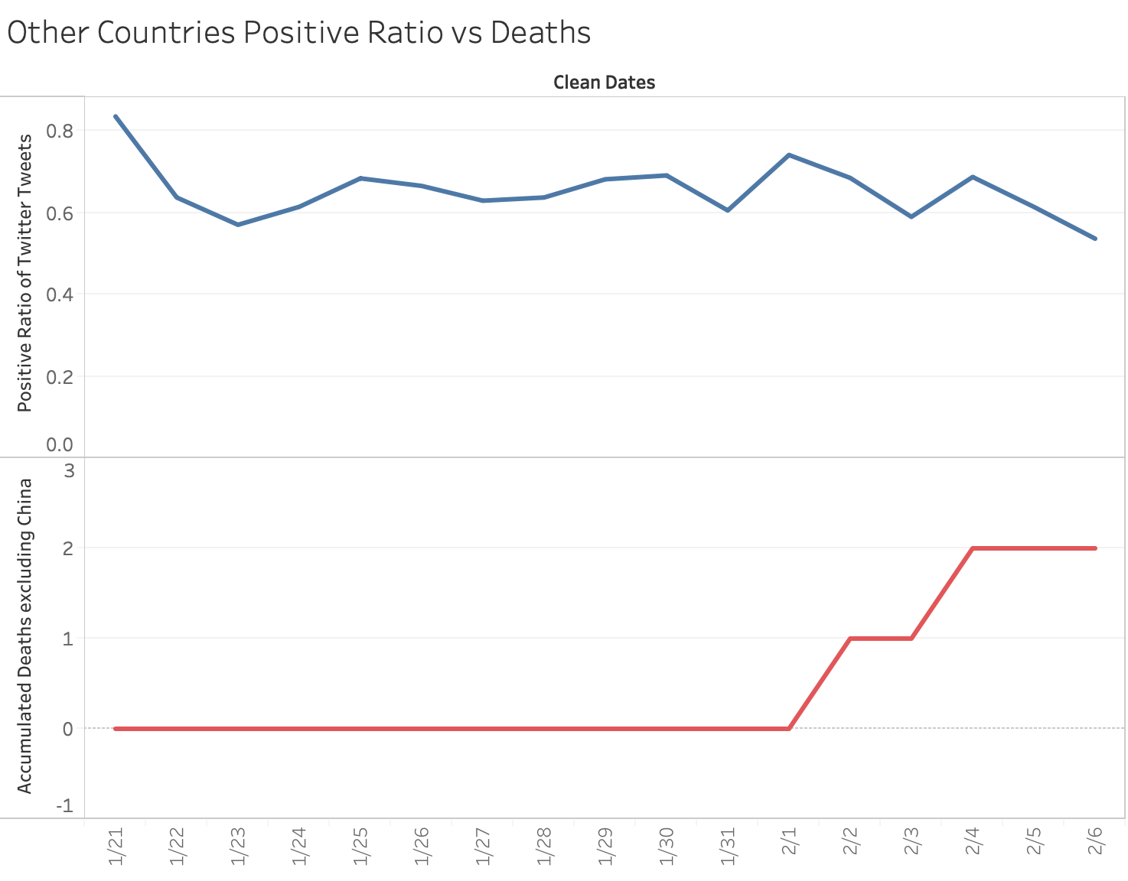
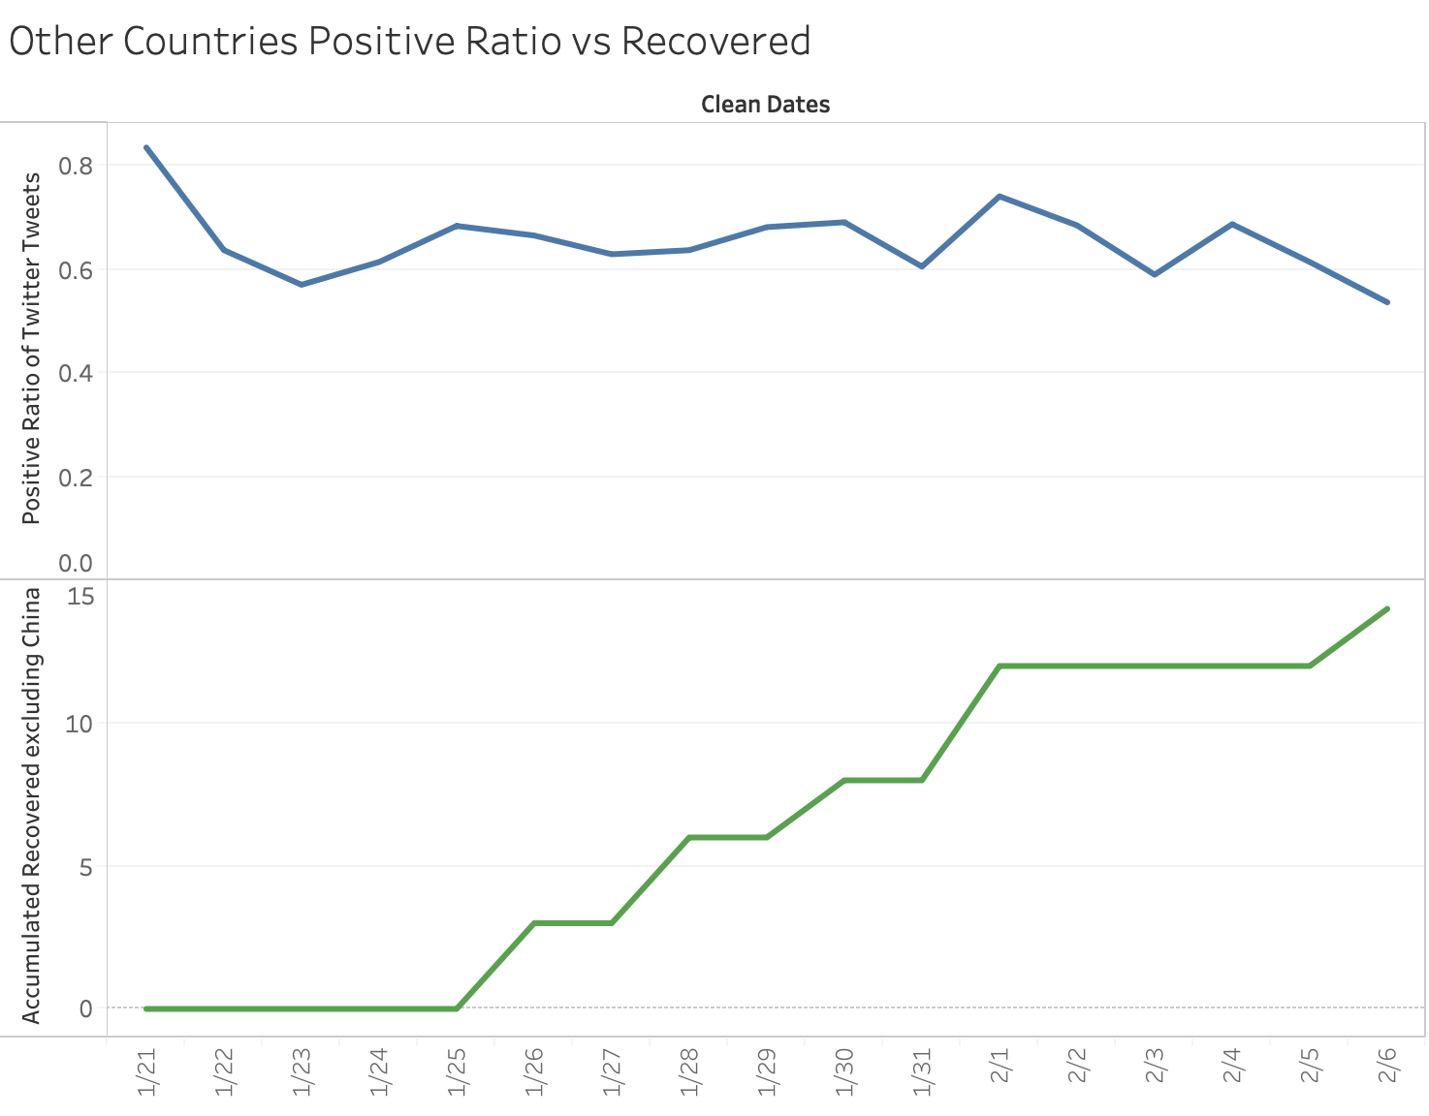
Tracking Minds: Tweet Sentiment (Weibo and Twitter)
Twitter
Correlation:
-0.14499143
Was not able to find a strong correlation between Sentiment vs Deaths or Recovered.
But it seems to have a negative correlation which may mean that more people are becoming more worried.
Correlation:
-0.10349502

Slide 11
Tracking Minds: Tweet Sentiment (Weibo and Twitter)
From the Tweet sentiment results, we may be able to say that in countries where the virus is already spreading widely, people tend to think optimistically such as eradiation and curing.
On the other hand, in countries where the virus hasn’t spread too much yet, people may be thinking more negatively, such as fear of infection.

Slide 12
Difficulties during the DevFest
2019-nCoV data had incorrect values
Limited # in Tweets that can be collected
+ Noisy tweets (Retweets)
+ Other languages
Prediction of the spread in coronavirus is too difficult
Amaury spilled water and broke his MacBook
Amaury got ill

Slide 13
References
1.Barnaghi, Peiman, Parsa Ghaffari, and John G. Breslin. "Opinion mining and sentiment polarity on twitter and correlation between events and sentiment." 2016 IEEE Second International Conference on Big Data Computing Service and Applications (BigDataService). IEEE, 2016.Limited # in Tweets that can be collected
2.https://www.nytimes.com/2020/02/09/world/asia/coronavirus-china.htmlAmaury lost his voice
3.https://zhuanlan.zhihu.com/p/70153413
4.https://zhuanlan.zhihu.com/p/30061051
5.https://www.rollingstone.com/culture/culture-news/coronavirus-wuhan-china-virus-quarantine-death-toll-941417/
6.https://news.163.com/special/epidemic/
7.https://towardsdatascience.com/twitter-sentiment-analysis-classification-using-nltk-python-fa912578614c
8.Ji, Xiang, Soon Ae Chun, and James Geller. "Monitoring public health concerns using twitter sentiment classifications." 2013 IEEE International Conference on Healthcare Informatics. IEEE, 2013.
9.Pollacci, Laura, et al. "Sentiment spreading: an epidemic model for lexicon-based sentiment analysis on twitter." Conference of the Italian Association for Artificial Intelligence. Springer, Cham, 2017.
10.https://github.com/jonbakerfish/TweetScraper

