Slide 1
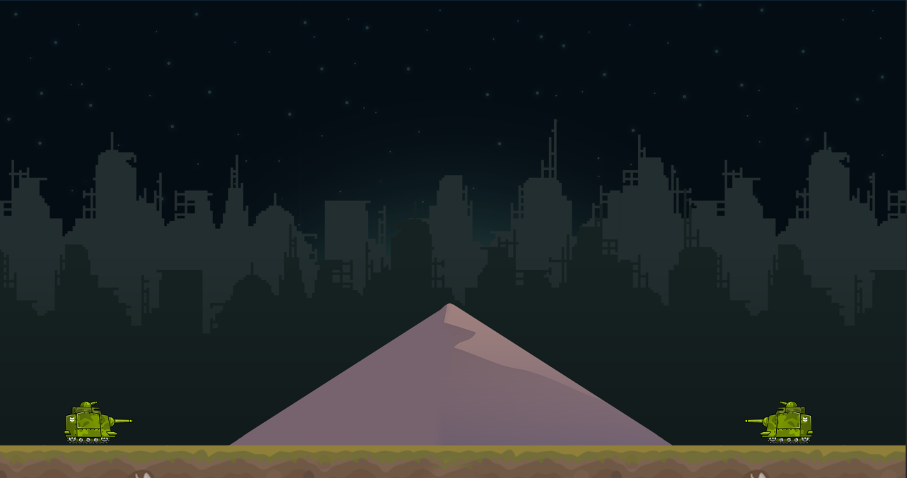

Two Player Artillery Game
Alex Poole
Derek Casey

