Slide 1
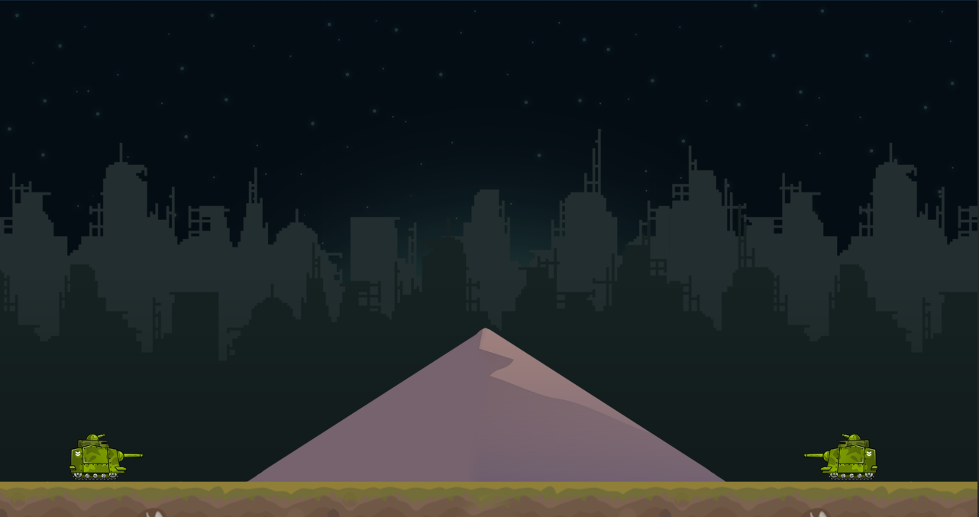

Two Player Artillery Game
Alex Poole
Derek Casey

Slide 2
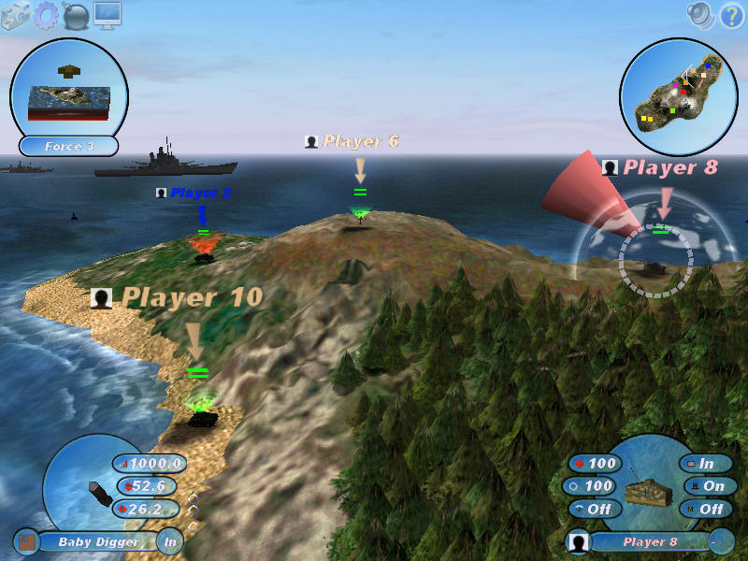
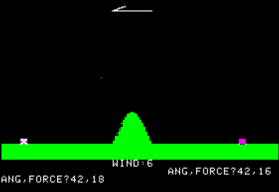
A Brief History of Artillery Games
Inspired by original purpose of computers
First graphical based game Artillery in 1980 for the Apple II
Modern day equivalent: Scorched Earth 3D (2001)

Slide 3

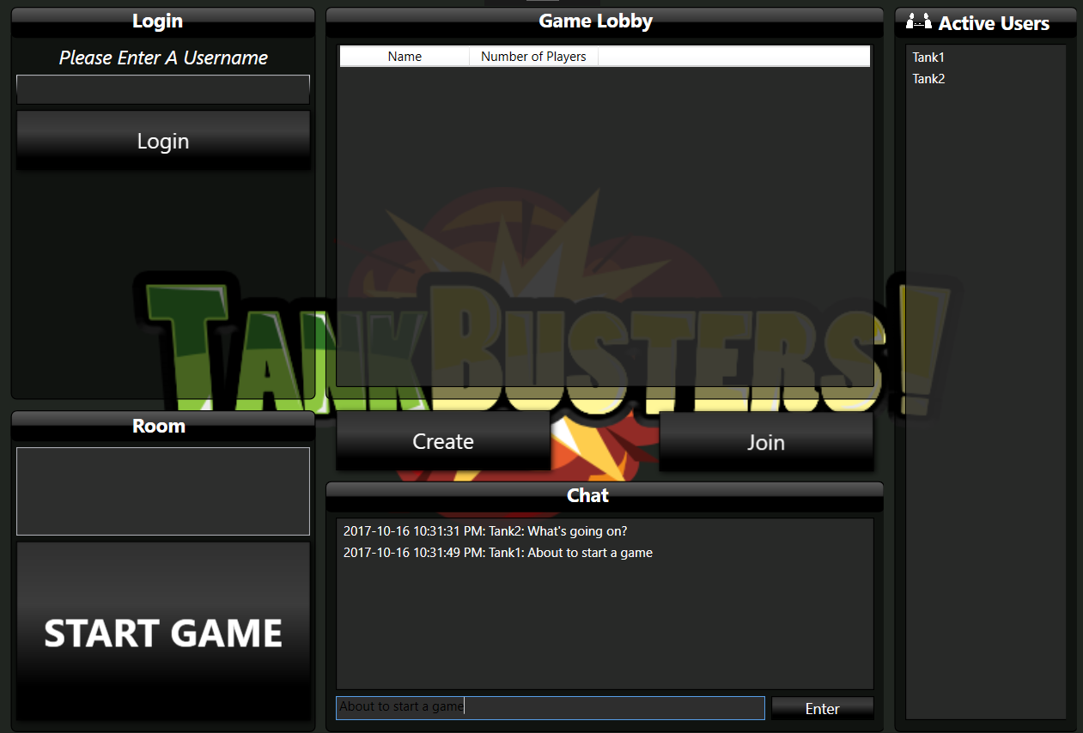
Login Page
Players can login
Become Active Users
One player clicks “Create”
Other presses “Join”
Active Users can chat

Slide 4
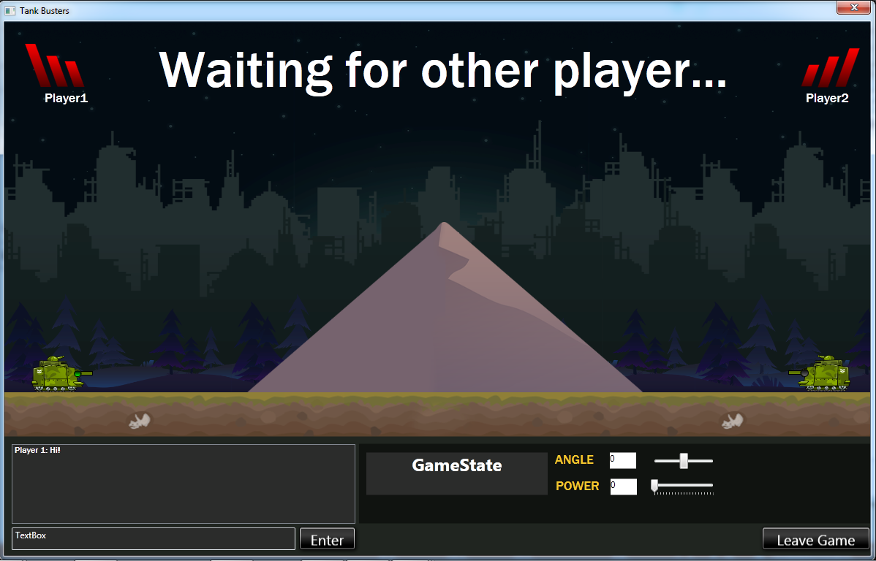
Gameplay
Player rotates barrel
Changes Power
Fires
Collision detects health loss

Slide 5
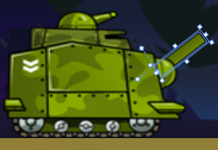
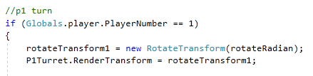

Interacting with Objects
P1Turret
RotateTransform Class
Rotates an object clockwise about a specified point in a 2-D x-y coordinate system.
DispatcherTimer Class
A timer which is processed at a specified interval of time and at a specified priority.

Slide 6
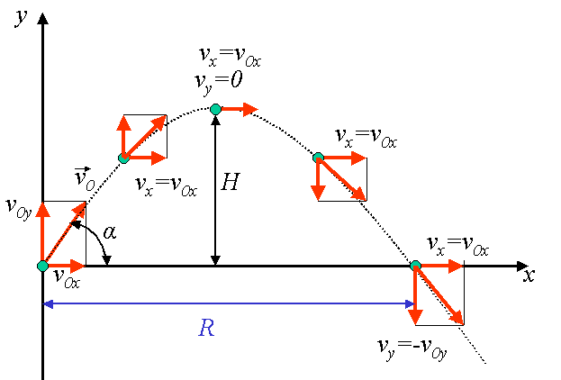
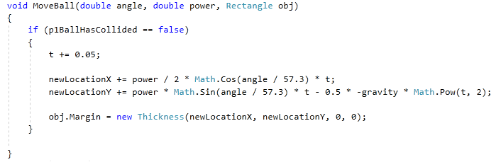
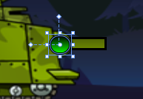
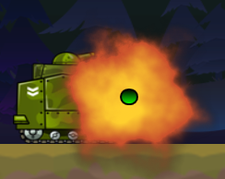
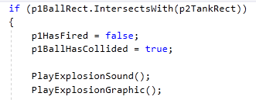

Blowing Things Up!
Parabolic Trajectory/Projectile Motion
Fire
Gravity
Margins
Collisions

Slide 7
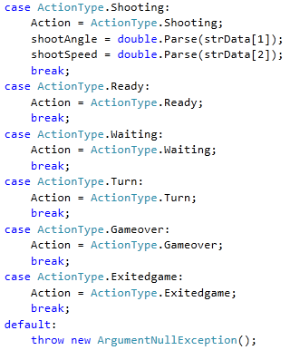
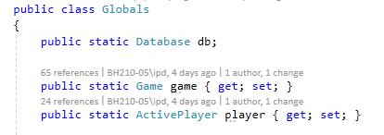
Syncing the players
Chatting in Real Time
Globals Class
Message Class

Slide 8
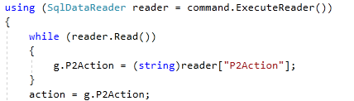

Syncing the players part 2
Updating and Reading Actions

Slide 9
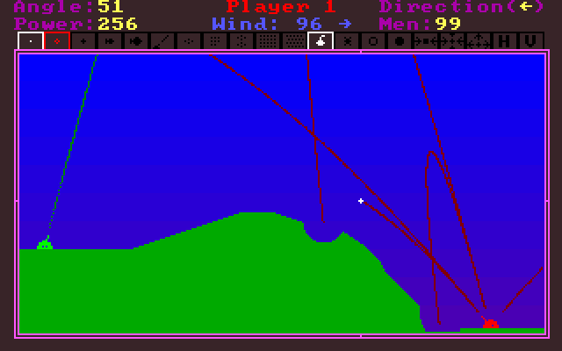
Future Work
Canvas size shot issues
Wind Variable
Map Destruction
Display past shots

Slide 10
Summary
Login Page
Chat Box
Artillery Game

