Slide 1
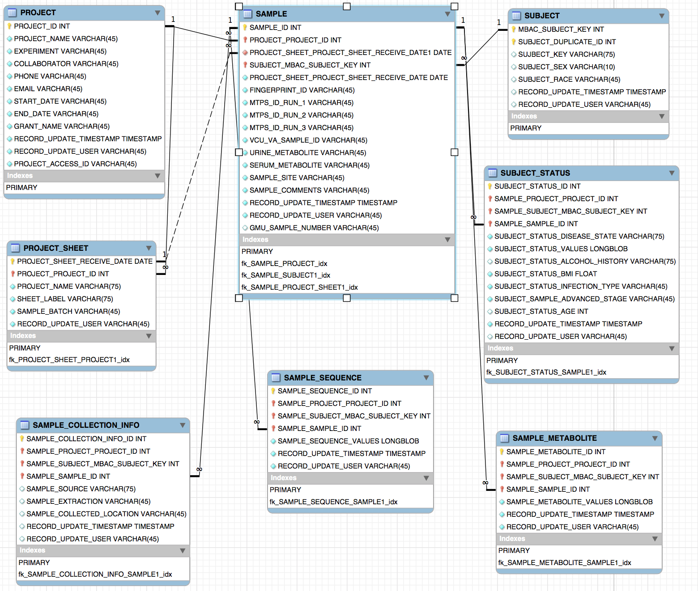
BINF401 Databases with MySQL
Dr. Bob Brown

Slide 2
Structured Query Language SQL
An industry standard started in the 1980s
Allows users to learn one language to talk to a different databases. PostGres, MySQL, Oracle, etc.
Based on
Select (Read)
Insert (add new data)
Update (change existing data)
Delete (remove data)

Slide 3
MySQL DB
A critical component to performing multi-variant analysis is ….. Keeping track of your data
A word to the wise – Excel is NOT good enough
And I love Excel – the program for why desktop computers exist
My term – the multi-list problem
Several spreadsheets of the “same” data and each is different in different way – no Master (Authoritative) source
Especially important, if you work with researchers in separate labs, or many researchers in one lab
Mistakes are made and everyone attempts to correct
New data comes in – data is not static

Slide 4
Laboratory Information Management Systems (LIMS)
Laboratory Information Management Systems (LIMS) a generally helpful with physical sample location and tracking – but not your feature data and analysis
Is it relatively easy to create your own database and load data into it – then make the database data the master values
You can update that info as needed
Redcap is one system
FreezerPro is another with a different focus

Slide 5
MySQL (open source)
A Structure Query Language (SQL) compliant relational database (DBMS)
Comprised of Databases (often called schemas although they are really not the same – but unimportant here)
A database is comprised of tables
Tables are like a tab on a spreadsheet with columns that have names
A column usually has a given type of data values allows e.g.(integer, text, real numbers, dates)
Each column has a unique name
Tables are related to other tables by specified common columns in both tables (hence relational database
PostGres is semi-popular as well

Slide 6
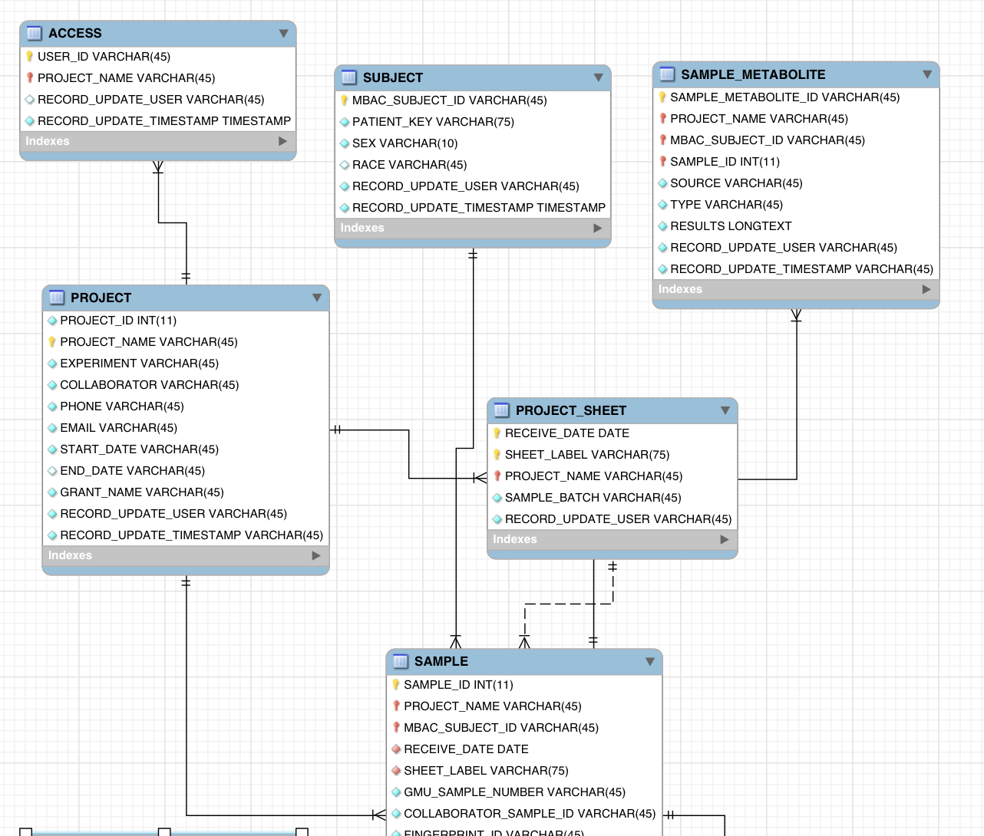
Entity Relationship Diagrams (ERD)

Slide 7
Entity Relationship Diagrams
Graphical display of a schema
Tables with column names and key icons
Relationships between tables
Can be forward-engineered to create a schema
An ERD can be extracted from an existing schema

Slide 8
MySQLWorkbench (open source)
A program that allows you to view, change, load, and configure your MySQL database
Create Schemas, Tables, and Alter Tables
Database A “bucket” for related tables
Tables – a series of columns and 0 to N rows for each
Columns – A field in a Table that can be required to be in many different formats – text, integer, real, time
Keys – Special columns – more later
Run Queries, verify they are correct, and see the results

Slide 9
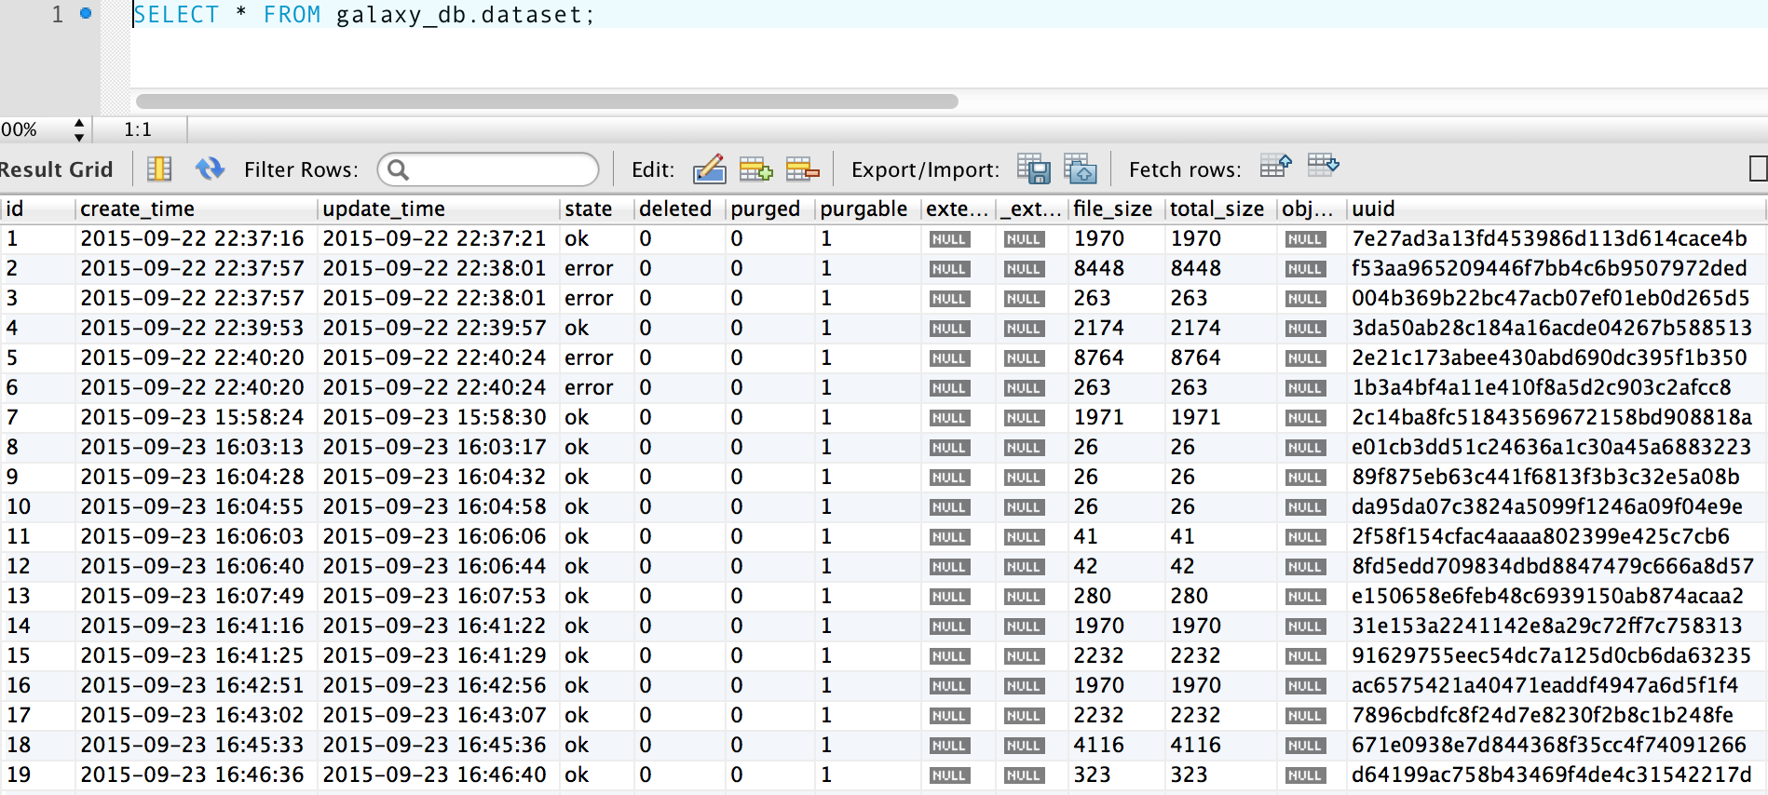
Tables comprised of Columns and Rows

Slide 10
Parent and Child Tables
If the column/field (e.g user_id) is the same in two different tables
The Parent table supplies an identifying key (secondary) to a Child Table
There cannot be data in the Child Table using that Secondary Key unless there is data with that key in the Parent Table
Otherwise the data in the Child Table is called Orphan rows
Generally a Parent Child relationship is also a one-to-many (rows) between the Parent and Child tables

Slide 11
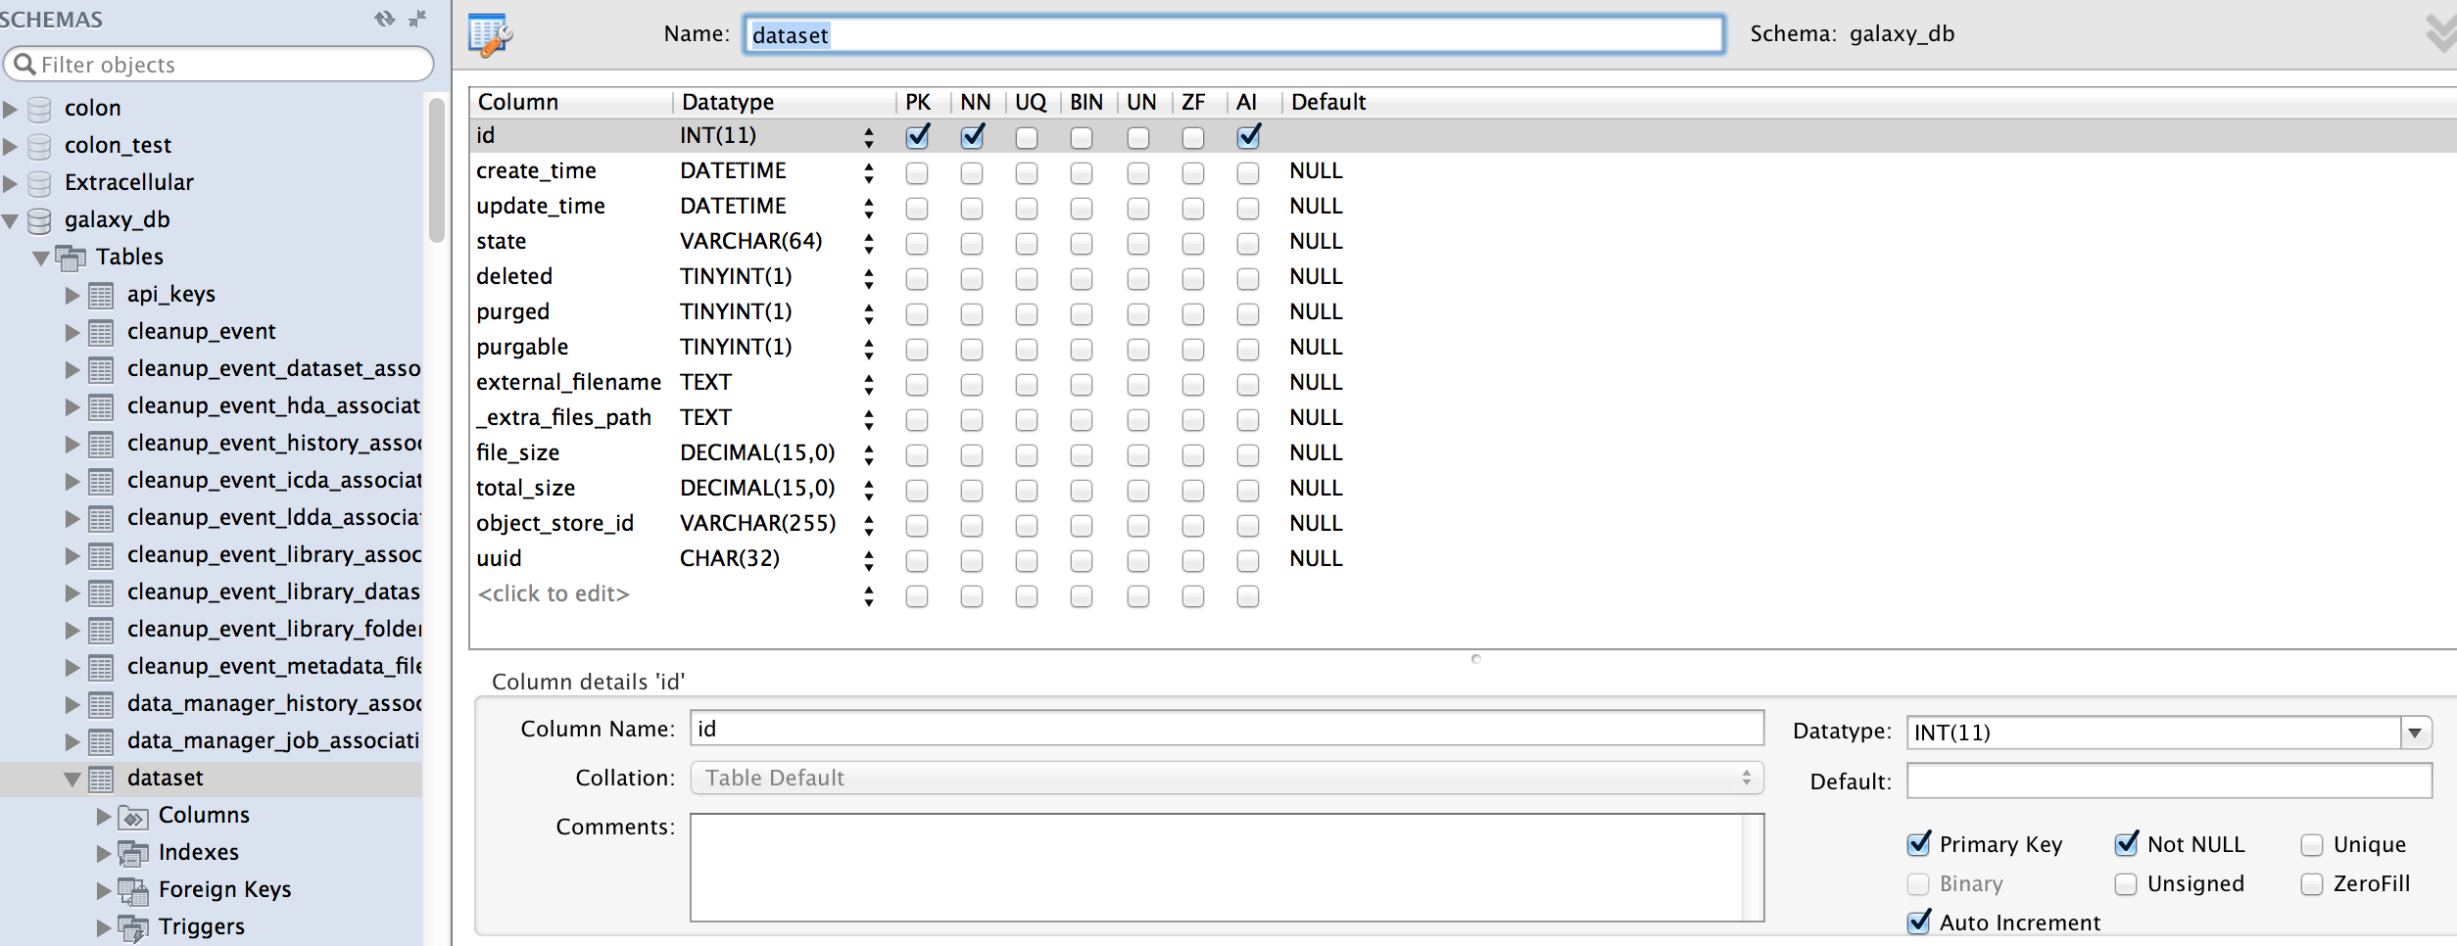
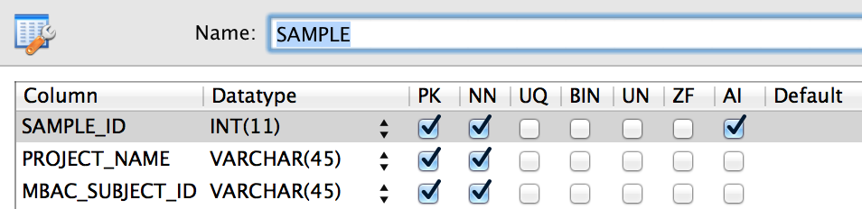
Primary and Secondary keys

Slide 12
Primary and Secondary keys
A primary key can only retrieve 0 or 1 row from its Table
A secondary key can retrieve 0 to N rows from the Table
One or more secondary keys comprise a primary key
Key originates from a Parent Table
They are both indexes and retrieve more quickly than a sequential query
Sequential query looks at ALL rows to see if there is a match search) no indexing of rows

Slide 13
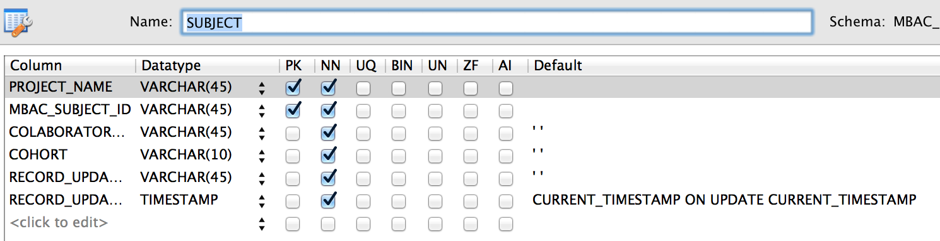
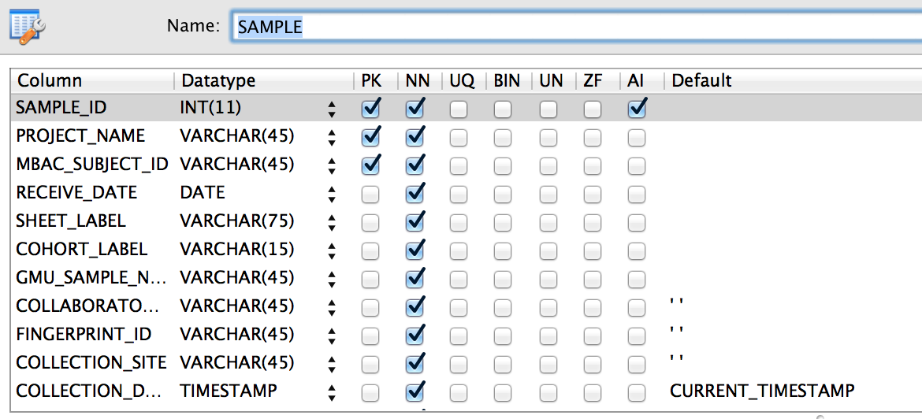
Foreign Keys and Relationships

Slide 14
Foreign Keys and Relationships
If the column/field is a primary or secondary key in BOTH tables it is called an IDENTIFYING RELATIONSHIP (solid line in ERD)
It identifies (is part of the primary key in the Child (dependent ) table
Relationships are usually one-to-many meaning the columns is the entire primary key in the primary table and part of the primary key (a secondary key) in the dependent table
The Child Table will have a Compound Primary Key (made up of 2 or more columns in its Table
If the column/field is a primary or secondary key in only one of the tables it is called an NON-IDENTIFYING RELATIONSHIP (dashed line in ERD)
It does not identify rows (non-key) in the secondary table

Slide 15
Database Summary
We learned the basics of a Relational Database Management System (DBMS) or DB for short
MySQL is open-source (free) and follows the SQL standard with extensions
Tables comprised of Columns and Rows
Primary and Secondary keys
Foreign Keys and Relationships
Entity Relationship Diagrams (ERD)

