Slide 1
Outside looking in
How public records can be used to research a ransomware attack
Derek Held (@derekheld)

Slide 2
What will be covered
Washington State Public Records law
How and what records I requested
Strategies for reviewing records
Things I found related to the attack
Things I didn’t expect but found in the records
Notes:
I love government transparency, so I am really pumped to be talking about public records and information security today
I’m going to start off talking about Washington State’s Public Records Act and what makes it such a strong tool for researchers.
Then I’ll show you how easy it is to request records, followed by giving you tips and tricks when it comes to making requests and reviewing the records you get back.
Finally I’ll dig into the things I found in the records and show you how these records provide a view you often don’t see unless you’re in the incident yourself along with some things that I found that I wasn’t looking for.

Slide 3
Public Records Law

Slide 4
Public Records Act (Chapter 42.56 RCW)
Any document, record, or data a public agency produces is a public record
Washington State’s laws are strongly written towards disclosure
42.56.120 covers what you can be charged
Common reactions may be under
42.56.420(4) (information security exemption)
42.56.230 (personal information)
5.60.060 (attorney-client privilege)
Notes:
The public records act has a much longer definition, but a public record is basically anything produced by a public agency as part of conducting their duties.
The law very strongly favors release and states explicitly that the act should be interpreted liberally in favor of the public and narrowly in favor of exemptions.
Within the PRA there’s a few sections that will probably be of particular interest to you.
One section covers what charges are allowable for requests and it’s very minimal. I wasn’t charged for any of my requests. In Washington you can’t be charged for the labor to prepare the records except for some very narrow specific cases.
There’s three exemptions you’ll likely see most often in this kind of research.
The information security exemption is defined as information that increases risk to confidentiality, integrity, or availability of infrastructure or assets. Examples include things like credentials or specific vulnerability information.
Personal information does not cover things like the contact information of people the agency is conducting business with, but for my project would cover personal information of students and parents.
Finally, since we’re talking security breaches you’ll likely run into attorney-client privilege exemption.
It’s also up to the agency to decide what, if any redactions they want to make unless they are specifically required by law as is the case with certain personal information.

Slide 5
Public Records Case Law
Just because it was redacted doesn’t mean it is a permitted redaction
Municipal Research and Services Center of Washington maintains an entire directory of Public Records case law (https://mrsc.org)
The law and courts place the burden on the agency to prove the redaction is explicitly permitted
Notes:
On the topic of exemptions and redactions, it’s important to remember that it’s always possible that an agency will improperly redact a document.
The Municipal Research and Services Center of Washington has useful page where they have a whole list of public records case decisions.
What you’ll find is that the law and the courts very much place the burden on the agency to show redactions have been explicitly allowed.
This leads me to…

Slide 6
Legal Remedies and Review
You can appeal a redaction directly with the agency
If it’s a state agency, the Attorney General’s office can be asked to review
A lawsuit can be filed in Superior Court of the agency’s county
If you win, the agency must pay your court and reasonable legal fees
Notes:
What do you do if you have received records you believe have been improperly redacted?
Well for one, just ask about it. Explain why you think the redaction is improper and give them the chance to take another look.
If you’re dealing with a state agency, you can ask the Attorney General’s office to conduct a 3rd party review.
The last resort option is a lawsuit, which you file in the county the agency is in. If you win the agency must pay court costs, legal fees, and potentially damages if the court finds bad faith or improper procedures.

Slide 7
Requesting Records

Slide 8
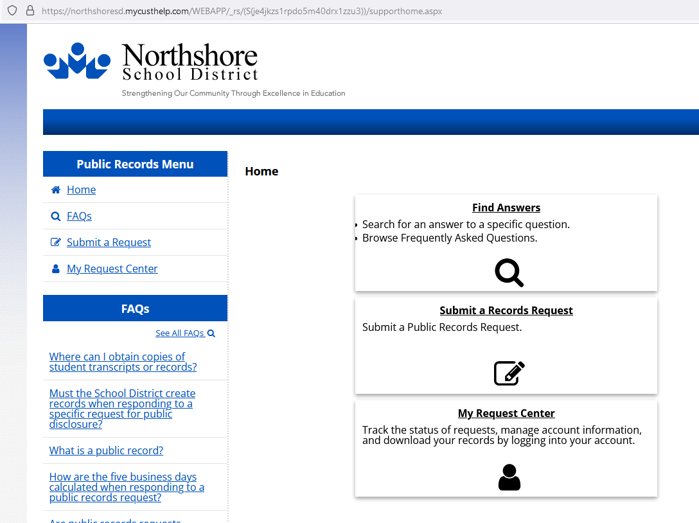
How I requested records
I used Muckrock to be the interface for all my requests
Like many public agencies, the district uses GovQA public records portal
Another common way agencies handle public records requests is just via a dedicated email
Notes:
Muckrock is a cool tool that helps you make public records requests, organize those requests, and help you track progress.
If the agency you are submitted a records request to isn’t present, you have to provide some information to add it.
It can be a great tool but it can also be a little frustrating if you run into issues like communications not showing up which I did.
Another option is to just make your requests directly with the agency, if I was doing this again I think I would have done.
In the screenshot you can see Northshore’s GovQA portal for records requests. This is a very common portal for request tracking and is easy to use.
Not all agencies use software like this, sometimes it’s just an email you send your request to. But the PRA requires agencies to make their public records request process easily found.
So it’s always going to be pretty easy to find using a search engine with the agency’s name and the phrase “public records request”.

Slide 9
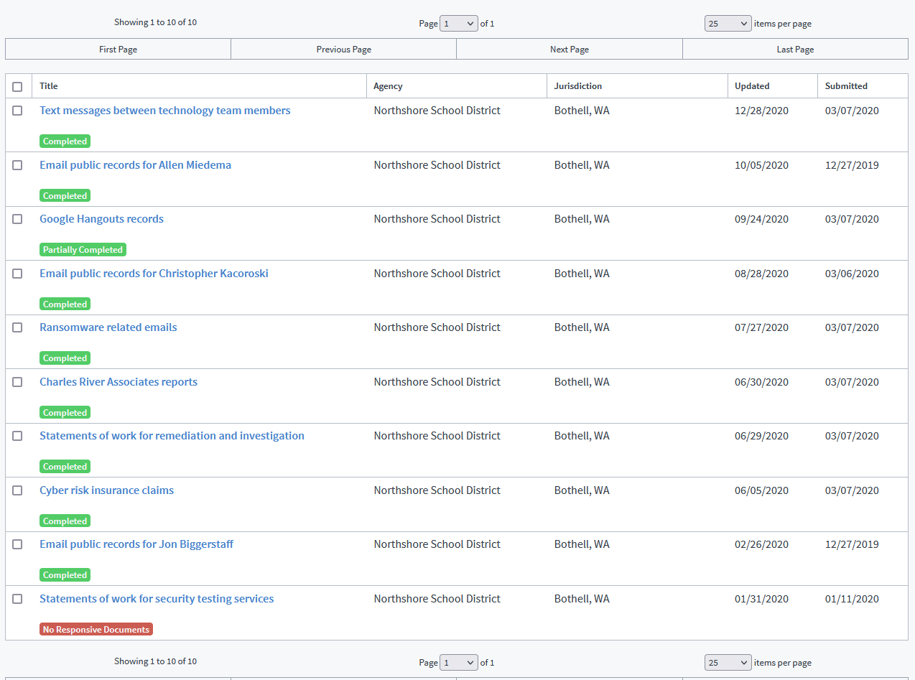
My Muckrock Requests
Notes:
This is all the individual requests I made for this project, 10 in all.
If you look at the dates you’ll see that start to finish it took one year for all the requests I made to be fulfilled and I was often waiting months.
This is not a fast process, there’s a lot of patience required.

Slide 10
Make prescriptive requests
Do not rely on the interpretation of others
Good: “All emails sent/received dated from September 20th 2019 to October 4th 2019 containing any of the following words: ransom, ransomware, Ryuk, bitcoin, crypto, or cryptocurrency”
Bad: “Records from the fall about ransoms or ransom payment”
Notes:
Ok let’s start digging into making requests. When making a request you want to use very prescriptive language. Don’t rely on the other person “getting it”, you want they to know exactly what you are looking for.
Here’s an example of the same request, one prescriptive and one vague.
In the good request I specify the type of records I want inspected, the exact date range I want included, and the exact words I am looking for. This also makes their job easier because they can just plug this right into their discovery tools.
With the bad request there’s a lot of room for interpretation. There’s no specific records types, there no specific dates, and while there is a subject it’s been left up to the agency to determine how to locate records matching those subjects.

Slide 11
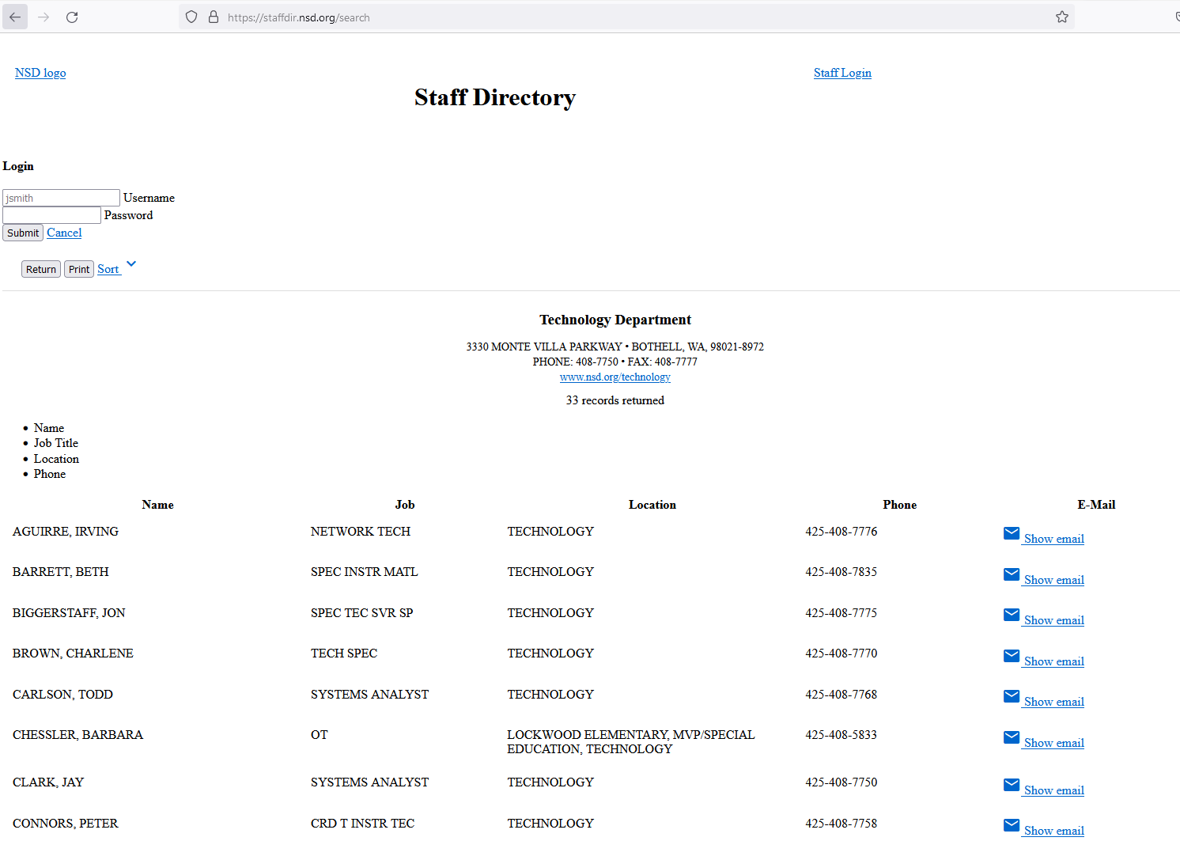
Use open-source intelligence (OSINT)
All basic employment information is a public record and often searchable
Staff directory
Search engines
Sites such as GovSalaries
Might find requests for proposals for acquisitions
Can provide additional context or fill in the gaps for both making and reviewing requests
Notes:
An important source of information when making or reviewing records is open source intelligence.
For example, all basic employment information for public agencies are public records and often easily searchable.
They can be located in staff directories, in aggregation websites like GovSalaries, or even just discoverable via search engine.
Of course LinkedIn can always be a nice repository of information too.
I used the district’s directory to figure out which people should be part of my initial requests.
You might be able to find purchasing related records that might help direct your requests.
Using OSINT is also helpful for getting additional context or filling in gaps when you are reviewing records.

Slide 12
Don’t start narrow
Broad requests can help you make targeted requests
Helps provide context
Can direct you to topics or documents you didn’t know to request
Requested all emails from September 18th through October 4th for
Allen Miedema (Director of IT)
Jon Biggerstaff (Windows Systems Administrator)
Notes:
This is going to be more specific to doing this kind of research
Broad requests in these kinds of situations means you will have to wait longer but will provide so much more information
You will get context and you will get things you didn’t even think to look for
All this information will help you make those very targeted, narrow requests
I started my search by requesting all emails for only two staff members for a 17 day period covering just before the attack and about 2 weeks after.
I wanted emails for the Director of IT, that seemed pretty relevant
And I also wanted the emails for the person who had the title of Windows Systems Administrator, because you know, ransomware….

Slide 13
Review Strategies

Slide 14
Refine requests based on results
Use records you get back to make further requests
Additional people
Additional forms of communications
Additional types of records (invoices, statements of work, insurance claims)
Notes:
When I got the initial records back for Jon Biggerstaff I used them to inform my next batches of requests.
I was able to find out more people and companies involved and the kinds of work being done
I was able to find additional communications tools being used like Google Hangouts thanks to an emailed reminder about maintaining public records.
Using all that information my next batch of requests covering more communication methods, more individuals, and more record types.

Slide 15
Read around the redactions
Even if a redaction is made, use clues in the email and OSINT
They improperly redacted purchase records (improper security exemption)
I also found out they had just setup Bitwarden despite a redaction attempt
Additional or overlapping requests can be your friend
Notes:
In an event like this where sensitivity is high and desire for secrecy is high you are going to encounter a lot of redactions, maybe even improper ones.
While you can appeal, you can also just use your security knowledge and OSINT skills
Initially they were even redacting the words “ransomware” and “ryuk”, despite this having been publicly reported within days by ransomware monitoring sites. They stopped after I put in a records request specifically asking for emails containing those words.
They weirdly redacted, as far as I could tell, the name and URL of the state’s E-Certifcation system despite it being a public web app
Despite redactions I was able to find out about their Bitwarden instance, how the outside incident response team brought in Carbon Black and Gigamon all by looking at what wasn’t redacted.
In my case I also noticed that redactions seemed to change over time. Early documents were redacted more heavily than later documents and that’s something you might run into as well.
One fun thing is when you have redacted emails involving another public agency, you can always put in a records request for the other agency and see if you can get an unredacted copy or different redactions.
Even overlapping requests with the same agency can sometimes provide different results.

Slide 16
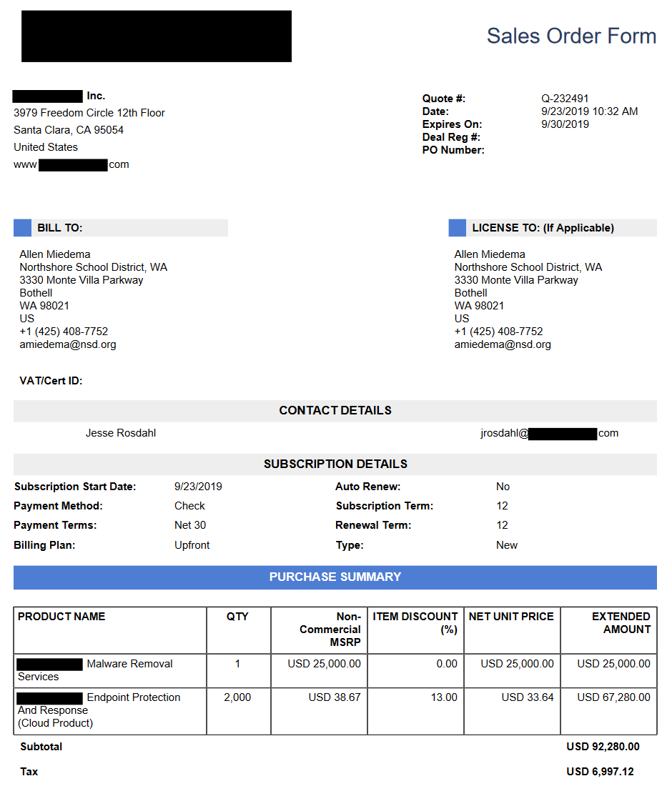
Notes:
On the topic of reading around redactions, I’m going to use this as an example.
This is a quote that I would say was improperly redacted under the security exemption.
I could have pushed back and explained my position, but it was simply not necessary.
How many clues can you see in this email that can tell you the vendor involved?
Address, product names, the name of the sales person for you to look up on LinkedIn, and even just the entire template including color used.

Slide 17
Remembering what you read
Prepare for tens of thousands of pages in the records
Use a system for taking notes about what you find and where
Organize your records to make source material easy to find based on your notes
Notes:
Especially if you are using broader searches, you are going to end up with a huge volume of records
Because of this you’ll also need a system for taking notes. I just used some simple notepad type scratch notes with page numbers and a note about what I found but pick a system that fits your need
Notebook, commenting or notation features in a PDF reader, extracting out specific pages are all options.
Also consider how you want to organize your records. I kept mine organized by request but make sure your system for notes and record organizing go together.

Slide 18
Things I found

Slide 19
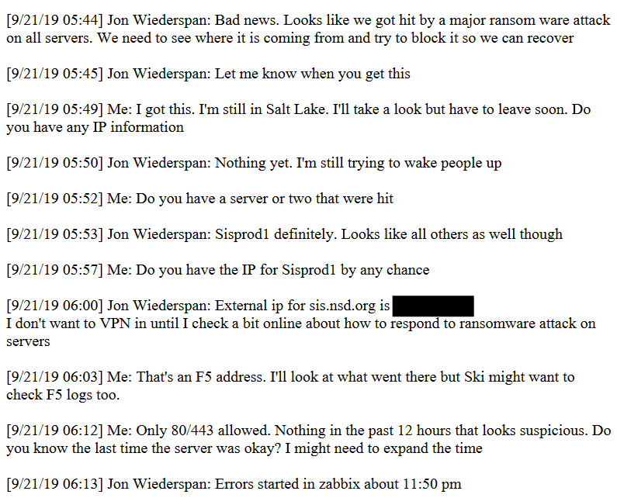
The Morning After
The attack was discovered early morning on Saturday the 21st
Initial work was focused on stopping the attack
Initial investigations looked at it as outside-in initiated/ongoing
Attack started the previous night
Notes:
Let’s start with the morning the attack was discovered.
The ransomware attack was discovered early Saturday morning by a DBA who logged in and discovered an important database was not working.
They reached out to others on the IT team and word got around quick.
These text messages are between Jon Wiederspan, Elizabeth Hunter both networking engineers after that discovery was made.
Their first concern is of course stopping the attack.
We can see that there was no plan for dealing with an incident like this and that the team needed time to develop a plan, this is not uncommon of course.
We also get a look at what were considering as the source of the attack. They were thinking this was something that came through the perimeter recently, though from experience many of us know that the attackers have been in their systems for awhile already.
Finally we can see what time the encryption attack started as Zabbix remained online and they were able to see when alerts started triggering. Though it also tells us nobody was getting paged either.

Slide 20
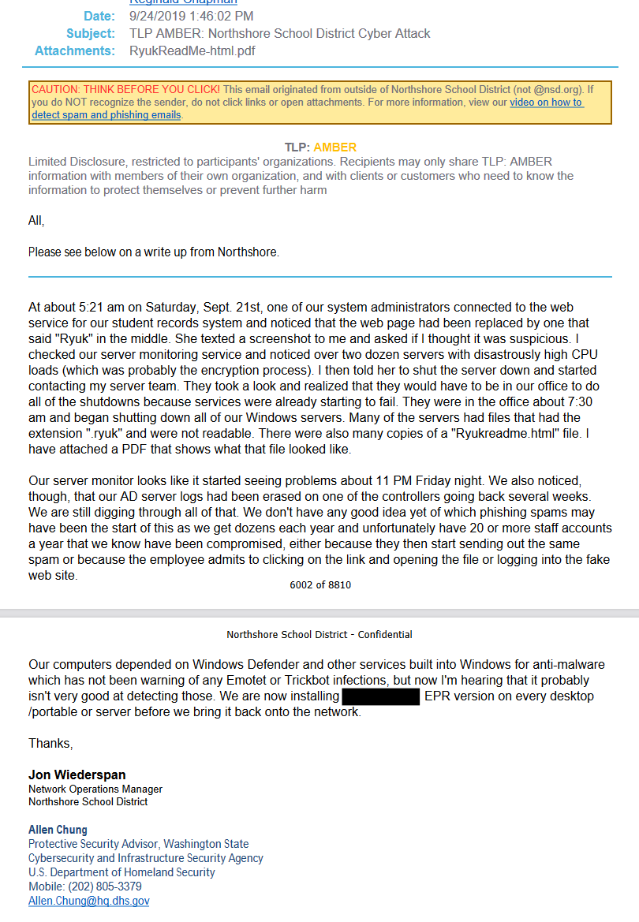
TLP: Amber
The notice sent out by CISA included a description of events the morning after the attack
Because services began to fail, remote administration became more difficult
Took over 2, critical hours from discovery to full server shutdown
Notes:
With the involvement of law enforcement and other government agencies came a notice sent by CISA about the attack
This notice included a description of the events, including that it was discovered at 5:21am
From the notice it is clear they also attempted to shut down servers remotely but were stymied as more encrypted systems took critical services offline
This meant getting engineers on site to finish the shut down, which by the end took over 2 hours to accomplish

Slide 21
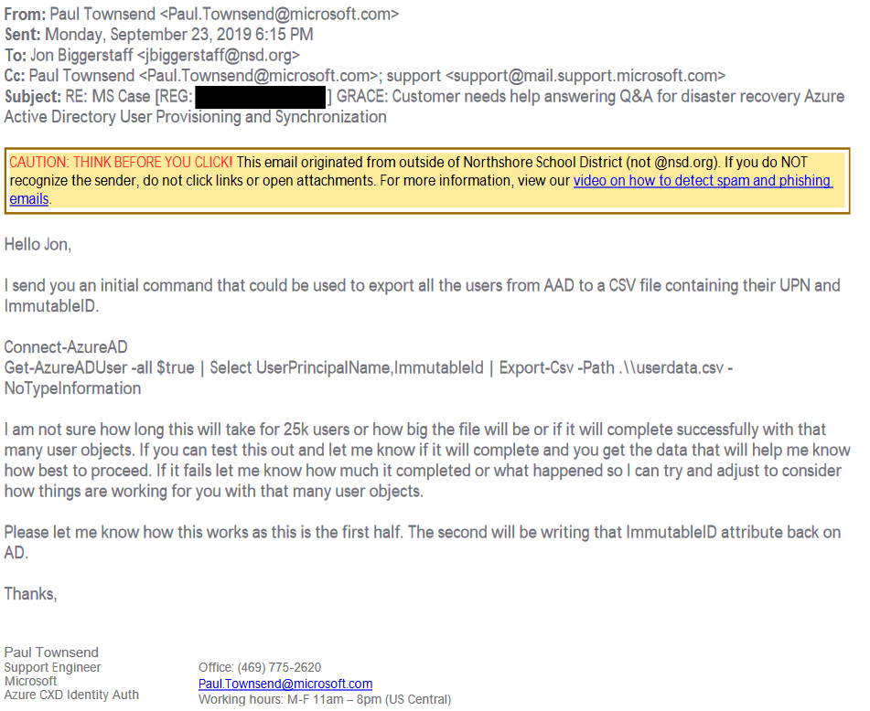
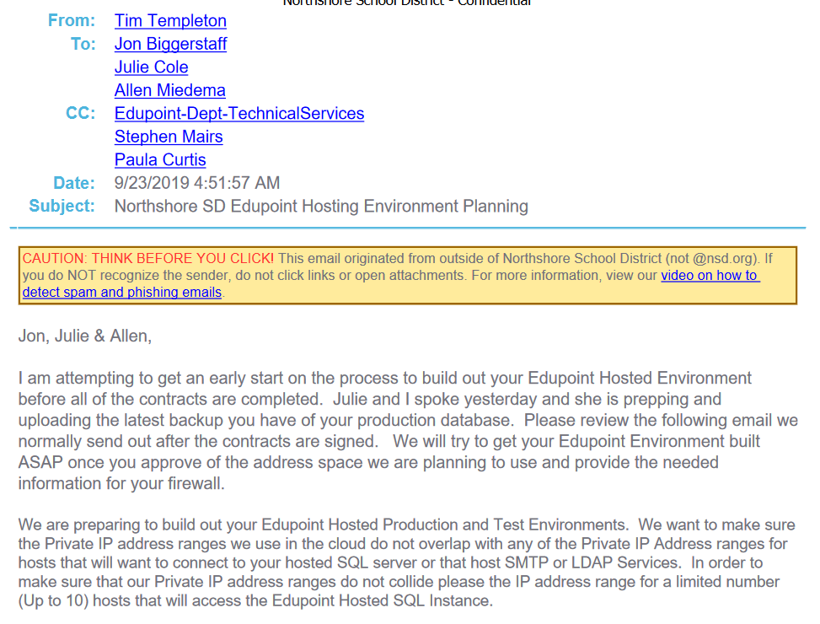
People want to help
Notes:
Another thing I found a lot of was people wanting to help.
Your best partners are the ones ready to help in any way they can to get you back up and running.
There were many emails with Microsoft engineers and resources on how to quickly get a new domain established and reconnect the new domain with Azure AD.
Edupoint, which provided a student information system named Synergy to the district, kicked off technical planning and work before the contract was even signed for their software as a service offering.
But unfortunately mixed in with the helpful people, you have some not so helpful people.

Slide 22
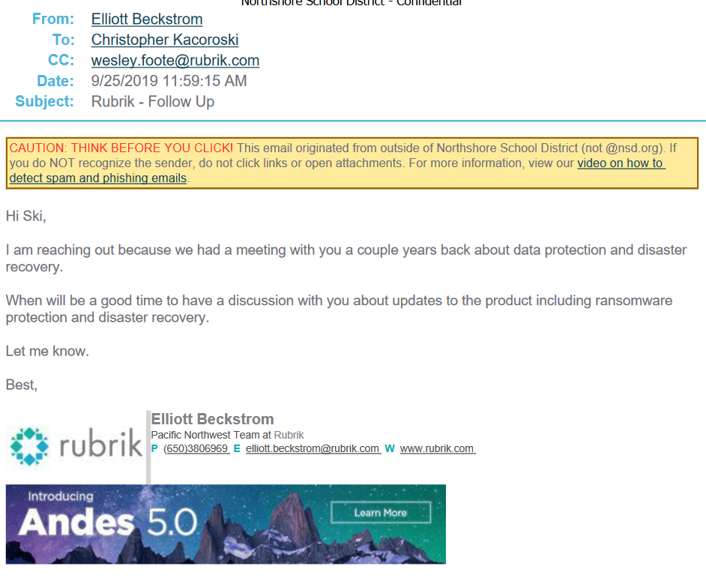
Ambulance chasers
Notes:
But you’ll also have not so helpful people trying to leverage it as a sales opportunity.

Slide 23
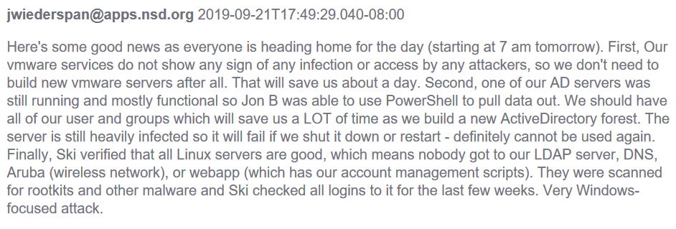
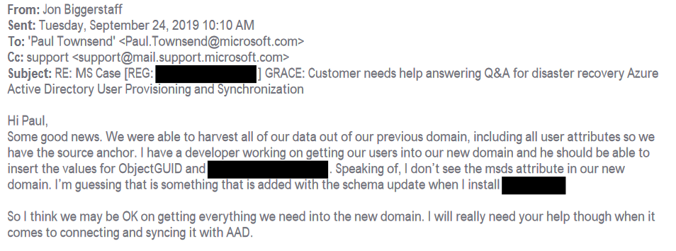
Sometimes you get lucky
Veeam backup servers were targeted and data destroyed
Mixed OS environment meant some services remained functional and helped recovery
One domain controller remained online and working just well enough to pull directory information from
Notes:
In any security breach sometimes you catch breaks just by being lucky.
The district was using Veeam as their main backup system, which was also targeted in the attack.
But the district ran both Windows and Linux servers. Their Linux servers remained online and services available. This meant they could still do things like deploy VMs in ESXi.
In a stroke of luck reminiscent of the Maersk NotPetya attack, they discovered a domain controller that was still operational.
This allowed the team to pull directory information and provide a significant boost to their ability to bring identity services back online quickly since they didn’t have to start from scratch.

Slide 24
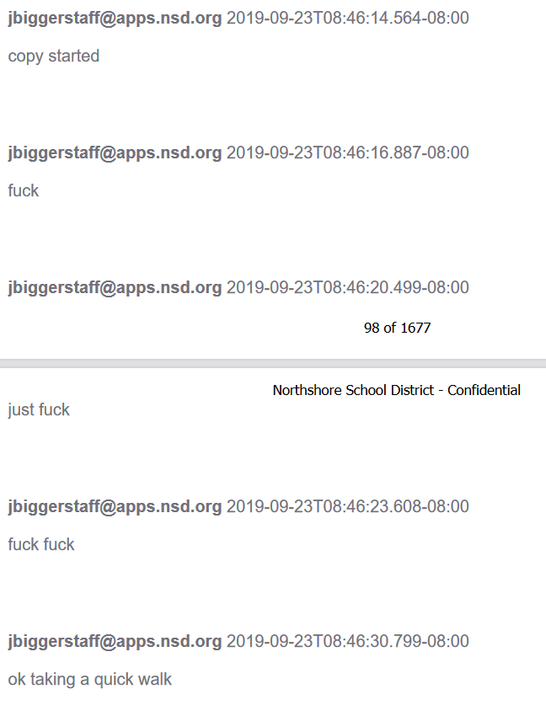
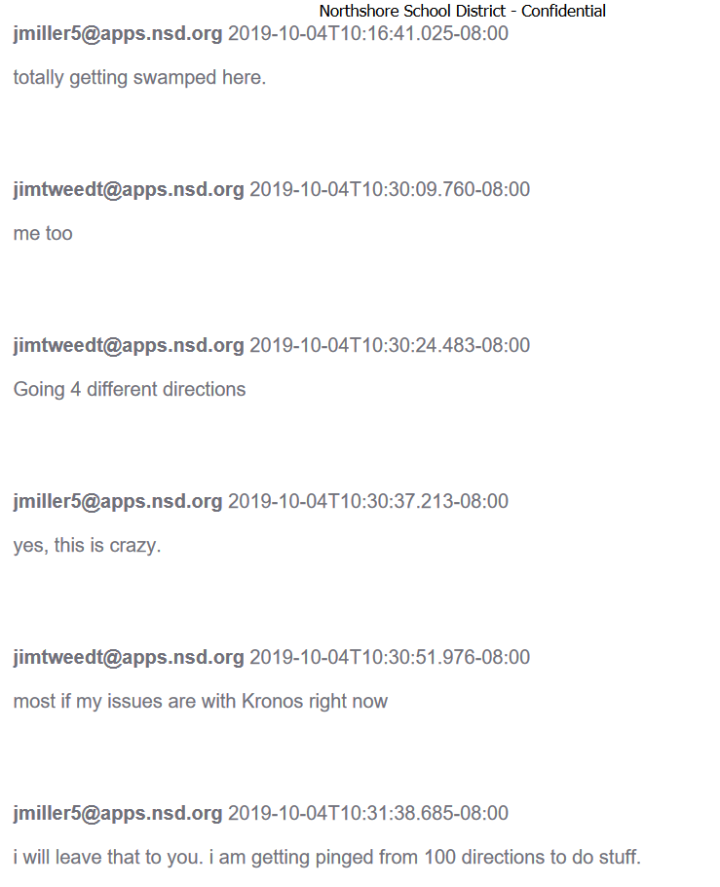
But there’s also just a lot of stress
Notes:
On the other hand, there’s also just a lot of stress.
It’s not a great feeling having the servers you were responsible for being attacked and destroyed when part of your job was protecting them.
There’s also a lot of people needing a lot of things. You have teachers who can’t access student records, librarians who lost inventory records, lunch staff unable to access meal accounts, building engineers unable to control HVAC, and the list goes on.
There’s a lot of pressure to get everything back online as fast as possible.

Slide 25
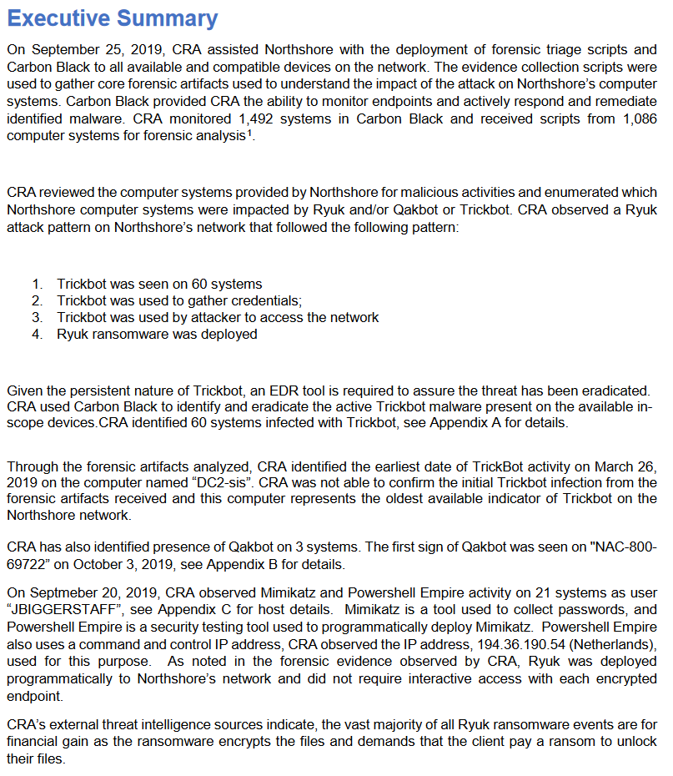
A copy of the forensics report
Forensics engagement concluded in February 2020, almost 5 months later
Initial presence established using Trickbot, 6 months or longer prior to Ryuk ransomware being deployed
Attackers used the Windows admin’s account for executing Powershell Empire.
Notes:
Of course I couldn’t do all this work to not ask for a copy of the report from the firm brought in to do the incident investigation.
The report fills in some of the details that don’t show up in the other requested records.
We can see the initial presence was established using TrickBot some 6 plus months prior to the Ryuk attack.
This kind of long persistence isn’t rare of course but
And when it came time to execute the ransomware attack the Window’s admins account was used to execute Powershell Empire and deploy the ransomware.

Slide 26
Things I didn’t expect

Slide 27
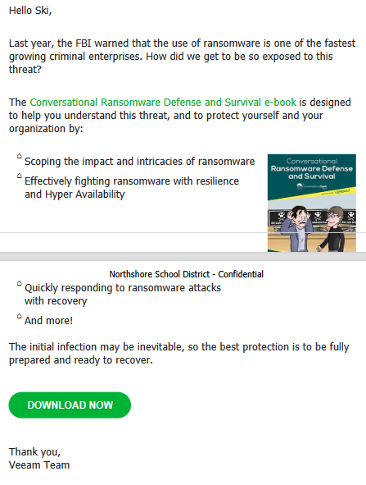

Veeam’s awkward timing
Notes:
Sometimes marketing emails just arrive with incredibly awkward timing.
I don’t know if Ski ended up reading the guide but he might have wished it arrived a little earlier in the year.

Slide 28
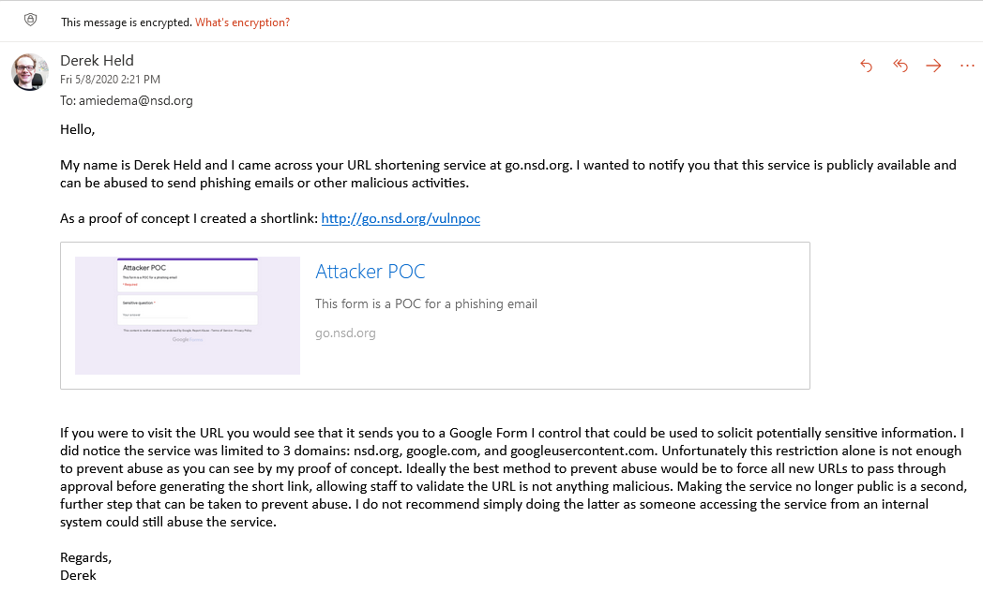
Publicly open URL shortener
go.nsd.org is a URL shortening service they offer internally
It had domain restrictions but was publicly available with no authentication
Discovered and reported in May 2020, about 7 months after attack
Notes:
I also wasn’t expecting to find a system vulnerability to report.
In many emails I kept seeing this URL shortening service that was running at go.nsd.org.
At one point I was reading some emails about phishing attacks and some of the challenges they have had responding.
So my brain immediately though “oh, I wonder if I could abuse their URL shortener for a phishing attack”
I went to the site and quickly noticed that not only was it fully public, but the only control implemented was a basic allow list.
The problem is, their allow list permitted all Google URLs for products like Google Workspace. You might see where this is going.
I went ahead and created a phishing form using my own Google account and then created a shortlink to that form.
I sent an email to the Director of IT explaining the vulnerability and the impact, along with providing some ideas for additional controls, and they did take action.
While it was a simple vulnerability, it just shows how even with an intense focus on improving security after an attack it’s still easy to miss things that could be impactful.

Slide 29
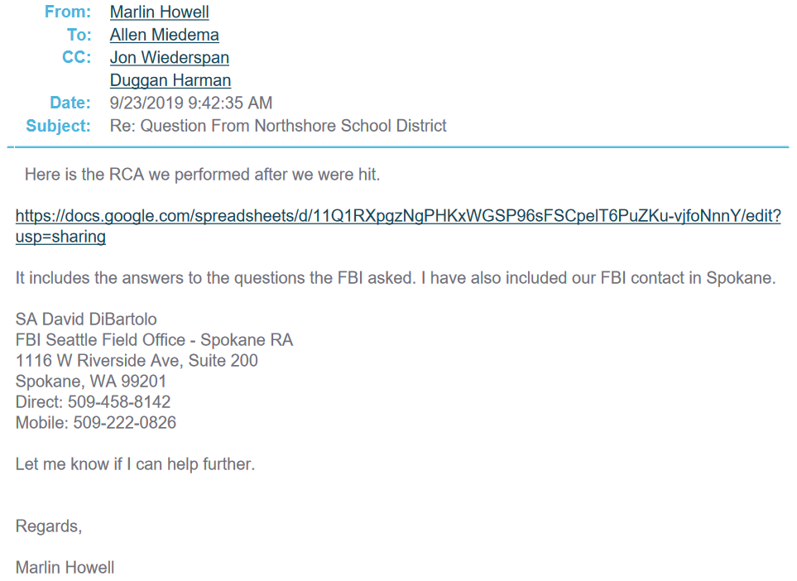
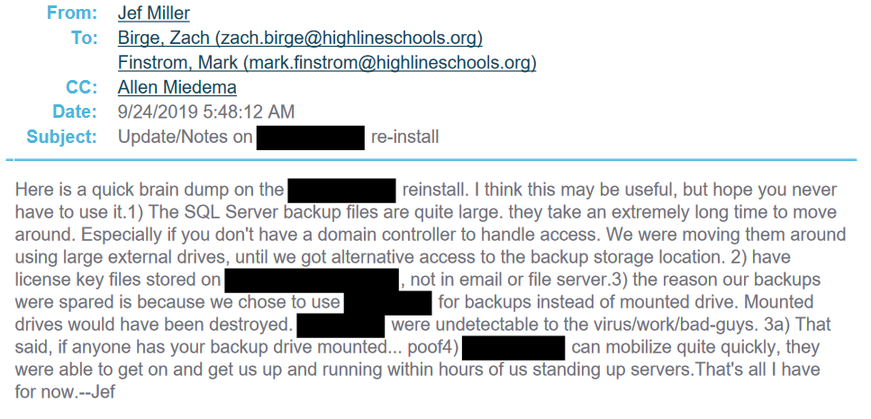
Other Ransomware Attacks
Moses lake school district
Highline public schools
Notes:
Part of people wanting to be helpful turned out to be talking about when they got hit with ransomware.
Moses Lake had been hit in July 2019 and yes, I did visit that URL and found they had it open so that anyone with the link could view it.
Their root cause analysis boiled down to “we asked for better antimalware but our budget request was rejected and this is was the consequence”.
And while the Moses Lake incident had made news, I also found out Highline Public Schools also got hit but it doesn’t seem to have been reported about.

Slide 30
Wrap up

Slide 31
Things to remember
Washington State’s laws favor disclosure over secrecy
Use OSINT to help drive your requests and add context
Redactions aren’t always a barrier
Broad searches help you see an overall picture and help you make informed narrow requests
This isn’t to armchair quarterback, this is about getting to peek behind the curtain

Slide 32
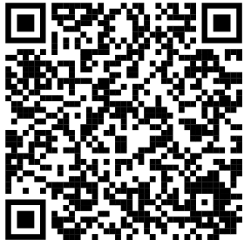
Dig into the records yourself!
https://keybase.pub/derekheld/northshoresd.zip
Notes:
If you want to get your own look at the records you can! I encourage everyone to!
There’s so much in there that I haven’t talked about.
You can see how they decided to not join their new backup servers to the domain.
You can see how they looked for compromised user accounts, or how food services estimated a $250k-$400k revenue hit.
There’s plenty of boring stuff too, but it is quite fascinating getting this kind of perspective.

Slide 33
Thank you!

Slide 34
Eventual inside story
While there was a lot of secrecy when I engaged, this eventually loosened
Ski Kacaroski did multiple
Malware Bytes Lock and Code, S02E12
LISA21
The Ransomware Files
Notes:
I am very much an advocate about transparency and knowledge sharing
To me, incidents like this should be rallying cries for under resourced public agencies and opportunities to teach, and you can’t do that being silent
Eventually Ski Kacaroski talked publicly about this, for a Malware Bytes podcast and at LISA21.
It’s a cool opportunity to not only see records from the district but then also hear from someone who was on the team.

Slide 35
The records must exist
You cannot ask an agency to make a new record for you
You can only request records which the agency already possesses
Notes:
To wrap up this section there’s one last important thing to remember:
What you’re asking for has to actually exist. You only get to request records the agency already possesses; you don’t get to request they create new records for you.

Slide 36
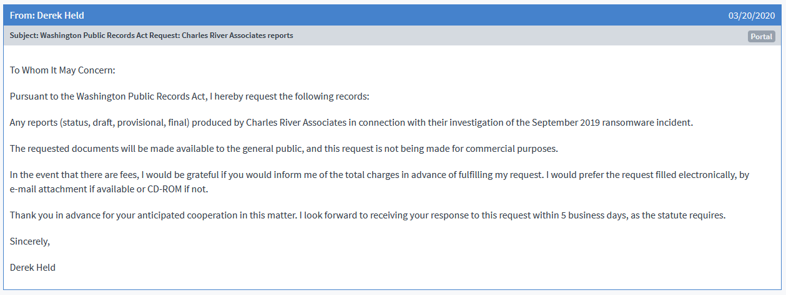
Example request
Notes:
Here’s an example using one of the requests I made.
Muckrock added a lot of template language but the core of my request is in the red box.
The rest of the language is not necessary for your request, just what Muckrock includes.

