Slide 1
My job hunt journey
Landing a job in the current and challenging environment

Slide 2
Lots of BAD news out there
Every week a tech company is laying off thousands of people
First six weeks of 2024 > 45k layoffs
Many long term unemployed tech workers 12-18 months
AI is taking over the world ☺ -- Companies are looking to move to AI and focus on that
Wall street profit chasing is driving a lot of the layoffs

Slide 3
Turn lemons into lemonade
Learn / have the right skills
Lots of free stuff out there
Leverage your network (former colleagues, classmates, connections)
Openings they might have
Connections they might have – ask for introductions
Ask for recommendations (managers, peers, employees, customers / vendors)
Make yourself known
Write articles
Contribute to discussions
Etc.
Create / update resume, cover letter
Update your LinkedIn profile (LI), and have a mission statement (every bit helps)

Slide 4
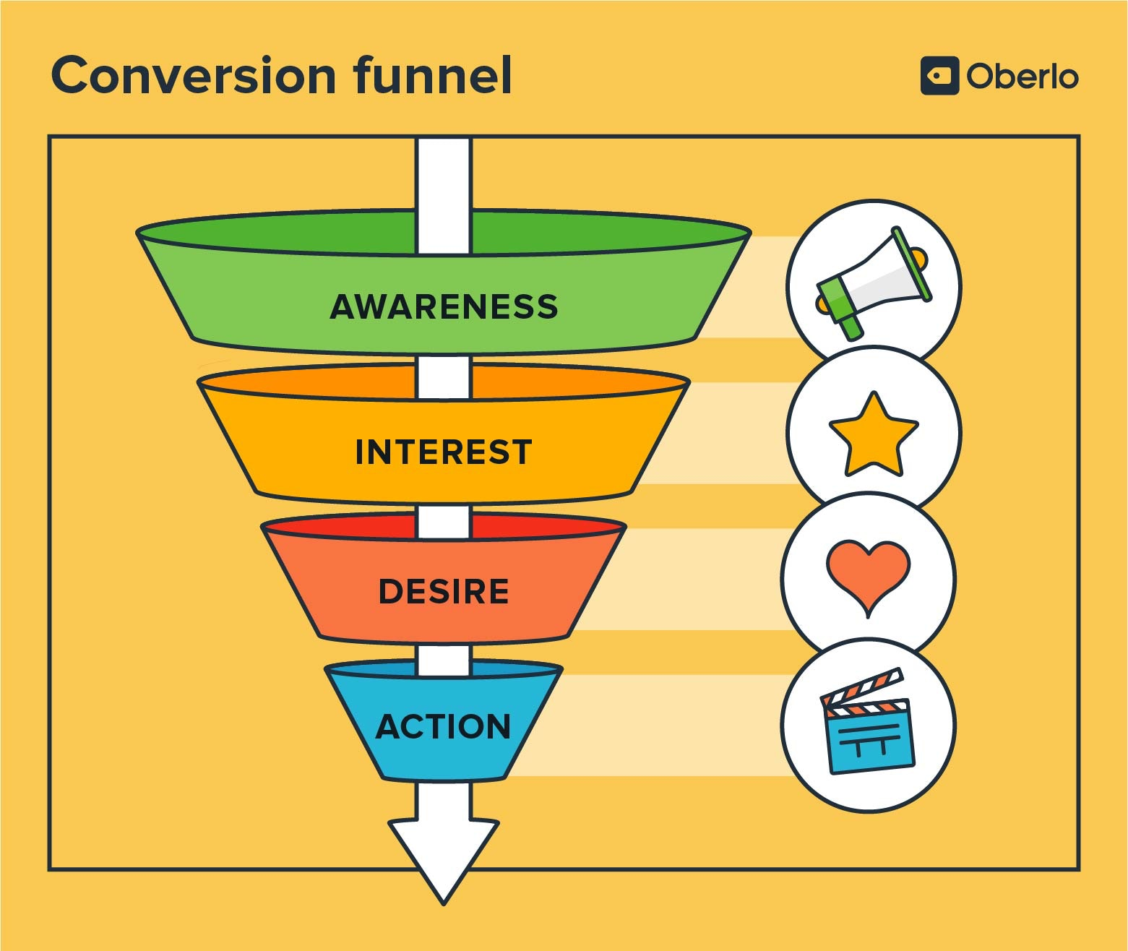
Marketing 101
Only a small percentage of the inputs make it to the output stage
Control what you can

Slide 5
My journey (90 days)
Update resume, get critical feedback, write cover letter template, update LI
Work my network (over 2000 connections in LI)
Write several articles, ask people to like / comment to generate a greater interest
Apply, apply, apply
Finding a job is a full-time job

Slide 6
The numbers
700+ applications
(cast a wide net – dream jobs, realistic jobs, and even down-scope jobs)
25 companies - calls with recruiters (they contacted me) – 1st round
10 companies - second and third round interviews
4 companies - down the final 2 – 3 candidates
(3 out of 4 were via connections)
2 offers

Slide 7
Interesting reading
https://www.businessinsider.com/job-applications-hiring-ai-bots-spam-resume-cover-letter-2024-3
https://www.businessinsider.com/using-ai-in-your-job-search-resumes-cover-letter-dealbreaker-2023-5
https://www.hrdive.com/news/job-seekers-ai-tools-job-hunt/707368/
https://www.forbes.com/sites/shodewan/2024/02/29/what-not-to-do-with-ai-in-your-job-search

Slide 8
Current & future security openings at Zayo https://www.zayo.com/careers/
Senior IAM Security Engineer (2 positions)
Senior Application Security Engineer (my position)
Future roles (Q3 and beyond)
Application Security Engineer (my position)
Cloud Security Engineer (my position)
Security Operations (SOC, IR)
Infrastructure Security
Data Security Analyst
And more

