Slide 1
Agenda
Threat Modeling Presentation
Threat Modeling Exercises, two if time permits
Job Hunt Presentation
Any other topics?
Rules: Ask questions, I prefer interaction
My contact: derek@dh-solutions.com or derek.hill@zayo.com
LI: https://www.linkedin.com/in/derekphill/
Slides available: https://github.com/derekhillhp/willamette

Slide 2
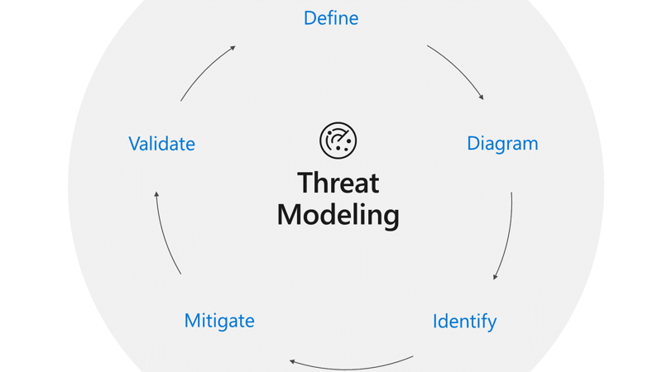
why, what, when, how & more
A brief primer
by
Derek Hill
Image: Microsoft

Slide 3
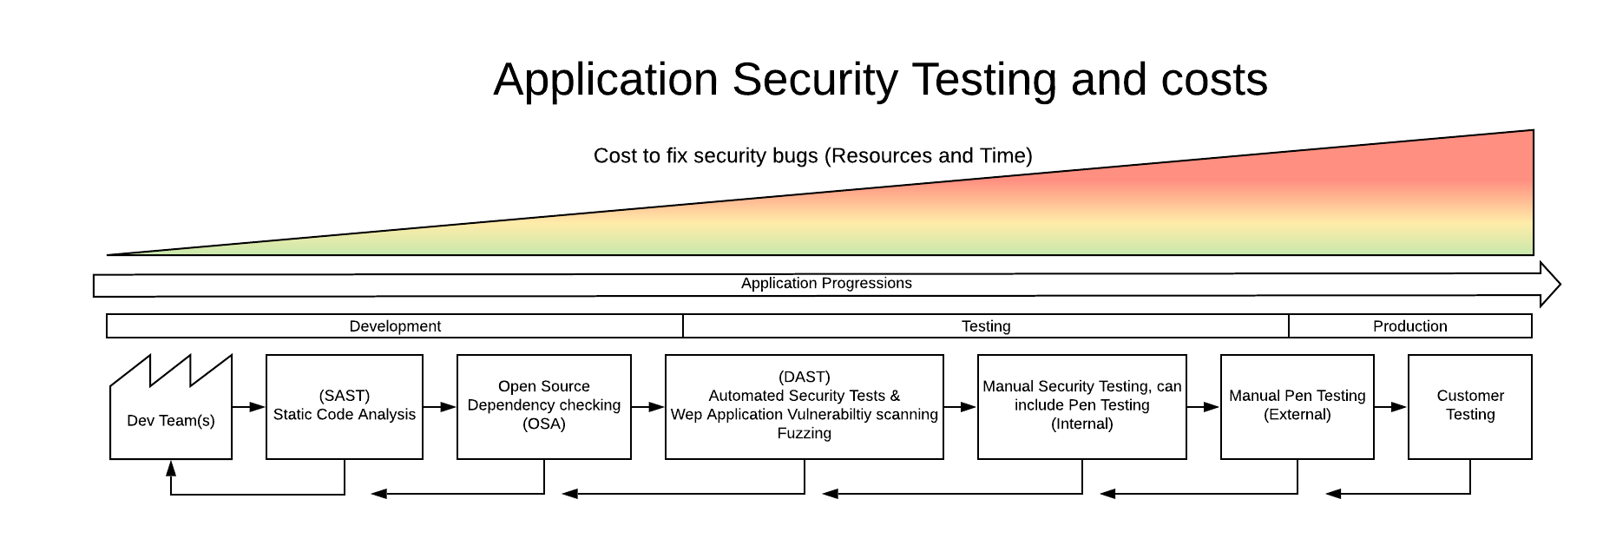
A little bit of background
Security defects are expensive, not only in terms of reputation (think breach), customer satisfaction, trust and sales, but also from an internal cost (support, rework, IR, etc.) , you don’t generate revenue fixing security issues, vs. working on new features.
The cost to fix security issues increases as it moves closer to production.
The best-case scenario is that security issues are never introduced into the application and/or product.

Slide 4
The SDLC and where does Threat Modeling (TM) fit in?
Requirements
Design
Development
Testing
Production
Security reqs
Abuse cases
Risk assessment
Threat modeling
Attack surface analysis
Design reqs
Code review
Static analysis
Use approved tools and functions
Security testing
Dynamic analysis
Attack surface review
Final security review
Create IR plan
Certify release
Security monitoring
Chart adapted from SANS MGT512 course
In an ideal scenario, Threat Modeling would be started before an application is architected and a single line of code is written.
Threat Modeling and Attack Surface Analysis can often be completed together.

Slide 5
What is a Threat Model?
Definition: (Wikipedia)
A threat model is essentially a structured representation of all the information that affects the security of an application. In essence, it is a view of the application and its environment through security glasses.
Threat modeling is a process for capturing, organizing, and analyzing all of this information. Threat modeling enables informed decision-making about application security risk. In addition to producing a model, typical threat modeling efforts also produce a prioritized list of security improvements to the concept, requirements, design, or implementation.
Purpose: (mine)
To improve overall system security by identifying vulnerabilities and objectives. This will allow us to mitigate the threats by developing countermeasures such as application changes and/or changing the architecture/infrastructure of the system.
This can include:
An abstraction of the system, by looking at the bigger picture rather than the code itself
Profiles of potential attackers, including their goals and methods
A catalog of potential threats that may arise, especially for code that hasn't been written yet - catch those problems before they are created by anticipating those threats that could affect your application(s)

Slide 6
Why Threat Model?
It is better to prevent security flaws or at least find them when there is time to fix them.
It can save time, revenue, and your company’s reputation.
To build a secure application and/or product.
To bridge the gap between developers and security.
It provides a document of all the identified threats and rated threats.
It offers knowledge and awareness of the latest risks and vulnerabilities.

Slide 7
When to Threat Model?
Ideally the goal is to try and identify potential security issues before an application and/or product is developed, or features are added (new EPICs).
Sometimes existing applications need to be Threat Modeled to help identify older risks and address technical debt.
It comes down to 4 basic questions that need to be asked and answered.
What are we working on?
What can go wrong?
What are we going to do about it?
Did we do a good job?
The first 2 steps are usually done at the same time and will include entity diagrams including trust boundaries, etc. -- similar to what you would see during an Attack Surface Analysis
Design phase
Design & Development phases
Development & Testing phases
Note: Set of 4 questions originated from Adam Shostack – “Threat Modeling - Designing for security”,
considered to be one of the fathers of modern threat modeling.
Notes:
When to Threat Model?
There are some variation of opinions on this but it should be a continual process, not something that only happens once in a blue moon.
Before a major release
For each EPIC
For each new feature or change of an existing feature
When addressing technical debt (rework)
When changing architecture significantly
Encryption changes
Technology changes
Moving from on prem to the cloud
Integration with other tools
Over time a threat model will/should provide a complete assessment of the security vulnerabilities of an application/system. A threat model is a constantly evolving landscape and just like code, it should be updated regularly.
Questions to ask for Threat Modeling:
1. What are we working on?
Keep the focus small, don't try to worry about the things that you cannot control. It is better to focus on a small element and later expand vs. trying to boil the ocean.
What can go wrong?
Think like an attacker. How can I break it, what can I steal, how can I monetize it, how can I cause denial of service.
What are we going to do about it?
Start thinking of prevention methods, changing the architecture, focus on defense in depth, be creative.
Did we do a good job?
Can our security testing tools, our in house pen testers or even external pen tester get around our defenses?

Slide 8
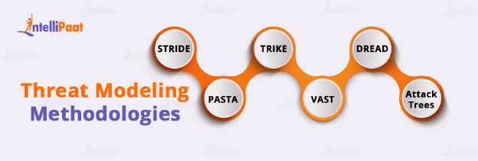
Methodologies
Lots to pick from, but three common ones are:
STRIDE
PASTA
Attack Trees
There are many others, but not highlighted here such as:
DREAD, CVSS, VAST, TRIKE, OCTAVE, Security Cards, LINDDUN, QTMM
Notes:
QTMM – Quantitative TM’ing

Slide 9
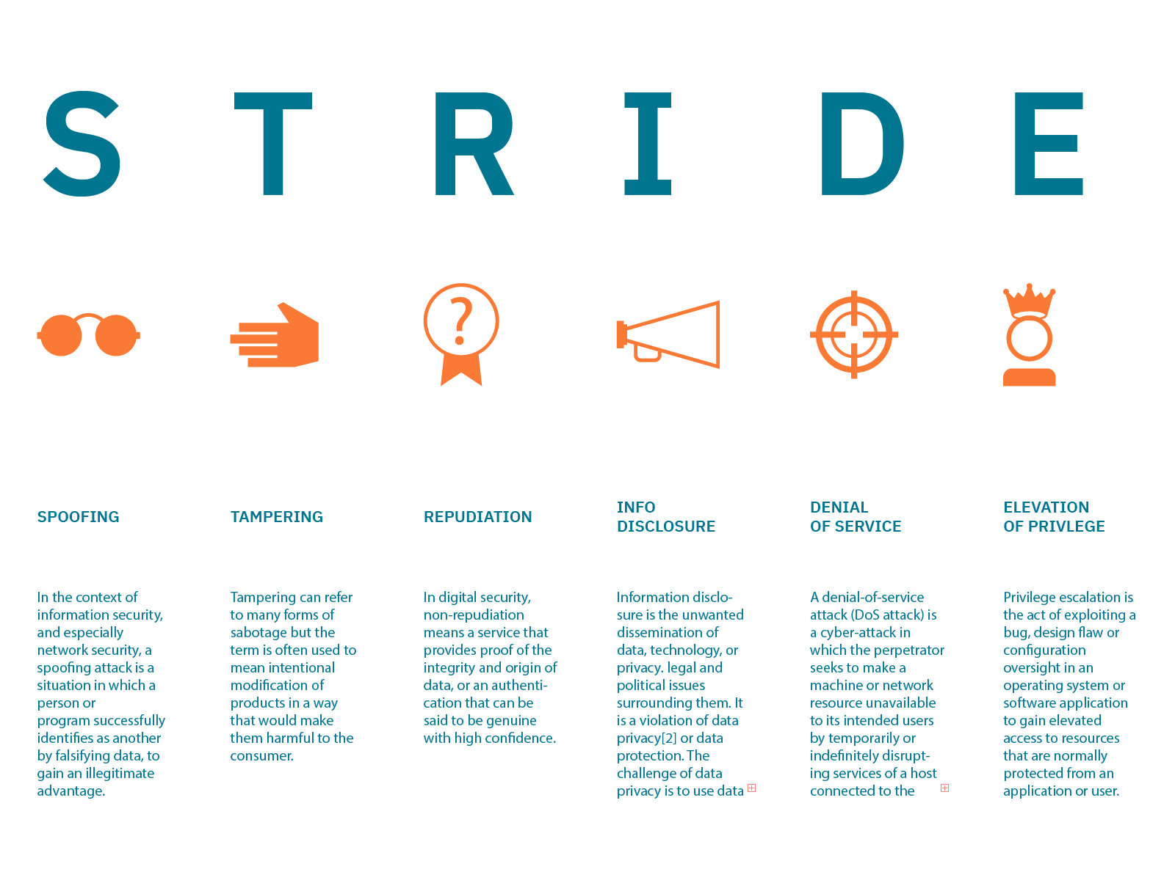
Notes:
Developer Focused

Slide 10
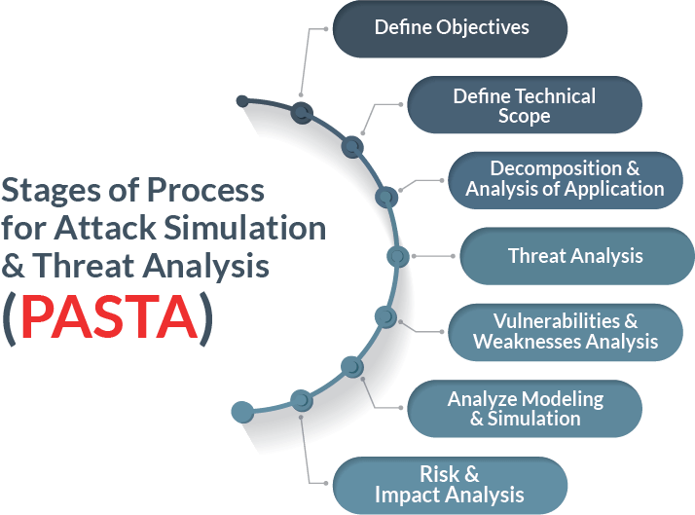
Notes:
Risk Centric
Business Context
Can be very complex and time consuming
https://threat-modeling.com/pasta-threat-modeling/

Slide 11
Attack Trees
Attack trees are diagrams that depict attacks on a system in tree form. The tree root is the goal for the attack, and the leaves are ways to achieve that goal. Each goal is represented as a separate tree. Thus, the system threat analysis produces a set of attack trees.
Notes:
Attacker Focused
One of the oldest TM methodologies out there, often it is being combined with STRIDE, PASTA and even CVSS.

Slide 12
Comparing the methodologies
STRIDE |  | PASTA |  | Attack Trees
PROS | CONS | PROS | CONS | PROS | CONS
Structured Approach | Less Detailed | Comprehensive | Harder to learn | Oldest, most mature | Cyber only focus
Easy to Use | Only focuses on STRIDE, might miss items outside of STRIDE | Business Centric | Complex | Try to find the root vulnerability | Complex
Collaboration with devs |  | Risk Prioritization | Requires available data | Focuses on the attacker | Focuses on attacker – advanced knowledge required
Better visualization |  |  | Resource intensive |  | Requires maturity in organization

Slide 13
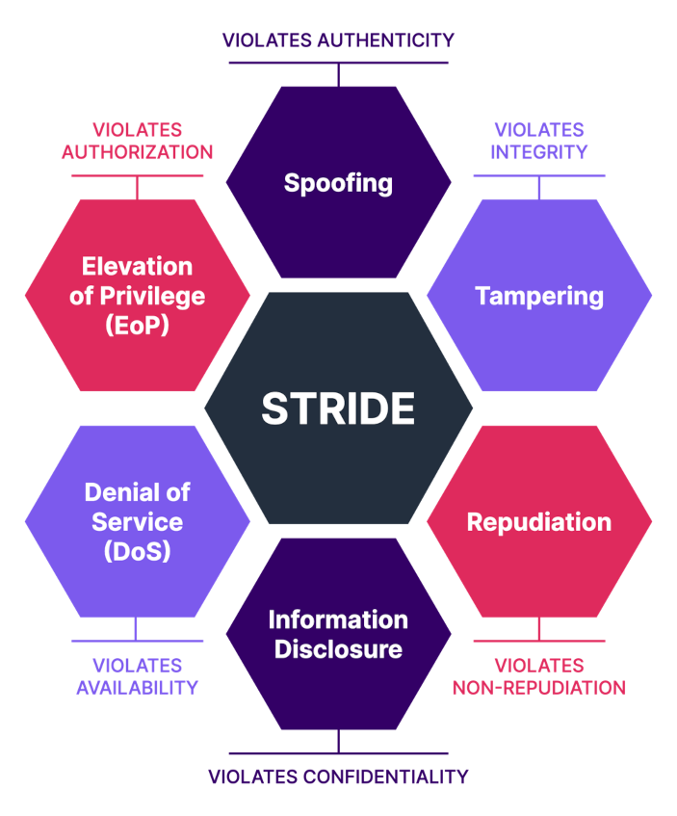
Picking One - STRIDE
STRIDE is easy to use
It can be gamified – Elevation of Privilege (EOP) Game
It encourages collaboration between security and development
If something is easy and fun, it will get used
Ultimately, developers can complete this without security involvement
It creates a security first mindset

Slide 14
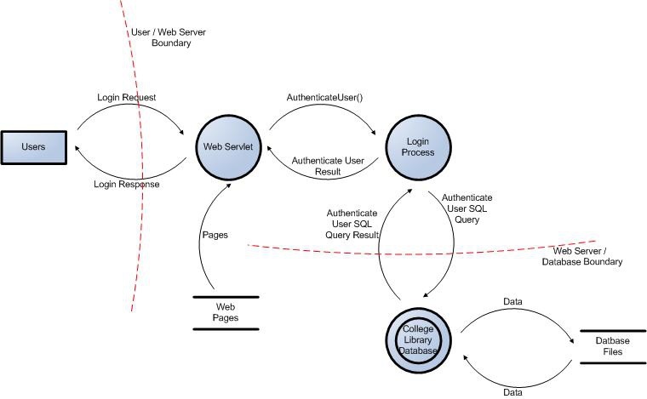
How to Threat Model?
Have the appropriate people in the “room”
Devs (2 or more, perhaps a dev lead)
Architect (could be a dev lead)
Security person
Distribute the supporting docs ahead of time to allow the participants to have educated themselves. – maximize productive time in session
Diagram the application / product
Identify areas of “interest” from a security perspective
Use the EOP game to come up with vulnerabilities
Notes:
Supporting documents:
Application / Product purpose, scope, etc
Architecture / Infrastructure Diagrams
Dataflow Diagrams
Process Diagrams
User / role mappings
Other documentation such as:
All endpoints (API, UI, etc)
Data storage (db, 3rd party storage, cloud, etc)
Technologies uses (languages, frameworks (frontend/backend/middleware), encryption, etc)
Authentication mechanisms
Etc.
Identifying Threats:
If you are not sure where to start, start with external entities such as the user / web browser
It doesn't really matter if you cover all the categories of STRIDE or even if you cannot classify a threat correctly (this is Information Disclosure vs. Spoofing). The answer here should be "who cares", the fact that you discovered a vulnerability that can be addressed is the value here
Focus on feasible threats, not the once in a "blue moon" threat that is so complex and remote. Granted, if you cannot find any other threats, then focus on the odd ball one out there, but generally there are more low hanging fruit out there that should be addressed first

Slide 15
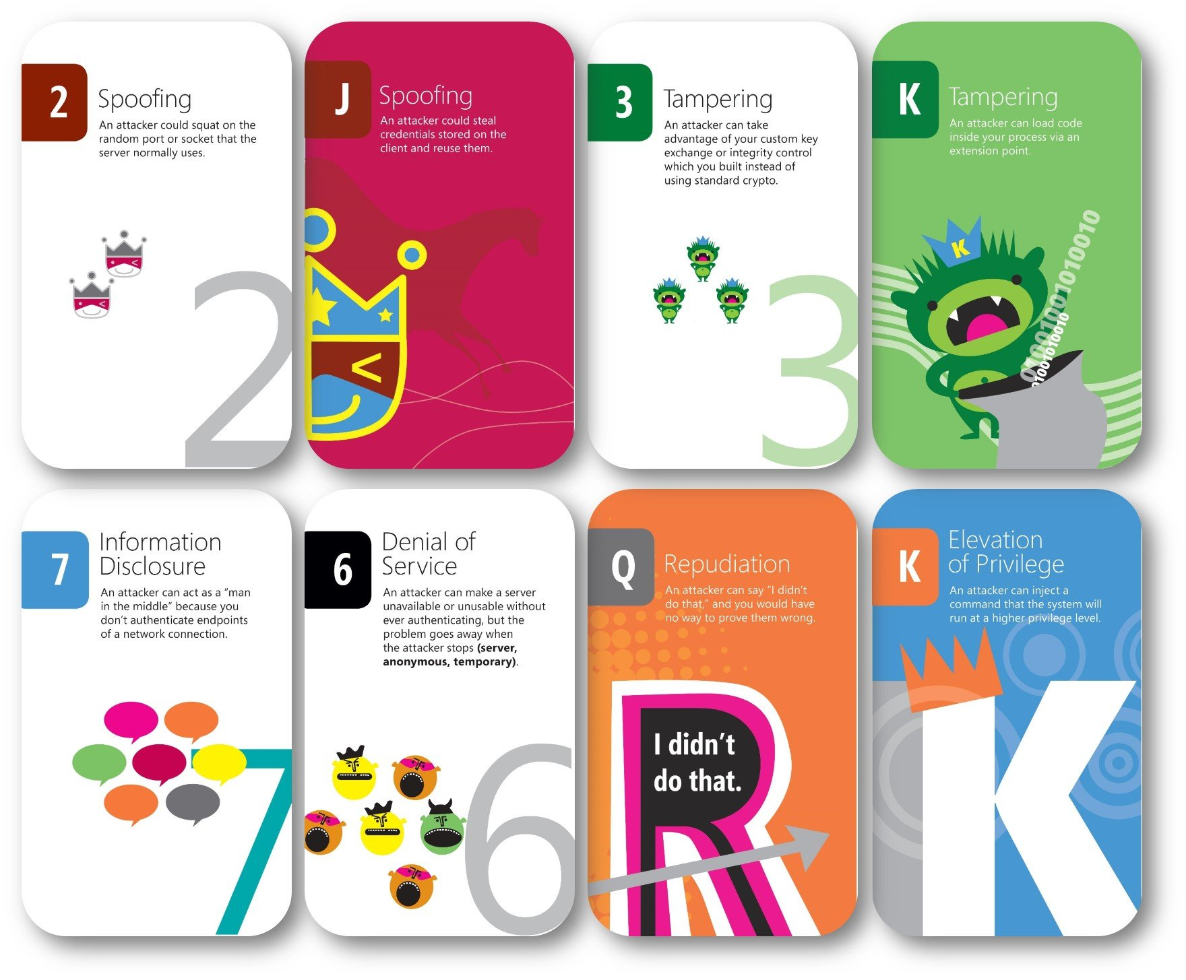
EOP Game – Sample Cards
Cards are available as physical cards or online versions for remote teams

Slide 16
Dealing with the threats
Mitigate the threat: Make it harder to take advantage of the threat, i.e. add passwords, password controls, etc. (This should be the default way of dealing with threats)
Eliminate the threat: Eliminate unneeded features / interfaces, move to a more secure channel, etc.
Transfer the threat: Shift the task to another process (i.e. authentication), move the trust boundary, etc.
Accept the risk: Accept the risk, assure you have appropriate controls in place and move on.

Slide 17
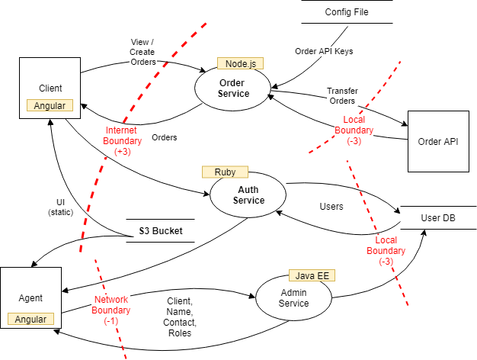
Diagramming
Focus on data flow, not control flow
Show all use cases of "sometimes" or "also", i.e if the app sometimes uses SSL and sometimes plain HTTP, indicate it as such
If you need more detail, draw it in
Include all the places where data is written and who / what uses it
The diagram should tell a story
Don't draw an eye chart, if it is too complex, create sub diagrams and reference those
Notes:
Control flow vs. data flow, less concerned about the sequence of execution of functions, procedures, etc vs. how the data moves from one place to another.

Slide 18
Completing & Checking the Threat Model
Add the threat type and proposed mitigation(s).
Is it complete?
Is it accurate?
Does it cover all the security decisions made?
Can we start the next version of this diagram without any changes?
If everyone agrees, your diagram / model is sufficiently up to date, if not update it until complete

Slide 19
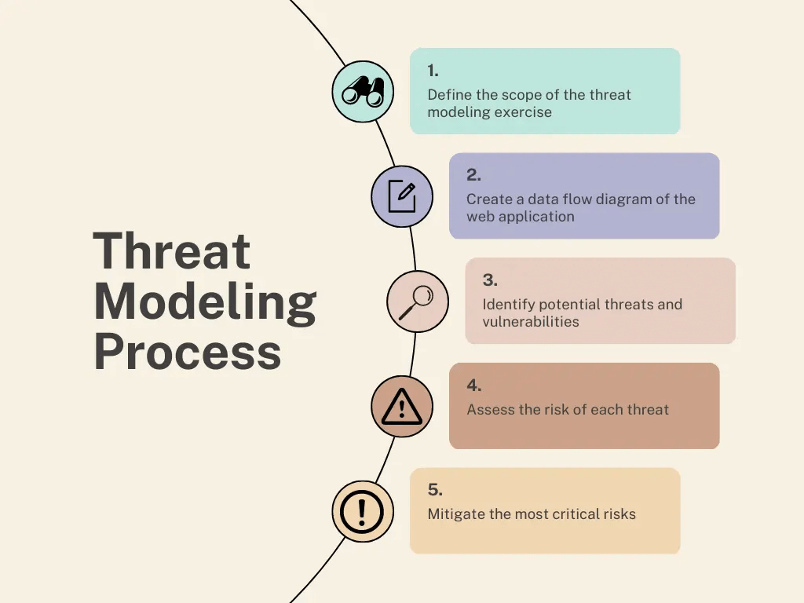
Validation
Did we find all the threats we should?
Are we doing the right thing for each threat?
Create tests (either manual or automated) to detect the threat(s) identified

Slide 20
Threat Modeling in practice (previous employers)
It is not a drop in process, requires a security first Mindshift
Developers want to write more secure code, but also want help (not easy to ask for).
Threat modeling should be part of your routine development lifecycle, enabling you to progressively refine your threat model and further reduce risk.
Initially it can seem like an expensive shift, multiple devs, security people in meetings discussing a future product.
It is easier to learn with new features in existing application as there is familiarity, vs. a completely new application or revisiting an existing legacy application.
Make the experience fun, if in person, do this with pizza or other food

Slide 21
Threat Modeling in practice - cont
Focus on feasible threats and low hanging fruit, not the extreme scenario (those can come later) – goal here is cost & risk reduction
IF you have to choose, focus on the applications with the greatest risk – generally external facing, containing sensitive data or can cause physical harm / damage
Previous Threat Models can be used to measure the effectiveness. For example, if bugs are filed after a release of a feature/epic that was threat modeled, you can take that as an opportunity to revisit the previously generated Threat Model to see if something was missed OR if it was listed, but the approach taken was not sufficient to mitigate the identified threat. These kind of issues can be used to further fine tune / improve the threat modeling methods being used.

Slide 22
Challenges
Time objections (don’t have time to spare x devs for y hours)
Security is causing me grief (preventing me from writing code)
No instant gratification (this is an investment in the future)
Distributed teams (can be challenging to have teams meet)
Lack of understanding – security risks
Lack of security education in CS majors (new grads / interns)
Lack of secure coding training programs inside of organization
Preference of tooling
Storage of threat models
Resistance to change
Notes:
Some tooling (biggest question to ask when using tools, where is the data stored and how secure is it)
https://www.iriusrisk.com/resources-blog/recommended-threat-modeling-tools

Slide 23
Questions & Discussion

Slide 24
Let’s Threat Model – lets pick some
Example 1: Complete Application - Banking
Example 2: Complete Application - Website
Example 3: New Feature – Create Account
Example 4: Student provide AI related

Slide 25
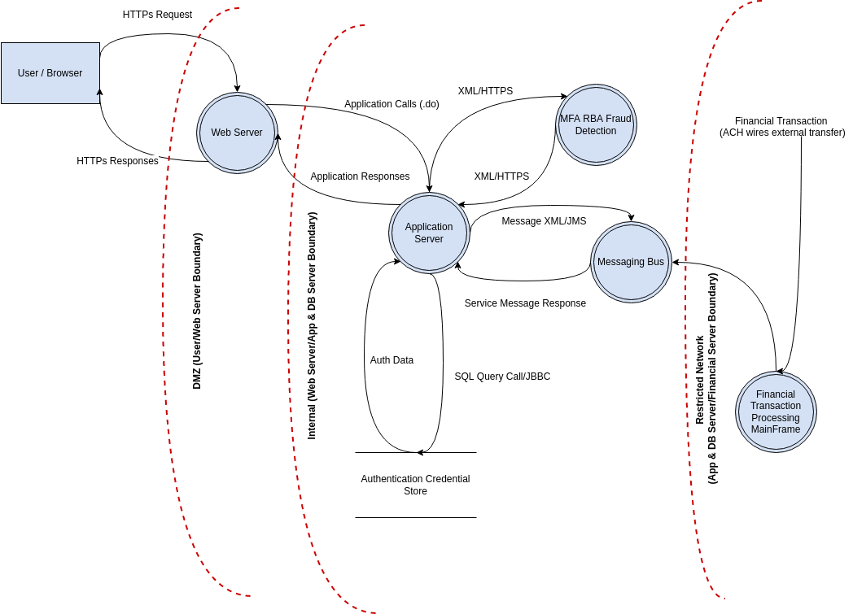
Banking App

Slide 26
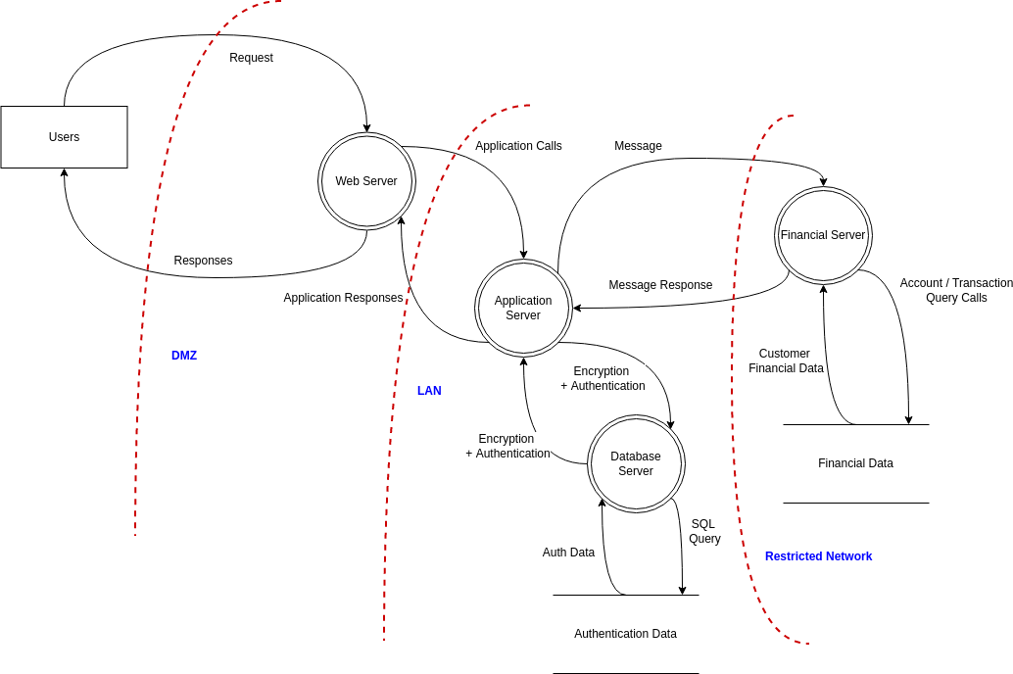
Website (3 tier) + financial data

Slide 27
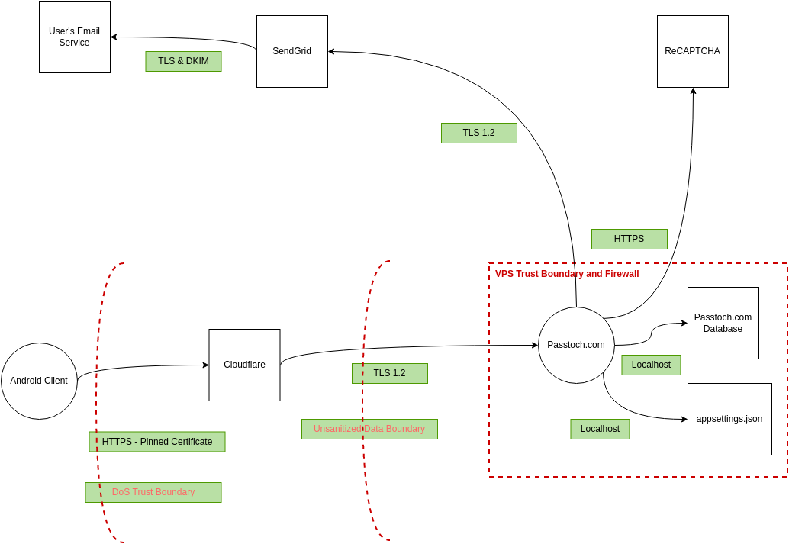
Feature – create account

Slide 28
Student Example – you provide examples
AI chatbot
ML decision making process
???

Slide 29
Tools to help
OWASP Threat Dragon – diagramming tool
https://owasp.org/www-project-threat-dragon/
Microsoft Threat Modeling Tool
https://docs.microsoft.com/en-us/azure/security/develop/threat-modeling-tool
Whiteboard
Old fashioned paper, chalkboard, dry erase
Online such as Google Jamboard or equivalent tools
Elevation of Privilege game (we will use the card deck)
https://www.microsoft.com/en-us/download/details.aspx?id=20303
https://github.com/adamshostack/eop
Commercial card deck (Agile): https://www.amazon.com/dp/B07NBRBXTT

