Slide 1
My job hunt journey
Landing a job in the current and challenging environment

Slide 2
Lots of BAD news out there
Every week a tech company is laying off thousands of people
First six weeks of 2024 > 45k layoffs
Many long term unemployed tech workers 12-18 months
AI is taking over the world ☺ -- Companies are looking to move to AI and focus on that
Wall street profit chasing is driving a lot of the layoffs

Slide 3
Turn lemons into lemonade
Learn / have the right skills
Lots of free stuff out there
Leverage your network (former colleagues, classmates, connections)
Openings they might have
Connections they might have – ask for introductions
Ask for recommendations (managers, peers, employees, customers / vendors)
Make yourself known
Write articles
Contribute to discussions
Etc.
Create / update resume, cover letter
Update your LinkedIn profile (LI), and have a mission statement (every bit helps)

Slide 4
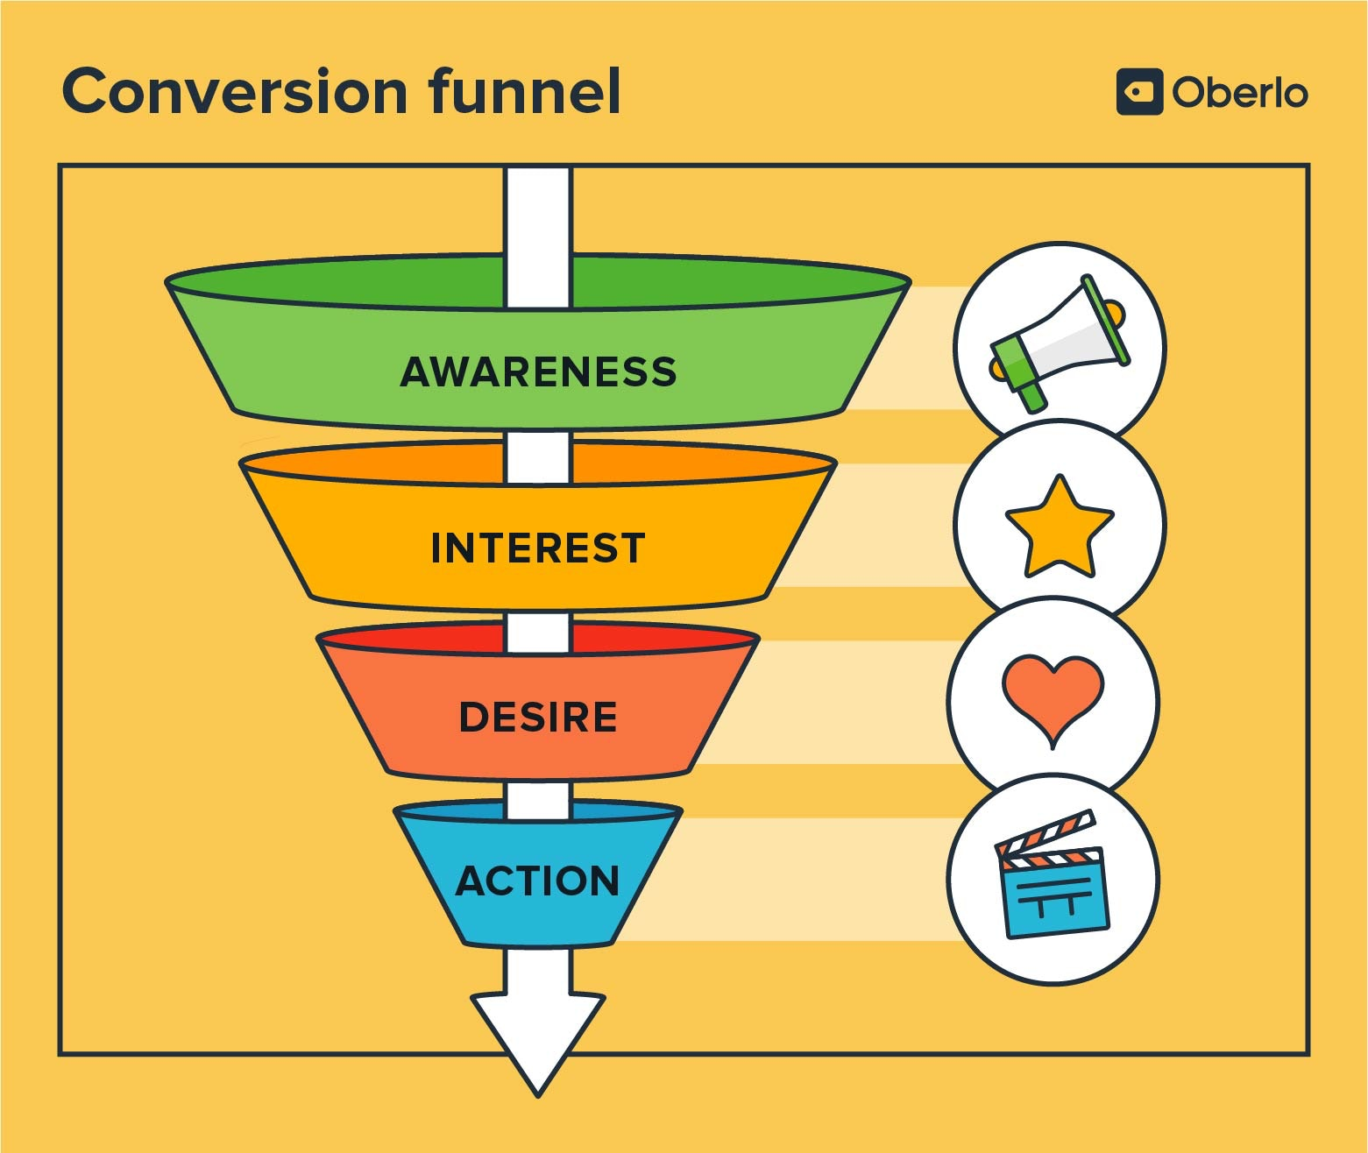
Marketing 101
Only a small percentage of the inputs make it to the output stage
Control what you can

Slide 5
My journey (90 days)
Update resume, get critical feedback, write cover letter template, update LI
Work my network (over 2000 connections in LI)
Write several articles, ask people to like / comment to generate a greater interest
Apply, apply, apply
Finding a job is a full-time job

Slide 6
The numbers
700+ applications
(cast a wide net – dream jobs, realistic jobs, and even down-scope jobs)
25 companies - calls with recruiters (they contacted me) – 1st round
10 companies - second and third round interviews
4 companies - down the final 2 – 3 candidates
(3 out of 4 were via connections)
2 offers

Slide 7
Interesting reading
https://www.businessinsider.com/job-applications-hiring-ai-bots-spam-resume-cover-letter-2024-3
https://www.businessinsider.com/using-ai-in-your-job-search-resumes-cover-letter-dealbreaker-2023-5
https://www.hrdive.com/news/job-seekers-ai-tools-job-hunt/707368/
https://www.forbes.com/sites/shodewan/2024/02/29/what-not-to-do-with-ai-in-your-job-search

