Slide 1
Partial Least Squares (PLS)
2022.02.22

Slide 2
Why PLS?
Currently, Principal Component Analysis (PCA) and correlation analysis are being used to construct Principal Network Modules.
For example, principal components of multiple phenotypic measures are being correlated against outcomes for the primary cohort.
While very similar to PCA, PLS goes a step farther and maximizes the correlation of a projection of the data matrix X to that of the target matrix Y.
Based on an experiment, PLS does a much better job of classification than does Principal Component Regression (PCR) even when the underlying labels are unbalanced; in terms of pure predictability, a case can be made for PLS over PCR.
Also, the mixOmics package in R implements a sparse PLS method that may be of use in narrowing down the list of relevant molecules.

Slide 3
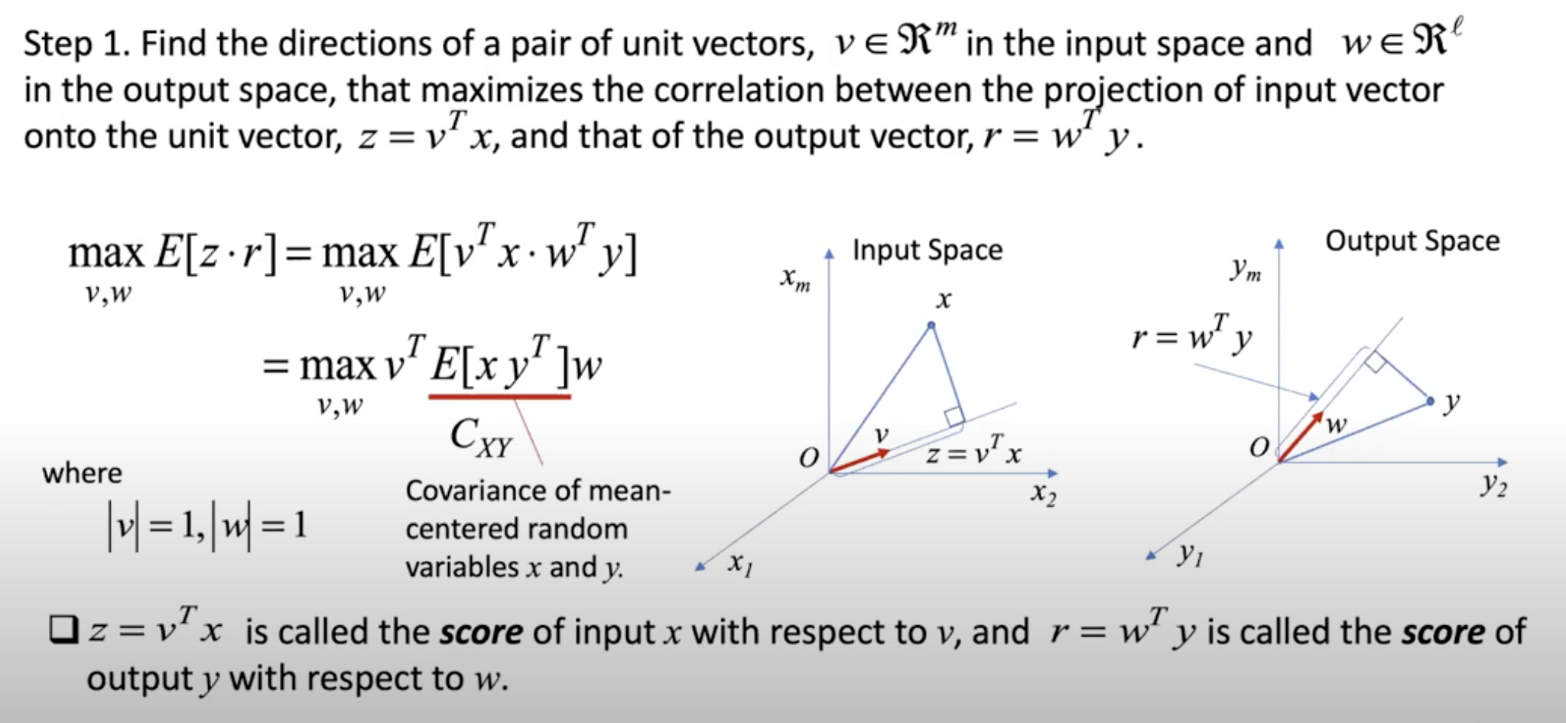
What is the objective of the algorithm¹?
¹Excerpts from Prof. Harry Asada’s lecture: https://www.youtube.com/watch?v=Px2otK2nZ1c.

Slide 4
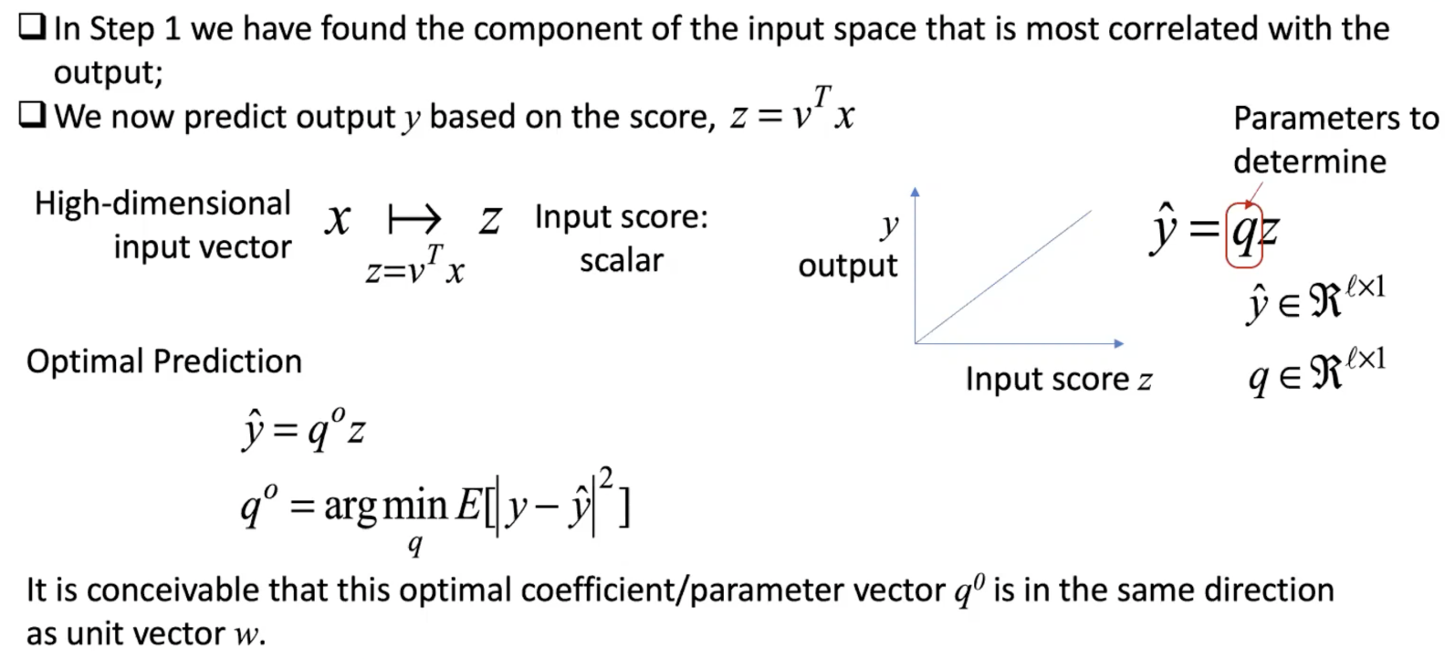
How are predictions made?
Step 2: Optimal Prediction with One Latent Variable¹
¹Excerpts from Prof. Harry Asada’s lecture: https://www.youtube.com/watch?v=Px2otK2nZ1c.
Notes:
- For non-linearity – either kernel PLSDA or dis-entagled VAE

Slide 5
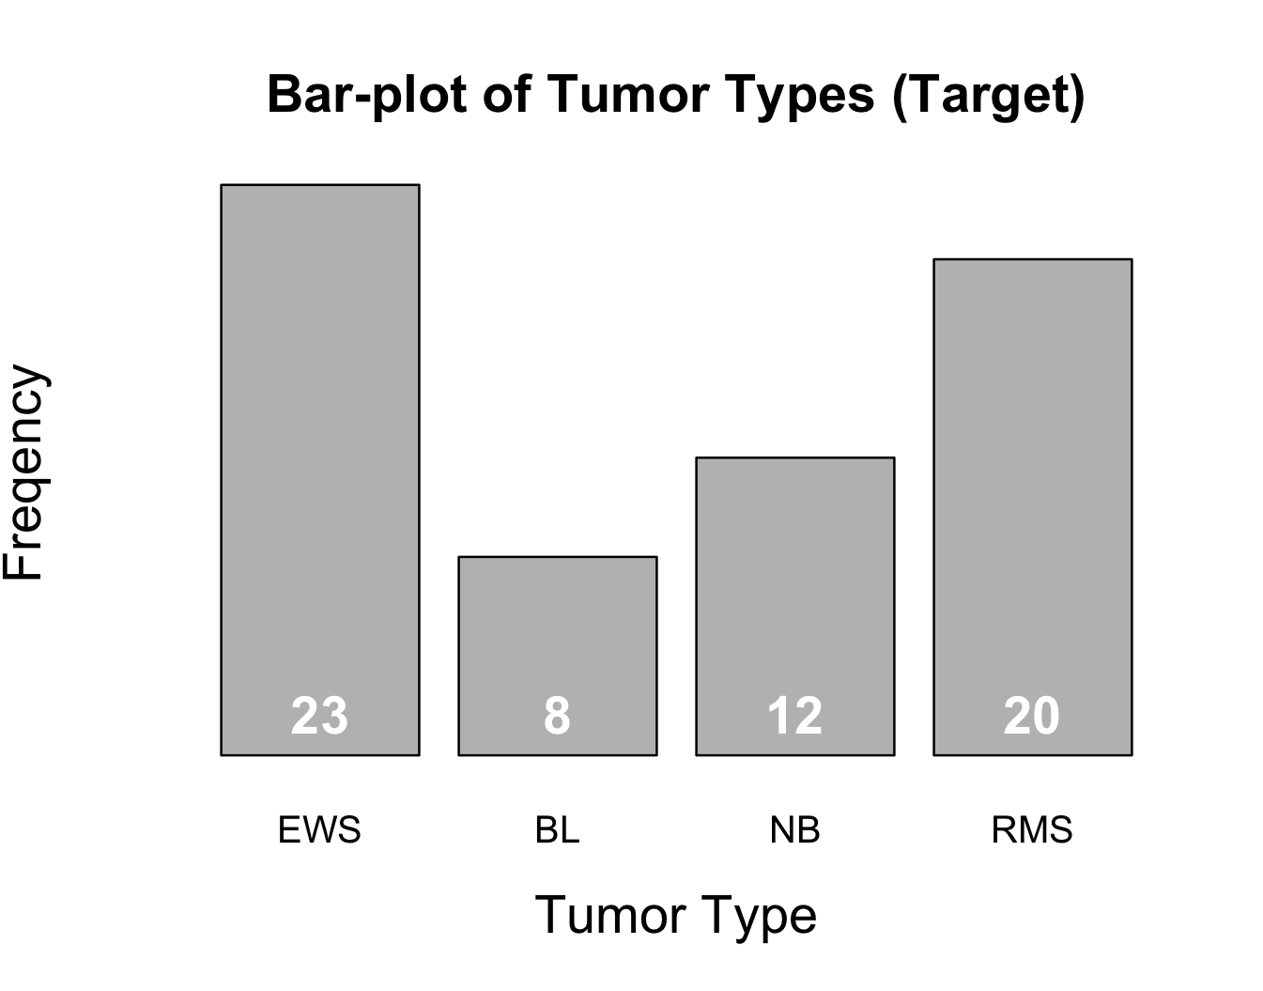
Test: PLS vs. PCR with Open-source Data
Algorithms (R Packages):
PCA + Multinomial Regression (nnet)
sPCA + Multinomial Regression (sparsepca, nnet)
PLSDA (mixOmics)
sPLSDA (mixOmics)
Dataset:
SRBCT dataset¹ with 63 samples of pre-processed 2308 gene expressions (X) and tumor types (Y)
Imbalance among classes:
Criteria: Mean Micro- and Macro-F1 scores
Method:
Nested loop w/ outer loop for testing (40 iterations).
Inner loop validation for picking the optimal number of components.
Given the label imbalance, stratified sampling of train, dev, and test sets (60:20:20) at the outer loop.
¹Khan, et al. Classification and diagnostic prediction of cancers using gene expression profiling and artificial neural networks. 2001. https://doi.org/10.1038/89044.
Notes:
Mention kernels; also another hyperparameter you can tune

Slide 6
Test: Micro- and Macro-F1 Scores (40 Iterations)
 | Micro-F1 |  | Macro-F1
Method | Optimal # Components¹ | Test Score² | Optimal # Components¹ | Test Score²
PCR | 2, 4.95 (2.88) | 0.3 (0.15) | 2, 3.38 (1.69) | 0.63
sPCR | 2, 4.6 (2.70) | 0.29 (0.14) | 2, 4.25 (3.28) | 0.53
PLSDA | 3, 4.25 (1.28) | 0.96 (0.053) | 3, 4.25 (1.28) | 0.96 (0.049)
sPLSDA | 3, 3.4 (0.9) | 0.97 (0.039) | 3, 3.4 (0.9) | 0.97 (0.036)
PLSDA and sPLSDA far outperform their counterparts with more stability and superior handling of class imbalance.
For PCR and sPCR, the true positive counts for BL and NB classes, which have lower representations in the dataset, are almost always zero.
¹Mode, mean (standard deviation).
²Mean (standard deviation, where available).
Notes:
- Maybe mention how VAE may be more useful for the WP dataset.

Slide 7
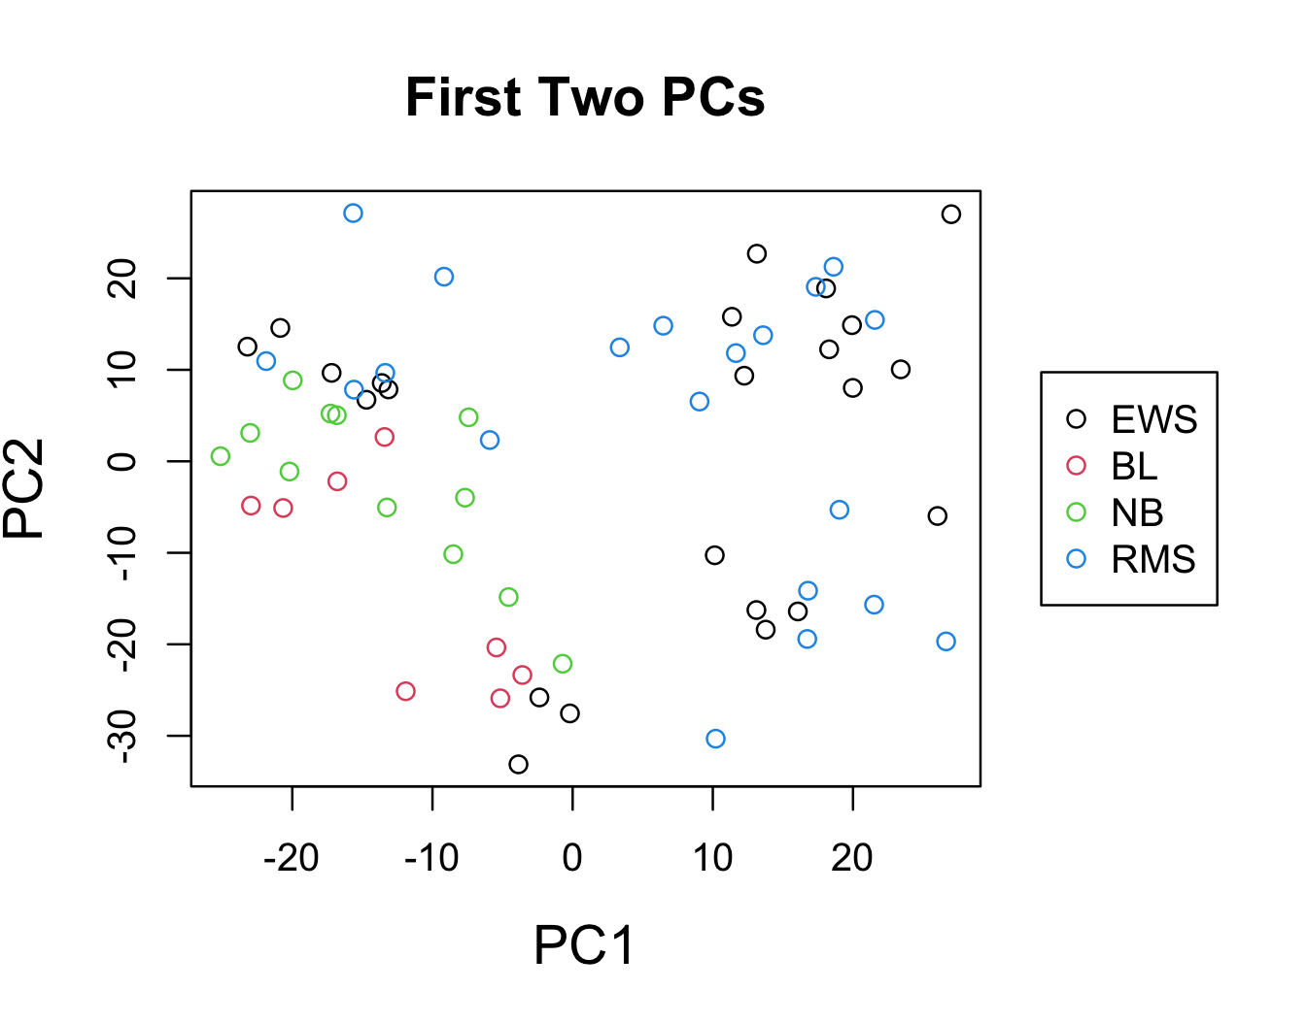
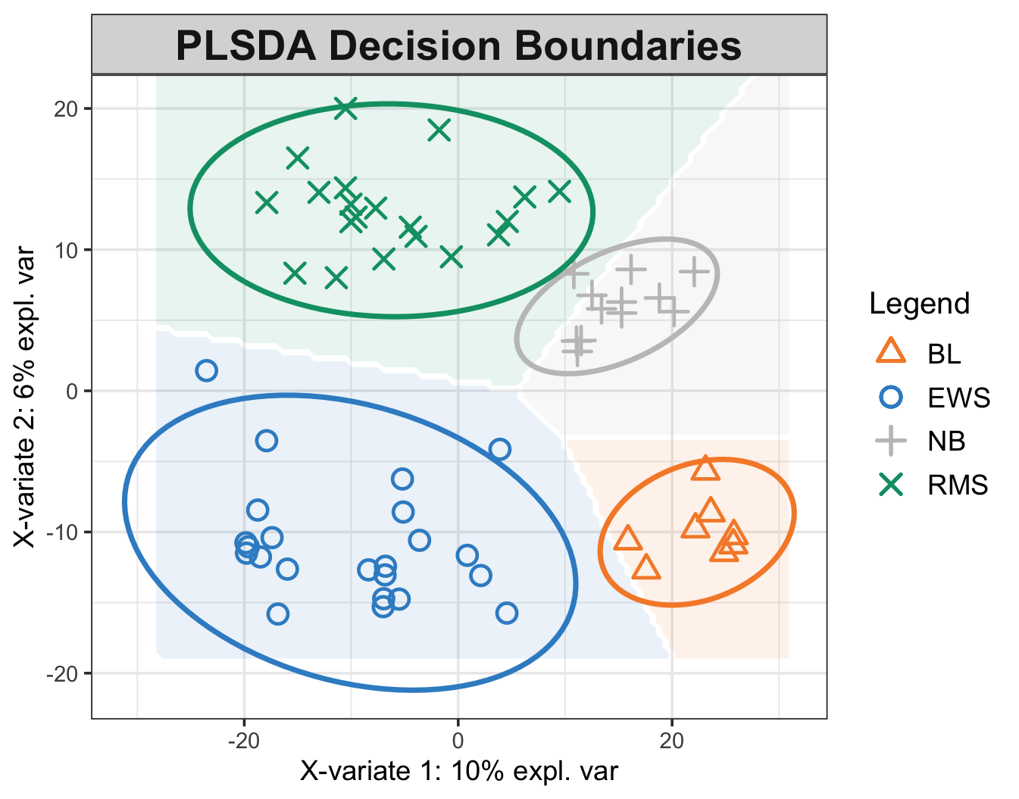
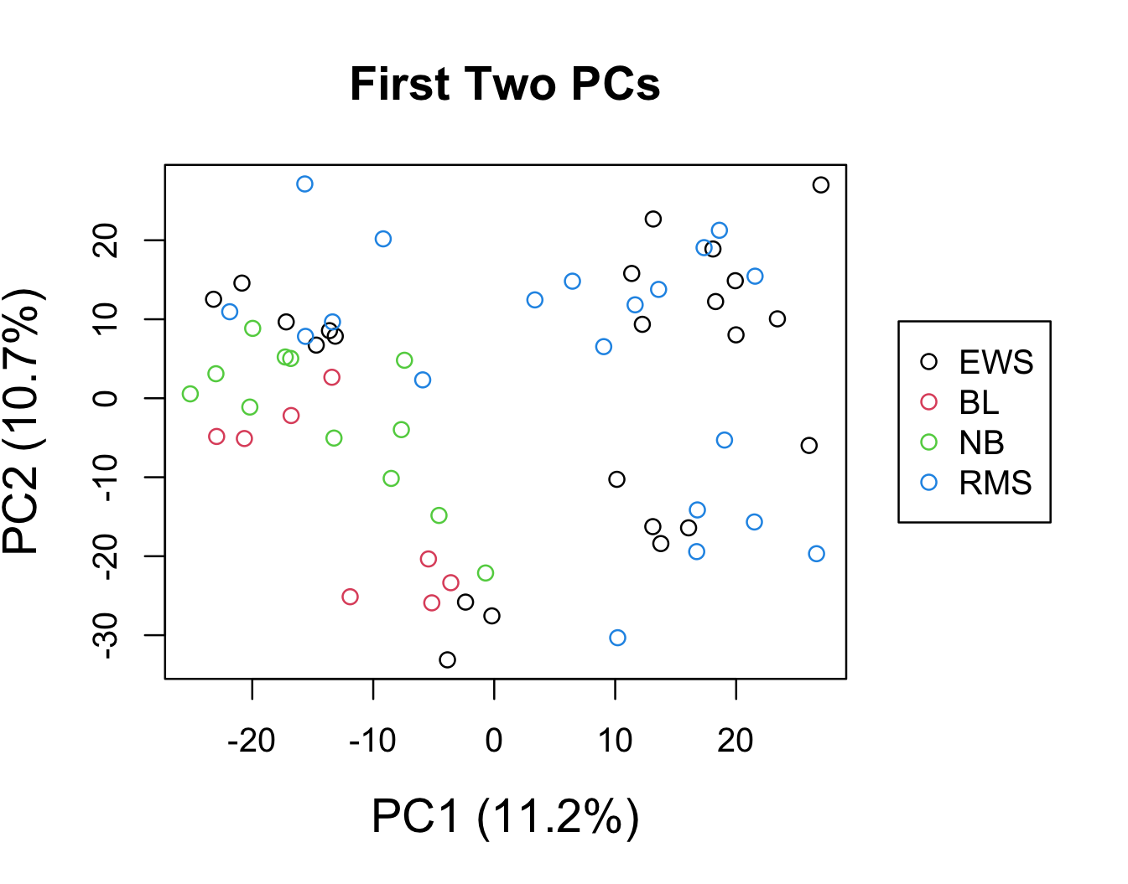
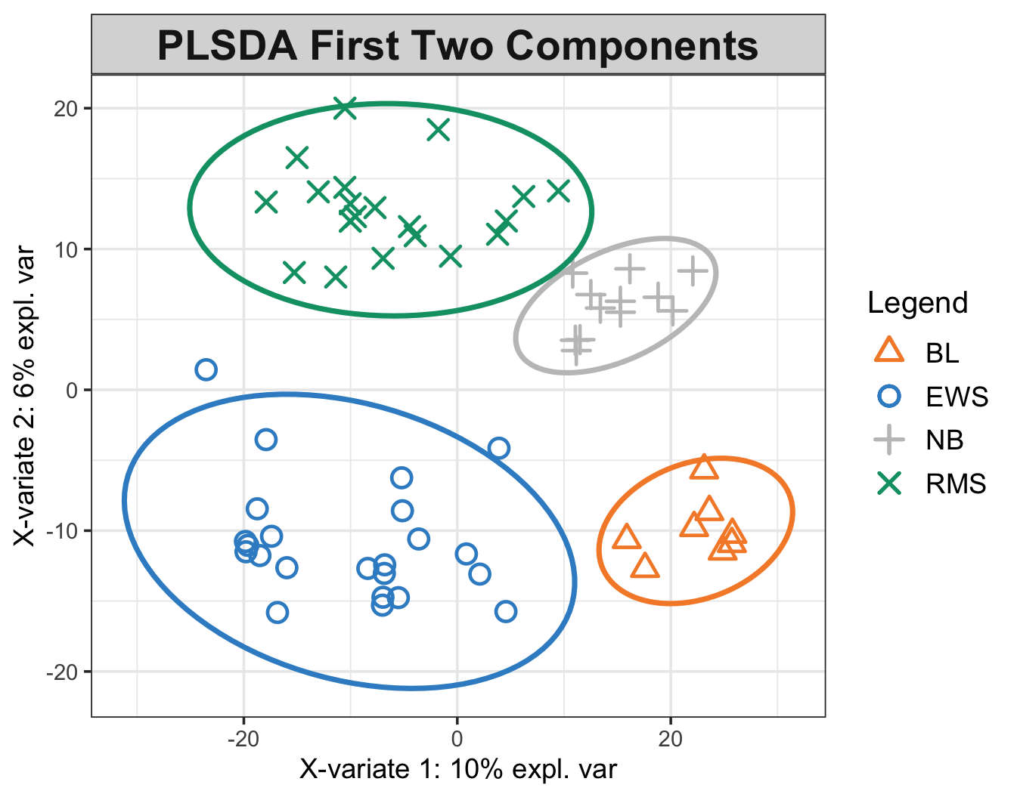
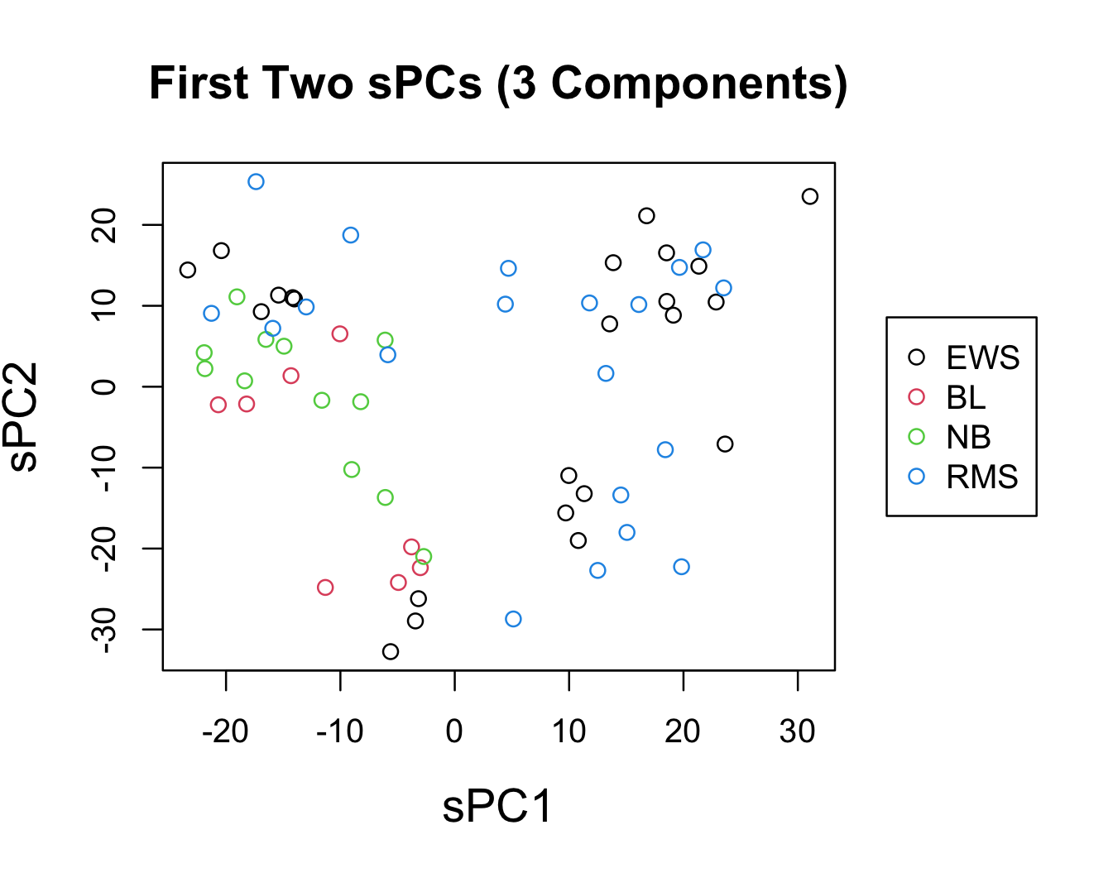
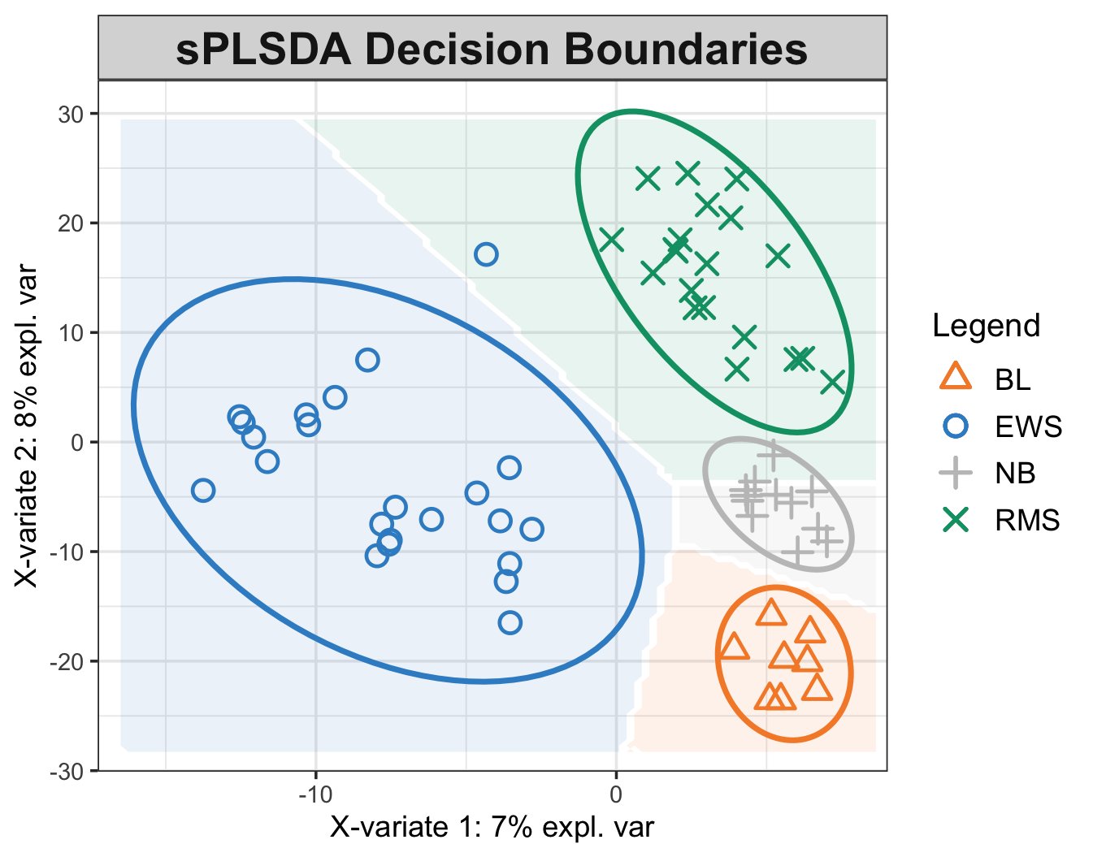
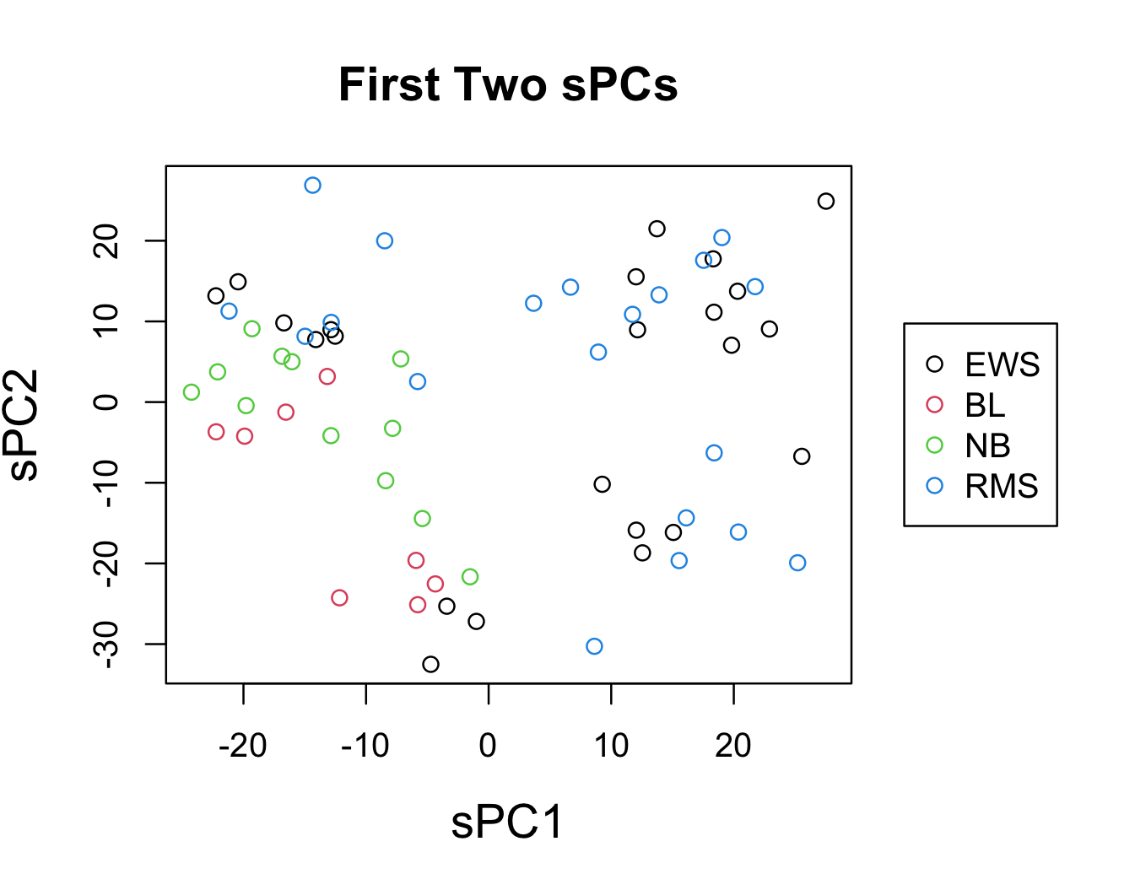
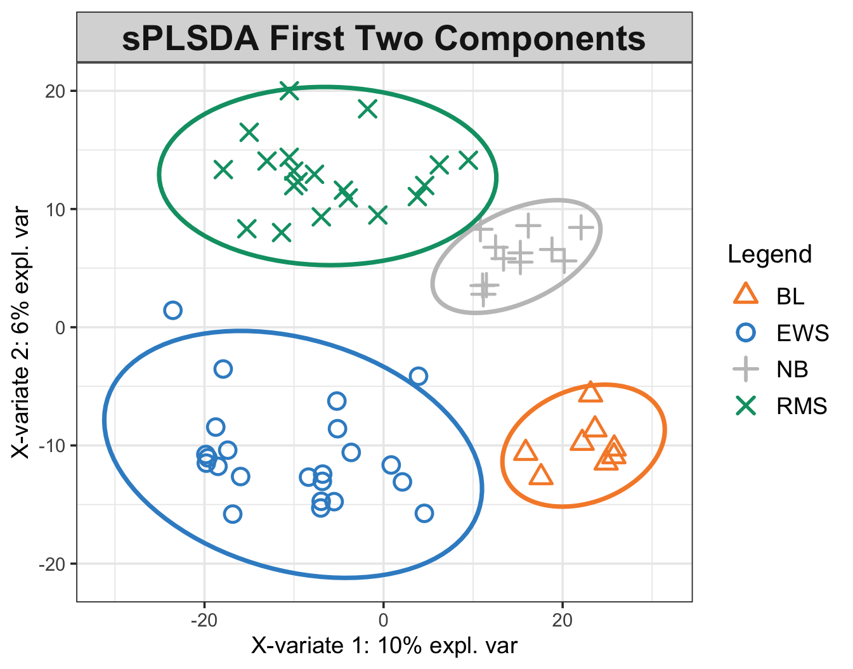
Test: A Visual Comparison of Class Separation
Notes:
- Caveat – true for this not necessarily for all

Slide 8
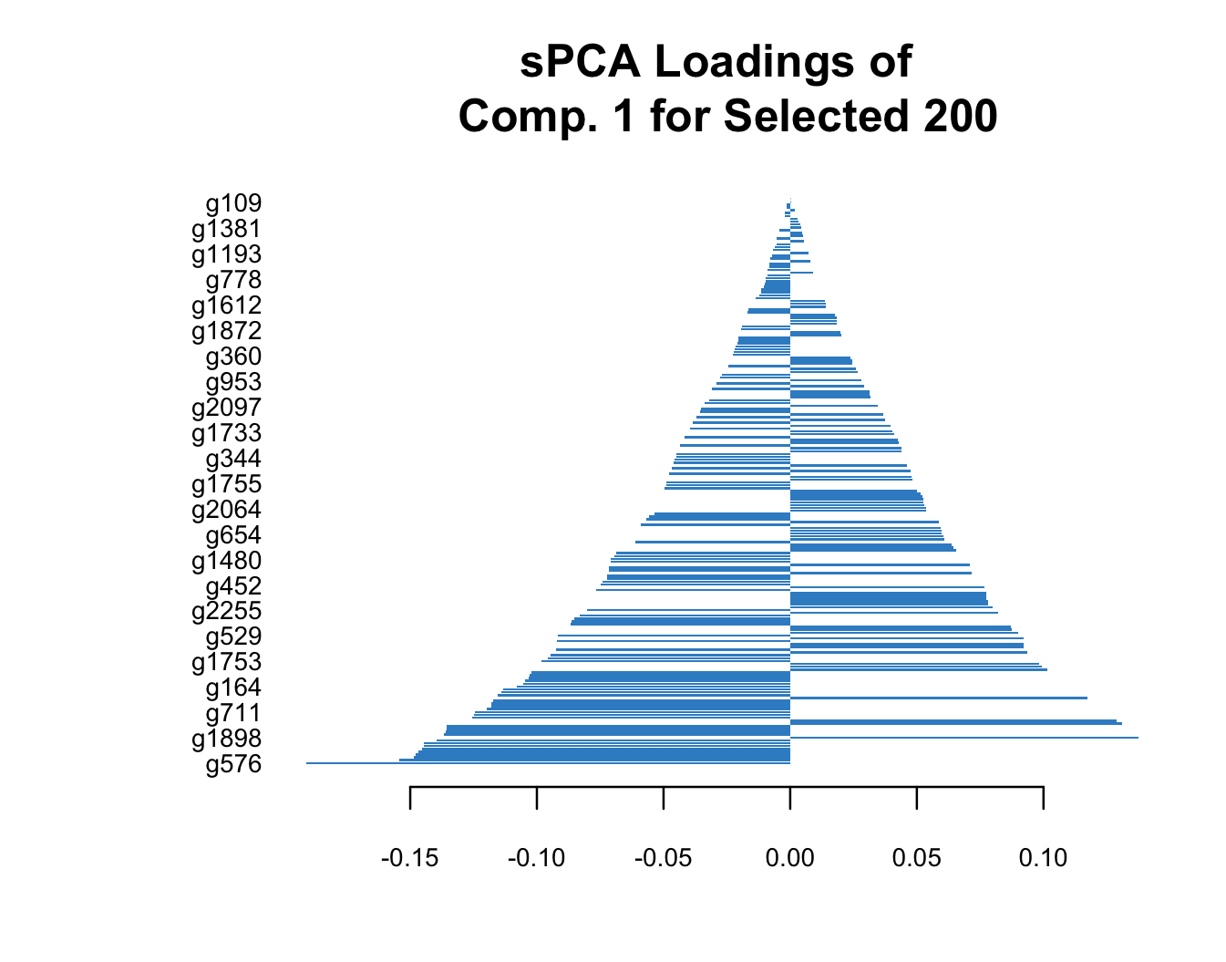
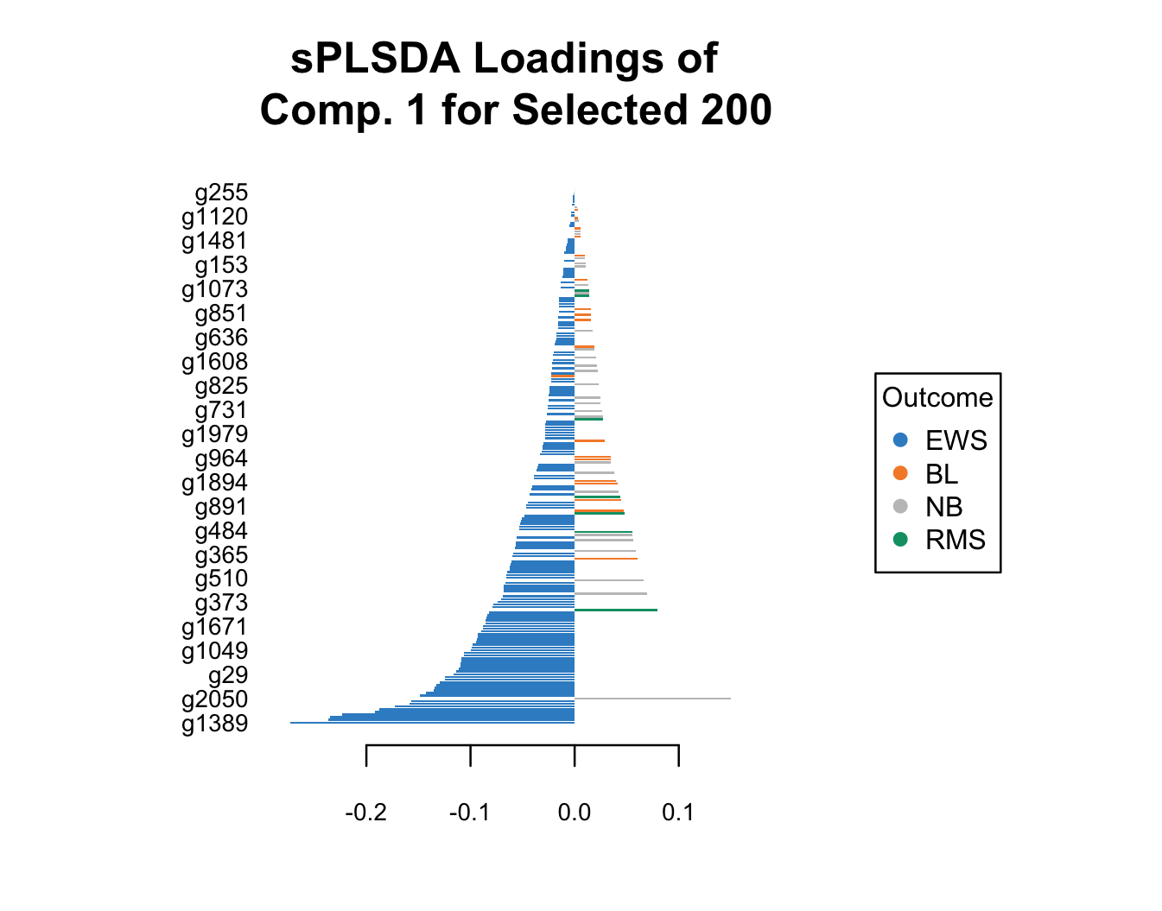
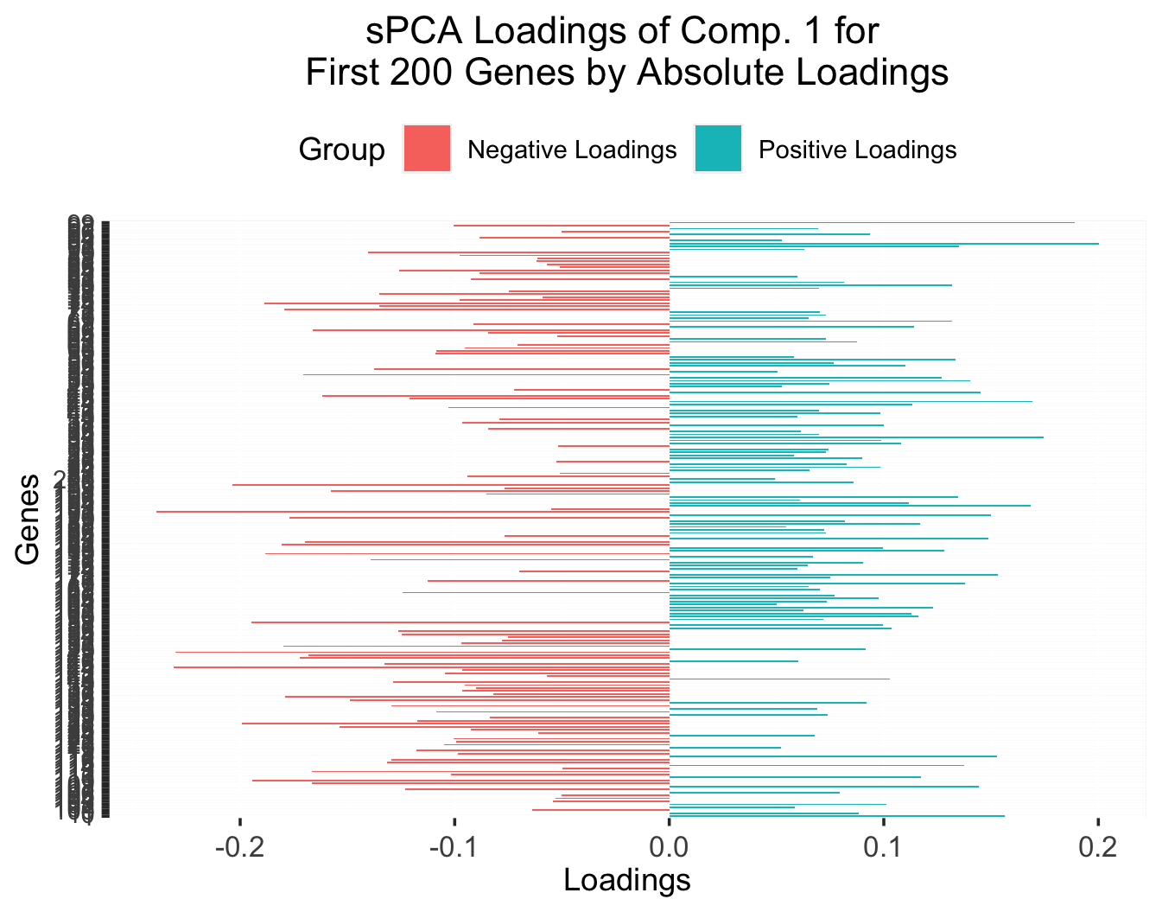
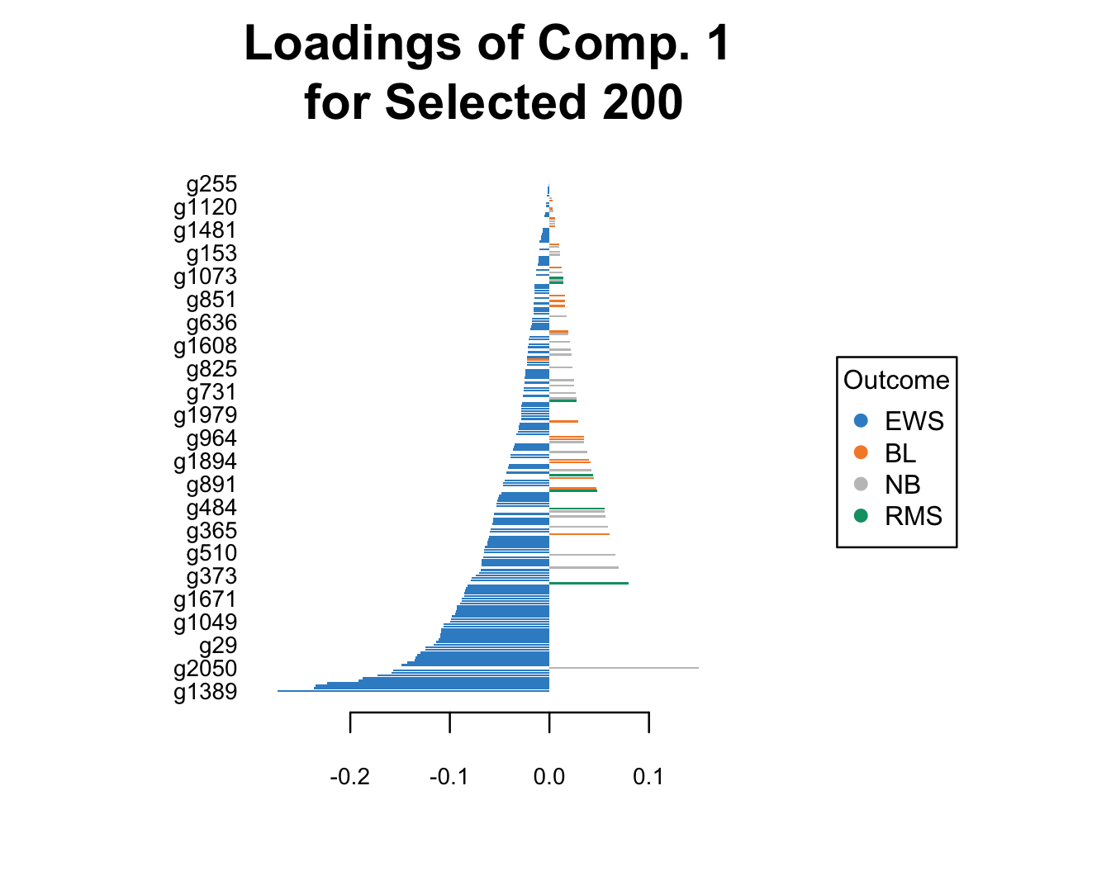
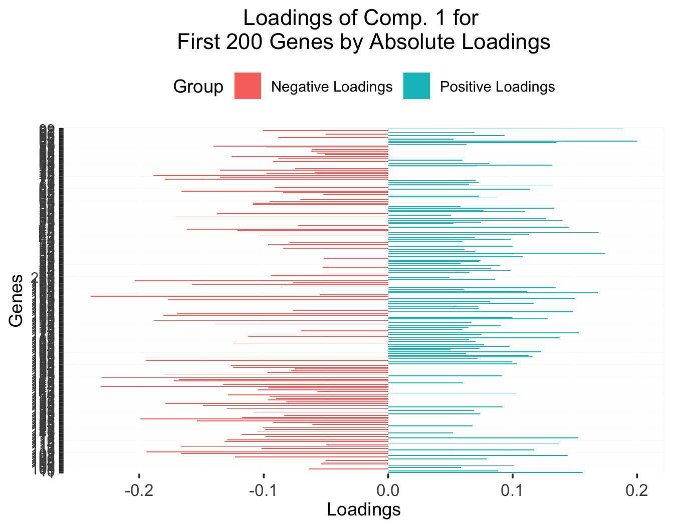
Test: Loading Factors for Sparse Methods
For the plot on the right, the color corresponds to the group in which the feature is most abundant; sPLS may bear some value in narrowing down the list of molecules of interest while being more predictive power than sPCR.
Notes:
- Discuss how this may reduce the search space for getting to the biological story.

Slide 9
Limitations
Still a linear approach (can be overcome with kernel methods but at the cost of interpretability).
No way to factor in complex biological priors; e.g. pathways that inputs belong to can be accounted for with block PLS, but causal directionality within each pathway would be very difficult to incorporate.

Slide 10
Appendix

Slide 11
Are there more components?
Step 3: Optimal Prediction with One Latent Variable
It is unlikely that just one round of projections will explain the covariance well.
To generate more components, we exclude “parts” of the data (X) and target (Y) matrices that have been “explained” away by the initial round of projections.
In other words, we look for the residuals that remain after the first round through a process called “deflation;” then the process repeats again from step 1 to get additional orthogonal components.
The predictions across rounds are aggregated for a final prediction.

Slide 12
Test: Performance Based on Selected Variables
Method | Mean Test Macro-F1 (SD) | Mean Test Micro-F1 (SD)
PLSDA | 0.98 (0.047) | 0.98 (0.041)
Conducting full PLSDA with the selected variables, the scores are even better; the variable selection process seems reasonably robust based on this result. The scores are based on 40 runs.

Slide 13
Test 2: NutriMouse Dataset¹ – Overview
The dataset contains expression measure of 120 genes potentially involved in nutritional problems and the concentrations of 21 hepatic fatty acids for 40 mice.
The target is the diet regimens the mice had for an extended period (5 fatty diets).
The dataset is balanced.
¹Martin, et al. Novel aspects of PPARα-mediated regulation of lipid and xenobiotic metabolism revealed through a nutrigenomic study. 2007. https://doi.org/10.1002/hep.21510.

Slide 14
Test 2: F1 Scores (40 Tests)
 | Micro-F1 |  | Macro-F1
Method | Optimal # Components¹ | Test Score² | Optimal # Components¹ | Test Score²
PCR | 2, 3.53 (1.85) | 0.42 (0.21) | NA | NA
sPCR | 2, 3.68 (1.76) | 0.41 (0.18) | NA | NA
PLSDA | 6, 5.88 (1.32) | 0.91 (0.11) | 6, 5.88 (1.32) | 0.97 (0.056)
sPLSDA | 6, 5.7 (1.22) | 0.93 (0.094) | 6, 5.65 (1.48) | 0.97 (0.047)
As with the SBRCT dataset, PLSDA and sPLSDA far outperform their counterparts.
However, for all methods, there are cases in which the number of true positives for some classes come out to be zero.
This happens far more frequently for the PCR methods as can be seen by the lack of macro-F1 scores.
¹Mode, mean (standard deviation, where available).
²Mean (standard deviation, where available).

