Slide 1
Partial Least Squares Advantages and Limitations
Advantages
Partial Least Squares (PLS) goes a step farther than does Principal Component Regression (PCR) and maximizes the correlation of a projection of the data matrix X to that of the target matrix Y.
Based on an experiment, PLS does a much better job of classification than does PCR even when the underlying labels are unbalanced.
Also, another sparse implementation of PLS may be of use in variable selection.
Limitations
It is still a linear method; this can be overcome with kernel methods but at the cost of interpretability.
It may be difficult to factor in complex biological priors into the model; some pathway grouping of the input data is possible with block PLS, but accounting for more complex information like causal directionality would be challenging.

Slide 2
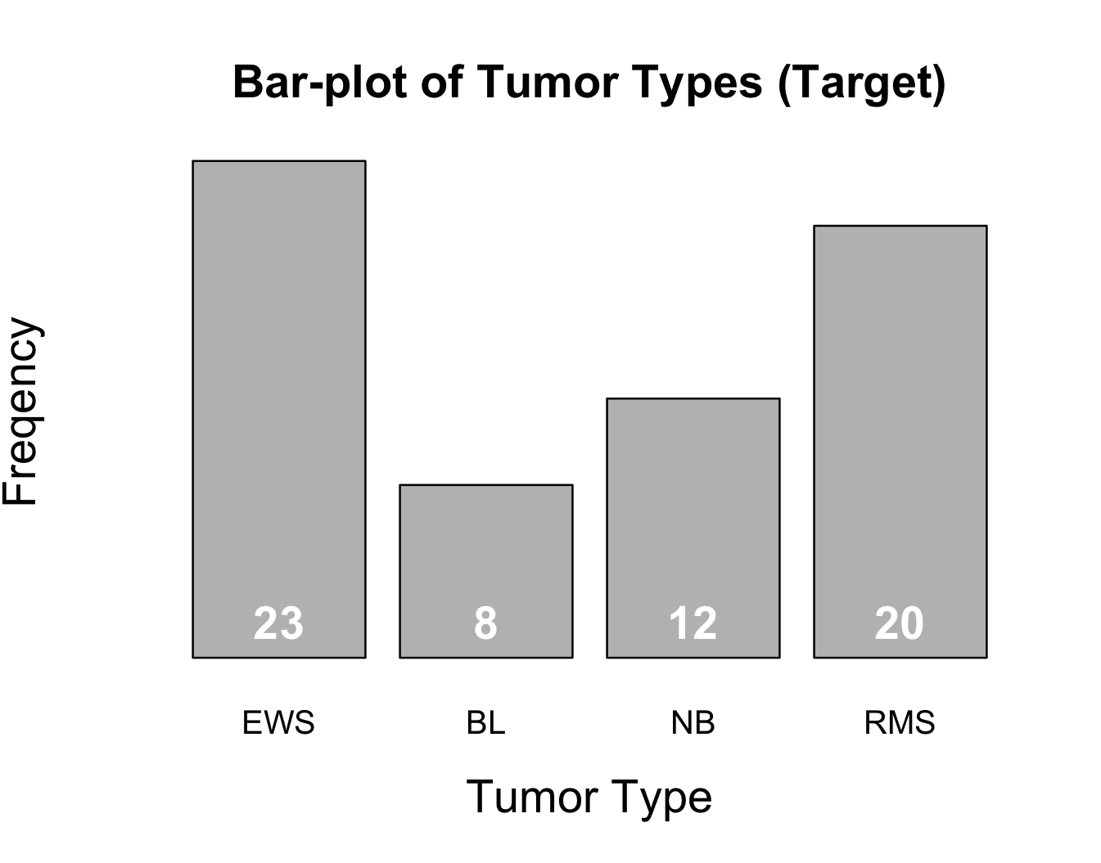
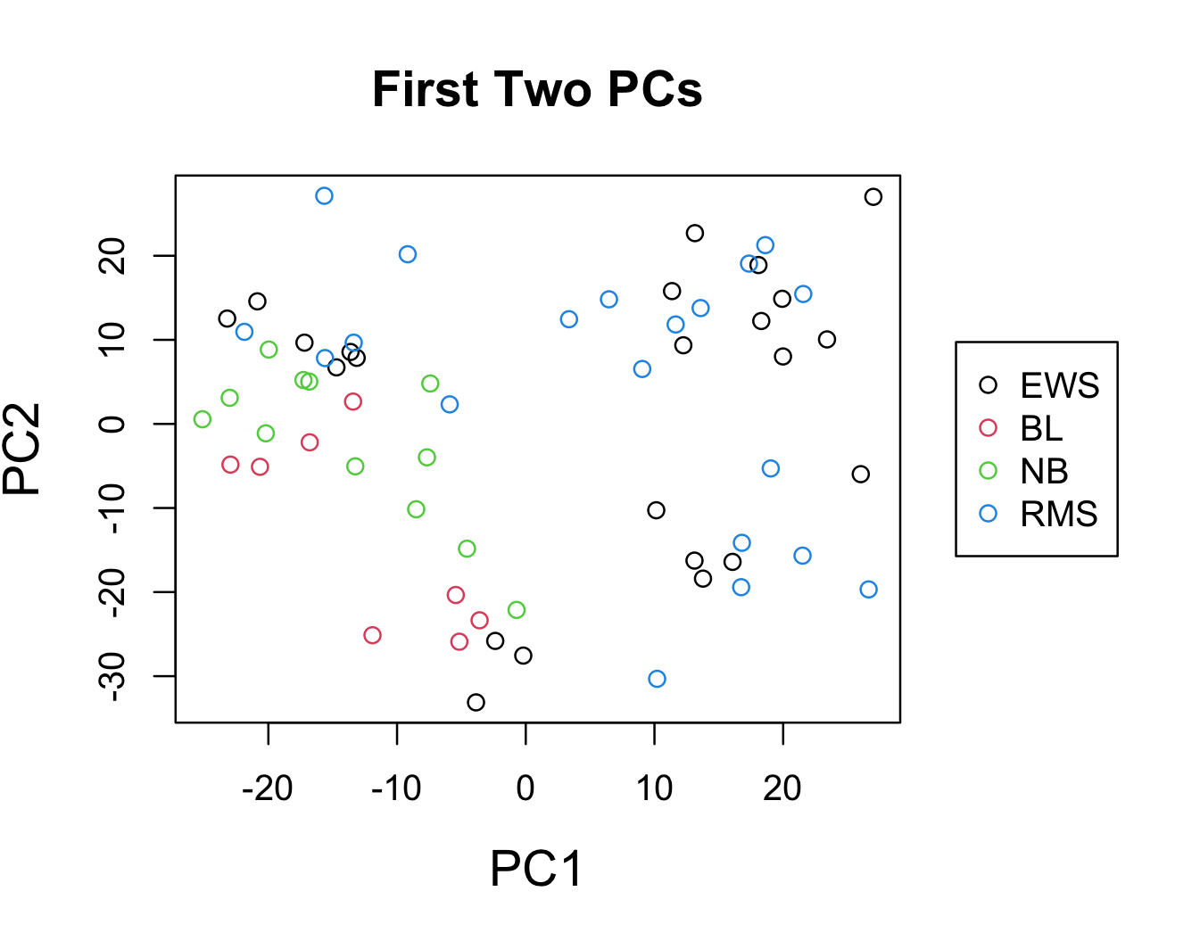
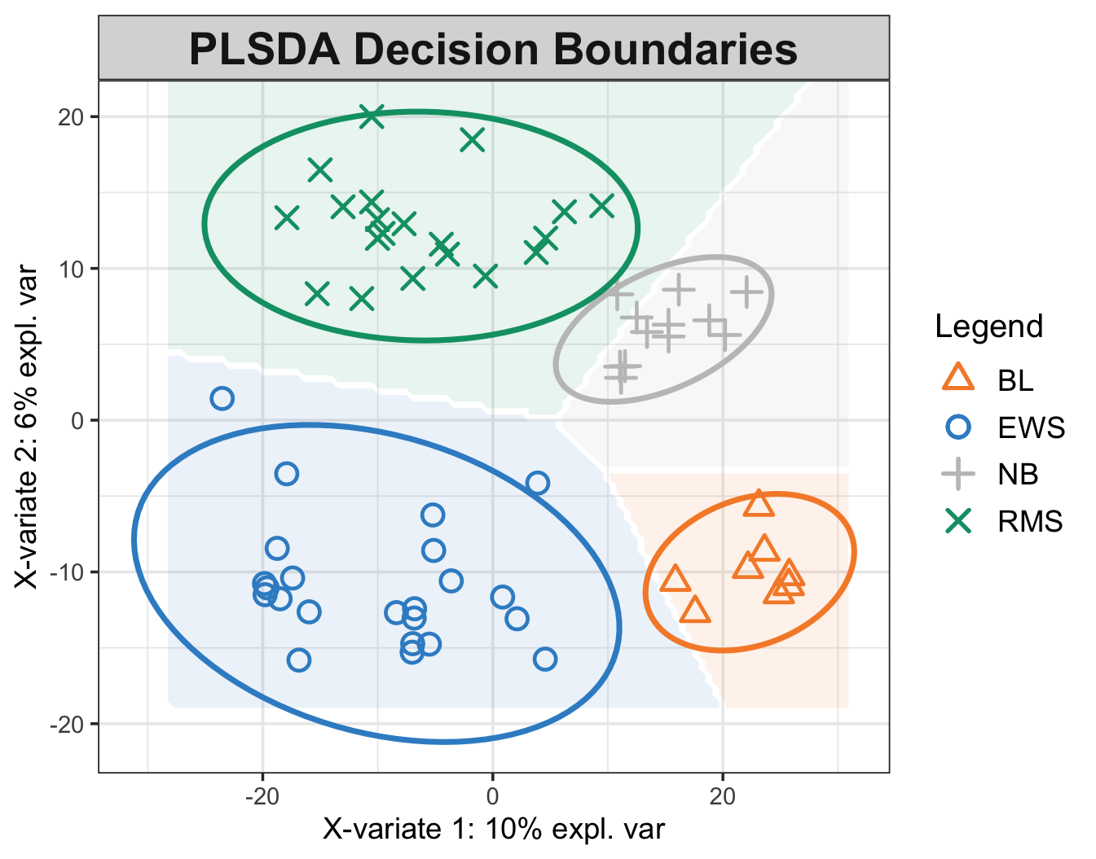
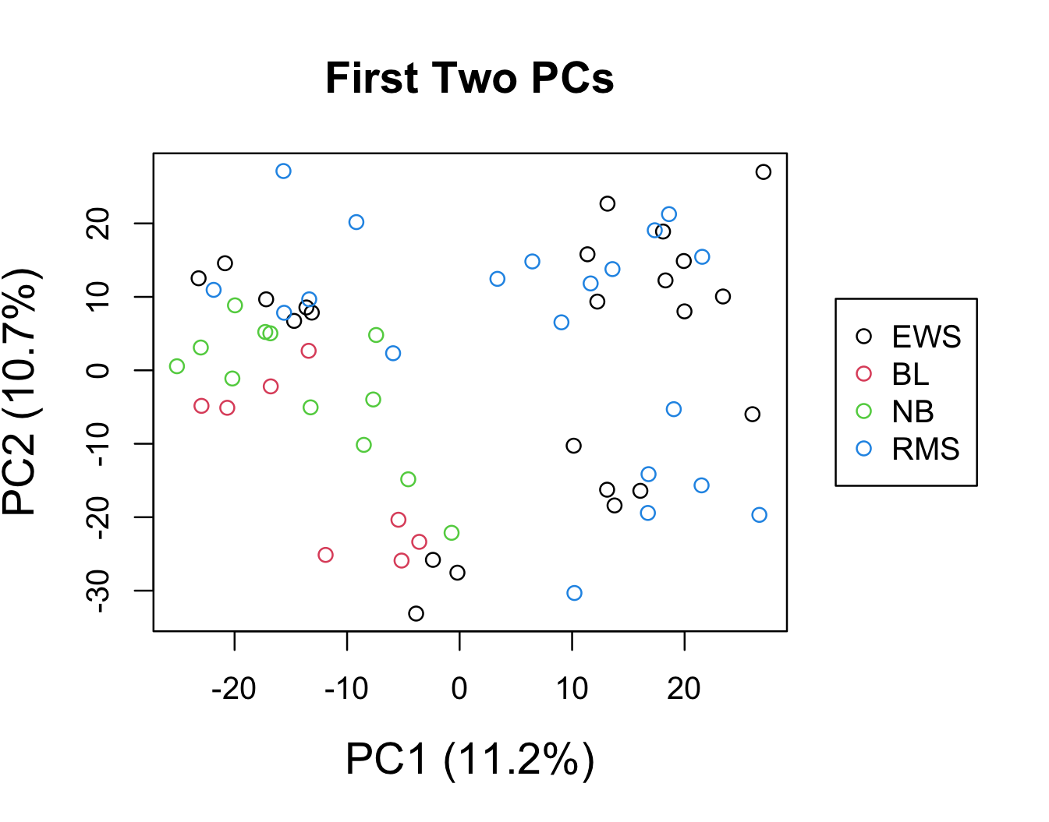
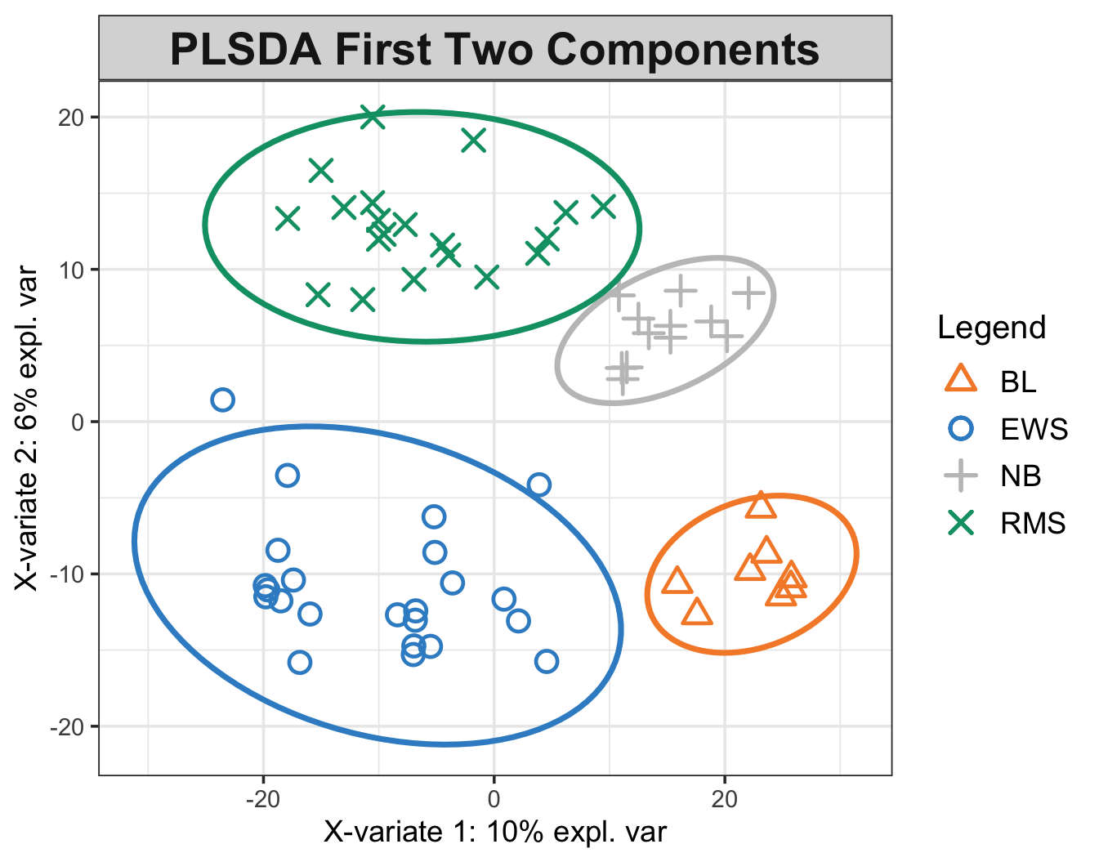
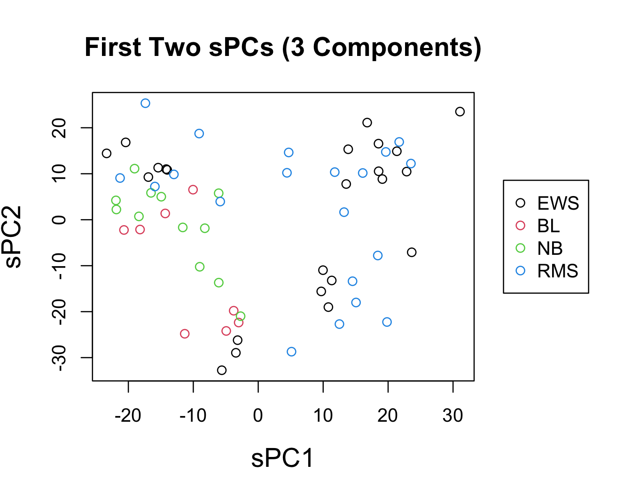
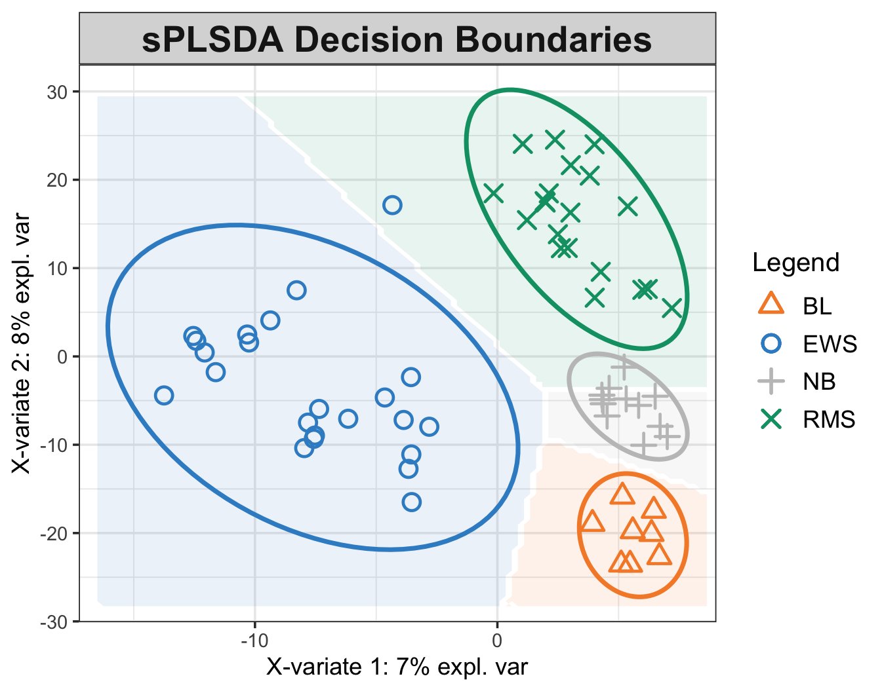
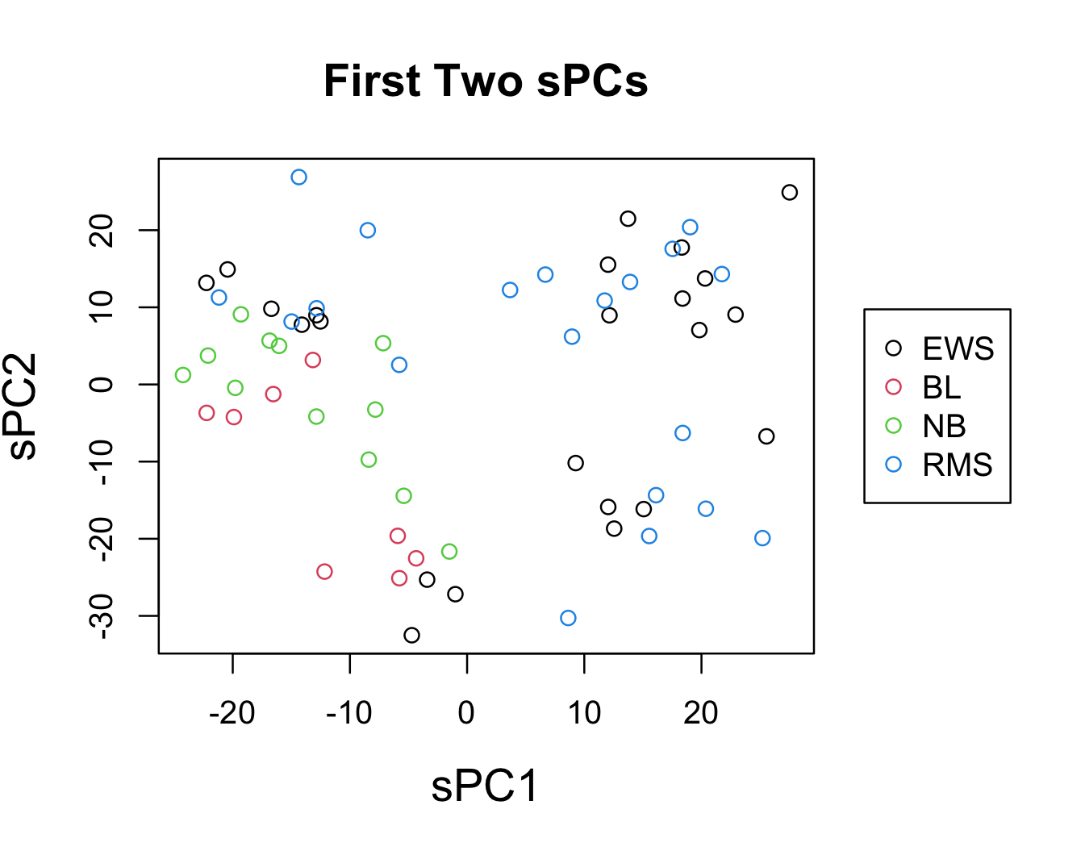
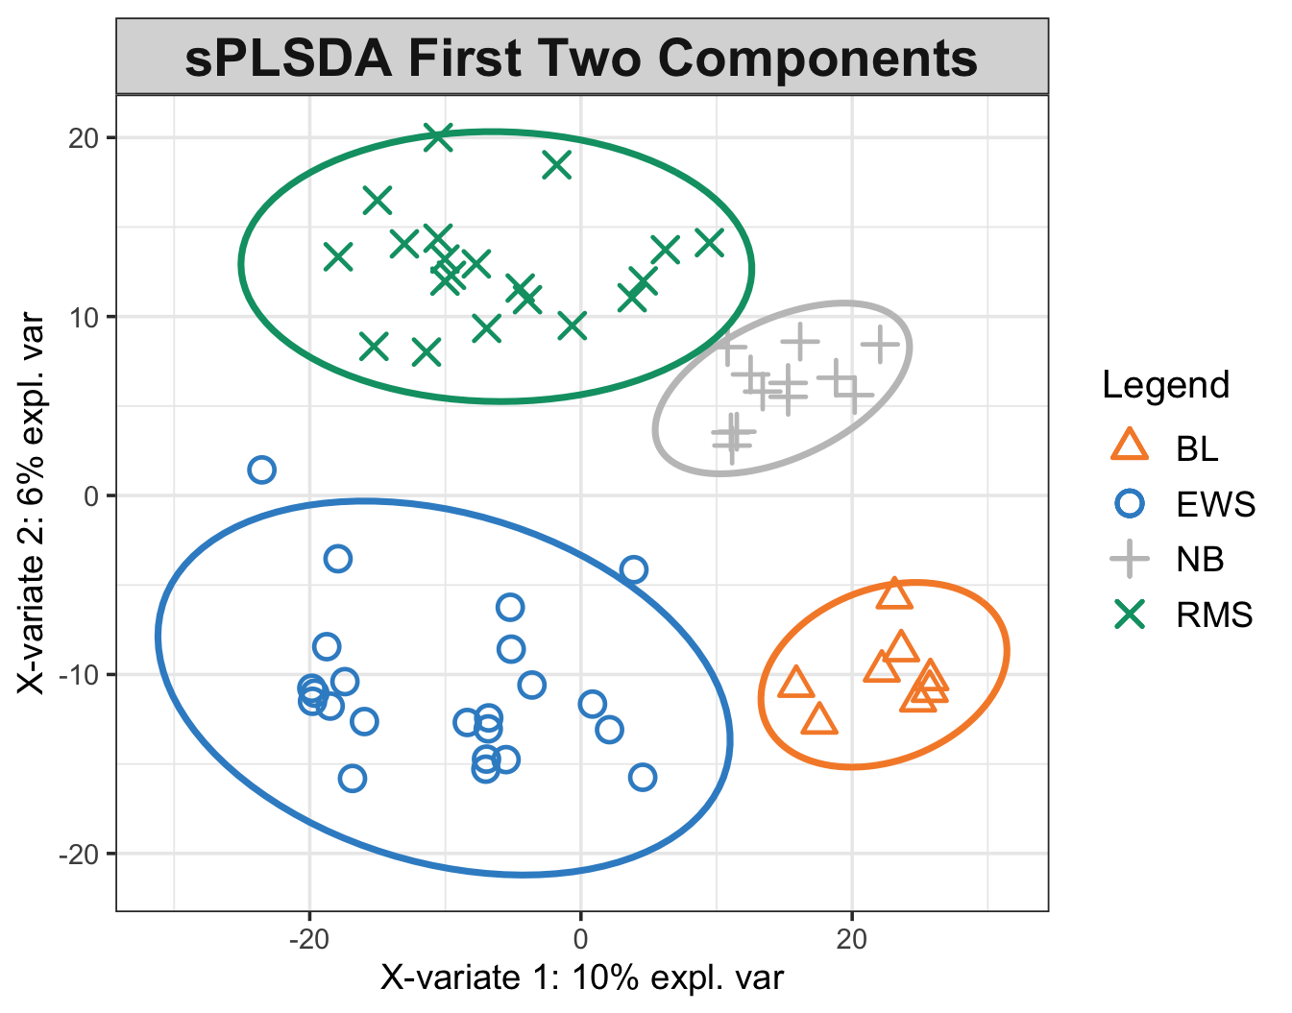
PLS is much better at classifying the SRBCT data¹.
Comparison Candidates (R Packages):
PCA/sPCA + Polytomous Classification (sparsepca, nnet)
PLS/sPLS Discriminant Analysis (mixOmics)
Dataset:
The SRBCT dataset: 63 samples of pre-processed 2308 gene expressions (X) and small-blue-round-cell tumor types (Y).
A noticeable label imbalance:
Method:
A nested loop with outer loop for testing (40 iterations).
Given the label imbalance, stratified sampling of train, dev, and test sets (60:20:20) at the outer loop.
A dev set validation at the inner loop for picking the optimal number of components (both PCR and PLSDA).
Result: Clear outperformance by PLS methods.
Visualization of Label Separation
A much clearer label separation for PLS methods.
Algorithm | Micro-F1² | Macro-F1²
PCR | 0.3 (0.15) | 0.63
sPCR | 0.29 (0.14) | 0.53
PLSDA | 0.96 (0.053) | 0.96 (0.049)
sPLSDA | 0.97 (0.039) | 0.97 (0.036)
¹Khan, et al. Classification and diagnostic prediction of cancers using gene expression profiling and artificial neural networks. 2001. https://doi.org/10.1038/89044.
²Mean (standard deviation where available; PCR algorithms generated no true positives for the BL label in most cases).

